Slide 1


Telerik AppBuilder
Let's get going .. You're going to love this!

Slide 2
So, you want to build a mobile app?

Slide 3








Slide 4
See the problem?
Yeah, let's not always do that.

Slide 5
There is a better way
You need Cross-Platform!

Slide 6
Use your Web skills
Build Hybrid Cross-Platform mobile apps!

Slide 7

Why you'll love Hybrid
True single Codebase for all platforms
Ease of HTM5/CSS/JavaScript Access to Native APIs
App Store presence & monetization Users cannot tell the difference

Slide 8
Introducing
Part of the Telerik Platform

Slide 9
AppBuilder
Hybrid Mobile Development, simplified!
1. Developer Freedom
2. End-to-End Tooling 3. All needed Services

Slide 10
AppBuilder under Covers
Uses Apache Cordova
JavaScript proxies to Native APIs

Slide 11
Let's build an App

Slide 12
Where to begin?
Head over to
https://platform.telerik.com And sign in ..

Slide 13
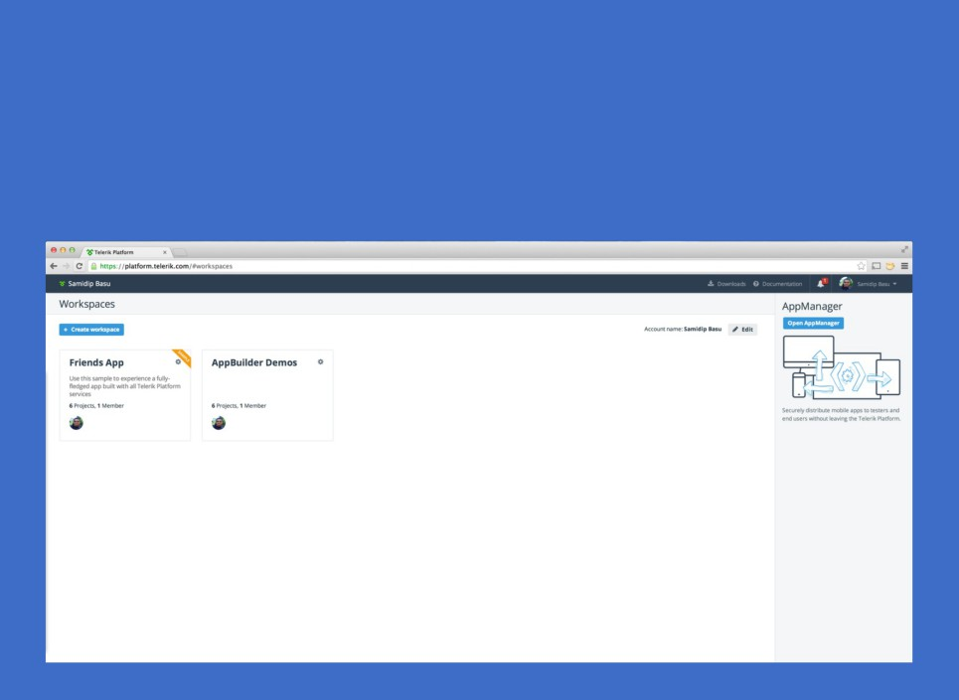
Get set up
WorkSpace - Placeholder for AppBuilder projects Create a new one!

Slide 14
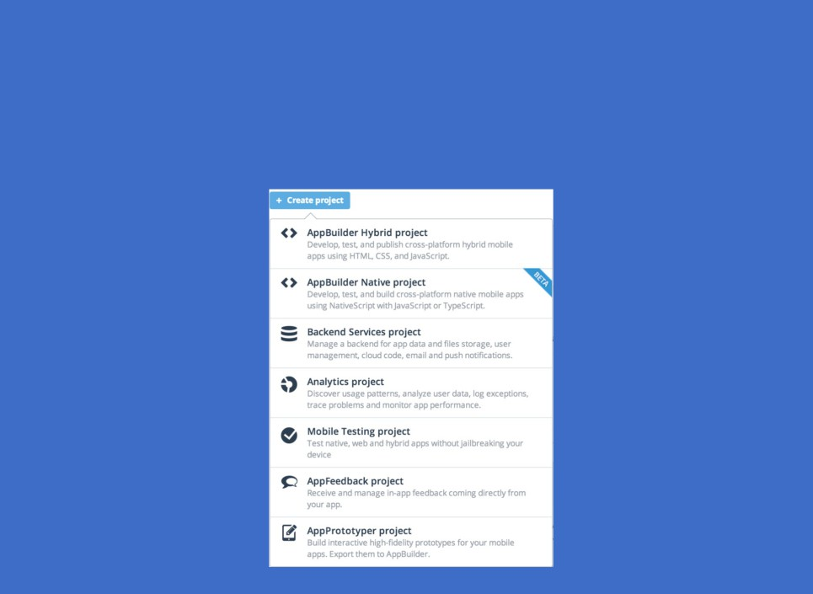
Start
Once you have a WorkSpace, create a Project Pick AppBuilder Hybrid

Slide 15
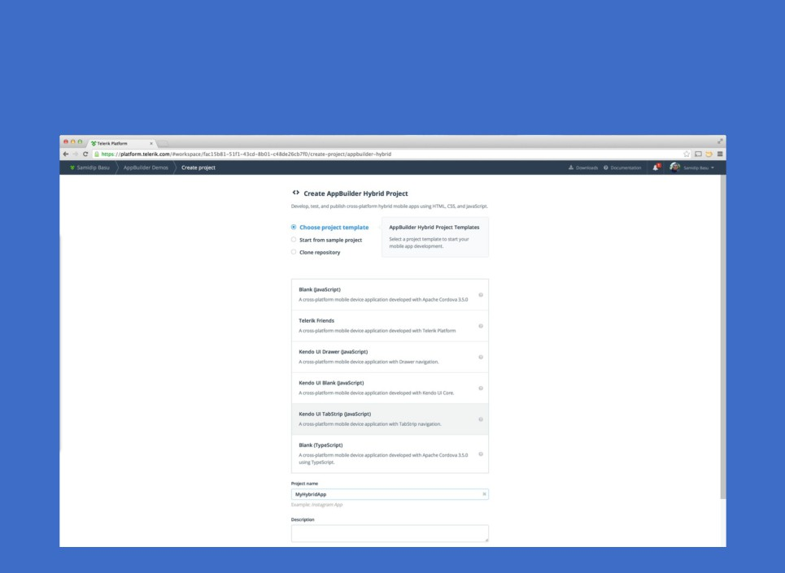
Next up, choose a template
And name your app!

Slide 16
Wait .. as Unicorns create your AppBuilder Project

Slide 17
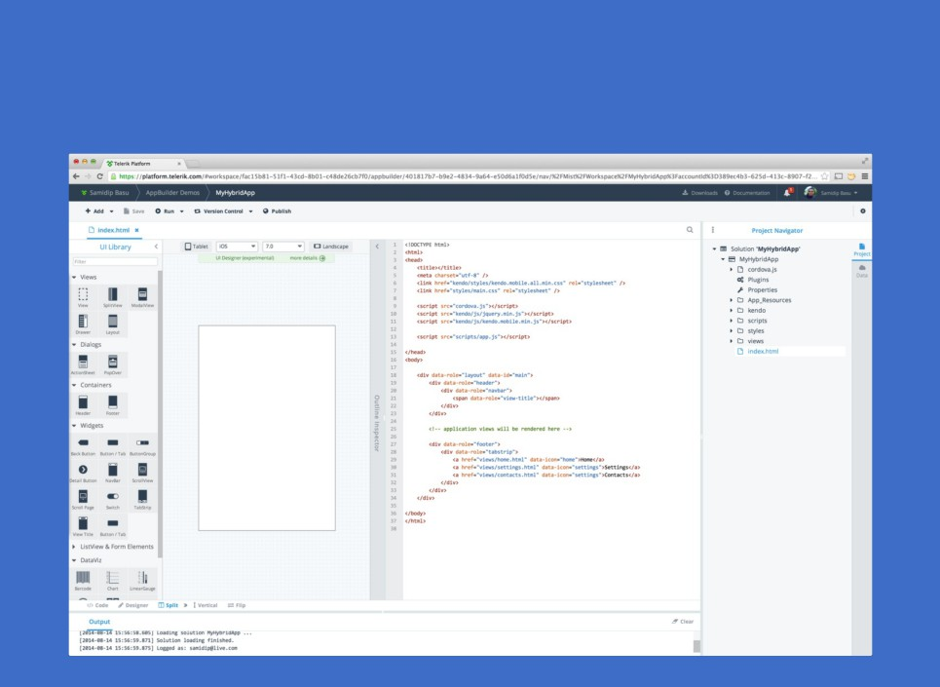
Voila .. your Mobile dev kit
In a Browser!

Slide 18

AppBuilder In-browser Client
Solution Explorer
Device-specific WYSIWIG panel
Markup/JS Editor with syntax highlighting File Manager & OutPut window Build/Deploy/Publish options

Slide 19
Seeing is believing
Project looks good
But, where can we run our App?

Slide 20
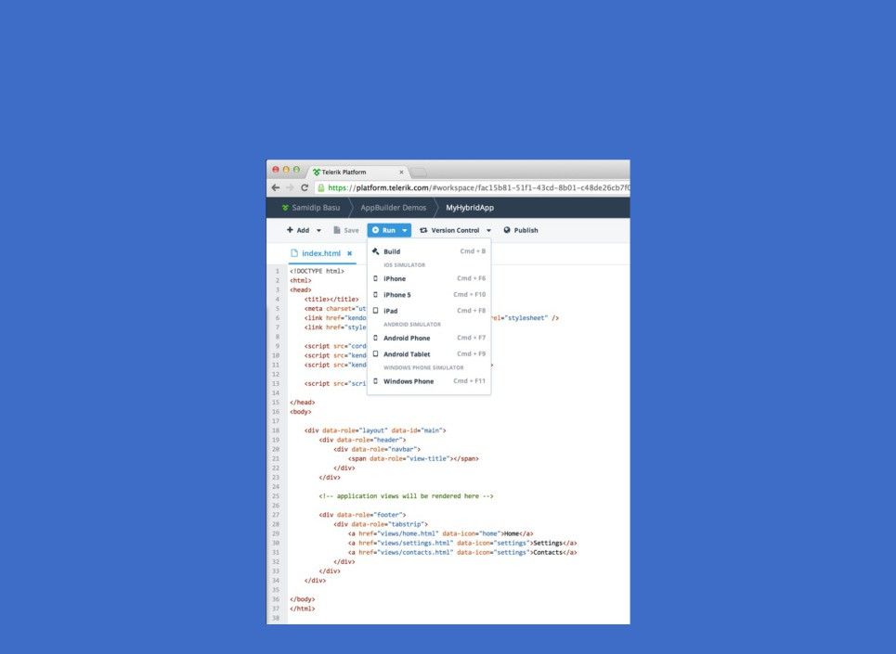
Just pick your platform
And fire away!

Slide 21
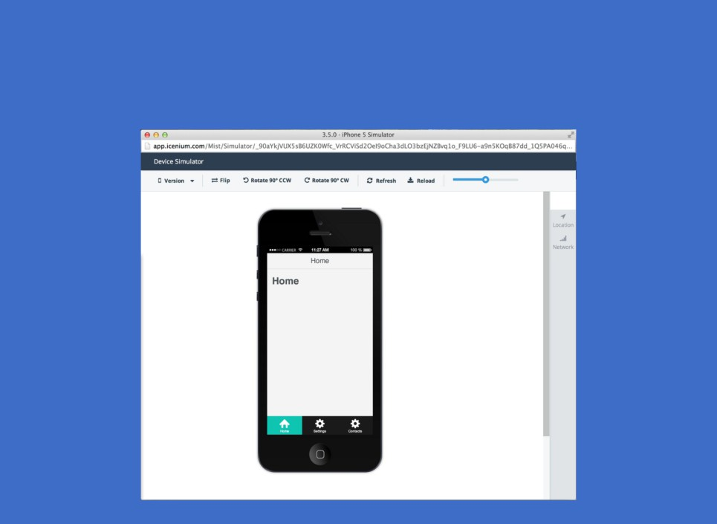
Boom .. iOS Simulator
In your Browser!

Slide 22
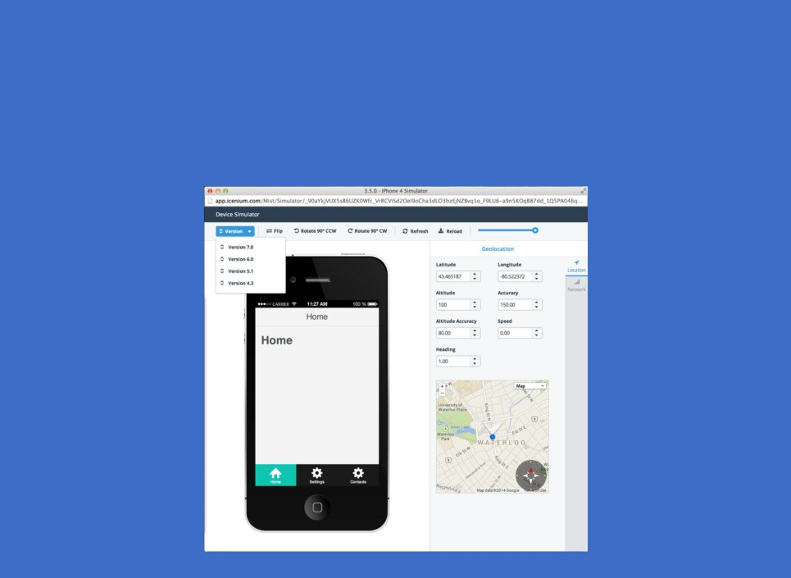
Simulator flexibility
You can switch up OS versions
And simulate GeoLocation & Network strength

Slide 23
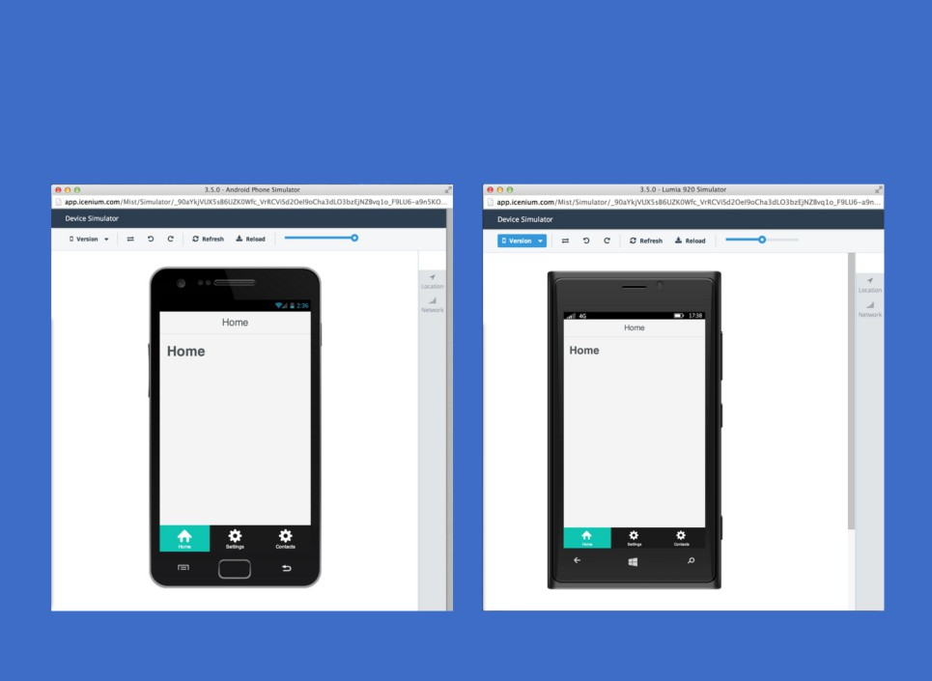
Other platforms?
Sure, works the same in Android & Windows Phone

Slide 24
But simulators go only as far
I want the App running on a real device ..

Slide 25
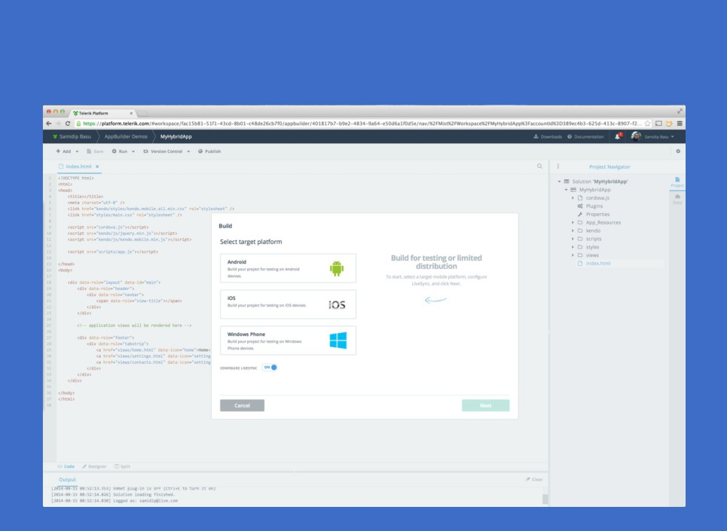
Let's fire up a Build

Slide 26
Build artifacts
You can build App Packages for each platform Or, build for the AppBuilder Companion App!

Slide 27
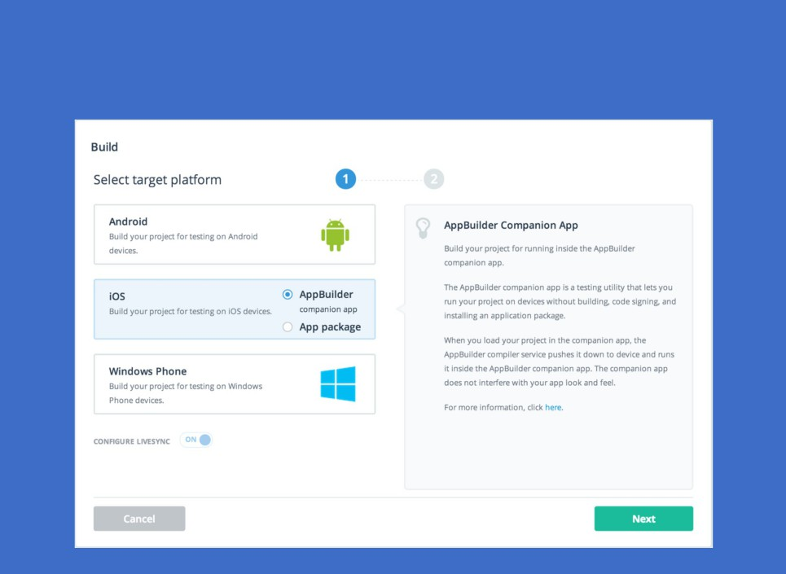
Pick what you need

Slide 28
AppBuilder Companion App
Think of it as a shell that runs your Hybrid app
Available in iOS, Android & Windows Phone Stores

Slide 29
Companion App benefits
Allows for provision-less app deployment To real devices!
Did we mention ..
You don't need a Mac to build iOS apps!

Slide 30
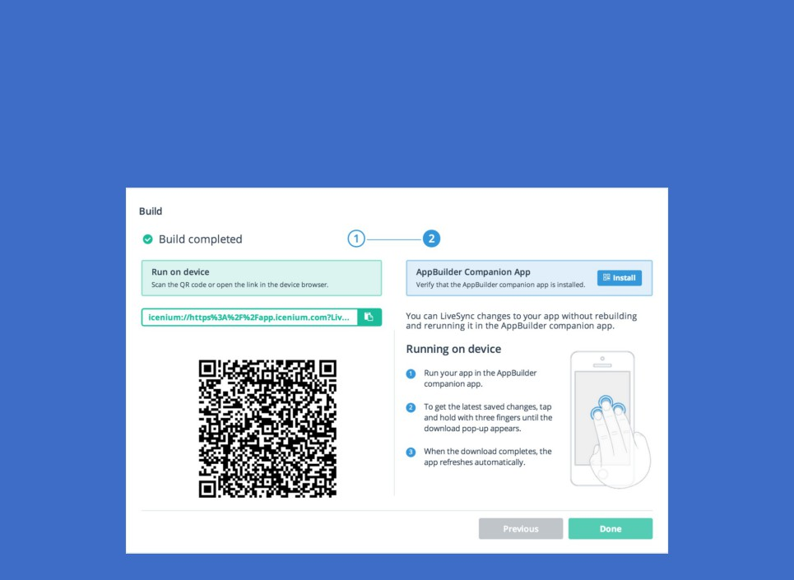
Deployment
Simple .. just scan the QR Code
Works the same way in iOS, Android & Windows Phone!

Slide 31
LiveSync
Once deployed, no need for full Builds
Simply Save your changes in AppBuilder project
Works on simulators & real devices!

Slide 32
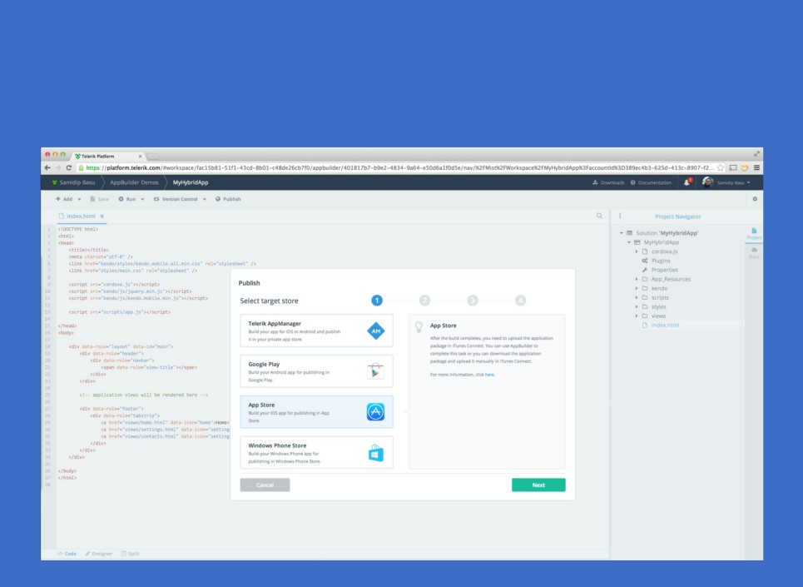
Oh, and see the Publish link on top?

Slide 33
Pull the trigger
Publish to iOS, Android & Windows Phone Stores Straight from inside of AppBuilder!
Off course, needs provisioning or certificates & so on ..

Slide 34
Few more AppBuilder features ..

Slide 35
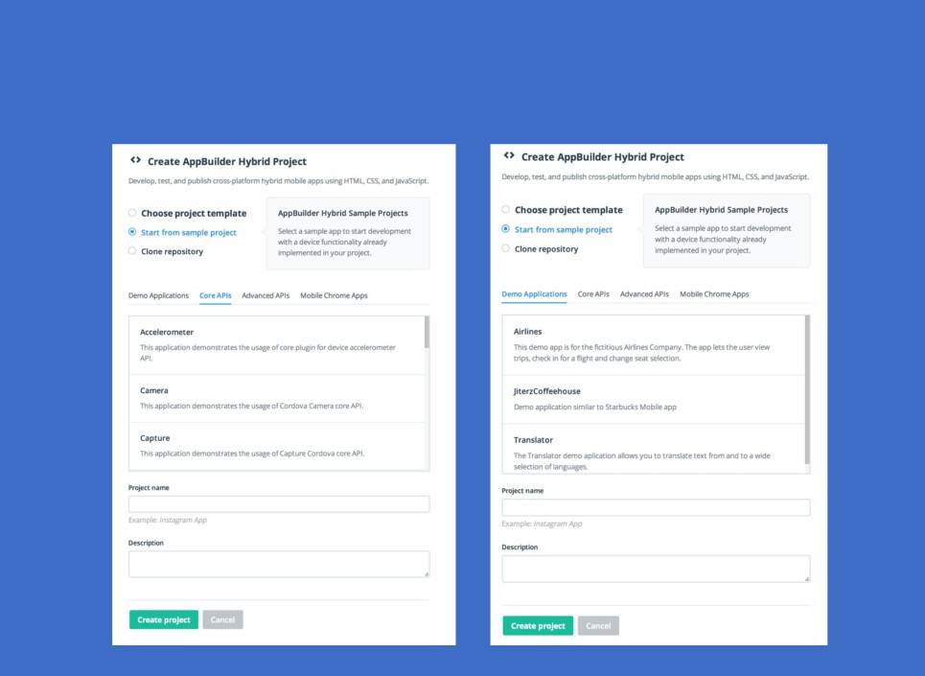
Project Templates that help

Slide 36
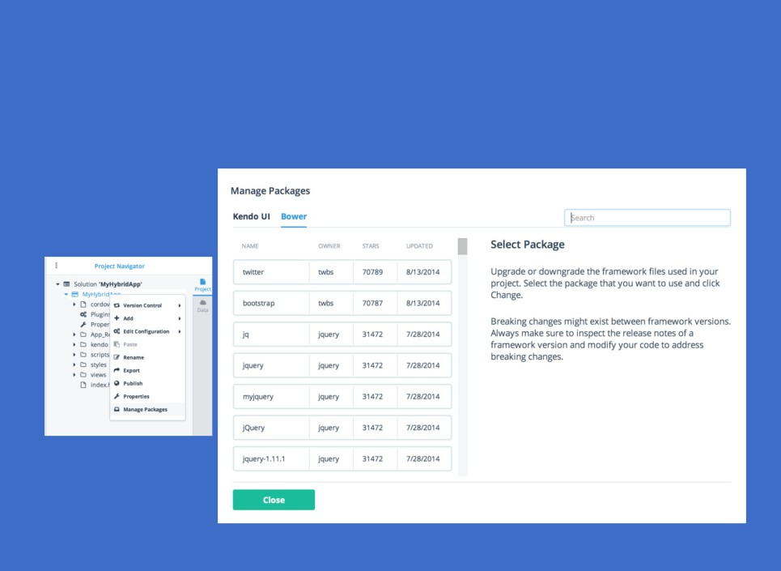
Plug & Play
Package Managers .. out of the box!

Slide 37
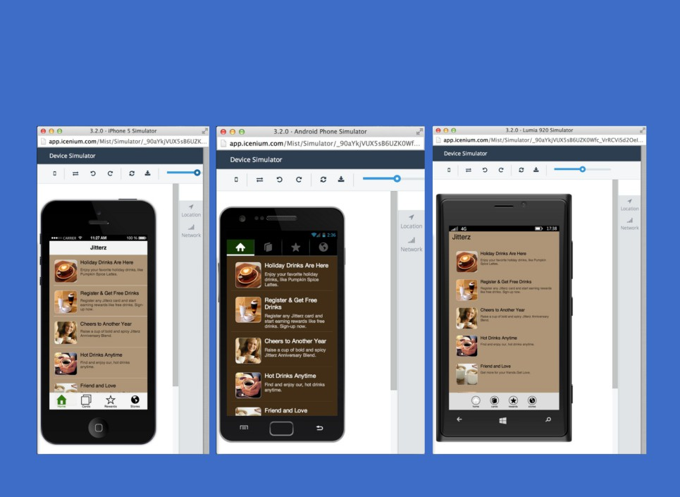
Adaptive Rendering
Thanks to Open-Source Kendo UI Mobile framework ..

Slide 38
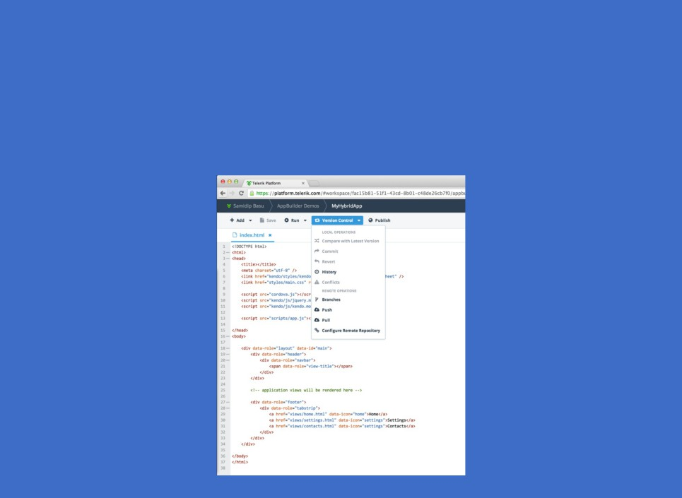
Collaborate
Hook up your AppBuilder project to a Repo Work in teams .. always stay in sync!

Slide 39
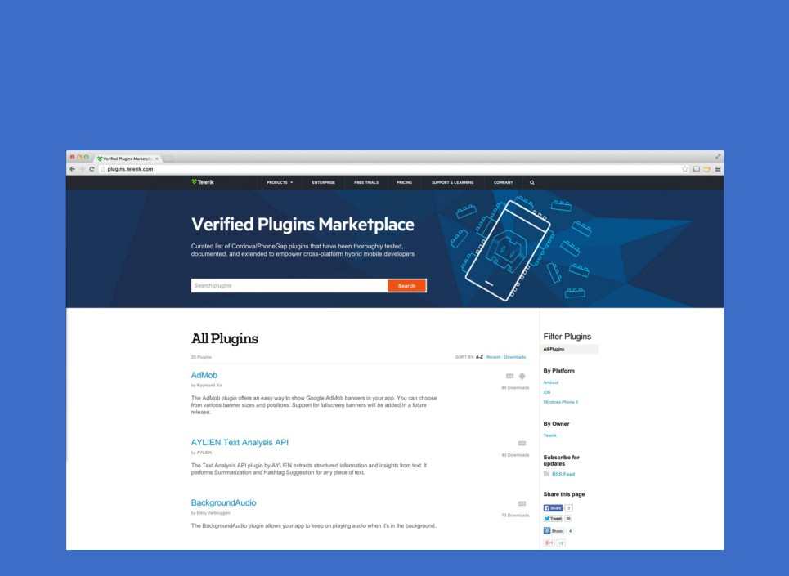
Plugins to Native APIs
Use Cordova or Telerik verified Plugins ..

Slide 40
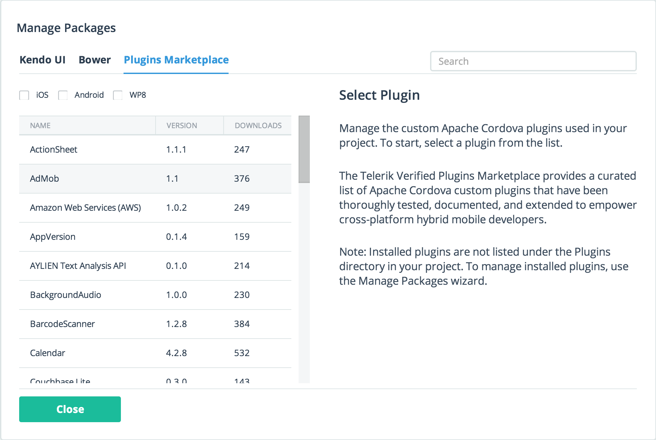
Search & Pull in Plugins
From right inside your project ..

Slide 41
One more thing ..
You can do all this from
AppBuilder Command Line Interface!
Works on both OSX & Windows

Slide 42
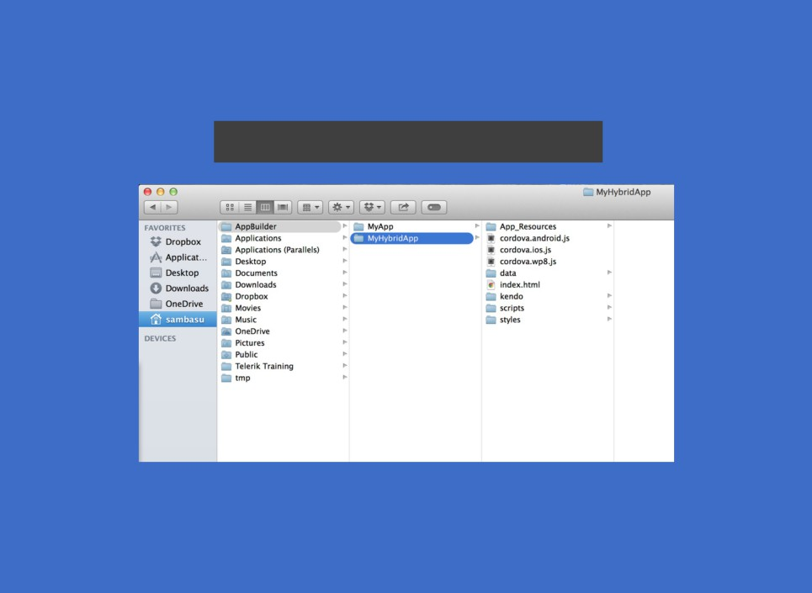
Install & Create
$ sudo npm install -g appbuilder
$ appbuilder create hybrid MyHybridApp
Same Project structures .. All Templates supported!

Slide 43
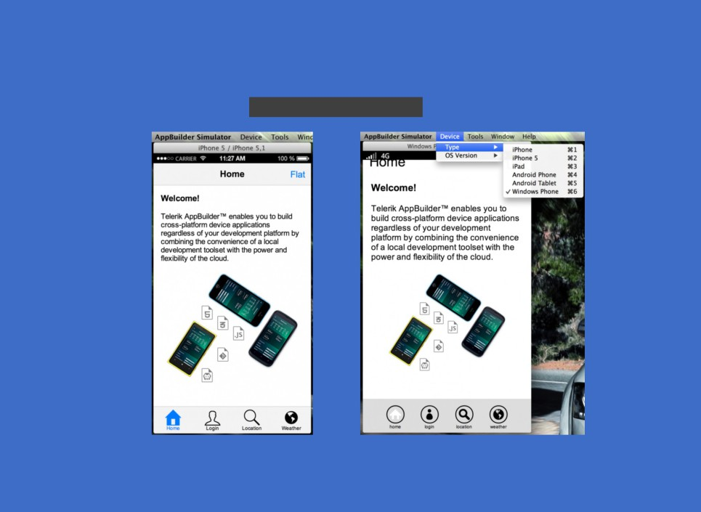
Simulate
$ appbuilder simulate
Native simulators for iOS, Android & Windows Phone!

Slide 44

Build
$ appbuilder build ios -companion
$ appbuilder build android --companion $ appbuilder build wp--companion
Companion or Native App Packages QR Code Deployment!

Slide 45
And, one more thing ..
We love SubLime Text as much as do!

Slide 46
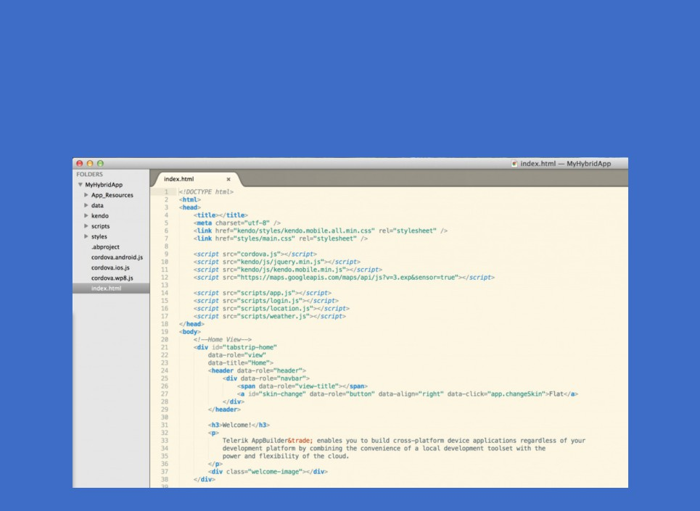
Stay in Sublime
All day long ..
With the AppBuilder Package for Sublime!

Slide 47
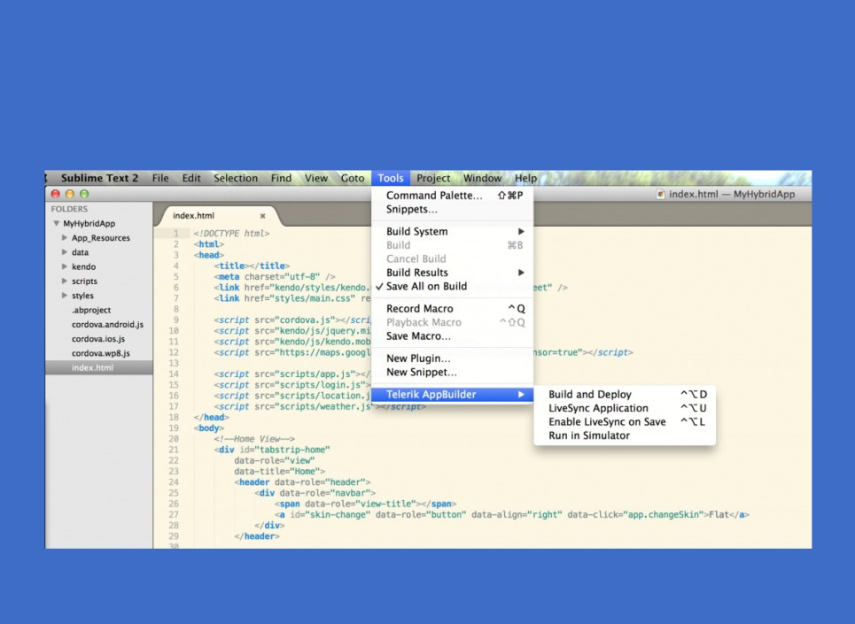
Build & Deploy

Slide 48
One last thing ..
You know that IDE that developers LOVE? Yup, Visual Studio
Yeah, you can do everything in Visual Studio!

Slide 49
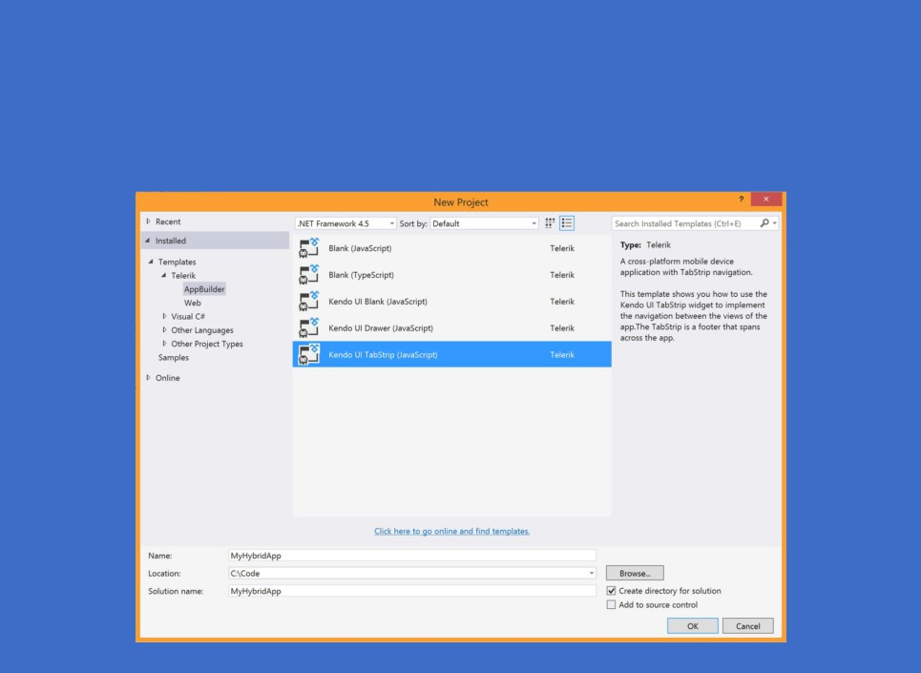
AppBuilder VS Extension
Same project templates ..

Slide 50
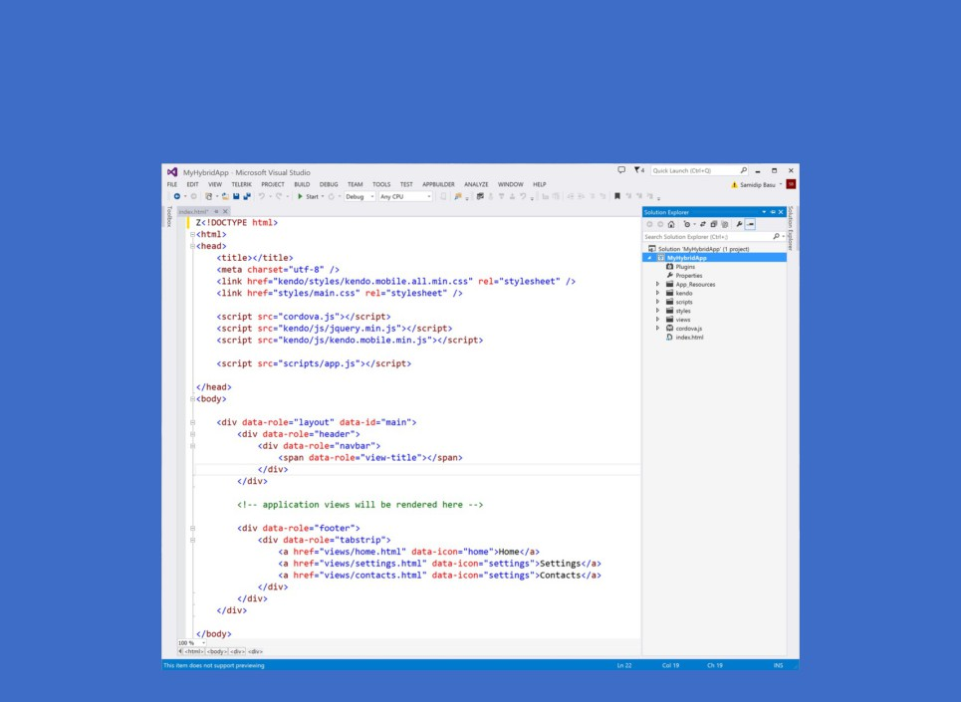
Build X-Plat Mobile apps
Never having to leave Visual Studio!

Slide 51
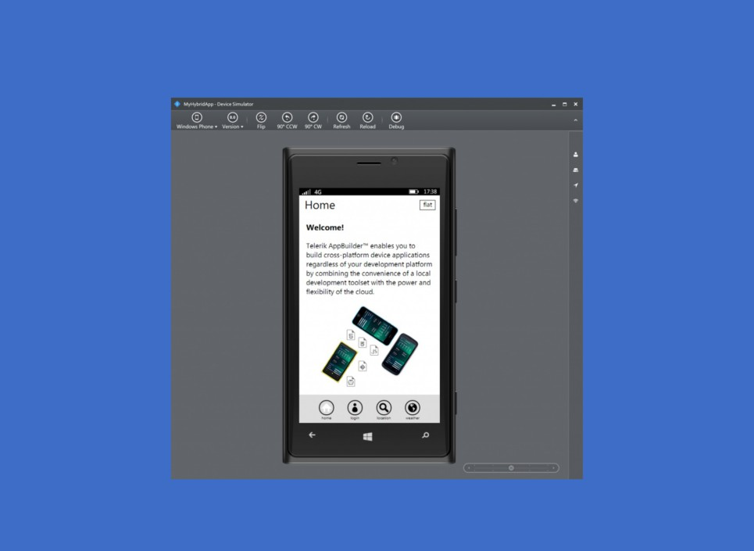
Just hit F5 to run your app
Native simulators for iOS, Android & Windows Phone!

Slide 52
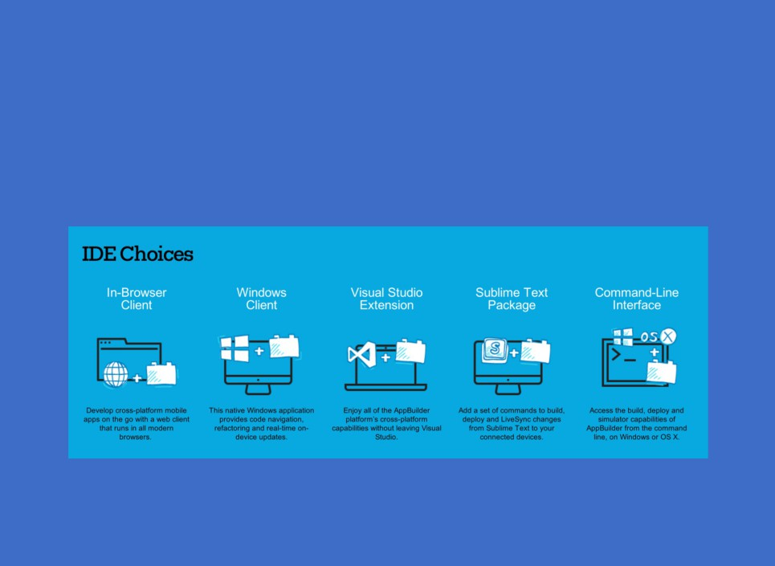
We promised Developer freedom!

Slide 53
It's okay ..
We're just as excited!

Slide 54
X-Plat Mobile Developers Rock
Now, go build your dream
We're right here to support you!

