Slide 1
Stock Management System

Slide 2
Team members
Mehmet Reşit ÇAĞAN – Subject Matter Expert
Ali GÖKMEN – Team Member
Gökhan MUTLU – Team Member
Mamady III DIAKITE – Team Member

Slide 3
Motivation
Why do you do it? We choose it because some complexity issue and connectionless between customer, stock, warehouse, item and transaction activities.

Slide 4
Project description
What is the system and what does it do?
It ensures the presence of products, customers and stocks in stores. Thus, it aims to reduce complexity in corporate companies.
Handling flows between the activity of Customer, Stock, Warehouse, Item and Transaction.
We have an admin that can search a specific customer also add, update and delete customer.
Admin can make changes on the bills like adding, editting and updating.
User can request report of stock, product and store.
Who is the customer? The customer is the end user of the stock management system who interacts with the system to place orders or check product availability.

Slide 5
EXAMPLE FUNCTIONAL REQUIREMENTS
Requirement Identifier | Source (e.g. Interview with XX on DD/MM/YYYY) | Priority (High/ Medium/ Low) | Description
FR-1 | Ahmet Büyük | High | Ability to add, update, and remove inventory items.
FR-2 | Ahmet Büyük | Medium | Ability to generate reports on stock levels, inventory turnover, and sales.
FR-3 | Ahmet Büyük | High | Ability to manage orders and shipping information.
FR-4 | Ahmet Büyük | High | Ability to view product information and pricing.
FR-5 | Ahmet Büyük | Medium | Ability to add, update, and remove inventory users.

Slide 6
EXAMPLE NONFUNCTIONAL REQUIREMENTS
Requirement Identifier | Source | Priority | Description
NR-1 | Ahmet Büyük | High | The system should respond in 2 seconds to user requests.
NR-2 | Ahmet Büyük | High | The system should be able to handle increasing amountsda data such as handling 10.000 of inventory items in 3 seconds.
NR-3 | Ahmet Büyük | Medium | The system's user interface should comply with WCAG 2.1 accessibility standards, ensuring accessibility for users with disabilities. It should also provide clear and intuitive navigation, with a maximum learning curve of 15 minutes for new users.
NR-4 | Ahmet Büyük | High | The system should encrypt sensitive data, such as user credentials and financial transactions, using industry-standard encryption algorithms.

Slide 7
Actors and Roles
List of actors to be mentioned in use cases. Who interacts with the system
Manager: Responsible for managing and overseeing the overall stock management system, including adding, updating, and removing inventory items, managing suppliers, generating reports, and handling any system issues or errors.
Employee: Responsible for daily tasks related to the stock management system, such as adding new inventory items, updating stock levels, and generating reports.
Customer: The end user of the stock management system who interacts with the system to place orders or check product availability.
Supplier: Provides products to the stock management system and may interact with the system to update product information, manage orders, or receive payments.

Slide 8
USE CASE
Use Case Identifier | UC-1
Use Case Name | Add Supplier
Participating Actors | Manager
Flow of events | 1)Manager log-in the system. 2)Manager clicking adding button. 3)Fill the blanks about the supplier information. 4)Click the save button and exit.
Entry condition | Log in the system as Manager.
Exit conditions | Supplier has been added.
Related non-functional requirements

Slide 9
UC-2
Use Case Identifier | UC-2
Use Case Name | Update Inventory
Participating Actors | Employee
Flow of events | 1)Employee log-in the system. 2)Employee clicking update button. 3)Fill the blanks about the inventory information. 4)Click the save button and exit.
Entry condition | Log in the system as Employee.
Exit conditions | Inventory has been updated.
Related non-functional requirements | NR-1

Slide 10
Use Case Identifier | UC-3
Use Case Name | View Item Information
Participating Actors | Customer
Flow of events | 1) Customer log-in the system. 2) Customer search for an item. 3) Click the item and view the information.
Entry condition | Log in the system as Customer.
Exit conditions | Product has been seen by the customer.
Related non-functional requirements | NR-3

Slide 11
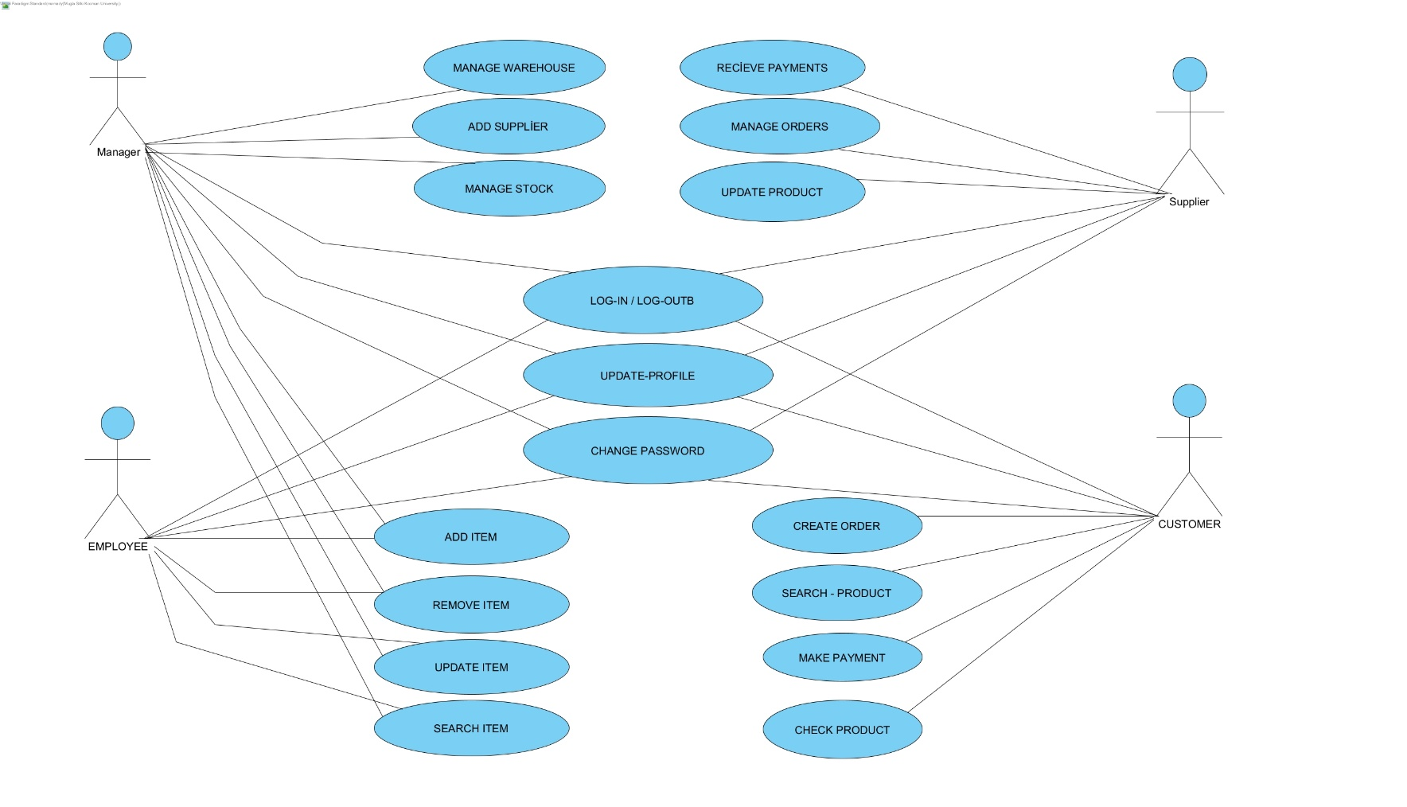
USE CASE DIAGRAMS

Slide 12
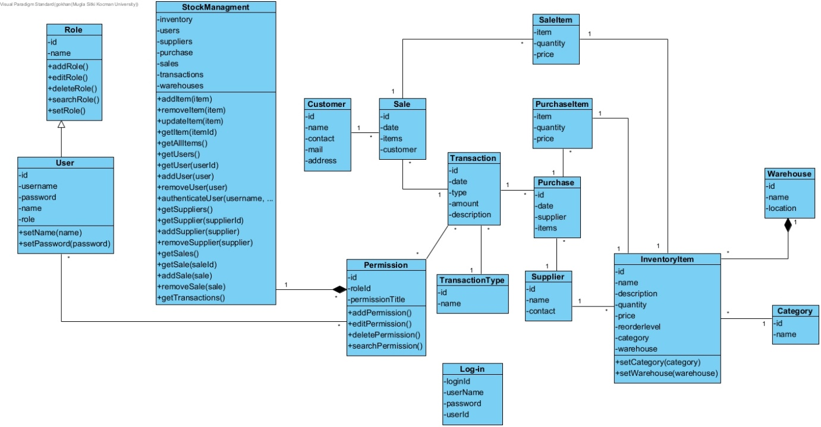
CLASS DIAGRAMS

Slide 13
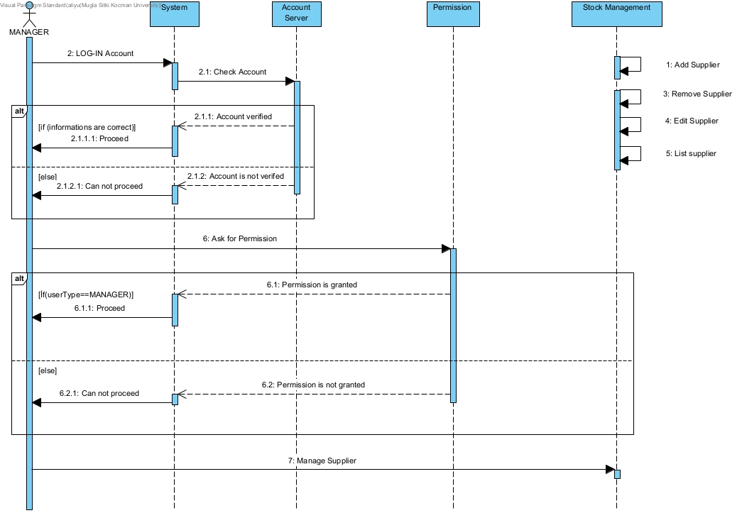
SEQUENCE DIAGRAM

Slide 14
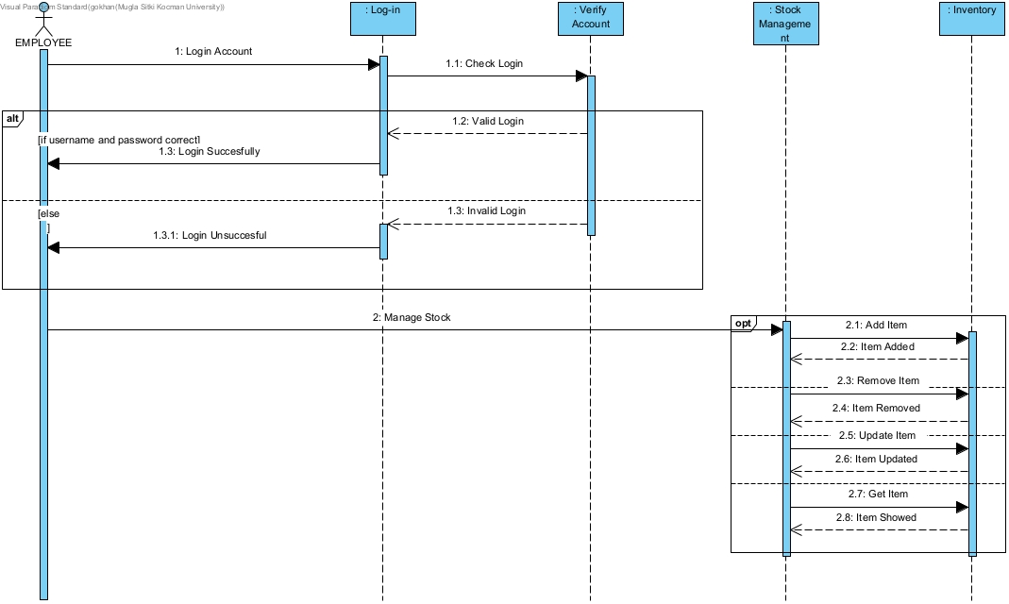
SEQUENCE DIAGRAM

Slide 15
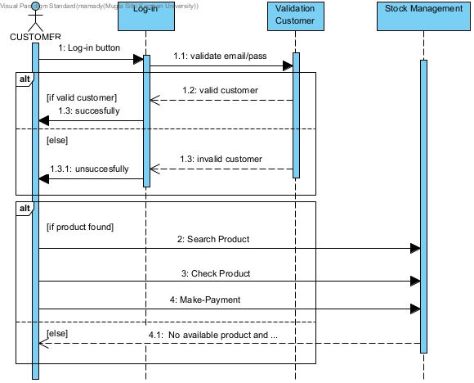
SEQUENCE DIAGRAM

Slide 16
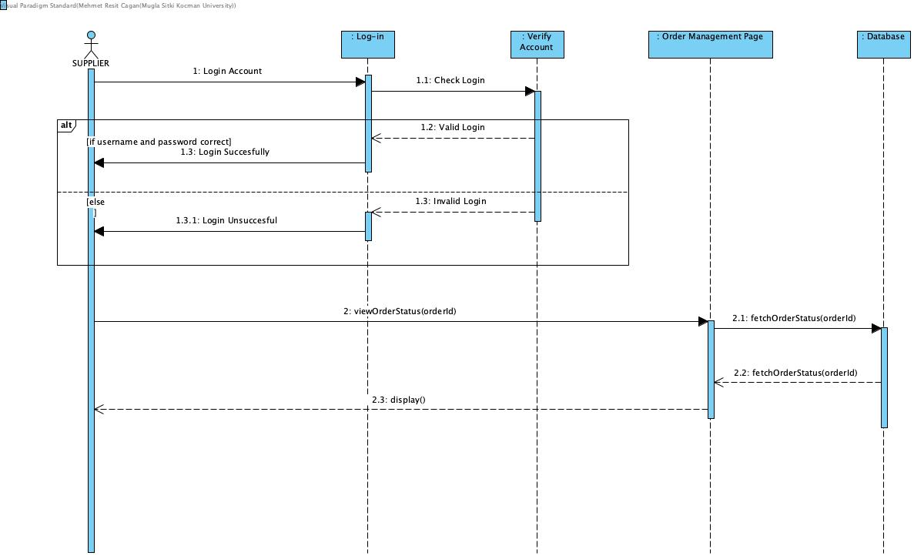
SEQUENCE DIAGRAM

Slide 17
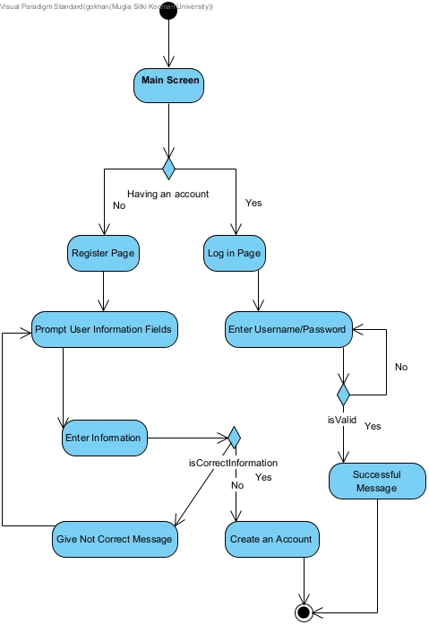
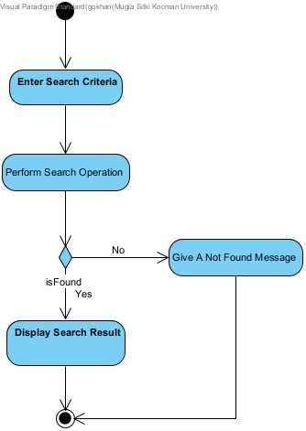
ACTIVITY DIAGRAM

Slide 18
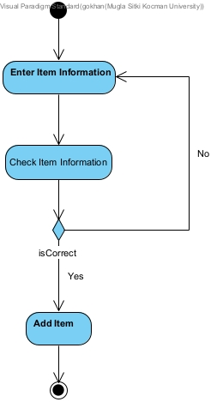
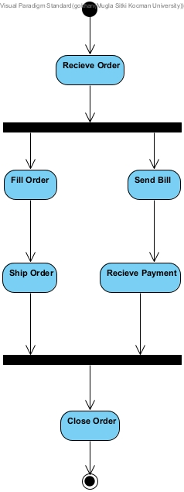
ACTIVITY DIAGRAM

Slide 19
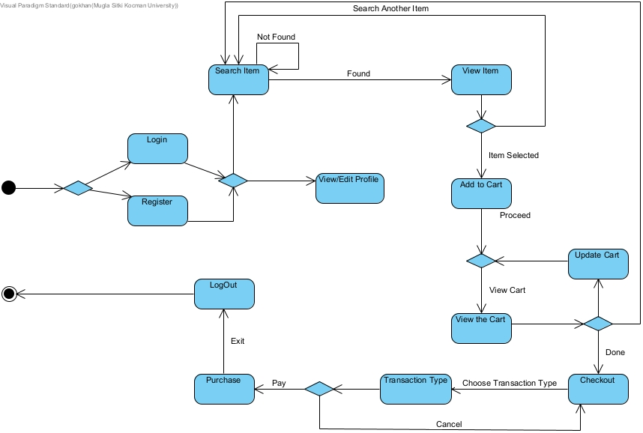
STATECHART DIAGRAM

Slide 20
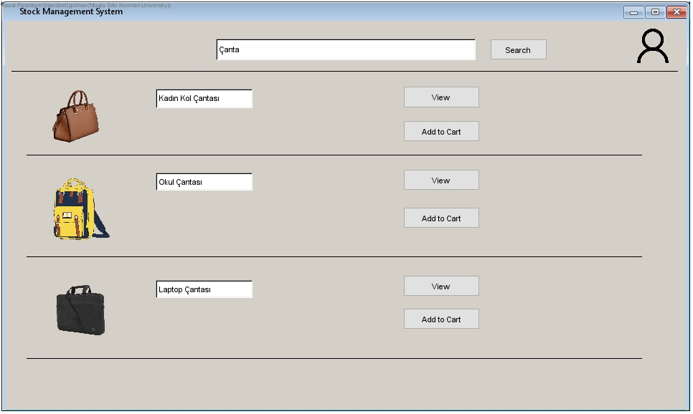
USER INTERFACE DIAGRAM

Slide 21
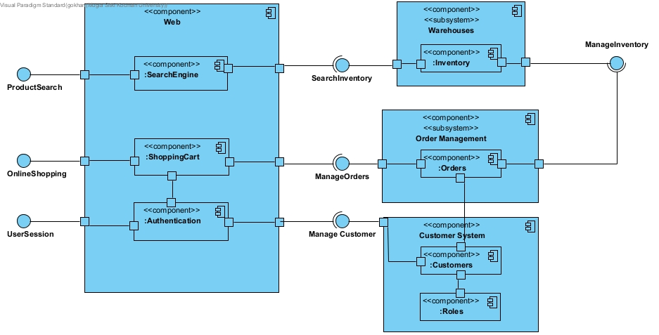
COMPONENT DIAGRAM
Notes:
Sistem 3 alt sistemden oluşuyor. Warehouse, order management, customer system.
Web component şu alt compenentleri içeriyor: search engine, shoppingcart, authentication.
Warehouse subsystem inventory compenent içeriyor.
Ordermanagement subsytem order compenent içeriyor.
Customer ‘’

Slide 22
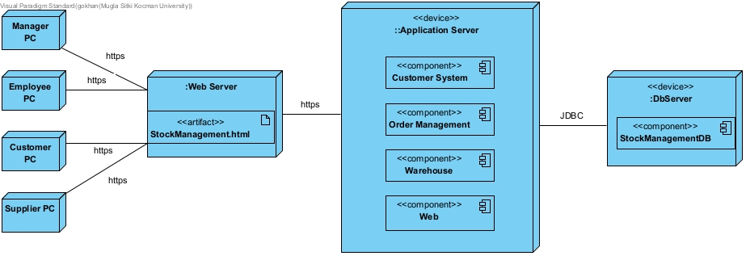
DEPLOYMENT DIAGRAM
Notes:
Aktörler web üzerinden stock manegment’a erişiyorlar. İstedikleri işlemleri bu web sayfası üzerinden yapıyorlar. Application server gereken işlemleri databaseden gerçekleştirir.

Slide 23
CONCURRENCY
Does the system provide access to multiple users?
Which entity objects of the object model can be executed independently from each other?
Can a single request to the system be decomposed into multiple requests?
Can these requests be handled in parallel?
RACE CONDITION
Notes:
…

Slide 24
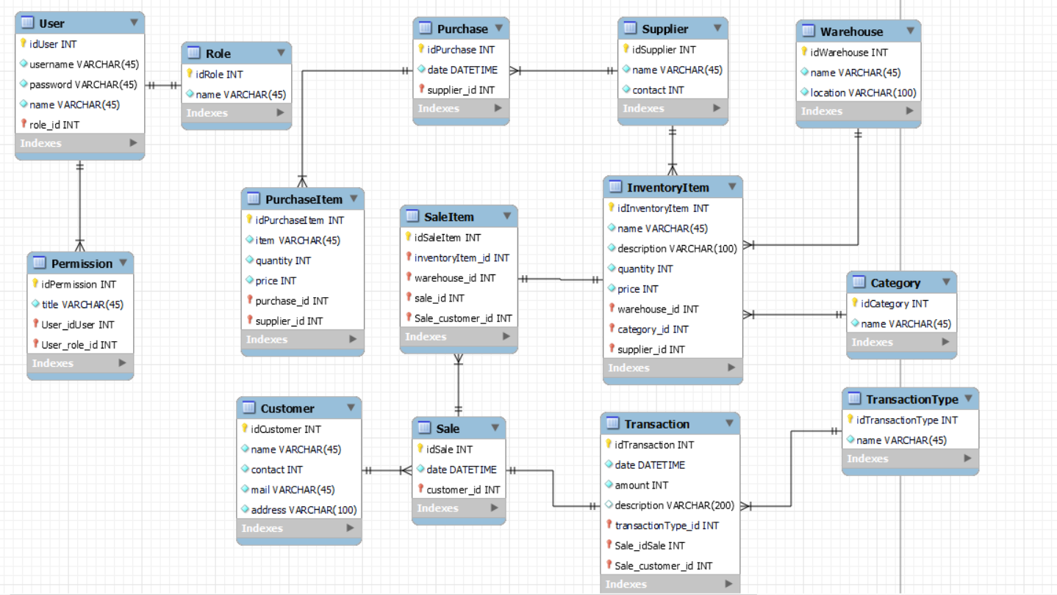
DATA MANAGEMENT

Slide 25
GLOBAL RESOURCE HANDLING
Authentication Mechanisms:
Username and Password
Authorization Mechanisms:
Role-Based Access Control

Slide 26
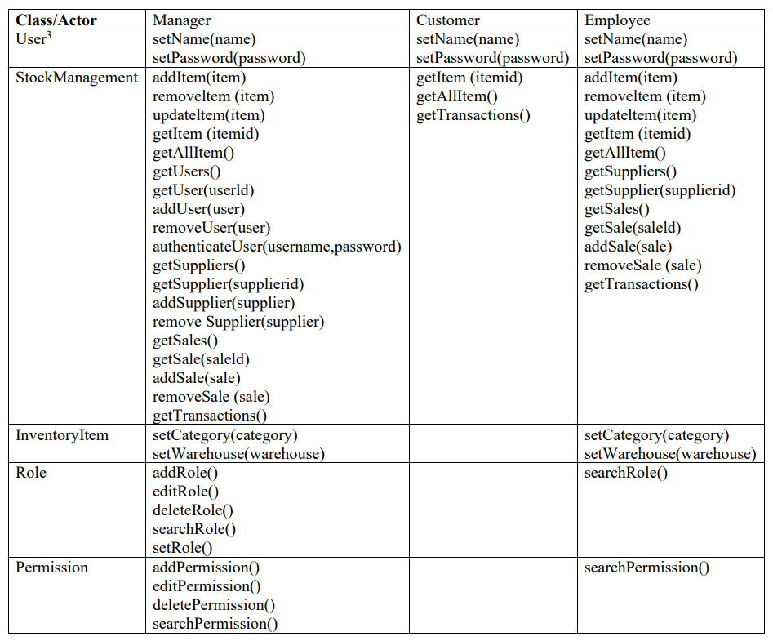
ACCESS MATRIX

Slide 27
BOUNDARY CONDITIONS
INITIALIZATION
TERMINATION
FAILURE

Slide 28
THANKS FOR LISTENING

