Slide 1
CHILD MARRIAGE / ADOLESCENT PREGNANCIES MATERNAL/NEONATAL OUTCOMES
Prof. Dr. faik Mumtaz Koyuncu
University of Celal Bayar
Manisa

Slide 2
Formal marriage or informal union before age 18..
The reality for both boys and girls are affected. The girls, most disproportionately affected.
Lead to a lifetime disadvantage and deprivation
slide…. With the permission of Prof. Dr. Baloglu

Slide 3
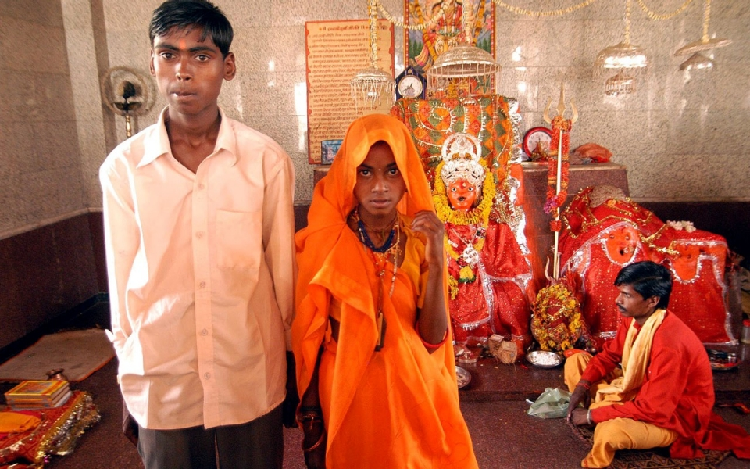
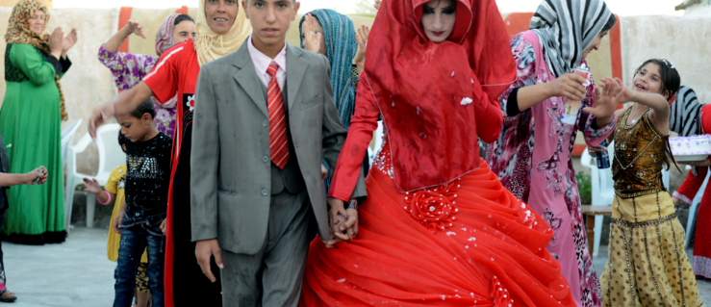
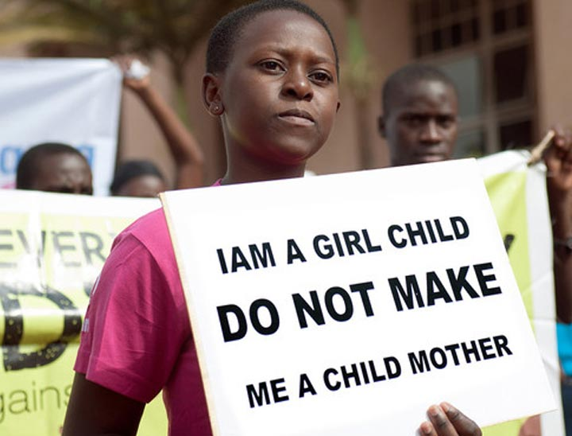
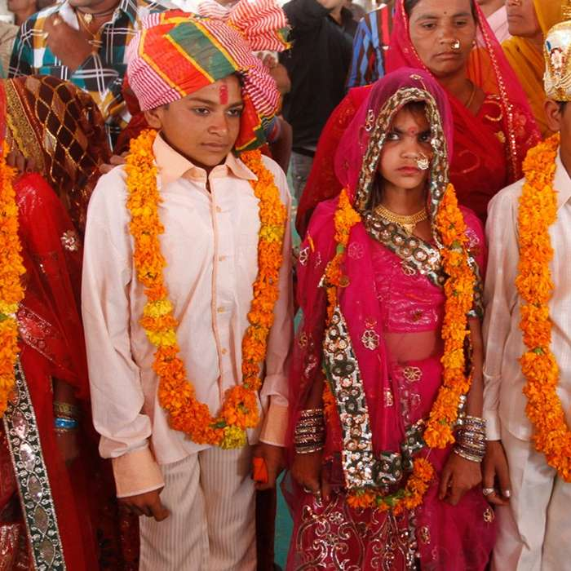

Slide 4
Adolescent
0
10
19
Yaş
15
24
Youth
Young Period

Slide 5
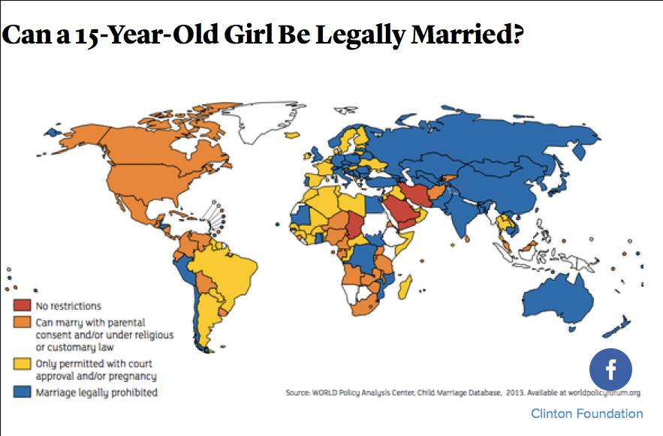
A girl who is 15 years of age.. Marriage???

Slide 6
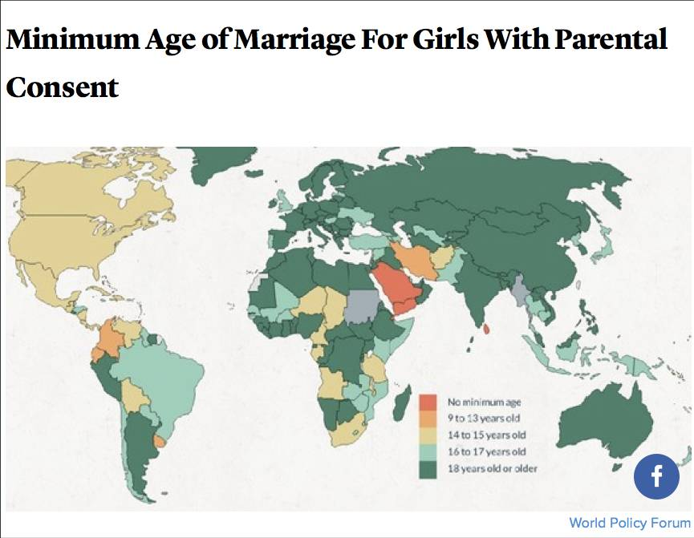
With parental consent ??

Slide 7
Worldwide, more than 700 million women alive today were married as children.
More than 1 in 3 – or some 250 million – were married before 15.
Girls who marry before they turn 18 are less likely to remain in school and more likely to experience domestic violence.
Young teenage girls are more likely to die due to complications in pregnancy and childbirth than women in their 20s; their infants are more likely to be stillborn or die in the first month of life
UNICEF 2014

Slide 8
Child marriage
39 000 / every day,
More than 140 million girls will marry between 2016 and 2022.
The average global birth rate among 15 to 19 years old is 49 per 1000 girls.
2014 World Health Statistics.
Country rates range from 1 to 299 births per 1000 girls, with the highest rates in sub-Saharan Africa.
United Nations Foundation/UNFPA/UNICEF/UN Women/WHO/World Vision/World YWCA

Slide 9
Each year, more than half a million women die from causes related to pregnancy and childbirth,
Nearly 4 million newborns die within 28 days of birth. Millions more suffer from disability, disease, infection and injury
UNICEF

Slide 10
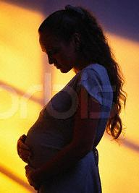
Really important
The most common cause of death for adolescent girls is pregnancy.
An emerging and global health problem of the World.
WHO 2015

Slide 15
Adolescents/Teenager/Risks, Sexual and Reproductive Health Concerns
The mother of the child born in the world in a year is about 14 million of adolescent age.
4 million of unsafe abortion occurring in every year belong to the adolescent age group (25%).
About one in every 20 Adolescent suffer from STD besides HIV/AIDS .
Half of the current HIV/AIDS cases are from the 10-24 years of age group.

Slide 16
Adolescent teen girls deliver 14 million babies every year to the World.
South America 1.8 mill
Developed Countries 1.3 mill
Africa 4..5 mill.
Asia 5.7 mill.
North America& Middle East .1.0 mill.

Slide 17
The vast majority of births are the result of unwanted pregnancy (age under 20)
Sub-Saharan Africa Latin America
3 of every 6 delivery 2 of every 6 delivery
Adapted from Population Reports, 2008.

Slide 18
Adolescent pregnancy trends
90
80
70
60
Sweden
50
Russia
France
Bulgaria
40
England
Ukrain
Estonia
30
20
10
0
1980
1985
1990
2000
2013

Slide 19
Adolescent birth rate in different regions
Region,Country | Birth Rate (‰)
World Mean Rate | 45,4
1. Nijer | 204,8
Lowest one North Korea | 0,6
113.Turkey | 30,9
European Mean Rate | 15,0
Bulgaria | 35,9
UK | 25,8
Greece | 11,9
USA | 31,0
UNPFA(2013) Population Exp. Revision: 2012.

Slide 20
Adolescent Birth Rate 2013.
Province | No of Delivery | 15-19 year population | Adolescent Birth Rate (‰)
Turkey | 91.114 | 3.098.038 | 29,4
Ağrı | 2.165 | 29.975 | 72,2
Kars | 936 | 14.651 | 63,9
Muş | 1.418 | 23.471 | 60,4
Van | 3.253 | 58.867 | 55,3
Niğde | 805 | 15.617 | 51,5
Rize | 153 | 13.528 | 11,3
Trabzon | 345 | 31.963 | 10,8
Tunceli | 35 | 2.652 | 13,2
Artvin | 83 | 6.247 | 13,3
İstanbul | 10.031 | 513.910 | 19,5
İzmir | 3.075 | 139.012 | 22,1

Slide 21
Adolescent Birth Rates yearly 2001-2014
Year | No of deliveries | 15-19 years old population | Adolescent Birth Rate (‰)
2001 | 154.322 | 3.132.000 | 49,3
2002 | 135.104 | 3.099.000 | 43,6
2003 | 123.999 | 3.066.000 | 40,4
2004 | 123.834 | 3.051.000 | 40,6
2005 | 123.475 | 3.035.000 | 40,7
2006 | 121.572 | 3.019.000 | 40,3
2007 | 119.962 | 3.001.000 | 40,0
2008 | 118.759 | 2.985.000 | 39,8
2009 | 110.505 | 3.025.257 | 36,5
2010 | 101.220 | 3.047.707 | 33,2
2011 | 95.280 | 3.067.737 | 31,1
2012 | 91.114 | 3.098.038 | 29,4
TÜİK, 2014.

Slide 22
Underlying causes
Low socioeconomic status and income
Rape
A lack of peer pressure
Low level of education
Partner suppressing
Weak family ties (Shattered families)
Losing sense of belonging
Living early and unprotected sex
Gender inequality

Slide 23



Faced risks of Adolescents/Youngs
Pubertae / menarch
Sexuality
Sexual activity
Risk of pregnancy
Unexpected pregnancies
Planned abortion
Contraception
STD
Gender discrimination
Sexuel violance
Cigarette/alcohol/
substance use

Slide 24
Detrimental effects of early child marriage
Still births and newborn deaths are 50% higher among mothers under 20 than in women who get pregnant in their 20’s.
In many poor countries, most young girls, regardless of age, are forced to demonstrate their fertility once they are married,
These children, because that’s what they are, are discouraged from using contraceptives or might have to ask their husbands’ permission, or they have no knowledge of or access to what they need.

Slide 25
Parents
Researchs during the past decade confirm the common belief that children of adolescent mothers do not fare as well as those of adult mothers.
These children have increased risks of developmental delay, academic difficulties, behavioral disorders, substance abuse, early sexual activity, depression, and becoming adolescent parents themselves.

Slide 26
High rates of maternal mortality
Maternal mortality rate of 1000 live births
28
24
20
16
12
8
4
0
Nigeria
Bangladesh
Ethiopia
Nigeria
Bangladesh
Ethiopia
≤ 15 yrs
20-24 yrs
30-34 yrs
Studies in Family Planning, 1986; British Journal of Ob/Gyn, 2002.

Slide 27
Medical risks of adolescent pregnancy
Under age 16: As a result:
Narrow pelvis Difficult and prolonged labor
Primigravida:
Hypertansive Disease PPH and Eclampsia

Slide 28
Adolescent Pregnancy ,Fetal and Maternal Results. Baloğlu.A, et all.2012 .MKU Med.Jour.2013 -32.
Pregnant women more than 20 weeks of gestation in our hospital between the dates of 01.01.2008-01.08.2012. Case Groups : 80 AP versus 102 Controls.
Live, single pregnant women who gave birth under and over 19 years of age were examined during same period retrospectively.
The demographic characteristics of the group (age, gravity, parity, is the married official with the spouse, relationship with spouse), obstetric outcomes (gestational age at birth, shape, birth weight, 1 and 5 minute Apgar scores,The presence of anemia) and obstetric complications (preterm birth, intrauterine development retardation, oligohydramnios, gestational diabetes, macrosomia, placental abnormalities, fetal distress) was comparable terms.
Results for the statistical significance as the level of P <0.05 .

Slide 29
Obstetric and neonatal outcomes of adolescent pregnancy
CONCLUSION: (n=341) In our retrospective study, we found lower our complication rates in adolescent age group when compared with the adult age group, and other studies performed in adolescents. Since our hospital is a tertiary health care institute, and we monitorized our patients closely, our incidence rates can be better than those cited in the literature. As long as proper antenatal surveillance is employed, adolescent mothers do not seem to have increased risk for most of obstetric complications.
Tuncay Yuce et al North Clin Istanbul 2015;2(2):122-127 doi: 10.14744/nci.2015.86158 Ankara Univ

Slide 30
Original Research - Qualitative Pregnant adolescent women’s perceptions of depression and psychiatric services in the United States
Adolescent mothers do not often recognize the symptoms of depression and have limited experiences with psychiatric services. In order for adolescent women to engage in services practical and psychological barriers as well as the underlying causes of depression should be addressed.
Problem or issue
Pregnant adolescent women with depression have low levels of engagement and retention in psychiatric services.
What is already known
Adolescent mothers and their children are a high-risk group for depression and the associated negative educational, social, health, and economic outcomes. Few pregnant adolescent women with depression receive psychiatric services, especially low-income or racial/ethnic minority adolescent women.
Women and Birth 11 February 2017

Slide 31
Children….. Unprotected/vulnerable….. Need love
Young people….. Energetic……. Need responsibility
Senior people…. Experienced…. Need respect
IF WE DO ALL WELL…… CAN CREAT A PLACE TURNING INTO HUMANISTIC
IT MIGHT BE CALLED PARADISE

Slide 32
Our nation is determined to become a strong nation. This is one of the motivations for our women to rise in every regard. Because of this, our men and women of Science they will be teaching and go through all the steps will be the owner.
Our religion has never demanded women to be lower than men. Commanded by God as well for men and women, Muslims must obtain enlightenments. Men and women seek science and wisdom, and wherever they could find they should go and furnished with.
Mustafa Kemal Ataturk

Slide 33
Take Home Messages
Adolescent pregnancy is a global issue.
Decrease in the rate is gratifying for each year.
Early diagnosis and management is so important.
Effective contraception should be applied.
EDUCATION… EDUCATION…. EDUCATION

Slide 34
Thank you

Slide 35
Tradition of child marriage
Migration and human rights barriers
Adolescent pregnancy is in the immediate vicinity of the marriage or extramarital adolescent pregnancy
Sexual violence
Contraceptional restriction
National policies
Appropriate sex education
Reproductive health units not being developed…

Slide 38
Psychological and social consequences of pregnancy in unmarried Adolescent
The single mother and social stigma of the child
Lack of education,
Limited job and career opportunities
Heavy economic burden
Depression, insecurity of young women,
Children’s psychological, social and economic aspects are more problematic..

