Slide 1

Ismt e-117 text analytics & Natural language processing
FINAL PROJECT PRESENTATION BY:
GOKHAN ULUDERYA, NIKHAR SHAH, COLE CRAWFORD, CECILIA BUTLER
2019 FALL SEMESTER

Slide 2
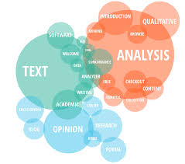
agenda
OVERVIEW
APPROACH W/DEMO
ANALYSIS REVIEW
ADDITIONAL BUSINESS USE CASES
KEY LEARNINGS

Slide 3
TOPIC MODELING, DISCOVERY & SUBCLASSES USING NEWS DATASETS PROJECT SUMMARY
GOAL: Use a dataset and apply supervised, unsupervised and NLP techniques, including data cleansing to measure accuracy by comparing outputs.
BUSINESS CASE:
Archival of news/newsgroup digital media, articles, stories and posts by topic and sub-topics or additional terms and classifications that could apply to the articles.
ANALYSIS TECHNIQUES:
Use supervised and unsupervised methods to determine topics and terms for classification using the following:
LDA Topic Modeling & Discovery
Supervised Training Using Labelled Data
Data Cleansing & NLP Techniques

Slide 4

demo
GOKHAN ULUDERYA, NIKHAR SHAH, COLE CRAWFORD, CECILIA BUTLER

Slide 5
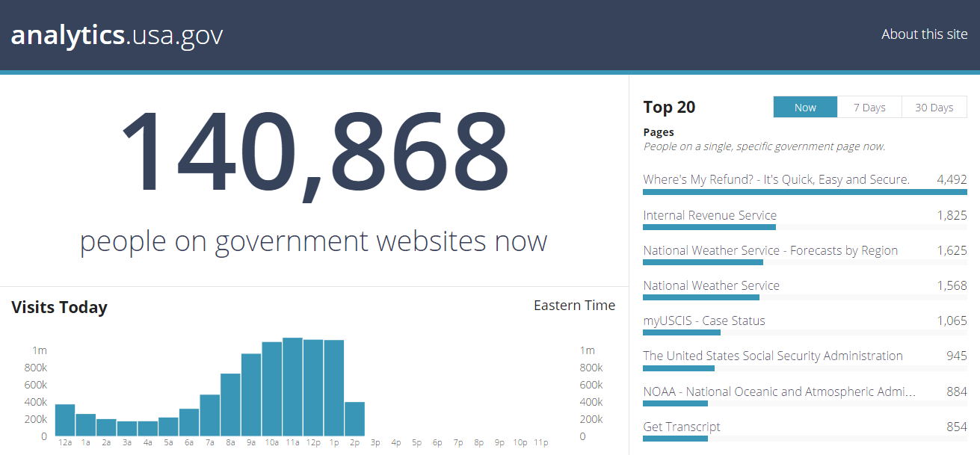
ANALYSIS OF RESULTS
GOKHAN ULUDERYA, NIKHAR SHAH, COLE CRAWFORD, CECILIA BUTLER
HOLD FOR OUR RESULTS
This Photo by Unknown Author is licensed under CC BY-SA

Slide 6
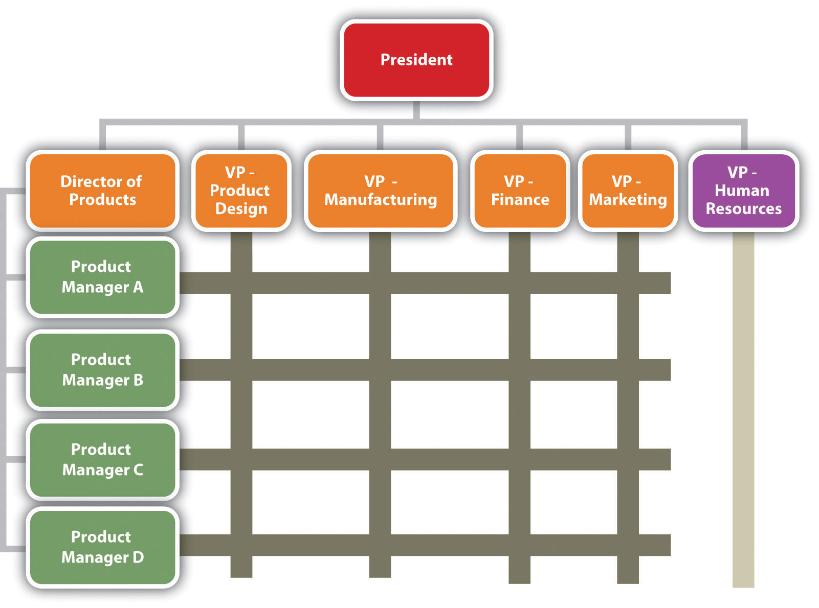
BUSINESS USE CASES
TBD
TBD
TBD
This Photo by Unknown Author is licensed under CC BY-SA-NC

