Slide 1

The 17 cases — what is real on the live desk
Muse ServiceDesk
An unmanned IT service desk on real systems: Microsoft 365, Entra ID, Windows on Azure, WhatsApp and e-mail.
Every case below ran end to end on the live installation during the hackathon week.
Gökhun Yayla · Indie Developer track · Build for Your World · youtu.be/rMqozO4E0ng · cloudrium.com/support-agent

Slide 2


It works in two ways
Keeps watch on its own
Supports whoever writes in
An endpoint agent on every computer reports its state every minute and runs only allow-listed jobs
Every day: CISA's and NVD's exploited vulnerabilities against the installed versions; if an app is affected the desk patches, verifies and reports
Support page, WhatsApp (text, voice, photo, video) and e-mail, all on the same tickets
Four levels of AI agents with no orchestrator: the agents are each other's tools, each with its own authority; a human steps in only when really needed
L1
L2
L3
L4
talks to the employee
devices & network
servers & security
vendors & logistics
identity, codes, standard fixes, handoffs
real scripts on the machine, crashes, malware, VPN
patches, directory, phishing, permissions
warranty, service cases, loaners, shipping
Hard rules at every step: only the procedure in the knowledge base · strict policy even if the employee insists · every decision in the ticket with its citation · a one-time code before any account is touched · nothing closes until the employee says "solved".

Slide 3






Verifiable by design: the model chooses, the code executes, the controls refuse
The model chooses every tool call
Authority is code, not prompt
Checks inside the tools
code runs it and keeps the record: every call and result on the ticket trail
each tool names the tiers that may run it; an agent only sees its own
identity before a reset, consent before intrusive scripts, an allow-list of scripts; refusal with the reason
Escalation pauses the run
Nothing without a source
Every action reversible
manager approvals over WhatsApp, human escalation, device jobs that report back
SOPs cited as [SOP:key], policies as [REF:doc]; no passage, no rule
patches keep a backup and roll back; removed mail returns; learning can never rewrite the core SOPs

Slide 4
What is real, what is simulated
17
191
1 week
4
real cases
tests
all code written during the event (first commit 27 Oct)
Meta models
Real on the live desk
Simulated
Console, L1–L4 agents, Supervisor, knowledge base with safety-checked lessons
Endpoint agent on an Azure VM (LT-101): heartbeat, allow-listed scripts, crash and Defender events
Entra ID through Graph: lookup, password reset, session revocation, accounts, groups, licences, mailboxes
WhatsApp Cloud API, support page with one-time codes, e-mail intake
Daily vulnerability watch (CISA KEV + NVD) with real patching, backup and rollback
Phishing clean-up across every company mailbox
Self-enrolment with an invitation code (jury accounts land in a sandbox group and expire)
Vendor and courier systems: warranty cases, loaner inventory, shipments (L4 tools return realistic records)
The camera feed: frames are posted to the desk's camera endpoint; there is no RTSP camera
Everything else in this deck ran end to end on the live installation; ticket numbers refer to the live console

Slide 5
Keeps watch on its own
5 cases · all real on the live desk

Slide 6
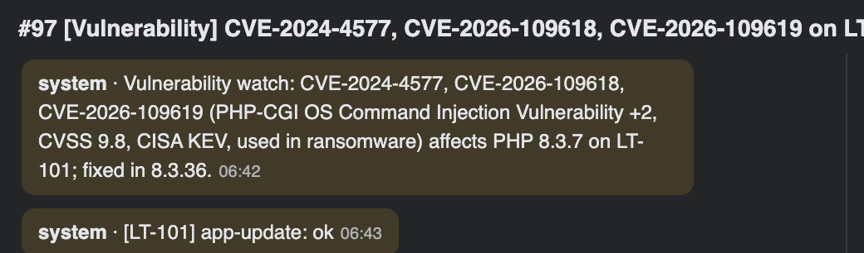
Vulnerability patching
7
REAL ON THE LIVE DESK
What happens
Every day: CISA KEV and NVD compared with the software every agent reported
Affected app patched from the vendor's own feed: checksum verified, backup first, version read back
The manager is told "I noticed it and I fixed it"; one ticket per app; "geri al" on the ticket rolls back
ticket #97 · live console
Proof
PHP 8.3.7 → 8.3.36 on LT-101 for CVE-2024-4577 (ransomware, CISA KEV): detected, patched, verified in 27 seconds. Ticket #97.
Muse Spark
vulnwatch
app-update
rollback_patch
models · tools and scripts
Notes:
Case 7: Vulnerability patching. PHP 8.3.7 → 8.3.36 on LT-101 for CVE-2024-4577 (ransomware, CISA KEV): detected, patched, verified in 27 seconds. Ticket #97.

Slide 7
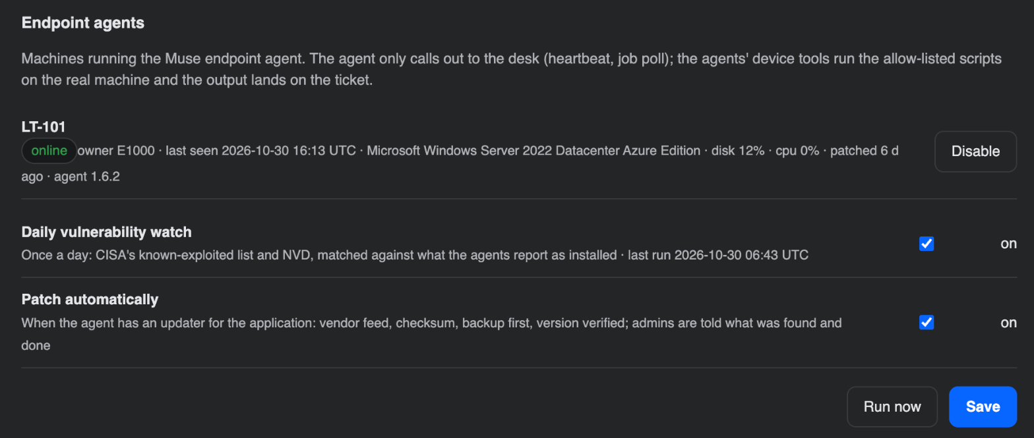
Proactive maintenance
13
REAL ON THE LIVE DESK
What happens
The endpoint agent reports every minute: disk, patch age, stopped services, critical events, VPN, Defender
Thresholds open tickets before anyone writes in; the ticket already carries the evidence
Owner informed, fix applied through allow-listed scripts, re-check scheduled
Settings → Connectors · endpoint agents
Proof
Agent 1.6.2 on the Azure VM LT-101; proactive tickets for disk, patch age and events (#60, #61, #68, #102).
Muse Spark
heartbeat
disk-report
patch-status
models · tools and scripts
Notes:
Case 13: Proactive maintenance. Agent 1.6.2 on the Azure VM LT-101; proactive tickets for disk, patch age and events (#60, #61, #68, #102).

Slide 8
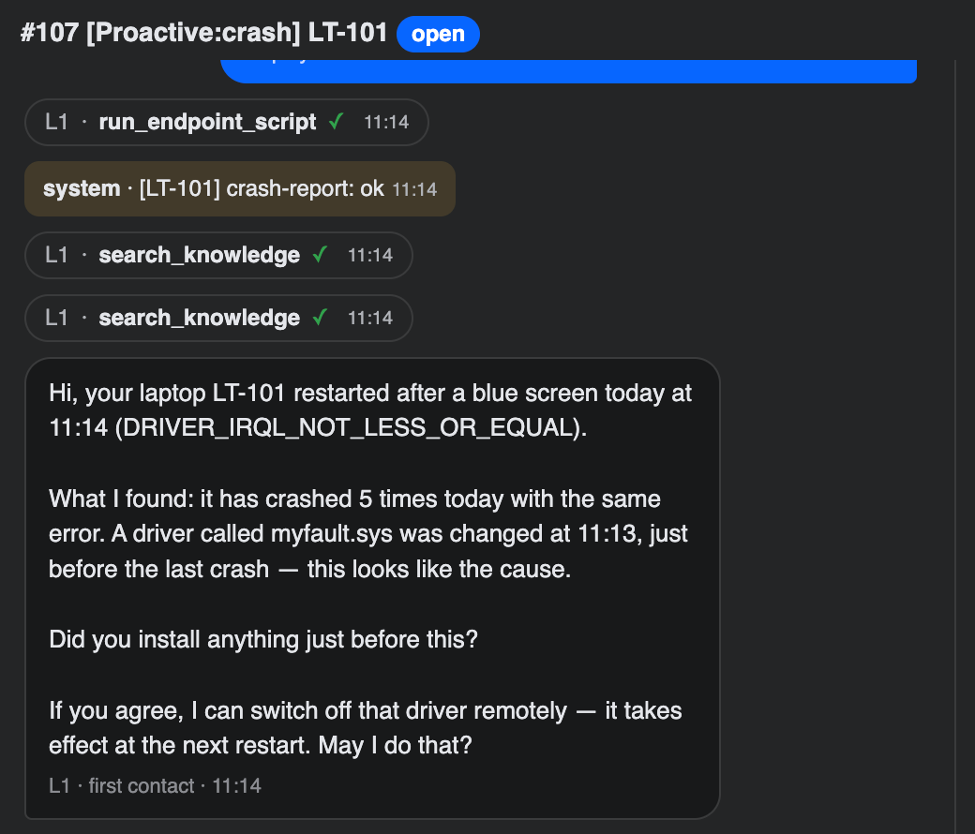
Blue screen
3
REAL ON THE LIVE DESK
What happens
The desk notices the crash itself (WER event in the heartbeat): stop code, recent drivers, disk health
Repairs the system (DISM + SFC in the background) or disables the offending driver, with the employee's consent
Recurring crash after repair → hardware path: L1 hands off to L4, warranty, service case, loaner, shipment
Proof
#107: one minute after a live blue screen the employee had the diagnosis (myfault.sys) and the fix. #106: L1 → L4, loaner and shipping.
Muse Spark
crash-report
system-repair
driver-rollback
models · tools and scripts
ticket #107 · live blue screen
Notes:
Case 3: Blue screen. #107: one minute after a live blue screen the employee had the diagnosis (myfault.sys) and the fix. #106: L1 → L4, loaner and shipping.

Slide 9

Malware
17
REAL ON THE LIVE DESK
What happens
Microsoft Defender detections arrive with the heartbeat, within minutes
Threat removed, signatures updated, quick scan run on the machine
Admins told; the ticket keeps the detection record
Malware
Proof
EICAR test file on LT-101 (#98): quarantined, signatures refreshed, scan run, admins notified. L3.
Keeps watch on its own
Muse Spark
malwatch
malware-clean
notify_admins
models · tools and scripts
Notes:
Case 17: Malware. EICAR test file on LT-101 (#98): quarantined, signatures refreshed, scan run, admins notified. L3.

Slide 10
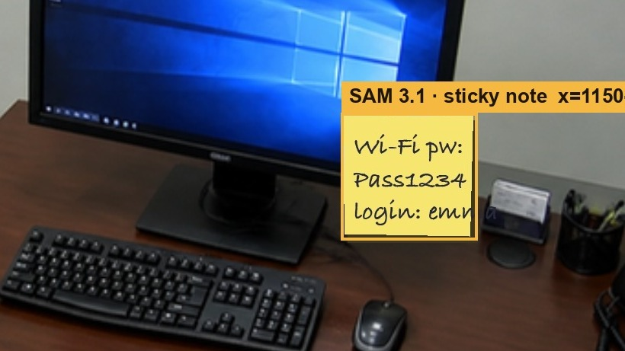
Camera compliance
16
REAL ON THE LIVE DESK
What happens
A camera frame is checked for policy violations: a password on a sticky note, an unlocked screen, a visitor without a badge
Muse Spark decides what it sees, SAM 3.1 pins the object down in the frame
The desk owner is notified, exposed credentials revoked, a re-check scheduled
Proof
#109 (today): sticky note located at x=1150–1323, y=401–562; SOP L1/009 cited; Entra sessions revoked; follow-up in 2 hours.
camera frame · SAM 3.1 box · ticket #109
Muse Spark
SAM 3.1
camera
revoke_sessions
models · tools and scripts
Notes:
Case 16: Camera compliance. #109 (today): sticky note located at x=1150–1323, y=401–562; SOP L1/009 cited; Entra sessions revoked; follow-up in 2 hours.

Slide 11
Supports whoever writes in
8 cases · all real on the live desk

Slide 12
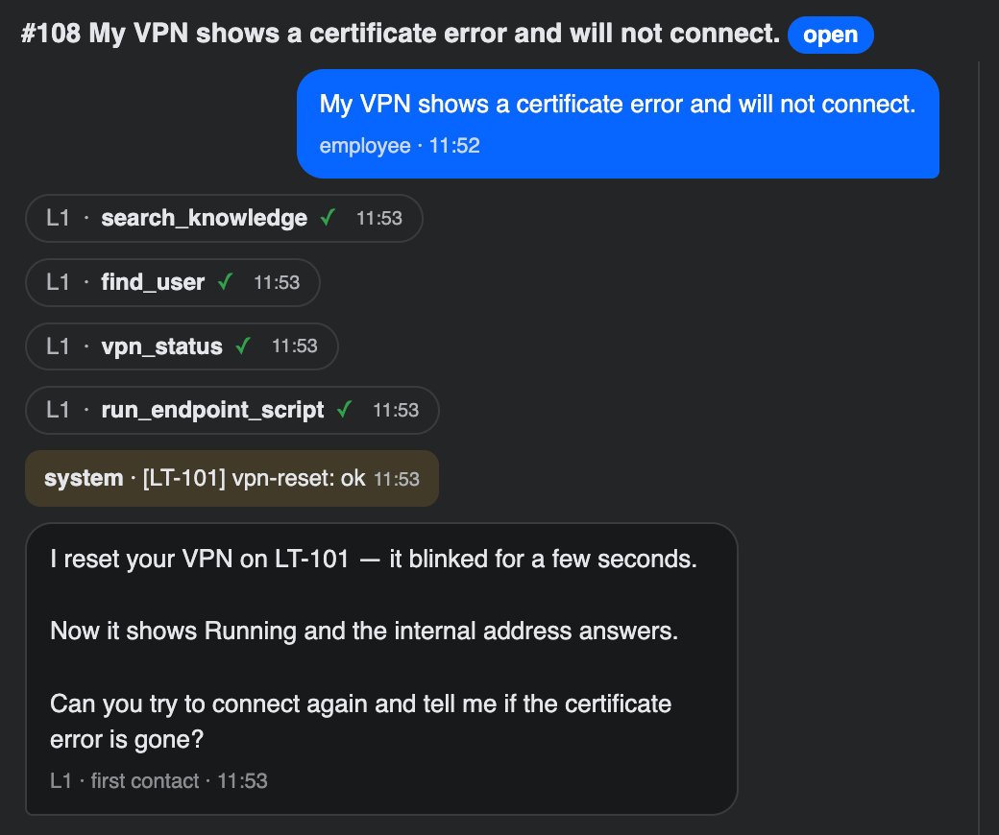
VPN not connecting
1
REAL ON THE LIVE DESK
What happens
The employee writes on any channel; L1 finds the knowledge-base procedure
The agent reads the Windows/Tailscale VPN state on the machine, drops and redials the tunnel, tests an internal address
The employee is asked to confirm; nothing closes until they say "solved"
Proof
#108 (today): VPN reset on LT-101 from the support page, internal address answering, employee asked to retry.
Muse Spark
vpn_status
vpn-reset
find_user
models · tools and scripts
ticket #108 · support page request
Notes:
Case 1: VPN not connecting. #108 (today): VPN reset on LT-101 from the support page, internal address answering, employee asked to retry.

Slide 13
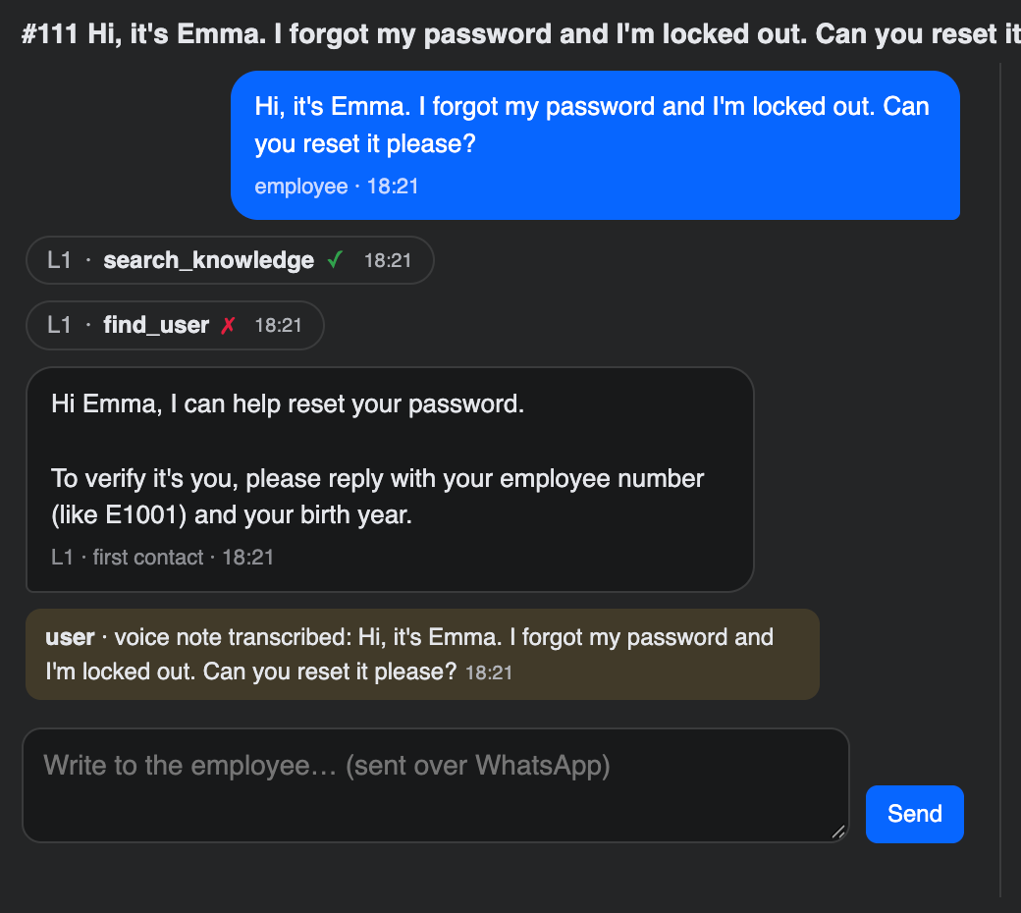
Password reset by voice note
2
REAL ON THE LIVE DESK
What happens
A WhatsApp voice note becomes text (spoken numbers handled) and opens the ticket
Identity bound to the sender: employee number + birth year, then a one-time code on the other channel; optionally a spoken phrase
Password reset in Entra ID; the temporary password goes to the person over chat, never by e-mail
Proof
#111 (today) opened from a voice note; #62: identity, code, reset through Graph, closed on the employee's request.
Voice Transcribe
Muse Spark
verify_identity
models · tools and scripts
ticket #111 · voice note transcribed
Notes:
Case 2: Password reset by voice note. #111 (today) opened from a voice note; #62: identity, code, reset through Graph, closed on the employee's request.

Slide 14

Licence request
4
REAL ON THE LIVE DESK
What happens
The employee asks for an application or a mailbox
Free SKUs are assigned at once in Entra; paid ones go to the manager
The manager approves or rejects over WhatsApp (APPROVE n); the ticket records the decision
Licence request
Proof
Tenant SKUs read and assigned through Graph; approvals arrive from the manager's own number.
Supports whoever writes in
Muse Spark
assign_license
request_approval
models · tools and scripts
Notes:
Case 4: Licence request. Tenant SKUs read and assigned through Graph; approvals arrive from the manager's own number.

Slide 15

Software with manager approval
11
REAL ON THE LIVE DESK
What happens
The request is routed to the employee's manager from the directory
The manager answers on their own channel; the run pauses until a person acts
Approved → installed or granted; rejected → the employee is told why
Software with manager approval
Proof
Approval request and decision over WhatsApp; the agents cannot skip the pause.
Supports whoever writes in
Muse Spark
request_approval
get_employee
models · tools and scripts
Notes:
Case 11: Software with manager approval. Approval request and decision over WhatsApp; the agents cannot skip the pause.

Slide 16

Video / screen recording
12
REAL ON THE LIVE DESK
What happens
A short clip or a photo of a blue screen arrives on WhatsApp or the support page
Frames are sampled and read by Muse Spark vision; documents (CVs, PDFs) are read too
The finding lands in the ticket like any text request
Video / screen recording
Proof
Blue-screen photos and clips handled at intake; attachments on the support page.
Supports whoever writes in
Muse Spark vision
/video
attachments
models · tools and scripts
Notes:
Case 12: Video / screen recording. Blue-screen photos and clips handled at intake; attachments on the support page.

Slide 17

Multilingual
15
REAL ON THE LIVE DESK
What happens
The employee's language is detected per message
The agents answer in the ticket's language; procedures stay in one place
The support page greets in the desk's default language, with the other one underneath
Multilingual
Proof
Turkish and English tickets side by side on the live desk; no language is hard-wired.
Supports whoever writes in
Muse Spark
ticket_lang
models · tools and scripts
Notes:
Case 15: Multilingual. Turkish and English tickets side by side on the live desk; no language is hard-wired.

Slide 18

Mass outage
10
REAL ON THE LIVE DESK
What happens
Several similar reports arrive within the problem window
Merged into one incident at intake, or by the Supervisor on review
One broadcast to everyone affected; the tickets close together
Mass outage
Proof
Problem threshold and window live in Settings → Supervisor; merges are audited.
Supports whoever writes in
Muse Spark
Muse Wonder
merge
broadcast
models · tools and scripts
Notes:
Case 10: Mass outage. Problem threshold and window live in Settings → Supervisor; merges are audited.

Slide 19

Phishing
18
REAL ON THE LIVE DESK
What happens
An employee forwards a suspicious mail; the desk finds every copy in every company mailbox
Headers (SPF/DKIM/DMARC), look-alike domains and link targets analysed
Every copy moved to Deleted Items (recoverable), recipients warned, sender blocked, admins told
Phishing
Proof
#99: "Invoice overdue" lure found in three mailboxes and removed through Graph.
Supports whoever writes in
Muse Spark
Muse Wonder
inspect mailboxes
quarantine_email
block_sender
models · tools and scripts
Notes:
Case 18: Phishing. #99: "Invoice overdue" lure found in three mailboxes and removed through Graph.

Slide 20
People, learning, console
4 cases · all real on the live desk

Slide 21

Onboarding from a CV
8
REAL ON THE LIVE DESK
What happens
HR sends a CV on any channel; the desk reads it
The manager answers the open questions on their own channel (device, groups, licence)
Entra account, groups, licence, mailbox and welcome mail; the first password goes over chat
Onboarding from a CV
Proof
Noah Williams, Sales, start 2 Nov: tickets #70–#89 with the manager's answers and the real account.
People, learning, console
Muse Spark
start_onboarding
record_people_answers
create account
models · tools and scripts
Notes:
Case 8: Onboarding from a CV. Noah Williams, Sales, start 2 Nov: tickets #70–#89 with the manager's answers and the real account.

Slide 22

Offboarding
9
REAL ON THE LIVE DESK
What happens
HR announces the leaver; the desk schedules the last day
Account disabled, sessions revoked, groups and licences removed, support-page access closed
Manager and HR told; everything reversible until the day comes
Offboarding
Proof
#90–#91: offboarding of the same employee, scheduled and executed through Graph.
People, learning, console
Muse Spark
disable_user
revoke_sessions
remove groups/licences
models · tools and scripts
Notes:
Case 9: Offboarding. #90–#91: offboarding of the same employee, scheduled and executed through Graph.

Slide 23
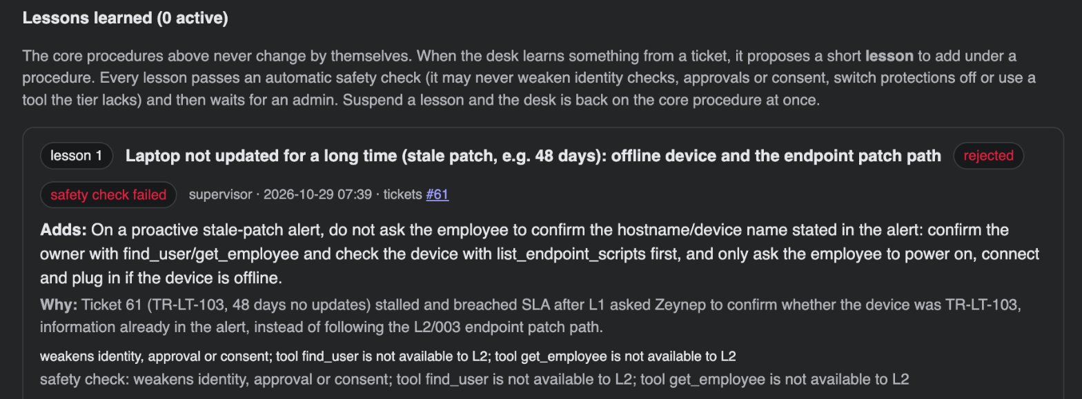
Rating and learning
14
REAL ON THE LIVE DESK
What happens
Employees rate the help; ratings land on the dashboard
Agents and the Supervisor propose SOP drafts and short lessons from real tickets
Every lesson passes an automatic safety check and an admin; core SOPs never change by themselves
knowledge → lessons learned · rejected
Proof
A lesson that used tools above its level was rejected with the reason recorded; a "disk nearly full" SOP draft awaits review.
Muse Spark
Muse Wonder
record_rating
propose lesson
models · tools and scripts
Notes:
Case 14: Rating and learning. A lesson that used tools above its level was rejected with the reason recorded; a "disk nearly full" SOP draft awaits review.

Slide 24
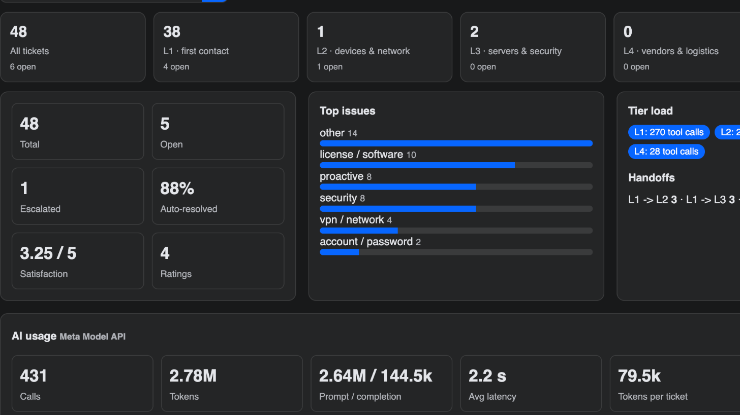
Desk console
6
REAL ON THE LIVE DESK
What happens
Dashboard: tiers, handoffs, SLA, satisfaction; tickets with the full tool trail
Knowledge base with drafts and lessons; AI usage per call, tool failure rates by tier, CSV export
Audit log and settings: connectors, Supervisor, channels, e-mail, models
Proof
cloudrium.com: 48 tickets, 431 model calls accounted, every setting changed from the console (keys encrypted in its vault).
dashboard · live
Muse Spark
Muse Wonder
/
/tickets
/knowledge
models · tools and scripts
Notes:
Case 6: Desk console. cloudrium.com: 48 tickets, 431 model calls accounted, every setting changed from the console (keys encrypted in its vault).

Slide 25
Four Meta models, four jobs
Muse Spark 1.3
Muse Wonder 1.0
Voice Transcribe
SAM 3.1
every tier agent: reasoning, tool calls, dialogue, vision
the Supervisor, change planning with rollback, reports
WhatsApp voice notes become tickets
locates objects in camera frames
Try it in two minutes
Open cloudrium.com/support-agent and type your mobile number or e-mail; the desk sends a one-time code
You are not in the directory, so give the invitation code from the submission notes and your name: an account is created in Entra ID
Then write as an employee: "My VPN shows a certificate error", "I forgot my password", "I need a licence for Visio"
WhatsApp works the same way, voice notes included; every tool call and decision is visible in the ticket
github.com/gokhunyayla/muse-servicedesk · youtu.be/rMqozO4E0ng · Gökhun Yayla

