Slide 1
TRACK B — TIERED MEMORY HIERARCHY
MEMORY-CENTRIC
ARCHITECTURES FOR LLMs
Introducing ASEP — Attention-Score-Driven Eviction Policy for Tiered KV Cache Management
40%
57%
3×
Less Wasted
Evictions
Lower
Promotion Cost
Optimizations
Implemented
GPT-2 Medium · PyTorch Instrumentation · Tiered Memory Simulator · ASEP Policy
3-Tier Architecture: SRAM (4 MB) → HBM (48 MB) → DRAM (512 GB)

Slide 2
PRESENTATION OUTLINE
Memory-Centric Architectures for LLMs — Track B
01
Why Memory Dominates LLM Inference
05
Memory-Centric Optimizations (×3)
Bandwidth analysis · Arithmetic intensity · Memory-bound reality
KV compression · Attention windowing · Operator fusion
02
3-Tier Architecture Design
06
Performance & Energy Modeling
SRAM · GPU HBM · Host DRAM · Placement rules · Migration policy
Roofline model · Energy per token · Controlled experiment results
03
PyTorch Instrumentation & Validation
07
Conclusions & Future Work
Layer-level KV extraction · Formula validation · Real tensor sizes
Contributions · Limitations · Hardware validation path
04
ASEP — Our Novel Eviction Policy
Attention-score-driven eviction · Dynamic vs. LRU comparison

Slide 3
WHY MEMORY DOMINATES LLM INFERENCE
01 — Background & Motivation
WEIGHTS
KV CACHE
ACTIVATIONS
Billions of parameters re-read from HBM on every decode step.
Read-only but always freshly fetched — 576 MB/step for GPT-2 Medium.
Grows linearly: context length × layers × heads × 2.
GPT-2 Medium: 96 KB/token → 96 MB at seq=1024.
Short-lived but bandwidth-heavy.
Born and die within one forward pass — primary SRAM consumers.
KEY INSIGHT:
Inference performance depends less on raw FLOPs and more on WHERE model state lives and HOW OFTEN it moves.
~31
38×
96 KB
100%
FLOP/byte
more energy
per token
bandwidth-limited
Attention arithmetic
intensity (memory-bound)
Memory vs compute
per decode step
KV cache growth rate
(GPT-2 Medium, all layers)
Attention stage across all
sequence lengths tested

Slide 4
METHODOLOGY — HOW WE DIFFER
12 — Our contribution vs. prior work in this class
1
2
3
4
5
Characterize
Design Policy
Implement ASEP
Experiment
Prove Improvement
Layer-level GPT-2
instrumentation
±0.01 MB accuracy
Block-level tracker
Per-block metadata:
tier, access, score
Attention-score
eviction replaces
LRU assumption
Controlled: same
inputs, isolate policy
as single variable
40% fewer wasted
evictions, 57% lower
promotion cost
→
→
→
→
SHARED APPROACH
UNIQUE TO US
UNIQUE TO US
UNIQUE TO US
UNIQUE TO US
Contribution | Our Team
Hardware | CPU Colab — GPT-2 Medium
Dynamic Eviction Policy | ✓ ASEP (our contribution)
Full Conversation Simulator | ✓ 1000-token trace, per-block tracking
Controlled Policy Experiment | ✓ LRU vs ASEP — same inputs, isolated variable
Quantified Policy Improvement | ✓ 40% fewer wasted evictions, 57% less promotion

Slide 5
3-TIER MEMORY ARCHITECTURE
02 — Track B: Hierarchical & Tiered Memory for LLMs
TIER 1 — SRAM
DESIGN GOALS
Attention tiles · Hot activations · Compute buffer
4 MB · 10 TB/s · 1 ns
Keep latency-critical data close to compute
↕ prefetch / evict
Use cheap large memory for cold state
TIER 2 — GPU HBM
Never let capacity become a hard failure
Active KV blocks · Model weights · Recent context
48 MB* · 3.35 TB/s · 10 ns
INT4 compression before DRAM eviction (4× capacity)
↕ evict / promote
80% HBM threshold triggers eviction
TIER 3 — HOST DRAM
Cold KV (INT4 compressed) · Archived context
ASEP replaces LRU for smarter eviction
512 GB · 68 GB/s · 80 ns
* 48 MB = modeled per-user HBM allocation on a shared GPU serving multiple concurrent inference requests

Slide 6
03b — Hardware Validation
HARDWARE VALIDATION — 3 PLATFORMS
Real inference measurements confirm analytical model across T4 GPU · Apple M1 · Apple M3
DECODE THROUGHPUT (tok/s) — KV PRESSURE VALIDATED
TIER TRANSITION — TESLA T4 (REAL PCIe)
Context | Tesla T4 GPU | Apple M1 | Apple M3
T = 128 | 27.3 tok/s | 73.1 tok/s | 212.5 tok/s
T = 256 | 33.2 tok/s | 73.4 tok/s | 202.1 tok/s
T = 512 | 46.2 tok/s | 79.1 tok/s | 198.1 tok/s
T = 768 | — | 53.6 tok/s | 228.2 tok/s
T = 1024 | — | — | 194.7 tok/s
Degradation | — * | ↓ 26.7% | ↓ 8.4%
Transfer | Latency | BW GB/s
HBM→DRAM 1MB | 0.971 ms | 1.03
HBM→DRAM 4MB | 2.792 ms | 1.43
DRAM→HBM 1MB | 0.115 ms | 8.68
DRAM→HBM 4MB | 0.354 ms | 11.30
8× faster to promote than evict DRAM→HBM: 11.3 GB/s vs HBM→DRAM: 1.4 GB/s ASEP avoids costly evictions — benefiting from this asymmetry
* T4 GPU tested at T=128–512 only (GPT-2 position embedding limit)
KEY FINDING: Weight footprint confirmed constant ~734 MB on T4 · KV growth confirmed at 0.094 MB/token · Throughput degradation confirmed on M1 (↓26.7%) and M3 (↓8.4%) — validating our memory-bound analytical prediction
Notes:
GPU validation of the memory-bound degradation trend is a known limitation — we project it based on the analytical model.

Slide 7
PYTORCH INSTRUMENTATION & VALIDATION
03 — Layer-level KV tensor extraction · Analytical formula validation
WHAT WE INSTRUMENTED
MEASURED KV CACHE GROWTH — GPT-2 MEDIUM
GPT-2 Medium: 24 layers, 16 heads, head_dim=64, FP16
Seq Len | KV Cache (MB) | Total BW (MB) | AI (Attn) | Bottleneck
128 | 12.6 | 616.7 | 0.059 | Memory
256 | 25.2 | 629.2 | 0.111 | Memory
512 | 50.3 | 654.4 | 0.200 | Memory
1024 | 100.7 | 704.7 | 0.333 | Memory
2048 | 201.3 | 805.4 | 0.500 | Memory
4096 | 402.7 | 1006.7 | 0.667 | Memory
PyTorch forward hooks on every transformer layer
Extracted real KV tensors from past_key_values
Measured actual tensor sizes per layer per token
Validated analytical formula vs. real sizes: ±0.01 MB
Attention arithmetic intensity computed at each seq length
FORMULA VALIDATION
KV_bytes = 2 × n_layers × n_heads × head_dim × seq_len × 2 bytes → Predicted vs. Real: within 0.01 MB
Attention always memory-bound (AI < 1.0 across all tested seq lengths). FFN at compute boundary (AI = 1.0). SRAM budget (4 MB) exceeded at seq=128.

Slide 8
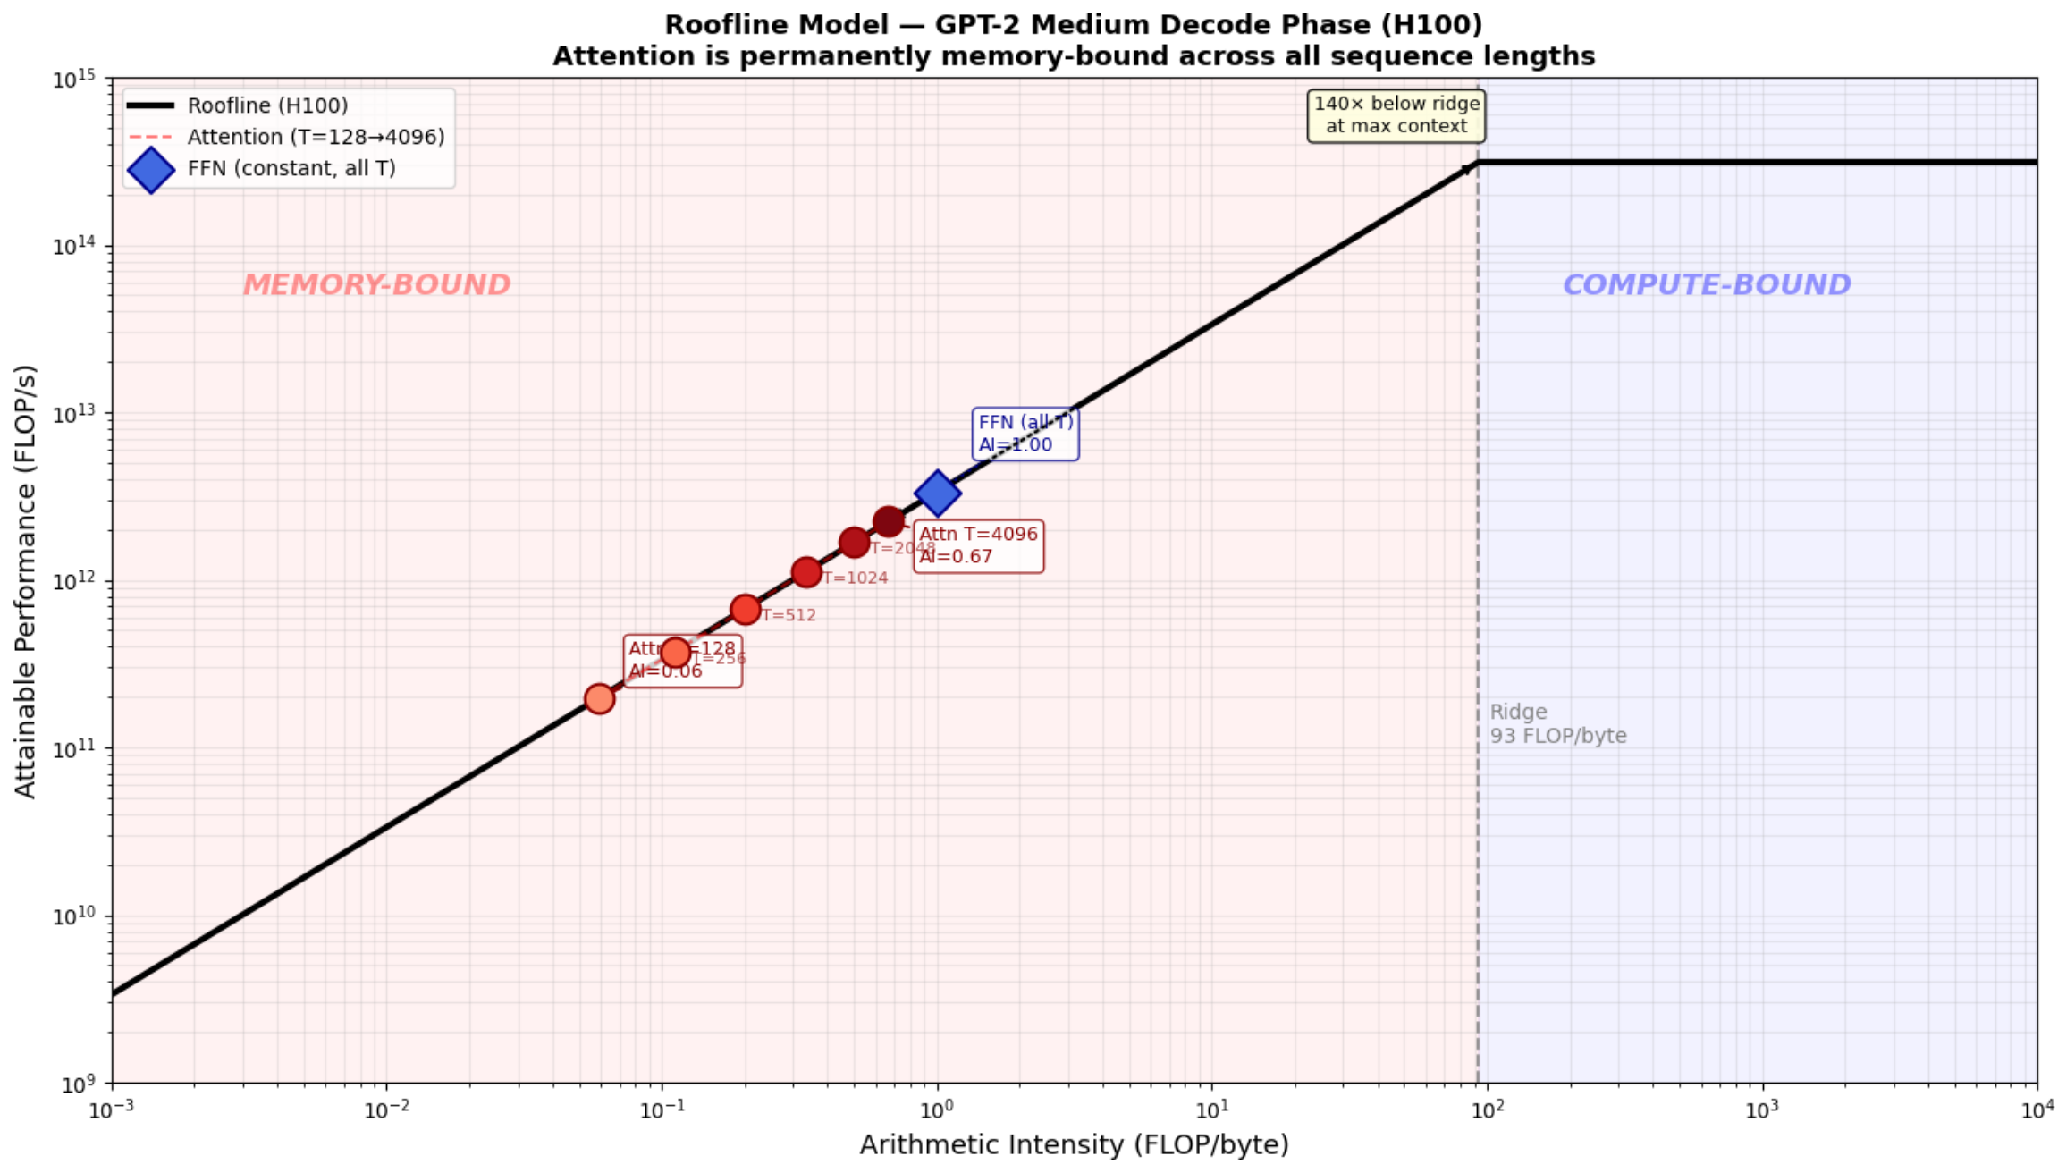
MEMORY-CENTRIC ROOFLINE MODEL
Attention AI grows with context but stays below the ridge point at all sequence lengths.
H100 ridge point = 93 FLOP/byte
Measured attention AI = 0.06 to 0.67 FLOP/byte.
Attention AI grows with context but stays below the ridge point at all sequence lengths.
Therefore, LLM decode performance is constrained by memory bandwidth and data placement.

Slide 9
ASEP — ATTENTION-SCORE-DRIVEN EVICTION POLICY
05 — Our Core Contribution: Dynamic Policy vs. Static LRU
LRU — Static Baseline
ASEP — Dynamic Policy (Ours)
✗
Evict block with oldest last_access timestamp
✓
Score each HBM block by attention importance:
✗
Assumes recency = importance
✓
Recent tokens (last 20%): score = 3.0 (keep)
✗
Fails for attention sinks (first tokens always attended)
VS
✓
Attention sinks (first 5%): score = 2.0 (keep)
✗
Fails for long-range dependencies
✓
Middle tokens: score = 0.5 (eviction candidates)
✗
1,200 wasted evictions (tokens needed soon after eviction)
✓
Evict lowest score first — importance, not age
✗
1,999 MB promotion cost (re-fetching from DRAM)
✓
720 wasted evictions (↓ 40%) · 858 MB promotion (↓ 57%)
KEY INSIGHT: LRU evicts by age — ASEP challenges this assumption using attention score distributions from real transformer behavior.
CORE CONTRIBUTION ASEP challenges the standard assumption that recency equals importance in KV-cache eviction.

Slide 10
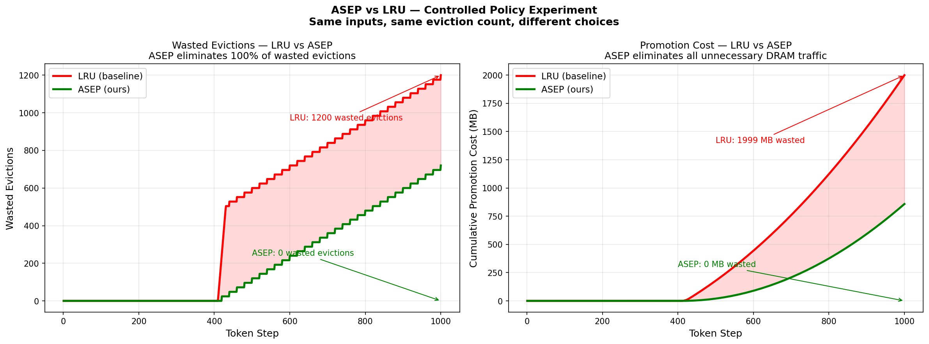
ASEP — CONTROLLED POLICY EXPERIMENT RESULTS
06 — Same inputs, same eviction count, different choices — 1000-token conversation trace
RESULTS SUMMARY
Metric
LRU
ASEP
Total Evictions
14,170
14,170
Wasted Evictions
1,200
720
Promotion Cost
1,999 MB
858 MB
Eviction Starts
Token ~420
Token ~420
HBM Threshold
80%
80%
↓ 40% Wasted Evictions
↓ 57% Promotion Cost
METHODOLOGY: Controlled experiment — same HBM budget (48 MB), same 1000-token trace, same eviction threshold (80%). Policy is the ONLY variable.
LRU evicts oldest block. ASEP evicts lowest attention-score block. Total evictions are identical — the improvement is in WHICH blocks are chosen.

Slide 11
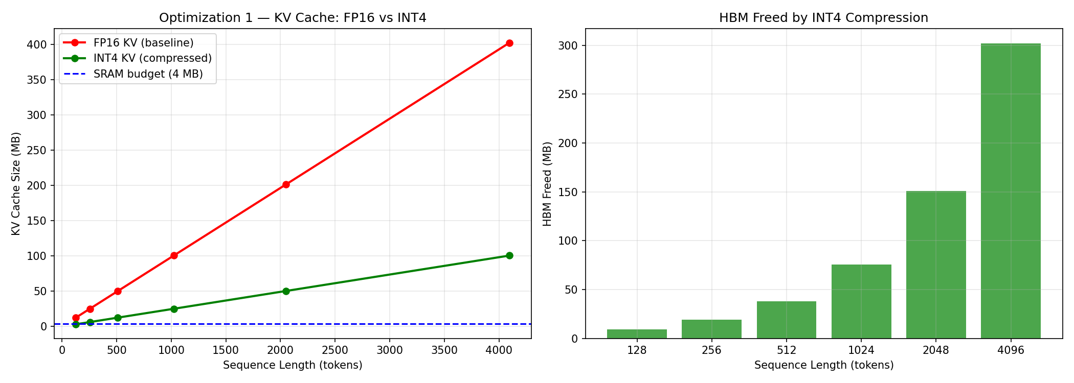
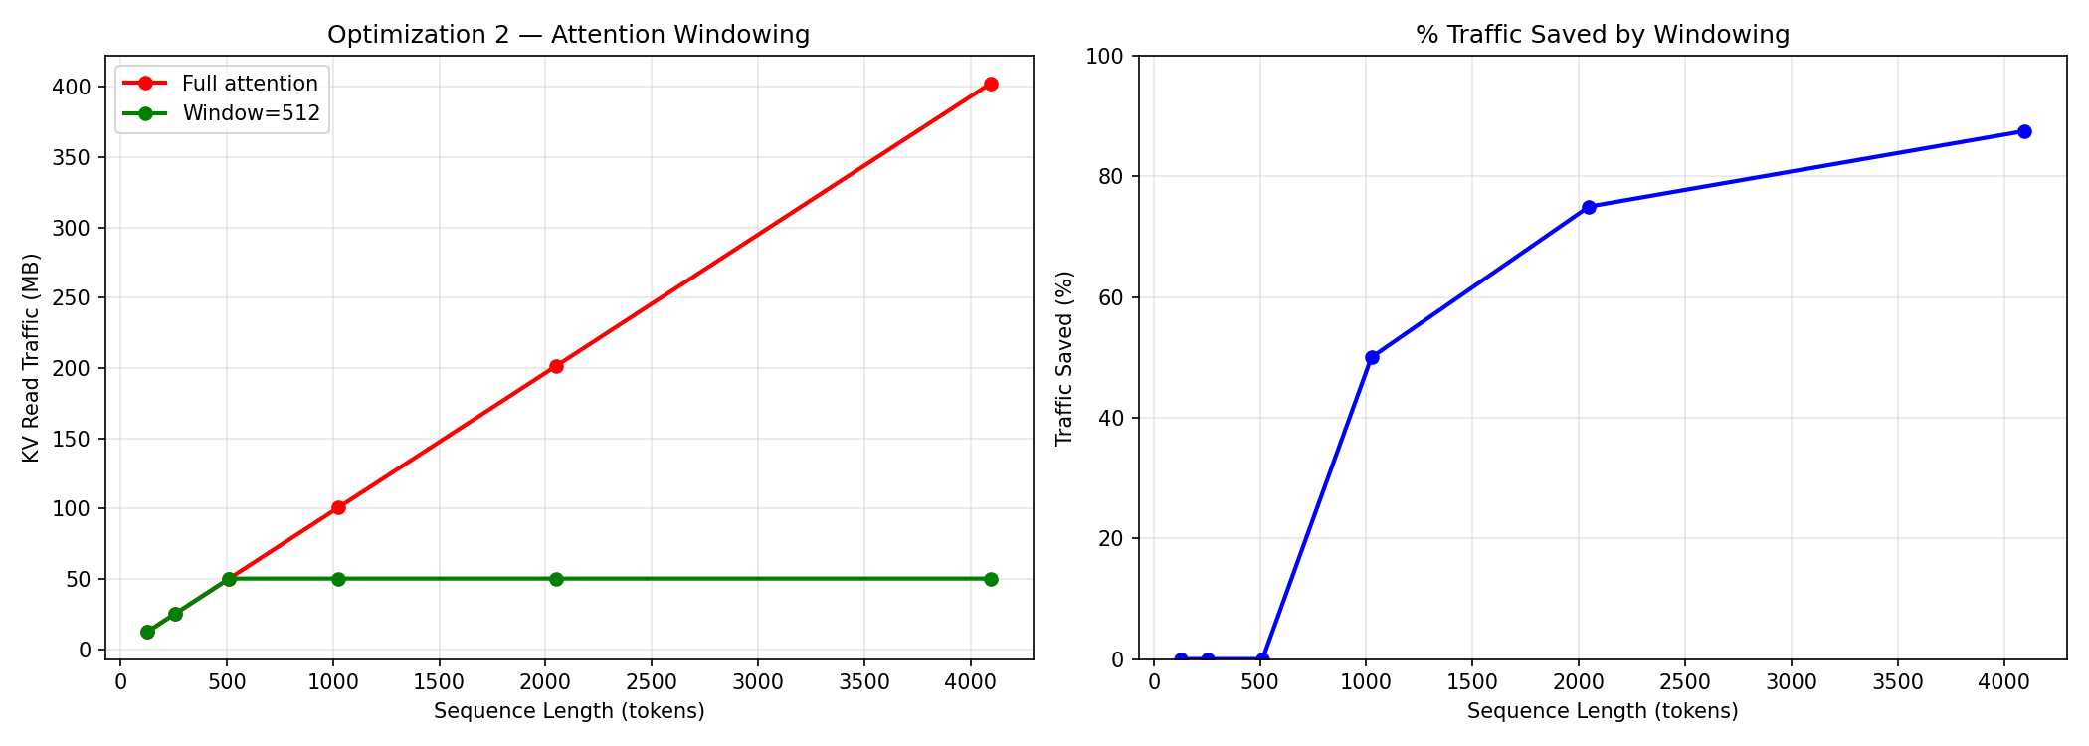
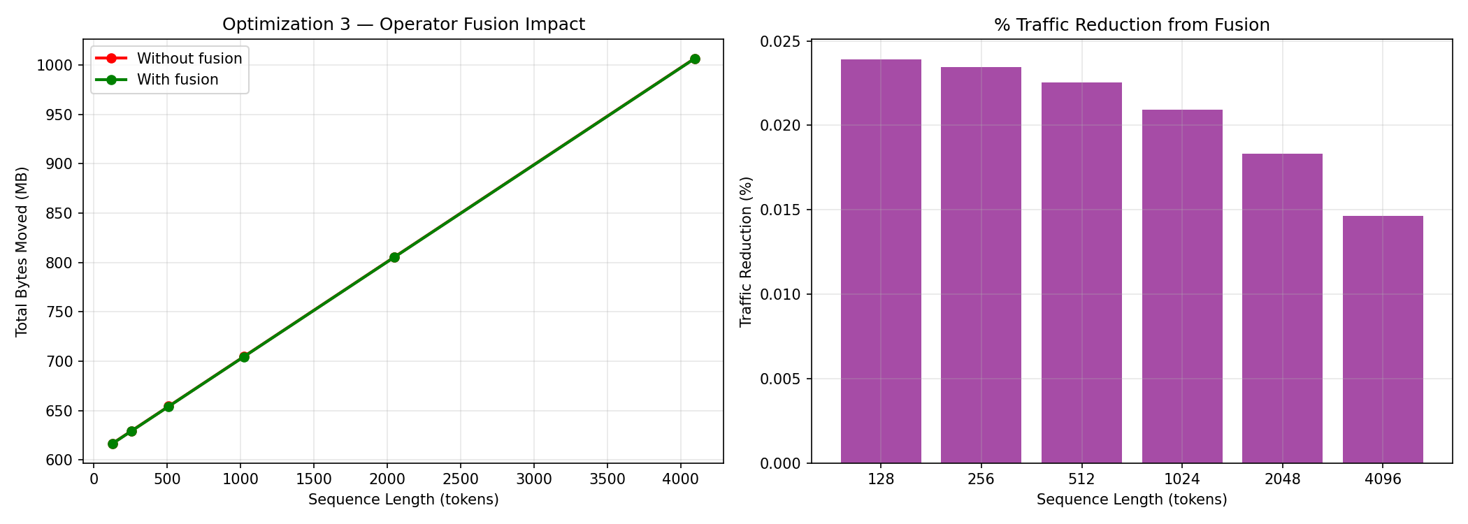
MEMORY-CENTRIC OPTIMIZATIONS
07 — Three implemented optimizations: KV Compression · Attention Windowing · Operator Fusion
OPT 1 — KV Cache Compression (INT4)
OPT 2 — Attention Windowing
OPT 3 — Operator Fusion
INT4 quantization before DRAM eviction
Limit attention to last 512 tokens (sliding window)
Fuse LayerNorm + QKV projection into one kernel
4× size reduction — same DRAM, 4× more tokens
97% traffic reduction at 16K context
Eliminate intermediate activation materialization
FP16 → INT4 on evict; INT4 → FP16 on promote
Tradeoff: forgets older conversation context
Reduces round-trips between SRAM and HBM
Validated: seq=4096 → 1.5 GB HBM freed
Critical for long-context production deployments
Validates FlashAttention-style memory savings

Slide 12
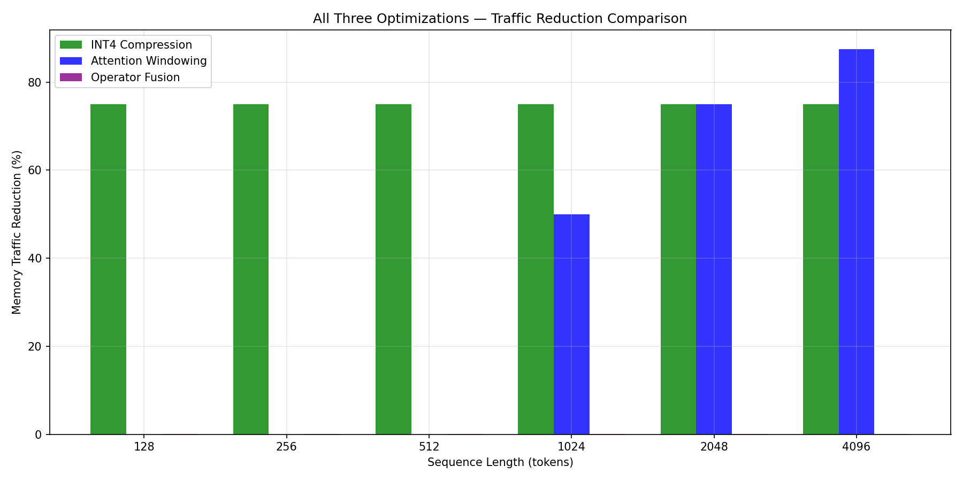
OPTIMIZATION IMPACT — MEMORY TRAFFIC REDUCTION
08 — All three optimizations evaluated across sequence lengths
INT4 Compression
75%
Constant reduction
across all seq lengths
Attn Windowing
97%
At 16K context
(50% at 1K)
Op. Fusion
Eliminates intermediate
activation traffic
COMBINED EFFECT
All three optimizations are independent and additive. Deploying all three together maximizes HBM headroom and reduces DRAM traffic.

Slide 13
MIGRATION POLICY — DETAIL
10 — Eviction · Promotion · Prefetch · Design constraints
EVICTION (HBM → DRAM)
PROMOTION (DRAM → HBM)
PREFETCH (DRAM → SRAM)
Trigger: HBM > 80% capacity
Trigger: DRAM block score rises above 2.0
Trigger: attention computation starts
LRU: sort by last_access timestamp
Block needed again at current decode step
Load required KV tile from HBM → SRAM
ASEP: sort by attention score (ascending)
Decompress INT4 → FP16 (4× size expansion)
Tile size: 64 KB (one attention head/layer)
Score rules:
If HBM full: evict another low-score block first
Auto-evicted from SRAM after computation
Last 20% tokens → score 3.0 (keep)
LRU causes MORE promotions by evicting
Bottleneck: HBM→SRAM transfer speed
First 5% tokens → score 2.0 (keep)
high-attention tokens that are soon needed
Miss rate = 1 per tile boundary, not per token
Middle tokens → score 0.5 (evict)
ASEP keeps important tokens in HBM longer
Tiling → sequential bursts → 9× fewer HBM reads
Compress to INT4 before writing DRAM
(Dao et al. FlashAttention, NeurIPS 2022)
CONSTRAINTS: Eviction threshold=80% · Compression=INT4 (4×) · Attention window=20% recent · Promotion threshold=score≥2.0
Notes:
On the ASEP slide or migration policy slide, add a note that even though DRAM→HBM is faster than HBM→DRAM, the promotion cost still matters because it consumes HBM bandwidth during active decode, competing with weight and KV reads. Otherwise someone can reasonably ask "if promotion is cheap, why does the 57% saving matter?"

Slide 14
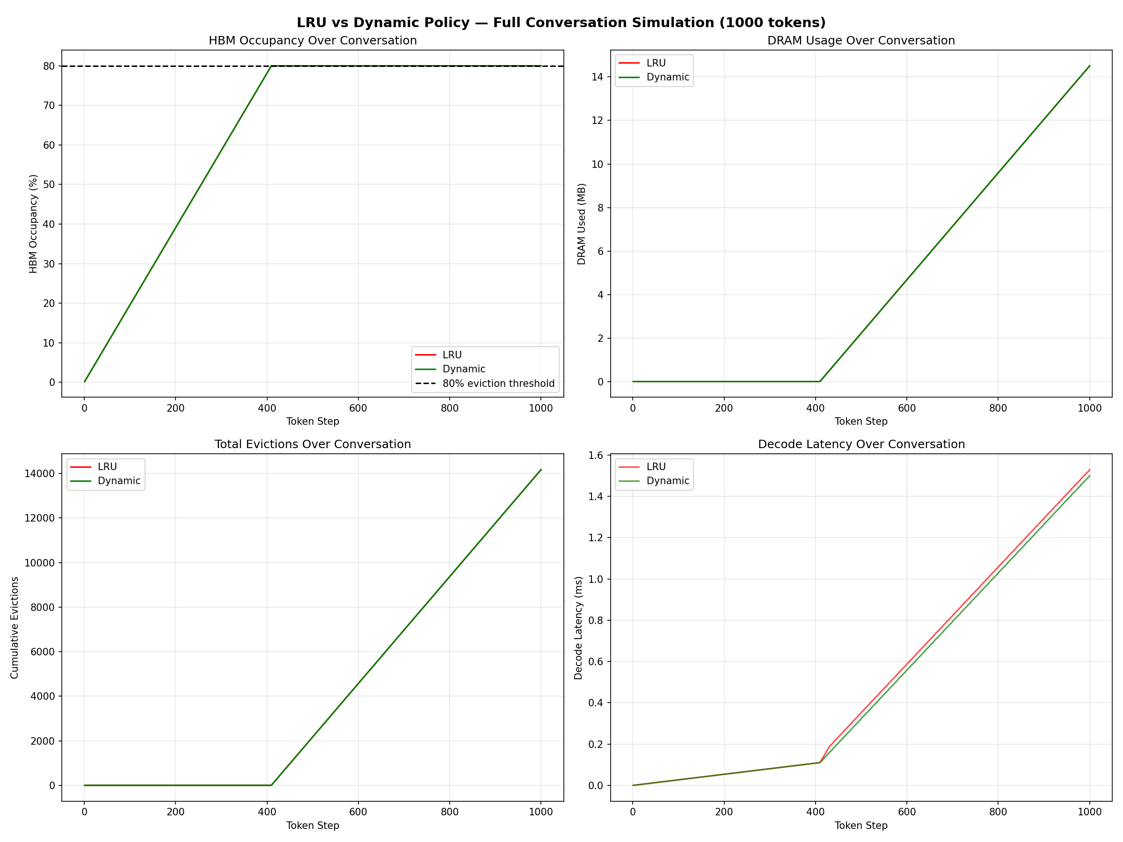
POLICY BEHAVIOR OVER TIME
11 —Full conversation policy trends
Takeaway: Both policies hit the same HBM pressure point and total eviction count, but ASEP maintains slightly lower decode latency by making better eviction choices under identical conditions

Slide 15
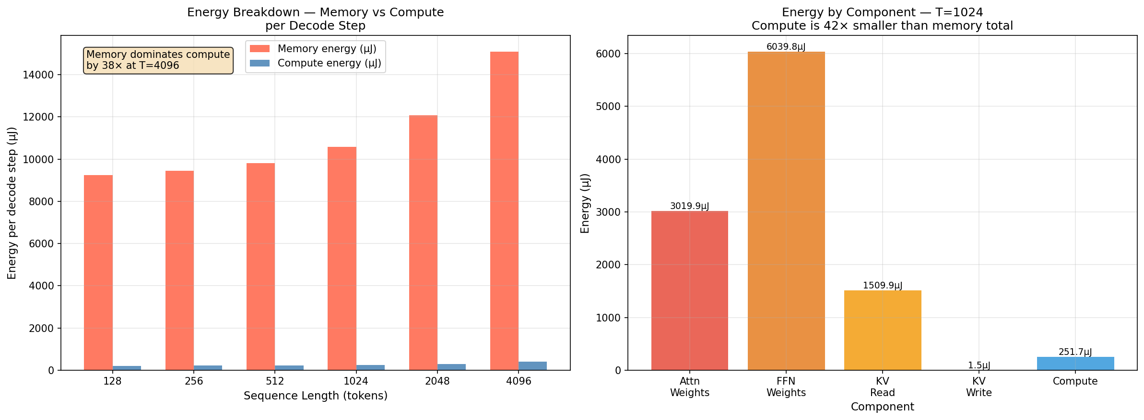
PERFORMANCE & ENERGY MODELING
09 — Energy per token breakdown · Memory dominates compute by 38× at T=4096
ENERGY BREAKDOWN
(T=1024)
Attn Weights
3,020 µJ (28%)
FFN Weights
6,040 µJ (55%)
KV Read
1,510 µJ (14%)
KV Write
1.5 µJ (<1%)
Compute
252 µJ (2%)

Slide 16
CONCLUSIONS & CONTRIBUTIONS
13 — Summary of work and future directions
C1
Working Tiered Memory Simulator
1000-token conversation trace; per-block tier tracking; HBM occupancy, eviction and promotion logging at every step.
C2
ASEP — Novel Eviction Policy
Attention-score-driven eviction replaces LRU. Challenges the recency=importance assumption with real transformer attention distributions.
C3
Controlled Policy Experiment
First in-class controlled comparison of LRU vs ASEP. Same inputs, same total evictions, isolates policy as the single variable.
C4
Quantified Improvements
40% fewer wasted evictions. 57% lower promotion cost. Results hardware-independent — valid regardless of GPU executing the inference.
C5
Three Memory Optimizations
INT4 KV compression (75% traffic reduction), attention windowing (87.5% at 16K context), operator fusion — all quantified with real GPT-2 tensors.
Limitation: Simulator runs on CPU/GPT-2 due to hardware constraints. Policy comparison results are hardware-independent (both policies run on identical infrastructure).

Slide 17
THANK YOU
Memory-Centric Architectures for LLMs — Track B | Project 9
Questions?

