Slide 1
Probabilistic Latent Semantic Analysis on Yelp Academic Dataset
Computational Optimization Project
-Venkat Palampally
-Ravi Teja Mulpuri

Slide 2


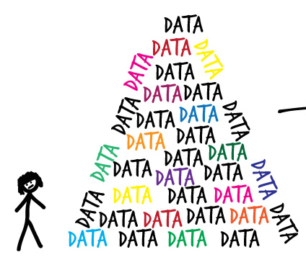
Why
We(sic) love food! and we love
Real world data set is interesting
yelp.com/dataset_challenge
Consumers value online reviews
Notes:
Which is why every major site and local guide has their presence on yelp

Slide 3

Brainstorming
Multi-label classification using convolution neural networks
Probabilistic Latent Semantic Analysis for topic mining
Latent Dirichlet Allocation for topic modeling

Slide 4
Format of Yelp Academic Dataset
Original data set has 4 million restaurant reviews
Utilized all the restaurant reviews for our analysis
Data set is in series of JSON files
Reviews , Business details, check-in's, tips and user
Converted Reviews , Business details JSON files to .csv files

Slide 5
Format of JSON files
Review JSON file
Business JSON file
{
'type': 'review',
'business_id': (encrypted business id),
'user_id': (encrypted user id),
'stars': (star rating, rounded to half-stars),
'text': (review text), 'date': (date, formatted like '2012-03-14'),
'votes': {(vote type): (count)},
}
{
'business_id': (encrypted business id),
'categories': [(localized category names)]
}

Slide 6
What did we do with this data
['barb', 's', 'breakfasts', 'cannot', 'be', 'beat', 'but',
'truly', 'any', 'meal', 'you', 'get', 'there', 'you', 'won', 't',
'regret', 'everything', 'is', 'made', 'to', 'order', 'with',
'fair', 'portions', 'and', 'great', 'prices', 'my',
'recommendation', 'is', 'a', 'breakfast', 'sandwich', 'on', 'a',
'bagel', 'and', 'a', 'coffee', 'there', 's', 'nothing', 'better',
'than', 'drinking', 'from', 'a', 'cup', 'that', 'could', 'have', 'come', 'from', 'your', 'grandma', 's', 'kitchen']
Cleaning each document (review)
Barb's breakfasts cannot be beat, but truly any meal you get there you won't regret. Everything is made to order, with fair portions, and great prices. My recommendation is a breakfast sandwich on a bagel and a coffee. There's nothing better than drinking from a cup that could have come from your grandma's kitchen.
Tokenization
Removing
stop words
['barb', 'breakfasts', 'beat', 'meal', 'won', 'regret', 'fair', 'portions', 'prices', 'recommendation', 'breakfast', 'sandwich', 'bagel', 'coffee', 'drinking', 'cup', 'grandma', 'kitchen']
Stemming
[u'barb', u'breakfast', u'beat', u'meal', u'won', u'regret', u'fair', u'portion', u'price', u'recommend', u'breakfast', u'sandwich', u'bagel', u'coffe', u'drink', u'cup', u'grandma', u'kitchen']
Notes:
Tokenizing: converting a document to its atomic elements.
Stopping: removing meaningless words.
Stemming: merging words that are equivalent in meaning.

Slide 7
What next ?
Brief introduction to Probabilistic Latent Semantic Analysis (PLSA)

Slide 8
Probabilistic Latent Semantic Analysis (pLSA)
pLSA considers each document as a bag of words
pLSA assumes that each word in a document is independent of others
pLSA identifies each document as a mixture of underlying k topics

Slide 9
Barb's breakfasts cannot be beat, but truly any meal you get there you won't regret. Everything is made to order, with fair portions, and great prices. My recommendation is a breakfast sandwich on a bagel and a coffee. There's nothing better than drinking from a cup that could have come from your grandma's kitchen.
breakfast 0.064
coffe 0.035
bagel 0.032
ice 0.024
………… ……………
Probabilistic Latent Semantic Analysis
sushi 0.111
fish 0.055
chef 0.025
fresh 0.018
………… ……………
N documents
I recommend the fried green beans with aioli -- soooo good! Who knew I liked green beans?! And this trip I tried some sushi and got the spicy tuna roll. Although it was clearly not pieced together by an expert sushi chef, it was extremely fresh and delish (so who cares if it's not beautiful?!)"
K topics
taco 0.048 burrito 0.034 salsa 0.026 bean 0.023
………… ……………
We had the pretzel with cheese dip appetizer and the nachos, Pretzel was very nice, nachos not so much. The pizza I had was ok even though the crust was charcoal due to over cooking.
pizza 0.135
wing 0.036
good 0.023
crust 0.021
………… ……………
"Wonderful ambiance and great selection of brews and food. Absolutely love the the tofu tacos and pineapple habanero salsa.
Notes:
Tokenizing: converting a document to its atomic elements.
Stopping: removing meaningless words.
Stemming: merging words that are equivalent in meaning.

Slide 10
pLSA – Optimization model
Unsupervised technique
A document is a mixture of topics, and each topic has its own characteristic word distribution
d
z
w
document
topic
word
P(w|d)
P(z|d)
P(w|z)

Slide 11
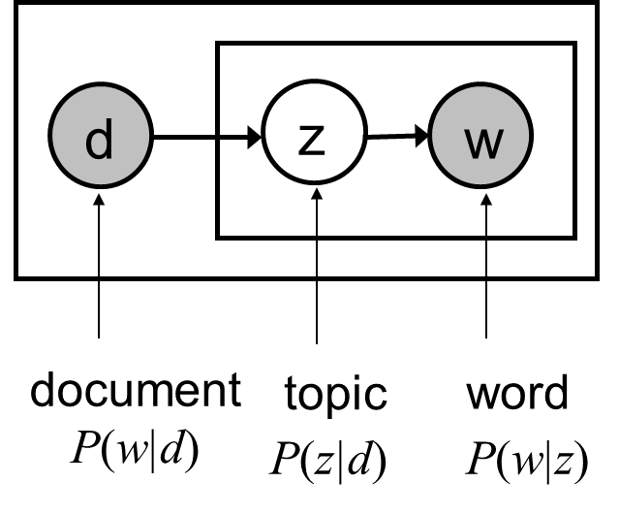
pLSA – word probabilities
N documents
N documents
K topics
p(w_{i}|d_{j})
p(z_{k}|d_{j})
p(w_{i}|z_{k})
M words
K topics (π_{k})
M words (θ_{M})
=
M unique words
N documents
(M×N)
k topics – model argument
N documents
(k×N)
M unique words
k topics
(M×k)

Slide 12
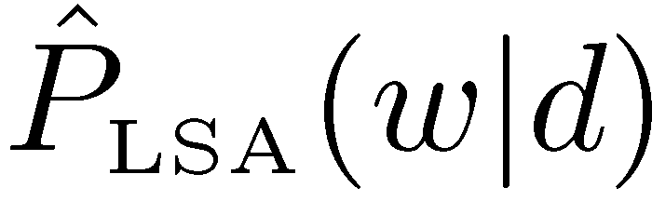
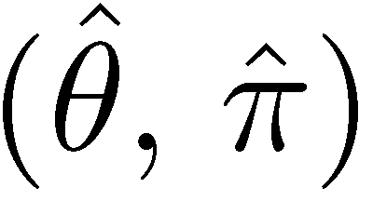
Objective function - Likelihood Maximization
Log-Likelihood
Objective: Find model parameters that maximize the log-likelihood, i.e. maximize the average predictive probability for observed word occurrences
argmax
Observed
word frequencies
Predictive probability
of pLSA mixture model

Slide 13
pLSA - model constraints
Constraints:
Sum of topic distribution probabilities for each document in the corpus
Sum of word distribution probabilities in a topic

Slide 14
pSLA - Maximum likelihood estimation
Proability based model for estimating parameters
Intilialitzation of parameters (π_{k} , θ_{M}) to start the iterative process
Every iterative process has two steps
Expectation step
Maximization step
Tunes free parameters (π_{k} , θ_{M}) to provide optimal fit

Slide 15
EM algorithm – E step
E- Step (Expectation)
Calculates the probability that a word ‘w‘ occuring in a document ‘ d‘ is explanied by the topic ‘k‘

Slide 16
EM algorithm – M step
M-Step (Maximization)
Determine the actual parameters
Find the parameters that maximizes the likelihood function

Slide 17
EM algorithm - Example
Word | c(w,d)
Analysis | 4 | 0.25 | 0.33 | 0.20 | 0.29 | 0.18 | 0.26
Text | 2 | 0.25 | 0.45 | 0.14 | 0.32 | 0.10 | 0.25
Mining | 4 | 0.25 | 0.71 | 0.44 | 0.81 | 0.50 | 0.93
Project | 2 | 0.25 | 0.71 | 0.22 | 0.69 | 0.22 | 0.69
Objective value |  |  | -16.96 |  | -16.13 |  | -16.02

Slide 18
pLSA results – Yelp academic dataset
Results visualization

Slide 19
Additional things
Topic naming from topic distribution

Slide 20
Applications of pLSA (Topic mining)
Matching Ads to Web Pages
Find predominant topics in research papers
Skimming Medical Reports to find reports of Interest
Important topics in News Paper Articles

Slide 21
Thank you

