Slide 1
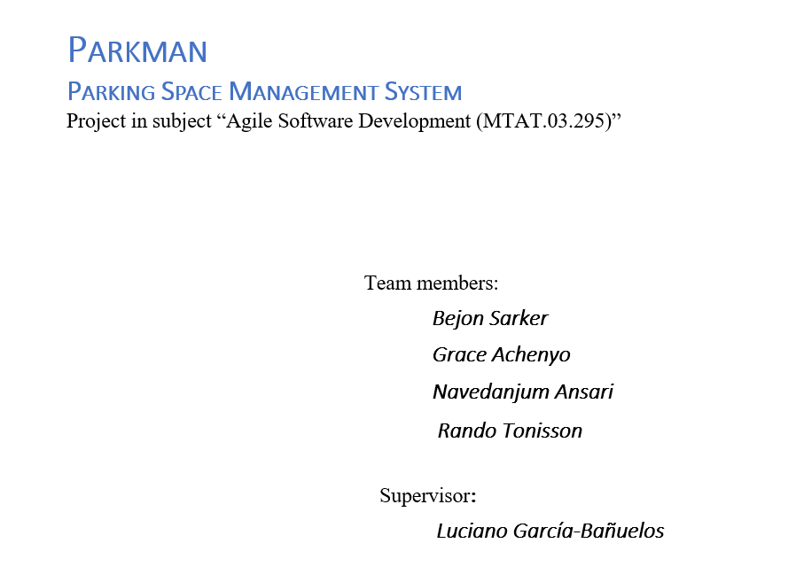

Slide 2
Parkman Application Demo
Front End using Quasar framework
Backend using Phoenix framework

