Slide 1


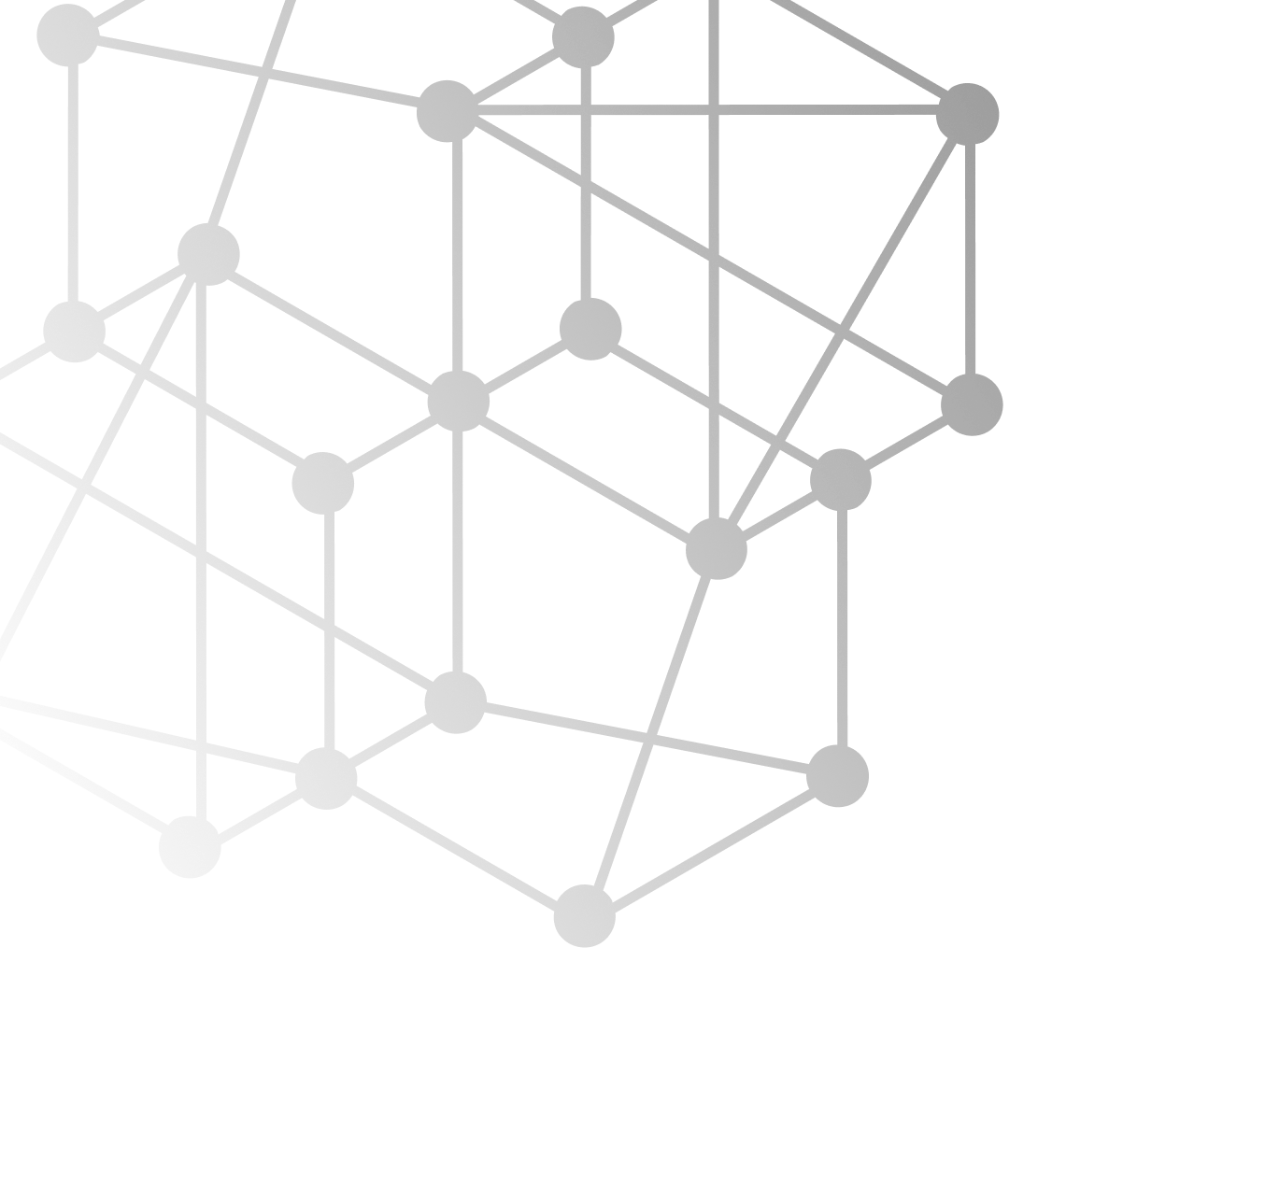
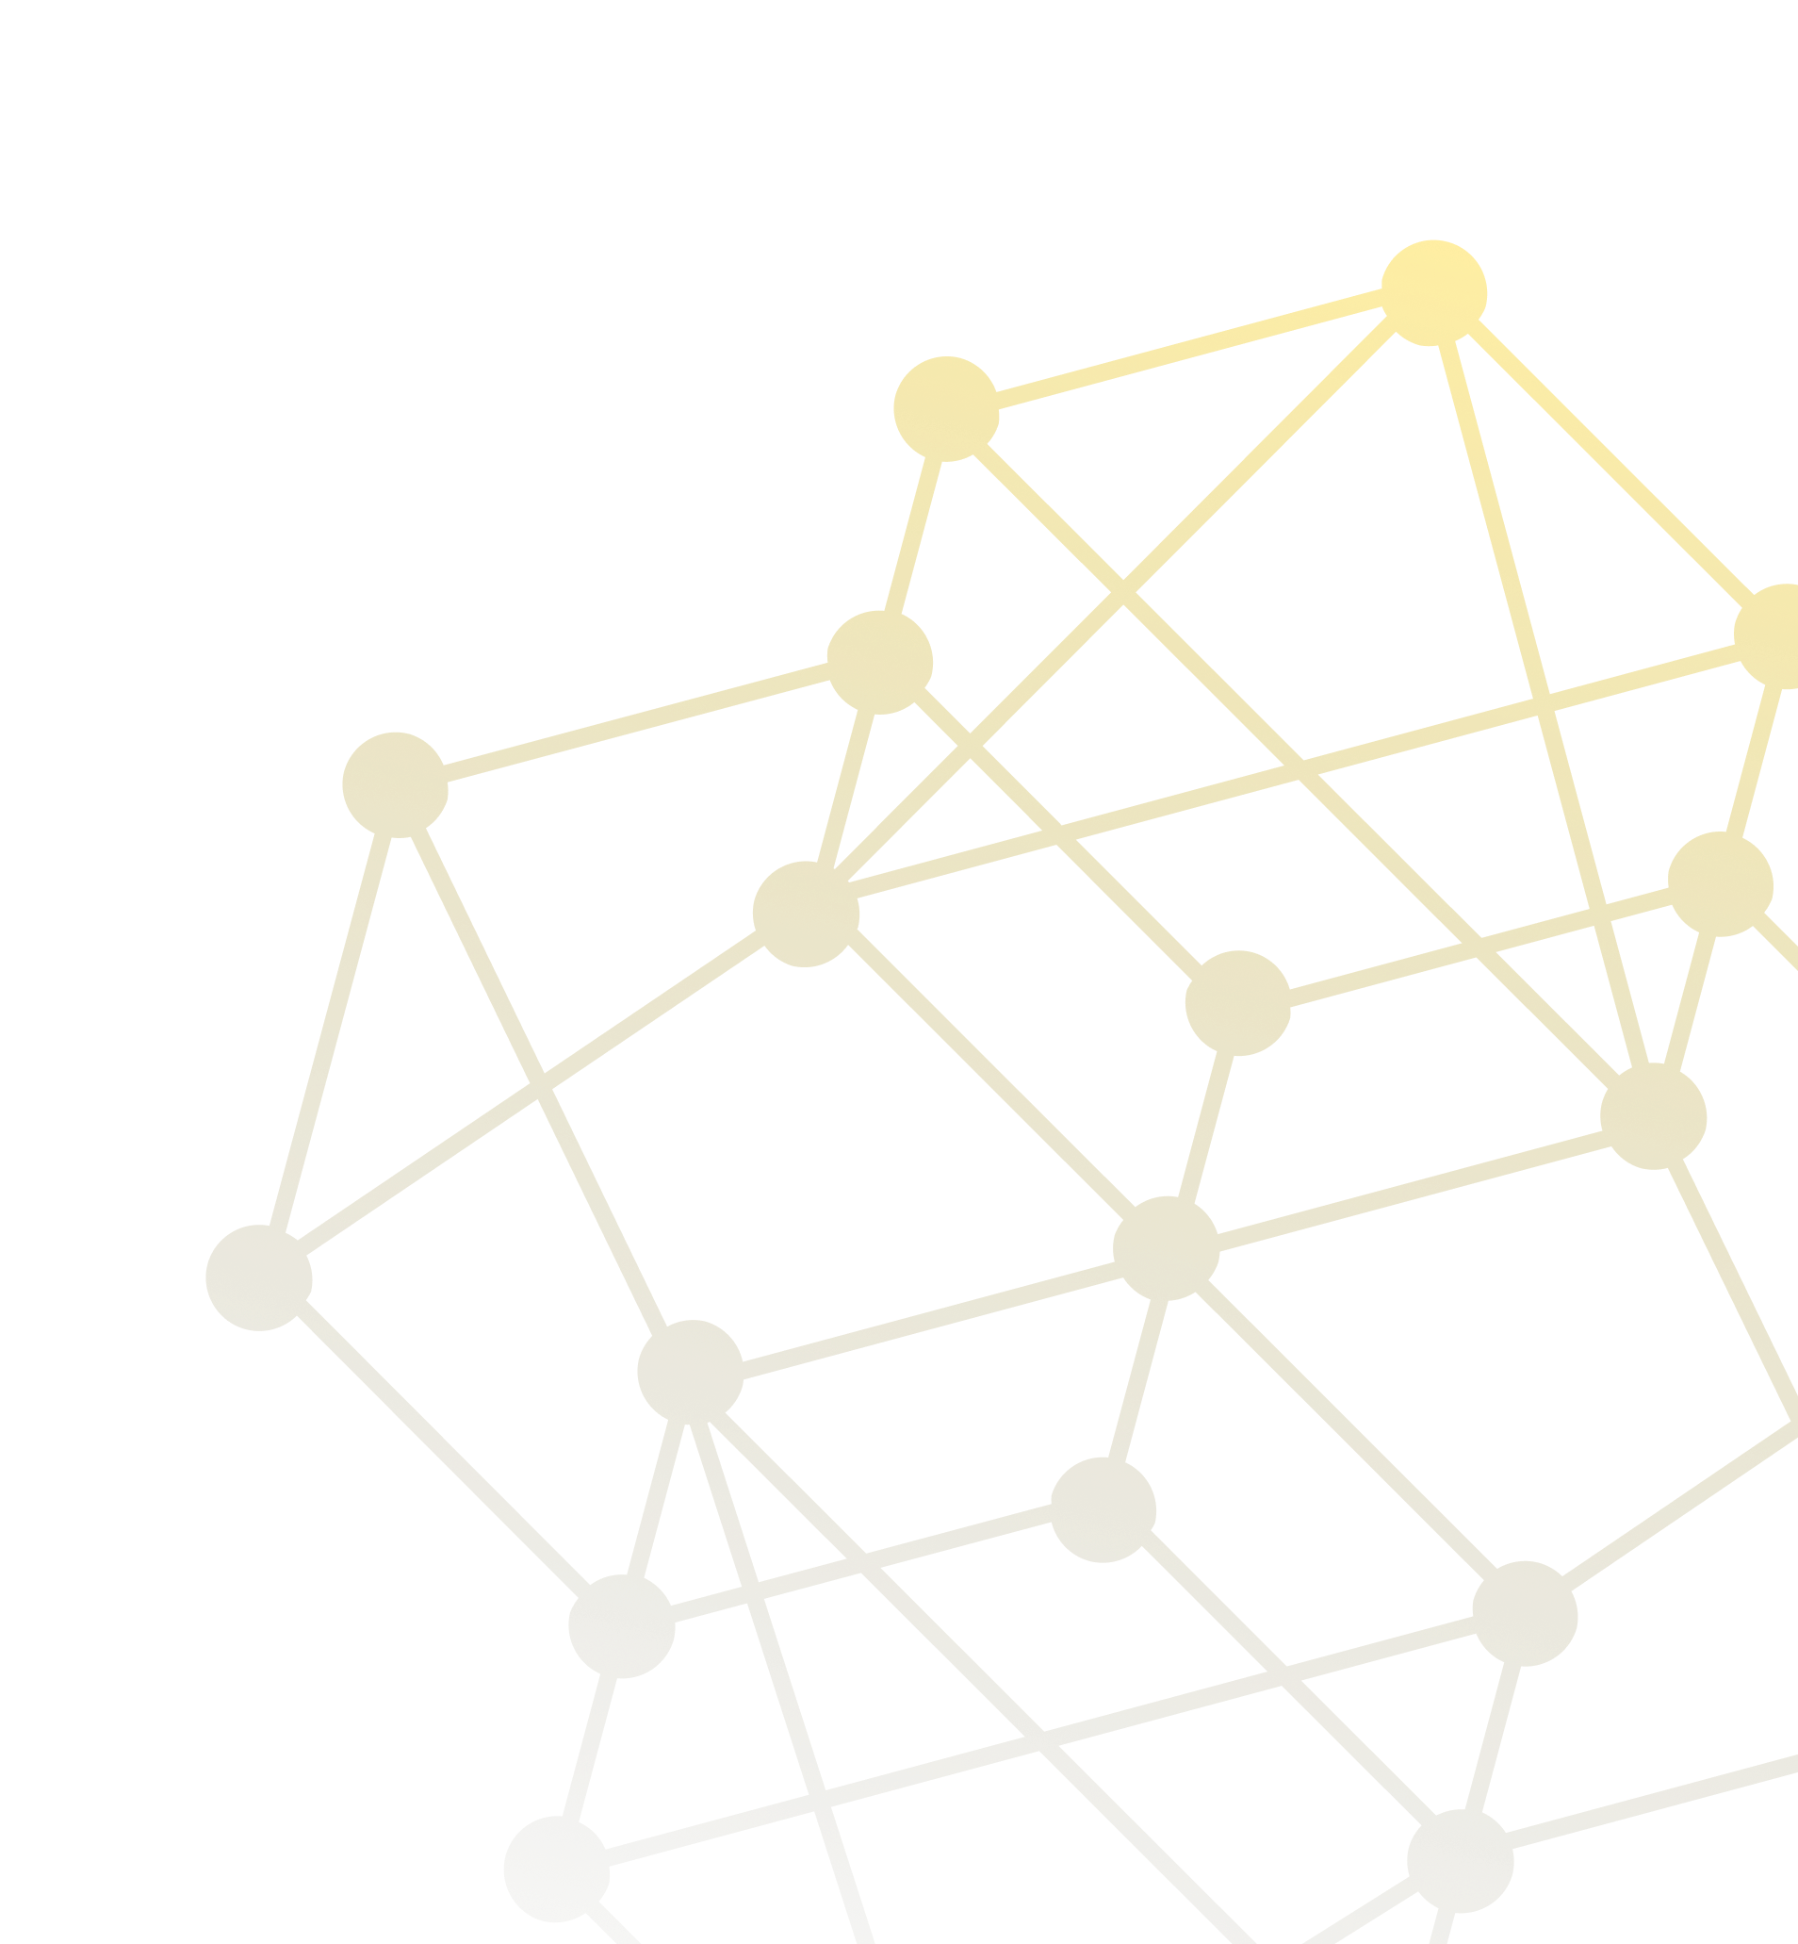
Code of Duty
3B

Slide 2



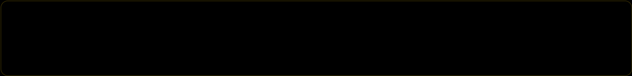
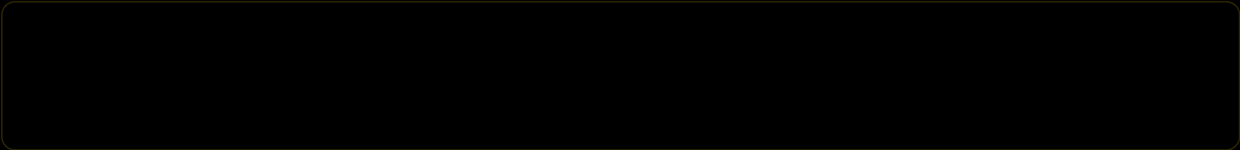
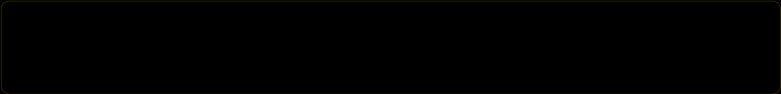
Our Team
1
Ercan Palta | Software Tester
2
Evren Çağılcı | Software Project Analyst
3
Seyit Ahmet Koçyiğit | Software Project Architect
4
Muhammet Göktuğ Ocaklıoğlu | Software Configuration Manager
5
Yasin Kömür | Software Project Manager

Slide 3

Content
1
What Did Our Team Members Do?
2
Technologies Used | Backend
3
Technologies Used | Frontend
4
Difficulties Faced
5
How Did Our Team Handle Difficulties?

Slide 4
What Did Our Team Members Do?
Our team worked together on many areas to have a collaborated work. Specifically, everyone in the team has done their own specific job to contribute the team. You can see individual contribution of every team member below:
Ercan Palta Ercan is the Software Tester of our team. He has done all the necessary tests and bug controls during the project development. He also has done a lot of frontend work and created the theme of the 3B project.
Muhammet Göktuğ Ocaklıoğlu He has tracked compliance to policies and procedures and resolved or escalated any compliance issues and spent a lot of time creating database tables and functions. He has also helped our team a lot connecting backend to database and frontend.
Seyit Ahmet Koçyiğit Seyit was the architect of our software team. He has solved many connection problems between backend and frontend. He has also done lots of work creating necessary functions and solving some use state problems on the frontend.
Evren Çağılcı Evren is the analyst of our team and he has solved the problems that we have encountered on the backend of the system by analyzing necessary use cases. He has also done many frontend work by creating use cases’ pages and contributing frontend designs.
Yasin Kömür He has managed the process of creating project and using necessary technologies. He has created backend functions and resolved bugs during the test phase of the project.

Slide 5


Technologies Used | Backend
We tried to use technologies that can be learned in a faster pace and implemented straightforwardly. We decided to use Java Spring Boot as our backend technology since all the team members were familiar with Java and could do some changes on Spring Boot.
We used MySQL for our database connection. We received assistance using MySQL workbench.
Branch
Spring Boot simplifies the setup and configuration of Java applications, reducing boilerplate code and allowing for faster development
Hash of the 1st group of transactions
Spring Boot is well-suited for building microservices architectures, providing extensive support for developing, deploying, and scaling independent services.
Transaction 3

Slide 6
Technologies Used | Frontend
We used React for our frontend development. It is easy to use and has a lot of plugins that can help us during the development phase. Our team were also familiar with React and this made the development even faster. Here are some specific reasons why we used React.
Component-Based Architecture: React follows a component-based architecture, allowing developers to build complex user interfaces by breaking them down into reusable and self-contained components. This modular approach promotes code reusability, maintainability, and scalability, making it easier to manage and update different parts of an application.
Virtual DOM: React utilizes a virtual DOM (Document Object Model) that efficiently updates and renders only the necessary components when the underlying data changes. This minimizes the number of actual DOM manipulations, resulting in improved performance and a smoother user experience.
Rich Ecosystem and Community Support: React has a thriving ecosystem with a vast collection of open-source libraries, tools, and community-driven resources. This ecosystem provides developers with a wide range of options for integrating additional functionality, such as routing, state management, form handling, and UI components, which can significantly speed up development and enhance the quality of the application.
Transaction 3

Slide 7
Difficulties Faced
Since it is a software project and a lot of unexpected parameters, we experienced many difficulties during the way. Here are some of them.
Finding Common Time to Develop: Since all of our team members are university students, they all have other responsibilities to be have done. Sometimes, we couldn’t find time to meet up and ponder on the project. This rarely made our project behind the schedule.
Encountering Unexpected Problems: We have encountered many unexpected software problems. To illustrate, we had another schedule to develop but at the same time bump into some big bugs and had to solve them. This cost us a lot of time in some days.
Hash of the 1st group of transactions
Learning and Implementing at the Same Time: Most of our team members were not familiar with the all technologies we should have been using. This sometimes directed us creating new components and developing on the project. Instead of developing, we had to learn new concepts and this cost us some time.

Slide 8
How Did Our Team Handle Difficulties?
There were many ways that we could handle with all the setbacks. But the most important one is that all of our team members were responsible for every step of the journey. Sometimes some of our team members couldn’t do what they need to do but others compensated them.
Identifying and Defining Problems: Instead of trying to hard code everything and solving every problem without pondering about them, we first tried to understand what can cause the problem, thinking of the ways that we can follow then utilized necessary tools and thinking ways to solve the problems.
Breaking Problems Down: We tried to break down every single problem even if it’s a smaller one. Problems can seem easy to solve but they can lead us bigger problems if we don’t try to solve them step by step. This is one of our main ways to deal with the problems.
Communication and Collaboration: We at least met up 2 times in a week. This made our team have strong connections. We were also helping each other on different areas even if we are not proficient about the problems. By doing this, our team encouraged and had a great development experience

