Slide 1
Image Classification
Göktuğ YILDIRIM - 041502012

Slide 2
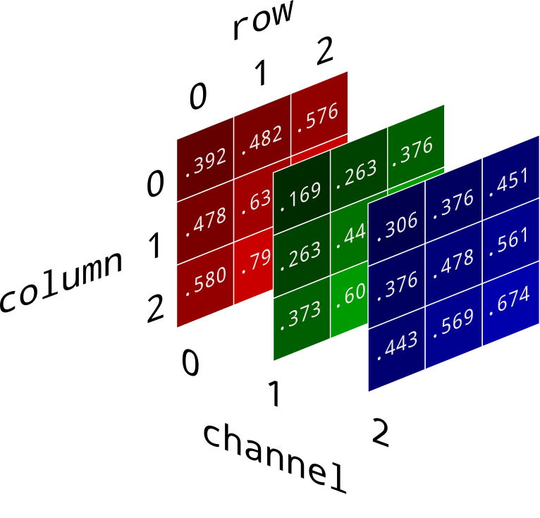
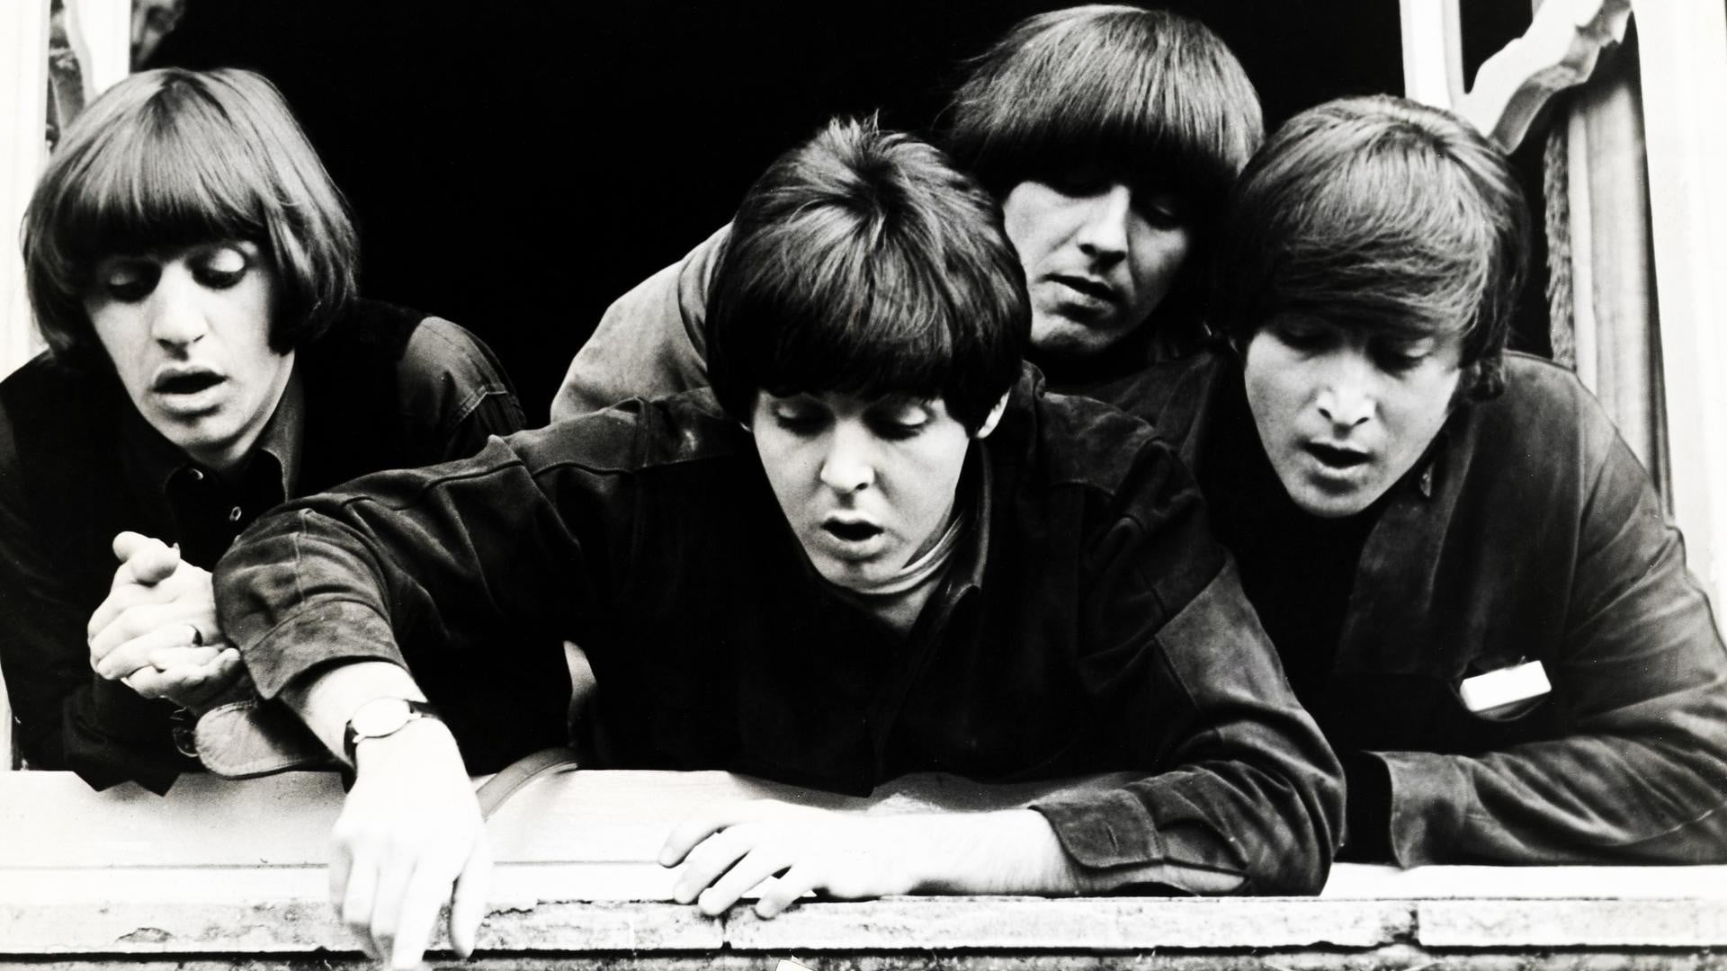
Digital Image Background
RGB Image
Digital images are stored as a 3D tensors in the computer, if the images are coded with RGB color model.
Each feature attribute represents with an integer values changes between 0-255.
(channels, row, column)
(3, 28, 28)
Grayscale Image
(channels, row, column)
(1, 28, 28)

Slide 3
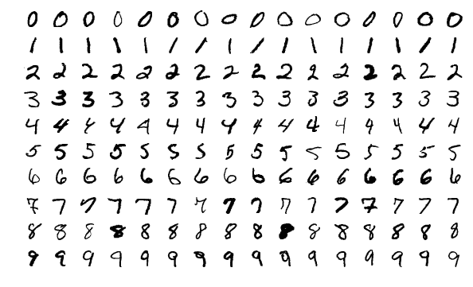
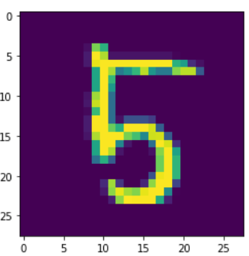
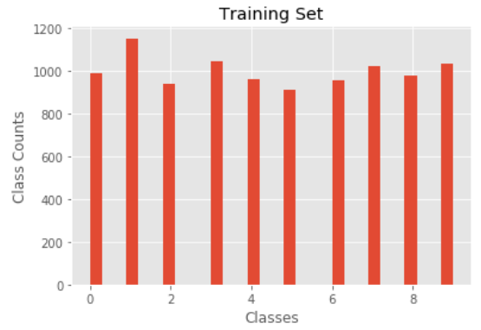
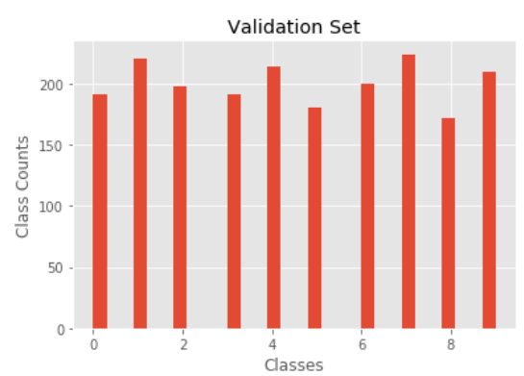
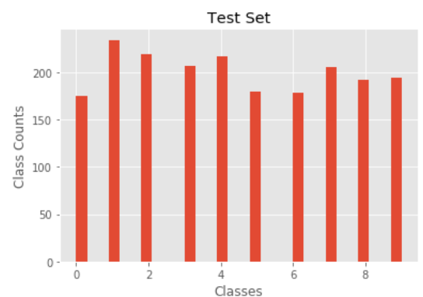
Dataset
MNIST Dataset consists of 60000 grayscale image samples in 10 different digit classes.
Each image size is 28x28.
With flatten operation: (60000, 784)
Tranining set: (10000, 784)
Validation set: (2000, 784)
Test set: (2000, 784)
https://www.kaggle.com/oddrationale/mnist-in-csv
Distribution of Classes

Slide 4
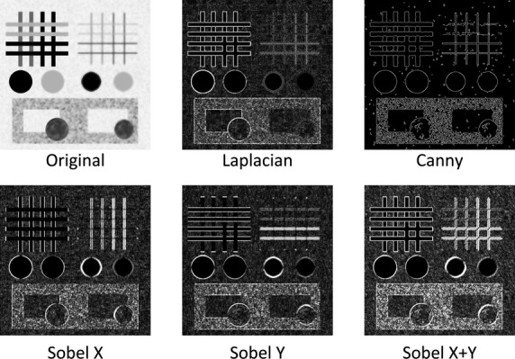
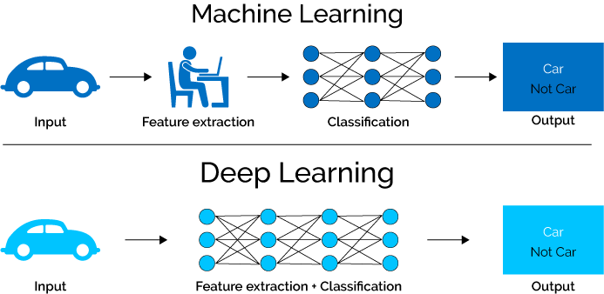
Classification and It’s Steps
Data normalization (0, 255) to (0, 1).
Feature extraction with Convolutional Neural Networks.
to reveal the desired information of any object .
a kind of filtering operation on the redundant data.
Classification with Artificial Neural Network.
Popular deep learning libraries: TensorFlow, Keras, PyTorch
Feature Extraction

Slide 5
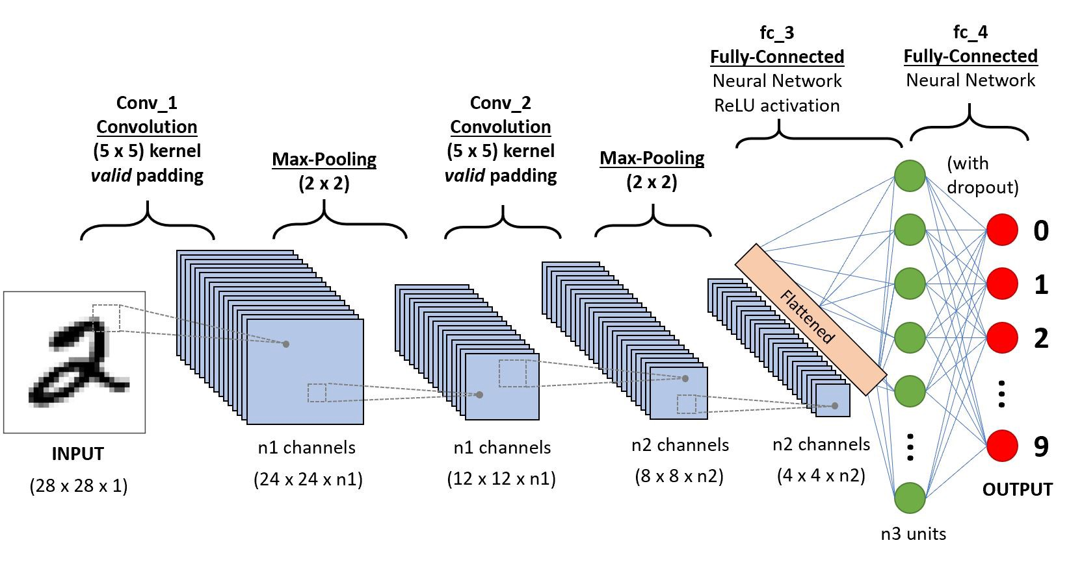
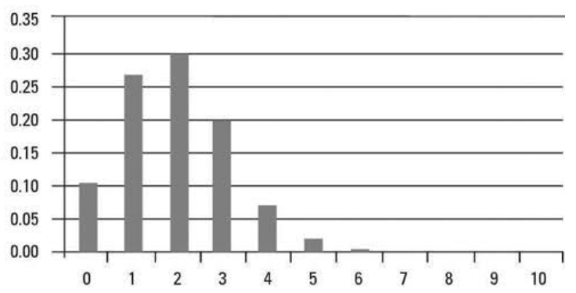
Image Classification with Deep-Learning
Inputs for Convolutional Neural Networks:
It takes 4D tensors.
After dimension expansion operation:
x_train: (10000, 1, 28, 28)
x_validation(2000, 1, 28, 28)
x_test(2000, 1, 28, 28)
Inputs for Artificial Neural Networks:
It takes 2D tensors => (num_samples, feature_dim)
Output of CNN:
(num_samples, num_last_channel, last_dim1, last_dim2)
Reshape: (num_samples, n2*4*4 = feature_dim)
Labels for Artificial Neural Networks:
It’s not Logistic Regression (Sigmoid) because of multi-labels.
Labels for Sigmoid function: [0] or [1]
We can use Softmax function to classify multi-labeled data.
One-Hot Encoded Labels for Softmax:
[3] -> [0., 0., 0., 1., 0., 0., 0., 0., 0., 0.]
y_train: (10000,10) , y_validation(2000,10), y_test(2000,10)
Softmax returns output that has binomial distribution.
Binomial Distribution

Slide 6
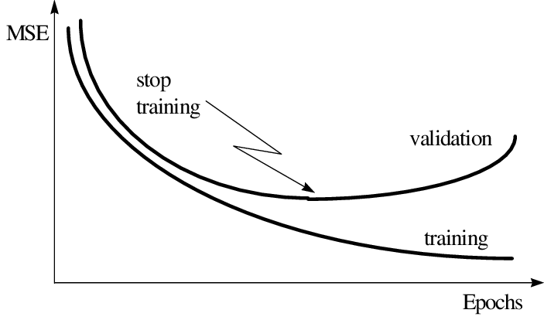
What happens in every epoch?
Forward Propagation
predictions = ForwardPropagation(x_train) Yes regularization
MSELoss(predictions, y_train)
BackwardPropagation() → (Learning)
predictions = ForwardPropagation(x_validation) No regularization
MSELoss(predictions, y_validation) Check overfitting!
predictions = ForwardPropagation(x_test) No regularization
7) CalculateAccuracy(predictions, y_test) Check accuracy!
x_train
y_train
Backward Propagation
predictions = [0.05, 0.05, 0.2, 0.3, 0.05, 0.05, 0.05, 0.05, 0.1, 0.1]
predictions = [0., 0., 0., 1., 0., 0., 0., 0., 0., 0.]
y_test = [0., 0., 0., 1., 0., 0., 0., 0., 0., 0.]
True Prediction!

Slide 7
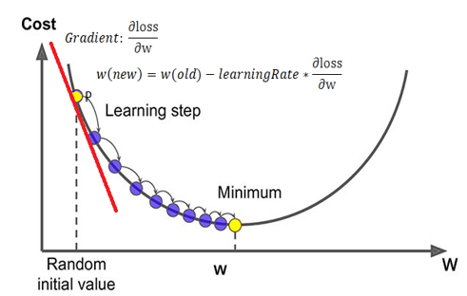
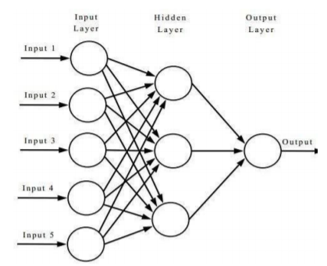
Optimization of the Cost Function
Gradient Descent is an optimization algorithm used to minimize the cost function.
Cost function consists of losses calculated in every epoch.
Prediction = weight*x_train + bias
MSE(prediction, y_train)

Slide 8
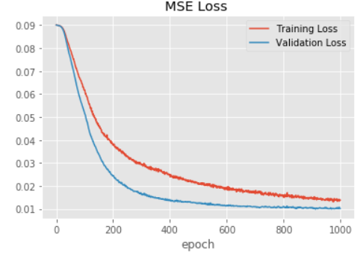
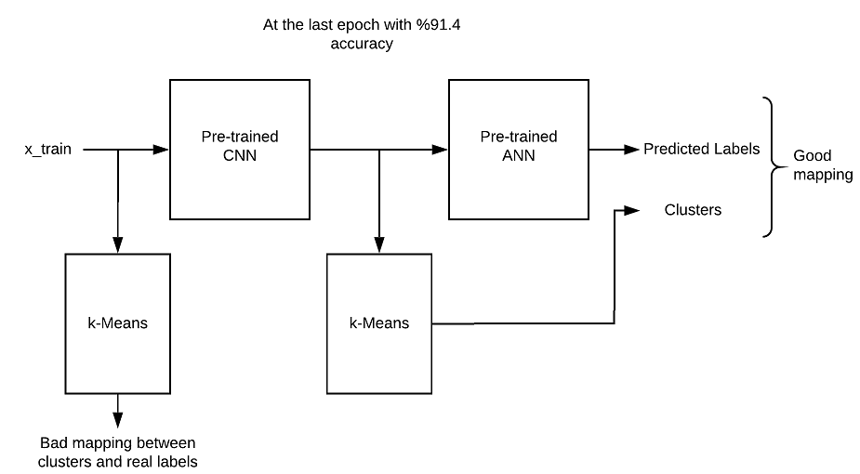
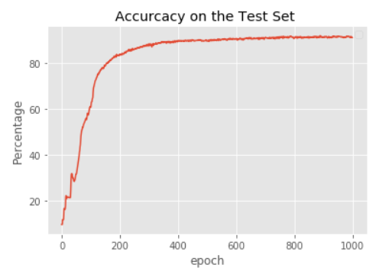
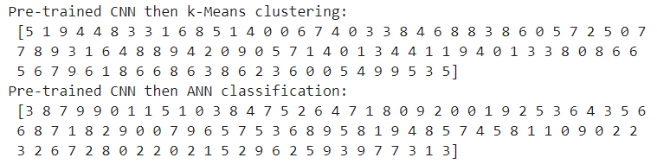
Results
Power of the CNNs
More clear
feature space
No regularization!

Slide 9
Thank you!

