Slide 1

MATCHMAKER
Makes your competitions more fun.

Slide 2

MISSION
Create a pool of players you add and never have a problem with shortage of players again. Vote them after matches.

Slide 3

FACILITIES
Add the facilities around you to the system and never waste time for communication again.

Slide 4
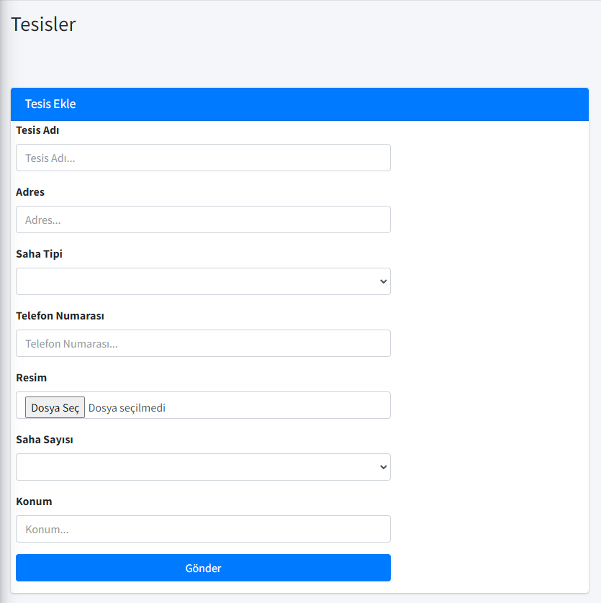
Addıng facılıtıes
You can add facilities around you, in this page.

Slide 5

players
Create a player pool by adding the players that you will play a football match with or that you have done before to the system.

Slide 6
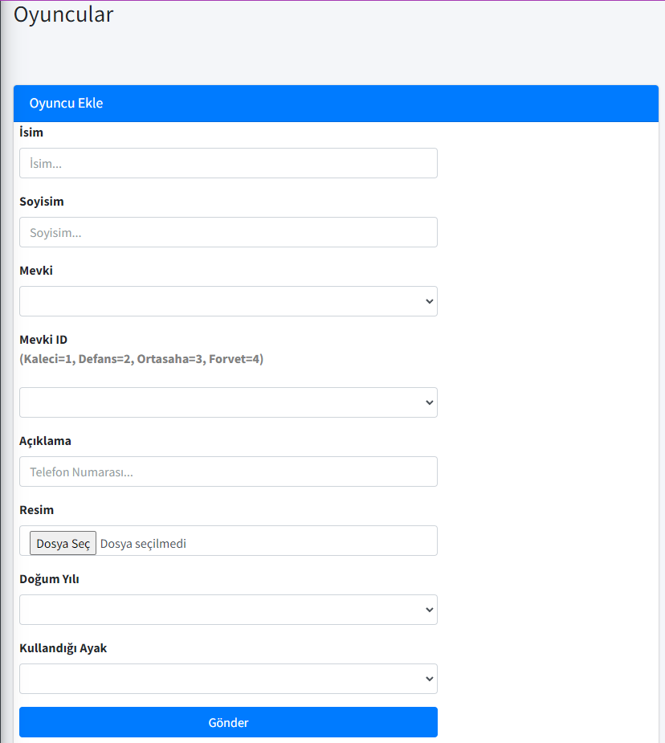
Addıng Players
You can add players around you, in this page.

Slide 7

MATCHES
Create a match using player and diagnostic data you have uploaded to the system.

Slide 8
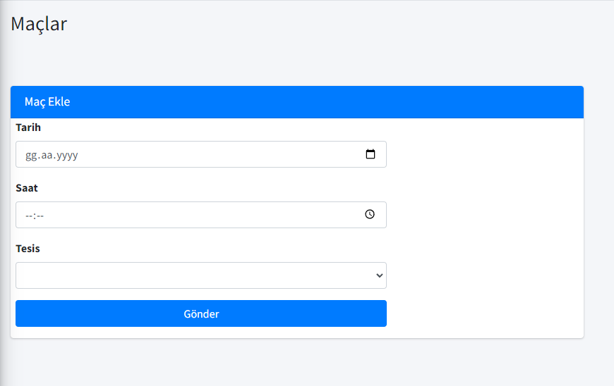
Addıng matches
You can add matchs in this page.

Slide 9
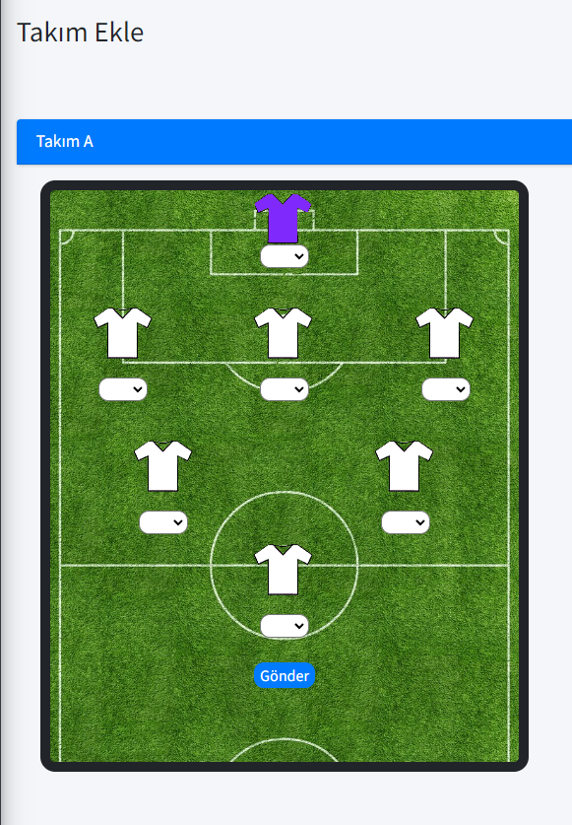
Addıng teams
You can add teams in this page.

Slide 10

VOTE
Rate the players after the matches and save them in the system.

Slide 11
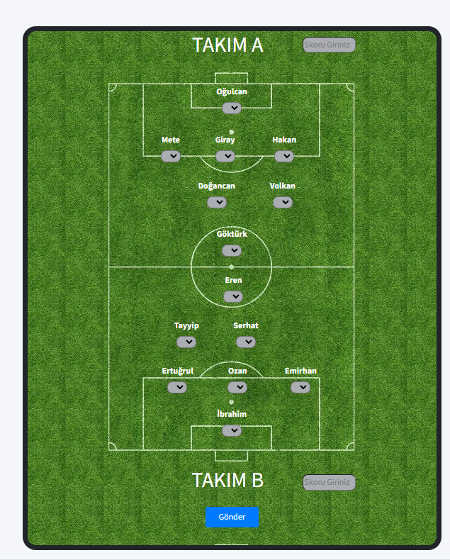
Voting players
You can vote players in this page.

Slide 12

DEVELOPER
Göktürk Razaman DOĞAN
Computer Engineering
170212013

