Slide 1
Chapter 3
Context Free Grammars and Parsing

Slide 2
Review of Chapter 2
Scanner
Regular Expressions
Finite Automata
Convert from
RE➔NFA ➔ DFA ➔ Transition Table ➔ Code

Slide 3
Terms
Parser
  build a Parse tree
  Parse Tree: structural representation of the expression
Grammar
  Relation between Grammar and Regular Expression
  Does have concatenation and choice.

Slide 4
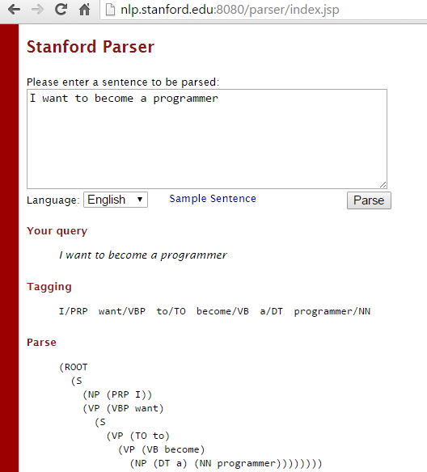
NLP: Grammar and Parsing
Online Stanford parser

Slide 5
The Parsing Process
Sequence of tokens → Syntax Tree
SyntaxTree = parse();

Slide 6
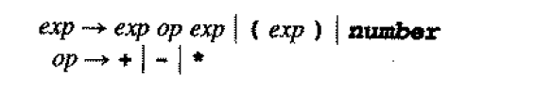
Context Free Grammars
Notation: names are written in italic like Regular Expressions. We use →instead of equality
We have concatenation, and choice, but no closure

Slide 7
Context Free Grammars
Grammar is expressed as a set of rules.
Each structure (the left term) is expressed using one of the choice to the right.

Slide 8
Context Free Grammars –
Derivations and the Language Defined by Grammar
a derivation is a sequence of replacement of structure names by choices on the right-hand sides of grammar rules
It begins with a single structure name and ends with a token.
At each step in the derivation, a single replacement is made using one choice from a grammar rule

Slide 9
Context Free Grammars –
Derivations and the Language Defined by Grammar
( number – number ) * number, can be used to derive:
  (34 – 3) * 42, but not
  ( 34 – 3 * 42

Slide 10
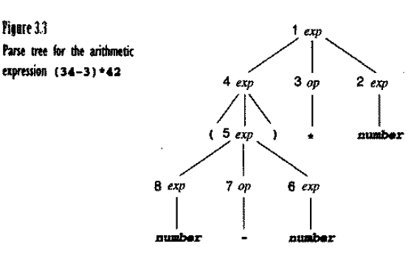
Context Free Grammars –
Derivations and the Language Defined by Grammar
(34 – 3) * 42

Slide 11
Context Free Grammars –
Derivations and the Language Defined by Grammar
exp
exp op ex [exp → exp op exp]
exp op number [exp → number]
exp * number [op → *]
( exp ) * number [exp → ( exp )]
(exp op exp) * number [exp→exp op exp]
( exp op exp) * number [exp → number]
(exp – number) * number [op → - ]
(number – number)*number [exp → number]

Slide 12
Grammars and Parsing
Chapter 3

Slide 13
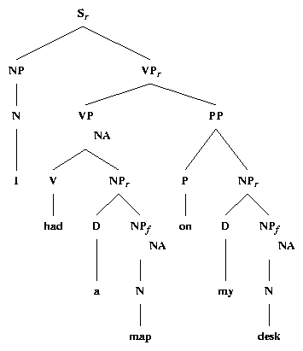
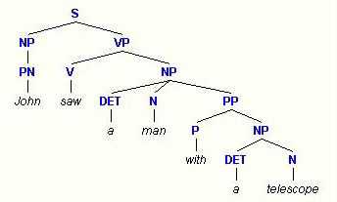
Parse Trees
http://www.ling.gu.se/~lager/kurser/ExploringOz/ParseTrees/
http://www.cis.upenn.edu/~xtag/tech-report/node13.html

Slide 14
Derivation
Grammar rules determines the legal strings of token symbols by means of a derivation.
Terminals and tokens are the same

Slide 15

Derivations – Example 1
The Grammar G is defined as follows:
  E → ( E ) | a
Generates the language
  L(G) → { a, (a), ((a)), (((a))), etc}
  (^{n}a)^{n}| n>=0

Slide 16
Derivations – Example 2
The Grammar G is defined as follows:
  E → ( E )

Slide 17
Derivations – Example 3
The Grammar G is defined as follows:
  E → E + a | a
This generates the language
  L(G) = { a, a+a, a+a+a, … }

Slide 18
Derivations – Example 4
Statement → if-stmt | other
  If-stmt → if ( exp ) statement
  | if ( exp ) statement else statement
  exp → 0 | 1

Slide 19
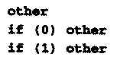
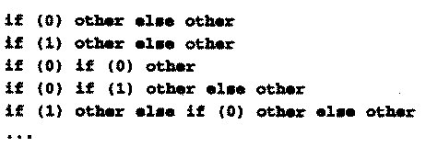
Derivations – Example 4
Statement → if-stmt | other
  If-stmt → if ( exp ) statement
  | if ( exp ) statement else statement
  exp → 0 | 1
  Examples of strings
  generated by the
  language are:

Slide 20
Repetition (closure)
We use recursion to achieve the same effect as the closure (*) in Regular Expressions.

Slide 21

Recursion in Grammars
A → A a | a, or
A → a A | a
Generates the same language {a^{n} | n >= 1}
aaaa can be generated by the first grammar rule with the derivation:
The first grammar is left recursive, the second is right recursive.

Slide 22
Recursion in Grammars
A → A α | β
a and B represent arbitrary strings and B does not begin with A. this rule generates all strings of the form B, Bα, Bαα, Bααα, .. This grammar is equivalent to
A → α A | β

Slide 23
Grammar for closure (*)
ϵ-productions
  empty → ϵ
A grammar which is equivalent to a* is as follows
  A → A a | ϵ, or
  A → a A | ϵ

Slide 24

Derivations – Example 5
  A → ( A ) A | ϵ
(() (()))() is generate by the following derivations

Slide 25
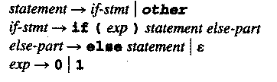

Slide 26
Derivations – Example 6
stmt-sequence → stmt ; stmt-sequence | stmt
  Stmt → s
L(G) = { s, s;s, s;s;s … }

Slide 27
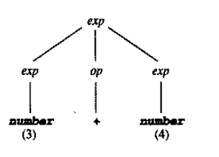
Parse Tree and Abstract Syntax Trees
Parse Tree & Syntax Tree
Parse Tree contains much more information than is absolutely necessary for a compiler to produce executable code.

Slide 28
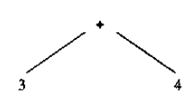
Parse Tree and Abstract Syntax Trees

Slide 29
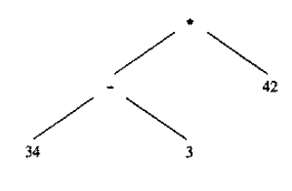
Parse Tree and Abstract Syntax Trees

Slide 30

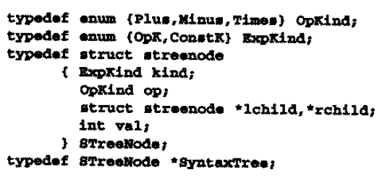
Parse Tree and Abstract Syntax Trees

Slide 31
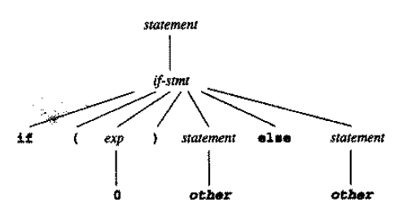
Parse Tree and Abstract Syntax Trees – Exampe 3.8
Statement → if-stmt | other
  If-stmt → if ( exp ) statement
  | if ( exp ) statement else statement
  exp → 0 | 1
The Parse Tree for
If (0) other else other

Slide 32
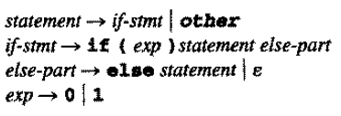
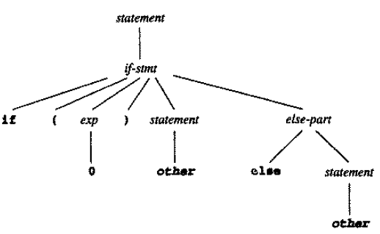
Parse Tree and Abstract Syntax Trees
The Parse Tree for
If (0) other else other

Slide 33

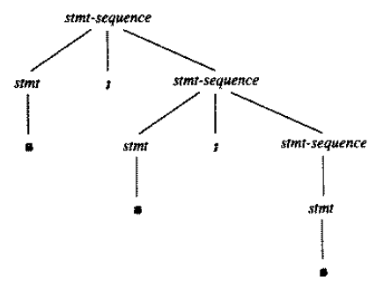
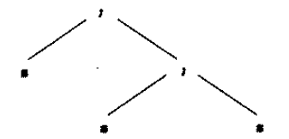
Parse Tree and Abstract Syntax Trees – Example 3.9
The Parse Tree for
s ; s ; s
A possible Syntax Tree for
this same string is

Slide 34
Ambiguity
It is possible for a grammar to permit a string to have more than one Parse Tree.
Exp → exp op exp | ( exp ) | number
Op → + | - | *

Slide 35
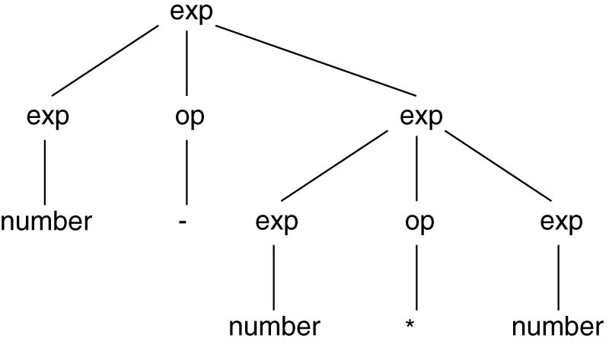
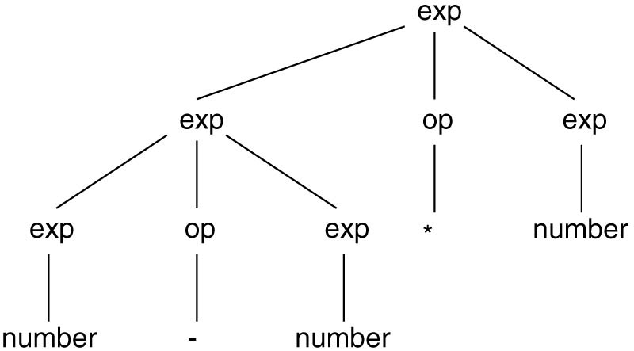
Ambiguity
Exp → exp op exp | ( exp ) | number
  Op → + | - | *

Slide 36
Ambiguity
Exp → exp op exp | ( exp ) | number
  Op → + | - | *
[leftmost derivations for the ambiguous grammar]
Exp ➔ exp op exp …

Slide 37

Ambiguity
It is possible for a grammar to permit a string to have one more than on Parse Tree.
For example the following string with the following grammar
  34 – 3 * 42

Slide 38
Ambiguity
The First Parse Tree

Slide 39
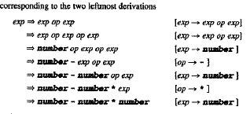
Ambiguity
The First Derivation

Slide 40
Ambiguity
The second Parse Tree

Slide 41
Ambiguity
The second Derivation

Slide 42
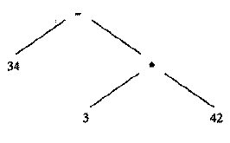
Ambiguity
The associated Syntax Trees

Slide 43
Ambiguity
A grammar that generates a string with two distinct Parse Trees is called ambiguous.
Dealing with ambiguous grammar:
  using disambiguating rule: use a rule which specify for each ambiguous case which Parse Tree should be used.
  Change the grammar in such a way that it forces the construction of the correct Parse Tree.

Slide 44
Ambiguity
How to represent the priorities of mathematical operators in the Parse Tree.
given the expression 34 – 3 * 42, we know that the “*” has higher precedence (should be evaluated first).

Slide 45
Ambiguity
How can we encode the precedence in 34-3*42 (multiplication first) into the Parse Tree?
Answer:
  what has to be evaluated first should be stored in lower levels in the Parse Tree.
  The subtraction node should be a child of multiplication node
  So we have to implement a rule which construct this type of tree which has “-” as a child of “*”

Slide 46
Ambiguity
Consider 34-3-42, again we have two Parse Trees
The above case is considered an example of left-associative.

Slide 47
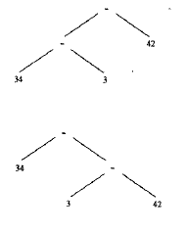
Ambiguity

Slide 48
Ambiguity
So we have to implement a disambiguating rule to resolve the ambiguity.
According to Math specification, the tree which evaluate the leftmost “-” is chosen

Slide 49
Ambiguity
Non-associate operations: more than one operations of the same type is not allowed.

Slide 50
Ambiguity
Modified version of the grammar for mathematical expressions

Slide 51
Ambiguity
In this case expressions such as 34-3-42 or 34-3*42 are not allowed except with parenthesises.

Slide 52
Precedence and Associativity

Slide 53
Precedence and Associativity
We must group operators into groups of equal precedence.
Multiplication is grouped under the term rule
Addition is group under the exp rule

Slide 54
Precedence and Associativity
Addition and subtraction will appear higher in the Parse and Syntax Tree, and thus received lower precedence.
This grouping of operators into different groups based on precedence is called precedence cascade.

Slide 55
Precedence and Associativity
The grammar still suffer from associative ambiguity.
Solution (in next slide)
  replace one of the recursions on either side of the operator with base case, forcing the repetitive matches on the side with the remaining recursion thus replacing the rule

Slide 56
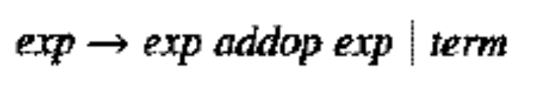
Precedence and Associativity
Solution
  replace one of the recursions on either side of the operator with base case, forcing the repetitive matches on the side with the remaining recursion thus replacing the rule
  by

Slide 57
Precedence and Associativity
Using the previous grammar, the Parse Tree for 34-3*42 is

Slide 58
Precedence and Associativity
The Parse Tree for the expression 34-4-42 is as follows

Slide 59
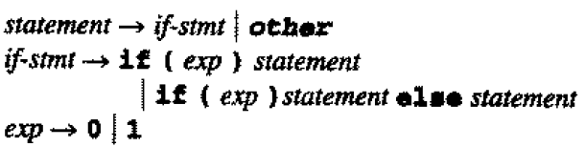
The Dangling Else Problem
Consider the grammar
The grammar is ambiguous. Consider the example in the next slide.

Slide 60
The Dangling Else Problem
Using the grammar in the previous slide, it be concluded that the string
    If (0) if (1) other else other
  Has two Parse Trees as show in the next slide.

Slide 61
The Dangling Else Problem
The first Parse Tree

Slide 62
The Dangling Else Problem
The second Parse Tree

Slide 63
The Dangling Else Problem
The ambiguity in the previous example is due to having two case:
  the else statement belongs to the first if statement
  the else statement belongs to the second if statement.
Which type of Parse tree should be chosen? (answer next slides)

Slide 64
The Dangling Else Problem
Consider the following code:
If else is associated with the first if, then a division by 0 will occur. Otherwise no division by zero. Therefore, else should be associated with the last if statement. This is called Most Closely nested Rule.

Slide 65

The Dangling Else Problem
The same grammar using brackets {}

Slide 66

The Dangling Else Problem
The solution to the Dangling else is as follows

Slide 67
Extended Notations: EBNF and Syntax Diagrams
What is EBNF?
  It is method for specify context free grammars.
  It is precise and unambiguous.
  More http://condor.depaul.edu/ichu/csc447/notes/wk3/BNF.pdf

Slide 68
Extended Notations: EVNF and Syntax Diagrams
Notation:
  A → A a | B
  A → B a*
  A → B {a}

Slide 69
Extended Notations: EVNF and Syntax Diagrams
The rule for statement in the following grammar
  stmt-sequence → stmt ; stmpt-sequence | stmt
  Stmt → s
Can be rewritten as
  Stmt-sequence → {stmpt ; } stmpt
  Or
  Stmt-sequence → stmt {; stmt}

Slide 70
Extended Notations: EVNF and Syntax Diagrams
Exp → exp addop term | term
Can be rewritten as
Exp → term {addop term}
The right associate rule is
Exp → {term addop } term

Slide 71
Syntax Diagram
Graphical representation of EBNF
Consists of:
  Boxes (terminals and non-terminals)
    Round or oval box (terminals)
    Square or rectangular box (terminals)
  Arrowed lines (sequencing and choices)
  Nonterminal labels (grammar rule defining that nonterminal)

Slide 72
Syntax Diagram
Factor → ( exp ) | number
The above rule can be represented as

Slide 73
Syntax Diagram
A → { B }

Slide 74
Syntax Diagram
A → [ B ]

Slide 75
Formal Properties of Context-Free Languages
A set T of Terminals
A set N of non-terminals
A set P of productions (grammar rules) of the form A → a, where A is an element of N and a is an element of (T U N)*
A start symbol S from the set N.

Slide 76
Formal Properties of Context-Free Languages
Let G = (T, N, P, S), a derivation step over G is of the form:
  a A y ➔ a B y, where a and y are elements of (T U N)* and A → B is in P.
(T U N)* sometimes is called set of symbols of G or sentential form.
a ➔ * B holds true if there exists a sequence of 0 or more derivation a1 ➔ a2 ➔ … a_{n} such that a = a1 and B = an.
A derivation over the grammar G is of the form S ➔ * w, where w є T*

Slide 77
Formal Properties of Context-Free Languages
Language generated by G, L(G) = { w є T*| there exists a derivation S➔* w of G}
Leftmost derivation S ➔* w is a derivation in which each derivation step a A y ➔ a B y is such that a є T*
Rightmost derivation S ➔* w is a derivation in which each derivation step a A y ➔ a B y is such that y є T*

Slide 78
Formal Properties of Context-Free Languages
Parse Tree
  Each node is labeled with a terminal or nonterminal or є
  The root node is labeled with the start symbol S
  Each leaf node is labeled with a terminal or є
  Each non-leaf node is labeled with a nonterminal
  If a node with label A є N has n children with labels X1, X2, …, Xn, then A→ X1 X2 … Xn є P

Slide 79
Ambiguity examples
S → AB | CD
A → 0 A 1 | 01
B → 2 B | 2 B
C → 0 C | 0 C
D → 1 D 2 | 12
A generates equal 0’s and 1’s. B generates any sequence of 2’s. C generates any sequence of 0’s
S ⇒ AB ⇒ 01 B ⇒ 012
S ⇒ CD ⇒ 0 D ⇒ 012
http://www.inf.unibz.it/~artale/Compiler/slide5-PT-CFG.pdf

