Slide 1

Sistema de Planeamento Anual e Orçamento
The annual action plan and budget of a public body, from the first activity to the approved envelope
Implemented by G-Kakaroto
Notes:
Introduce the system: one place where a public body plans its year and its budget. It is not tied to one institution; the Ministry of Transport and Communications appears only as a sample dataset.

Slide 2



One system from the first plan to the final budget
Plan
Approve
Distribute
Units write their activities, indicators and budget lines by economic category.
Each plan is reviewed and validated up the chain until the head of the institution approves it.
The approved envelope is shared over the approved plan, to the cent, never above what was planned.
Notes:
Three verbs: plan, approve, distribute. The distribution is exact to the cent and never gives a unit more than it asked for; any surplus stays unallocated.

Slide 3
The annual cycle of a ministry
1
Units plan
2
Internal approval
3
To the CRO
Units draft activities with indicators and budget lines.
Directors review and validate; the head approves the plan.
The approved plan goes to the Comité de Revisão Político.
4
Ministry total
5
Budget law
6
Distribution
The CRO decides the total for the ministry.
Parliament approves and the President promulgates; the envelope is registered.
The envelope is shared over the approved plan.
Notes:
This is the order verified with the users: plan, internal approval, CRO, ministry total, Parliament and promulgation, envelope, distribution. Distribution only uses approved activities.

Slide 4
From a programme to an activity: what is recorded
Programme
Activity
Indicators
OGE code, name, objective. Set up once by the administrator.
What will be done in the year: description, priority, the quarters it runs in, start and end dates, who manages it. Starts as a Draft. The quarters it runs in also set its spending schedule.
What success looks like: a target, a baseline and a unit of measure, followed quarter by quarter.
Unit
Budget lines
The directorate or unit that owns and answers for the work.
The money, by economic category (salaries, goods and services, transfers, capital) with an amount each.
An activity can be submitted when
It has at least one budget line with an amount
It has at least one indicator with a target
The end date is not before the start date
Notes:
A programme and its units are created first. A unit then creates an activity under a programme, and gives it indicators (what will be delivered) and budget lines (what it will cost, by economic category). The system refuses to submit an activity without a budget line with an amount, an indicator, and sensible dates.

Slide 5
From draft to approved: who does what
1
Draft
2
Submitted
3
Reviewed
4
Validated
5
Approved
The unit
Planner or unit director
Director of the unit
Director of the unit above
Ministry level
The top director sends it up and the Minister gives the final approval.
Completes the activity, its indicators and budget lines.
Sends it for review once it passes the checks.
Reviews it; where there is a unit above, it goes up for validation.
Validates the plans of the units beneath.
Directorate or gabinete
The Director or Chefe do Gabinete gives the final approval.
Returned with a reason
At any step a reviewer can send it back. The unit sees the reason, corrects it and submits again.
Locked once approved
An approved activity is not edited. Reopening it needs a written reason.
Every step is on record
Who, when and any note are kept in the approval trail, and approvers can approve many at once.
Notes:
This is the chain the system enforces. Who gives the final approval follows the level of the institution. In a ministry the top director sends the validated activity up (status Waiting Approval) and the Minister approves it. In a directorate or gabinete there is no Minister: the Director or Chefe do Gabinete approves it directly. Both rules, and whether a parent director validates first, can be adjusted in Settings.

Slide 6
After approval: on to execution
Approved plan
Budget decided
Distributed
Executed
Reported
Only approved activities go forward. The plan is sent up: to the CRO in a ministry, to the ministry for an office.
The CRO decides the ministry total and the budget law is passed; an office receives its allocation. The envelope is registered.
The envelope is shared over the approved budget lines, to the cent, never above what was planned.
Each quarter the unit reports what each line committed and paid. Someone else verifies it.
Dashboard and reports show paid against the calendar, by quarter and programme, with the activities falling behind.
One chain of data, end to end
Programme, unit, activity, budget line, approved amount, committed and paid. Every figure in a report traces back to a budget line of an approved activity, and every change on the way is in the audit trail.
Notes:
Execution is new: units report what each approved budget line committed and paid per quarter, a different person verifies it, and only verified figures count. The sample data follows today's date, so the running year shows its finished quarters and the current one part-way.

Slide 7




Everyone sees and does what their role allows
Administrator
Minister
Director
Planning
Viewer
Sets up the institution, users and settings.
Gives the final approval and registers the envelope.
Reviews and validates the plans of the unit and its sub-units.
Prepares activities, indicators and budget lines.
Reads plans and reports; changes nothing.
Notes:
Five roles. Directors only see their own unit and the units beneath it. Every action is checked on the server, not only hidden in the menu.

Slide 8

One system, set for the level of the institution
A ministry
A directorate or gabinete
Final approval
Final approval
The Minister
The Director or Chefe do Gabinete
The plan goes to
The plan goes to
The CRO, the Budget Review Committee
The ministry, or the team there that prepares the budget
Its cycle
Its cycle
Ceiling, CRO decision, State Budget law, envelope, distribution
Plan approved, sent to the ministry, allocation received, distribution
These are presets. Who gives the final approval, and whether a parent director validates first, can be adjusted in Settings; every change is audited.
Notes:
A ministry sends its plan to the CRO and the Minister approves. An office inside a ministry has no Minister: its head approves and the plan goes to the ministry. The presets can be adjusted, and changes are recorded in the audit trail.

Slide 9



What the system gives each institution
Activities and indicators
Each activity carries targets, quarterly progress and its budget lines.
3
languages: English, Portuguese and Tetum
Budget by economic category
Salaries, goods and services, transfers and capital, in the State Budget's own classification.
PDF
approved plan for the CRO
A clear approval chain
Submit, review, validate, approve, with notifications at each step.
Dashboard and reports
Planned against approved, by unit and by programme, ready for the CRO.
CSV
import and export of activities
Quarterly monitoring
Verified progress against targets, and verified spending (committed and paid) against the budget.
Notes:
The screens, notifications and reports work in three languages. The PDF is the approved plan that goes to the CRO.

Slide 10
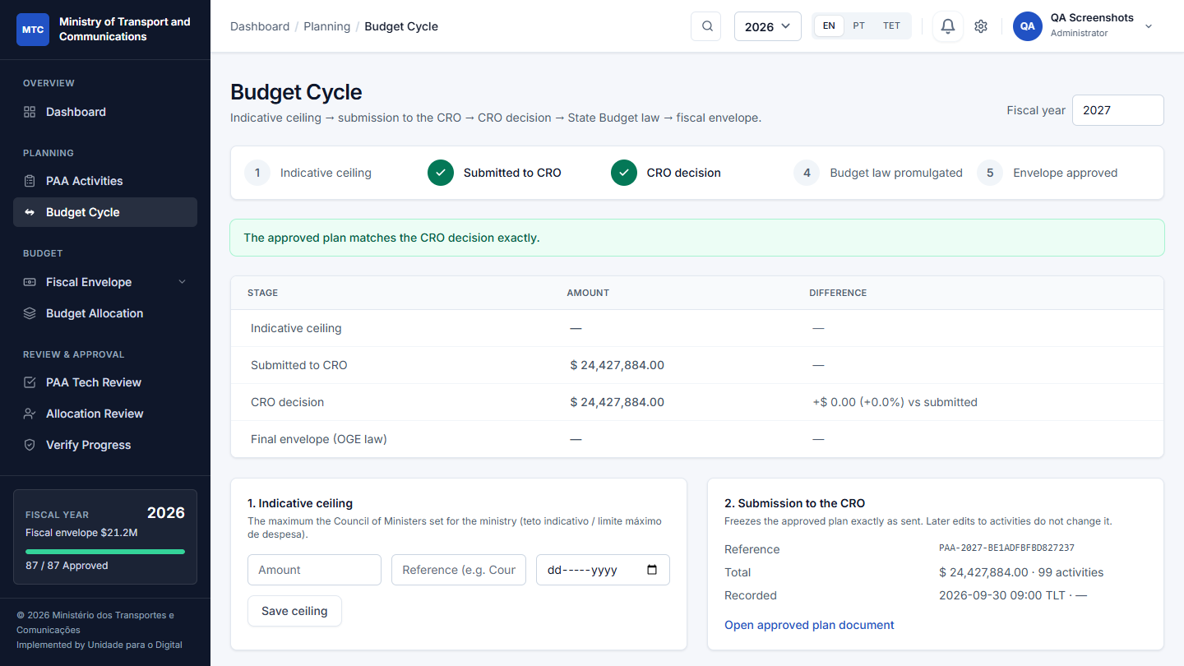
An office sees only what it controls
1
No CRO, no State Budget law
Those are decided elsewhere, so they are not steps of an office's own cycle.
2
Five steps it does control
Ceiling from the ministry (optional), plan approved, sent to the ministry, allocation received, distributed.
3
An allocation, not a law
The envelope is what the ministry gives the office; a reference to its decision is optional.
The Budget Cycle page of the Gabinete de Digitalização e Segurança Cibernética
Notes:
This is the real screen. A ministry would see the CRO decision and the State Budget law as well.

Slide 11
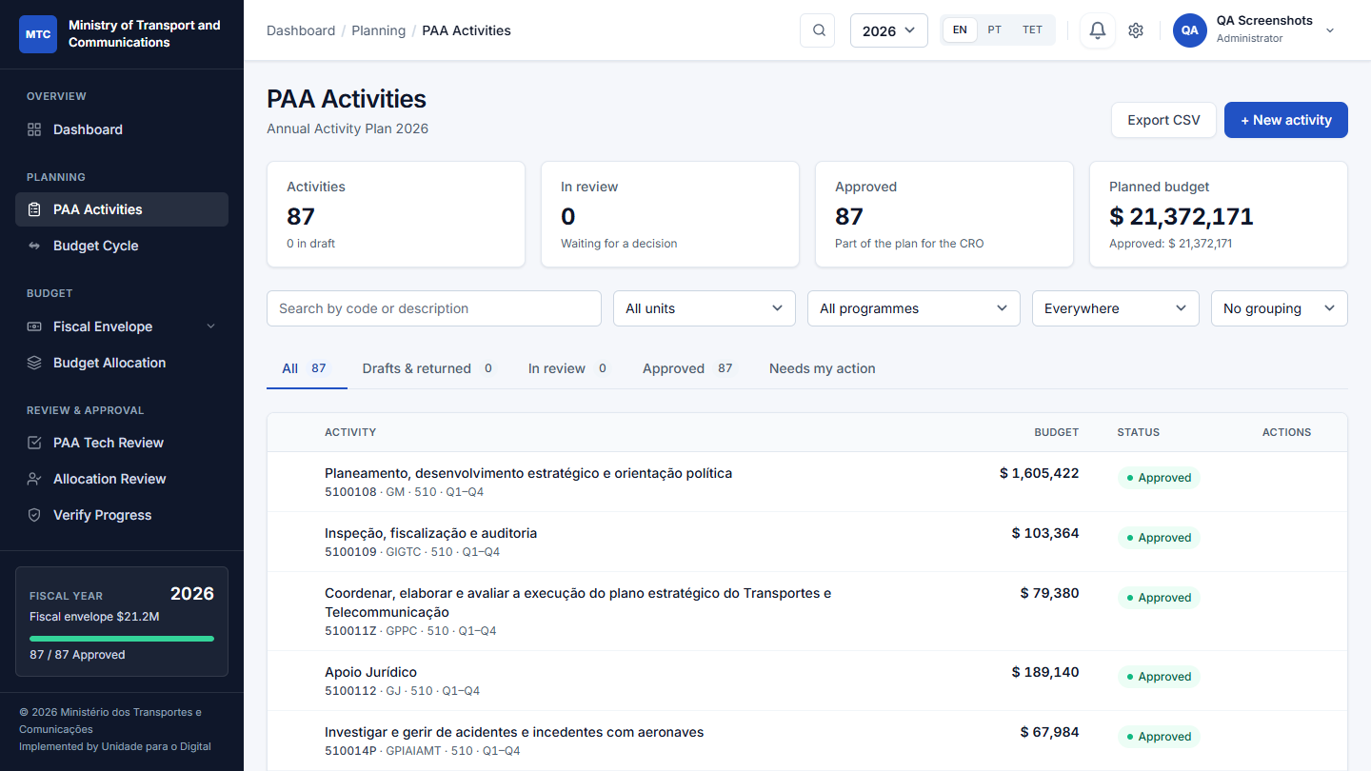



A professional, accessible interface
Clear at a glance
Compact tables, status chips with a dot and a word, figures that line up.
Accessible to everyone
Automated WCAG A/AA checks pass on every screen; keyboard use and focus are visible.
In three languages
English, Portuguese and Tetum; a test blocks any new text without its translations.
Notes:
Screenshot of the PAA Activities page. The redesign is applied through shared design tokens and components, so every screen follows it.

Slide 12
Built for any institution, whole ministry or one office
Institution
One deployment, one institution
Name, structure and programmes are set in the app; nothing is hard-coded to a ministry.
Directorate
Gabinete
Autonomous body
Whole ministry or a single office
Start with one gabinete or directorate and add the rest later.
Units
Units
Units
Autonomous bodies included
Public bodies with their own legal personality sit in the same tree, flagged as indirect administration.
Any depth the law defines
Notes:
The Ministry of Transport and Communications is only a sample. A deployment serves one institution; you can start with a single office such as the Gabinete de Digitalização e Segurança Cibernética.

Slide 13






Controls an institution can rely on
Audit trail
Role permissions
Two-factor sign-in
Every change to plans, budgets and settings is recorded with who and when.
Checked on the server for every action, not only hidden in the menu.
Authenticator codes and recovery codes; required for senior roles.
Closed registration
Backups and health
Tested
No self-sign-up; sign-in attempts are rate-limited.
Nightly backups and a health check for uptime monitoring.
More than 220 automated tests guard the approval and budget rules.
Notes:
Audit trail covers model saves. Two-factor is required for the Administrator and Minister roles by default and can be extended.

Slide 14
Fast with a full year of data
2 min+ to under 0.3 s
Annual report, which did not finish before
3.3 MB to 92 KB
Monitoring page size
Measured on a development server with 3,000 activities; the MTC sample holds about 270 across three years. Hosted timings to be confirmed after deployment.
Notes:
These figures come from a load test with synthetic data. Guardrails now fail the build when a page runs too many database queries, and slow requests are logged in production.

Slide 15
Try it with sample data
One office
The whole ministry
Gabinete de Digitalização e Segurança Cibernética, with the Unidade para o Digital and the Unidade de Segurança Cibernética.
Plans for 2026 and 2027 at every step of the approval workflow, and 2026 spending up to the current quarter. The default.
The Ministry of Transport and Communications and its autonomous bodies.
The real State Budget plans for 2025 to 2027, with the 2025 and 2026 envelopes distributed and their execution.
Loaded and removed by an administrator at Management > Sample Data; real data is never touched.
Notes:
Both datasets are optional and removable. The Gabinete plan is illustrative; the ministry plan is taken from the published State Budget books.

Slide 16
Proposed next steps
1
Deploy for real use
Production server, Redis for sessions and cache, and a scheduled nightly job.
2
Pilot with one office
Start with the Gabinete and its two units, then widen.
3
Watch real usage
Slow requests are logged with their query counts; fix what real users hit.
4
Keep improving
Finish moving page logic out of the views, and keep every text translated.
Notes:
Close with the ask: agree the pilot office and the deployment date.

