Slide 1

Plano de Ação Anual (PAA)
The Annual Action Plan of a public body: written by its units, approved by its directorates, revised through versions, carried out and reported
Implemented by G-Kakaroto
Notes:
The application is the Annual Action Plan. Everything else, approval, revisions, execution and reports, exists to write the plan, approve it, keep it true when it has to change, carry it out and report on it. There is no separate budget to register or distribute: the plan carries its own budget lines. It is not tied to one institution; the Ministry of Transport and Communications appears only as a sample dataset.

Slide 2




What the Annual Action Plan is
What
Who
When
With what
How we will know
The activities of the year, under the programme and subprogramme they serve.
The unit that owns each activity, and the person responsible.
The quarters it runs in and the months of each of its actions.
The budget lines by economic category, each with its funding source.
Indicators with a baseline and a target, reported month by month and quarter by quarter.
Notes:
The PAA answers five questions for each unit: what will we do, who is responsible, when, with what means, and how will we know. Every activity of the plan carries those five answers, and the whole application keeps them together.

Slide 3
Everything in the application serves the plan
Units write it
Activities, indicators, actions, budget lines
Revisions keep it true
A change is a new version, approved again
The Annual
Action Plan
(PAA)
Directorates approve it
Prepare, certify, approve; named approvers
Units carry it out
Monthly executed amount and quarterly indicators, verified
Directorates finalize it
Each head ends planning for their own plan
Reports show it
The plan and its results in the Ministry of Finance form
Notes:
The plan is at the centre. Units write it, directorates approve and finalize it, a revision changes an approved activity into a new version, units carry it out and report on it, and the reports are the plan and its results in the formal template. Every step and every version is in the audit record.

Slide 4
The year of the plan
1
Write
2
Approve
3
Finalize
Units draft activities and submit them between the dates of the calendar.
Each activity is prepared, certified and approved by the heads of its directorate.
Each directorate's head finalizes the plan of their own directorate.
4
Carry out
5
Report
6
Revise
Units report the executed amount and indicators inside the monthly and quarterly dates.
Others verify, directors compile the quarter, and the reports are printed.
When an approved activity must change, a revision makes a new version and goes through the approval again.
Notes:
The life of the Annual Action Plan over the year. Planning ends per directorate; the whole year's planning ends when every directorate that planned has finalized. Finalizing stops new activities only; approved activities can still be revised at any time.

Slide 5
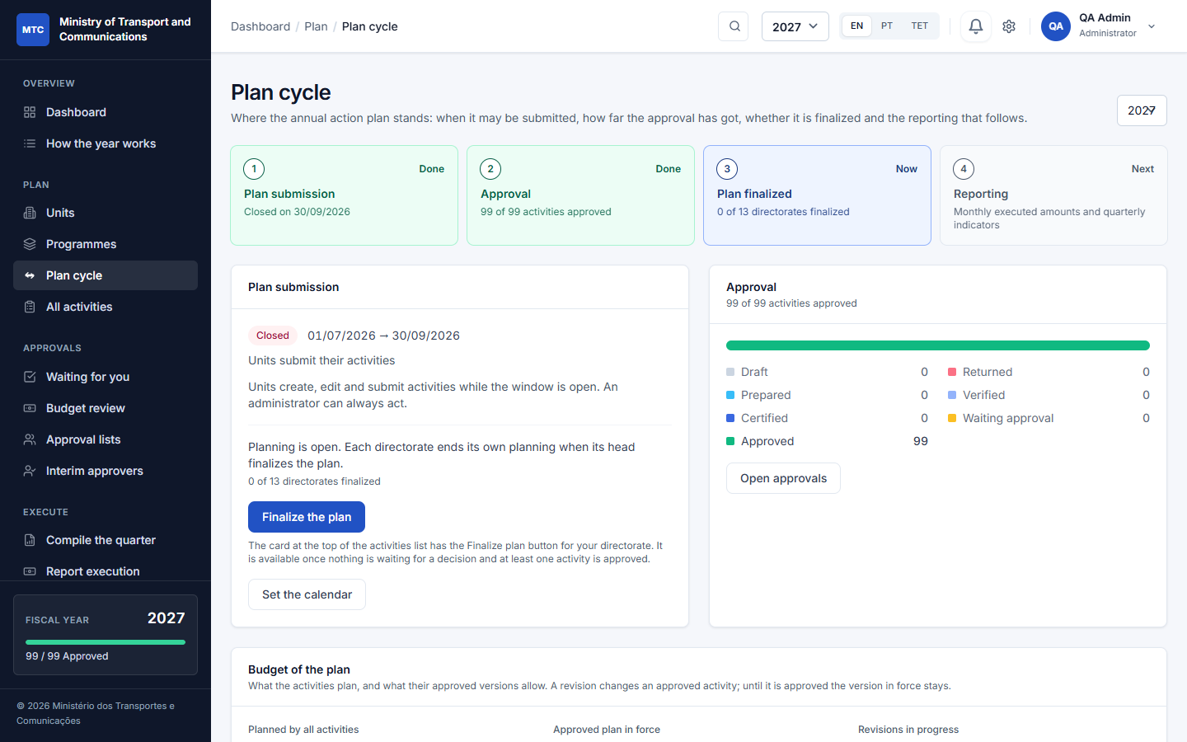
One page shows where the plan stands
The calendar
The administrator sets the dates for submitting, approving and finalizing the plan, and for each month and quarter. No dates means open; an administrator can always act.
Always current
Approval progress, the budget and the reporting status are read live; nothing is typed in by hand.
Where things are done
Buttons to report execution, compile the quarter and open the printed reports.
The Plan cycle page, fiscal year 2027, with the sample dataset
Notes:
The Plan cycle page and the dashboard show the same steps and which one is current. The dates come from the calendar the administrator sets; a step with no dates is open.

Slide 6
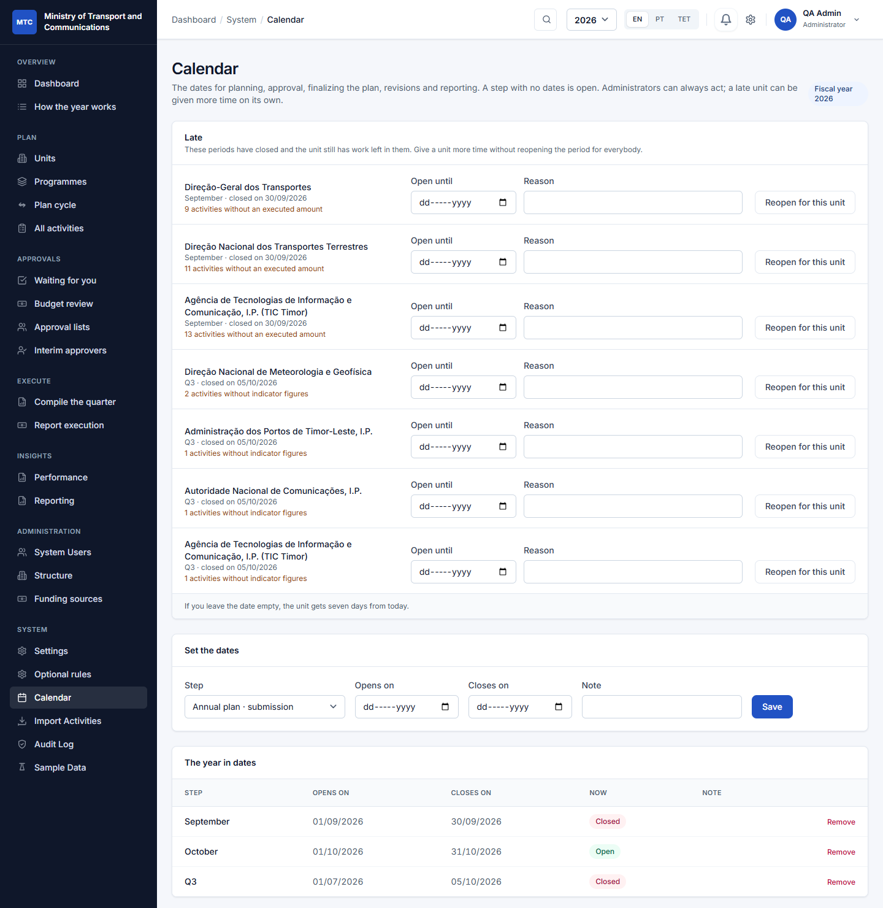
A calendar for every step, and more time for a late unit
Dates for every step
Plan submission, approval, finalizing, revisions, each month and each quarter. No dates means open.
More time for one unit
A late unit is listed with what is left; the administrator reopens the step for it only, until a date, with a reason.
Nobody is surprised
The dashboard and the working pages show what closes soon, and a late unit can ask the administrator.
The calendar for 2026: dates, a late unit and extra time
Notes:
The administrator sets dates for submitting, approving and finalizing the plan, for revisions, and for each month and quarter of reporting. A step with no dates is open. When a step has closed and a unit is still late, the administrator reopens it for that unit only, with a date and a reason; the unit is told and everything is in the audit log. Everyone sees the dates that concern them on the dashboard and where they work.

Slide 7
What an entry of the plan contains
Programme
Activity
Indicators and actions
OGE code, name, objective. Set up once for the year by the administrator.
What will be done in the year: description, priority, the quarters it runs in, dates, the person responsible. Starts as a Draft.
A target and a baseline, with the numbered actions that carry it out and the months each takes place in.
Unit
Budget lines
The directorate or unit that owns the work and has its own people.
An amount by economic category with a funding source, optionally tied to the indicator it pays for.
An activity can be submitted when
It has a budget line with an amount
It has an indicator with a target
The dates are in order and the window is open
Notes:
A programme and its units exist first. A unit creates an activity under a programme, gives it indicators with numbered actions and months, and budget lines with a funding source, each optionally tied to an indicator. The system refuses to submit an incomplete activity.

Slide 8
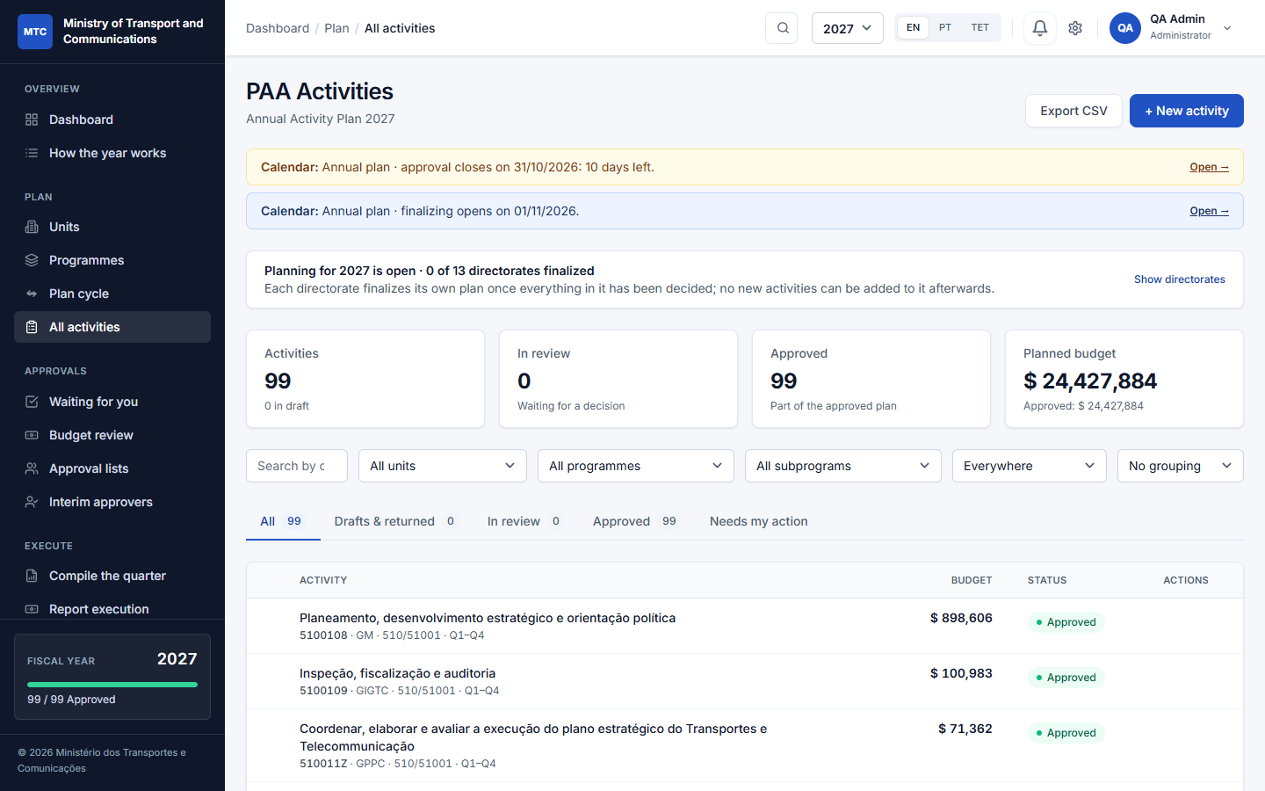
Each unit writes its own part of the plan
Its own people
Each unit has a technical officer and a director; what a person sees and writes follows their unit.
Copy last year
Start from the previous plan as drafts, once; review, adjust and submit.
Import and export
Load activities from a CSV file (checked line by line) and export the plan.
The activities of the plan: filters, tabs and status chips
Notes:
Every unit has its own people: a technical officer who prepares and a director who certifies. A unit sees its own activities and those of the units below it. Tabs separate drafts and returned work, activities in review, approved ones, and the ones that need my action. At the start of a year the previous year's plan can be copied as drafts, once.

Slide 9
Prepare, certify, approve
1
Draft
2
Prepared
3
Verified
4
Certified
5
Approved
The unit
Technical officer or director
Director of the unit
Director of the unit above
Head of the directorate
Completes the activity, its indicators and budget lines.
Submits it once it passes the checks.
Certifies it; where a unit above validates, it goes up.
Validates the plans of the units beneath.
Gives the final approval of the plan of their own directorate.
Returned with a reason
At any step a reviewer sends it back; the unit sees why, corrects it and submits again.
Changed by revision
An approved activity is not edited. A revision, with a reason, makes a new version.
Every step is on record
Who, when and any note are kept in the history; many can be approved at once.
Notes:
Statuses: Draft (being prepared), Prepared (submitted), Verified (certified by the unit's director, where a unit above validates first), Certified (validated), Approved. The head of the top-level unit gives the final approval; the Minister does not approve plans. A return needs a reason; an approved activity is not edited: it is revised, with a reason, through the whole chain again.

Slide 10
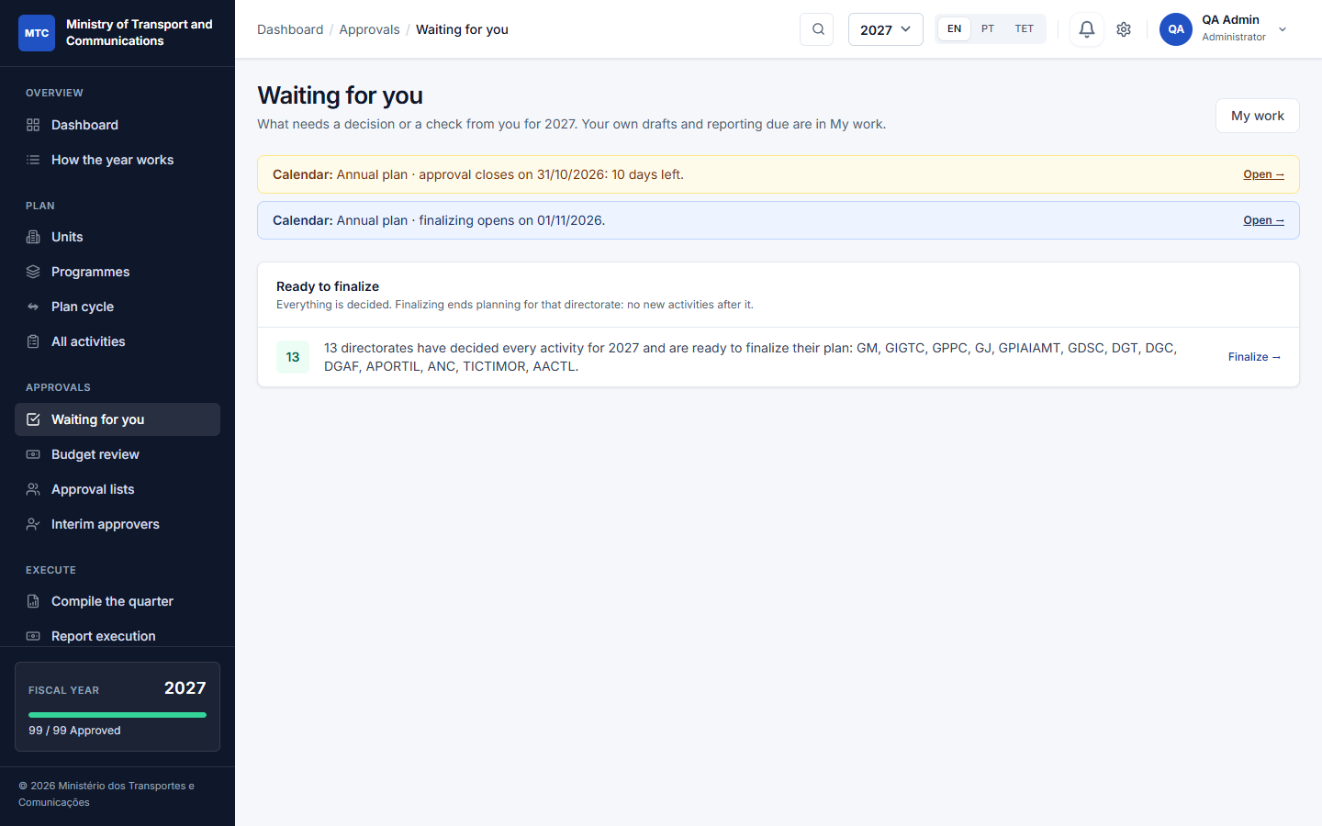
One inbox for everything waiting on the plan
Decide
Certify, approve or return with a reason, one by one or many at once; each is checked again as it is written.
Verify
Execution figures wait for someone other than the person who reported them.
Finalize
Each head is told when their directorate's plan is ready to be finalized.
Approvals: what is waiting for you, each with a link
Notes:
Approvals is one page with everything waiting for the person: activities to decide, execution figures to verify (never their own), the plan ready to be finalized for the directorates they head, budget steps, and their own drafts and returned work. The dashboard's Needs your attention is the same list.

Slide 11


Named approvers, interim cover and reshuffles
Approval lists
Interim approvers
Reshuffles
Name who prepares, certifies and approves the activities of a unit.
The nearest list above a unit applies to the units below it.
No list: the default rule (the director) stays.
Someone stands in for a director between two dates.
They certify and approve for the unit, even where a list names other people.
It ends on its date, or when revoked.
Move a unit to another parent: the heads and lists above take over, pending work follows.
Replace one person by another in every list at once.
An administrator can move an activity to another unit, with a remark.
Notes:
A director keeps the list of people who prepare, certify and approve for their units. The nearest list above a unit applies. An interim stands in for a director for dates; they certify and approve but do not prepare. A reshuffle needs no clean-up because authority is worked out from the tree and the lists at the moment someone acts.

Slide 12
Everyone signs in order, and nothing is ever erased
Signing in order
Rounds and the record
1
Ana signs first
Round 1
Ana signed, Bento signed. Carla returned the activity with a reason.
Both signatures: voided (by Carla, with the reason). Kept.
2
Bento signs second
Round 2
The unit corrected it. Ana, Bento and Carla sign again, in order.
Approved. All six signatures stay in the history.
3
Carla signs last
The activity is approved only after the last signature. An interim signs in the place of the next name; administrators are never held up.
Signatures are never deleted: each belongs to a numbered round and is completed or voided, with who and why. Every change is also in the audit log.
Notes:
A certify or approve list of two or more people can sign in order: each in turn, and the activity moves on only after the last signature. If the activity is returned or reopened, a new round starts and the earlier signatures stay on record, marked as voided with who voided them and why. The history tab shows every signature of every round, so who signed before a reset can always be told.

Slide 13
Each directorate finalizes its own plan
Finalized by the head
When everything in the directorate is decided, its head finalizes the plan, with a remark.
In order
Submit everything, then approve, then finalize. Reports warn when the plan is not fully approved before they are printed.
Reopened with a reason
Only the head or an administrator, with a reason; all of it is in the audit trail. Approved activities can still be revised.
The banner counts the directorates that have finalized
Notes:
The head of each top-level unit finalizes the plan of their own directorate once nothing in it waits for a decision. A finalized directorate takes no new activities, imports or roll-forward copies for the year; the others keep planning. The year ends when all directorates that planned have finalized; planning can be reopened by the head or an administrator, with a reason. Revisions are not stopped by finalizing.

Slide 14
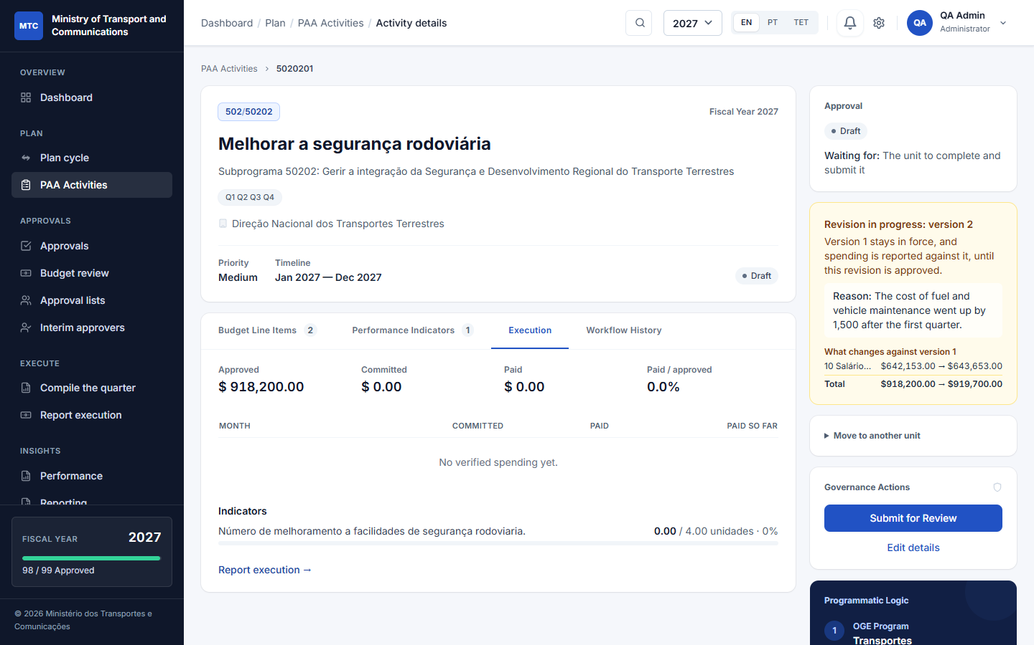
Changing an approved activity: a revision
Start with a reason
Revise on the approved activity. The reason is required and is kept with the new version.
The approved version stays in force
Its amounts are untouched while the revision is pending; reporting goes on against them.
Approved again, in full
Prepare, certify, approve, including lists that sign in order; then it becomes version 2.
A revision in progress: the reason, and what changes against the version in force
Notes:
There is no envelope and no distribution: what an approved activity may spend is what its approved version says. To change it, someone who prepares for the unit, its director, the final approver or an administrator starts a revision with a reason. The activity becomes a draft the unit can edit and goes through preparation, certification and approval again; meanwhile the approved version stays in force and the executed amount is reported against it. The banner lists exactly what changes against the version in force.

Slide 15
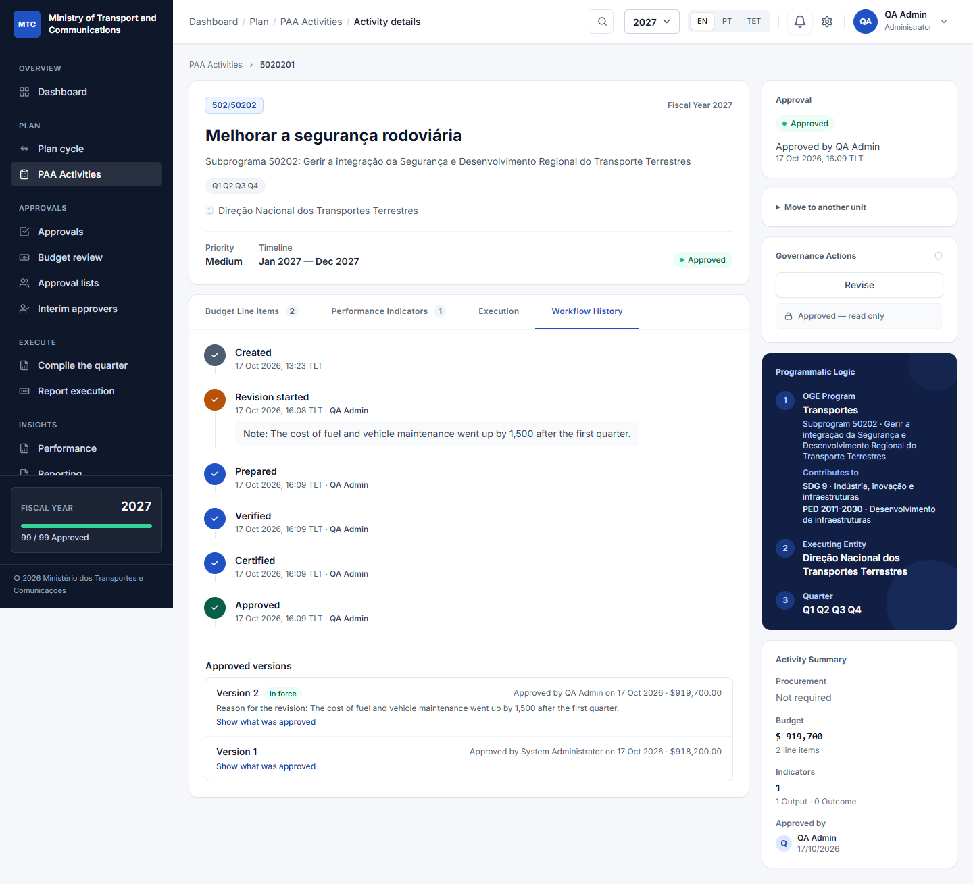
Every version is kept
Who, when and why
Each version shows who approved it, when, the total, and the reason for the revision.
What was approved
Open any version to see its budget lines and its indicators as they were.
Reported figures stay tied
Lines and indicators with reported figures are changed, never removed; the activity is never deleted.
Version 2 in force; version 1 kept
Notes:
Each approval makes a version: a copy of the activity, its indicators with their actions and its budget lines, kept as it was. The history lists every version with who approved it, when, the total and the reason for the revision, and opens what was approved. A budget line with an executed amount reported, or an indicator with progress reported, cannot be removed by a revision; an activity approved once is revised, never deleted.

Slide 16




Carrying out the plan: report, verify, compile
Monthly executed amount
Quarterly indicators
Narratives
One amount for each budget line, with what is left of the approved amount shown as it is typed.
Progress against each target, in the quarters its months fall in.
Results achieved and constraints, for each month and each quarter.
Verified by someone else
Calendar
Compile the quarter
Nobody verifies their own report; only verified figures reach the reports.
A period outside its dates cannot be reported; a late unit can be given more time on its own.
A draft from what the units reported, edited by the director into the text of the report.
Notes:
Each month the unit reports the amount each budget line executed. Each quarter it reports the indicators. Every month and quarter has a narrative. Figures count only once someone other than the reporter verifies them. Directors compile the quarter: the system drafts the text from what the units reported and the director edits and saves it.

Slide 17
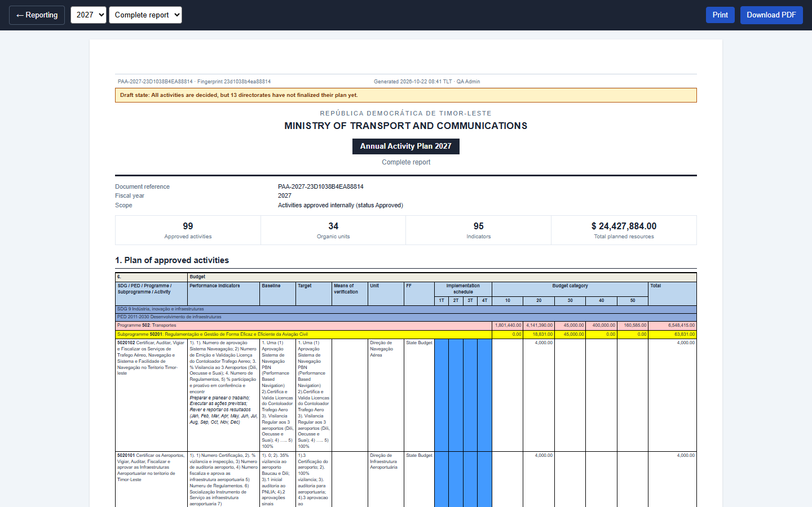
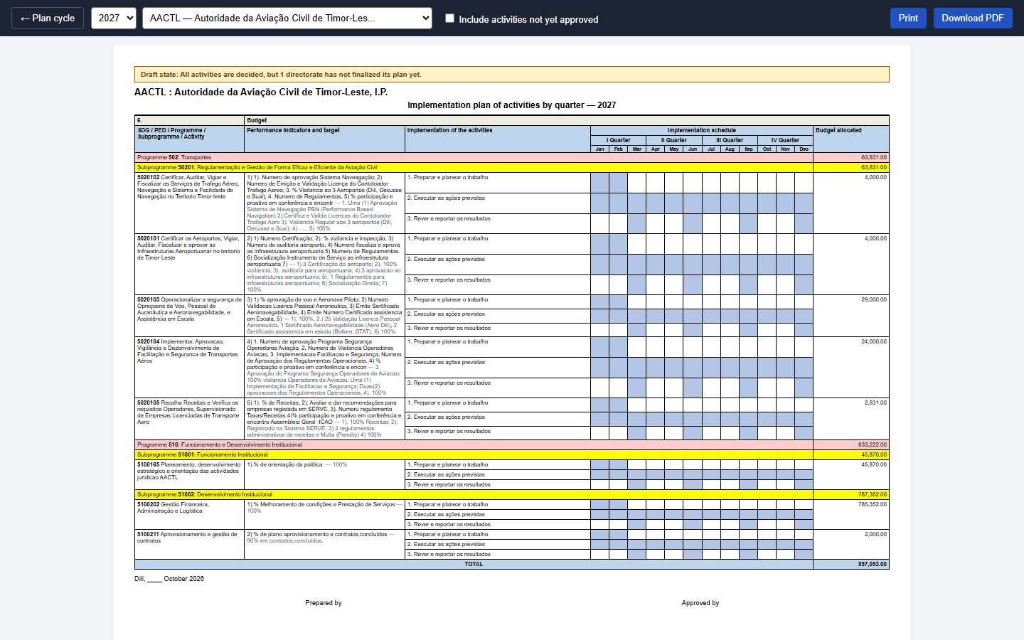
The plan and its results, in the Ministry of Finance form
Final plan report: complete or summary
Implementation plan of a unit, with actions and months
Also: the performance report (monthly or quarterly) with the narratives and the verified figures; CSV export of the activities and of the report data.
Notes:
Three printed forms follow the formal template: the final plan report (complete or summary), the implementation plan of a unit with its actions and the Jan-Dec grid, and the performance report monthly or quarterly. A4 landscape, programme and subprogramme bands, print or PDF. The final plan report is of the plan; it is not addressed to anyone.

Slide 18





Everyone sees and does what their role allows
Administrator
Minister
Director
Sets up the institution, users, the calendar and settings; can always act.
Sees every plan and every report; does not approve plans.
Certifies; the head of a directorate gives its final approval and finalizes its plan.
Technical officer
Finance
Viewer
Prepares activities, indicators and budget lines, and reports execution.
Confirms budget lines and verifies the executed amounts that units report.
Reads plans and reports; changes nothing.
Notes:
Six roles. The Minister sees every plan and every report but does not approve plans. The head of a directorate approves their own directorate's plans. Finance confirms budget lines and verifies the executed amounts. Permissions are checked on the server for every action.

Slide 19
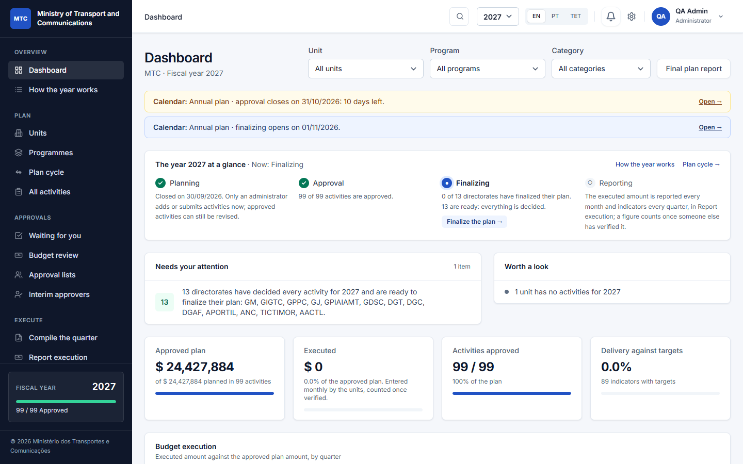


A professional, accessible interface
Clear at a glance
The plan's cycle, the figures and your own to-do list on one page.
Three languages
English, Portuguese and Tetum; a test blocks any new text without its translations.
Made for the role
The menu, the buttons and the inbox show only what your role can do.
The dashboard: the plan's cycle, key figures and what needs your attention
Notes:
Compact tables, status chips with a dot and a word, figures that line up. Automated accessibility checks pass on every screen, and every text exists in English, Portuguese and Tetum.

Slide 20
Built for any institution, whole ministry or one office
Institution
One deployment, one institution
Name, structure and programmes are set in the app; nothing is hard-coded to a ministry.
Directorate
Gabinete
Autonomous body
Whole ministry or a single office
Start with one directorate or gabinete and add the rest later.
Units, each with its people
Units, each with its people
Units, each with its people
Autonomous bodies included
Public bodies with their own legal personality sit in the same tree.
Any depth the law defines
Notes:
The Ministry of Transport and Communications is only a sample. A deployment serves one institution; you can start with a single directorate or office and add the rest later. Each directorate and unit has its own users.

Slide 21





Controls an institution can rely on
Audit trail and record
Role permissions
Two-factor sign-in
Every change, every version and every signature of every round, with who and when. Nothing is erased.
Checked on the server for every action, not only hidden in the menu.
Authenticator codes and recovery codes; required for senior roles.
Closed registration
Backups and health
Tested
No self-sign-up; sign-in attempts are rate-limited.
Nightly verified backups and a health check for uptime monitoring.
More than 480 automated tests guard the approval and revision rules.
Notes:
The audit log records every change with who and when. Permissions are checked on the server. Two-factor sign-in, closed registration, nightly backups, and more than 480 automated tests that guard the approval and revision rules.

Slide 22

Try it with sample data
A whole ministry
Practise the real flow
The Ministry of Transport and Communications with its directorates, municipal directorates and autonomous bodies; the real State Budget plans for 2025 to 2027 and a technical officer and a director for every unit.
Sign in as a technical officer, a director and the head of a directorate and follow an activity from draft to approved, with the lists, interim cover and signing in order.
Loaded and removed by an administrator at Management > Sample Data; real data is never touched. Refused in production.
Notes:
An administrator loads the optional sample at Management, Sample Data: a ministry with its directorates, municipal directorates and autonomous bodies, each with its technical officer and its director. Purging removes only the sample.

Slide 23
Proposed next steps
1
Deploy for real use
Docker Compose on one server: web, application, queue worker, scheduler, database and Redis, with HTTPS and the nightly backup. E-mail notifications go out through your own mail server.
2
Pilot with one directorate
Load the real structure and people, set the calendar, and run one full plan with its own technical officers and director.
3
Train with the manual
The user manual walks every role through the whole year; sample data lets people practise first.
4
Keep improving
Watch real usage, fix what real users hit, and keep every text translated.
Notes:
Close with the ask: agree the pilot directorate and the deployment date.

