Slide 1

Plano de Ação Anual (PAA)
The Annual Action Plan of a public body: written by its units, approved by its directorates, paid for by its budget, carried out and reported through the year
Implemented by G-Kakaroto
Notes:
The application is the Annual Action Plan. Everything else, approval, budget, execution and reports, exists to write the plan, approve it, pay for it, carry it out and report on it. It is not tied to one institution; the Ministry of Transport and Communications appears only as a sample dataset.

Slide 2




What the Annual Action Plan is
What
Who
When
With what
How we will know
The activities of the year, under the programme and subprogramme they serve.
The unit that owns each activity, and the person responsible.
The quarters it runs in and the months of each of its actions.
The budget lines by economic category, each with its funding source.
Indicators with a baseline and a target, reported month by month and quarter by quarter.
Notes:
The PAA answers five questions for each unit: what will we do, who is responsible, when, with what means, and how will we know. Every activity of the plan carries those five answers, and the whole application keeps them together.

Slide 3
Everything in the application serves the plan
Units write it
Activities, indicators, actions, budget lines
The budget pays for it
The envelope received, shared over the approved plan
The Annual
Action Plan
(PAA)
Directorates approve it
Prepare, certify, approve; named approvers
Units carry it out
Monthly spending and quarterly indicators, verified
Directorates finalize it
Each head ends planning for their own plan
Reports show it
The plan and its results in the Ministry of Finance form
Notes:
The plan is at the centre. Units write it, directorates approve and finalize it, the budget received pays for it, units carry it out and report on it, and the reports are the plan and its results in the formal template. Every step is in the audit record.

Slide 4
The year of the plan
1
Write
2
Approve
3
Finalize
Units draft activities and submit them while the submission window is open.
Each activity is prepared, certified and approved by the heads of its directorate.
Each directorate's head finalizes the plan of their own directorate.
4
Fund
5
Carry out
6
Report
The institution registers the envelope it receives and shares it over the approved plan.
Units report spending and indicators inside the monthly and quarterly windows.
Others verify, directors compile the quarter, and the reports are printed.
Notes:
The life of the Annual Action Plan over the year. Planning ends per directorate; the whole year's planning ends when every directorate that planned has finalized, or when the envelope is received. The plan cannot be reopened after the envelope; only its distribution changes.

Slide 5
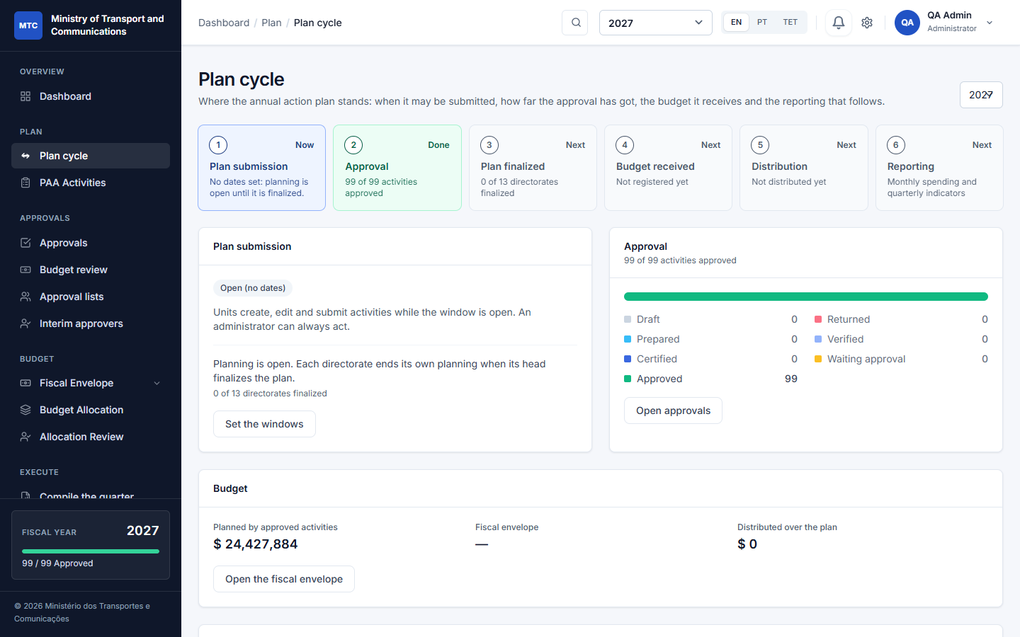
One page shows where the plan stands
Windows
The administrator sets the dates for plan submission and for each month and quarter. No dates means open; an administrator can always act.
Always current
Approval progress, the budget and the reporting status are read live; nothing is typed in by hand.
Where things are done
Buttons to report execution, compile the quarter and open the printed reports.
The Plan cycle page, fiscal year 2027, with the sample dataset
Notes:
The Plan cycle page and the dashboard show the same six steps and which one is current. Windows are set by the administrator; with no dates a window is open.

Slide 6
What an entry of the plan contains
Programme
Activity
Indicators and actions
OGE code, name, objective. Set up once for the year by the administrator.
What will be done in the year: description, priority, the quarters it runs in, dates, the person responsible. Starts as a Draft.
A target and a baseline, with the numbered actions that carry it out and the months each takes place in.
Unit
Budget lines
The directorate or unit that owns the work and has its own people.
An amount by economic category with a funding source, optionally tied to the indicator it pays for.
An activity can be submitted when
It has a budget line with an amount
It has an indicator with a target
The dates are in order and the window is open
Notes:
A programme and its units exist first. A unit creates an activity under a programme, gives it indicators with numbered actions and months, and budget lines with a funding source, each optionally tied to an indicator. The system refuses to submit an incomplete activity.

Slide 7
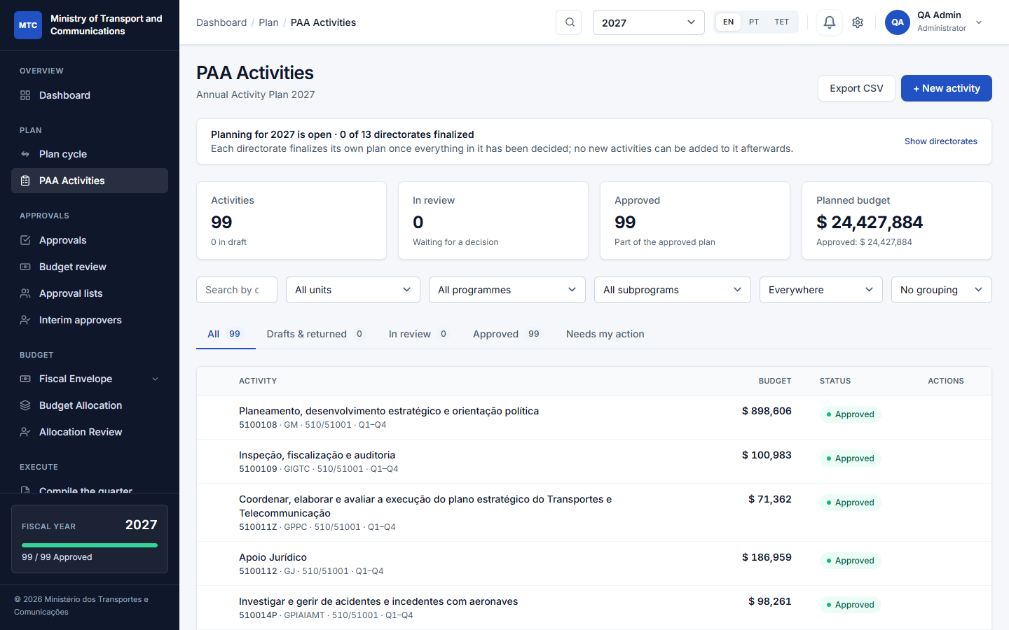
Each unit writes its own part of the plan
Its own people
Each unit has a planner and a director; what a person sees and writes follows their unit.
Copy last year
Start from the previous plan as drafts, once; review, adjust and submit.
Import and export
Load activities from a CSV file (checked line by line) and export the plan.
The activities of the plan: filters, tabs and status chips
Notes:
Every unit has its own people: a planner who prepares and a director who certifies. A unit sees its own activities and those of the units below it. Tabs separate drafts and returned work, activities in review, approved ones, and the ones that need my action. At the start of a year the previous year's plan can be copied as drafts, once.

Slide 8
Prepare, certify, approve
1
Draft
2
Prepared
3
Verified
4
Certified
5
Approved
The unit
Planner or director
Director of the unit
Director of the unit above
Head of the directorate
Completes the activity, its indicators and budget lines.
Submits it once it passes the checks.
Certifies it; where a unit above validates, it goes up.
Validates the plans of the units beneath.
Gives the final approval of the plan of their own directorate.
Returned with a reason
At any step a reviewer sends it back; the unit sees why, corrects it and submits again.
Locked once approved
An approved activity is not edited. Reopening it needs a written reason.
Every step is on record
Who, when and any note are kept in the history; many can be approved at once.
Notes:
Statuses: Draft (being prepared), Prepared (submitted), Verified (certified by the unit's director, where a unit above validates first), Certified (validated), Approved. The head of the top-level unit gives the final approval; the Minister does not approve plans. A return needs a reason; an approved activity is locked and can be reopened with a reason until the envelope is received.

Slide 9
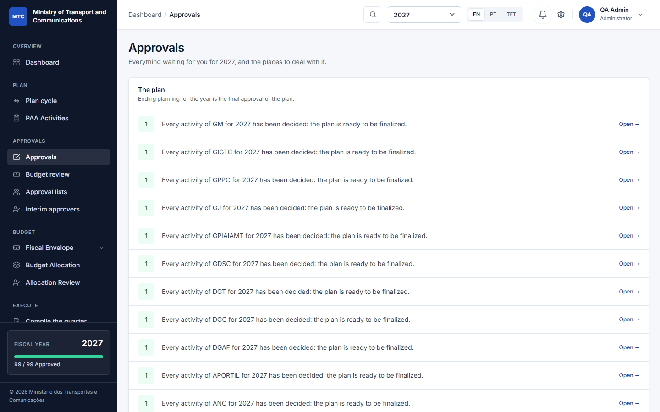
One inbox for everything waiting on the plan
Decide
Certify, approve or return with a reason, one by one or many at once; each is checked again as it is written.
Verify
Execution figures wait for someone other than the person who reported them.
Finalize
Each head is told when their directorate's plan is ready to be finalized.
Approvals: what is waiting for you, each with a link
Notes:
Approvals is one page with everything waiting for the person: activities to decide, execution figures to verify (never their own), the plan ready to be finalized for the directorates they head, budget steps, and their own drafts and returned work. The dashboard's Needs your attention is the same list.

Slide 10


Named approvers, interim cover and reshuffles
Approval lists
Interim approvers
Reshuffles
Name who prepares, certifies and approves the activities of a unit.
The nearest list above a unit applies to the units below it.
No list: the default rule (the director) stays.
Someone stands in for a director between two dates.
They certify and approve for the unit, even where a list names other people.
It ends on its date, or when revoked.
Move a unit to another parent: the heads and lists above take over, pending work follows.
Replace one person by another in every list at once.
An administrator can move an activity to another unit, with a remark.
Notes:
A director keeps the list of people who prepare, certify and approve for their units. The nearest list above a unit applies. An interim stands in for a director for dates; they certify and approve but do not prepare. A reshuffle needs no clean-up because authority is worked out from the tree and the lists at the moment someone acts.

Slide 11
Everyone signs in order, and nothing is ever erased
Signing in order
Rounds and the record
1
Ana signs first
Round 1
Ana signed, Bento signed. Carla returned the activity with a reason.
Both signatures: voided (by Carla, with the reason). Kept.
2
Bento signs second
Round 2
The unit corrected it. Ana, Bento and Carla sign again, in order.
Approved. All six signatures stay in the history.
3
Carla signs last
The activity is approved only after the last signature. An interim signs in the place of the next name; administrators are never held up.
Signatures are never deleted: each belongs to a numbered round and is completed or voided, with who and why. Every change is also in the audit log.
Notes:
A certify or approve list of two or more people can sign in order: each in turn, and the activity moves on only after the last signature. If the activity is returned or reopened, a new round starts and the earlier signatures stay on record, marked as voided with who voided them and why. The history tab shows every signature of every round, so who signed before a reset can always be told.

Slide 12
Each directorate finalizes its own plan
Finalized by the head
When everything in the directorate is decided, its head finalizes the plan, with a remark.
The others go on
A finalized directorate takes no new activities; the other directorates keep planning.
Reopened with a reason
Only the head or an administrator, only before the envelope is received. All of it is in the audit trail.
The banner counts the directorates that have finalized
Notes:
The head of each top-level unit finalizes the plan of their own directorate once nothing in it waits for a decision. A finalized directorate takes no new activities, imports or roll-forward copies for the year; the others keep planning. The year ends when all directorates that planned have finalized, or when the envelope is received; the plan can be reopened by the head or an administrator, with a reason, only before the envelope.

Slide 13
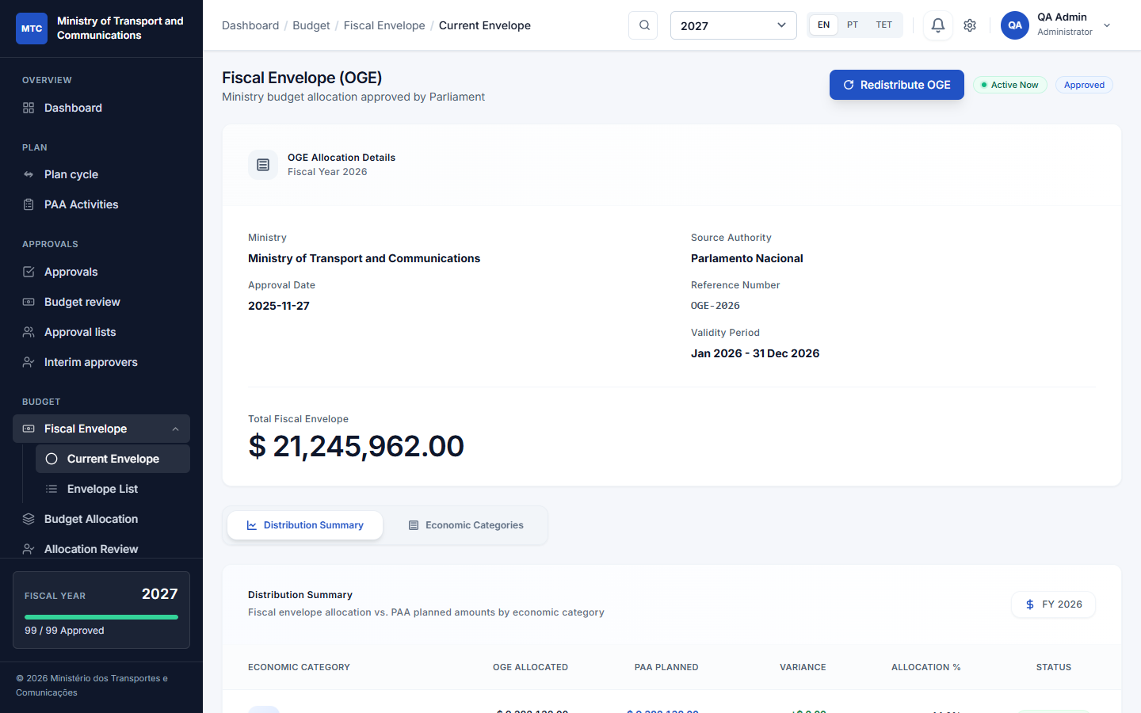
The budget pays for the approved plan
Register and approve
The envelope with its reference, dates and total, divided by economic category.
Distribute over the plan
Approved activities only: capped at what each line asked for, to the cent, in one transaction.
Review
Budget allocation and the allocation review show what each unit and programme received.
The fiscal envelope with its distribution by economic category
Notes:
The envelope is what the institution receives: the State Budget allocation for a ministry, an allocation from the ministry for a directorate. It is registered with its reference and approved. The distribution uses approved activities only, never gives a line more than it asked for, is exact to the cent and runs in one transaction. A surplus stays unallocated.

Slide 14




Carrying out the plan: report, verify, compile
Monthly spending
Quarterly indicators
Narratives
Committed and paid for each budget line, inside the window of the month.
Progress against each target, in the quarters its months fall in.
Results achieved and constraints, for each month and each quarter.
Verified by someone else
Windows
Compile the quarter
Nobody verifies their own report; only verified figures reach the reports.
A period outside its window cannot be reported; administrators always can.
A draft from what the units reported, edited by the director into the text of the report.
Notes:
Each month the unit reports committed and paid per budget line. Each quarter it reports the indicators. Every month and quarter has a narrative. Figures count only once someone other than the reporter verifies them. Directors compile the quarter: the system drafts the text from what the units reported and the director edits and saves it.

Slide 15
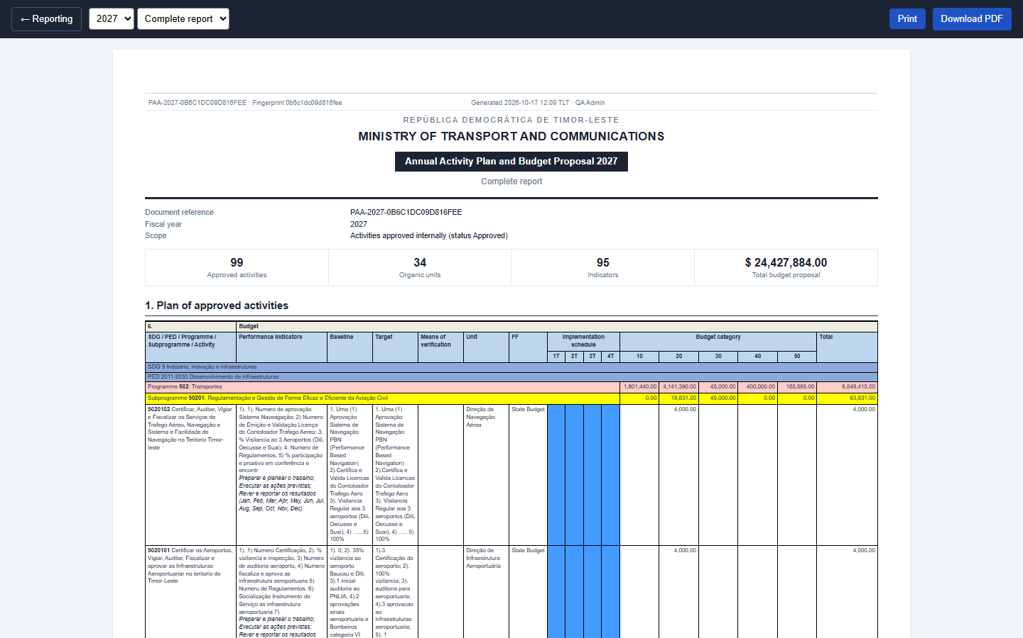
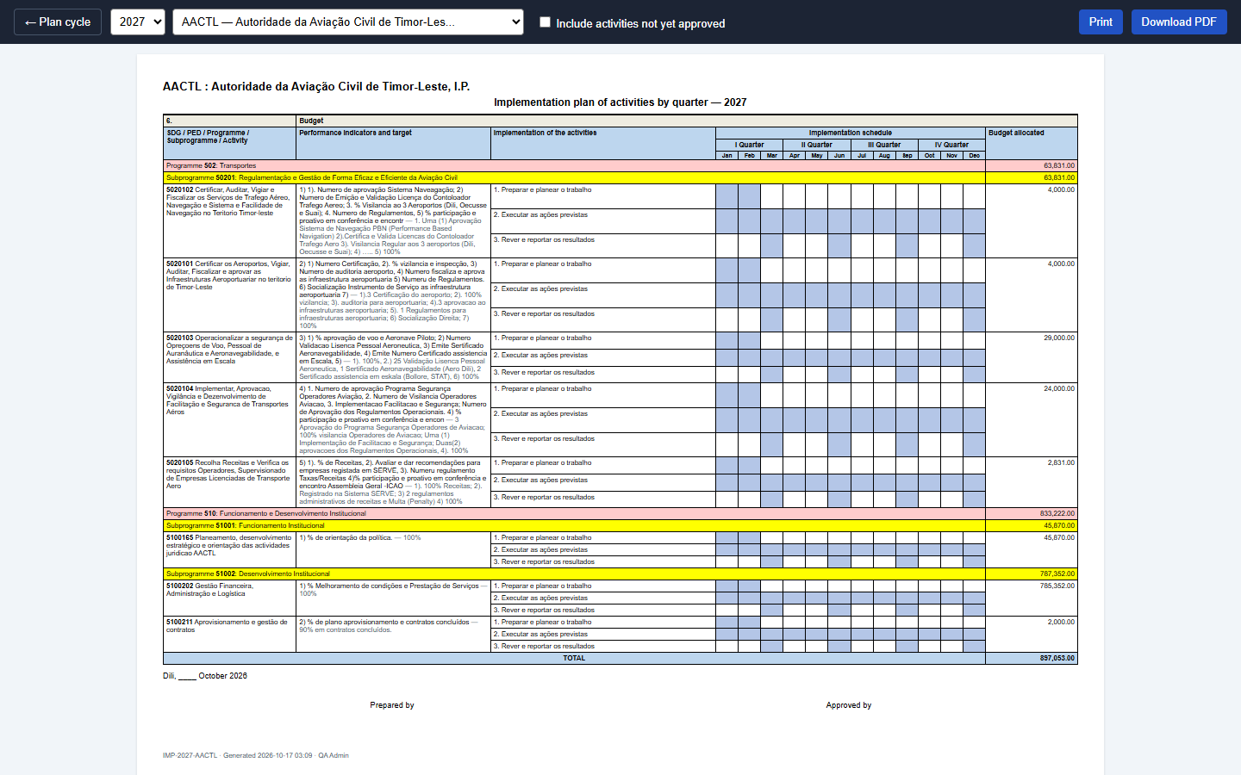
The plan and its results, in the Ministry of Finance form
Final plan report: complete or summary
Implementation plan of a unit, with actions and months
Also: the performance report (monthly or quarterly) with the narratives and the verified figures; CSV export of the activities and of the report data.
Notes:
Three printed forms follow the formal template: the final plan report (complete or summary), the implementation plan of a unit with its actions and the Jan-Dec grid, and the performance report monthly or quarterly. A4 landscape, programme and subprogramme bands, print or PDF. The final plan report is of the plan; it is not addressed to anyone.

Slide 16





Everyone sees and does what their role allows
Administrator
Minister
Director
Sets up the institution, users, windows and settings; can always act.
Sees every plan and approves the fiscal envelope.
Certifies; the head of a directorate gives its final approval and finalizes its plan.
Planner
Finance
Viewer
Prepares activities, indicators and budget lines, and reports execution.
Confirms budget lines and verifies the spending that units report.
Reads plans and reports; changes nothing.
Notes:
Six roles. The Minister sees every plan and approves the fiscal envelope but does not approve plans. The head of a directorate approves their own directorate's plans. Finance confirms budget lines and verifies spending. Permissions are checked on the server for every action.

Slide 17
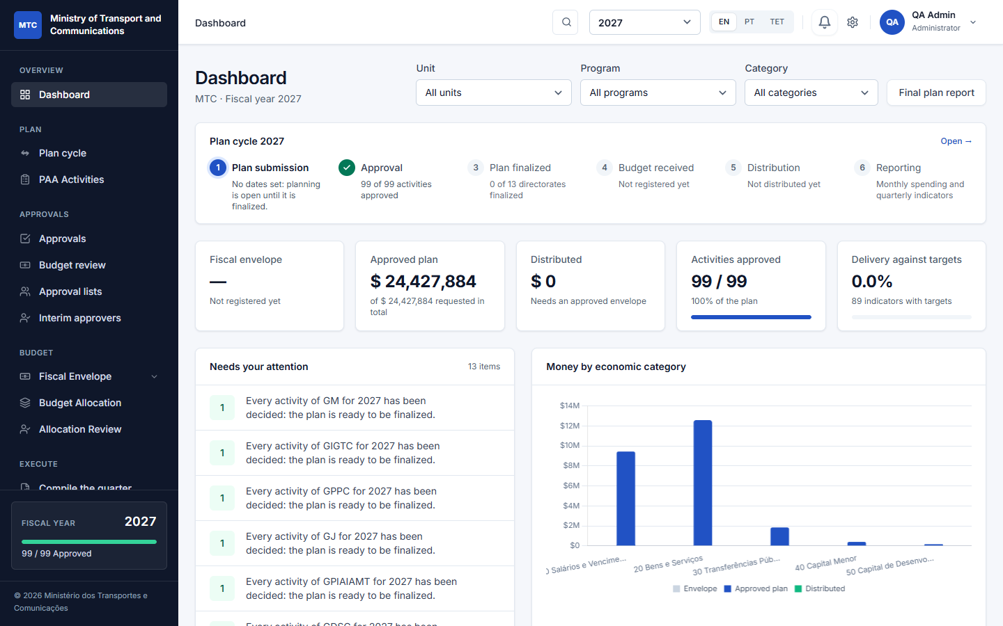


A professional, accessible interface
Clear at a glance
The plan's cycle, the figures and your own to-do list on one page.
Three languages
English, Portuguese and Tetum; a test blocks any new text without its translations.
Made for the role
The menu, the buttons and the inbox show only what your role can do.
The dashboard: the plan's cycle, key figures and what needs your attention
Notes:
Compact tables, status chips with a dot and a word, figures that line up. Automated accessibility checks pass on every screen, and every text exists in English, Portuguese and Tetum.

Slide 18
Built for any institution, whole ministry or one office
Institution
One deployment, one institution
Name, structure and programmes are set in the app; nothing is hard-coded to a ministry.
Directorate
Gabinete
Autonomous body
Whole ministry or a single office
Start with one directorate or gabinete and add the rest later.
Units, each with its people
Units, each with its people
Units, each with its people
Autonomous bodies included
Public bodies with their own legal personality sit in the same tree.
Any depth the law defines
Notes:
The Ministry of Transport and Communications is only a sample. A deployment serves one institution; you can start with a single directorate or office and add the rest later. Each directorate and unit has its own users.

Slide 19





Controls an institution can rely on
Audit trail and record
Role permissions
Two-factor sign-in
Every change, and every signature of every round, with who and when. Nothing is erased.
Checked on the server for every action, not only hidden in the menu.
Authenticator codes and recovery codes; required for senior roles.
Closed registration
Backups and health
Tested
No self-sign-up; sign-in attempts are rate-limited.
Nightly verified backups and a health check for uptime monitoring.
375 automated tests guard the approval and budget rules.
Notes:
The audit log records every change with who and when. Permissions are checked on the server. Two-factor sign-in, closed registration, nightly backups, and 375 automated tests that guard the approval and budget rules.

Slide 20

Try it with sample data
A whole ministry
Practise the real flow
The Ministry of Transport and Communications with its directorates, municipal directorates and autonomous bodies; the real State Budget plans for 2025 to 2027 and a planner and a director for every unit.
Sign in as a planner, a director and the head of a directorate and follow an activity from draft to approved, with the lists, interim cover and signing in order.
Loaded and removed by an administrator at Management > Sample Data; real data is never touched. Refused in production.
Notes:
An administrator loads the optional sample at Management, Sample Data: a ministry with its directorates, municipal directorates and autonomous bodies, each with its planner and its director. Purging removes only the sample.

Slide 21
Proposed next steps
1
Deploy for real use
Production server, queue worker for notifications, Redis for sessions and cache, and the nightly backup job.
2
Pilot with one directorate
Load the real structure and people, set the windows, and run one full plan with its own planners and director.
3
Train with the manual
The user manual walks every role through the whole year; sample data lets people practise first.
4
Keep improving
Watch real usage, fix what real users hit, and keep every text translated.
Notes:
Close with the ask: agree the pilot directorate and the deployment date.

