Slide 1


Guided By Mrs. Mohamed Fathima Barvin. S M.E., AP/CSE
PRINCE DR. K. VASUDEVAN COLLEGE
OF ENGINEERING AND TECHNOLOGY
Department of Computer Science and Engineering
PDKVCET
TITLE
DEEP LEARNING BASED 3D MRI SEGMENTATION USING CNN ALGORITHM FOR DETECTING THE BRAIN TUMOUR
Coordinated By
Mrs. Shalini. S M.E, (Ph.D),
Head of Department – CSE
Presented By
Gokul. K
Reg. No : 411620104004
Praveen Kumar. K
Reg. No : 411620104013

Slide 2
AIM AND OBJECTIVE
Identifying the presence and location of tumors in the brain at an early stage can lead to timely medical intervention and patient prognosis.
Accurate segmentation of brain tumors is essential for treatment planning.
Surgeons, radiation oncologists, and other healthcare professionals use the segmented regions to plan surgeries, radiotherapy, and other treatments.
Precise knowledge of the tumor location and extent is critical to minimizing damage to healthy brain tissue.
PDKVCET

Slide 3
ABSTRACT
A deep learning-based approach for the most precise brain tumor segmentation in medical images. Leveraging convolutional neural networks (CNNs), the model demonstrates robust performance in delineating tumor boundaries, providing a crucial tool for precise diagnosis and treatment planning in neuro-oncology. The methodology integrates advanced neural network architectures and explores optimization techniques to enhance segmentation accuracy . By predicting the tumor based on their size, grade and the location in which it is present we can able to identify the type of the tumor present in the brain and the seriousness of the tumor . And can able to give some suggestions for taking the actions regarding the rehabilitation of the brain tumor to the doctor.
PDKVCET

Slide 4
EXISTING SYSTEM
As MRI images are prone to more noise and interference, doctors felt difficult to detect the tumor at early stage.
They not only felt difficult to detect the tumor at early stage, but they also took many days to detect manually.
Due to these difficulties , medical field faces certain problems.
PDKVCET

Slide 5
DISADVANTAGES
These algorithms, however, suffer from several drawbacks, including low contrast images, incorrect tumor region segmentation caused by some artifacts.
A computationally complex method that needs more treatment time to correctly identify the tumor region, and existing deep learning.
PDKVCET

Slide 6
PROPOSED SYSTEM
This system detects the tumor from the MRI images through image processing method and that includes some techniques.
Those techniques are the modules of the project.
Data Preprocessing.
Feature Extraction.
Multimodal fusion.
Training Strategy
Depending upon the shape, size, grade and location, we can find the type of tumor that is present in brain.
PDKVCET

Slide 7
ADVANTAGES
Combining multiple imaging modalities enhances accuracy by providing complementary information. improving the system's ability to differentiate between tumor and normal tissue.
Enhances robustness-As the model can adapt to variations in image quality and characteristics across different modalities.
The incorporation of such diverse data sources can improve sensitivity and specificity, leading to more reliable and precise tumor identification in clinical settings.
We can be able to predict the brain tumor grade, size, and the location and by giving suggestions we can be able to treat the tumor with the most care.
PDKVCET

Slide 8
ALGORITHM USED
Deep Learning (DL) approaches have recently been popular in developing automated systems capable of accurately diagnosing or segmenting brain tumors in less time. DL enables a pre-trained Convolutional Neural Network (CNN) model for medical images, specifically for classifying brain cancers.
Some of the algorithm which are used are ,
Data Preprocessing.
Feature Extraction.
Multimodal fusion.
Training Strategy.
PDKVCET

Slide 9
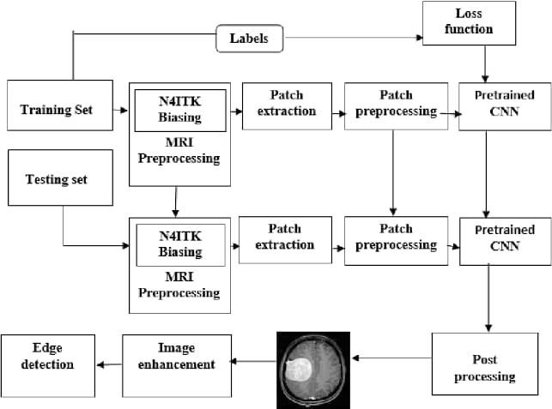
SYSTEM ARCHITECTURE
PDKVCET

Slide 10
SOFTWARE REQUIREMENTS
Windows 10
Python
Deep Learning Frameworks
Image Processing Libraries
Open-CV
PDKVCET

Slide 11
HARDWARE REQUIREMENTS
Processor Intel® Core™ i3
RAM: 4.00 GB
Hard Disk: 1 TB
PDKVCET

Slide 12
MODULES
MODULE 1:
Data Preprocessing
MODULE 2:
Features Extraction.
MODULE 3:
Multimodal Fusion.
MODULE 4:
Training Strategy

Slide 13
Module Description
1.Data Preprocessing
It is very difficult to process an image. Before any image is processed, it is very significant to remove unnecessary items it may hold. After removing unnecessary artifacts, the image can be processed successfully. The initial step of image processing is Image Pre-Processing. Preprocessing involves processes like conversion to grayscale image, noise removal and image reconstruction. Conversion to grey scale image is the most common pre-processing practice. After the image is converted to grayscale, then remove excess noise using different filtering methods.

Slide 14
2.Feature extraction
Feature extraction is an important step in the construction of any pattern classification and aims at the extraction of the relevant information that characterizes each class. In this process relevant features are extracted from objects/ alphabets to form feature vectors. These feature vectors are then used by classifiers to recognize the input unit with target output unit. It becomes easier for the classifier to classify between different classes by looking at these features as it allows fairly easy to distinguish. Feature extraction is the process to retrieve the most important data from the raw data.

Slide 15
3.Multimodal Fusion
Segmentation of images is important as large numbers of images are generated during the scan and it is unlikely for clinical experts to manually divide these images in reasonable time.
Image segmentation refers to segregation of given image into multiple non-overlapping regions. Segmentation represents the image into sets of pixels that are more significant and easier for analysis. It is applied to approximately locate the boundaries or objects in an image and the resulting segments collectively cover the complete image . The segmentation algorithms works on one of the two basic characteristics of image intensity; similarity and discontinuity

Slide 16
4.Training Strategy
Classification is used to classify each item in a set of data into one of predefined set of classes or groups. In other words, classification is an important technique used widely to differentiate normal and tumor brain images. The data analysis task classification is where a model or classifier is constructed to predict categorical labels (the class label attributes). Classification is a data mining function that assigns items in a collection to target categories or classes. The goal of classification is to accurately predict the target class for each case in the data

Slide 17
LITERATURE SURVEY

Slide 18
PAPER 1:
Title : “MRI Brain Tumor Detection Methods Using Contourlet Transform Based on Time Adaptive Self-Organizing Map”
Author : ALI FARZAMNIA 1 , (Senior Member, IEEE), SEYED HAMIDREZA HAZAVEH 2 , SEYEDE SAFIEH SIADAT3 , AND ERVIN GUBIN MOUNG
Year : 2023.
Explanation:
The paper proposes that the brain tumor has different forms and depending on the contour of the tumor present in the brain we can able find whether it is benign or malignant.

Slide 19
CONCEPT RELATED TO OUR PROJECT
The brain tumor can be found by the difference in cells in the brain.
We can also be able find the malignance of the tumor using the contour.
This will help us to differentiate the normal and tumor brain.

Slide 20
PAPER 2:
Title : “Brain Tumor Detection Using 3D-UNet Segmentation Features and Hybrid Machine Learning Model”
Author : Bhargav Mallampati; Abid Ishaq; Furqan Rustam; Venu Kuthala; Sultan Alfarhood.
Year :2023.
Explanation:
This study focuses on deploying a machine learning-based approach for brain tumor detection, utilizing Magnetic Resonance Imaging (MRI) features. We train the proposed model using 3D-UNet and 2D-UNet segmentation features extracted from MRI, encompassing shape, statistics, gray level size zone matrix, gray level dependence matrix, gray level co-occurrence matrix, and gray level run length matrix values. To improve performance, we propose a hybrid model that combines the strengths of two machine learning models, K-nearest neighbor (KNN) and gradient boosting classifier (GBC), using soft voting criteria.

Slide 21
CONCEPT RELATED TO OUR PROJECT
As our project is Brain tumor detection we use MRI images for finding the presence of tumor.
To find that we need to segment the MRI images into various pieces .
By doing this we can able to locate the position and the size of the tumor in the brain.

Slide 22
PAPER 3:
TITLE : “SEResU-Net for Multimodal Brain Tumor Segmentation“.
AUTHOR : CHENGDONG YAN1,2, JURONG DING 1,2, HUI ZHANG1,2 , KE TONG1,2, BO HUA1,2, AND SHAOLONG SHI .
YEAR : 2022
EXPLANATION:
Glioma is the most common type of brain tumor, and it has a high mortality rate. Accurate tumor segmentation based on magnetic resonance imaging (MRI) is of great significance for the diagnosis and treatment of brain tumors. Recently, the automatic segmentation of brain tumors based on U-Net has gained considerable attentiony. Our findings demonstrate that the proposed SEResU-Net has a competitive effect in segmenting multimodal brain tumors.

Slide 23
CONCEPT RELATED TO OUR PROJECT
The brain tumor segmentation is a challenging task due to the structural variations and in homogeneous intensity of tumors.
we proposed an improved U-Net model, which combines the deep residual network and the Squeeze-and-Excitation Network.
By evaluating on the data-sets of BraTS the result we obtained in dice-coefficient were 0.9373, 0.9108, and 0.8758 for the whole tumor.

Slide 24
PAPER 4:
TITLE : “Improving Effectiveness of Different Deep Transfer Learning-Based Models for Detecting Brain Tumors From MR Images “.
AUTHOR : WENHUI YI 1 , QURRAT UL AIN3 , JIN HOU4 , TAO YI5 , AND JINHAI SI.
YEAR : 2020
EXPLANATION:
Early classification of brain tumors from magnetic resonance imaging (MRI) plays an important role in the diagnosis of such diseases. There are many diagnostic imaging methods used to identify tumors in the brain. MRI is commonly used for such tasks because of its unmatched image quality. This study aimed to develop a robust and efficient method based on transfer learning technique for classifying brain tumors using MRI. The proposed method is superior to the existing literature, indicating that it can be used to quickly and accurately classify brain tumors.

Slide 25
CONCEPT RELATED TO OUR PROJECT
As the quality of the image is most important in the detection of tumor present in the brain the MRI image is used.
To enhance the user view of the brain, the images from the dataset were cropped, pre-processed , and augmented for accurate and fast training.
By doing this process we can achieve accuracy, sensitivity , precision score of about 99.67% while using a large dataset.

Slide 26
PAPER 5:
TITLE : “A Deep Learning Model Based on Concatenation Approach for the Diagnosis of Brain Tumor”.
AUTHOR : NEELUM NOREEN 1 , SELLAPPAN PALANIAPPAN.
YEAR : 2020
EXPLANATION:
This study proposes a method of multi-level features extraction and concatenation for early diagnosis of brain tumor. wo different scenarios of brain tumor detection and its classification were evaluated. First, the features from different Inception modules were extracted from pre-trained Inception-v3 model and concatenated these features for brain tumor classification. Then, these features were passed to softmax classifier to classify the brain tumor As results indicated, the proposed method based on features concatenation using pre-trained models outperformed as compared to existing state-of-the-art deep learning and machine learning based methods for brain tumor classification

Slide 27
CONCEPT RELATED TO OUR PROJECT
From this project we are using 3d U-net instead of using DensNet201 .
When we segment the image using the segmentation model we can get the contour of the brain.
But after segmentation has been carried out we will need to concatenate the image in order to get the visual as an output.

Slide 28
PAPER 6:
TITLE : “Brain Tumor Classification and Detection Based DL Models: A Systematic Review”.
AUTHOR :KARRAR NEAMAH1 , FARHAN MOHAMED 2MYASAR MUNDHER ADNAN 3 , TANZILA SABA 4 ,SAEED ALI BAHAJ 5 , KARRAR ABDULAMEER KADHIM.
YEAR : 2022
EXPLANATION:
The realms of computer vision and deep learning have ushered in transformative changes across various domains. Among these, deep learning stands out for its remarkable capacity to handle vast datasets, revolutionizing numerous fields, including the biomedical sector. In particular, its prowess has been harnessed in the realm of brain tumor identification through MRI scans, yielding impressive results. This research project is dedicated to conducting an exhaustive exploration of existing endeavors in the domain of brain tumor identification and classification via MRI scans.

Slide 29
CONCEPT RELATED TO OUR PROJECT
This innovative strategy minimizes the necessity for vast labeled datasets and accelerates the pace of model creation.
By continuously refining and optimizing Deep Learning algorithms, researchers can unlock the full potential of this technology.
Ultimately, these advancements hold the promise of enhancing patient outcomes through more accurate and timely tumor detection.

Slide 30
PAPER 7:
TITLE : “Brain Tumour Detection and Classification Using Intelligence Techniques”.
AUTHOR :SHUBHANGI SOLANKI, UDAY PRATAP SINGH, (Member, IEEE), SIDDHARTH SINGH CHOUHAN , AND SANJEEV JAIN.
YEAR : 2021
EXPLANATION : The main disinterest of this study stays to offer investigators, comprehensive literature on Magnetic Resonance (MR) imaging’s ability to identify brain tumors. Using computational intelligence and statistical image processing techniques, this research paper proposed several ways to detect brain cancer and tumors. This paper also explains the morphology of brain tumors, accessible data sets, augmentation methods, component extraction, and categorization among Deep Learning (DL). Finally, our study compiles all relevant material for the identification of understanding tumors, including their benefits, drawbacks, advancements, and upcoming trends.

Slide 31
CONCEPT RELATED TO OUR PROJECT
CAD systems for the detection of brain tumors are developed using brain MRI scans and digital image processing methods like pre-processing, separation, and classification.
This section provides a summary of commonly used MRI datasets. Although several deep learning methods are used for classification, CNN has shown to be quite accurate.
The development of an autonomous brain tumor detection system must consider reliability, accuracy, and calculation time.

Slide 32
PAPER 8:
TITLE : “An Efficient Classification of MRI Brain Images”.
AUTHOR : MUHAMMAD ASSAM, HIRA KANWAL, UMAR FAROOQ, SAID KHALID SHAH.
YEAR : 2020
EXPLANATION : This paper proposes a simple but efficient solution for the classification of MRI brain images into normal, and abnormal images containing disorders and injuries. It uses images with brain tumor, acute stroke and Alzheimer, besides normal images, from the public dataset developed by Harvard medical school, for evaluation purposes. The proposed model is a four-step process, in which the steps are named- Pre-processing, Features Extraction , Features Reduction , and Classification. Median filter, being one of the best algorithms, is used for the removal of noise such as salt and pepper, and unwanted components such as scalp and skull.

Slide 33
CONCEPT RELATED TO OUR PROJECT
We intend to extend the proposed model to investigate more individual and hybrid classifiers. This research would also be extended to evaluate the proposed model with more parameters.
This work could be also extended to use different features reduction methodologies while keeping the execution time at minimum. It would be interesting to compare the results of the proposed technique with the methods based on deep learning.
It would be further interesting to check the impact of statistical features other than those used in this work.

Slide 34
PAPER 9:
TITLE : “Exploring sMRI Biomarkers for Diagnosis of Autism Spectrum Disorders Based on Multi Class Activation Mapping Models”.
AUTHOR : RUI YANG , FENGKAI KE , HUANPING LIU , MINGCHENG ZHOU , AND HUI-MIN CAO .
YEAR : 2020
EXPLANATION : With the continuous development of artificial intelligence, image aided diagnosis of brain diseases has been widely studied and concerned. However, many doctors and researchers still doubt the diagnosis basis of the neural network and think that the neural network belongs to a limited interpretable black-box function approximator. They are not sure whether the neural network has learned some interpretive image features like humans. In order to solve this problem, three new models (2D CAM, 3D CAM and 3D Grad-CAM) are proposed for structural Magnetic Resonance Imaging (sMRI) data. The Regions Of Interest (ROI) of subcortical tissues among models and between groups are analyzed based on the heat maps of the three models.

Slide 35
CONCEPT RELATED TO OUR PROJECT
We propose 2D , 3D and 3D Grad-CAM for MRI data based on existing CAM and ad-CAM model.
CAM-based models can explain the classification basis of neural network and reflect the features extracted by neural network.
There are some differences in MRI acquisition methods, acquisition equipment and autism diagnosis methods in different sites.
We use the data set of a single site to obtain the ideal accuracy.

Slide 36
PAPER 10:
TITLE : “Brain Tumor and Glioma Grade Classification Using Gaussian Convolutional Neural Network”.
AUTHOR :MUHAMMAD RIZWAN 1 , (Member, IEEE), AYSHA SHABBIR1 , ABDUL REHMAN JAVED.
YEAR : 2021
EXPLANATION : Understanding brain diseases such as categorizing Brain-Tumor (BT) is critical to assess the tumors and facilitate the patient with proper cure as per their categorizations. Numerous imaging schemes exist for BT detection, such as Magnetic Resonance Imaging (MRI), generally utilized because of the better quality of images and the reality of depending on non-ionizing radiation. This paper proposes an approach to detect distinctive BT types using Gaussian Convolutional Neural Network (GCNN) on two datasets. One of the datasets is used to classify tumors into pituitary, glioma, and meningioma. The other one separates the three grades of glioma, i.e., Grade-two, Grade-three, and Grade-four.

Slide 37
CONCEPT RELATED TO OUR PROJECT
A CAD approach for detecting and categorizing BT’s radiological images into three kinds (pituitary-tumor, glioma-tumor, and meningioma-tumor).
We also classified glioma-tumor into various categories (Grade-two, Grade-three, and Grade-four) utilizing the CNN approach.
These layers are ordered like input layer convolutional layers along with activation functions.
Data augmentation proved favorable to depict effective outcomes, even though the dataset is generally not huge (because of the assortment of imaging views).

Slide 38
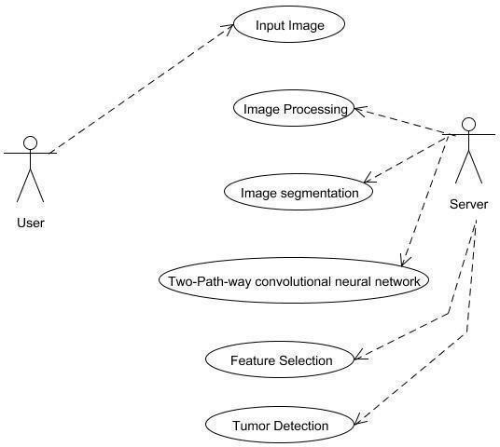
SYSTEM DESIGN
USE CASE DIAGRAM:
A use case diagram is a type of behavioral diagram created from a Use-case analysis. The purpose of use case is to present overview of the functionality provided by the system in terms of actors, their goals and any dependencies between those use cases.

Slide 39
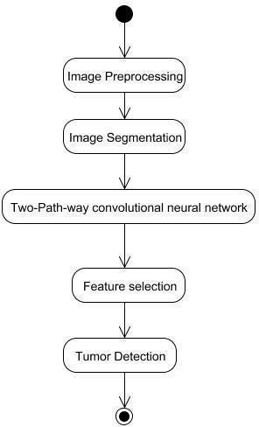
ACTIVITY DIAGRAM:
Activity diagram is a graphical representation of workflows of stepwise activities and actions with support for choice, iteration and concurrency. An activity diagram shows the overall flow of control.

Slide 40
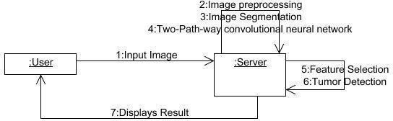
COLLABORATION DIAGRAM:
UML collaboration diagram illustrates the relationship and interaction between software objects. They assume that use cases, system usage contracts and domain models already exist. The collaboration diagram shows the messages sent between the class and the object.

Slide 41
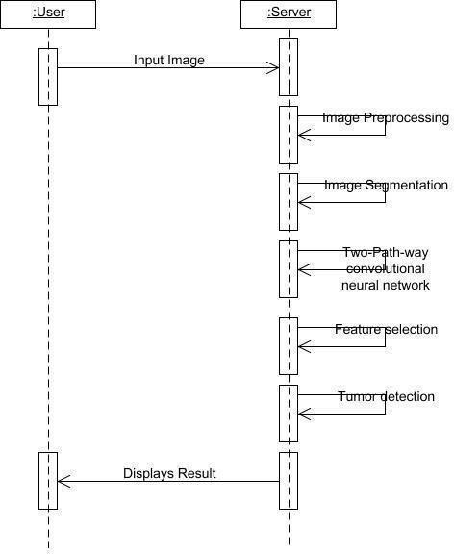
SEQUENCE DIAGRAM:
A sequence diagram is an interaction diagram that shows how and in what order the processes interact. This is the construction of message sequence diagrams, sometimes called event diagrams, event scenarios, and sequence diagrams.

Slide 42
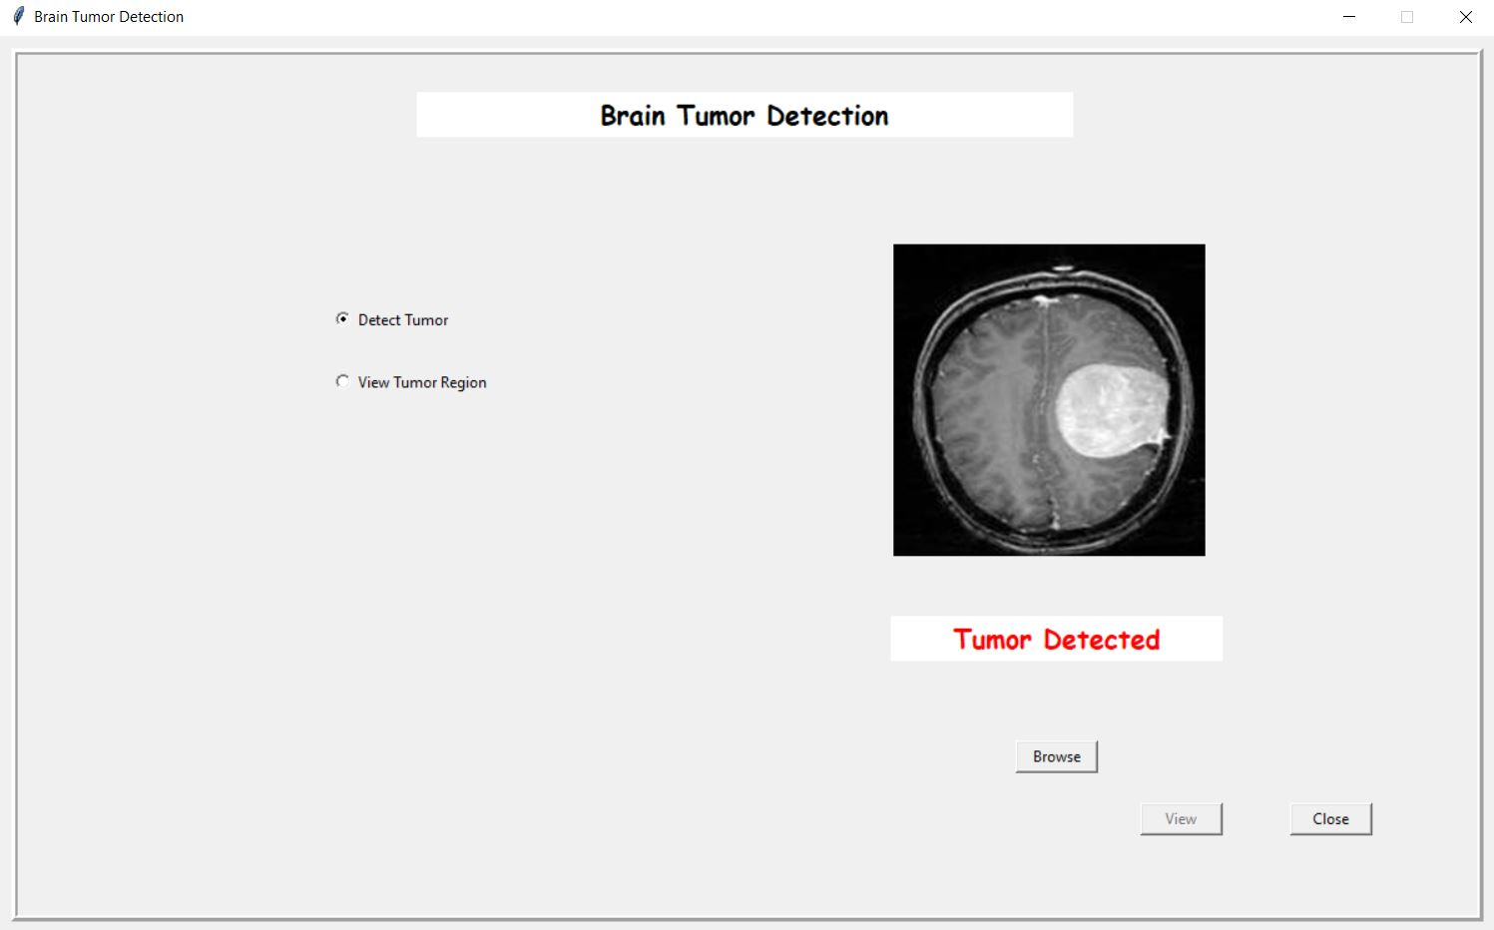
SCREENSHOTS

Slide 43
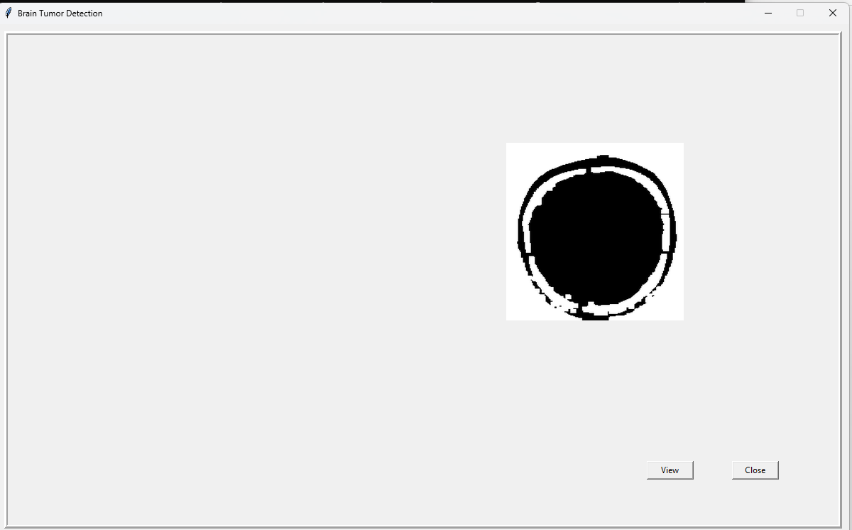
FEATURE EXTRACTION

Slide 44
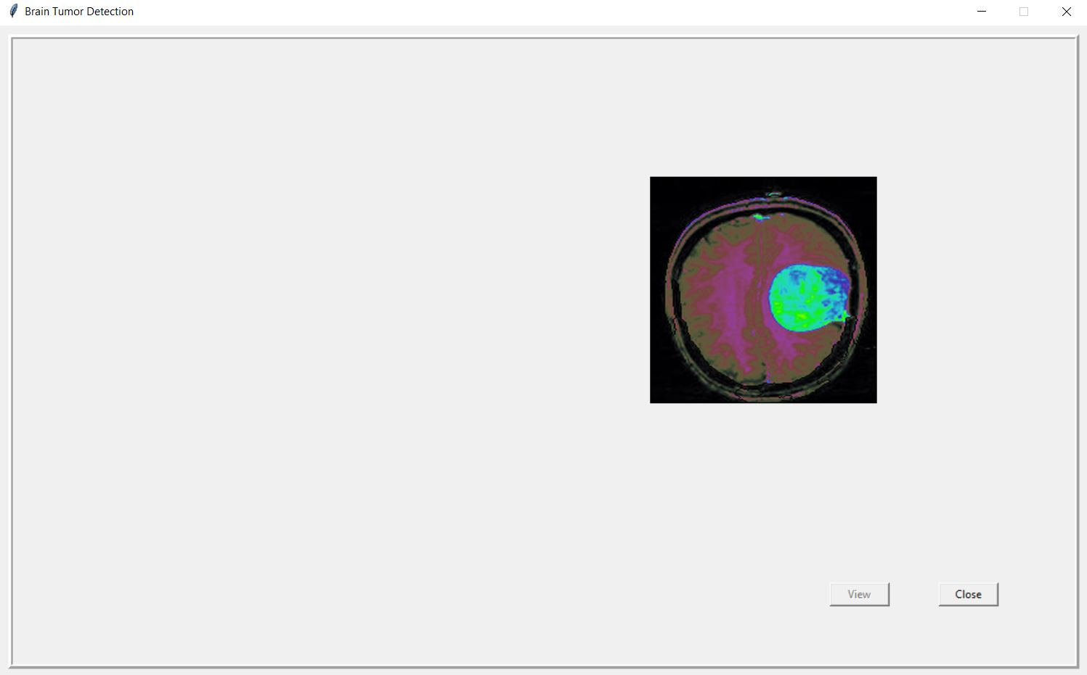
TUMOR REGION

Slide 45
REFERENCES
[1] Abhishek Anil, Aditya Raj, H Aravind Samra, Naveen Chandran Deepa P L,“Brain Tumor detection from brain MRI using Deep Learning” International Journal of Innovative Research in Applied Sciences and Engineering (IJIRASE), Volume 3,Issue 2.
[2] George, Dena Nadir, Hashem B. Jehlol, and Anwer Subhi Abdul Hussein. "Brain Tumor Detection Using Shape features and Machine Learning Algorithms".
[3] Leiner, Tim, et al. "Machine learning in cardiovascular magnetic resonance: basic concepts and applications." Journal of Cardiovascular Magnetic Resonance 21.1 (2019): 61.
[4] Işın, Ali, Cem Direkoğlu, and Melike Şah. "Review of MRI-based brain tumor image segmentation using deep learning methods." Procedia Computer Science 102 (2016): 317-324
[5]Lundervold, Alexander Selvikvåg, and Arvid Lundervold. "An overview of deep learning in medical imaging focusing on MRI." Zeitschrift für Medizinische Physik 29.2 (2019): 102-127.

Slide 46
REFERENCES
[6] Lundervold, Alexander Selvikvåg, and Arvid Lundervold. "An overview of deep learning in medical imaging focusing on MRI." Zeitschrift für Medizinische bPhysik 29.2 (2022): 102-127.
[7] Long, C., Basharat, A., Hoots, A.: A Coarse-to-fine Deep Convolutional Neural Network Framework for Frame Duplication Detection and Localization in Forged Videos, p. 10 (2021).
[8] M. Wu, C. Lin and C. Chang, "Brain Tumor Detection Using ColorBased K- Means Clustering Segmentation," Third International Conference on Intelligent Information Hiding and Multimedia Signal Processing (IIH-MSP2007), Kaohsiung, 2021.
[9] Mohsen, Heba, et al. "Classification using deep learning neuralnetworks for brain tumors." Future Computing and Informatics Journal3.1 (2021): 68-71.
[10] Nogovitsyn, N., et al.: Testing a deep convolutional neural network for automated hippocampus segmentation in a longitudinal sample of healthy participants. NeuroImage 197, 589–597 (2021).

Slide 47
REFERENCES
[11] Sharma, Komal, Akwinder Kaur, and Shruti Gujral. "Brain tumor detection based on machine learning algorithms." International Journal of Computer Applications 103.1 (2021).
[12] Sobhaninia, Zahra, et al. "Brain tumor segmentation using deep learning by type
specific sorting of images." arXiv preprint arXiv:1809.07786 (2020).
[13] Szegedy, C., Vanhoucke, V., Ioffe, S., Shlens, J., Wojna, Z.Rethinking the Inception Architecture for Computer Vision, arXiv:1512.00567 December 2020.
[14] Wang, Guotai, et al. "Interactive medical image segmentation using deep learning with image-specific fine tuning." IEEE transactions on medical imaging 37.7 (2020): 1562-1573.
[15] Zacharaki, E.I., et al.: Classification of brain tumor type and grade using MRI texture and shape in a machine learning scheme. Magn. Reson. Med. 62(6),1609–1618 (2019). https://doi.org/10.100mr.22147.

Slide 48
QUERY

Slide 49
THANK YOU

