Slide 1
Comparison of various trajectory-tracking controllers using UR5 robot
-ADITYA GUPTE , GOKUL NARAYANAN, JOSHUA RAJ, SINAN MORCEL

Slide 2
Introduction: Motivation
Generating Trajectories for manipulators – easy
Tracking trajectories effectively – hard (but also depends)
Unknown Dynamics
Approximate Dynamics
Gravity Compensation
Friction and Actuator Saturation (non-linear terms)
Tuning gains
Singularities

Slide 3
Problem Statement
Comparing the performance of the following controllers
Inverse Dynamic Controller
Baseline for comparison
Robust Feedback Linearization controller
Robust to disturbance (parametric uncertainty)
Passivity Based Controller
Constant bound on the uncertainty
Better Robustness Properties
Reinforcement Learning based controller
model free controller
Benchmark trajectory set
Straight line trajectory
Circular trajectory

Slide 4
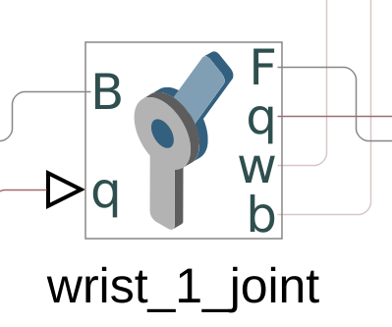
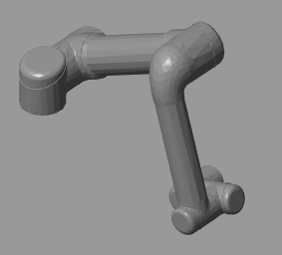
Pipeline
Matlab
ODE Simulation
Simulink
Animation
Matlab
Plots,Videos

Slide 5
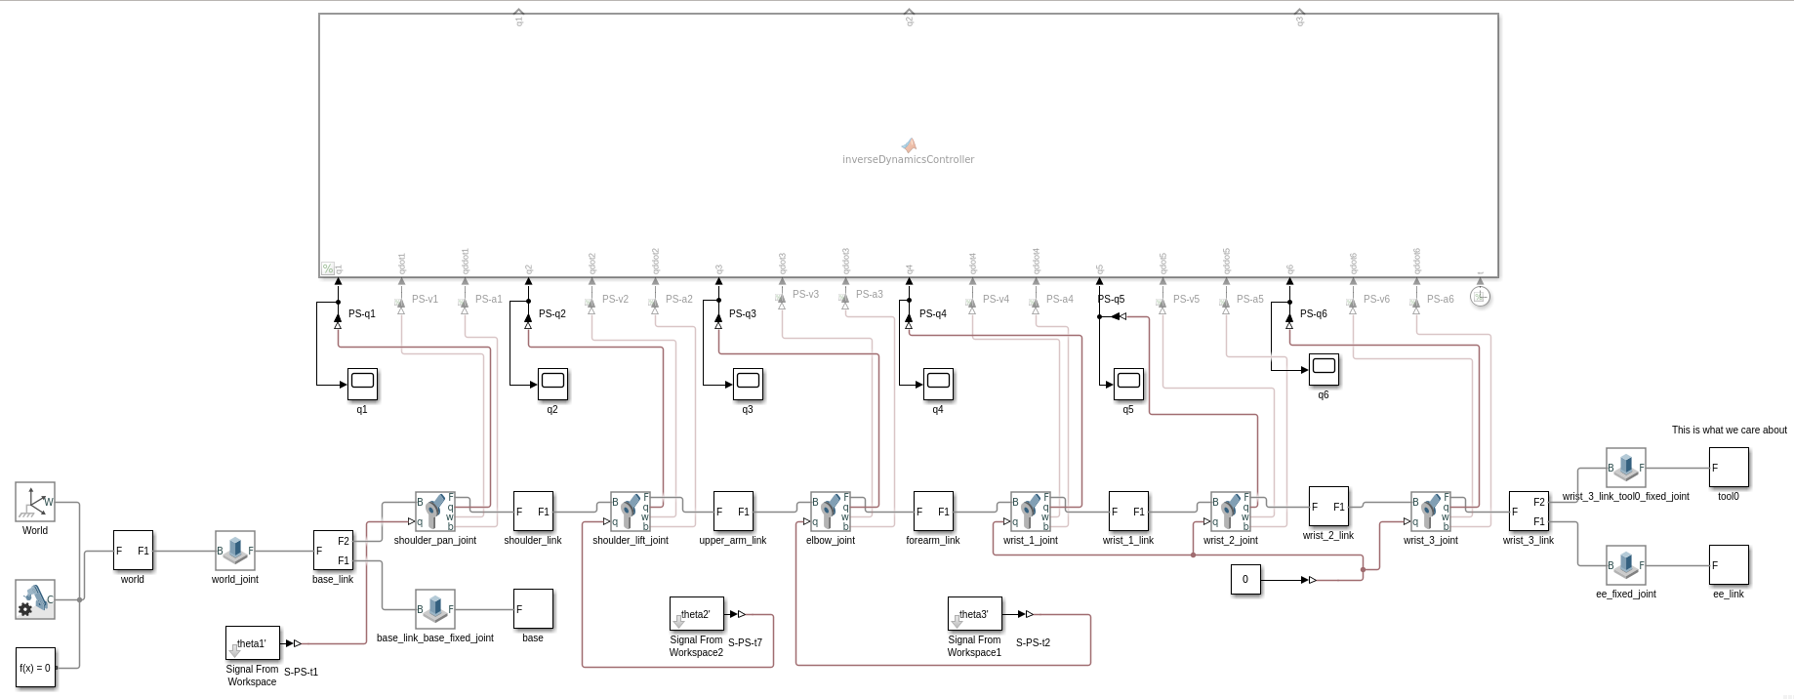
Methodology

Slide 6
Disclaimers
Dynamic model may not be accurate
Considering only position control
Considering errors in the mass of the first 3 links only
Errors random in every iteration
Simulink is only an animation tool
There is loss of time information for the videos

Slide 7
Challenges faced
Dealing with actual system dynamics is difficult.
Actual dynamics not provided but just a URDF
The dynamics you find online are approximations which may not work well with urdf given

Slide 8
So what about the RL controller?
Reinforcement learning based controller. Working with robots rquires to work in continious domain , thus causing us to use function aprroximators.
Traditional Rl uses: tables as approximators
Other fuction approximators used : neural networks, radial basis functions,etc .
Continuous space is always haeder to work with and you should not underestimate the transition

Slide 9
Controllers implemented
Inverse dynamics control in task space.
Passivity based control in task space
Robust feedback Linearization in task space
Passivity based robust control in task space

Slide 10

Inverse Dynamics Controller in Task Space
Dynamic equation of the system:
$$M\left(q\right)\ddot{q}+C\left(q,\dot{q}\right)\dot{q}+g\left(q\right)= τ$$
Compute control input:
$a_{X}=\ddot{X^{d}}+K_{P}\left(X^{d}−X\right)+K_{D}\left(\dot{X^{d}}−\dot{X}\right)$
$a_{q}=J^{−1}\left\{a_{X}−\dot{J}\dot{q}\right\}$
For this controller we need an accurate dynamic model

Slide 11

Passivity Based Control in Task Space
$r_{x}= \dot{e_{x}}+ Λe_{x}$
$$v_{x}= \dot{x_{d}}− Λe_{x}$$
$$a_{x}= \ddot{x_{d}}− Λ\dot{e_{x}}$$
Control Input:
$a_{q}= J^{∗}(a_{q}−\dot{J\left(q\right)v_{q})}$

Slide 12

Robust feedback Linearization in task space
$$a_{X}=\ddot{X^{d}}+K_{P}\left(X^{d}−X\right)+K_{D}\left(\dot{X^{d}}−\dot{X}\right)$$
$$a_{q}=J^{−1}\left\{a_{X}−\dot{J}\dot{q}\right\}+v$$
$v=−ρ\frac{B^{T}Pe}{\left.|B^{T}Pe\right.|}$ if $|\left.|B^{T}Pe\right.||>ε$
$v=$ $−ρ\frac{B^{T}Pe}{ε }$ if $\left|\left.|B^{T}Pe\right.\right||<ε$
$\ddot{q}=a_{q}+η\left(q,\dot{q},a_{q}\right)$ where, $η=M^{−1}\left(\tilde{M}a_{q}+\tilde{C}\dot{q}+\tilde{g}\right)$

Slide 13

Passivity based robust control in task space
$$r_{x}= \dot{e_{x}}+ Λe_{x}$$
$$v_{x}= \dot{x_{d}}− Λe_{x}$$
$$a_{x}= \ddot{x_{d}}− Λ\dot{e_{x}}$$
$$Y=[a_{q}, v_{q},1]$$
Control Input :
$τ=\overline{M} Y\left(1\right)+ \overline{C} Y\left(2\right)+Y\left(3\right)−K_{v}r$
Parameter Update:
$δα= −ρ\frac{ Y^{T}r}{||Y^{T}r||}$ if $\left|\left|Y^{T}r\right|\right|≥ε$
$δα= −ρ\frac{ Y^{T}r}{ε}$ if $\left|\left|Y^{T}r\right|\right|<ε$

Slide 14

Passivity based robust control in task space
$u=\hat{M}\left(q\right)a+C\left(q,\dot{q}\right)v+\hat{g}\left(q\right)−Kr$
Where
$$v=\dot{q^{d}}−Λ\tilde{q}$$
$$a=\dot{v}=\ddot{q^{d}}−Λ\dot{\tilde{q}}$$
$$r=\dot{q^{d}}−v=\dot{\tilde{q}}+Λ\tilde{q}$$
Control input:
$u=−ρ\frac{Y^{T}r}{\left.|Y^{T}r\right.|}$ if $\left.|Y^{T}r\right.|>ϵ$
$u=−\frac{ρ}{ϵ}Y^{T}r$ if $\left.|Y^{T}r\right.|>ϵ$
Here $ρ$ depends only on Inertia parameters. Hence the design

Slide 15
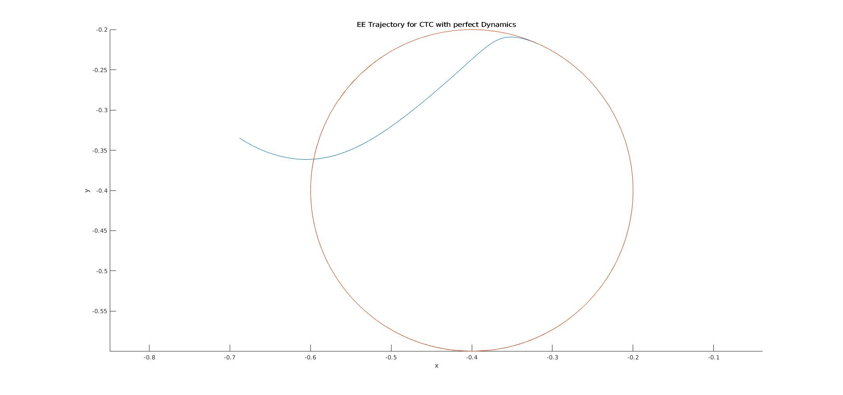
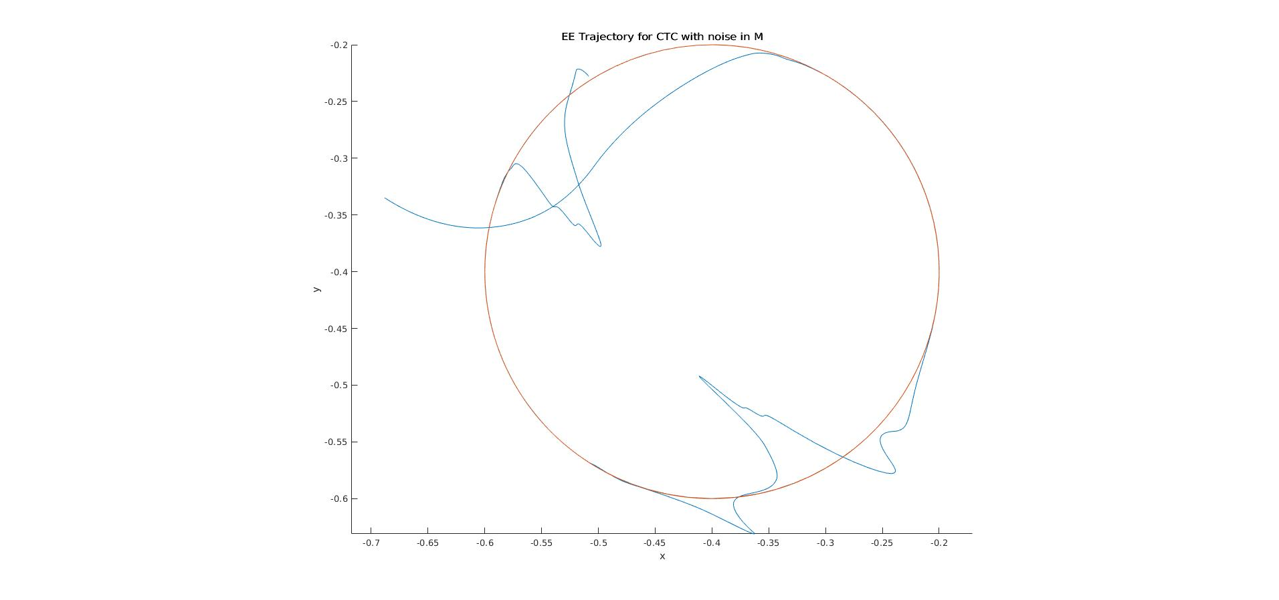
Results – Circular trajectory
Inverse Dynamic Controller
Perfect Dynamics
Imperfect Dynamics

Slide 16
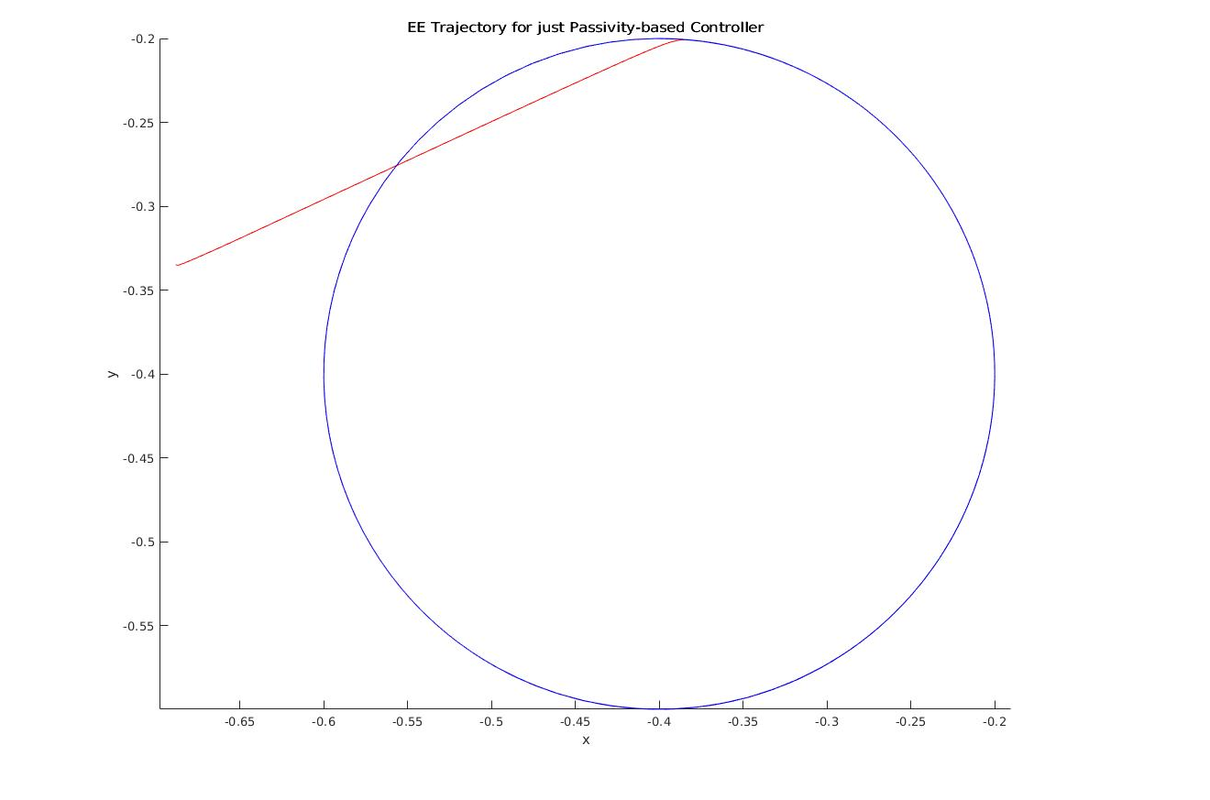
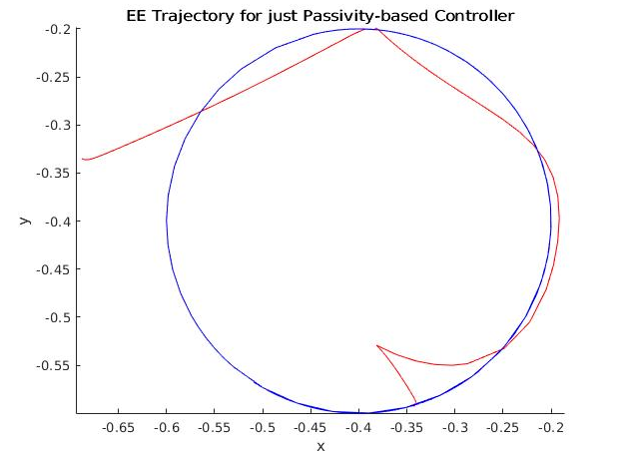
Results
Passivity Based Controller
Perfect Dynamics
Imperfect Dynamics

Slide 17
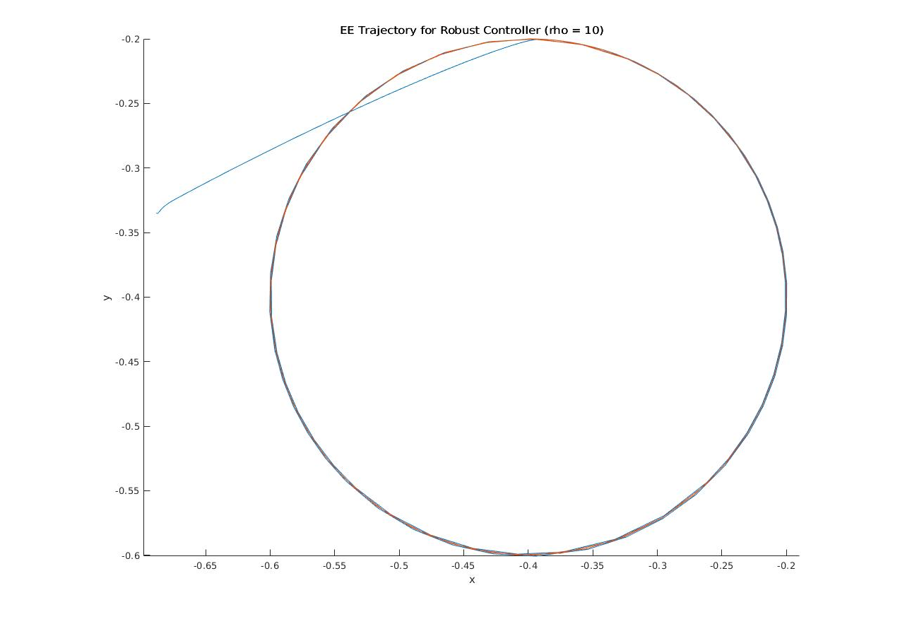
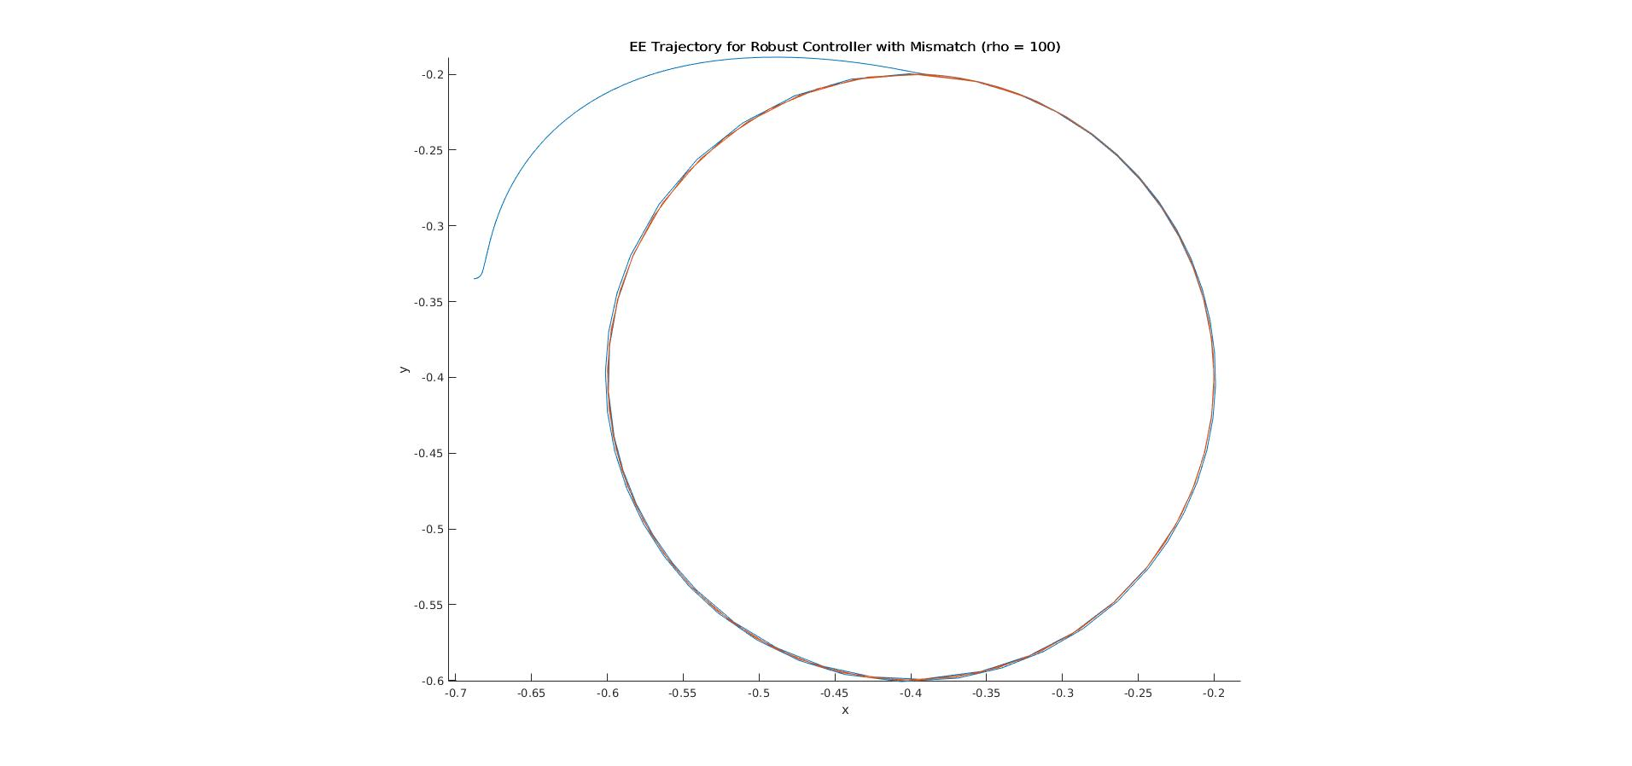
Results
Robust Controller
Perfect Dynamics
Imperfect Dynamics

Slide 18
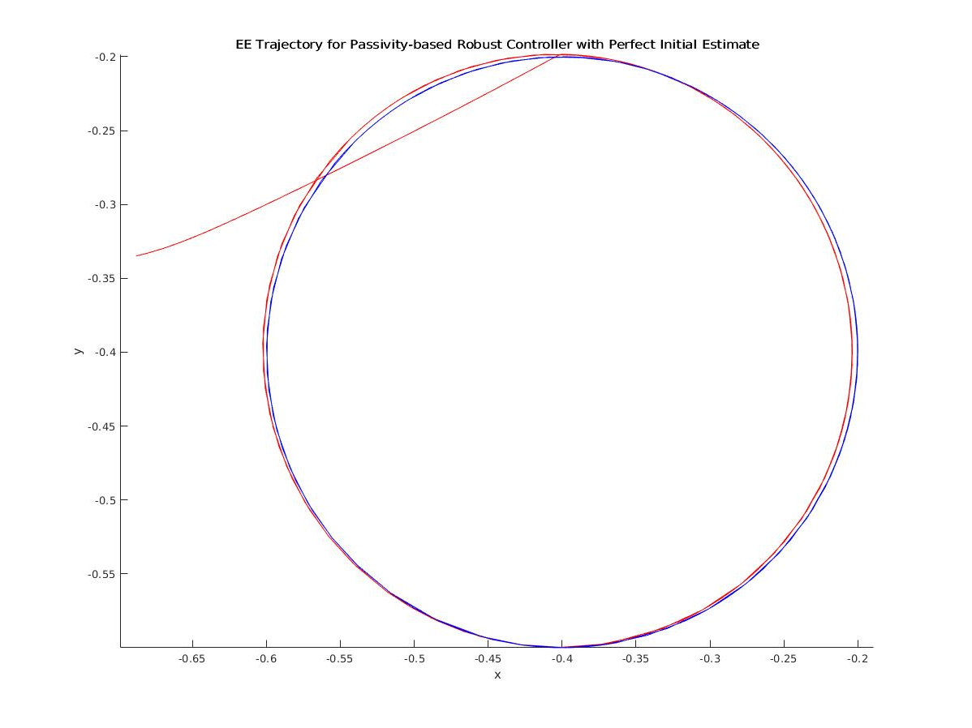
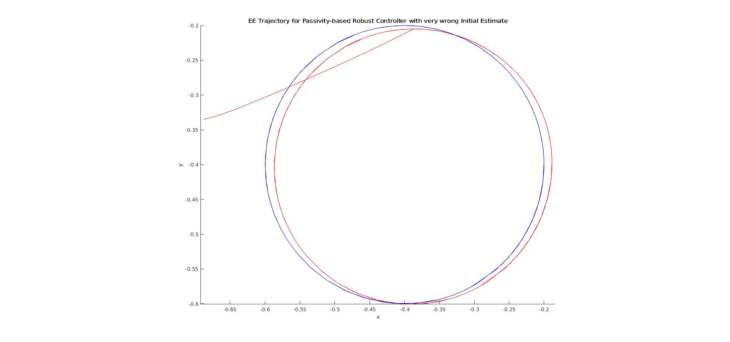
Results
Passivity based Robust Controller
Perfect Dynamics
Imperfect Dynamics

Slide 19
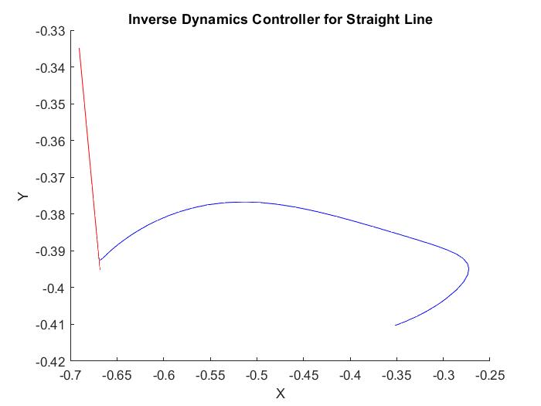
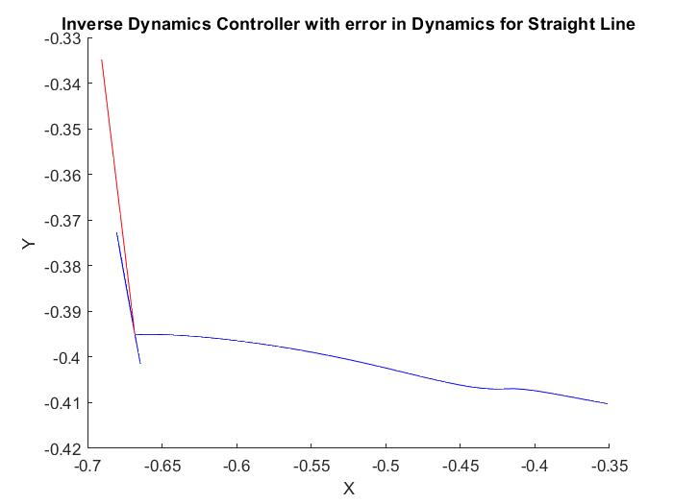
Results – Straight Line trajectory
Inverse Dynamics Controller
Perfect Dynamics
Imperfect Dynamics

Slide 20
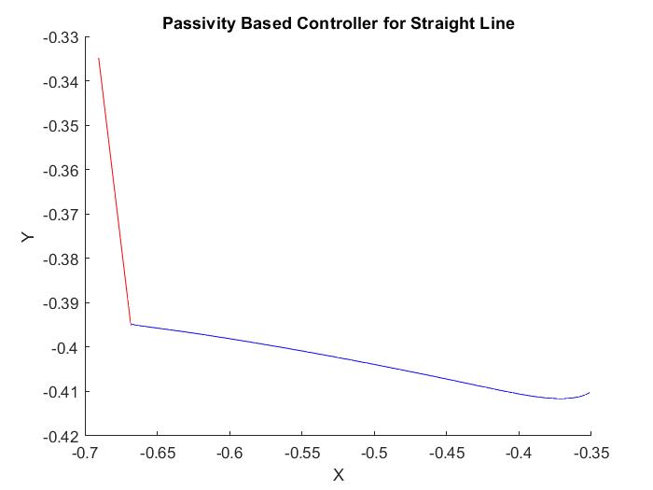
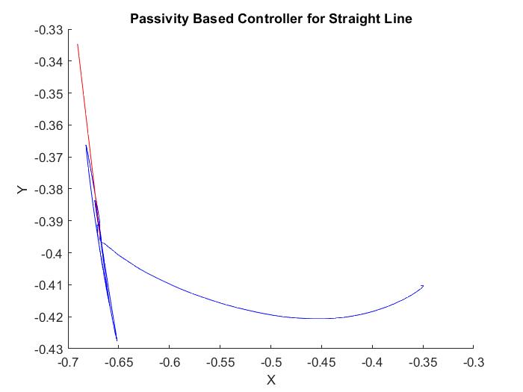
Results
Passivity Controller
Perfect Dynamics
Imperfect Dynamics

Slide 21
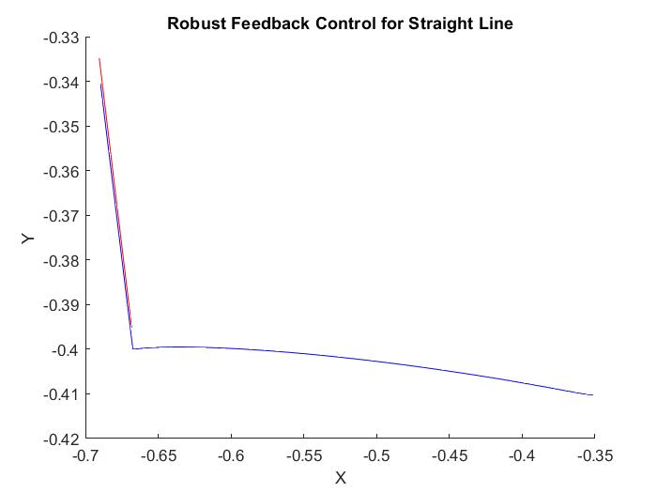
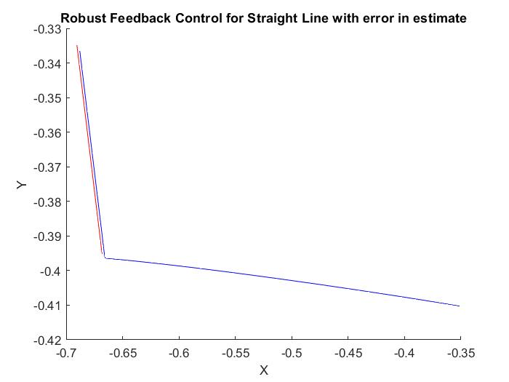
Results
Robust Controller
Perfect Dynamics
Imperfect Dynamics

Slide 22
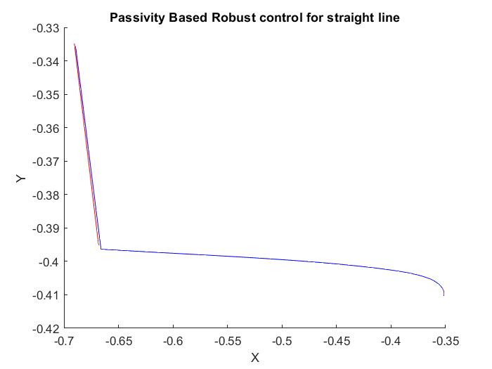
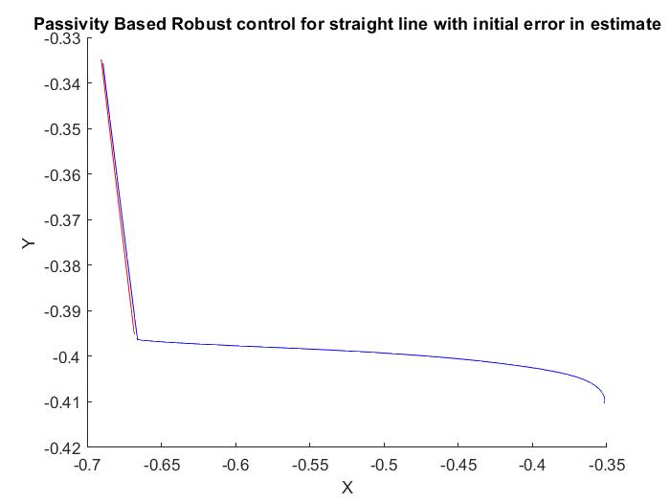
Results
Passivity Based Robust Controller
Perfect Dynamics
Imperfect Dynamics

Slide 23




VIDEOS
Quetions?
Thank You!

Slide 24
Discussion

