Slide 1
TEXTILE SHOP

Slide 2
ABSTRACT
The Textile management system application is developed for managing the textile shop.
How to manage the textile shop in a good manner.
How the things is proper in the shopping mall, what is the input in the shopping mall and what is the output how to track the goods are available there or which is sort.
All this is auto track by the application from which there will be no any difficulties facing by the management after all there are certain report generation based on the shopping mall daily turnover, monthly turnover etc .

Slide 3
Hardware Specification
PROCESSOR - PENTIUM-III
Speed - 1.1 GHz
Ram - 256 MB (min)
Hard Disk - 20 GB

Slide 4
Software Specification
Operating System :Windows 8/9/10
Application Server :Tomcat5.0/6.X
Front End :Java
Database :Mysql

Slide 5
EXISTING SYSTEM
The existing system the users very hard to maintain the textile shop.
We can’t calculate the amount of dress or material details manually.
Sometimes it makes confusing to find the dress rates it may cause big issue.

Slide 6
Disadvantages:
All works are manually implemented.
Changes to make mistakes in calculations.

Slide 7
PROPOSED SYSTEM
The purpose of the project is to develop a ‘Textile management system’, which will be used by the company through which all purchase details of textile can be managed by the company.
The system deals with very popular interface tool retrieval of the record is which faster than the present system.
Hence it cause to saving time for the further work.

Slide 8
Advantages:
Searching features is quite faster.
Attractive user interface.
Billing details very easy to handle

Slide 9
MODULES
Admin module
Customer module
Purchase module
Sales module
Billing module
Stock module

Slide 10
Admin Module:
Managing the whole work of our textile.
He is responsible person for maintaining the customer details , purchase order details , sales and billing.
Customer Module:
A Customer module is used to store the customers details in this module. We can search the customer details immediately.
We can managing the history of customers details which is helpful to find our regular customer.

Slide 11
Purchase module:
This modules contains are user purchase the item details maintained.
It includes are item name, purchasing date, no of quantity, rate details and so on.
Sales module:
This module has been used when the manager submit the billing after collecting the money.
This modules helps to calculate the stock and billing details. This module has contain dress and customer details.
.

Slide 12
Billing module:
Billing module is an output of our application also its an main module. This will generate the date wise bill details.
Also it will shown the customer details who is purchasing and how much they were purchasing.
Stock module:
Stock module has details of available stock.
With item , batch price and quantity details.
It also has details of sold stock details.
Using this details we can put more purchase order if we want.

Slide 13
Data Flow Diagram
Level 0

Slide 14
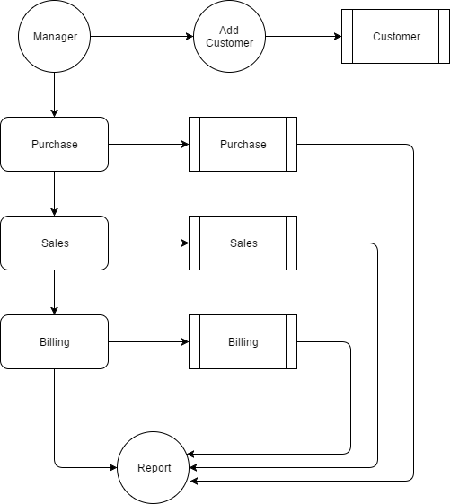
LEVEL 1:

Slide 15
Table : Admin
Primary key : Id
FIELD | DATA TYPE | SIZE
Id | Int | 8
User name | Varchar | 20
password | Varchar | 8

Slide 16
Table : Customer primary key: customer Id
FIELD | DATA TYPE | SIZE
Customer Id | Int | 10
Customer name | Varchar | 20
Address | Varchar | 20
Phone number | Int | 10
Pin code | Int | 6

Slide 17
Table : Product Primary key : product id
FIELD | DATA TYPE | SIZE
Product id | Int | 10
Company name | Varchar | 20
Brand | Varchar | 20
Product name | Varchar | 20
Price | Int | 7

Slide 18
Table : Purchase Primary key: Purchase id
FIELD | DATA TYPE | SIZE
Purchase id | Int | 10
Product name | Varchar | 20
Quantity | Int | 10
Company name | Varchar | 20
Brand | Varchar | 20
Price | Int | 7

Slide 19
Table : Sales Primary key: Sales id Foreign key : Customer id
FIELD | DATA TYPE | SIZE
Sales id | Int | 10
Customer id | Int | 10
Phone number | Int | 10
Customer name | Varchar | 20
Address | Varchar | 20
Pin code | Int | 6
Product name | Varchar | 20
Quantity | Int | 10
Company name | Varchar | 20
Brand | Varchar | 20
Price | Int | 7
Total amount | Int | 7

Slide 20
Table : Billing
FIELD | DATA TYPE | SIZE
Date | Date/time
Customer name | Varchar | 20
Company name | Varchar | 20
Brand | Varchar | 20
Product name | Varchar | 20
Price | Varchar | 7
Quantity | Int | 10
Total amount | Int | 7
Billing id | Int | 8

Slide 21
Table : Stock
FIELD | DATA TYPE | SIZE
Stock id | Int | 10
Company name | Varchar | 20
Brand name | Varchar | 20
Product name | Varchar | 20
Price | Int | 7
Stock | Int | 20

Slide 22
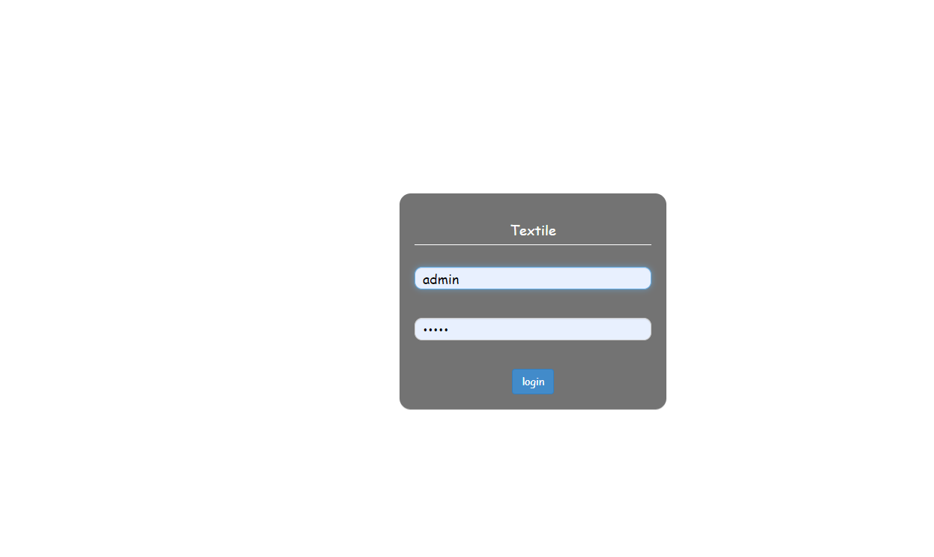
FORM DESIGN

Slide 23
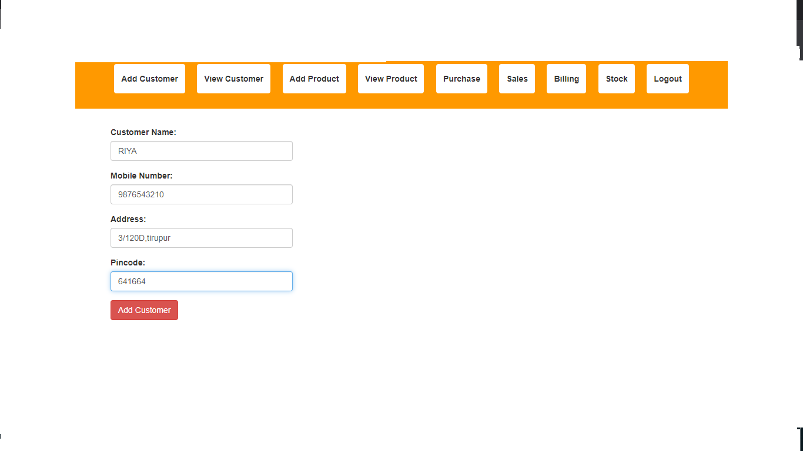
ADD CUSTOMER

Slide 24
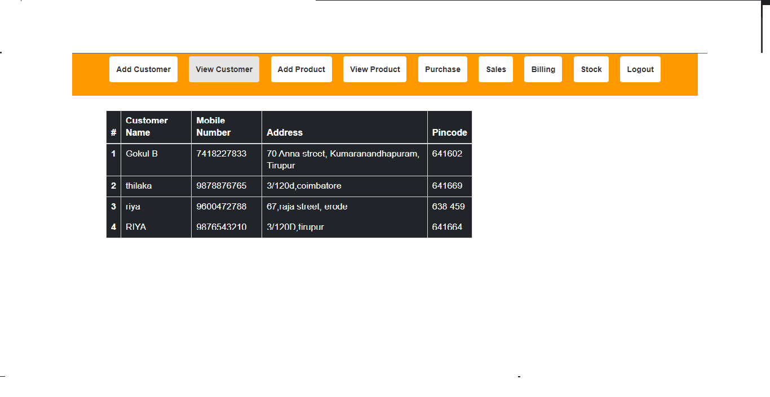
VIEW CUSTOMER

Slide 25
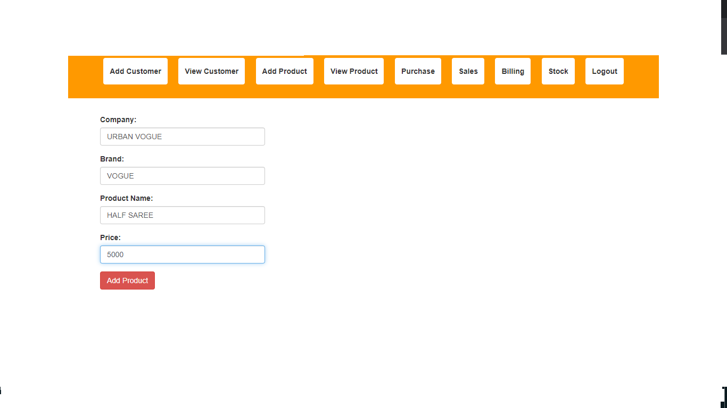
ADD PRODUCT

Slide 26
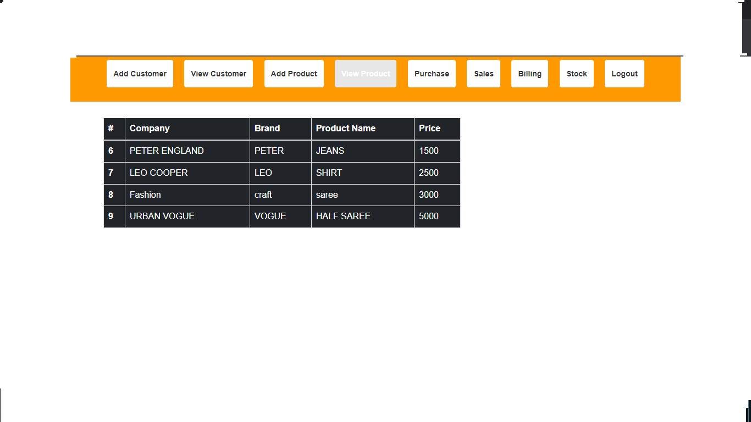
VIEW PRODUCT

Slide 27
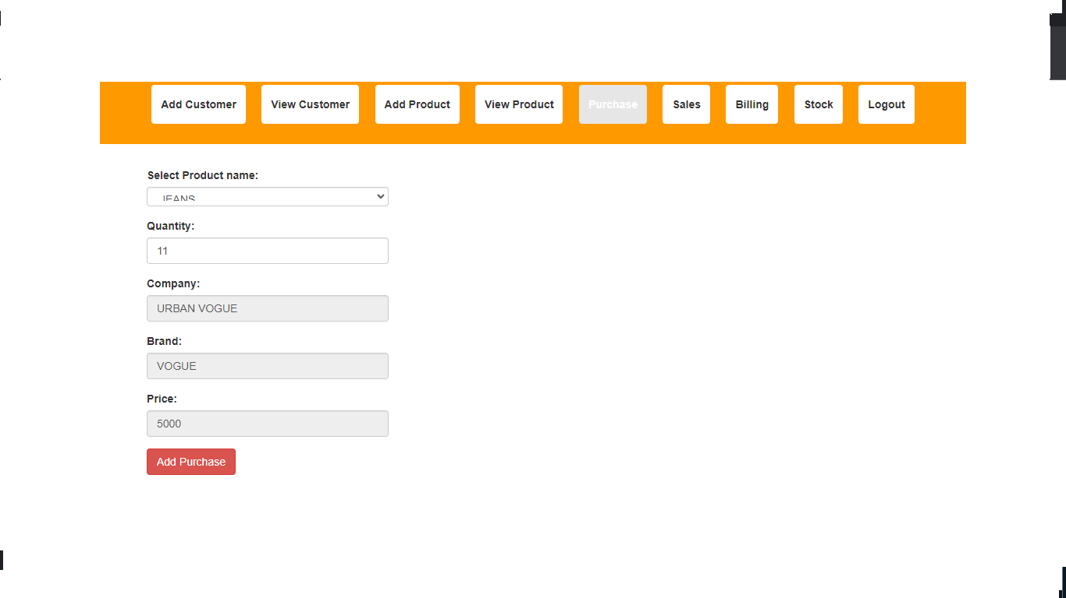
PURCHASE

Slide 28
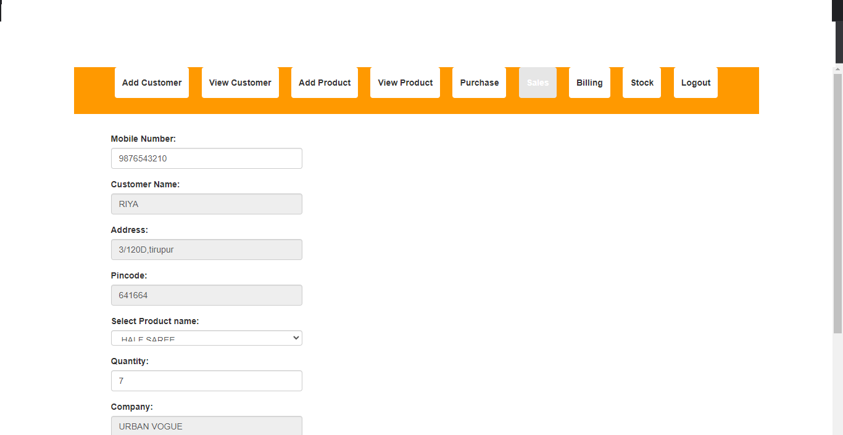
SALES

Slide 29
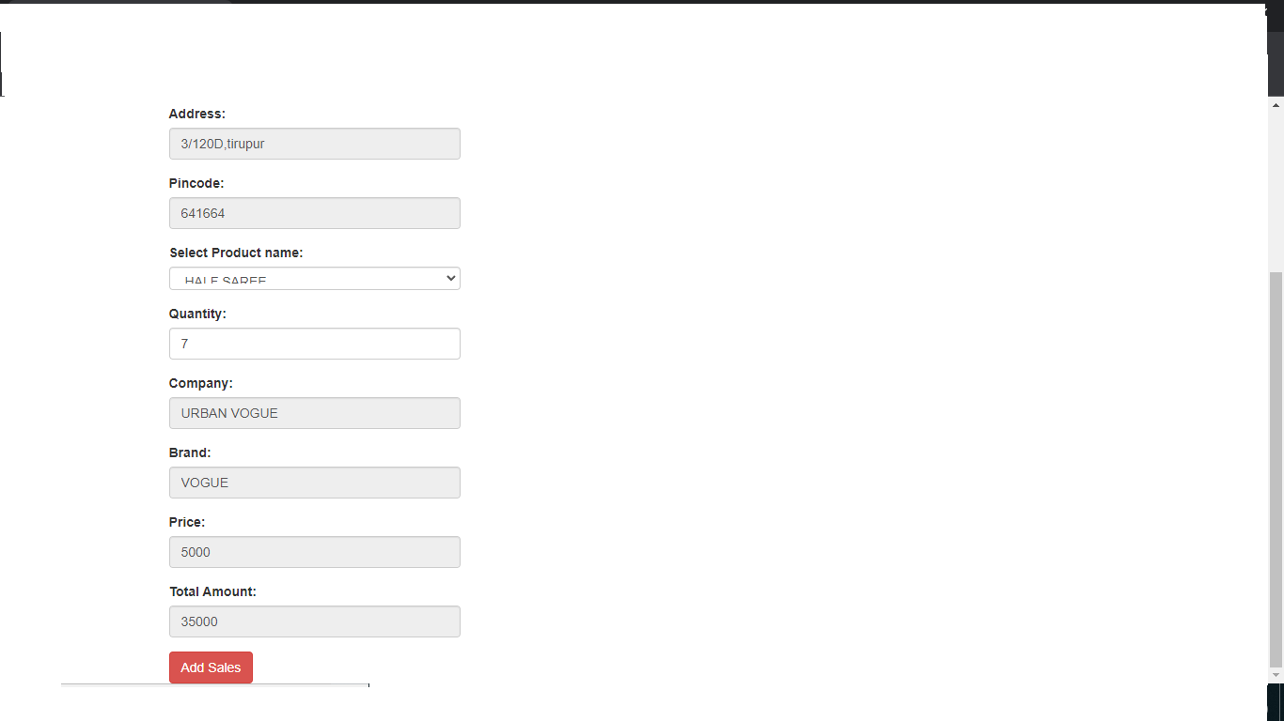

Slide 30
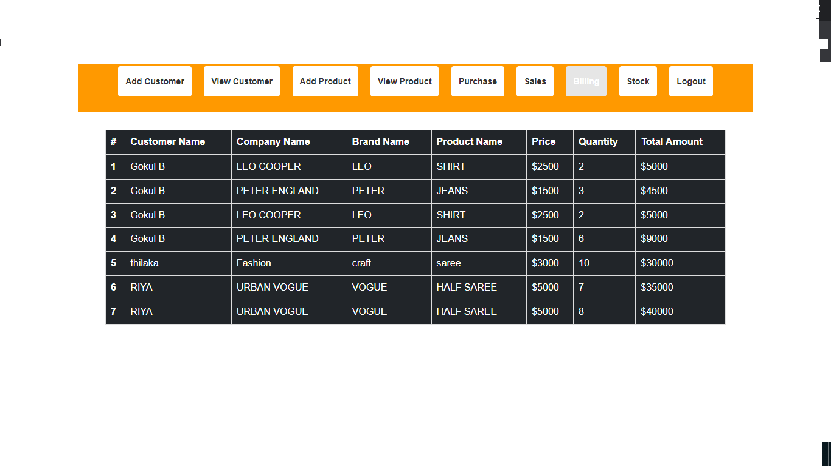
BILLING

Slide 31
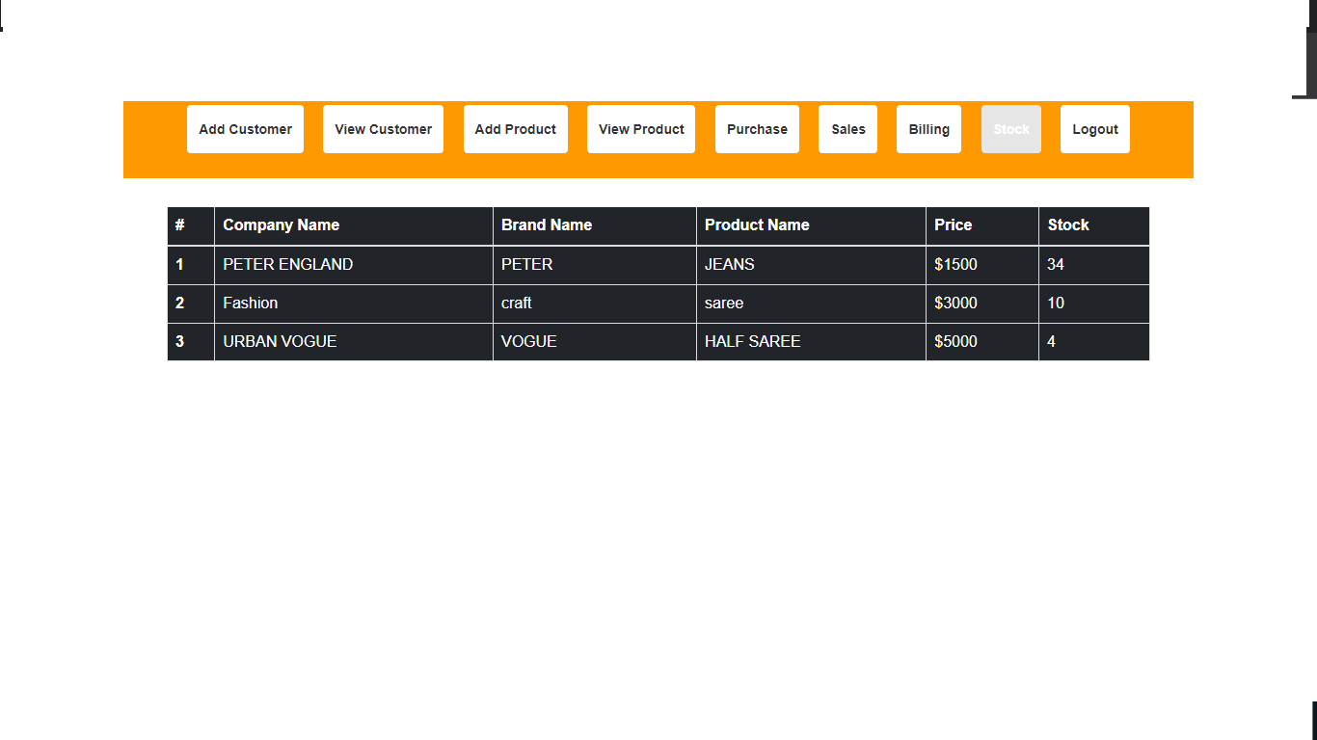
STOCK

Slide 32
Thank you.....

