Slide 1
TEXTILE SHOP

Slide 2
ABSTRACT
The Textile management system application is developed for managing the textile shop. This project is made in JAVA and the back end used is MYSQL server. The idea of textile shop development is how to manage the textile shop in a good manner or we can say managing the textile shop well from which people can get profit or just stay out from the difficulties, how the things is proper in the shopping mall, what is the input in the shopping mall and what is the output how to track the goods are available there or which is sort.
All this is auto track by the application from which there will be no any difficulties facing by the management after all there are certain report generation based on the shopping mall daily turnover, monthly turnover etc .

Slide 3
Hardware Specification
PROCESSOR - PENTIUM-III
Speed - 1.1 GHz
Ram - 256 MB (min)
Hard Disk - 20 GB

Slide 4
Software Specification
Operating System :Windows 8/9/10
Application Server :Tomcat5.0/6.X
Front End :Java
Database :Mysql

Slide 5
EXISTING SYSTEM
The existing system the users very hard to main the textile shop. We can’t know about the textile dress or material details manually. Sometimes it makes confusing to find the dress rates it may cause big issue.

Slide 6
Disadvantages:
Very hard to find the cost of dress.
All works are manually implemented.
Man power works too hard

Slide 7
PROPOSED SYSTEM
The purpose of the project is to develop a ‘Textile management system’, which will be used by the company through which all purchase details of textile can be managed by the company. The system deals with very popular interface tool retrieval of the record is which faster than the present system. Hence it cause to saving time for the further work.

Slide 8
Advantages:
Searching features is quite faster than.
Attractive user interface.
Billing details very easy to handle

Slide 9
MODULES
Customer Module:
A Customer module is used to store the customers details in this module. We can search the customer details immediately. We can managing the history of customers details which is helpful to find our regular customer.
Manager Module:
This module manager can enter username and password and login their module. Manager can only added their regular customer. After login only we can access this software otherwise we can’t access.

Slide 10
Purchase:
This modules contains are user purchase the item details maintained. It includes are item name, purchasing date, no of quantity, rate details and so on.
Sales:
This module has been used when the manager submit the billing after collecting the money. This modules helps to calculate the stock and billing details. This module has contain dress and customer details.
Billing:
Billing module is an output of our application also its an main module. This will generate the date wise bill details. Also it will shown the customer details who is purchasing and how much they were purchasing.

Slide 11
Data Flow Diagram
Level 0

Slide 12
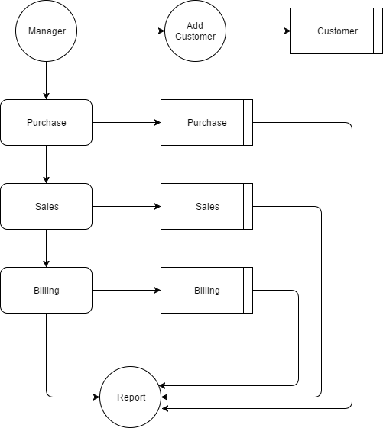
LEVEL 1:

Slide 13
Table : Admin
FIELD | DATA TYPE | SIZE | CONSTRAINT
Id | Int | 10 | Primary key
Username | Varchar | 30 | Foreign key
password | Varchar | 30 | Foreign key

Slide 14
Table : Customer
FIELD | DATA TYPE | SIZE | CONSTRAINT
Customer id | Int | 10 | Primary key
Name | Varchar | 30 | Not Null
Address | Varchar | 30 | Not Null
Contactno | Varchar | 10 | Not Null
Gender | Varchar | 10 | Not null
Email | Varchar | 10 | Not null

Slide 15
Table : Product
FIELD | DATA TYPE | SIZE | CONSTRAINT
Product_id | Int | 10 | Primary key
Company | Varchar | 10 | Not Null
Model | Varchar | 30 | Not Null
Price | Int | 10 | Not Null

Slide 16
Table : Purchase
FIELD | DATA TYPE | SIZE | CONSTRAINT
Purchase Id | Int | 10 | Primary key
Model Id | Int | 10 | Not Null
Model name | Varchar | 10 | Not Null
Quantity | Int | 10 | Not Null
Date | Varchar | 15 | Not null

Slide 17
Table : Sales
FIELD | DATA TYPE | SIZE | CONSTRAINT
Sales Id | Int | 10 | Primary key
Customer Id | Int | 10 | Foreign key
Model Id | Int | 10 | Foreign key
Model Name | Varchar | 10 | Not Null
Quantity | Int | 10 | Not null
Date | Varchar | 15 | Not null

Slide 18
Thank you.....

