Slide 1
MUNICIPAL CORPORATION MANAGEMENT SYSTEM

Slide 2
ABSTRACT
The common people under the jurisdiction of a municipal corporation to register their grievances about day-to-day problems in their ward through a web application.
It will provide a common man to deliver his complaints and problems to municipal authority as well as let the municipal authorities to address the problem in a short period of time.
An interface to register one’s complained and follow it up. It provides a complaint module which helps clicking up a picture of any problem that people are facing and upload its image along with the complaint. In India we don’t have any direct communication between the government and public in an efficient way for solving the problems.
I.e., for getting a problem solved in our place we have to bribe the officials and get them solved in 2 months which can be solved actually in 1 month of time.
In order to make the goal of NIC come true we are going to develop a system which will be able to provide the complete information to the public at any point of time regarding the problems.
They are facing currently and what is the impact of it and then how effectively the funds are utilized for the development purpose can be known by public which also includes the online discussion forums and feedback forms which will help them to communicate well with the government.

Slide 3
OBJECTIVE
The Online Complaint Management System provides a website solution for community issues by saving time.

Slide 4
HARDWARE SPECFICATION
Processor : P 4 700 GHz.
RAM : 4 GB RAM
Hard Disk Drive : 180 GB

Slide 5
SOFTWARE SPECIFICATION
Operating System : Windows 7/8/10
Front End : JAVA
Back End : SQL

Slide 6
EXISTING SYSTEM
The existing system of municipal corporation for difficult to handle the peoples issue without any software. There’s a lot of complaints and issues are possible to happen in day-to-day life. The municipal corporation team can’t handle all the process without any struggle.
DISADVANTAGES
Sometimes we can’t handle the issue
No records can be track
Lot of issues can face everyday

Slide 7
PROPOSED SYSTEM
In this system will over come the existing issues, in this software can manage the citizen details, complaints everything. Citizen’s are manually can check the status of the complaint via this application. Which ma help to change all the irregular process of the government. Most of the peoples can get benefit for this application.
ADVANTAGES
Track the status of the requested issue
We can get the solution in a proper way
Can avoid the waiting time for in a long in queue, for raising complaint in a government office.

Slide 8
Modules
New Citizens Registration
Apply Complaint Request
View Complaints
View All Citizens Details
Apply Request Actions

Slide 9
New Citizen Registration
This module the citizens are manually visit the page and give the details and register manually.
We can collect the citizen some unique and important information from this application.
Once the request has been submitted the admin can handle the approve.
Apply Complaint Request
After the login for citizen, raise the complaint we just collect the issue as complaint and raised the issue.
This notification will send to the admin portal. Can also check the status of the current process of the issue.
View Complaints
Once the admin portal has been viewing the requested information is completed, then admin changed the status of the process.
We can check the admin status as a point of important time.

Slide 10
View All citizen details
Admin can check the citizen details in the portal, only admin can see the details of the other citizen, only citizen can check the profile itself.
Apply request actions
Once the admin gets take an action for the issue, has to change the status as in progress, completed. Which mean user can easily identify the status of the issue.

Slide 11
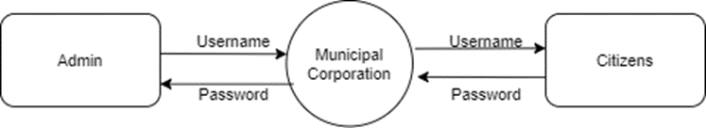
Data Flow Diagram
Level 0

Slide 12
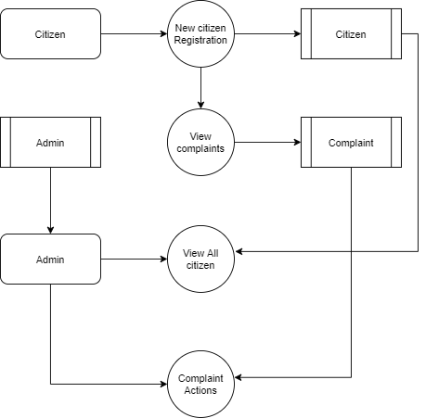
Level 1:

Slide 13
TABLE DESIGN
TABLE NAME: ADMIN
FIELD | DATATYPE | SIZE | CONSTRAINT
Admin id | int | 10 | Primary key
Admin name | varchar | 30 | Not null
Admin mobile | int | 10 | Not null
Password | varchar | 20 | Not null
address | varchar | 50 | Not null

Slide 14
TABLE NAME :CITIZEN
FIELD | DATATYPE | SIZE | CONSTRAINT
Citizen id | int | 10 | Primary key
First name | varchar | 20 | Not null
Last name | Varchar | 20 | Not null
Mobile | Int | 10 | Not null
Full address | Varchar | 50 | Not null
City | Varchar | 20 | Not null
State | Varchar | 20 | Not null
Pincode | int | 6 | Not null

Slide 15
TABLE NAME: COMPLAINT
FIELD | DATATYPE | SIZE | CONSTRAINT
Complaint id | int | 10 | Primary key
Citizen id | int | 10 | Foreign key
Mobile | int | 10 | Not null
Complaint | Varchar | 50 | Not null
Full address | Varchar | 50 | Not null
Complaint reason | Varchar | 20 | Not null
Current status | Varchar | 10 | Not null

Slide 16
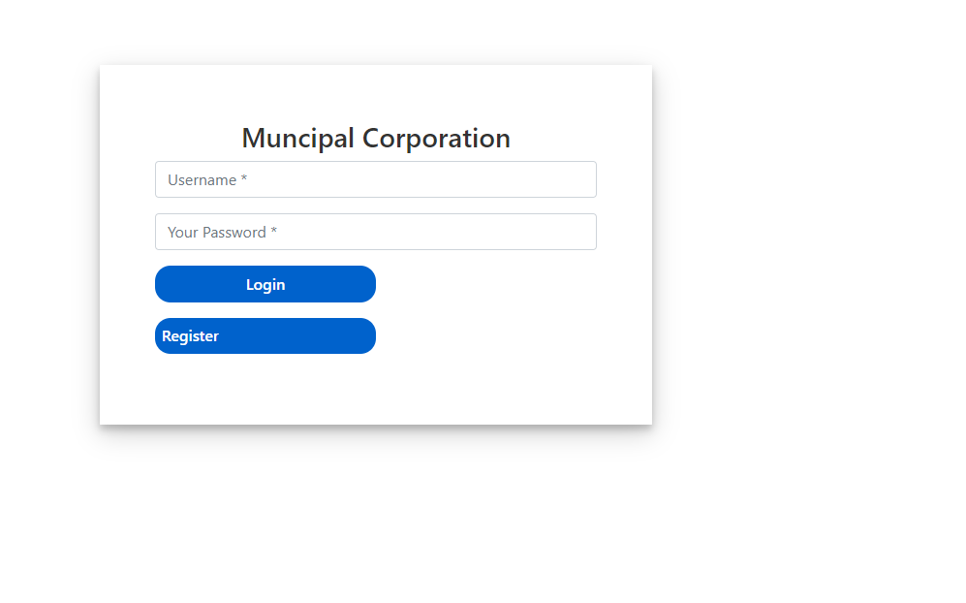
FORM DESIGN

Slide 17
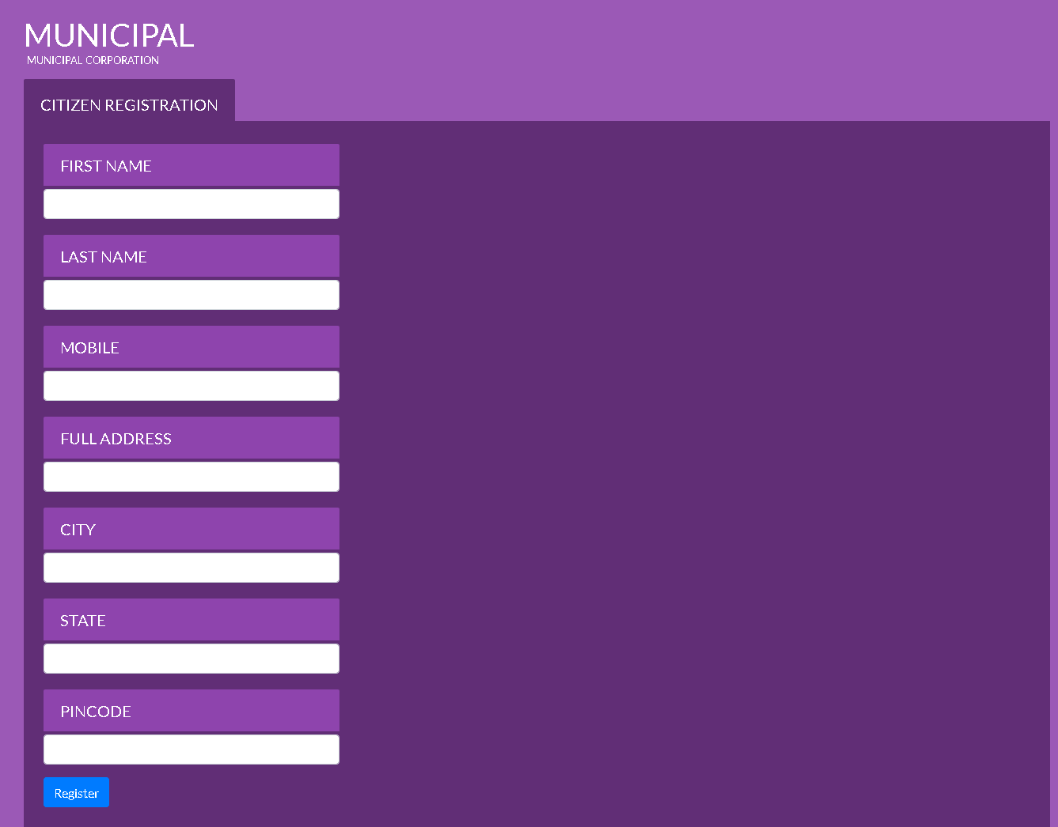

Slide 18
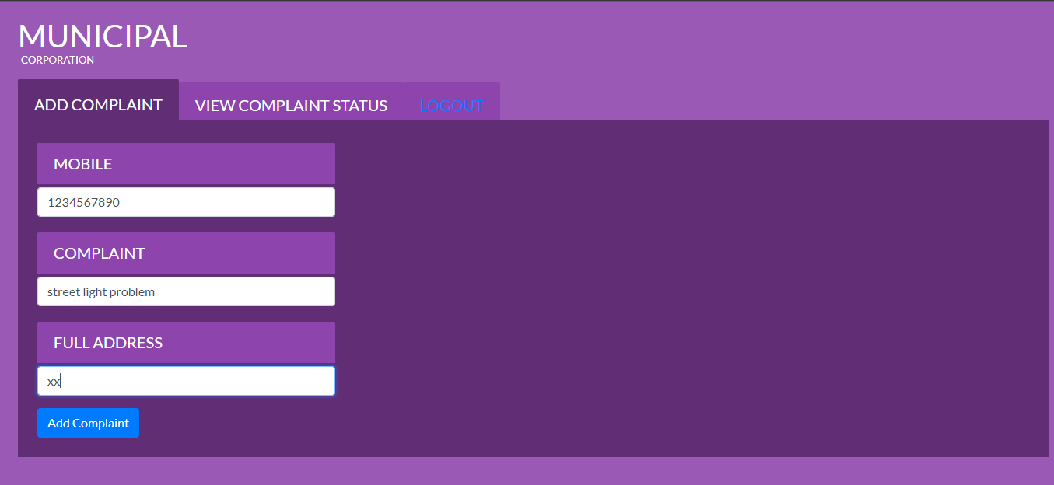

Slide 19
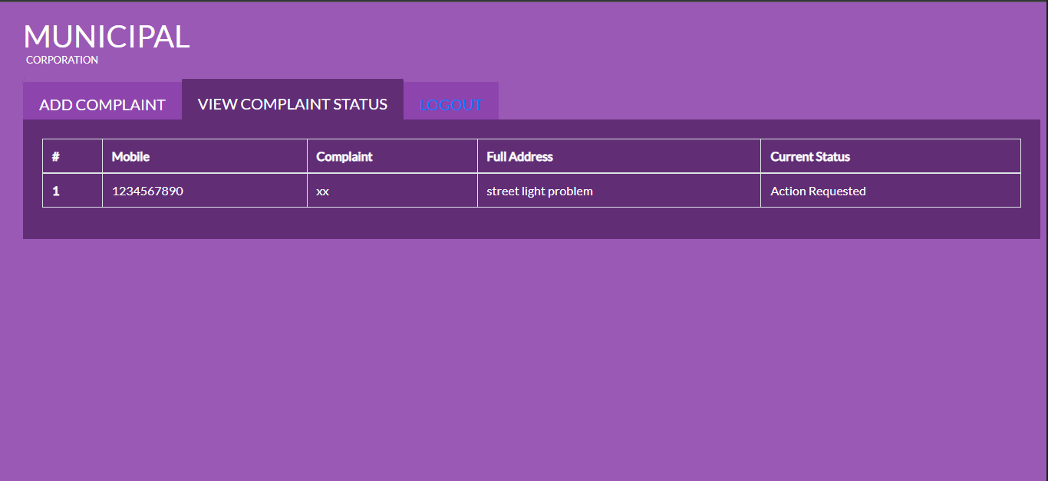

Slide 20
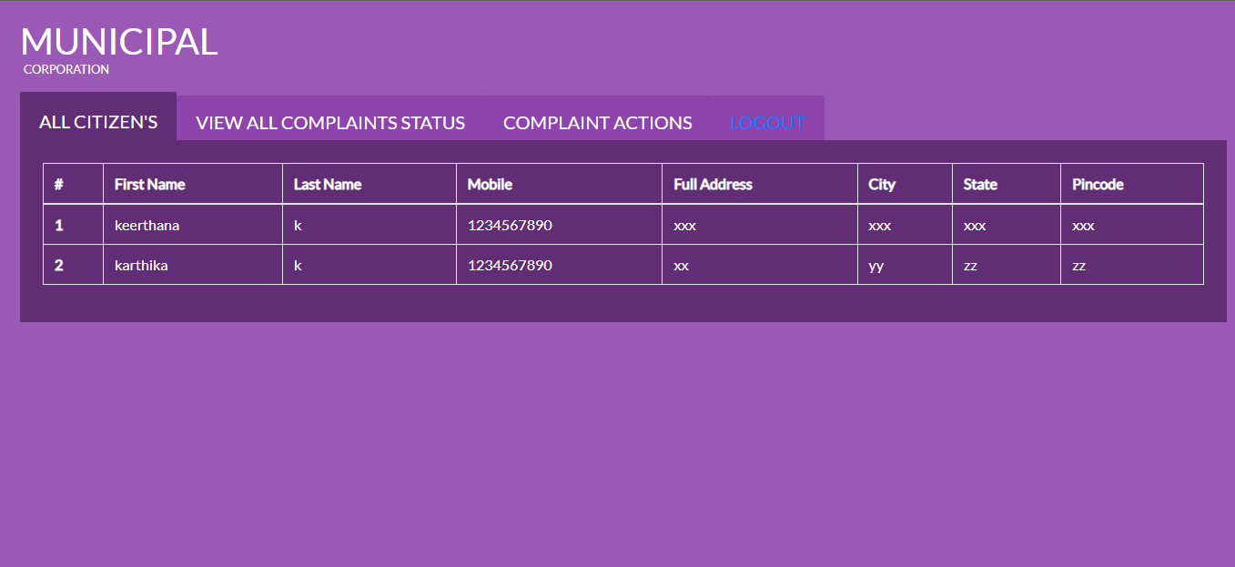

Slide 21
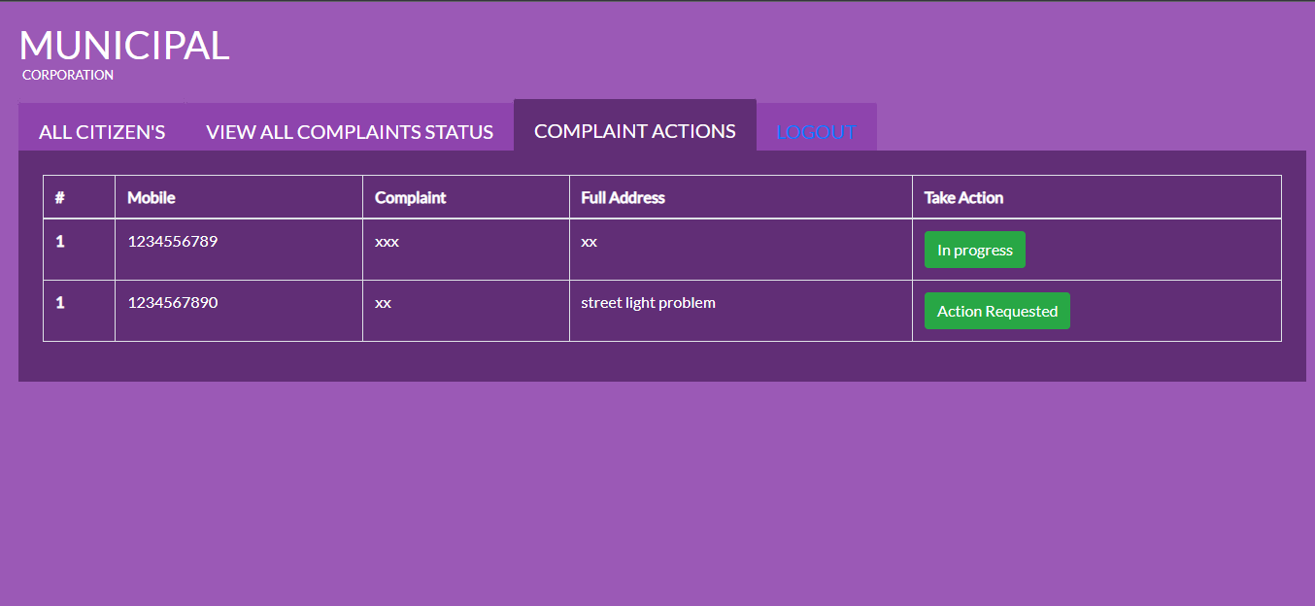

Slide 22
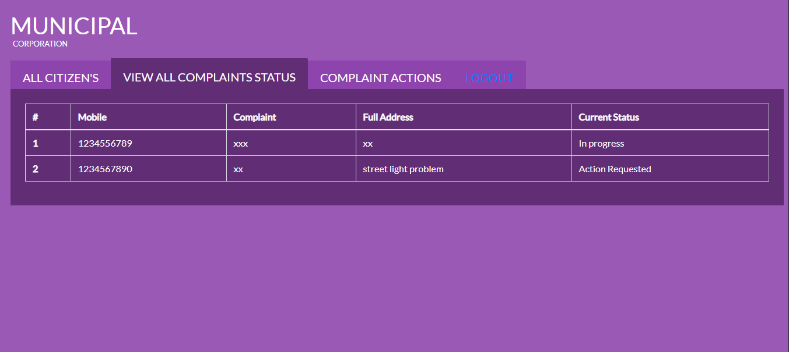

Slide 23
Thank You........

