Slide 1
PARKING MANAGEMENT SYSTEM
LRG GOVERNMENT ARTS COLLEGE FOR WOMEN
KAVITHA M, ||| BSC COMPUTER SCIENCE
GUIDE NAME : Mrs .KOMALA VALLI MSC...MPhil…

Slide 2
OUTLINE
ABSTRACT
OBJECTIVE
EXISTING SYSTEM
MODULES
DATA FLOW DIAGRAM

Slide 3
ABSTRACT
The proposed project is a parking system that provides institutes user an easy way of reserving a parking space using application. It overcomes the problem of finding a parking space in bike stand/organization areas that unnecessary consumes time. Hence, this project offers a system application where user can view various parking spaces and select nearby or specific area of their choice to view whether space is available or not. If the booking space is available, then user can book it for specific time slot. The booked space will be marked and will not be available for anyone else for the specified time. This system provides an additional feature of cancelling the bookings. User can cancel their reserved space anytime. User can also view previous parking booking details using the web application.
This project is very useful in this modern world.

Slide 4
OBJECTIVE
The main objective of this system is that for booking a vehicle parking systematically. This project will help to save lot of time and easy to manage the task.

Slide 5
HARDWARE SPECFICATION
Processor : P 4 700 GHz.
RAM : 4 GB RAM
Hard Disk Drive : 180 GB

Slide 6
SOFTWARE SPECIFICATION
Operating System : Windows 7/8/10
Front End : JAVA
Back End : SQL

Slide 7
EXISTING SYSTEM
Now a days a parking system will be worked by manually. A customer waiting a long time then parking a car/bike. A worker has manually calculated the timings and amount. Sometimes it causes some issue for calculating the amount.
DISADVANTAGES:
Customer waiting a long time for parking a vehicle.
Calculate amount manually.
Cause some issue
Hard to manage

Slide 8
PROPOSED SYSTEM
In this system can be user parking their vehicle automatically. User book their slot and parking that place. So, the workers have won’t get confused for allocating a space or something. This system has very useful to calculate time between the parking time.
ADVANTAGES:
Calculate amount automatically based on parking time.
No need to allocate search the free space.
Time consumption is very low.
Very easy to manage.

Slide 9
MODULES
Modules of the project are,
Customer Registration
Generate Token
Parking slot Registration
IN/OUT Entry Registration
Billing Report

Slide 10
Module Description :
Customer Registration
This module is used to create customer by workers or manager. Every customer has registered in this module. We can see our customer details manually.
Generate Token
After customer parking their vehicle token number was automatically generated. Based on this token number we can calculate the amount. The amount was automatically calculate based on the total number of hours.

Slide 11
Parking Slot Registration
This module will be creating slot for parking space. Before parking customer, the administrator will create the parking slot space. This is a kind of rule based on its parking area.
IN/OUT Entry Registration
An IN/OUT entry registration module handle the in out time details, some peoples are managing this, this is a main module because used on this to we can collect the parking and generating the bill amount
Billing Report
Billing report will be generated on every customer left. Administrator saw the income and outgoing billing report. We can saw the daily report also.

Slide 12
DATA FLOW DIAGRAM
Level 0
username username
password password
Parking management
owner
customer

Slide 13
LEVEL 1:
Add customer
details
customer
Admin
Parking slot
slot
In/out entry
In/out entry
Token generation
Token
Billing
Billing

Slide 14
TABLE NAME : ADMIN
FIELD | DATA TYPE | SIZE | CONSTRAINT
admin id | Int | 10 | Primary key
Username | varchar | 30 | Not null
Password | Varchar | 30 | Not null
TABLE NAME : CUSTOMER
FIELD | DATA TYPE | SIZE | CONSTRAINT
Customer id | Int | 10 | Primary key
Name | Varchar | 30 | Not null
Mobile number | Int | 10 | Not null
Password | Varchar | 20 | Not null
Vehicle | Varchar | 20 | Not null
Rc number | Varchar | 20 | Not null
Address | Varchar | 30 | Not null

Slide 15
TABLE NAME : SLOT
FIELD | DATA TYPE | SIZE | CONSTRAINT
Slot id | Int | 10 | Primary key
Slot name | Varchar | 30 | Not null
total | Int | 5 | Not null
TABLE NAME: IN/OUT
FIELD | DATA TYPE | SIZE | CONSTRAINT
In/out id | Int | 10 | Primary key
Customer id | Int | 10 | Foreign key
Slot id | Int | 10 | Foreign key
In time | Date | 10 | Not null
Out time | Date | 10 | Not null

Slide 16
TABLE NAME: BILLING
FIELD | DATA TYPE | SIZE | CONSTRAINT
Bill id | Int | 10 | Primary key
Slot id | Int | 10 | Foreign key
Customer id | Int | 10 | Foreign key
Token number | Int | 5 | Not null
In time | Date | 10 | Not null
Out time | Date | 10 | Not null
amount | Int | 5 | Not null

Slide 17
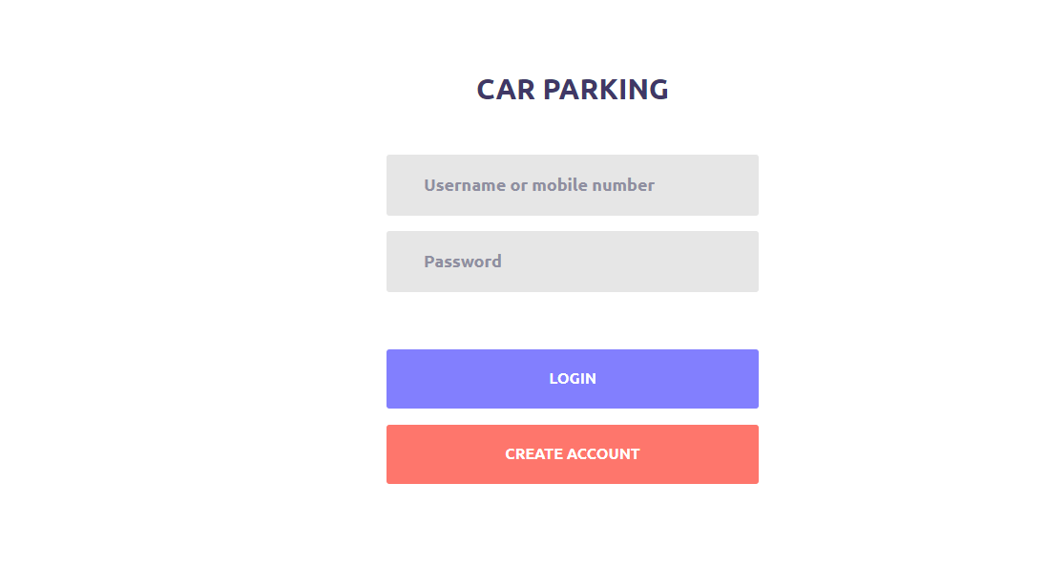

Slide 18
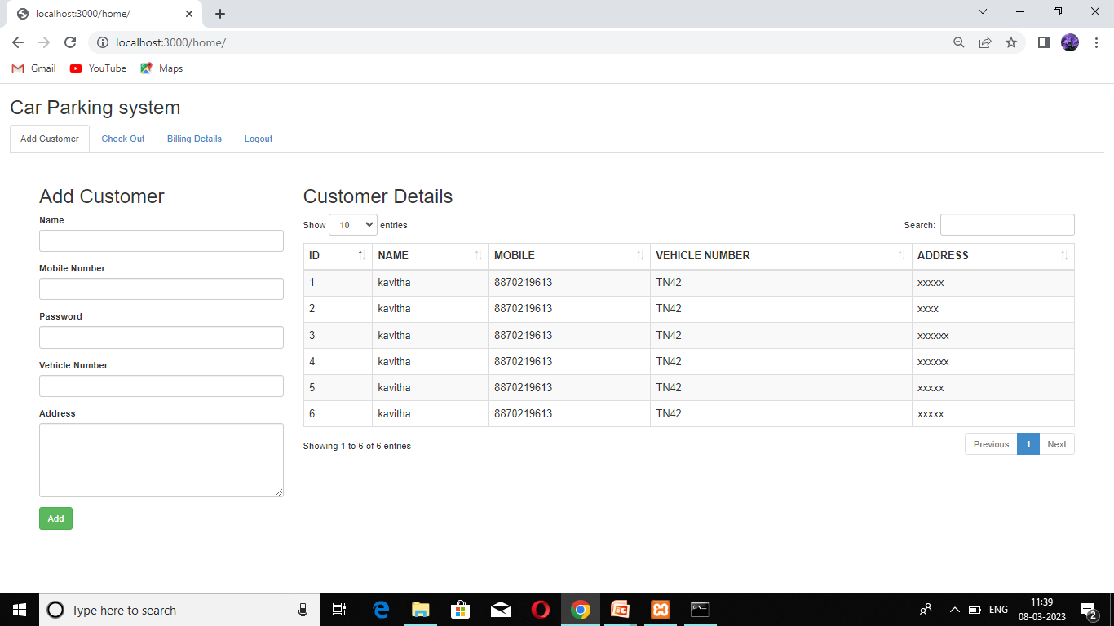

Slide 19
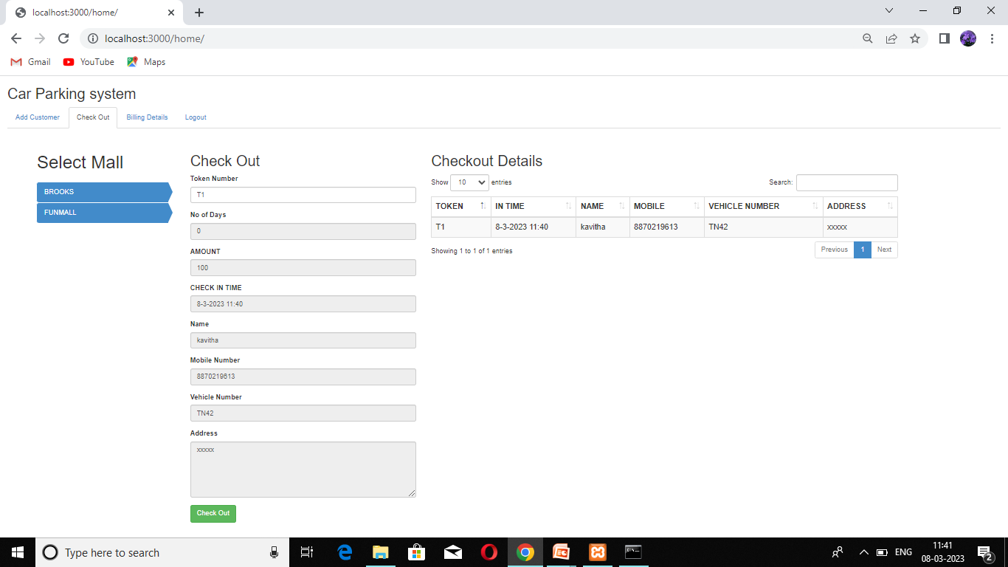

Slide 20
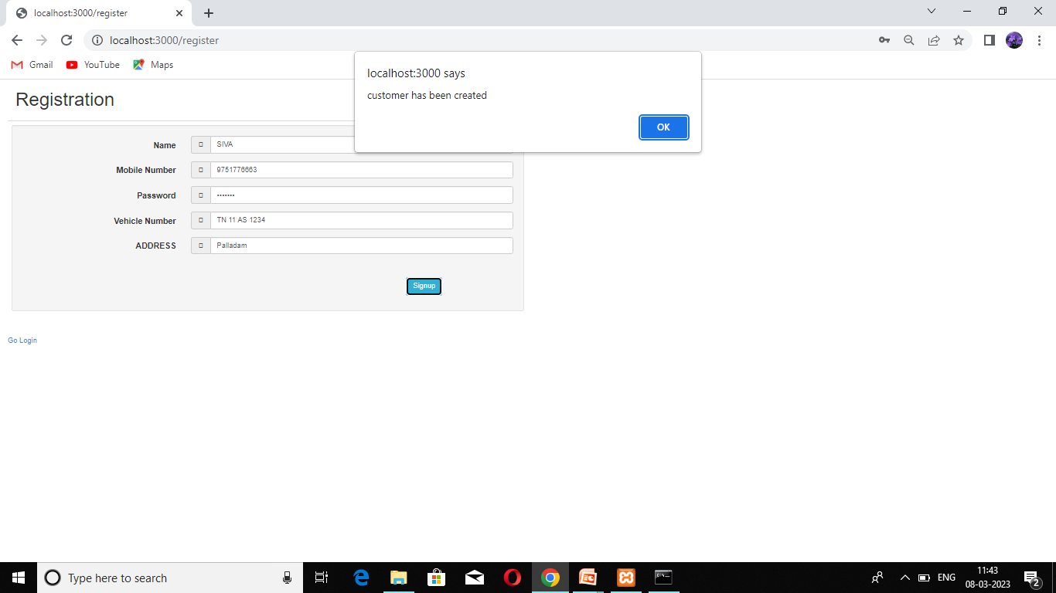

Slide 21
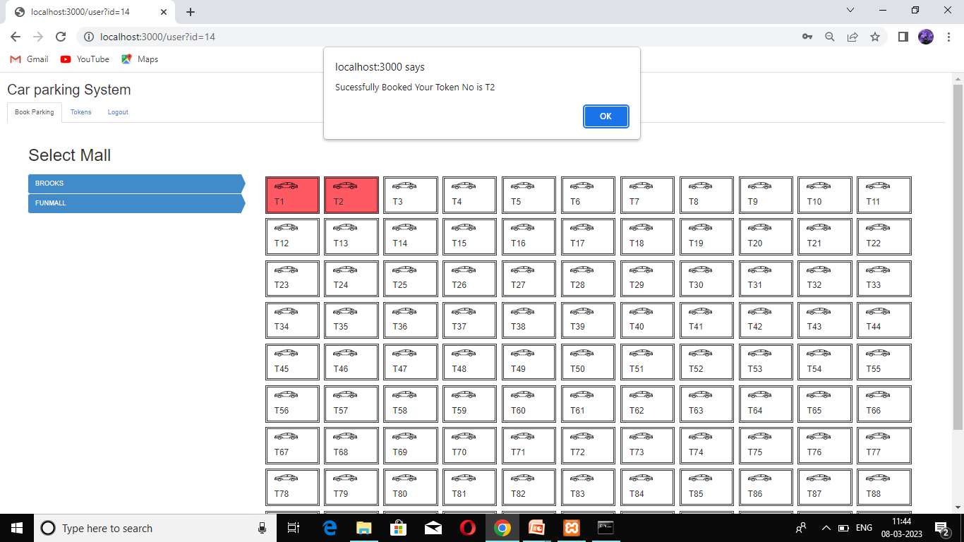

Slide 22
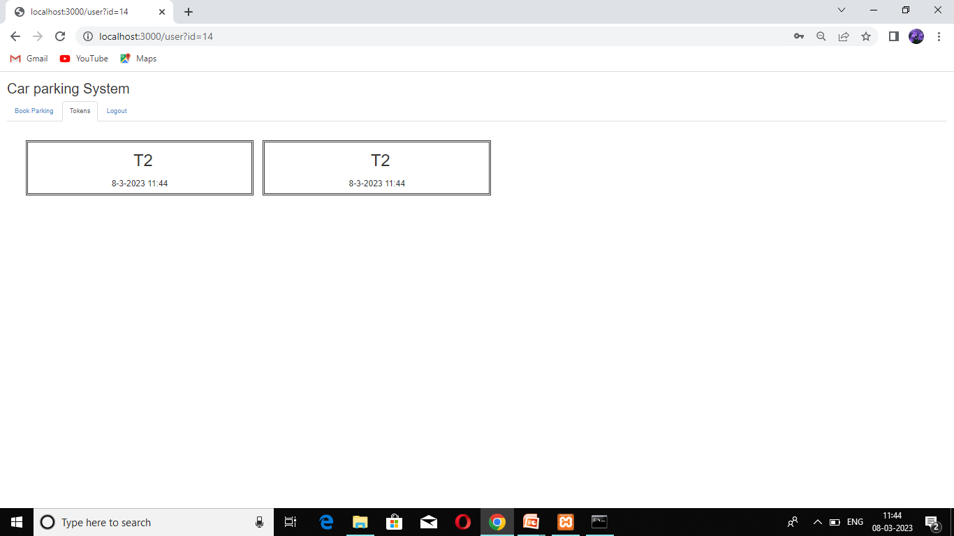

Slide 23
