Slide 1

2027 ODI World Cup
Team & Venue Intelligence — Data Analyst Portfolio
Prepared by Gokul • Tools: Python · Pandas · JSON · Power BI · DAX

Slide 2

Executive Summary
Objective
Team & venue intelligence for 2027 ODI World Cup
Workflow
Ball‑by‑ball JSON → team–venue measures → weighted scoring → Power BI
Scope
14 teams · 12 venues · 168 team–venue combos
Top Result
Pakistan @ Queens Sports Club — Score 87.10

Slide 3


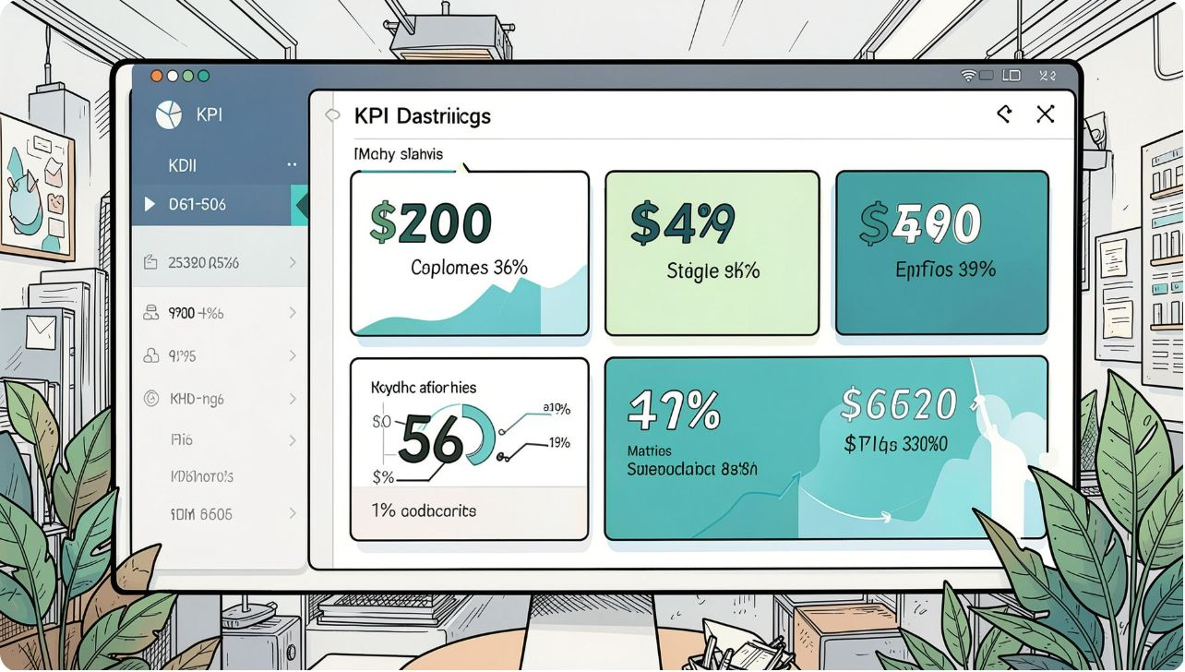



Project Snapshot
Project teams
Project venues
14
12
Team–venue combos
Historical coverage
78.57% historical · 21.43% fallback
168
Highest score
87.10 — Pakistan

Slide 4
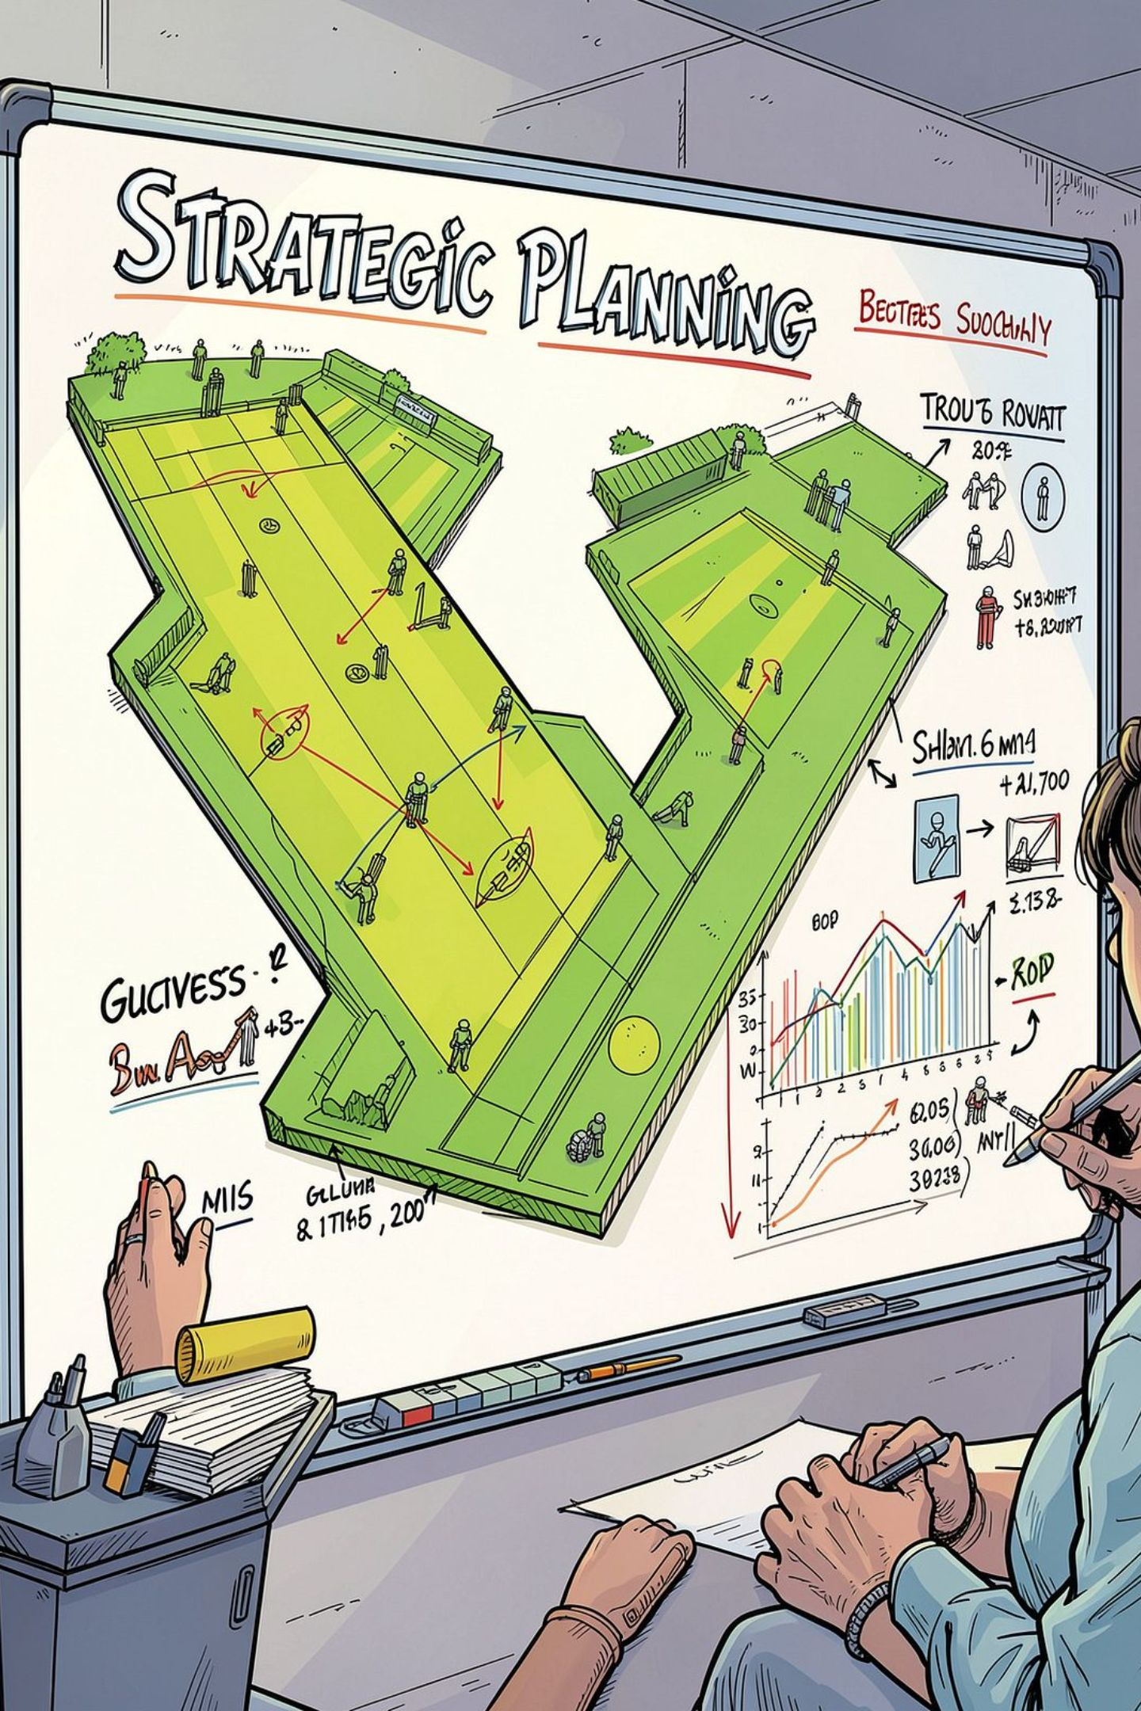
Business Objectives
Primary Goals
Identify favorable venues per team • Compare batting & bowling by venue
Scoring
Consistent 0–100 suitability framework
Coverage
Provide fallback logic where historical data missing
Delivery
Interactive Power BI dashboard for exploration

Slide 5
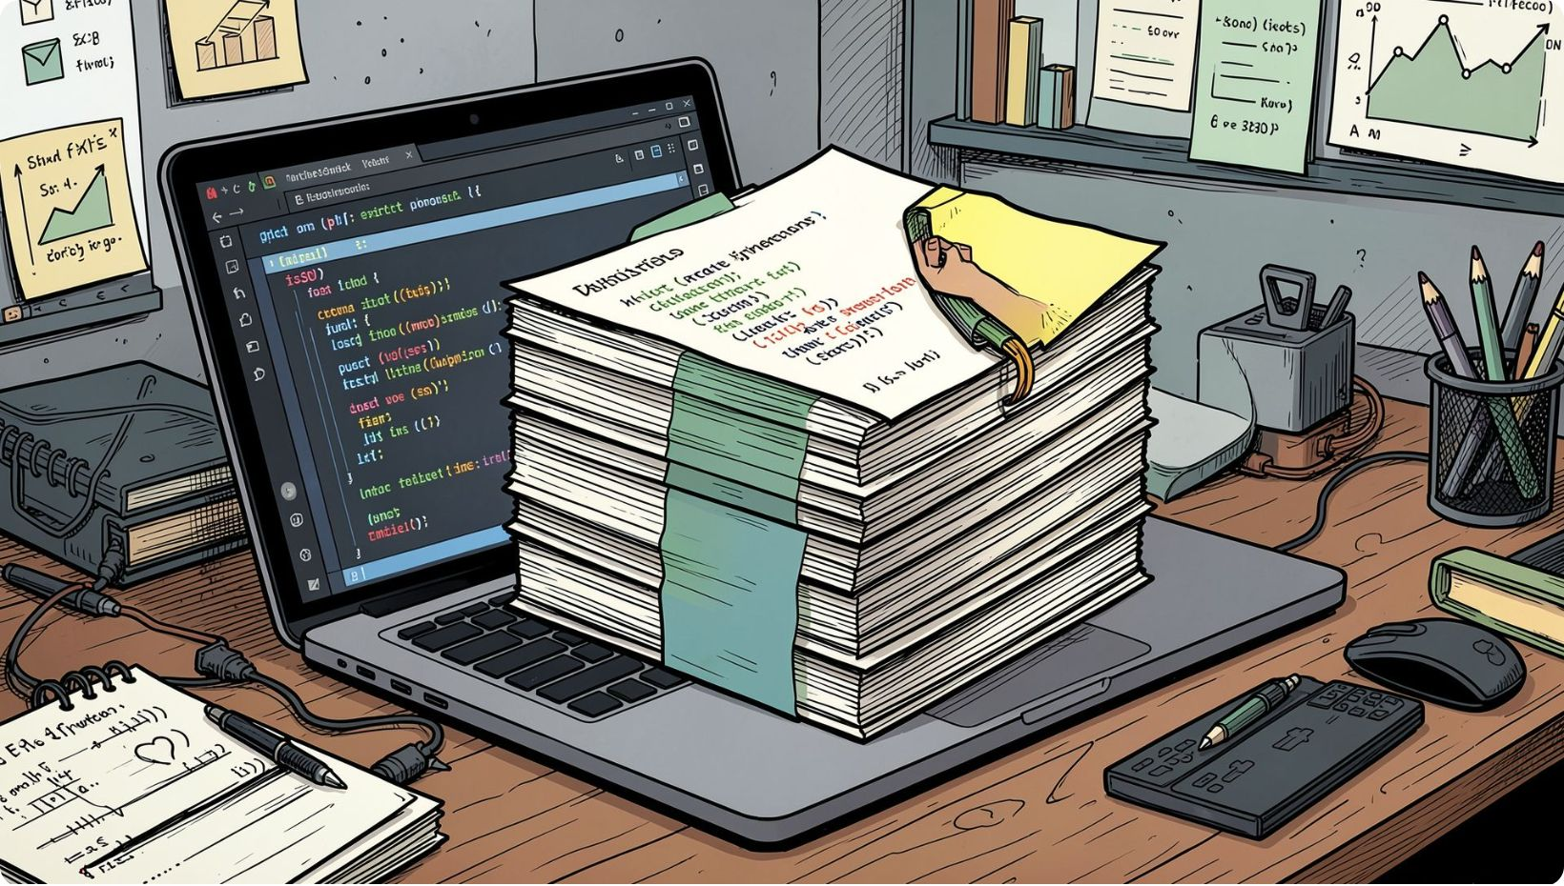
Data Source & Scope
Source: 2,565 men's ODI JSON files
Filtered: men's ODIs from 2015‑01‑01 onward
Standardized 12 project venues
Parsed ball‑by‑ball for batting & bowling
Qualifying match records in master dataset: 153

Slide 6
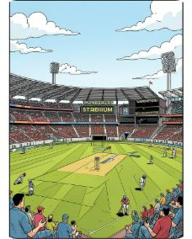
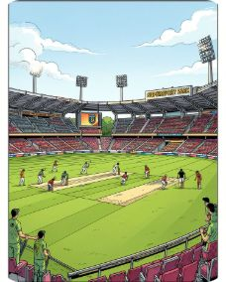
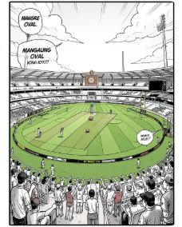
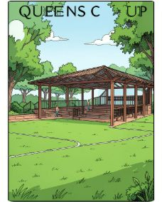
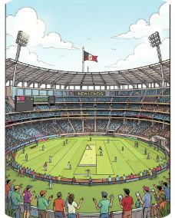
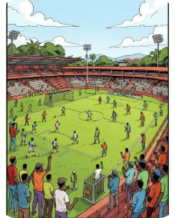
Venues & Teams
Wanderers
SuperSport Park
Mangaung Oval
Queens Sports Club
Newlands
Harare Sports Club
Teams: Australia, Bangladesh, England, India, Ireland, New Zealand, Pakistan, Scotland, South Africa, Sri Lanka, West Indies, Zimbabwe, Namibia, Afghanistan

Slide 7

Data Prep & Transformation
Ingestion
Read 2,565 JSON match files; extract metadata
Filtering
Men's ODIs from 2015 onward; selected venues
Extraction
Master Merge
Batting: runs, strike rate, 4s, 6s, dismissals. Bowling: wickets, econ, avg
JSON Ingest
Scope Filter
Extraction
Merge
Team–venue batting, bowling, results → master layer

Slide 8
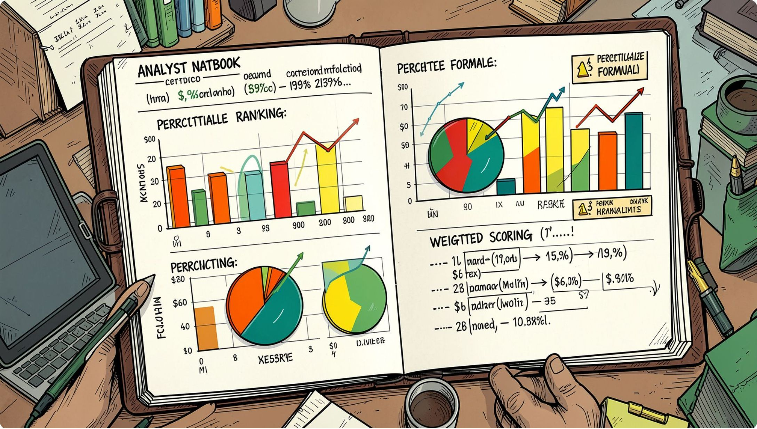
Scoring Methodology
Batting Components
Runs/innings 40% · Strike rate 30% · Fours 15% · Sixes 15%
Bowling Components
Wickets/match 40% · Economy 25% · Avg 20% · Strike rate 15%
Overall Score
50% batting + 50% bowling (percentile‑ranked components)

Slide 9
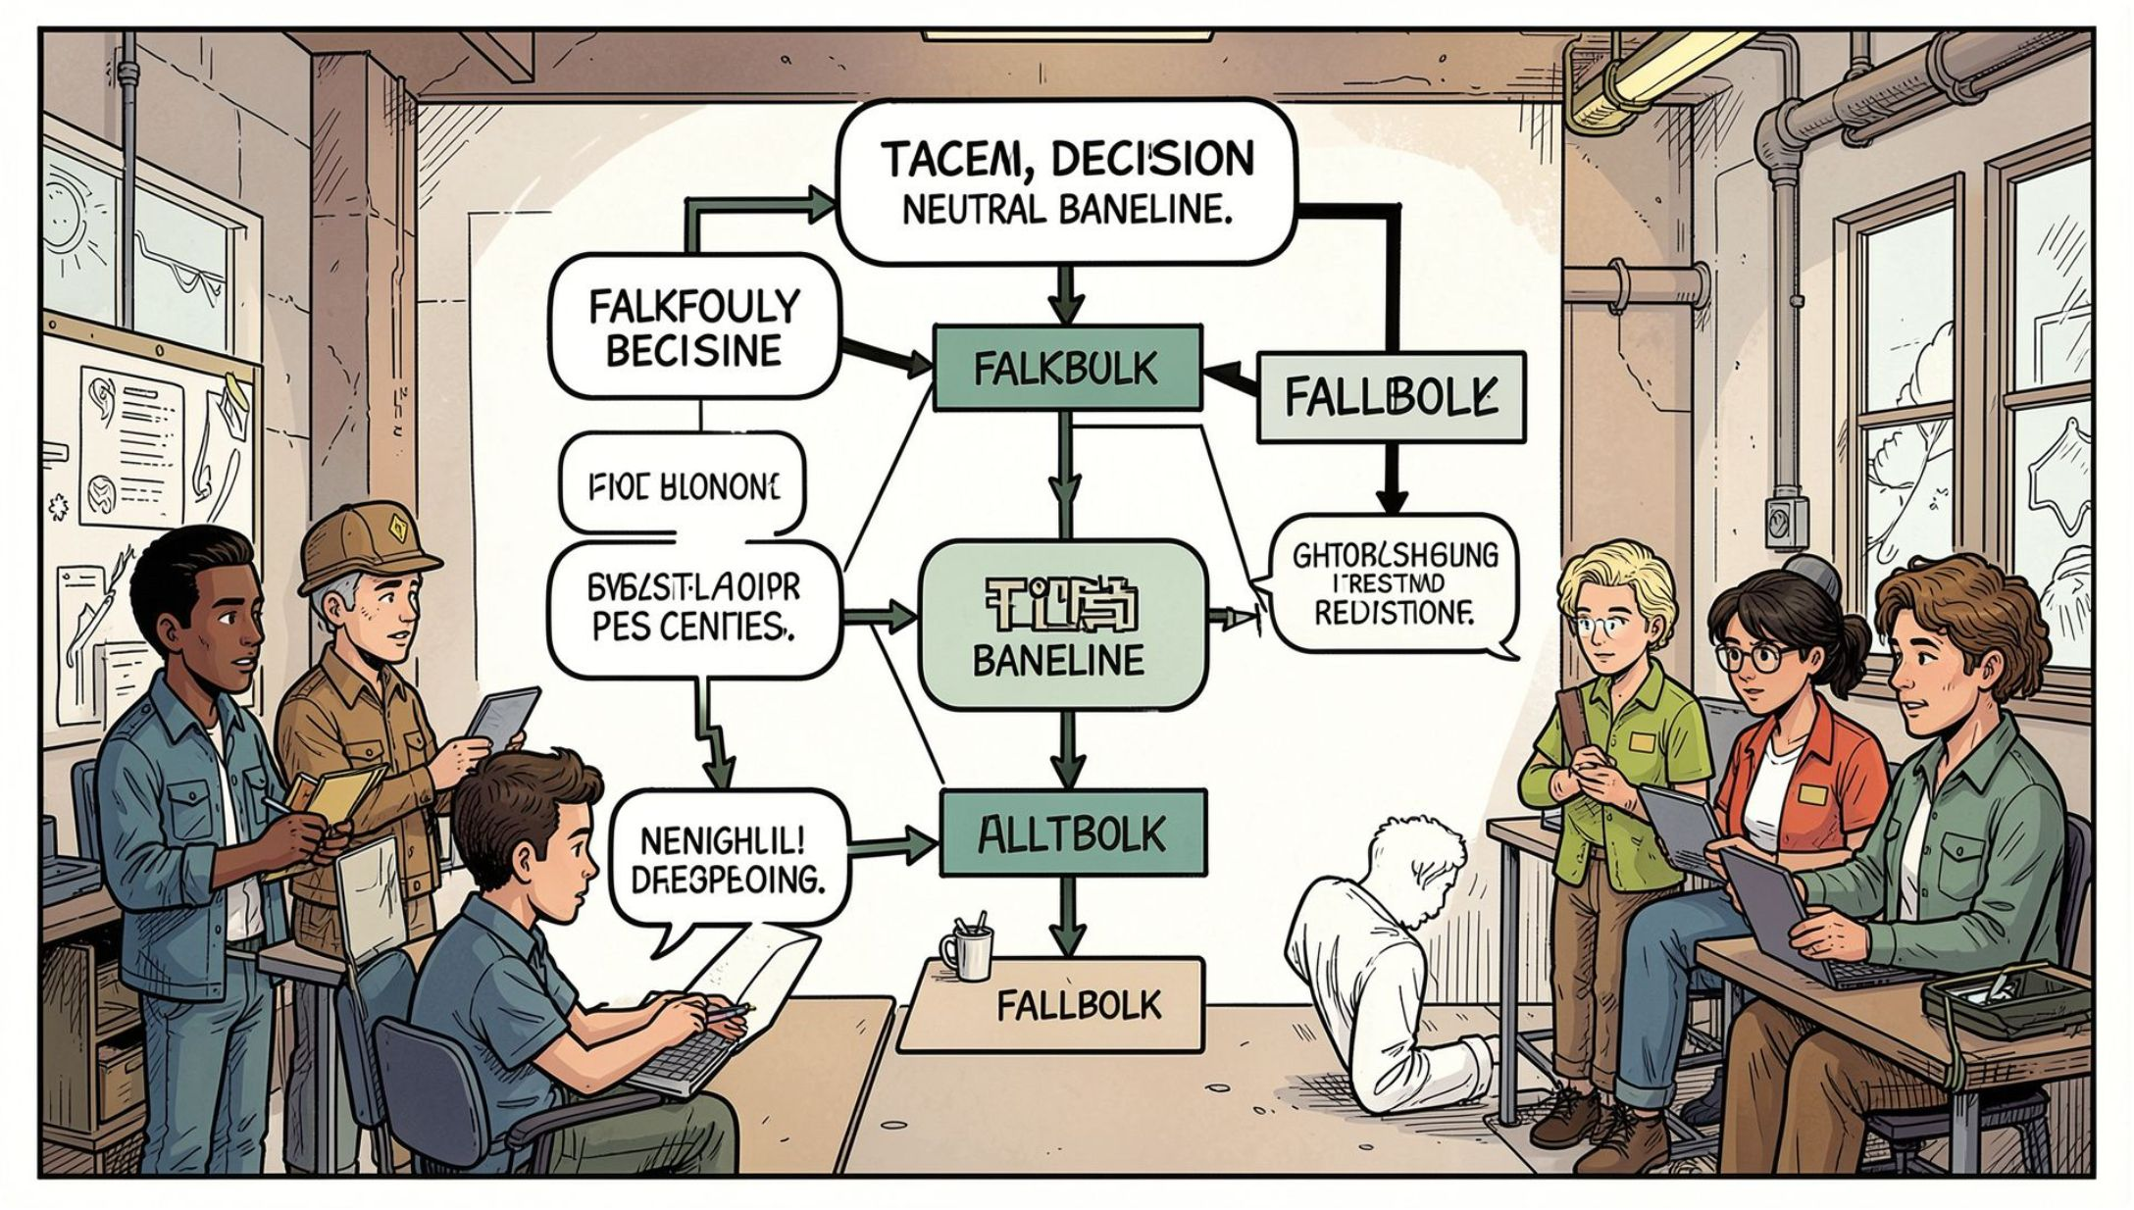
Fallback Logic & Coverage
All 168 team–venue combos created. Use:
Historical venue score when available
Team-level weighted venue fallback if missing
Neutral baseline when team has no historical score
Coverage: 68 combos historical (40.5%) · 100 combos fallback (59.5%)

Slide 10

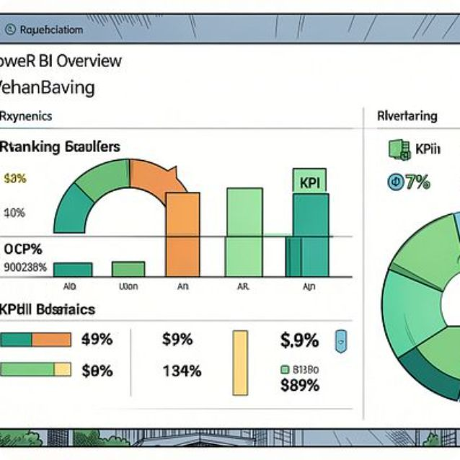
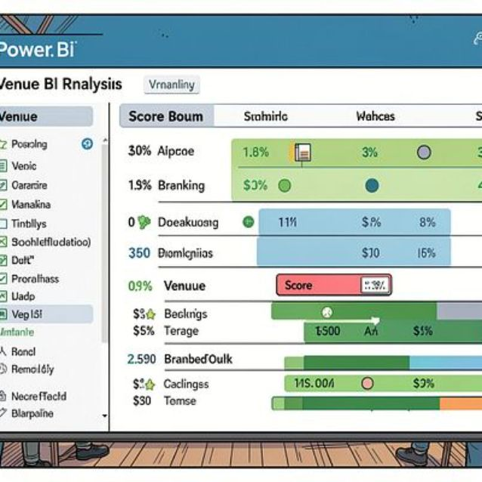



Key Findings & Dashboard
Top recommendation
Pakistan — Queens Sports Club — 87.10
Next top
South Africa — Buffalo Park — 85.63
Dashboard Pages
Overview · Team Analysis · Venue Recommendation Intelligence
Limitations: recommendations are suitability scores, not guaranteed outcomes. Historical coverage uneven; rank‑based normalization is relative.

