Slide 1

HDFC BANK — 5‑Year Financial & Banking Performance (FY2020‑21 to FY2024‑25)
Management analytics report prepared by Gokul G . Analysis built from Excel, SQL/MySQL, Python and Power BI to translate five years of financial and banking data into concise management insight across: Financial Performance, Banking Growth, Asset Quality, Efficiency, Capital and Cash Flow.

Slide 2

Executive Management Summary — Key Headlines
FY2024‑25 net profit: ₹70,792.25 Cr. Five‑year net profit CAGR: 22.12%. Advances: ₹26.20 Lakh Cr; Deposits: ₹27.15 Lakh Cr. Net profit rose from ₹31,833.21 Cr to ₹70,792.25 Cr; FY2023‑24 delivered the strongest annual growth at 39.27%.
Profitability
Business Growth
Asset & Efficiency Signals
Strong absolute profit growth, margin moderation (NIM 4.10% → 3.48%) and ROE moderation (peak 17.39% → 14.56%).
Advances grew 131.24% vs deposits 103.34% — a 27.90pp growth gap; credit‑deposit ratio peaked >100% in FY2023‑24.
GNPA/Net NPA improved then rose to 1.33% / 0.43%; Cost‑to‑Income rose 36.30% → 40.50%.
Capital & Cash
CAR stable ~18.8%–19.6%. Operating cash flow volatile but very strong in FY2024‑25.

Slide 3

Scope, Sources & Data Preparation
Scope: FY2020‑21 to FY2024‑25 covering financial performance, banking growth, asset quality, efficiency, returns, capital, cash flow and ad‑hoc analysis. Sources: HDFC Bank annual reports, Screener dataset; working dataset is consolidated while many banking KPIs are standalone.
Data Pipeline
Source data → Excel → MySQL/SQL → Python validation → final dataset → Power BI dashboards.
Cleaning Rules
Standardize years/units/fields, clean non‑numeric markers, keep NULLs for unavailable values, validate reconciliation and chronology.
Interpretation Note
HDFC Ltd merger (effective 1 Jul 2023) affects scale and comparability — interpret FY2023‑24 impacts with caution; avoid assuming causality from observed correlations.

Slide 4
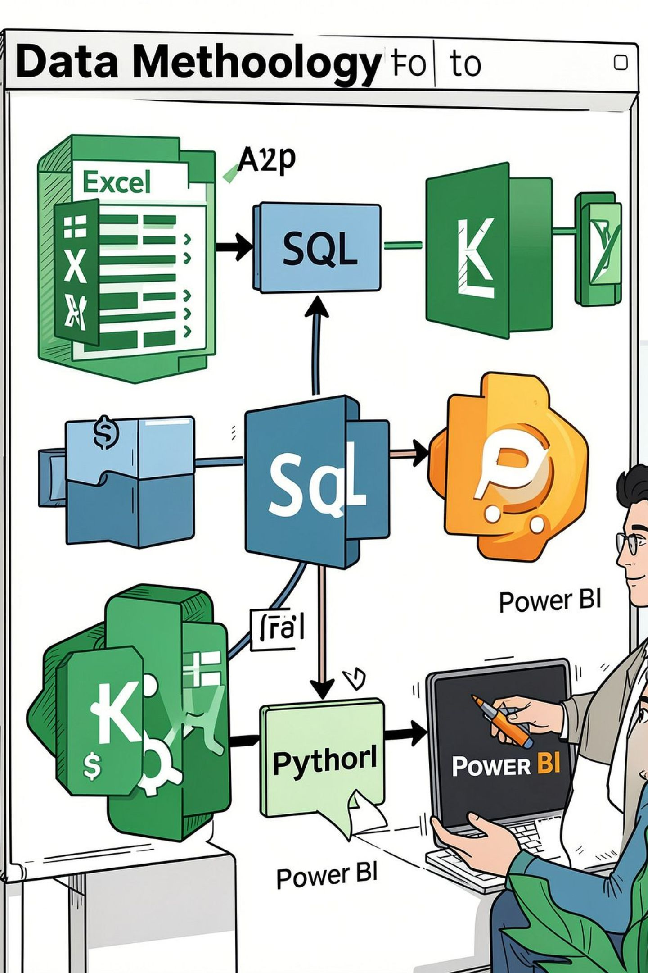
Analytical Methodology & Core Questions
Tools: Excel (cleaning), SQL/MySQL (relational analysis), Python (validation, ad‑hoc analysis, visuals), Power BI (six‑page management dashboard). The methodology emphasizes validation, reproducibility and management‑oriented outputs.
01
Primary Questions
Profitability evolution, strongest profit growth year; balance between advances and deposits; asset quality during expansion; margin, efficiency and return trends; CASA composition; capital adequacy; profit vs operating cash generation.
02
Management Lens
Assess growth alongside funding quality, asset quality, margin protection, efficiency, capital and cash generation rather than in isolation.

Slide 5
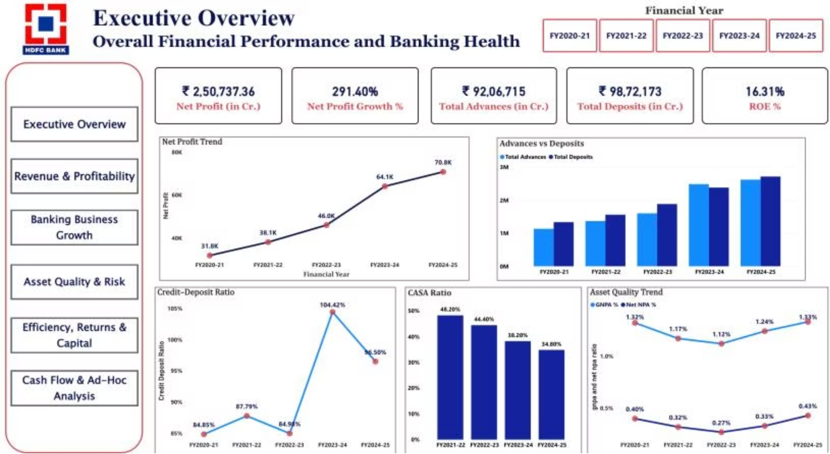

Power BI — Executive Overview (Dashboard Snapshot)
This page consolidates five‑year trends: net profit, advances, deposits, credit‑deposit ratio, CASA, GNPA/Net NPA and ROE. It answers: where the bank stands after five years across profitability, balance‑sheet growth, funding mix and asset‑quality indicators.
Key numbers (illustrative dashboard): Net Profit trend FY2020‑25: ₹31.8K → ₹70.8K Cr; Credit‑Deposit Ratio peaked at 104.42% in FY2023‑24; CASA declined to ~34.6% in FY2024‑25.

Slide 6
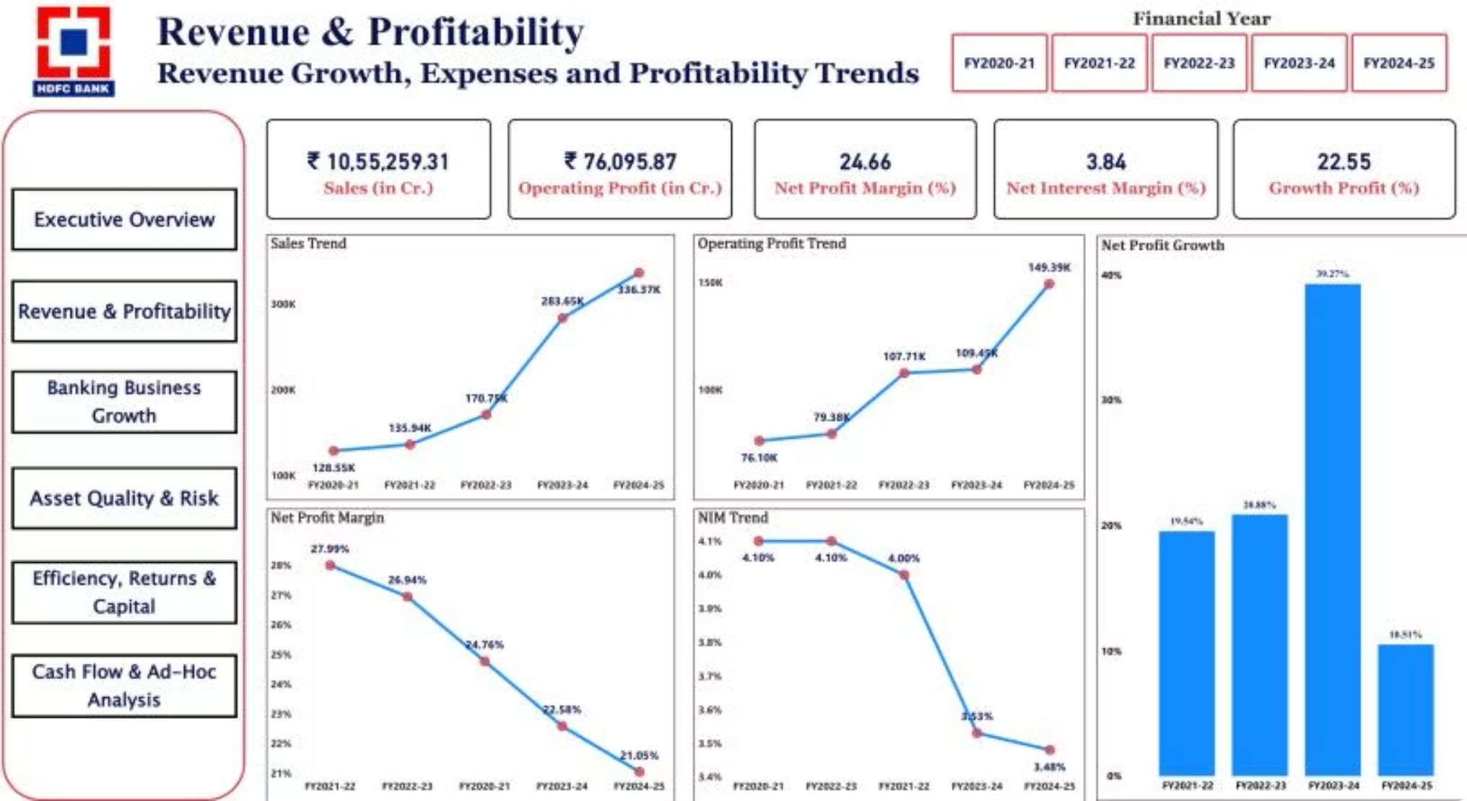
Revenue & Profitability — Findings
Sales grew from ₹1,28,552.40 Cr to ₹3,36,367.43 Cr. Operating profit expanded strongly (₹76,095.87 Cr → ₹1,49,392.98 Cr). Net profit margin moderated from ~24.76% to ~21.05%. NIM fell from 4.10% to 3.48%; net profit grew despite margin compression — monitor margin quality separately from absolute earnings.
Net Profit Growth
Other Income
FY2023‑24 was the high point for YoY profit growth (39.27%); FY2024‑25 growth 18.51%.
FY2023‑24 other income rose sharply; interpret in light of the HDFC Ltd merger — not proof of causation.

Slide 7
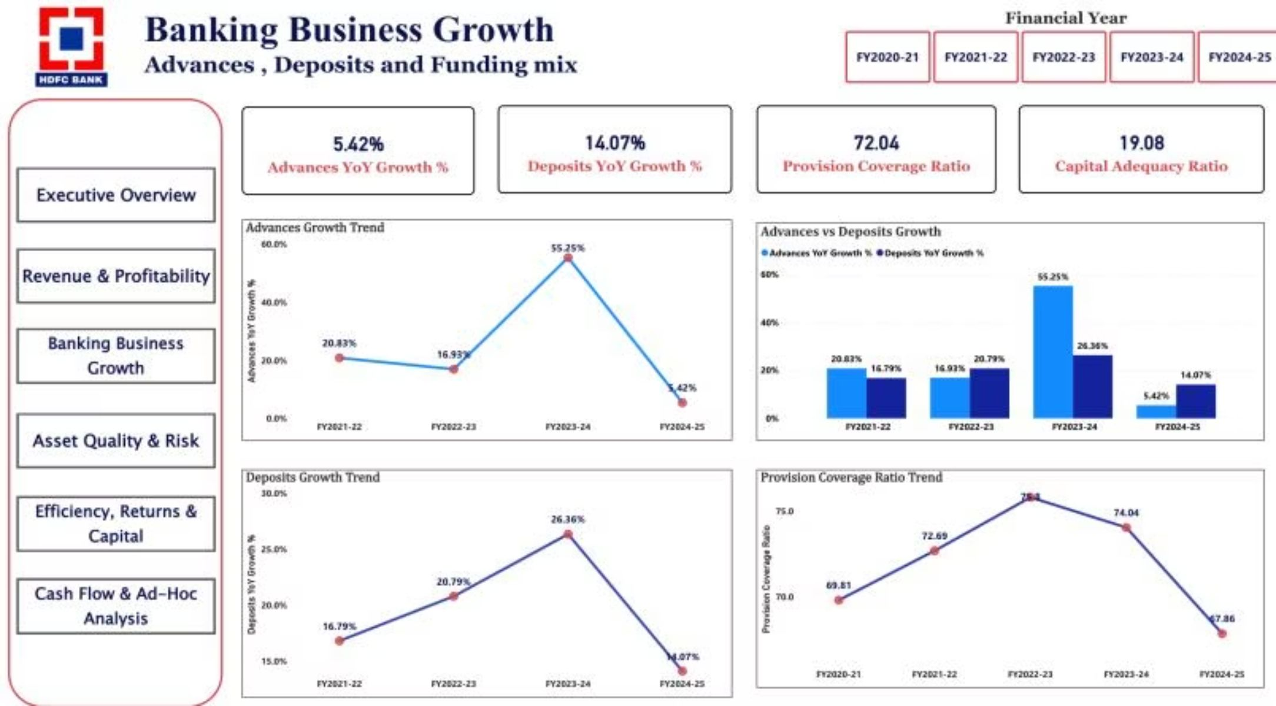
Banking Business Growth & KPIs
Advances increased from ₹11,32,837 Cr to ₹26,19,609 Cr; deposits from ₹13,35,060 Cr to ₹27,14,715 Cr. Overall advances growth 131.24% vs deposits 103.34% leading to a 27.90pp gap. Credit‑deposit ratio: 84.85% → 96.50% with a peak at 104.42% in FY2023‑24. CASA ratio declined ~13.4pp from FY2021‑22 to FY2024‑25.
Provisioning & Capital
Management Priority
PCR: peaked ~75.80% in FY2022‑23, fell to 67.86% in FY2024‑25. CAR remained strong ≈18.8%–19.6%.
Strengthen deposit mobilization and CASA while aligning capital planning to credit expansion.

Slide 8
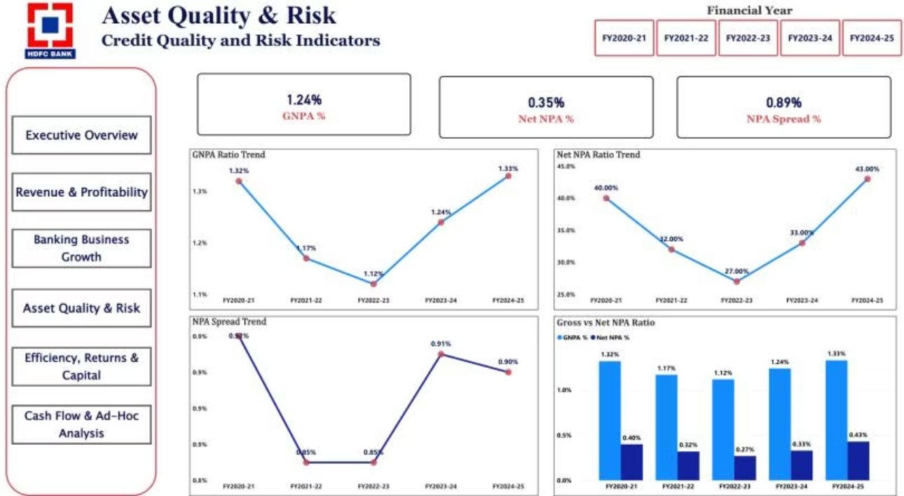
Asset Quality, Efficiency & Returns
GNPA improved to FY2022‑23 then rose to 1.33% in FY2024‑25; Net NPA followed similarly to 0.43%. NPA spread remained ~0.9pp. ROA peaked at 2.07% (FY2022‑23) then fell to 1.91%; ROE peaked 17.39% then moderated to 14.56%. Cost‑to‑Income increased from 36.30% to 40.50% — efficiency and productivity require management focus.

Slide 9
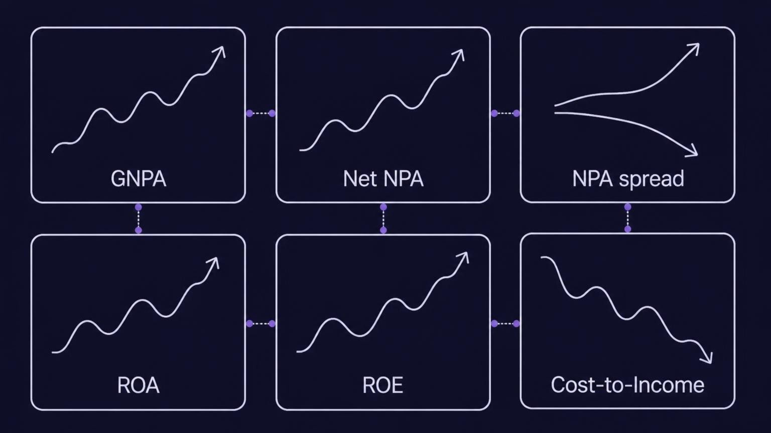

Slide 10
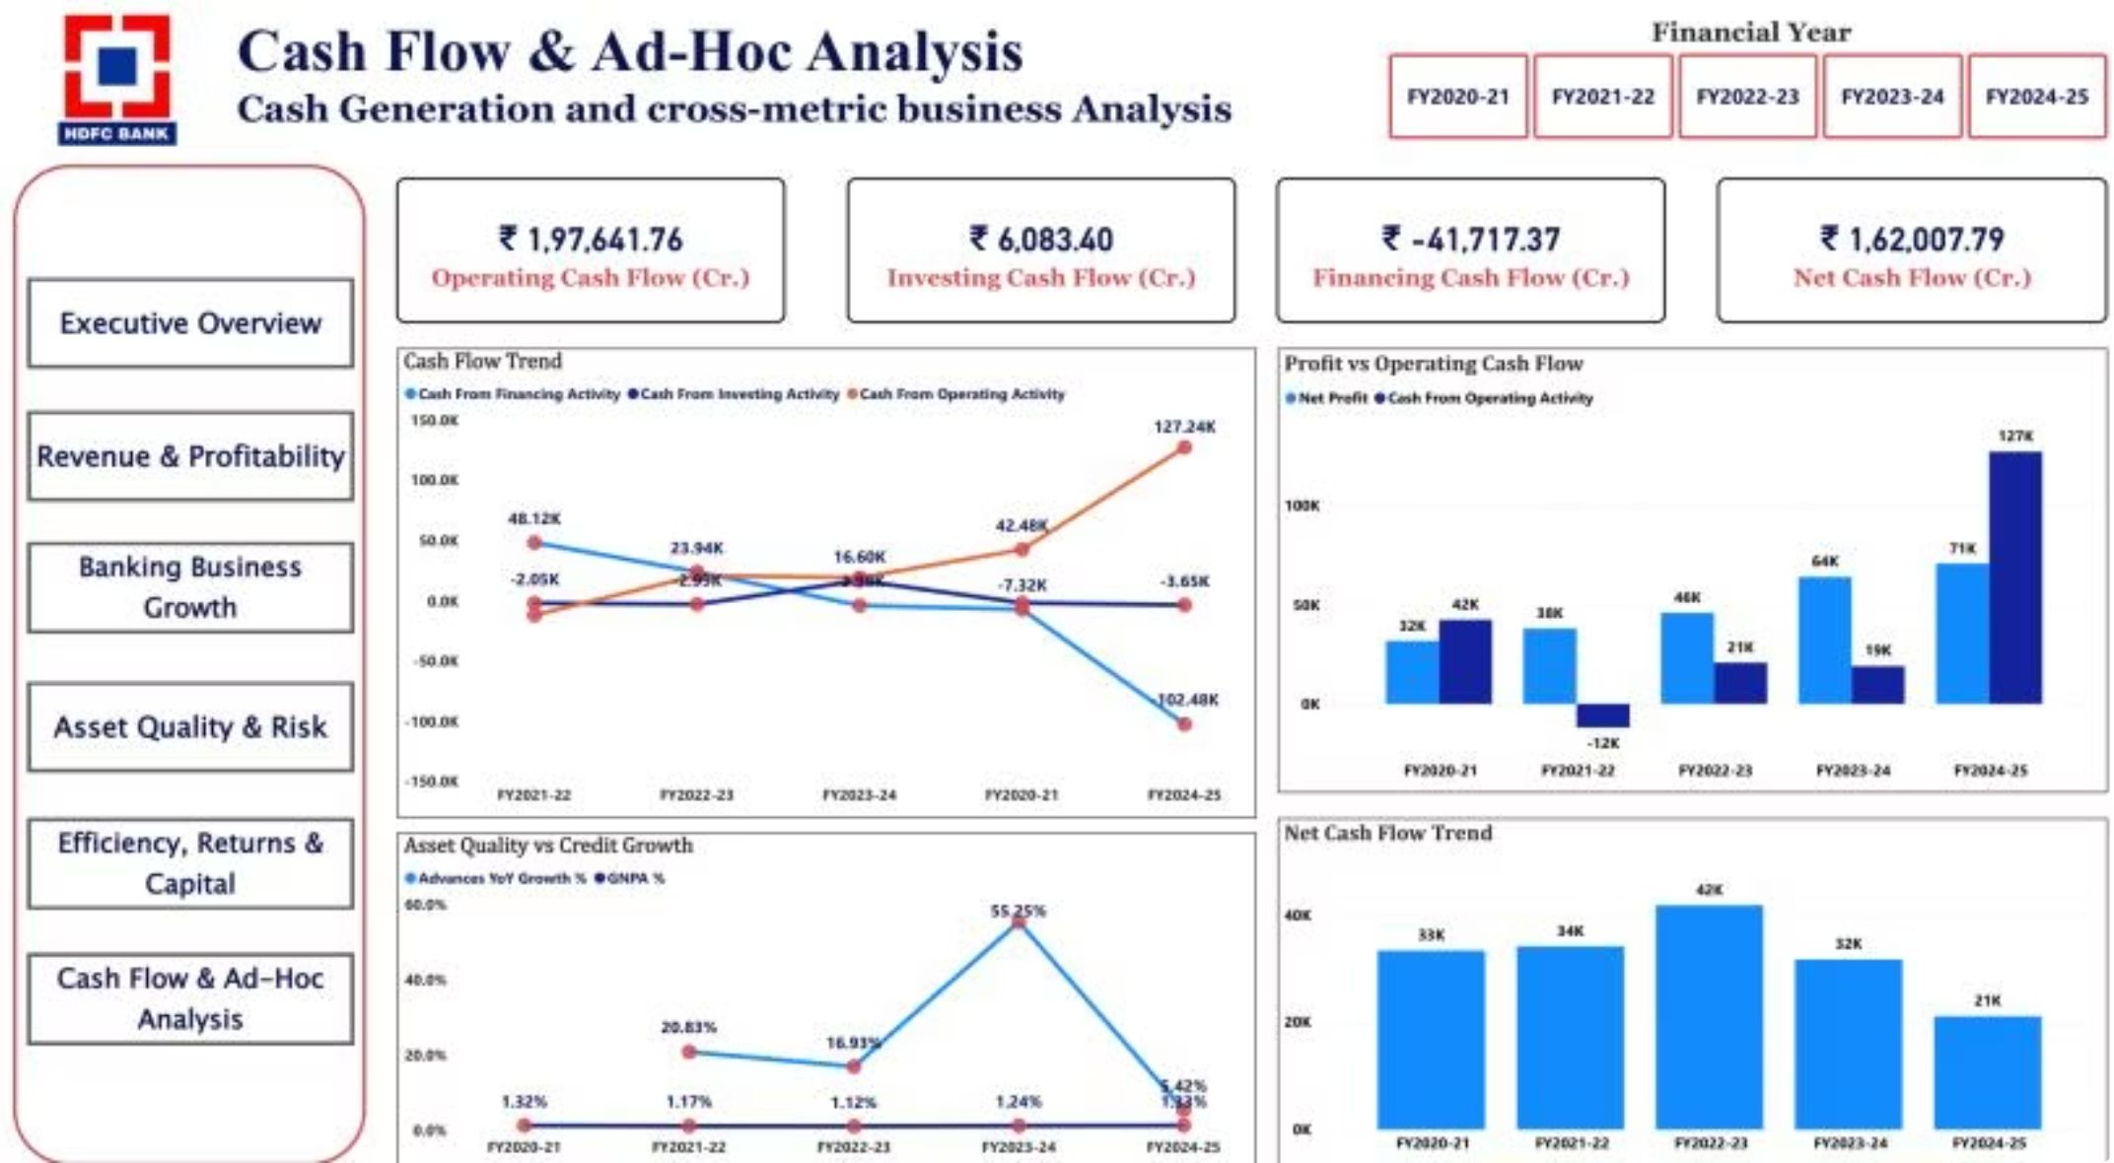
Cash Flow Analysis & Cross‑Metric Signals
Operating cash flow varied widely: FY2021‑22 negative ₹11,959.57 Cr → FY2024‑25 positive ₹1,27,241.84 Cr. Financing outflow in FY2024‑25 (₹1,02,477.54 Cr) materially reduced net cash. Net cash flow stayed positive every year, peaking ₹41,762.08 Cr (FY2022‑23) and falling to ₹21,113.39 Cr (FY2024‑25). Profit and OCF do not always move together — governance should monitor both.
Key Signal
Action
FY2024‑25 combined strong net profit and exceptionally high OCF — validate sustainability and drivers (working capital, consolidation effects).
Track operating, investing and financing flows alongside profitability to understand net cash outcomes and balance‑sheet impacts.

Slide 11
Ad‑Hoc Answers, Recommendations & Conclusion
Direct answers: Advances grew faster than deposits (131.24% vs 103.34%). Highest net‑profit growth: FY2023‑24 (39.27%) — consider merger impact. Asset quality improved to FY2022‑23 then weakened. NIM declined (4.10% → 3.48%) while net profit rose. CASA ratio fell ~13.4pp. CAR remained adequate. Profit did not always translate to OCF.
Priority Actions
Final Management Takeaway
Strengthen deposit mobilization and CASA composition.
Protect NIM and monitor margin quality vs absolute earnings.
Maintain disciplined underwriting, early warning and recovery processes.
Identify cost, productivity and process improvements to control Cost‑to‑Income.
Preserve capital buffers and align capital planning with credit growth.
Monitor operating, investing and financing cash flows with profitability metrics.
HDFC Bank shows strong expansion and profitability growth; the next phase must emphasize the quality, efficiency and resilience of that growth — focusing on deposit quality, asset quality, margin protection, efficiency, capital preservation and cash‑flow governance.

