Slide 1
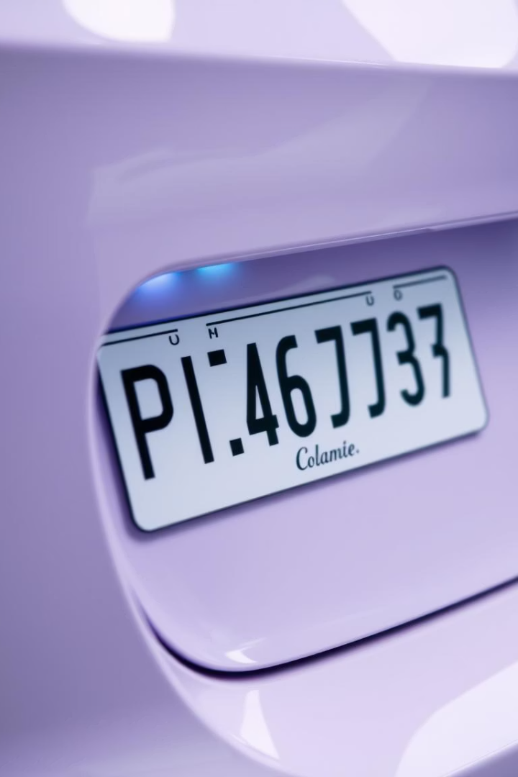
License Plate Recognition Using LLMs
An automated system to detect and read vehicle license plates in real-time.

Slide 2
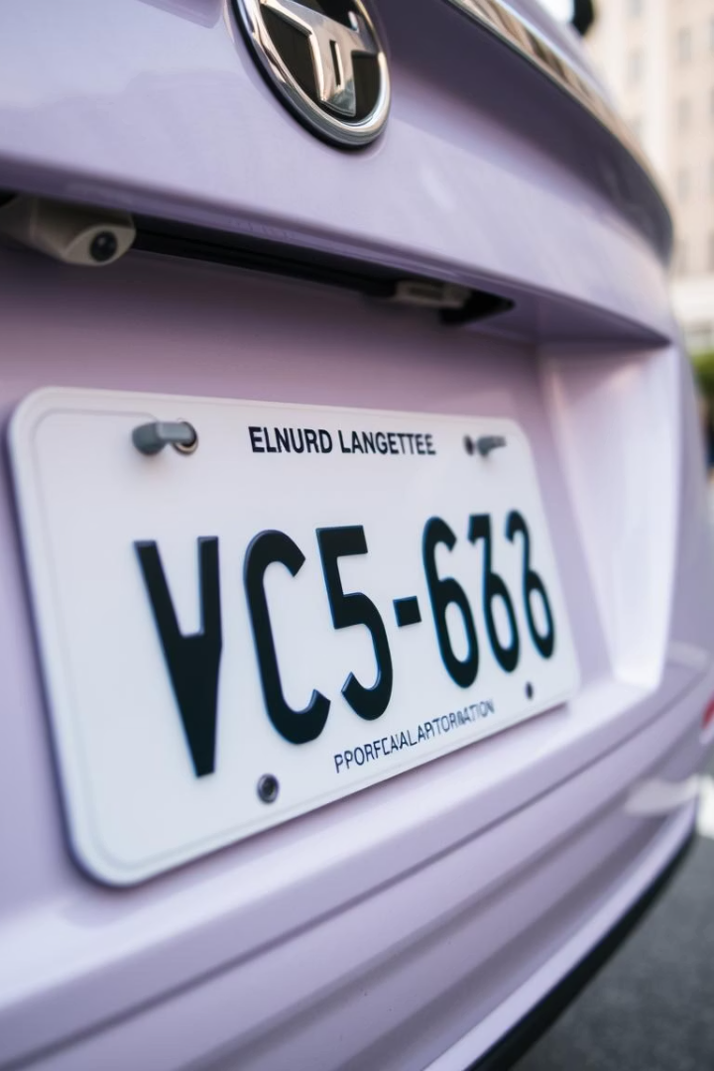
What is License Plate Recognition?
Definition
Applications
Technology to identify vehicle plates from images or video frames.
Used in traffic systems, parking, tolls, and law enforcement.
Process
Detect plate region and recognize characters using OCR.

Slide 3
OCR and CNN Models in LPR
OCR
CNN
EasyOCR
OpenCV & Imutils
Converts text in images to machine-readable form.
Deep learning model for image analysis powering OCR accuracy.
Uses CRNN and CTC loss for character sequence recognition.
Preprocessing, edge detection, and image manipulation tools.

Slide 4

License Plate Recognition Features
Detection
Works on static images and video feeds.
Recognition
Extracts text using EasyOCR.
Robustness
Handles lighting, angles, and font variations.
Visualization
Draws bounding boxes and displays recognized text.

Slide 5
System Pipeline Overview
Input image or video frame.
Preprocess with grayscale and noise filtering.
Apply edge detection and find contours.
Crop probable plate region.
Use EasyOCR to recognize text.
Display annotated results in real-time.

Slide 6

Limitations and Challenges
Image Quality
Blurred, tilted, or poorly lit plates reduce accuracy.
Character Set
Supports only English alphanumeric characters currently.
Multiple Vehicles
Struggles with overlapping plates or multiple vehicles.
False Positives
Rectangular shapes may be mistaken for plates.

Slide 7

Proposed Enhancements
Improved Detection
Custom OCR
Use YOLO or SSD models for better plate localization.
Train models for multiple languages and plate styles.
Vehicle Tracking
Low-Light Enhancement
Monitor plates over time in video streams.
Apply advanced image processing for dark conditions.

Slide 8
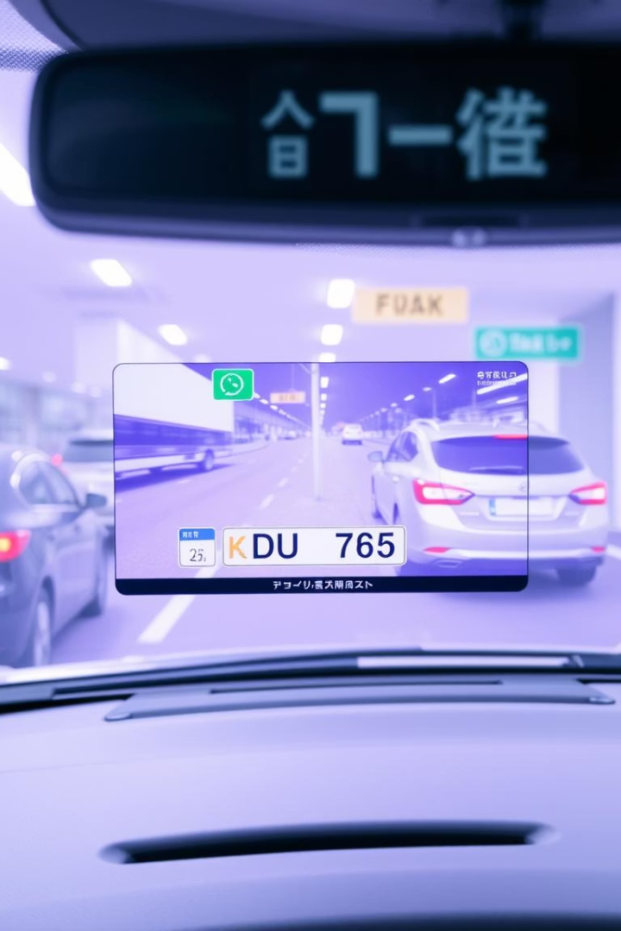
Conclusion and Future Potential
This project integrates deep learning OCR with image processing.
It detects and reads plates from images and videos effectively.
Future upgrades will boost accuracy and real-world usability.

