Slide 1
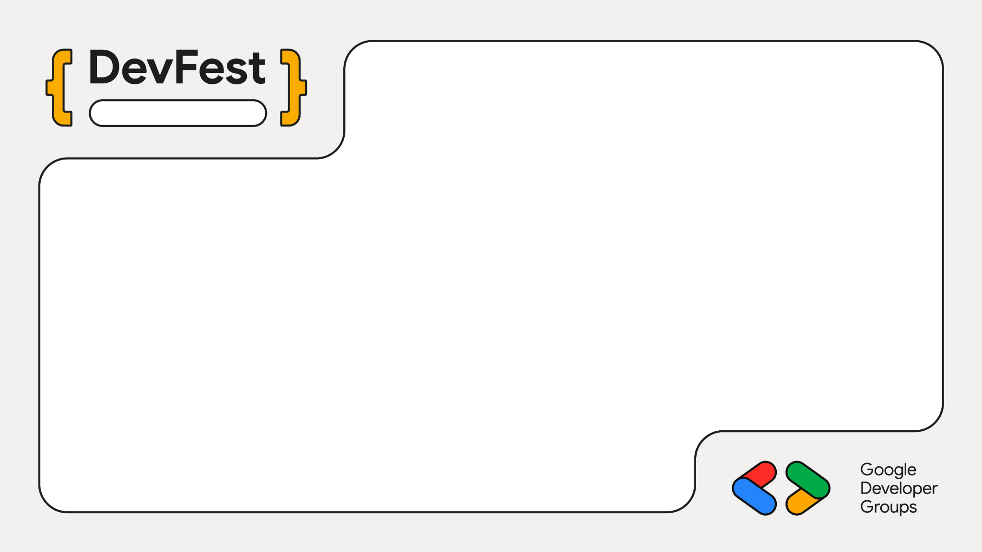
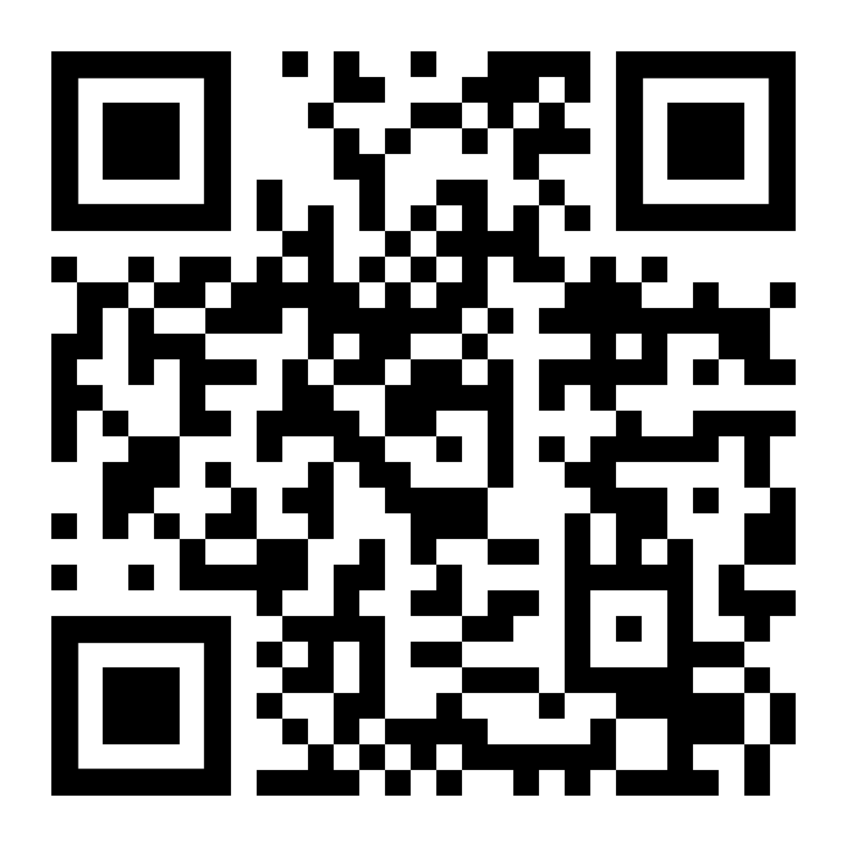
Chennai
Local AI:
The Google Gemma Edition
Gokulbarath SK (gokulbarath.is-a.dev)
Founder. BGO APPS . (www.bgoapps.xyz)

Slide 2
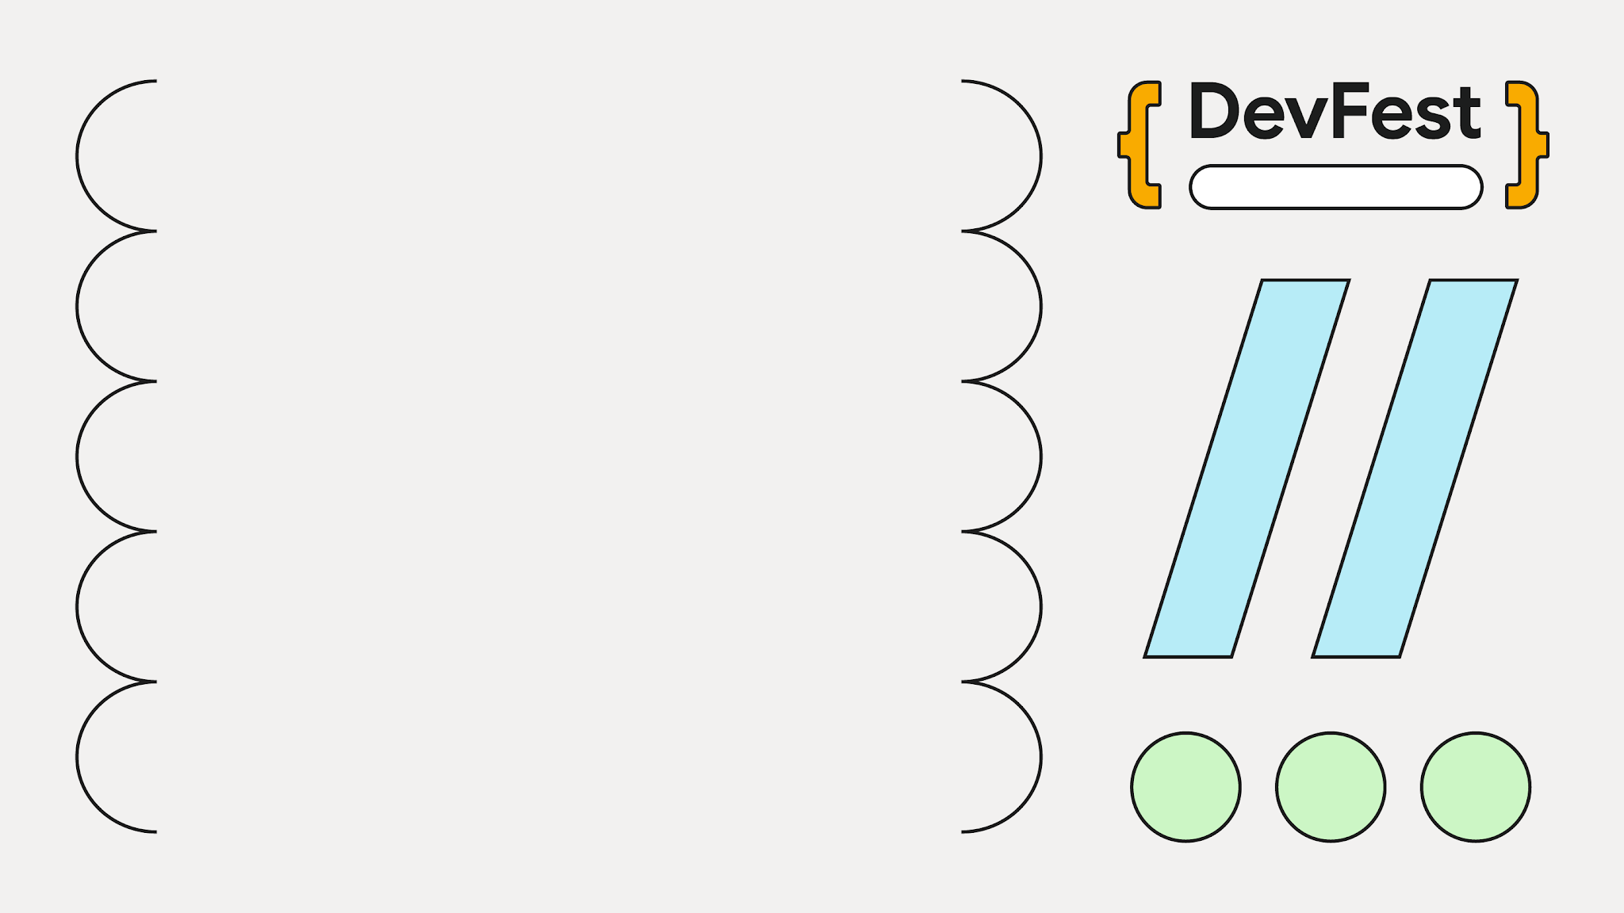
DevFest 2026
What if your AI never needed the internet?

Slide 3
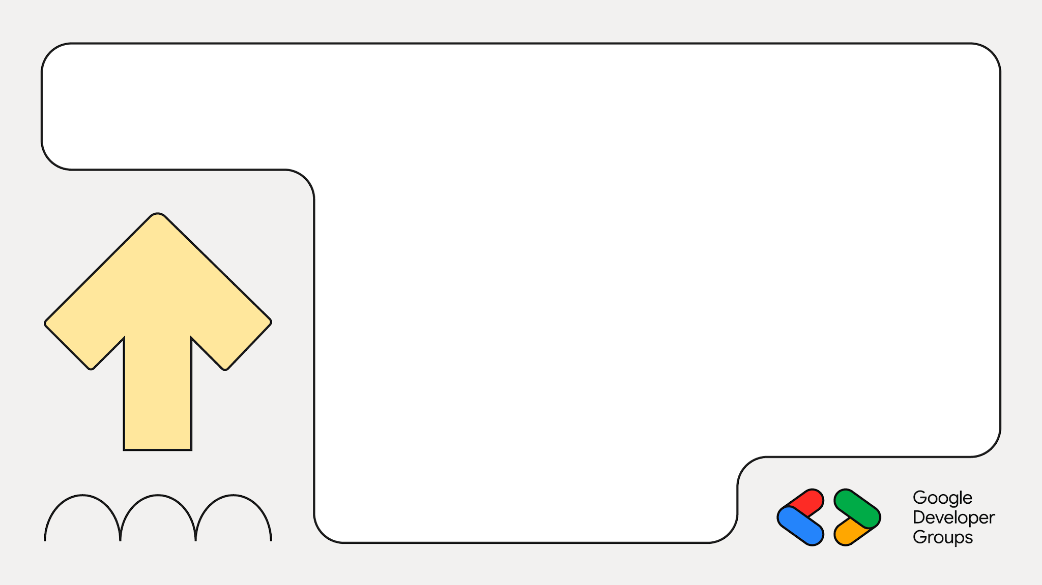
01
Local AI
What it is, and why it matters now

Slide 4
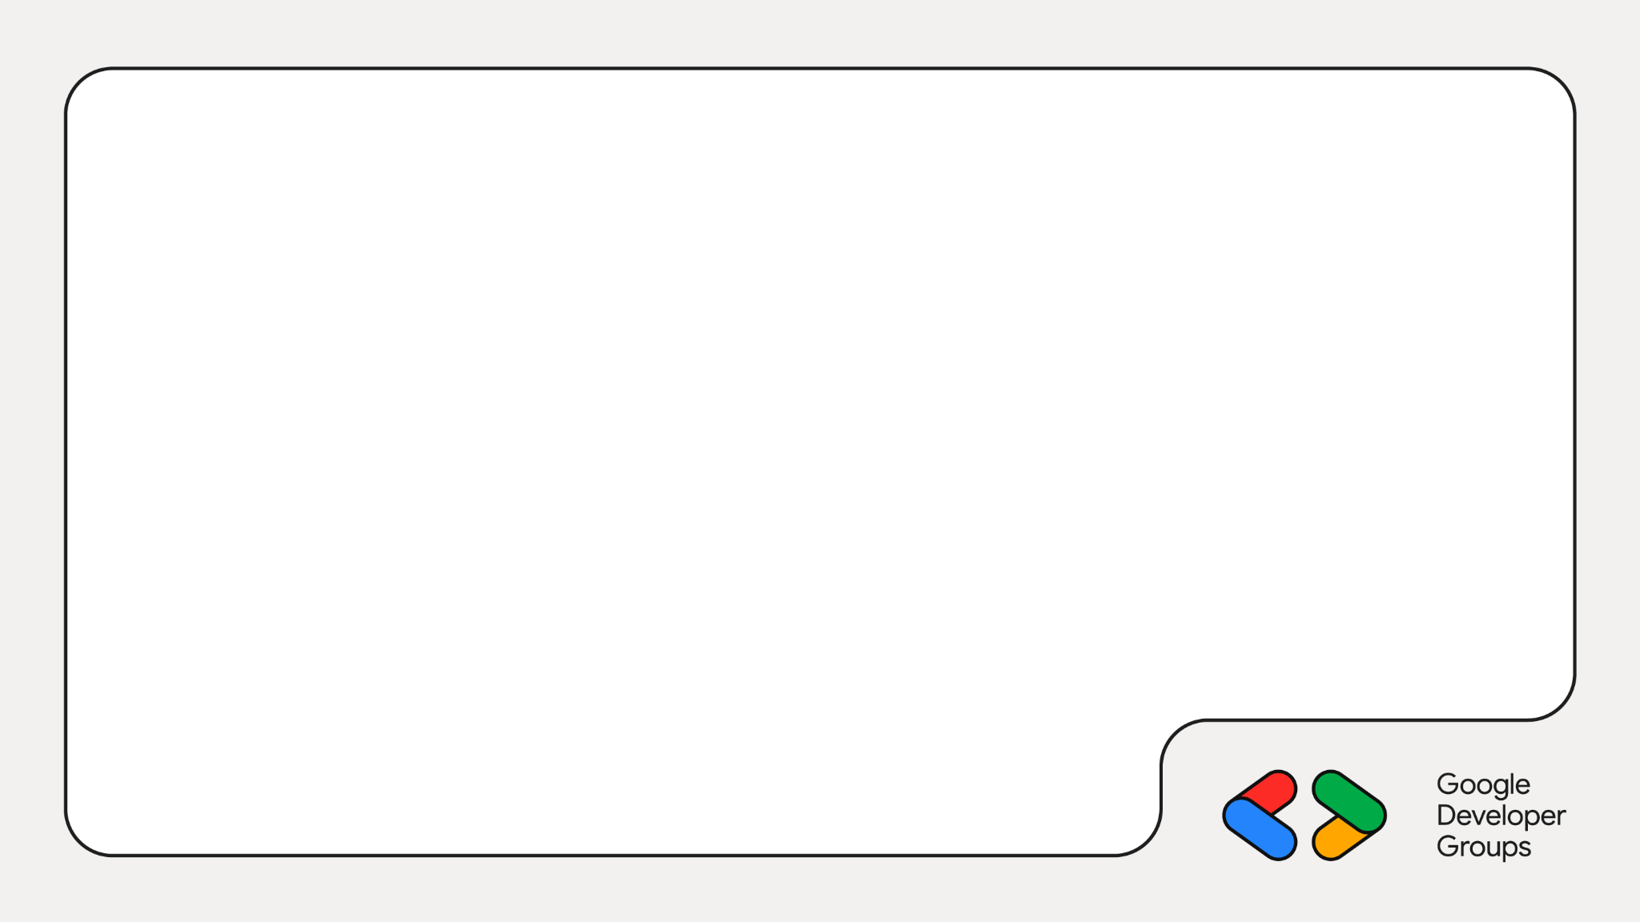
What is local AI?
The model's weights live on your own hardware
Prompts and answers never leave the device
Works with Wi-Fi switched off
Cloud AI
You
Internet
Data centre
Local AI
You
Your device

Slide 5
Why run it locally?
Privacy
Your data never leaves the device
Offline
No signal? It still answers
Cost
No per-token bill, ever
Control
You choose the model, version and rules

Slide 6
02
Meet Gemma 4
Google's open model family, Apache 2.0

Slide 7
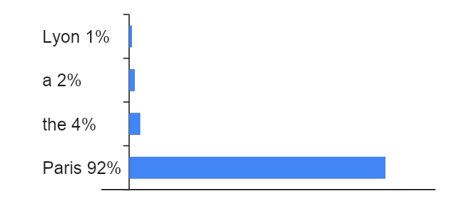
How an LLM answers: one token at a time
Text → tokens
Attention layers
Score every next token
Pick one, repeat
Input: “The capital of France is”
P(next token | everything so far)
Same spirit as Bayes: update a guess with new evidence.
No lookup, no database: just very good guessing, repeated.
Illustrative probabilities

Slide 8

Gemma 4 is truly open
Apache 2.0: free as in total freedom
No research-only clause
No “don't make money or we'll sue” clause
Fine-tune it, ship it, sell it

Slide 9
The Gemma 4 family
Model | Parameters | Q4_0 memory | Sweet spot
E2B | 2.3B effective | 2.9 GB | Phones, Raspberry Pi
E4B | 4.5B effective | 4.5 GB | Pi 5, laptops
26B A4B | 26B total / 3.8B active (MoE) | 14.4 GB | One consumer GPU
31B | 31B dense | 17.5 GB | 24 GB GPU
Green = what fits a Pi. All Apache 2.0 and multimodal. A 12B sits in between. “E” = effective parameters.

Slide 10
Decoding the names: E2B, A4B, it, QAT
Tag | What it means | Example
E2B · E4B | Effective parameters: the per-layer tables are just lookups | E2B: 2.3B effective, 5.1B stored
26B A4B | Mixture of Experts: 26B total, ~4B Active per token | A router picks a few experts
31B · 12B | Dense: every parameter works on every token | Biggest and most capable
it | Instruction-tuned, chat-ready (base = raw pretrained) | gemma4:e4b-it-qat
QAT | Quantization-aware training: built to survive 4-bit | Google ships QAT checkpoints
Q4_0 | 4-bit weight format, about 4.5 bits per weight | E2B: 11.4 GB to 2.9 GB
B = billions of parameters. Names follow Google's Gemma 4 docs.

Slide 11
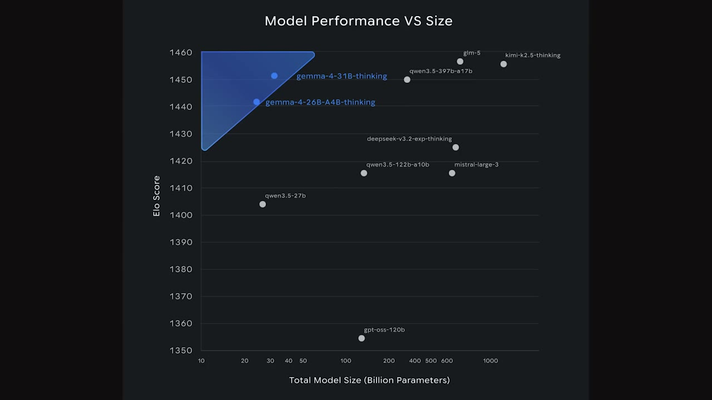
Small, but not weak
Top-left is the sweet spot: high score, few parameters
Gemma 4 31B and 26B A4B sit up there
E2B and E4B go further: phone and Pi class

Slide 12
Gemma vs the open-model field
Family | Licence | Local story
Llama | Community licence, extra usage terms | Strong, large
GPT-OSS | Apache 2.0 | Bigger models
Qwen · Kimi · DeepSeek | Open weights, terms vary | Frontier-scale, heavy
Gemma 4 | Apache 2.0, no strings | E2B / E4B run on a Pi
20 GB
Gemma 4 31B download
600+ GB
Kimi K2.5, a rival of similar benchmark class

Slide 13
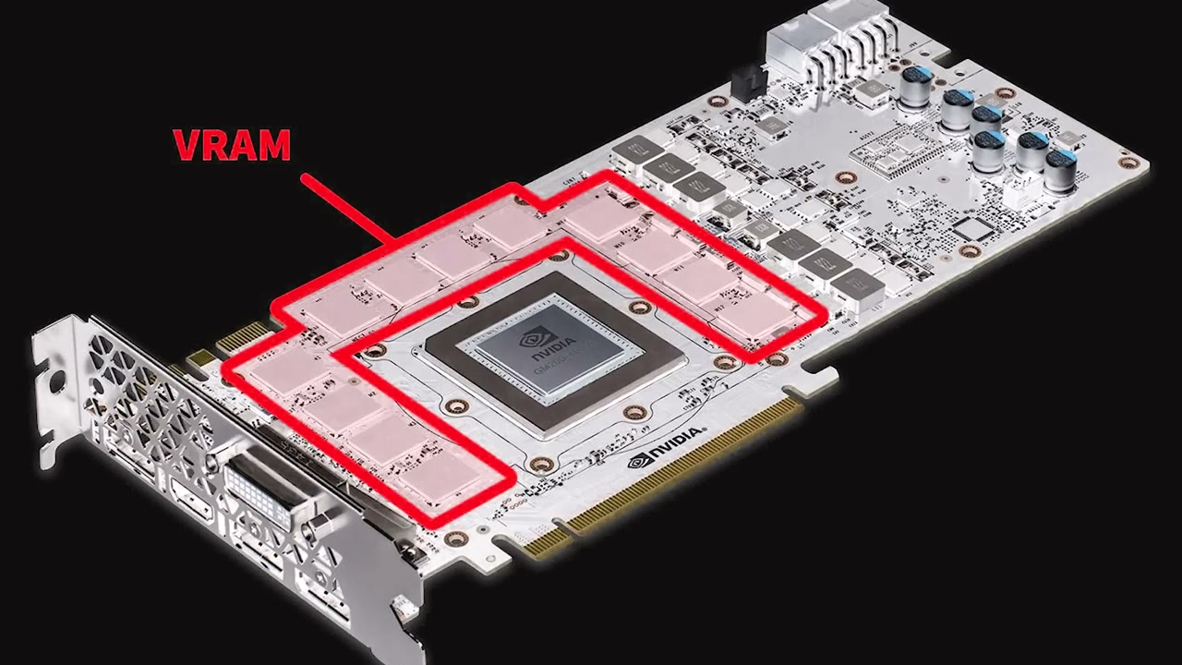
The real bottleneck: memory, not compute
Every token re-reads the model's weights from memory
Speed is about memory bandwidth ÷ bytes read
Parameter count alone is the wrong yardstick
Pi 5 back-of-envelope: 17 GB/s ÷ ~1.3 GB per token ≈ 13 tok/s ceiling. We measure ~8.

Slide 14
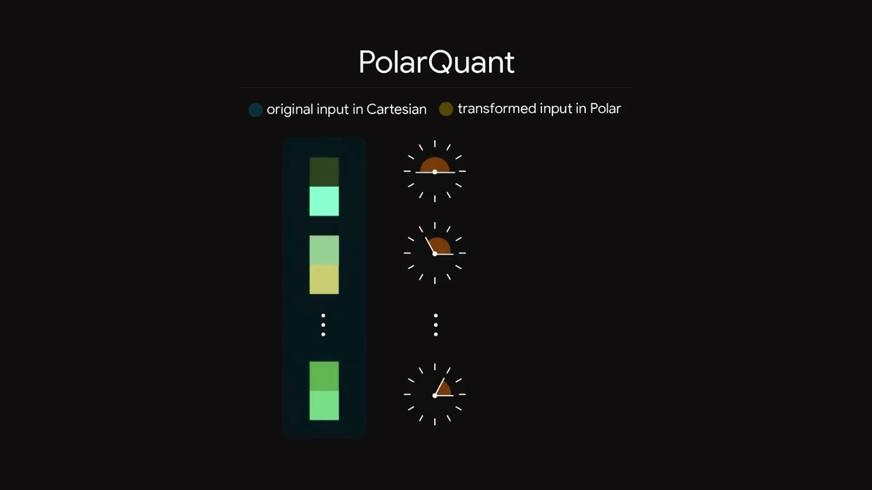
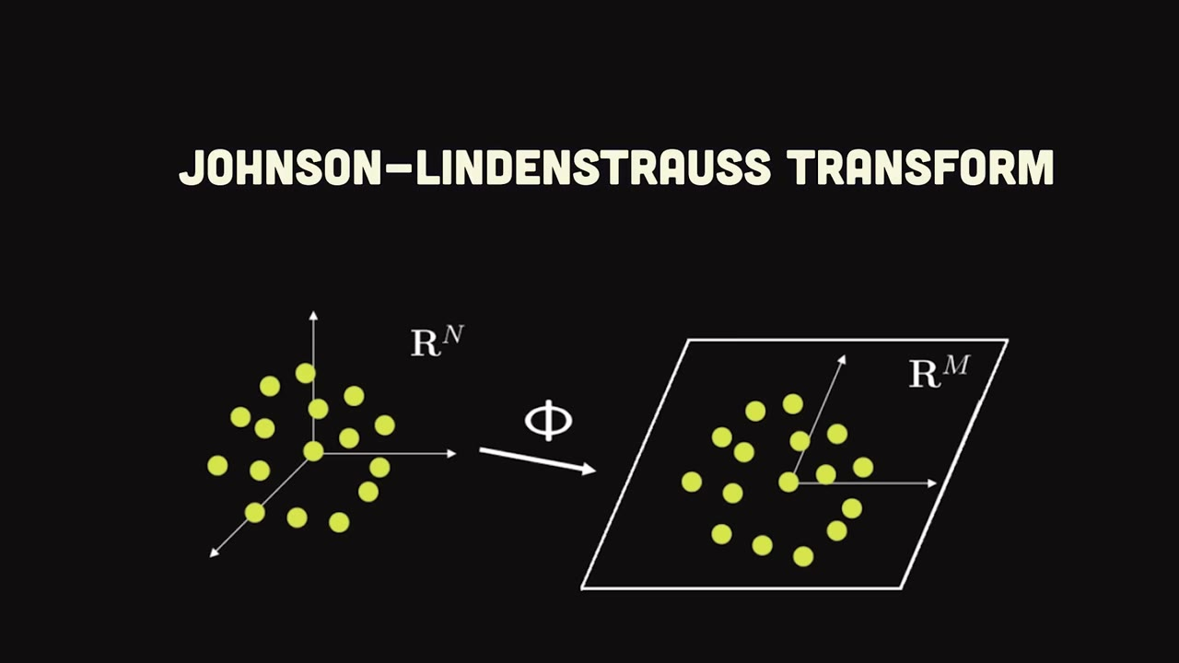
TurboQuant: shrinking the KV cache
1
PolarQuant
Cartesian to polar: store radius and angle, skip normalisation overhead
2
Johnson–Lindenstrauss
Squash to sign bits (+1 / −1) while keeping distances
3
~3 bits per value
Google Research, March 2026. It targets the KV cache, not the weights

Slide 15
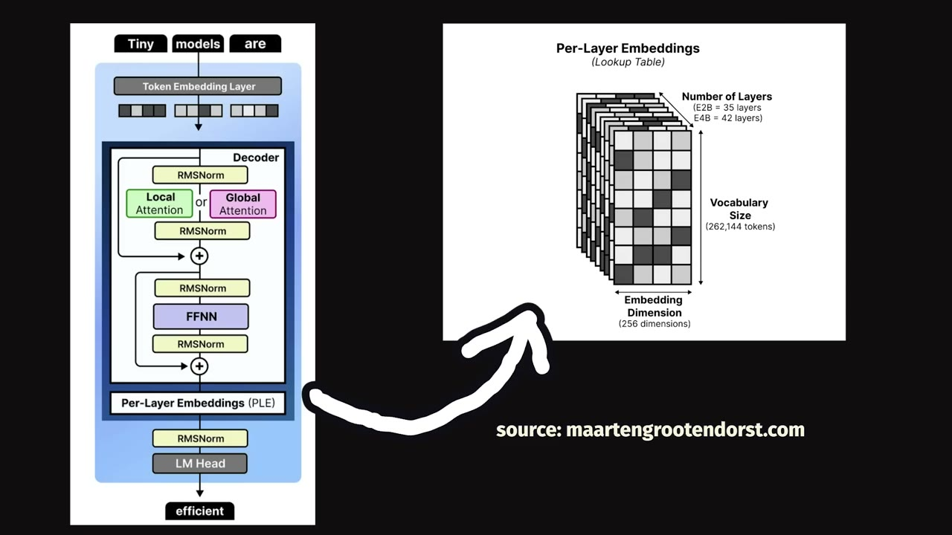
Per-layer embeddings: the “E” in E2B
Normal: one embedding at the input, carried through every layer
PLE: each layer gets its own small lookup for every token
E2B table: 262,144 tokens × 35 layers × 256 dims, just lookups, fine in flash
So: 2.3B effective, 5.1B stored

Slide 16
03
Gemma on a Raspberry Pi 5
Always on, a few watts, fully offline

Slide 17
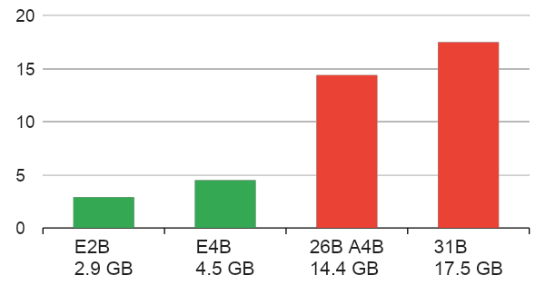
Pick the model the Pi can hold
Raspberry Pi 5 · 8 GB
4× Cortex-A76 @ 2.4 GHz
8 GB LPDDR4X (~17 GB/s)
CPU inference, no GPU
E4B on 8 GB works but RAM maxes out (7.3 of 7.9 GB, our tests). E2B leaves headroom.
Pi 5: 8 GB RAM, shared with the OS

Slide 18
Gemma on the Pi in 3 commands
$ curl -fsSL https://ollama.com/install.sh | sh
$ ollama pull gemma4:e4b-it-qat
$ ollama run gemma4:e4b-it-qat
Gotchas we hit
It's a thinking model: call /api/chat with think: false or you get empty replies
Cold load takes ~100 s: warm it up before you go on stage
Set keep_alive so it stays loaded
Ollama handles download, quantised weights and a local API on port 11434.

Slide 19
04
Gemma + Robotics
Say it. Gemma sees it. The arm does it

Slide 20
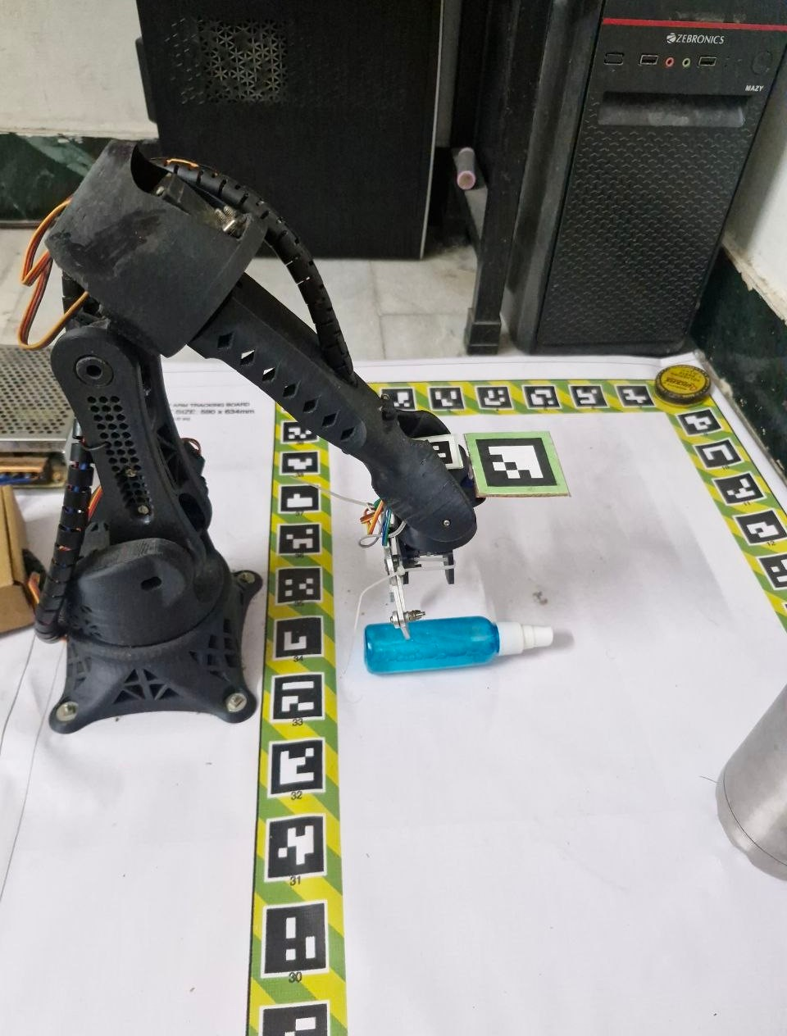
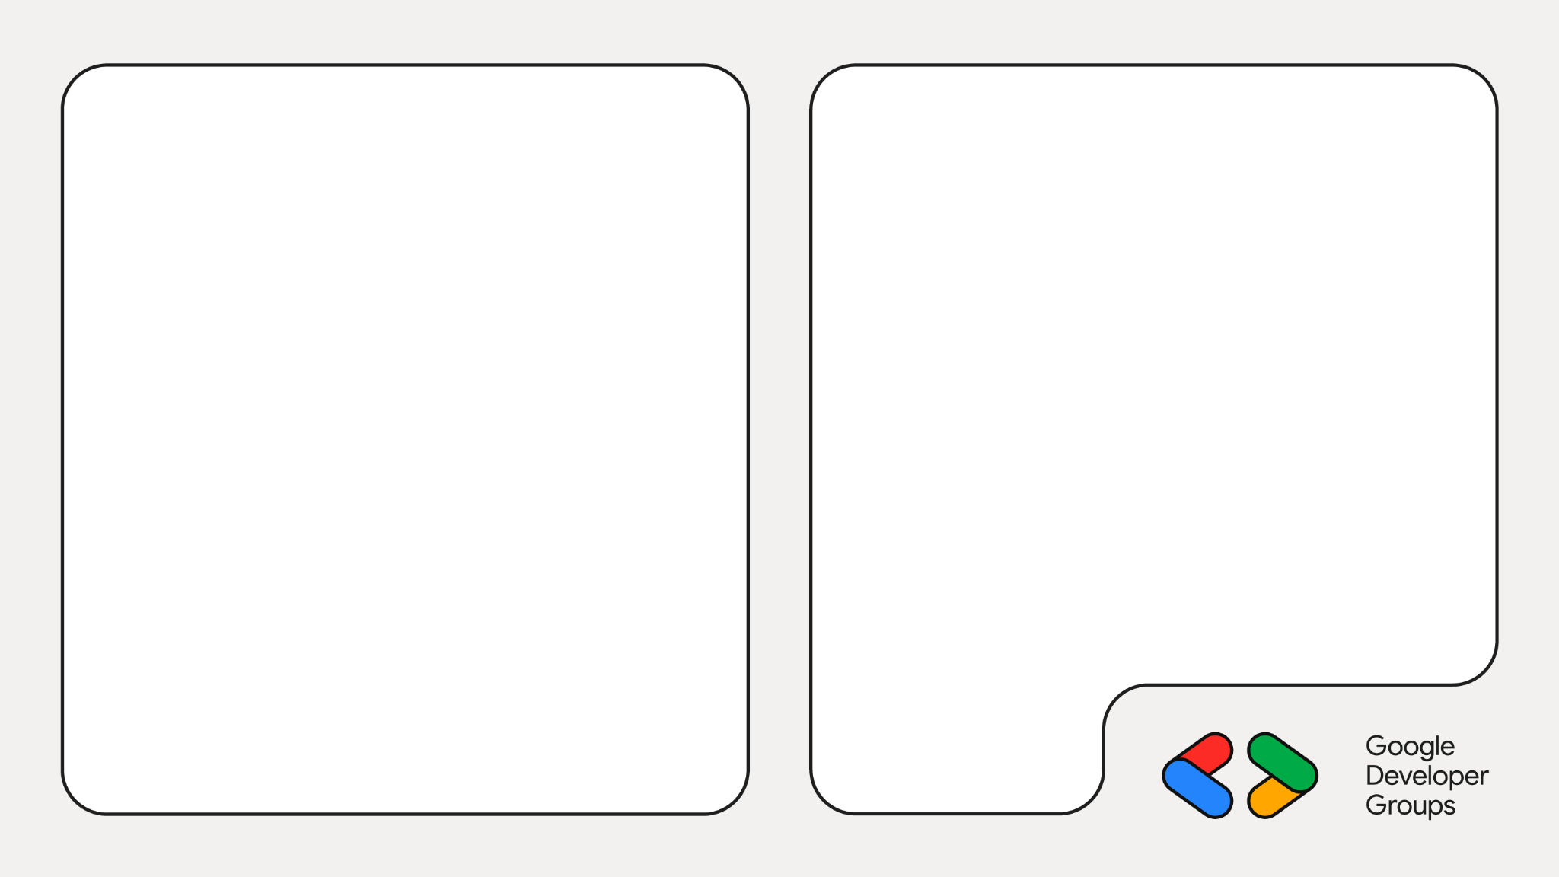
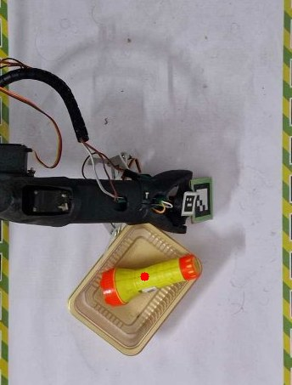
An offline robot arm
Phone camera sees the board
Gemma 4 finds the object
6-servo arm picks and places
All on a Raspberry Pi 5, no cloud

Slide 21
How it works: five stages, one Pi
Phone camera
Wide Cam app, USB to the Pi
Flatten board
ArUco markers + homography to mm
Gemma 4 E2B
Fine-tuned, Q4_0, llama.cpp
Refine
OpenCV: box to grasp point
Arm control
6 servos, safety limits
You: “pick up the torch and place it in the box”
Gemma: [{"do":"pick","box":[ymin,xmin,ymax,xmax]}, …] + one friendly sentence

Slide 22
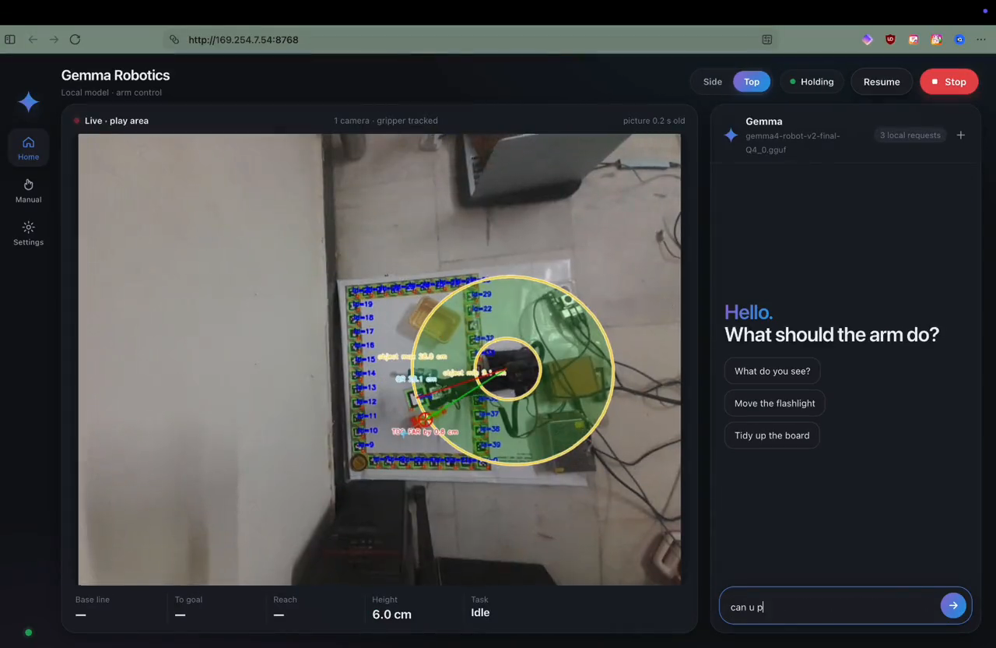
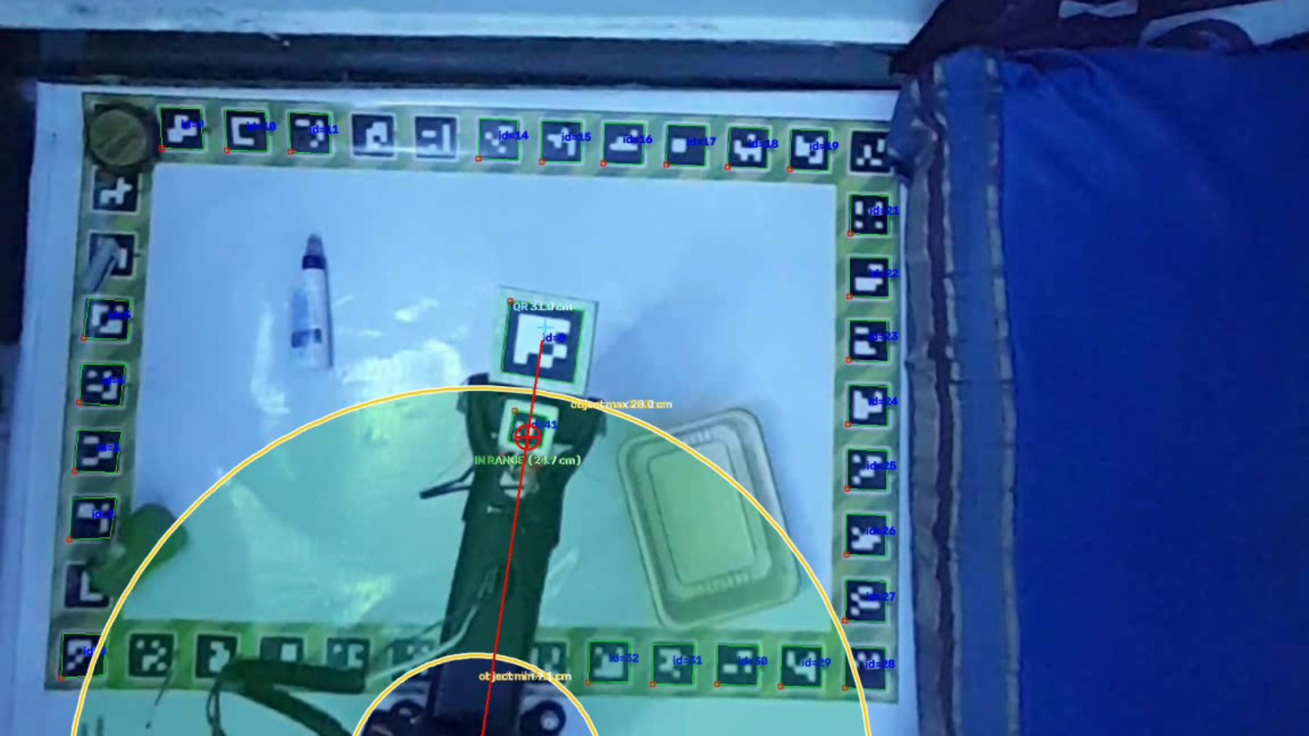
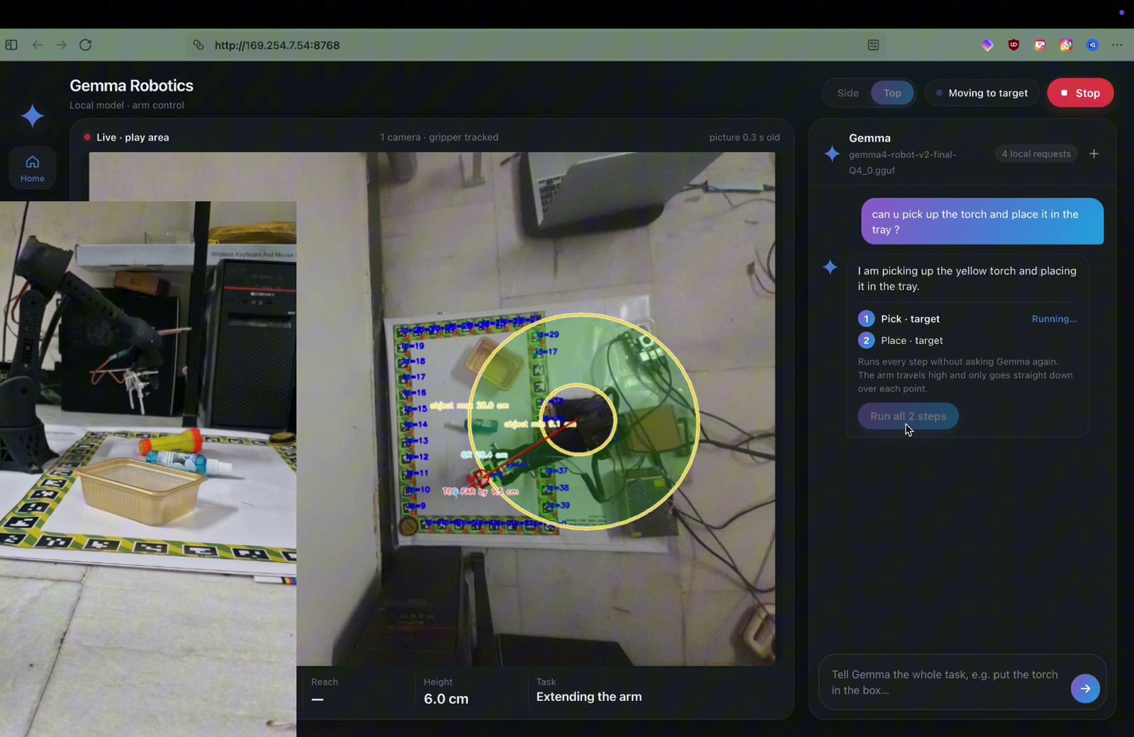
Demo: Pi-hosted Gemma controlling the arm
What to watch
Request becomes boxes
Base turns, reaches, grips, lifts, places
No Wi-Fi needed

Slide 23
Teaching Gemma to point: LoRA fine-tuning
Data
835 train, 62 val
Train
LoRA on free Colab T4
Merge
adapter into base
Quantise
GGUF Q4_0
Deploy
llama.cpp on Pi
Why LoRA?
Freeze the base model, train tiny low-rank adapters (rank 16) on attention and MLP layers. A checkpoint is ~50 MB.
What we kept fixed
Vision encoder stays as Google made it. Loss only on the answer tokens, at the same 140 image tokens the Pi uses.

Slide 24
What one training example looks like
image top-down board photo
user “Pick up the black flashlight.”
model [{"do":"pick",
"box":[412,380,531,455]}]
“Got it, grabbing the torch!”
boxes are 0 to 1000 on the image (values illustrative)
835
train examples
62
val, 4 unseen scenes
4×
views: flip, 180°, zoom + light
self
replies written by Gemma
Boards photographed from a real phone-camera frame; labels reviewed, 5 fixed by hand

Slide 25
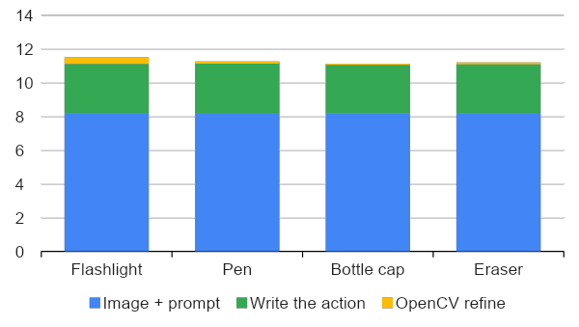
Benchmark: how fast on a Pi 5?
11.3 s
request to CV-checked grasp point
8 s
is just the image + prompt (140 tokens)
1.3 s
same model on an M4 Mac (median)
Pi 5, E2B Q4_0, 4 threads, no throttling; 4 single-object requests. Model load 4 s excluded

Slide 26
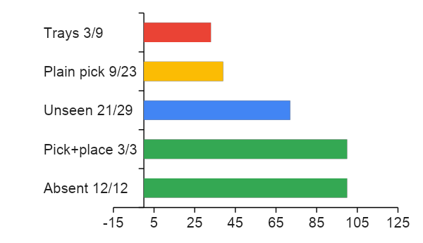
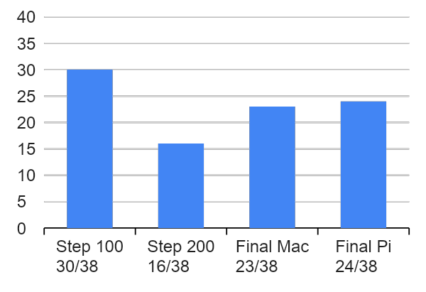
Benchmark: how often is it right?
On the Pi: 24 of 38 exam prompts pass (63%)
Accuracy swung between checkpoints
38-prompt dev exam; slices overlap. Development numbers, not a published benchmark

Slide 27
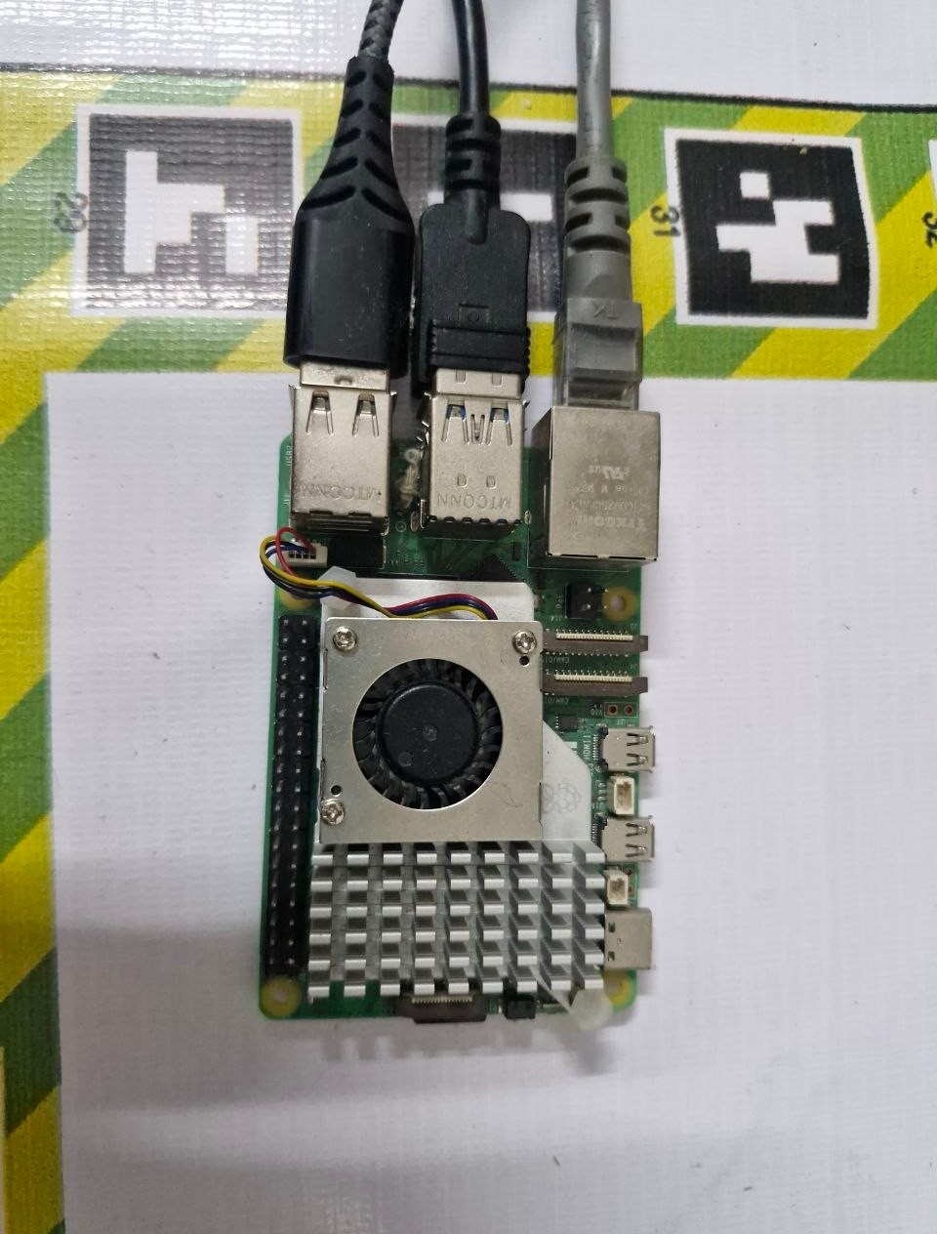
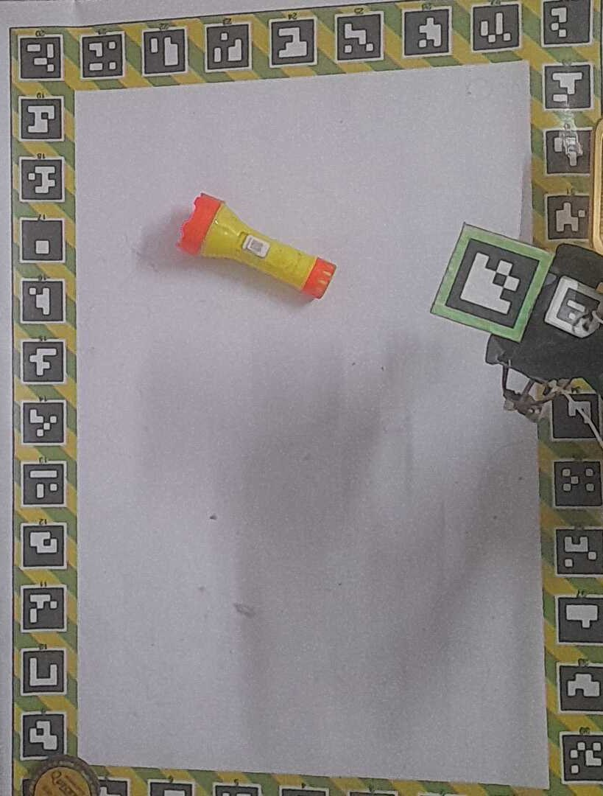
Gemma lessons
Thinking model: set think: false or replies come back empty.
Image tokens set latency: 140 is ~12 s, 280 is ~31 s.
Test every checkpoint: 30, then 16, then 23 of 38.
Teach it to say no: absent object means empty action.

Slide 28
05
The Future
Local brains for robots that can't phone home

Slide 29

1.3 s
Earth to Moon, one way
Earth to Mars: 3 to 22 min

Slide 30
From a desk to a multi-planetary builder
Today
An arm on a desk, Gemma on a Pi
Next
Home, farm and disaster-zone robots that think on-device
The Moon
Robot swarms building habitats and pads from lunar soil
Mars and beyond
Autonomous crews prepare bases before humans land
What has to be true: small offline models, tiny power budgets, self-calibration, swarm coordination, safety first.
A vision, not a forecast. NASA and ESA already study 3D-printing habitats from lunar regolith

Slide 31
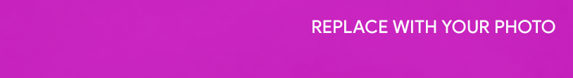
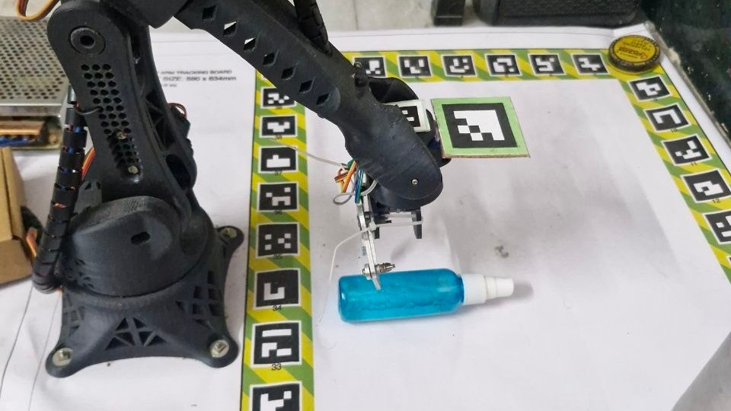
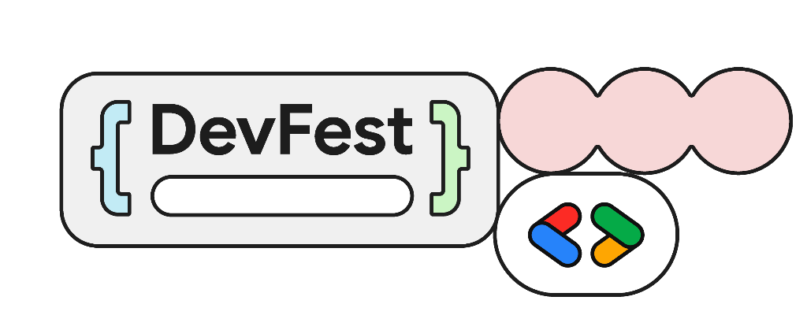

Chennai
Thank you!
Questions?
Slides, demo video & PDF:
gokulbarath.is-a.dev/devfest2026

