Slide 1
ECO-LOOP BUILDING AGENTS
PS ID – Question 1
PS Title – Eco-Loop Building Agents
Theme – Sustainable Buildings
Category – Software
Student – Gokulan Malli Jayaprakash
ID – C10421040
Notes:
Open with the problem: rigid BMS schedules waste energy and cannot adapt to weather, occupancy, or comfort. Eco-Loop closes that loop inside EnergyPlus.
[Sources]
- V:\BMS_automation\questions\Screenshot 2026-07-25 191031.png
- V:\BMS_simulation\pyproject.toml

Slide 2
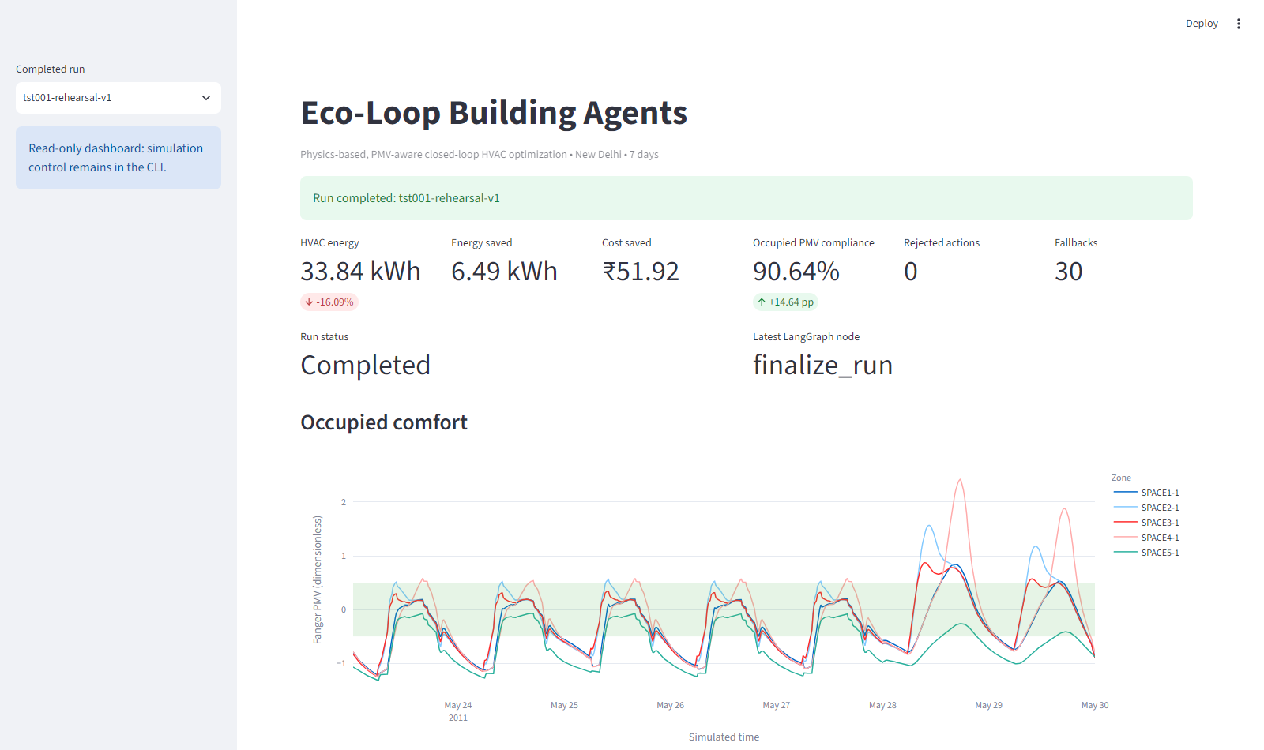
ECO-LOOP BUILDING AGENTS
Proposed Solution
EnergyPlus streams five-zone temperature, occupancy, PMV and HVAC energy.
LangGraph runs Energy → Comfort → Supervisor → Safety → Action → Reflection.
Measured: 16.09% less HVAC energy; occupied comfort rises from 76.00% to 90.64%.
Notes:
State the exact accepted outcome. The quantitative run uses the deterministic optimizer through the same autonomous LangGraph, safety, FastMCP and EnergyPlus path; Qwen remains advisory and safely fallible.
[Sources]
- V:\BMS_simulation\artifacts\accepted-run\comparison.csv
- V:\BMS_simulation\artifacts\accepted-run\summary.json
- V:\BMS_simulation\artifacts\demo\01-overview.png

Slide 3
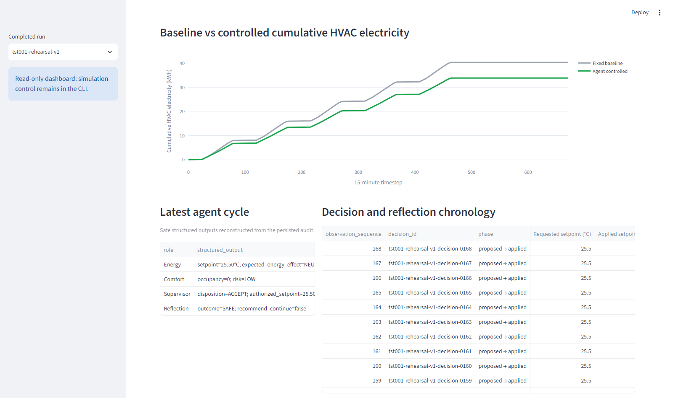
TECHNICAL APPROACH
Stack: Python 3.12, EnergyPlus 26.1, LangGraph, FastMCP, Pydantic, Streamlit and Qwen3 4B.
Loop: observe → agents → safety → server reauthorization → actuation → measured reflection.
Notes:
Explain the trust boundary: agents propose; deterministic validation and FastMCP independently reauthorize the exact setpoint before EnergyPlus can be changed. Provider timeout or malformed output abstains into a bounded fallback.
[Sources]
- V:\BMS_simulation\docs\architecture.md
- V:\BMS_simulation\docs\techspec.md
- V:\BMS_simulation\artifacts\demo\05-agents-decisions.png

Slide 4
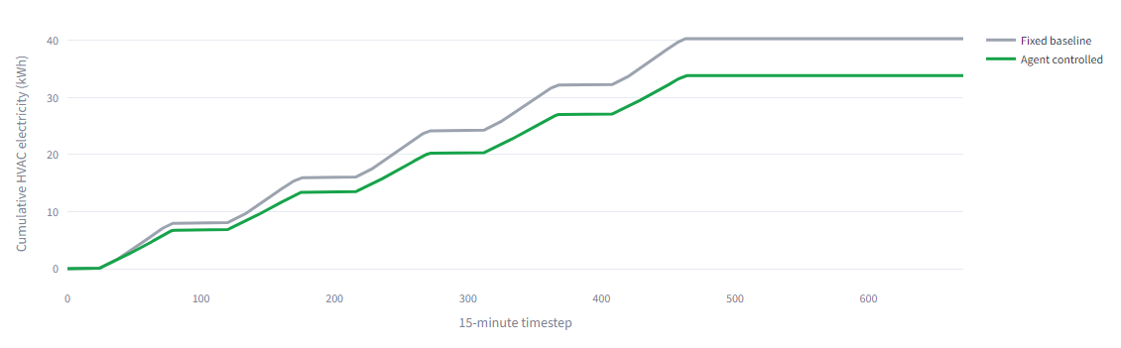
FEASIBILITY AND VIABILITY
Proven locally: 672 timesteps, 168/168 actions, 6.05 s and zero severe errors.
Risks: unsafe output, stale actions, timeout, comfort conflict and irreproducible runs.
Mitigation: PMV guard, 22–28°C bounds, 1°C limit, double authorization and immutable runs.
Notes:
Emphasize that feasibility is demonstrated rather than estimated: 40.3306 kWh baseline versus 33.8408 kWh controlled, 90.64% comfort compliance, five emergency violations in both cases, and zero severe EnergyPlus errors.
[Sources]
- V:\BMS_simulation\artifacts\accepted-run\comparison.csv
- V:\BMS_simulation\artifacts\accepted-run\summary.json
- V:\BMS_simulation\artifacts\demo\04-energy.png
- V:\BMS_simulation\docs\environment-report.md

Slide 5
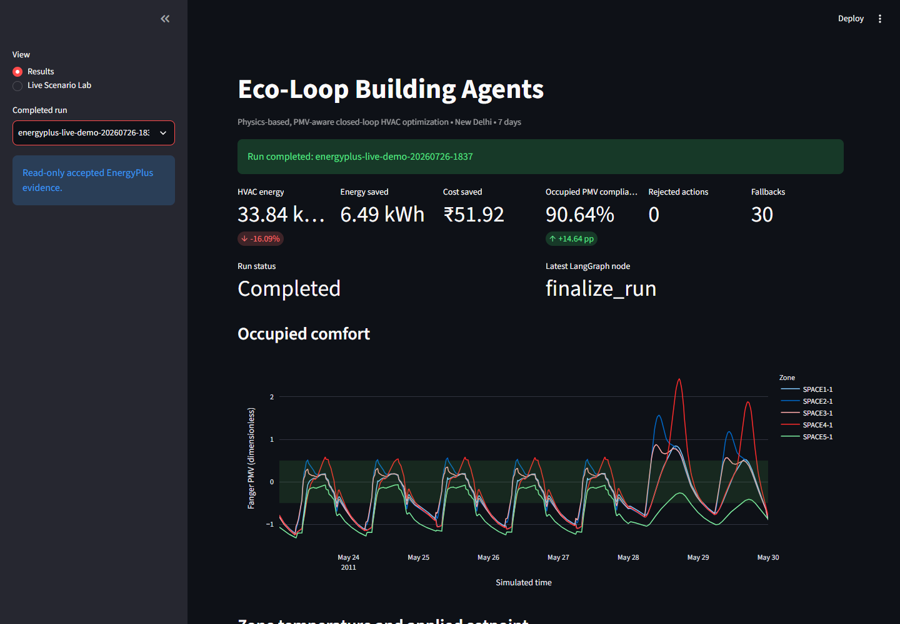
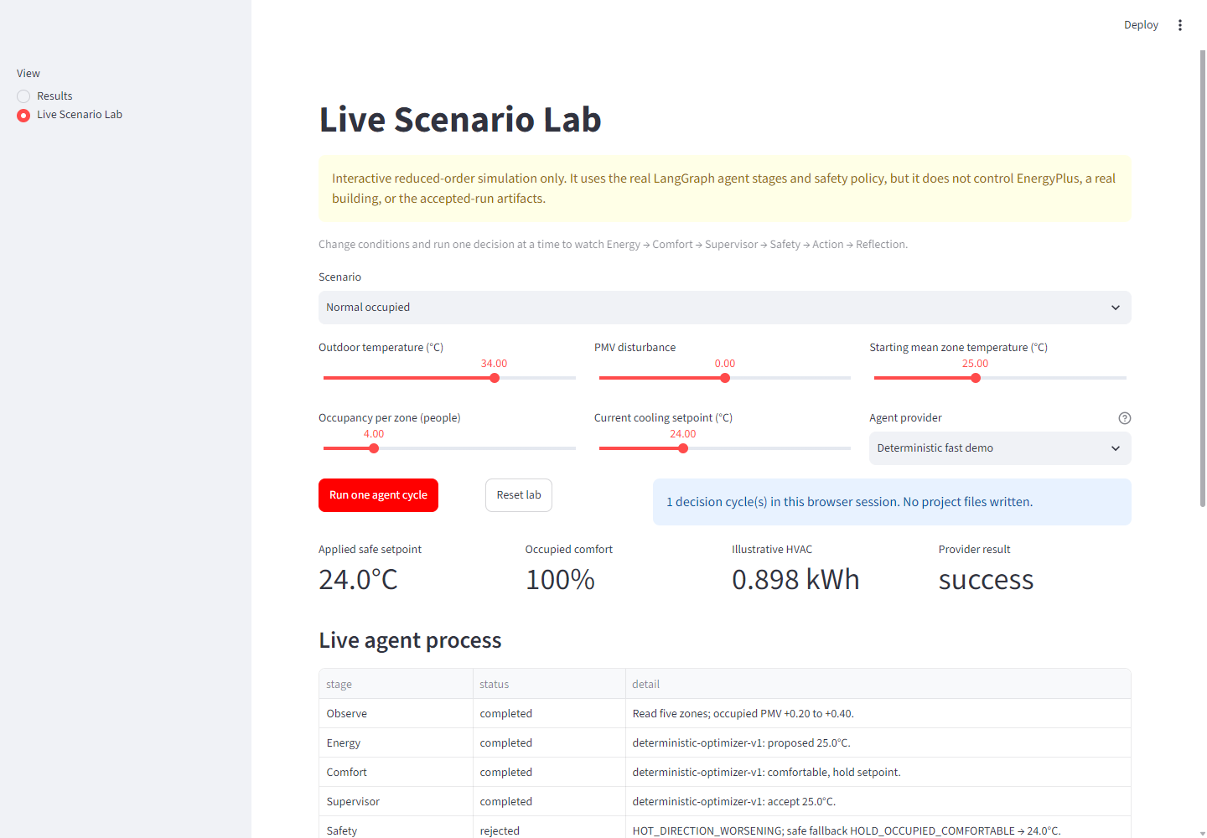
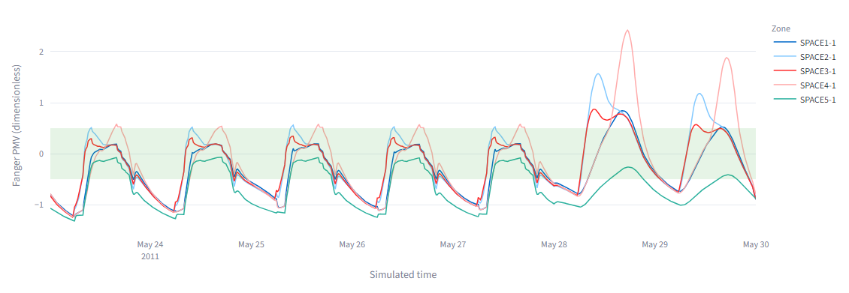
ARTIFACTS
Working proof:
Source, IDFs, lockfile and 377 tests
Real EnergyPlus, PMV and agent evidence
Isolated Live Scenario Lab
Notes:
Differentiate the evidence: the Results view and immutable run artifacts prove the real EnergyPlus result. The Live Scenario Lab is deliberately isolated and is only an interactive reduced-order demonstration.
[Sources]
- V:\BMS_simulation\artifacts\demo\09-real-energyplus-live-demo.png
- V:\BMS_simulation\artifacts\demo\02-comfort.png
- V:\BMS_simulation\artifacts\demo\06-live-scenario-lab.png
- V:\BMS_simulation\README.md

Slide 6
RESEARCH AND REFERENCES
EnergyPlus Python API — energyplus.readthedocs.io/en/latest/api.html Fanger PMV — bigladdersoftware.com/epx/docs/25-1/input-output-reference/ LangGraph — github.com/langchain-ai/langgraph Model Context Protocol Python SDK — github.com/modelcontextprotocol/python-sdk Ollama structured chat — docs.ollama.com/api/chat Project evidence — controlled-run001-optimized-v3; 377 tests; 90.47% branch coverage Honest boundary — accepted metrics use the deterministic optimizer; Qwen3 4B is advisory and cannot bypass safety.
Notes:
Close on defensible novelty: inspectable multi-agent autonomy, comfort-constrained optimization, and double authorization at the actuator boundary. Do not claim that Qwen produced the accepted 16.09% result.
[Sources]
- V:\BMS_simulation\docs\techspec.md
- V:\BMS_simulation\docs\architecture.md
- V:\BMS_simulation\artifacts\accepted-run\summary.json
- V:\BMS_simulation\docs\current-status.md

