Slide 1
End-to-End Quantitative Pipeline & Business Intelligence Dashboard
A production-grade data engineering and quantitative analytics system designed for the Indian Mutual Fund industry.
Prepared for: BlueStock Intern Project Evaluation Developed by: Capstone Technical Team Date: June 2026
MUTUAL FUND ANALYTICS
Capstone Project Presentation

Slide 2
Executive Summary
Automated ETL Pipeline: Standardized and cleaned 10 raw CSV datasets representing over 90,000 transaction, master, and index entries, resolving data anomalies programmatically.
Relational SQLite Database: Populated a Star Schema SQLite database (bluestock_mf.db) optimizing performance and storage, enforcing structural integrity and primary/foreign key relationships.
Quantitative Financial Engine: Computed returns, CAGR, Sharpe and Sortino ratios, CAPM Alpha/Beta, and Maximum Drawdowns across 40 schemes over a historical 4.5-year horizon.
Advanced Strategy Modeling: Developed Value at Risk (VaR), Conditional VaR (CVaR), Herfindahl-Hirschman Index (HHI) for sector concentrations, and customer cohort retention tracking.
Interactive Analytics Dashboard: Created a responsive 6-page dashboard featuring drill-through scorecards, state-wise flows, demographic insights, and a personalized recommendation engine.
DATABASE HIGHLIGHTS
• 40 Mutual Fund Schemes
• 10 Interlinked Tables
• 90,000+ Total Records
• 32,778 Investor Transactions
• 5,000 Unique Customers
• 1,043,664 Cr Total AUM
• 3,521.58M INR Inflow Value

Slide 3
System Architecture & Decoupled Data Pipeline
The system is structured as a modern data engineering pipeline, dividing operations into clear layers:
Layer 1: Raw Ingestion
• 10 Ingested CSV Files
• AMFI REST API Integration
• Historical Daily NAVs
• Investor Transactions
• Portfolio Sector Weights
• Index closing values
Layer 2: ETL & Storage
• Python Standardization
• Business-day Reindexing
• Missing NAV Forward-fill
• SQLite Normalized DB
• Foreign Key Constraints
• SQL indexing & queries
Layer 3: Quantitative Engine
• Returns, CAGR, & MDD
• Sharpe & Sortino ratios
• CAPM Alpha & Beta Model
• 95% Daily VaR & CVaR
• HHI Concentration
• Cohort retention matrices
Layer 4: Presentation Layer
• Python Server Backend
• REST API endpoints
• Vanilla JS Frontend
• Dynamic Chart.js visuals
• Multi-page filtering
• Recommendation UI

Slide 4
Relational Database Star Schema
dim_fund (Primary Dimension): Central master table representing 40 mutual fund schemes, mapping AMFI code, categories, benchmark, and expense ratios.
fact_nav (Historical Dimension): Stores historical daily NAVs and returns reindexed to business days over 4.5 years (~46,000 rows).
fact_performance (Analytical Dimension): Houses calculated composite scores, returns, Sharpe, Sortino, Alpha, Beta, MDD, and AUM.
fact_transactions (Behavioral Fact): Tracks 32,778 transaction logs containing demographic variables, transaction values, and payment modes.
fact_portfolio_holdings (Holding Fact): Maps portfolio stock symbols, weights, and sectors to each AMFI scheme.
fact_advanced_risk (Risk Fact): Captures calculated 95% Value at Risk (VaR) and 95% Conditional VaR (CVaR) for all 40 schemes.
fact_sector_concentration (Concentration Fact): Tracks Herfindahl-Hirschman Index (HHI) and concentration levels based on portfolio weightings.
fact_sip_inflows (Industry Fact): Tracks aggregate monthly mutual fund SIP inflows, folio registrations, and AUM growth in India.
fact_category_inflows (Industry Fact): Details net capital inflows across mutual fund categories on a monthly basis.
dim_aum_fund_house & dim_industry_folio: Store aggregate industry parameters and fund house AUM statements.

Slide 5
Data Ingestion Pipeline & ETL Process
Holiday Reindexing & Forward-Filling: Daily NAVs in raw data (1,150 dates, Jan 2022 to May 2026) were missing holidays. The pipeline reindexes each scheme to standard business days (freq='B') and forward-fills (ffill) missing values. This prevents computation gaps and keeps chronological data consistent.
Transaction Type Mapping & Normalization: Cleaned transactional metadata in investor logs. Standardized input strings to strict categories: SIP, Lumpsum, or Redemption, and discarded negative transaction amounts.
KYC Status Standardization: Cleaned KYC fields, eliminating missing or corrupt strings and mapping them strictly to Verified or Pending to maintain compliance accuracy.
Numeric Constraint Auditing: Verified that AUM, daily NAV, and transaction amount fields are strictly positive. Enforced expense ratios to standard ranges [0.1%, 2.5%] and converted drawdown percentages to negative values.
Automated Quality Assurance: Created verify_pipeline.py which performs automated assertions to check table population, relational referential integrity, and data ranges, outputting validation reports.

Slide 6
Quantitative Returns & Volatility Calculations
Trailing Daily NAV Returns: Calculated daily return series using: Return(t) = (NAV(t) - NAV(t-1)) / NAV(t-1). Enforced forward-filled NAVs to guarantee daily return continuity on consecutive business days.
Compounded Annual Growth Rate (CAGR): Formulated the compound growth rate: CAGR = (Ending Value / Beginning Value) ^ (365.25 / Days) - 1. Calculates annualized performance across the 4.5-year history.
Maximum Drawdown (MDD): Designed to measure peak-to-trough drops: Drawdown(t) = (NAV(t) - Peak(t)) / Peak(t). The MDD is the minimum observed drawdown value, serving as a worst-case risk proxy.
MATHEMATICAL FORMULAS
Daily Return Formula: R_t = (NAV_t - NAV_{t-1}) / NAV_{t-1}
CAGR Formula: CAGR = (V_end / V_begin) ^ (365.25 / d) - 1
Maximum Drawdown Formula: MDD = Min((NAV_t - Peak_t) / Peak_t)

Slide 7
Risk-Adjusted Performance & CAPM Model
Sharpe Ratio: Measures risk-adjusted excess return: Sharpe = (R_annualized - R_f) / Vol_annualized. Utilizes a standardized 6.0% annual risk-free rate (R_f), annualizing daily returns and standard deviations using 252 business days.
Sortino Ratio: Focuses solely on downside volatility: Sortino = (R_annualized - R_f) / Vol_downside. Downside deviation is computed strictly from negative daily returns, penalizing only negative variations.
CAPM Beta (β): Measures systemic market volatility matching daily fund returns against its assigned benchmark index (e.g. NIFTY 100): Beta = Cov(R_fund, R_market) / Var(R_market).
CAPM Alpha (α): Measures manager outperformance against the market: Alpha = R_fund - [R_f + Beta * (R_market - R_f)].
RISK MODEL EQUATIONS
Sharpe Ratio: (Mean(R_d)*252 - 0.06) / (Std(R_d)*sqrt(252))
Sortino Ratio: (Mean(R_d)*252 - 0.06) / (Std(R_neg)*sqrt(252))
CAPM Beta (β): Covariance(R_fund, R_index) / Variance(R_index)
CAPM Alpha (α): R_fund_ann - [R_f + β * (R_index_ann - R_f)]

Slide 8
Advanced Portfolio Risk & Strategy Analytics
Value at Risk (VaR): Calculated daily 95% VaR (5th percentile of daily return history). Represents the maximum expected loss over a single business day with a 95% confidence level.
Conditional Value at Risk (CVaR): Expected loss in the worst 5% tail events (Expected Shortfall). Measures the severity of extreme downside losses (where loss exceeds VaR), capturing systemic tail-risk.
Herfindahl-Hirschman Index (HHI): Formulated HHI = Sum(w_i^2) to assess sector concentration. Categorized as Diversified (HHI < 1,500), Moderately Concentrated (1,500 - 2,500), or Highly Concentrated (HHI > 2,500).
Cohort Retention Decay: Categorizes investors into cohorts based on onboarding quarter (e.g. 2024Q1). Tracks active participation decay rates at 3, 6, and 12-month marks to measure customer lifecycle duration.
SIP Continuation Alerts: Classifies systematic investment plans based on transaction recency. Accounts without transactions for 35+ days are flagged as At Risk to trigger proactive client outreach.

Slide 9
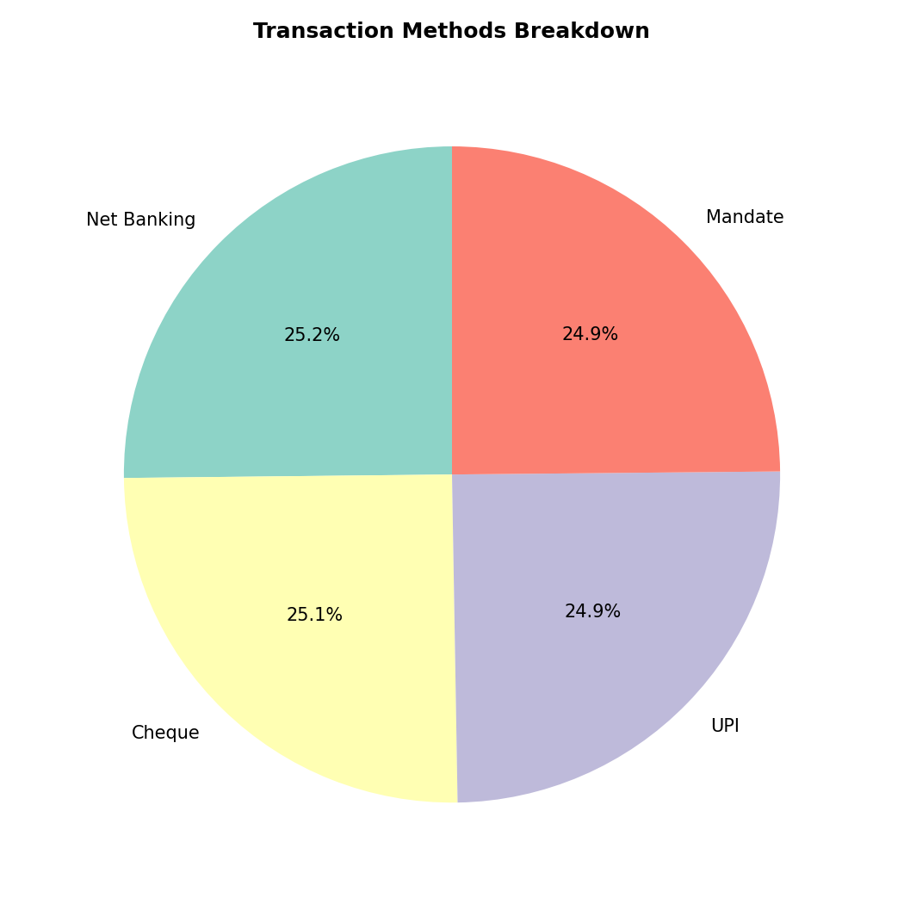
Key Project Metrics: Database Summary & Inflows
Total Assets Under Management: Encompasses 1,043,664.00 Crore INR (~10.4 Lakh Crore) across the 40 mutual fund schemes.
Transaction Auditing: Successfully verified 32,778 individual transactions spanning 5,000 unique active investors.
Cumulative Capital Inflows: Aggregated transaction value stands at 3,521,580,430.00 INR (~352 Crore INR).
Digital Payment Penetration: Digital modes (UPI: 888.24M, Net Banking: 893.49M) have reached complete volume and value parity with traditional methods (Cheque: 892.22M, Mandate: 847.63M).
Digitalization Trend: UPI accounts for 8,154 transactions, closely matching Net Banking (8,250 transactions) and Cheque (8,228 transactions), signaling high financial digitization.
Fig 1: Inflow volume and value distribution across payment channels

Slide 10
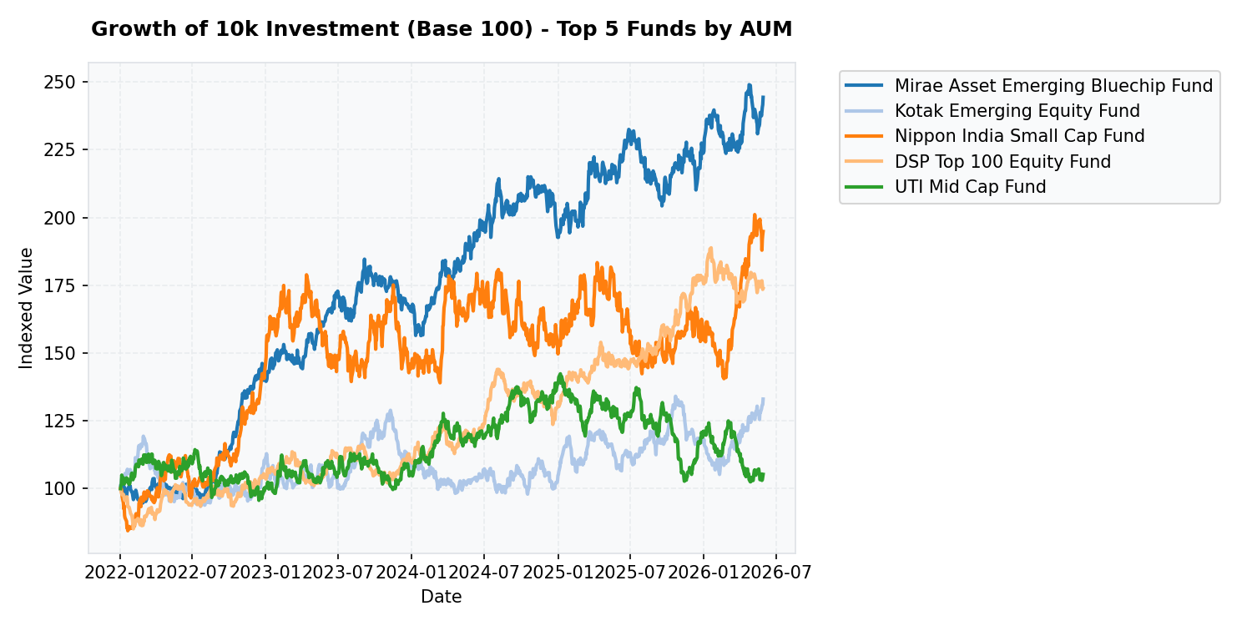
Mutual Fund Scorecard: Top & Bottom Performers
Weighted Scorecard formulation: Designed composite scores utilizing Sharpe (30%), CAPM Alpha (25%), CAGR (20%), Max Drawdown (15%), and Expense Ratio (10%).
Top Performing Funds: Mirae Asset Large Cap Fund (CAGR: 14.81%, Sharpe: 1.760, MDD: -11.27%), Kotak Flexicap Fund (CAGR: 15.65%, Sharpe: 1.568), and ICICI Pru Midcap Fund (CAGR: 18.08%, Sharpe: 1.391).
Bottom Performing Funds: Axis Small Cap Fund (CAGR: 1.52%, Sharpe: -0.179, MDD: -51.68%), UTI Mid Cap Fund (Sharpe: -0.266), and SBI Small Cap Fund (CAGR: 2.05%, MDD: -52.57%).
Performance Drivers: Mid-cap and Large-cap Equity funds dominated the scorecards due to strong bull market growth. Small-caps scored poorly due to severe maximum drawdowns (>50%).
Fig 2: Historical NAV growth trends of top performing mutual funds

Slide 11
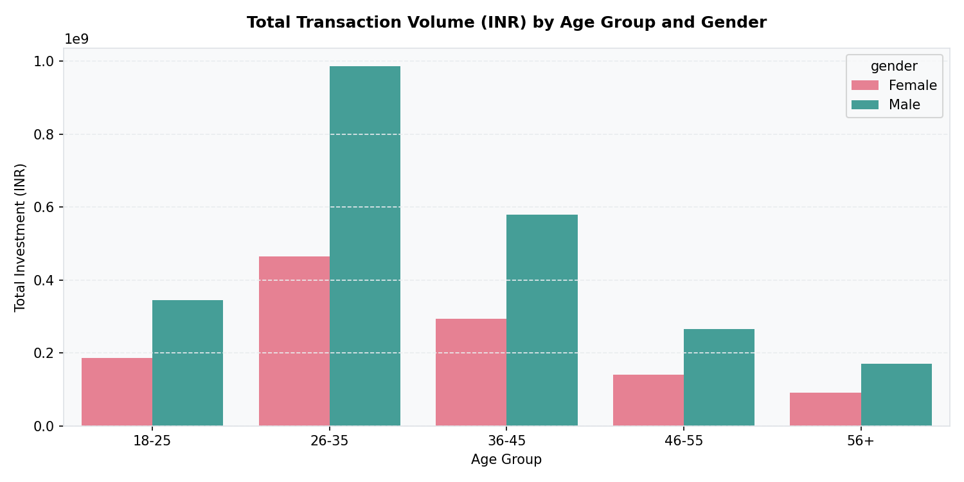
Investor Demographics & Geographic Insights
Millennial Dominance (26-35 age cohort): Represents the largest segment by value, accounting for 1,451,600,218.00 INR (41.2% total market share).
Mid-Career Segment (36-45 age cohort): Represents the second largest segment, contributing 871,647,528.00 INR (24.8% market share).
Gen Z Adoption (18-25 age cohort): Represents 15.1% of transactions (531.64M INR), showcasing emerging retail interest.
Geographic Leaders: Punjab leads with 2,965 transactions (315.78M INR), followed closely by Tamil Nadu (315.18M INR) and Madhya Pradesh (308.31M INR).
Retail Inflow Dispersion: Small ticket transaction values are highly spread across states, reflecting a broad retail investor footprint.
Fig 3: Age and Gender breakdown of transaction volume and value

Slide 12
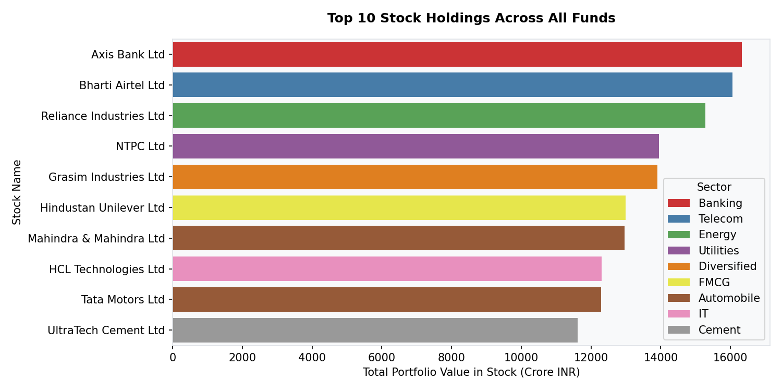
Portfolio Diversification & Sector Weightings
HHI Concentration Audit: Out of 34 equity funds, 3 are classified as Diversified (HHI < 1,500), 27 as Moderately Concentrated (1,500-2,500), and 4 as Highly Concentrated (HHI > 2,500).
Average Concentration Levels: The average HHI for moderately concentrated schemes lies at 2,014.96. Highly concentrated funds average 2,641.02, indicating high stock-specific risk.
Key Sector Allocations: Portfolio structures lean heavily on Banking (average weight of 10.87%, representing 62,840 Crore AUM) and IT sectors (average weight of 11.39%, 38,477 Crore AUM).
Concentration Risk: Highly concentrated funds require close monitoring, as their returns are tightly coupled to banking and IT sector cycles.
Fig 4: Sector holdings treemap showing asset allocations

Slide 13
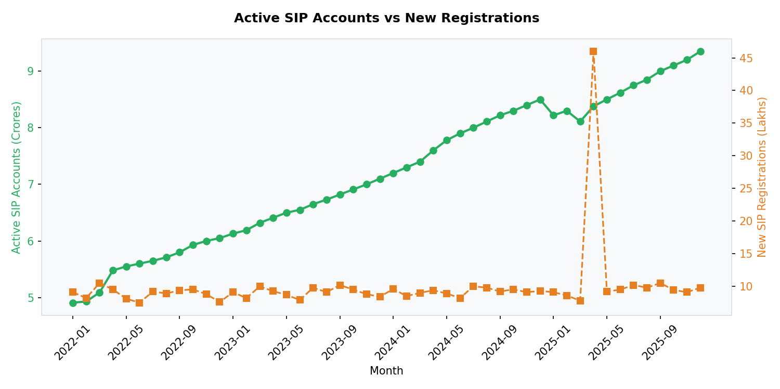
Investor Cohort Retention Analysis
Cohort Grouping: Monitored active investor decay quarterly based on onboarding cohorts to capture structural retention patterns.
2024Q1 Cohort (High Stability): Started with 3,236 investors. Exhibits strong retention: 70.92% active after 3 months, stabilizing at 69.62% active after 12 months.
2024Q2 Cohort (Moderate Decay): Onboarded 971 investors. Retention declines to 63.13% active after 3 months, dropping to 48.71% active at Year 1.
2024Q4 Cohort (Critical Churn): Onboarded 186 investors. Severe decay observed: only 40.32% active at 3 months, falling to 26.34% active at 6 months.
Strategic Conclusion: Year-end cohorts pose high attrition risk, necessitating engagement campaigns within their first 60 days.
Fig 5: Growth of active versus newly registered systematic investment plans

Slide 14
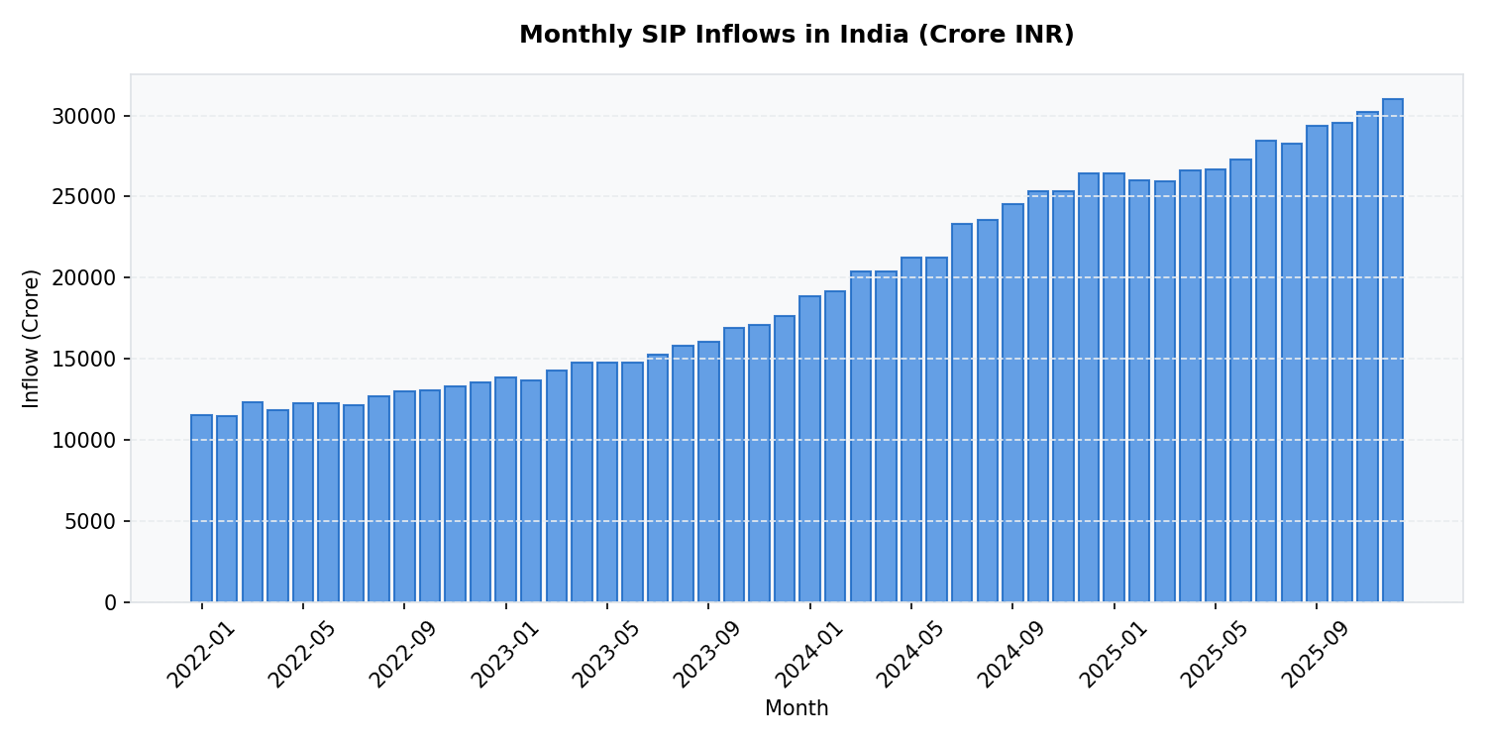
SIP Continuation & Investor Churn Risks
Continuation Classification: Classified SIP accounts based on transaction recency. Active SIPs have transacted in the last 35 days; At Risk SIPs show no activity for 35+ days.
Continuation Metrics: Active SIP Investors: 1,241 (26.1%). At Risk SIP Investors: 3,521 (73.9%).
Churn Hazard: More than 73% of SIP investors have lapsed, indicating a high number of paused or canceled mandates. This constitutes a severe cash flow retention risk.
Volatility Impacts: The high number of at-risk SIPs corresponds to periods of short-term market consolidation, causing retail investors to pause plans.
Strategic Imperative: Re-engaging at-risk accounts is the most critical commercial priority to stabilize recurring capital inflows.
Fig 6: Monthly SIP inflows (Crore INR) showing growth trajectory

Slide 15
Strategic Recommendations & Action Plan
Millennial Engagement & UPI Focus: Since investors aged 26-35 represent 41.2% (1,451M INR) of total transaction value, prioritize mobile-first interfaces, quick UPI payments, and seamless digital onboarding.
Q4 Cohort Retention Push: Cohorts onboarded in Q4 show severe drop-offs (only 26.3% active after 6 months). Deploy targeted push notifications, educational newsletters, and reward incentives in their first 60 days.
Automated SIP Resumption Prompts: To combat the 73.9% At-Risk SIP rate, implement automated triggers. When an investor skips a scheduled transaction (no contribution in 30 days), prompt them with one-click 'Resume' or 'Pause for 3 Months' actions.
HHI Concentration Alerts: For investors holding 'Highly Concentrated' portfolios (HHI > 2,500), implement dashboard recommendations proposing supplementary 'Diversified' funds (HHI < 1,500) to balance holdings risk.
Next Steps: Embed these metrics and automated notifications directly into the dashboard platform. Monitor monthly cohort decay to assess the effectiveness of the targeted retention campaigns.

