Slide 1
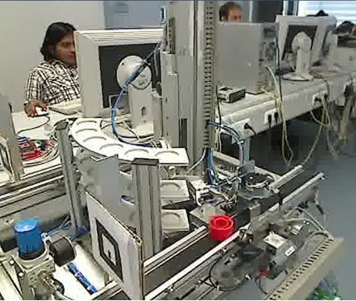
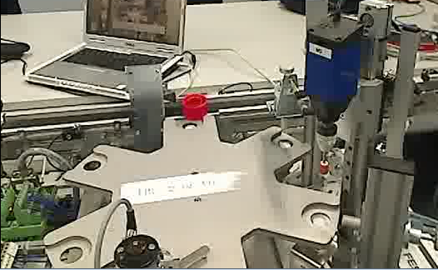
Rod1
Sensor1
Level2
Level3
Level1
P6
A
A
P5
A
B
B
P1
B
C
R1
X
Rod4
C
C
D
D
Sensor4
D
R2
E
E
E
F
F
F
R3
Drill
Sensor2
Sensor3
Y
R4
Rod3
Rod2
P4
P3
P2
Storing
Processing
Convey belt
Convey belt

Slide 2
Rod1
Sensor1
Level2
Level3
Level1
P6
A
A
P5
A
B
B
P1
B
C
R1
X
Rod4
C
C
D
D
Sensor4
D
R2
E
E
E
F
F
F
R3
Drill
Sensor2
Sensor3
Y
R4
Rod3
Rod2
P4
P3
P2
Abstract robot movement | Description
RobotPick | Pick an object from a position to the robot arm
RobotMove | Move robot arm from position to position (to reduce complexity, we only allow from Y to L1, l2 or L3)
RobotDrop | Drop an object from the robot arm to the position
Abstract belt movement | Description
BeltMove | Move the object from position to another position by the moving of belt
Abstract Rod movement | Description
RodPush | Push the object from position to another position using the rotation of rod

Slide 3
Rod1
Sensor1
Level2
Level3
Level1
P6
A
A
P5
A
B
B
P1
B
C
R1
X
Rod4
C
C
D
D
Sensor4
D
R2
E
E
E
F
F
F
R3
Drill
Sensor2
Sensor3
Y
R4
Rod3
Rod2
P4
P3
P2
Abstract sensor movement | Description (system)
ColorProbe | Move downwards to perform probing
Abstract sensor movement | Description (Environment)
ReturnColor | Return whether an object is red, white, or black (we need to ensure that the decision of the action is indifferent to the reading [game of imperfect information without memory])
Abstract drill movement | Description
Drill | When the object is FACE_CORRECT, then drill creates a hole Otherwise, the drill breaks

Slide 4
Rod1
Sensor1
Level2
Level3
Level1
P6
A
A
P5
A
B
B
P1
B
C
R1
X
Rod4
C
C
D
D
Sensor4
D
R2
E
E
E
F
F
F
R3
Drill
Sensor2
Sensor3
Y
R4
Rod3
Rod2
P4
P3
P2
Abstract sensor movement | Description (system)
HeightProbe | Move downwards to perform probing
Abstract sensor movement | Description (Environment)
ReturnUpDown | Return whether an object is placed up-or-down (we need to ensure that the decision of the action is indifferent to the reading [game of imperfect information without memory])
Abstract drill movement | Description
Drill | When the object is FACE_CORRECT, then drill creates a hole Otherwise, the drill breaks

Slide 5
Rod1
Sensor1
Level2
Level3
Level1
P6
A
A
P5
A
B
B
P1
B
C
R1
X
Rod4
C
C
D
D
Sensor4
D
R2
E
E
E
F
F
F
R3
Drill
Sensor2
Sensor3
Y
R4
Rod3
Rod2
P4
P3
P2
Goal description
The goal is to ensure the following Whenever an object is placed on the rack, it shall be processed. Whenever an object is placed on the rack, it is stored based on the color (RED: Level1, SILVER: Level2, Black: Level3) The drill shall never be broken (i.e., it always process the correct side).

