Slide 1
Master Thesis: CORE Pipeline Updates BACKEND-SEED DATABASE PROGRESS
Gokul Thothathri 03.06.2025

Slide 2
PostgreSQL Data Seeder for FDZ Database Simulation (FDZ/DM3)

Slide 3

Simulating OPS (Classification of Operations and Procedure) Codes via: OPS Catalog (2025) – Metadata TableCSV
OPS Code Licence & Catalogue Integration into the pipeline via BfArM: “Operationen- und Prozedurenschlüssel (OPS)” under §301 SGB V catalog
Legal Status
OPS Codes is an „anderes amtliches Werk“ under § 5 (2) UrhG → no copyright fees
Each OPS represents a specific medical operation or clinical procedure such as: surgeries (eg: appendectomy, hip replacement), Imaging (eg: MRI, CT Scans), Diagnostic Procedure(eg: colonoscopy), therapeutic interventions etc
Maintained and published by BfArM (Federal Institute for Drugs and Medical Devices)
“OPS, machine-readable version, © BfArM, downloaded 19 May 2025.”

Slide 4
Completion Status
All 17 tables have been successfully implemented in accordance with the HealthDataLab framework specifications. [https://github.com/gokulethirajanT/CORE/tree/class1]
All relational constraints have been defined and enforced, including appropriate primary key and foreign key relationships to maintain referential integrity across the database schema.
Currently in progress to fine-tune the frequency distributions within the synthetic seed dataset to better reflect HIV-related epidemiological patterns, including:
A higher proportion of HIV-related cases
A sex ratio skewed toward male patients
An age distribution with a lower representation of children and elderly individuals

Slide 5


Data migration to RKI
To facilate the cross-platform data migration and compatibility, a MySQL version of the CREATE TABLE schema was also developed based on the original PostgreSQL implementation. This should support broader deployment situations in the future.
A SQL lite version is also created to create a pull request to the Public Use File Repository.

Slide 6
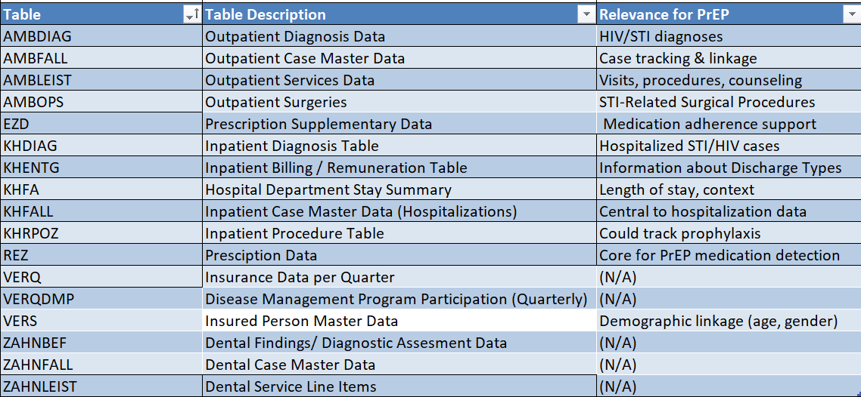

Slide 7
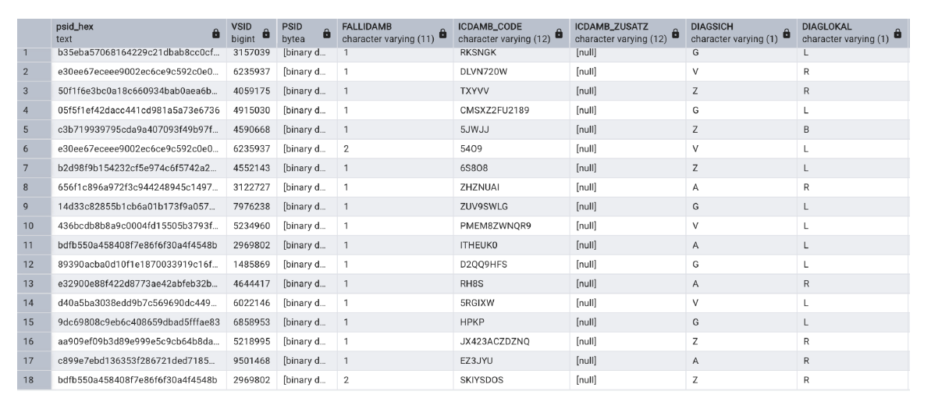
AMBDIAG (Outpatient Diagnosis Data)
https://github.com/gokulethirajanT/CORE/tree/class1

Slide 8
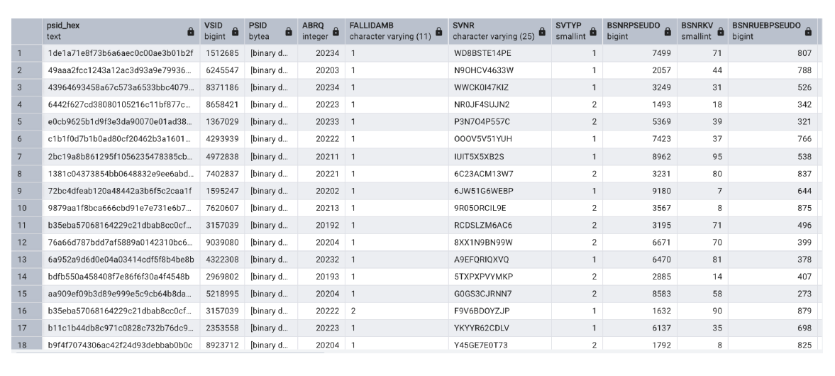
AMBFALL (Outpatient Case Master Data)
https://github.com/gokulethirajanT/CORE/tree/class1

Slide 9
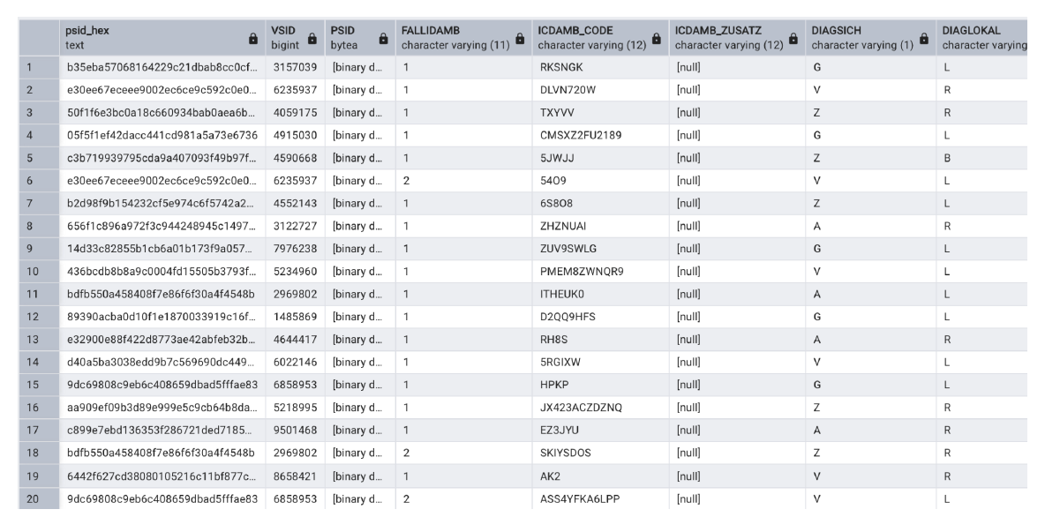
AMBLEIST (Outpatient Service Data)
https://github.com/gokulethirajanT/CORE/tree/class1

Slide 10
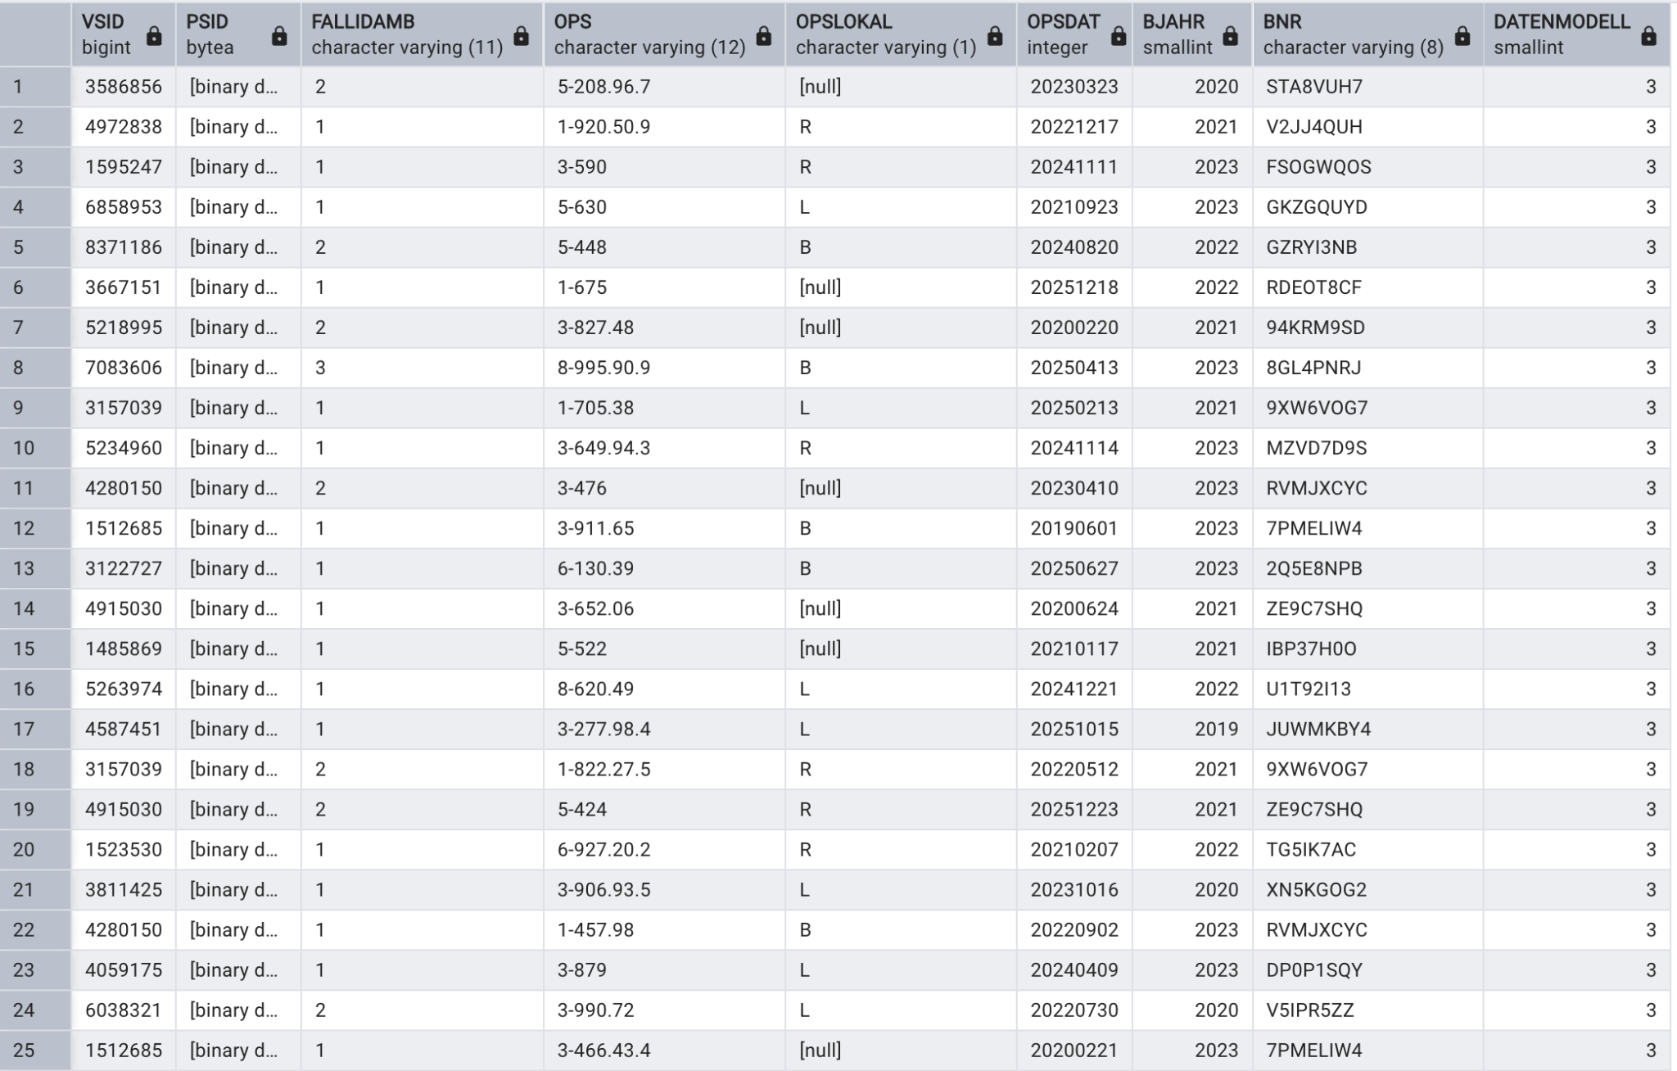
AMBOPS ( Outpatient Surgeries )
https://github.com/gokulethirajanT/CORE/tree/class1

Slide 11
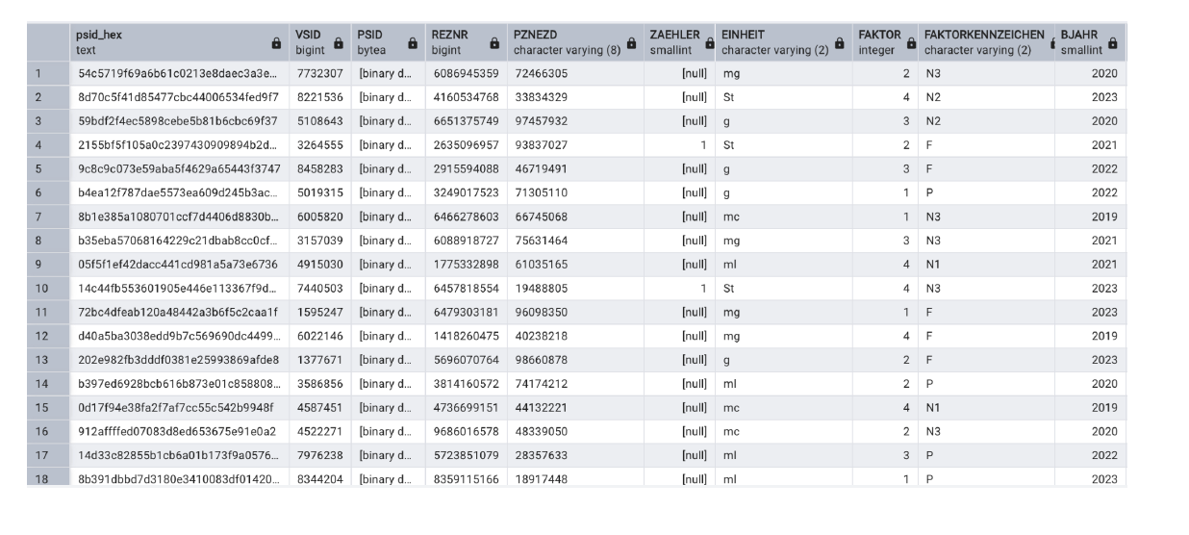
EZD ( Prescription Supplementary Data )
https://github.com/gokulethirajanT/CORE/tree/class1

Slide 12
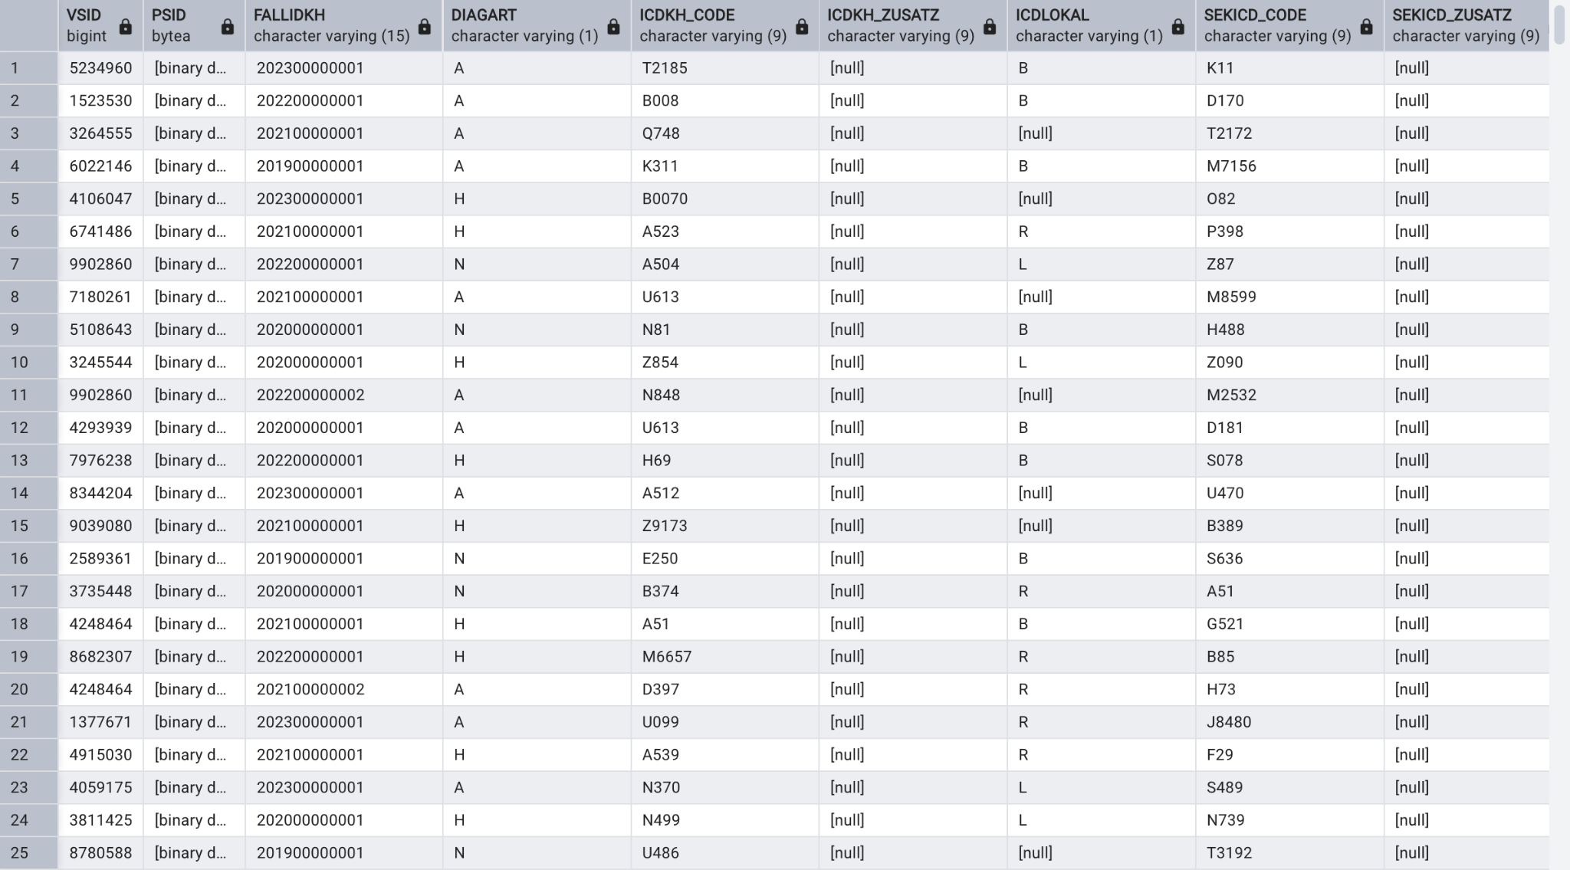
KHDIAG ( Inpatient Diagnosis Table )
https://github.com/gokulethirajanT/CORE/tree/class1

Slide 13
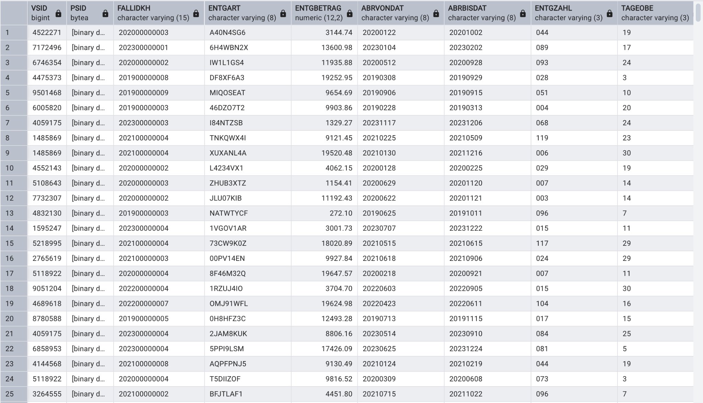
KHENTG ( Inpatient Billing)
https://github.com/gokulethirajanT/CORE/tree/class1

Slide 14
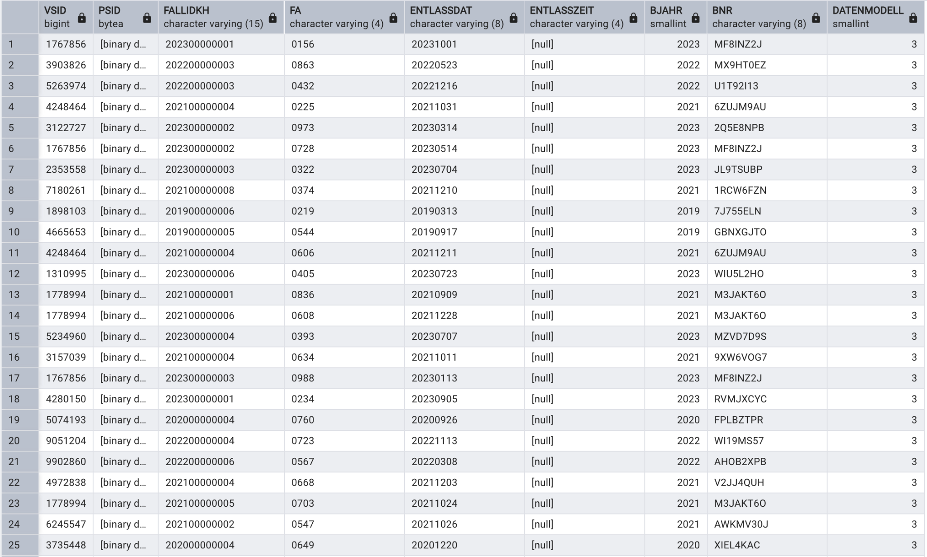
KHFA ( Hospital Department Stay Summary)
https://github.com/gokulethirajanT/CORE/tree/class1

Slide 15
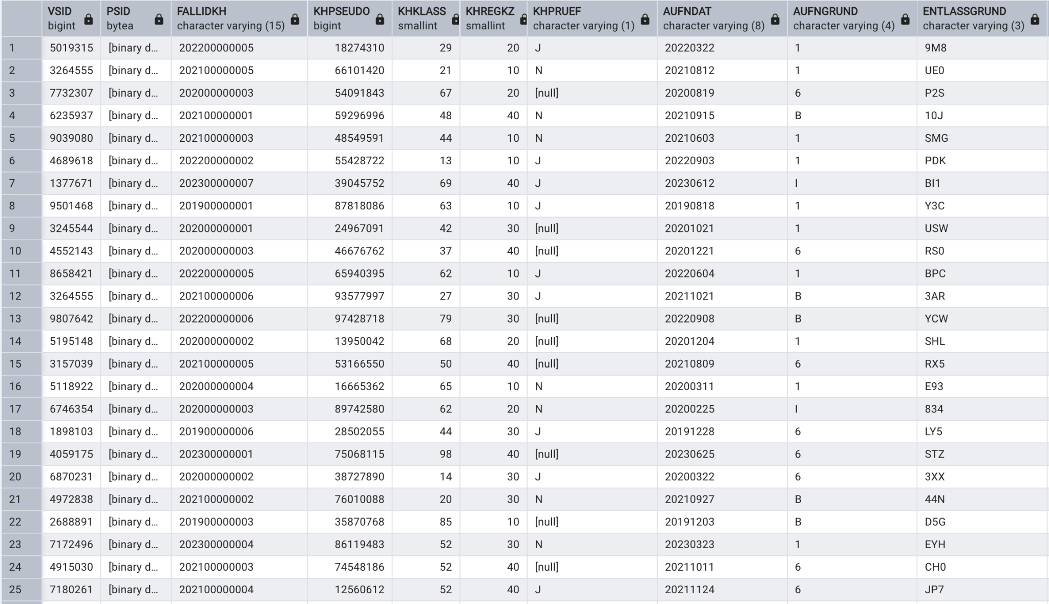
KHFALL ( Inpatient case master data )
https://github.com/gokulethirajanT/CORE/tree/class1

Slide 16
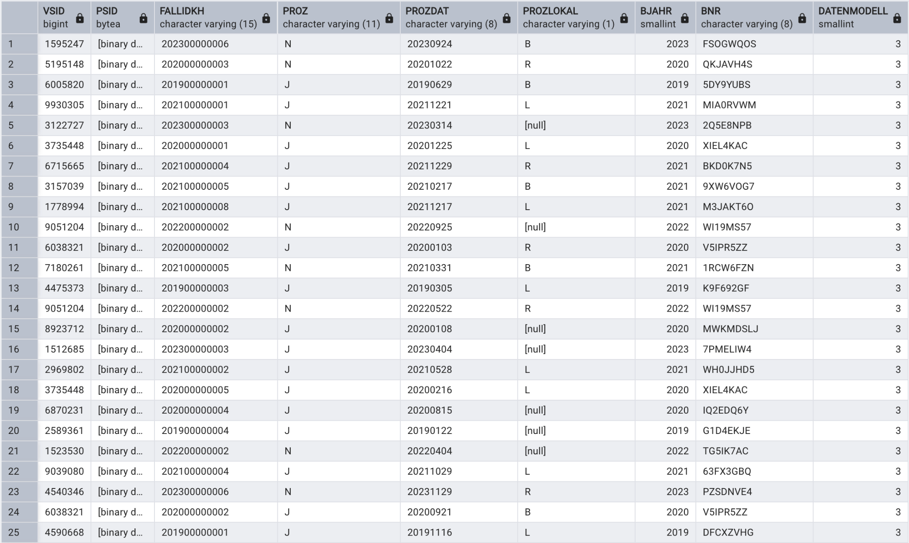
KHRPOZ ( Inpatient Procedure Table)
https://github.com/gokulethirajanT/CORE/tree/class1

Slide 17
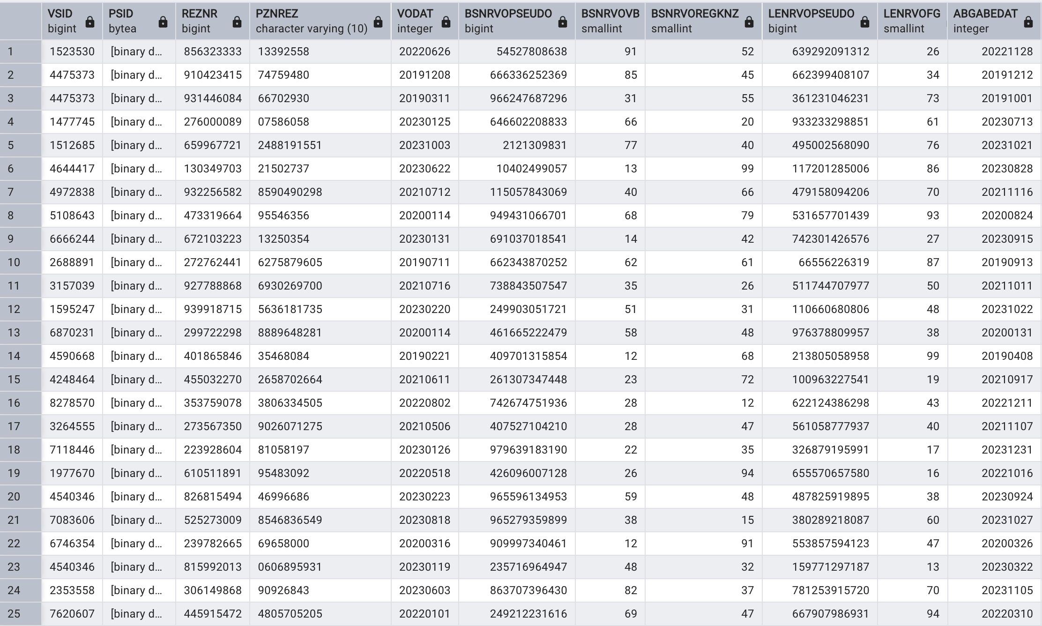
REZ ( Prescription Data)
https://github.com/gokulethirajanT/CORE/tree/class1

Slide 18
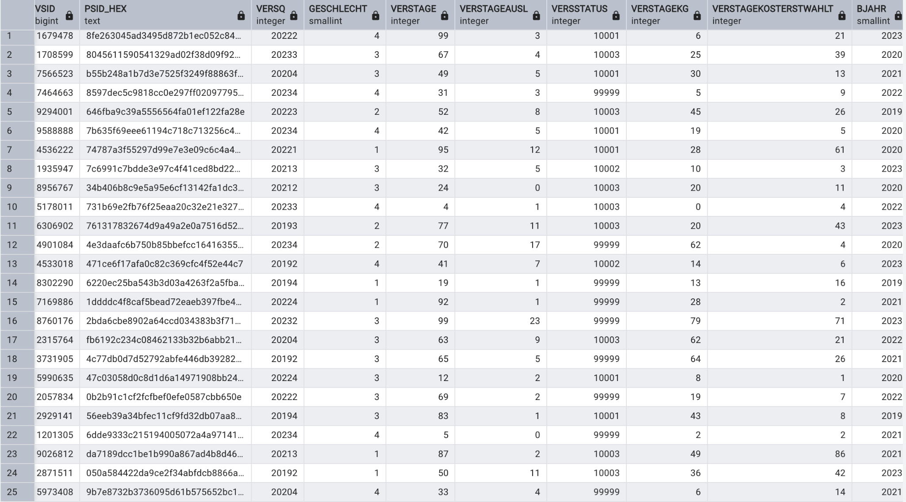
VERQ ( Insurance Data per Quarter)
https://github.com/gokulethirajanT/CORE/tree/class1

Slide 19
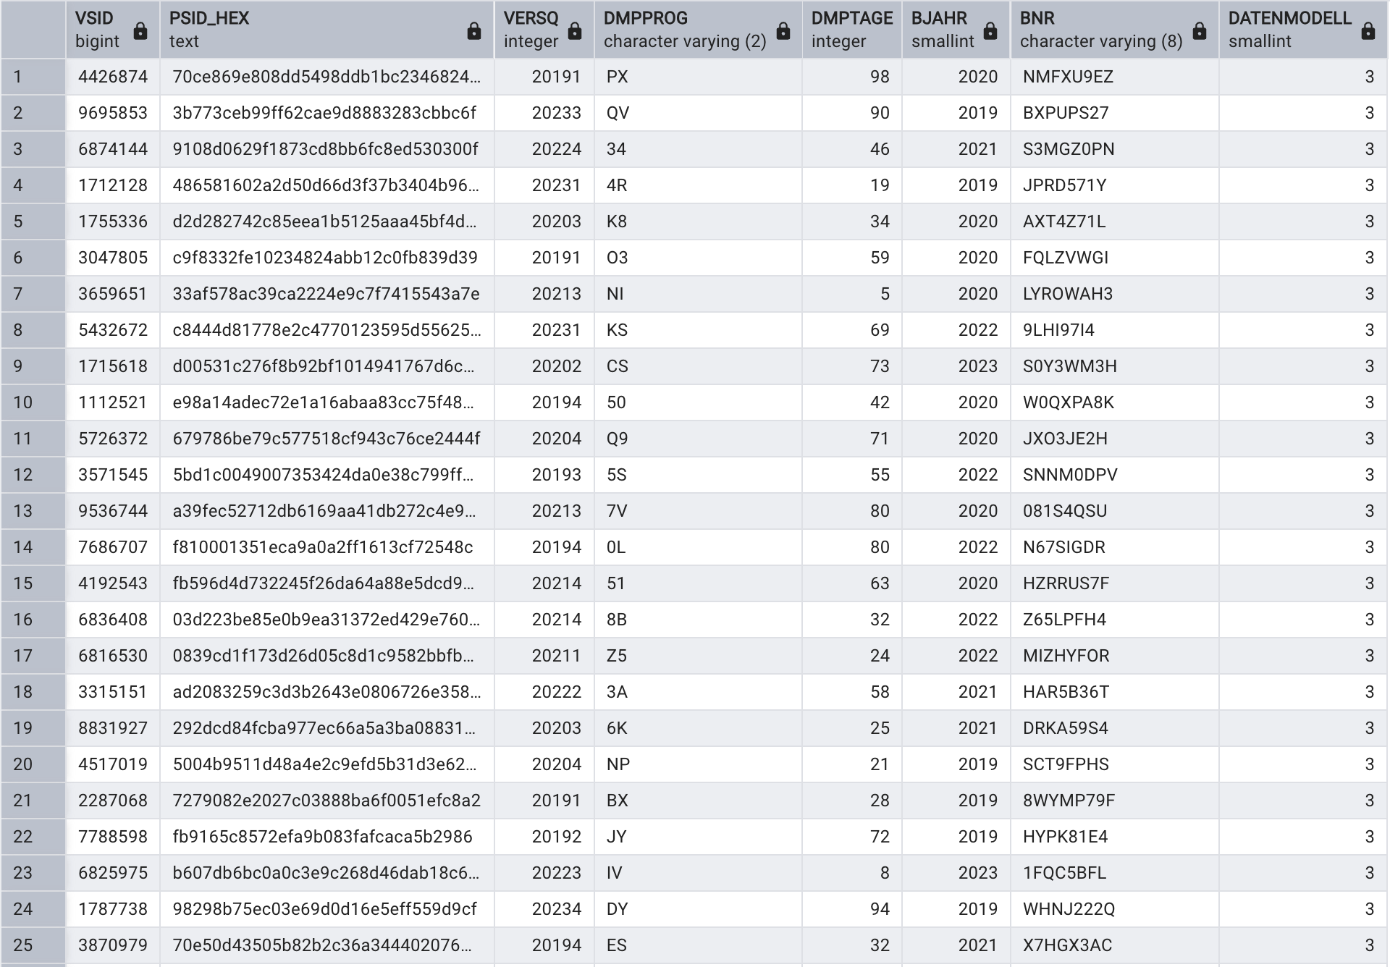
VERQDMP ( Diesease Management program Participation )
https://github.com/gokulethirajanT/CORE/tree/class1

Slide 20
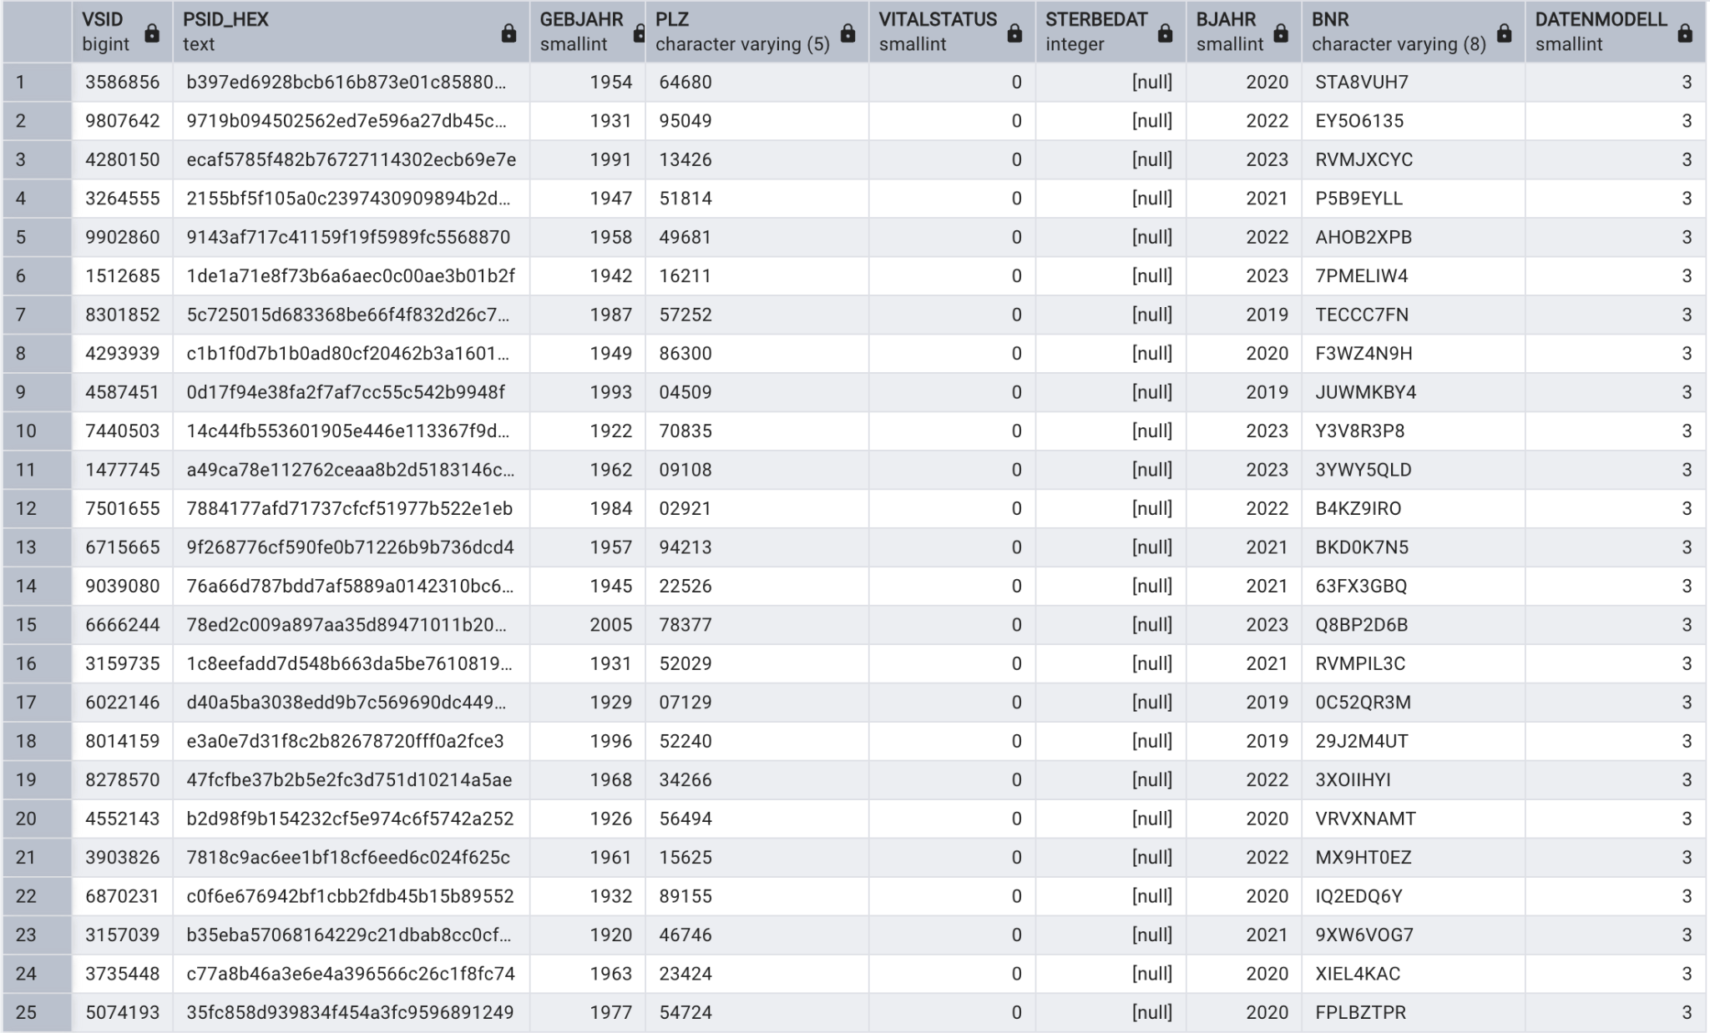
VERS ( Insured Person Master Data)
https://github.com/gokulethirajanT/CORE/tree/class1

Slide 21
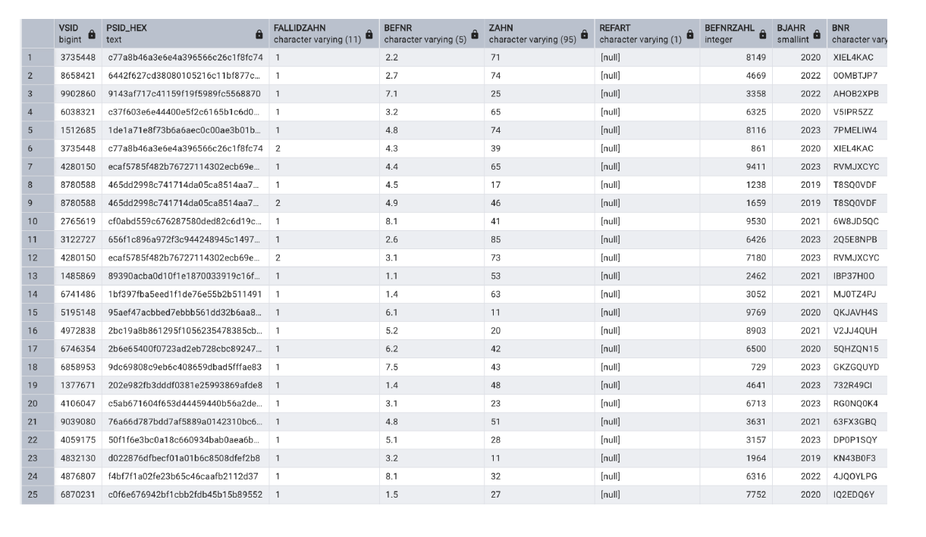
ZAHNBEF (Dental Findings /Diagnostic Assesment Data)
https://github.com/gokulethirajanT/CORE/tree/class1

Slide 22
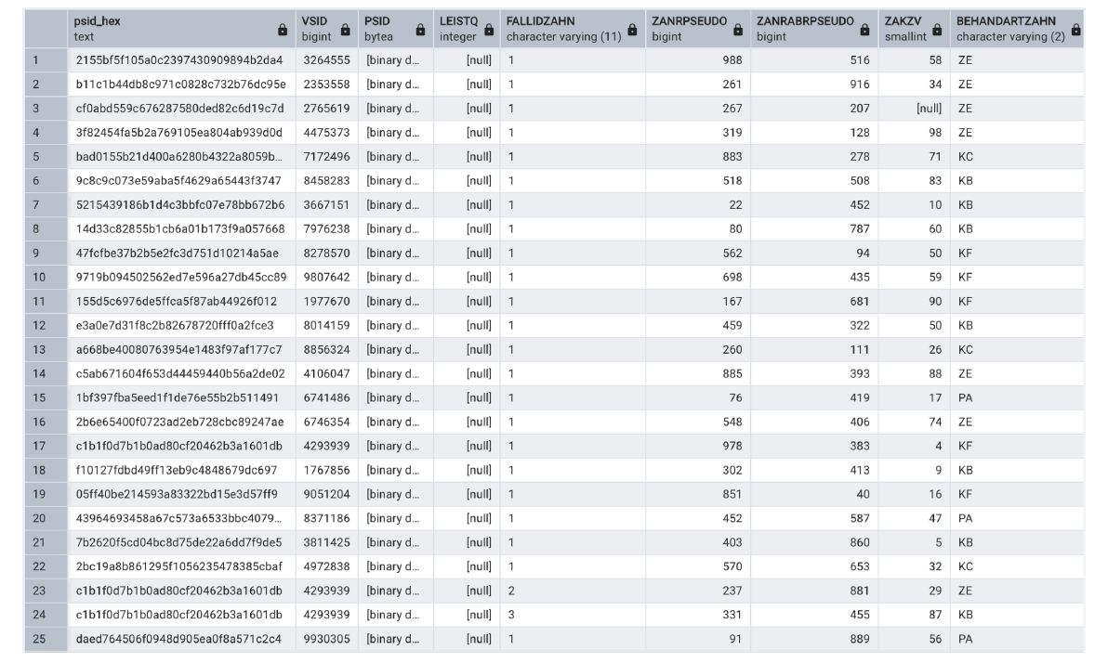
ZAHNFALL (Dental Case Master Data)
https://github.com/gokulethirajanT/CORE/tree/class1

Slide 23
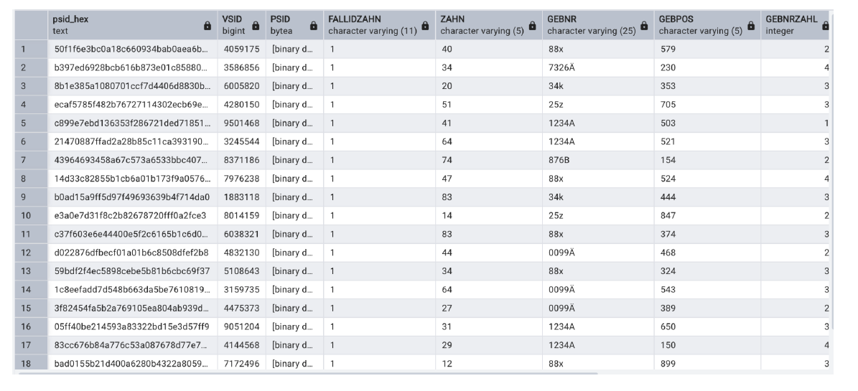
ZAHNLEIST (Dental Service Line Items)
https://github.com/gokulethirajanT/CORE/tree/class1

Slide 24
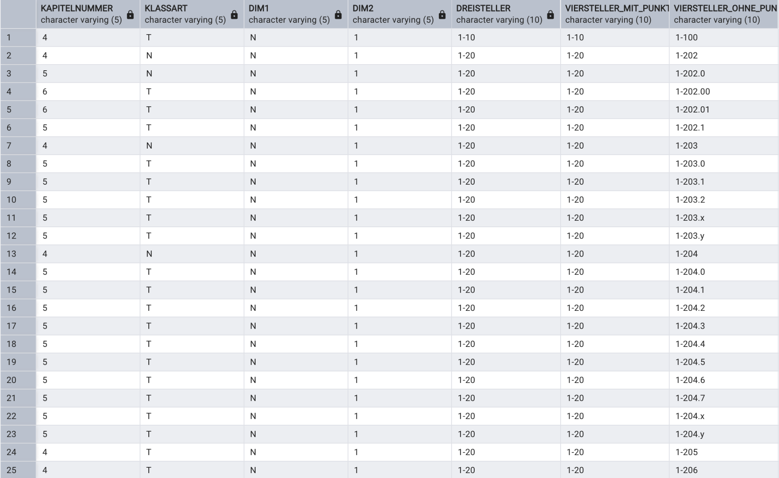
OPS CATALOG
https://github.com/gokulethirajanT/CORE/tree/class1

Slide 25
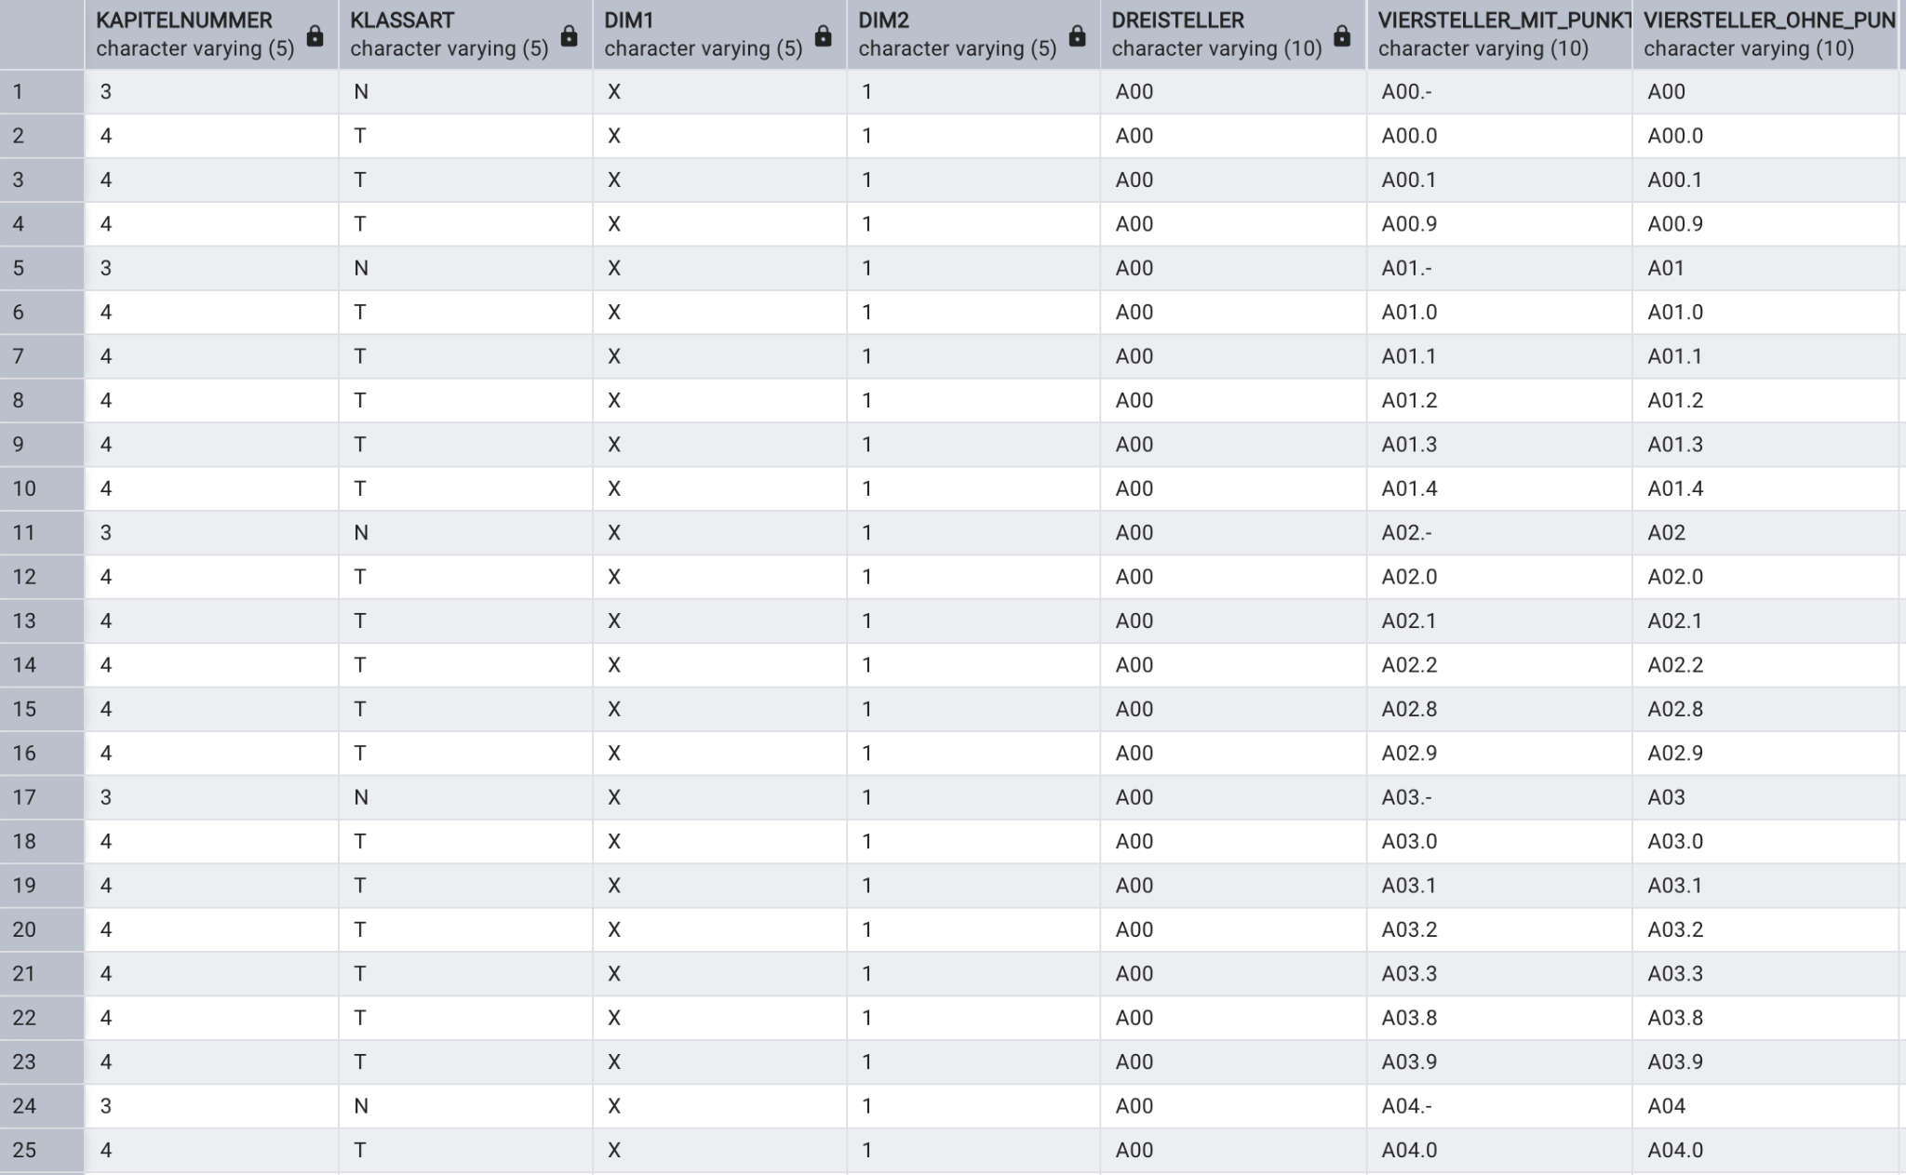
ICD-10 CATALOG
https://github.com/gokulethirajanT/CORE/tree/class1

