Slide 1
Master Thesis: CORE Pipeline Updates BACKEND PROGRESS
Gokul Thothathri 07.05.2025

Slide 2
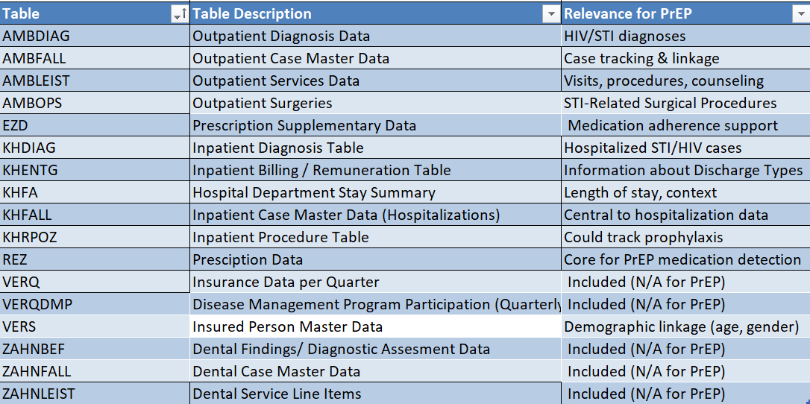
Clinical Table Descriptions and Relevance for PrEP

Slide 3
PostgreSQL Data Seeder for Public Use File Simulation (FDZ/DM3)

Slide 4
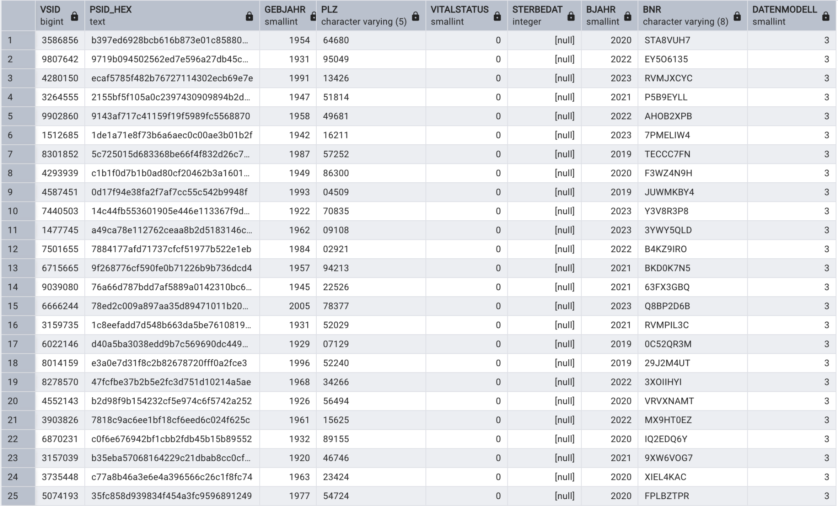
VERS (Insured Person Master Data)
https://github.com/gokulethirajanT/CORE/tree/class1

Slide 5
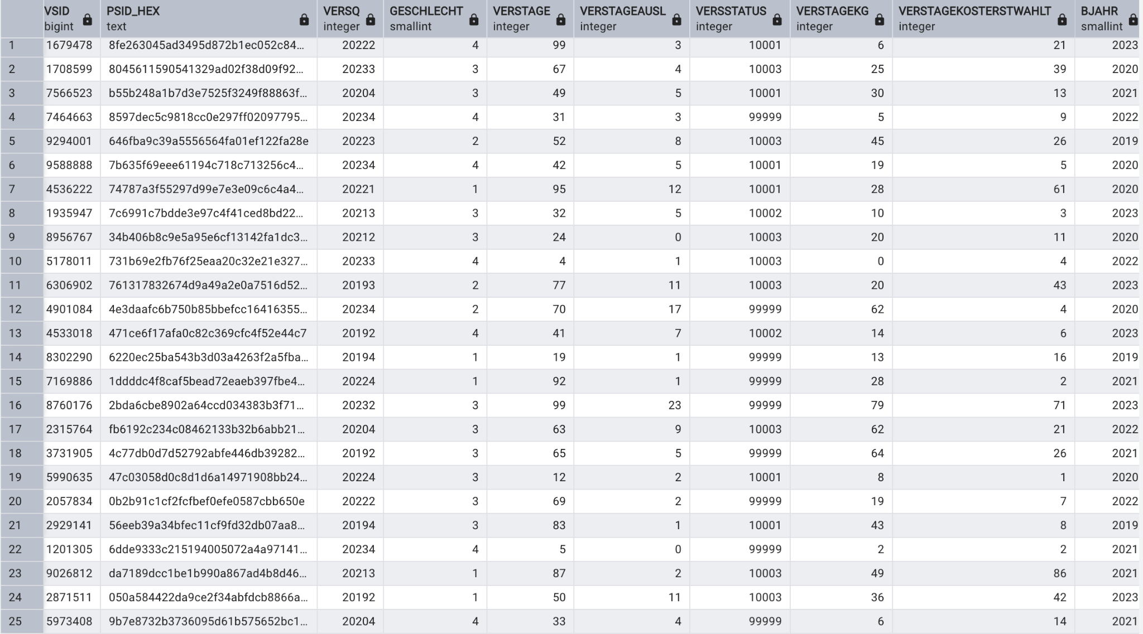
VERSQ (Insured Data Per Quarter)
https://github.com/gokulethirajanT/CORE/tree/class1

Slide 6
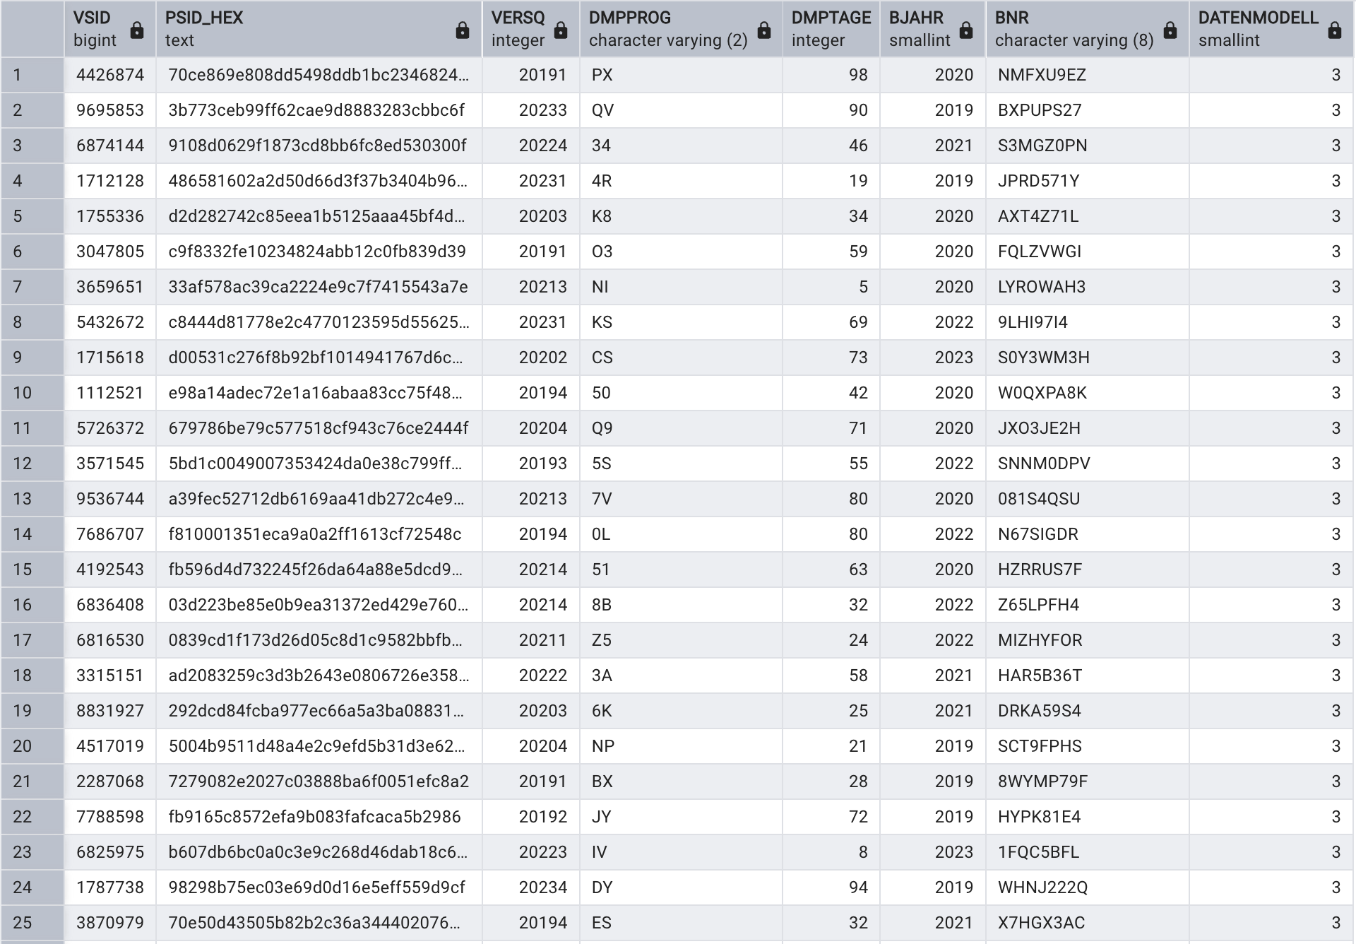
VERSQDMP (Disease Management Program Participation)
https://github.com/gokulethirajanT/CORE/tree/class1

Slide 7
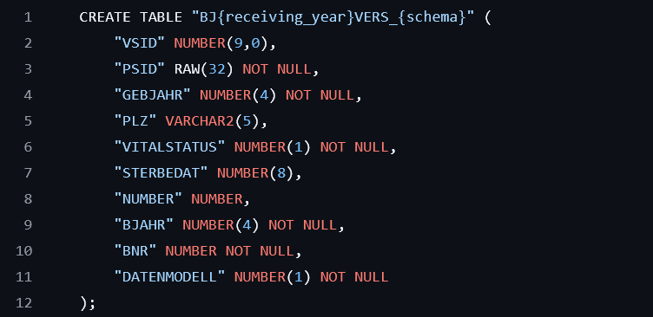
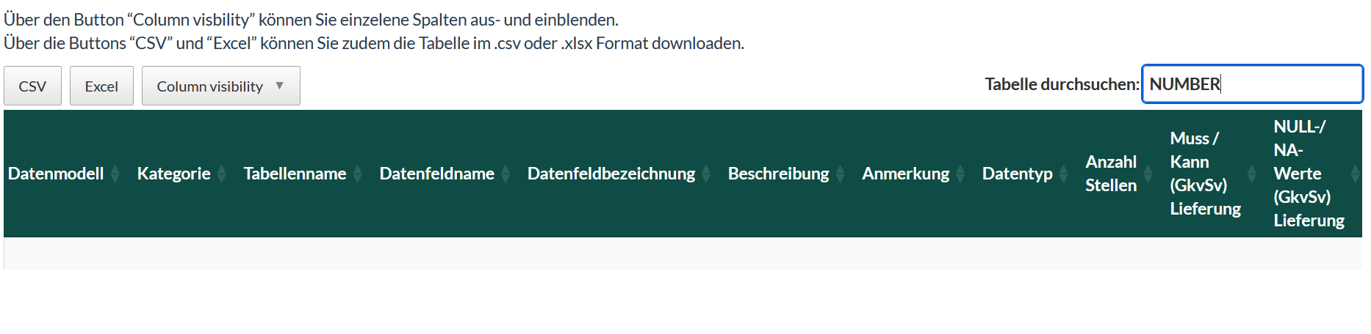
Source of Truth: FDZ Variable Definitions vs. Schema Implementation
NUMBER appears to be an unofficial or unintended column and should be reviewed or removed to ensure alignment with the FDZ ground truth
VERS TABLE SCHEMA: FDZ
VARIABLE DESCRIPTION IN HEALTHDATA_LAB

Slide 8
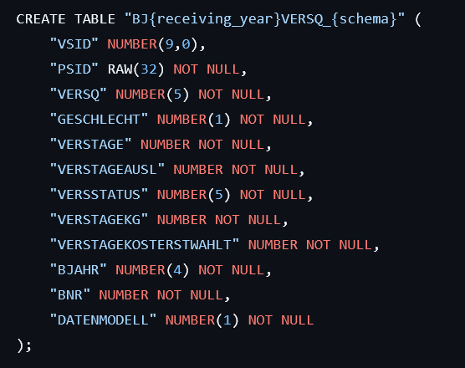
Source of Truth: FDZ Variable Definitions vs. Schema Implementation
Definition Conflict: The column BNR is defined in the FDZ variable reference file as an 8-character alphanumeric identifier (e.g. „8Z5T1876“), used to define the Krankenkasse number (insurance provider) number
NUMBER IS A STRICTLY NUMERICAL SCHEMA, DOES NOT SUPPORT ALPHANUMERIC CHARACTERS; BETTER SCHEMA IS TEXT OR VARCHAR(8)
VERS TABLE SCHEMA: FDZ

Slide 9
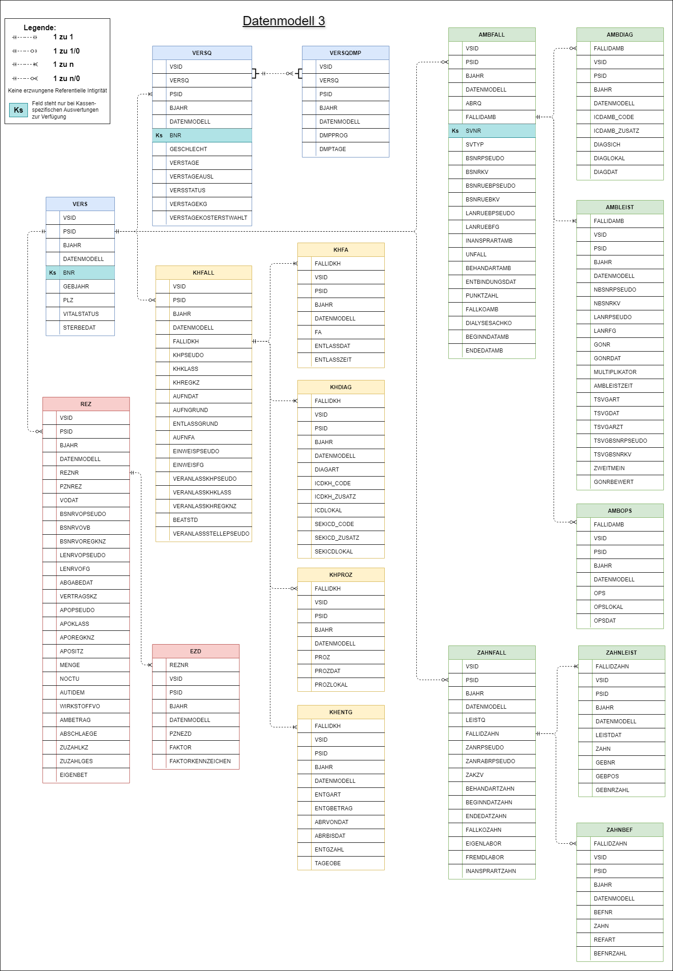
ER DIAGRAM WORKS ?
THINK OF ER DIAGRAMS AS A RELATIONAL VIEW, NOT A EXHAUSTIVE SYSTEM SCHEMA

Slide 10

Conclusion & Next Steps
Reference File is the ground truth (DSB_FDZ_Gesundheit_variable.csv from FDZ defines the authoritative structure for all variables including type, length and mandatory status.
Schema Deviations should be cleared before implementing any anonymization techniques to create the synthetic data structure.
Synthetic Seeder as a Simulator, this works but must align with specification (strictly match) reference types to avoid PostgreSQL errors or semantic errors. (optional: Schema validator for testing purpose)
Create Two-database architecture ---one for FDZ seed data and one for synthetic data (class 1) –to clearly separate sources and improve traceability, testing and validations workflows.
https://github.com/FDZ-Gesundheit/Public-Use-File/blob/main/dm3_testdaten.sqlite

