Slide 1
Master Thesis: CORE Pipeline Updates
Gokul Thothathri 09.04.2025

Slide 2
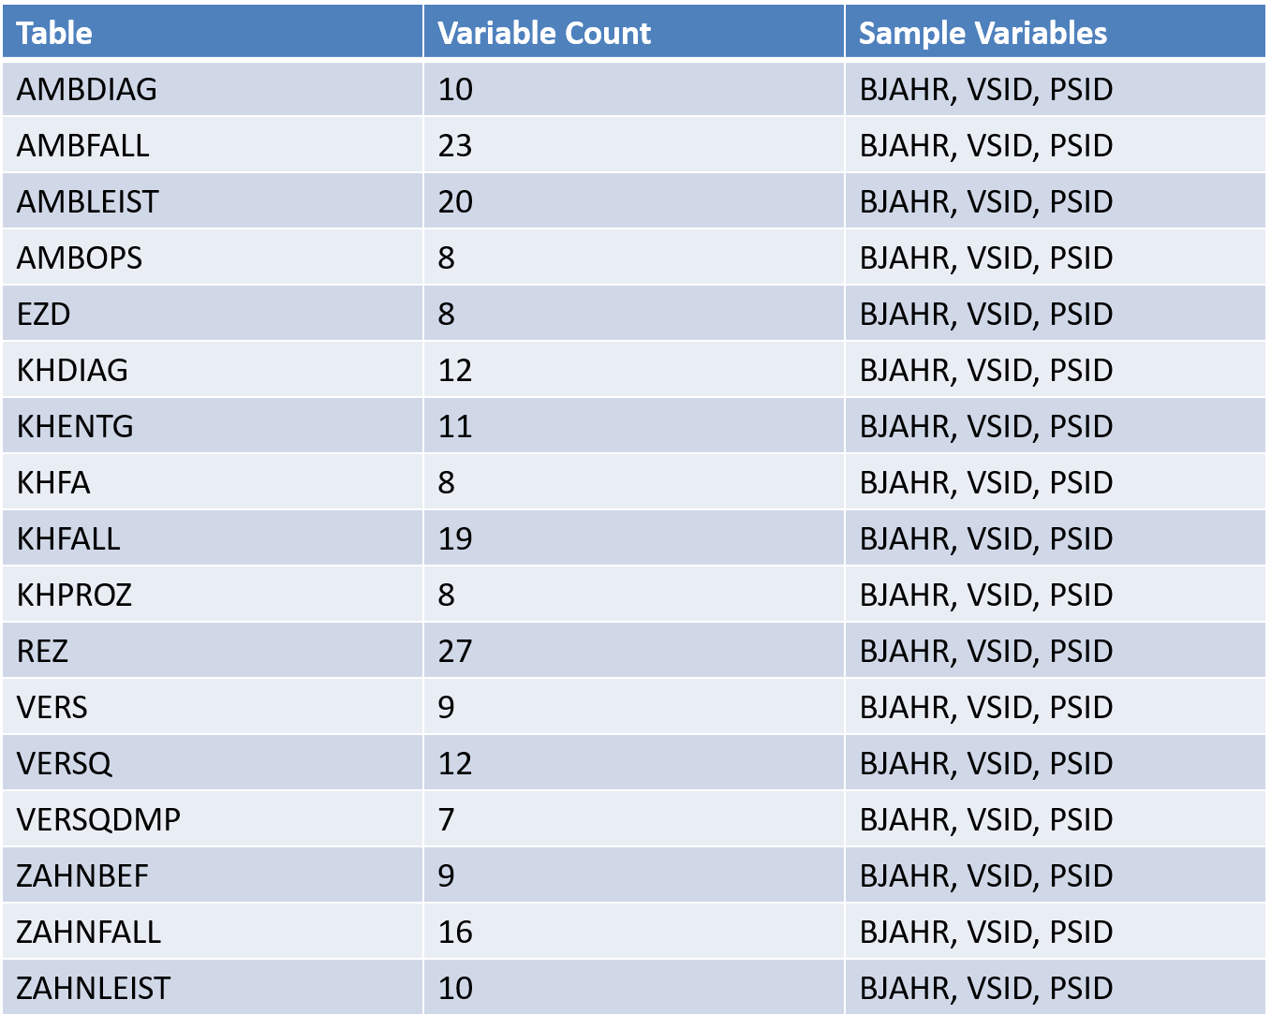
Metadata Overview of Health Data Lab Tables: DM3
The metadata comprises of 17 unique tables, each representing a distinct data domain in the Health Data Lab framework.
REZ, AMBFALL, AMBLIEST, KHFALL, ZAHNFALL are core Clinical/Billing Tables.
Commonly reported variables indicates (BJAHR – Reporting Year, VSID – Person-specific pseudonym for one year, PSID – Long-term pseudonym ) the tables are longitudinally linkable, essential for metadata cohort construction.
Many tables share structural identifiers,making joins and merges between tables possible, which is crucial for (1) Building Patient Jouneys (2) Synthetic PrEP datasets (3) Running temporal risk models

Slide 3
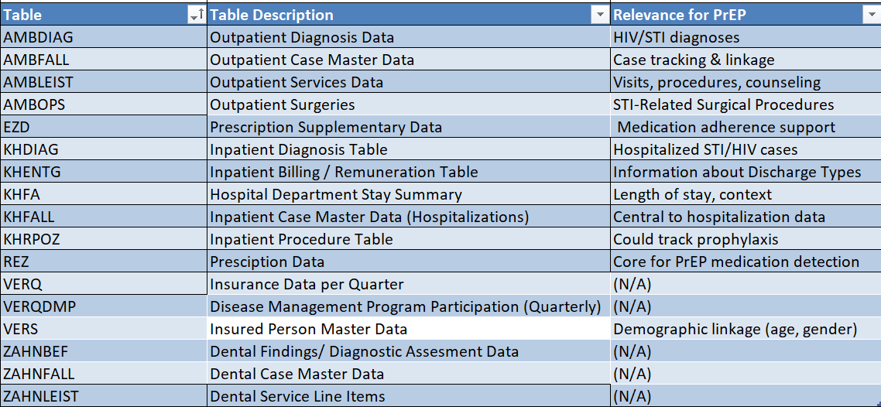
Clinical Table Descriptions and Relevance for PrEP

Slide 4
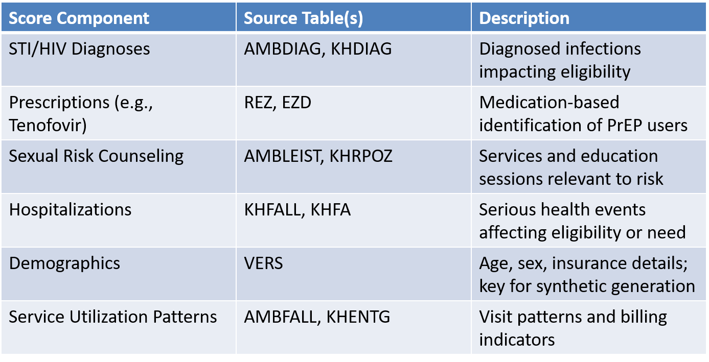
PrEP Score Components and Table Mapping
Modular Score Breakdown: Each row is a building block of the PrEP score—diagnoses, prescriptions, counseling, etc.
Table-to-Feature Mapping: The table maps each score component to its data source (table)
Enables Data Flow Modeling: By assigning where each score input originates, the table is the foundation for the synthetic data generation

Slide 5


Relational Database Management System (RDMS): PostgreSQL over SQLite in the CORE
Concurrency: Single User Vs Multi-user
Data Integrity: Minimal constraints Vs Strong Types & Constraints
Query Power: Basic SQL Vs Advanced SQL, JSON, indexes
Scalability: Local Use Only Vs Scales with Users
Security: Singularity Vs Role-Based Access
Extensions: None Vs Ecosystem Available

Slide 6
References
https://github.com/FDZ-Gesundheit/Public-Use-File/tree/main - FDZ PUF Generation Model
https://sqlite.org/datatype3.html – SQL Lite Data Types and Storage Classes
https://www.postgresql.org/docs/current/datatype.html – PostgreSQL Data Types

