Slide 1
Master Thesis: CORE Pipeline Updates BACKEND PROGRESS
Gokul Thothathri 21.05.2025

Slide 2
PostgreSQL Data Seeder for FDZ Database Simulation (FDZ/DM3)

Slide 3
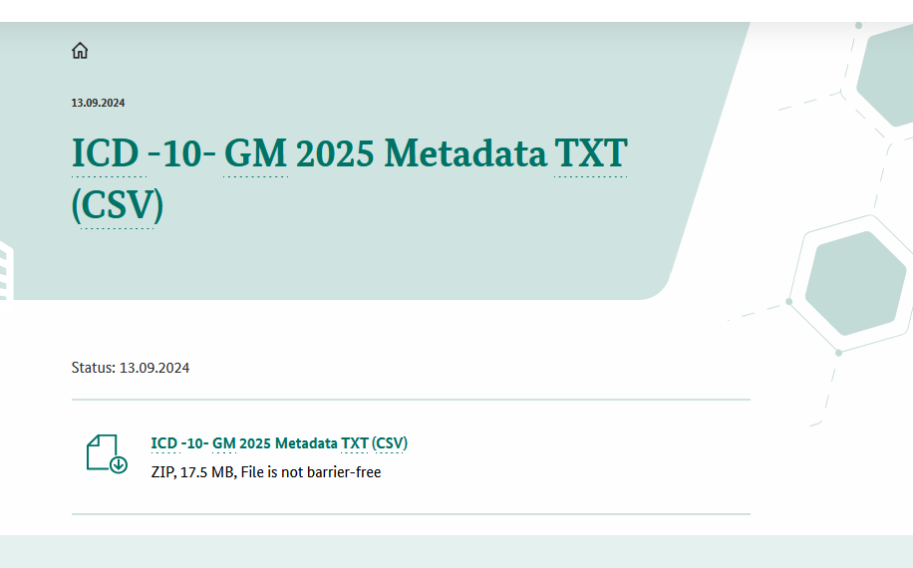
Simulating ICD-10 Codes via: ICD-10 –GM 2025 Metadata TXT (CSV)
ICD-10 GM License & Catalogue Integration to the pipeline via The BfArM „Download under conditions for the ICD- 10 - GM“
Legal Status
ICD-10-GM is an „anderes amtliches Werk“ under § 5 (2) UrhG → no copyright fees
Free downloadable & Internal use under BfArM Downloadbedingungen 2025
Forbidden: Alter Code Strings & their Wordings, Redistribute the raw and unmodified catalogue file, No anonymization (removing dot is fine according to FDZ database schema)
“ICD-10-GM 2024, machine-readable version, © BfArM, downloaded 19 May 2025.”

Slide 4
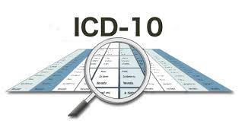
Implementation in the CORE pipeline: Sustainable ICD compliance
Load icd10gm2024syst_kodes.txt in to the schema (create new in prosgres table)
Preprocess the file (add header) and remove dots (allowed according to ICD-10 BfArm guidelines)
Seed in the PostgreSQL Data Seeder (FDZ DM3)
It is forbidden to upload the TXT file or the project‘s postgreSQL (with the ICD-10 schema) in the repository, so will be uploading the database in Git repo without the ICD-10 catalogue. The procedure to run the pipeline will have some technical backlog where the instructions will be provided in the supplementary section of the master thesis and Readme.md file in the git repository. Compliance Checklist for ICD -10 1. Dotless variant is reversible and allowed.
2. Source credited on every published artefact. 3. Raw CSV with ICD-10 codes with remains internal; only derived tables/scripts shared.

Slide 5
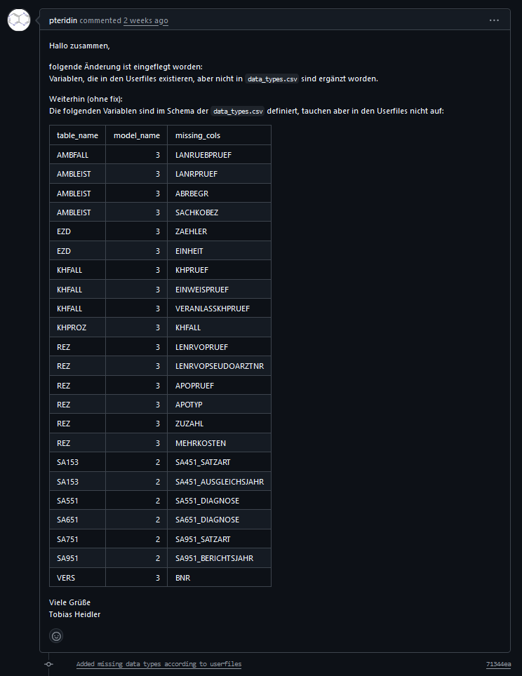
Solution to the missing data types; but not the descriptions for the headers (not available in the Health_dataLab variable description file)
https://github.com/FDZ-Gesundheit/Public-Use-File/pull/16

Slide 6
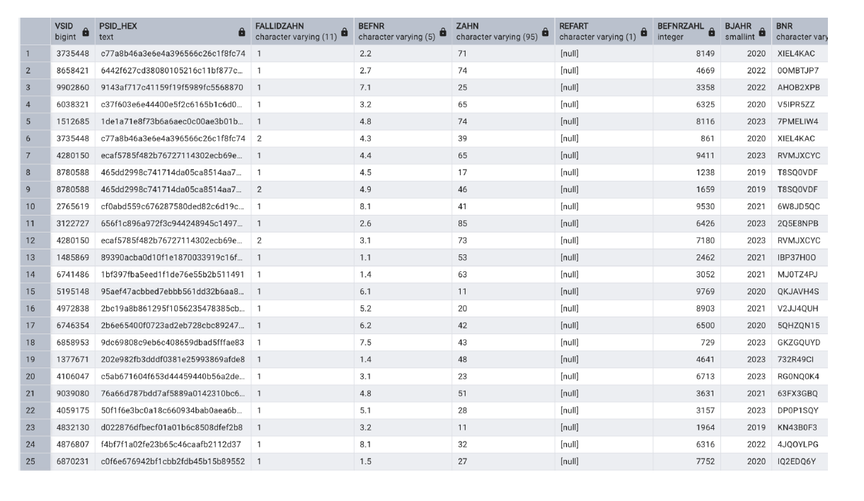
ZAHNBEF (Dental Findings /Diagnostic Assesment Data)
https://github.com/gokulethirajanT/CORE/tree/class1

Slide 7
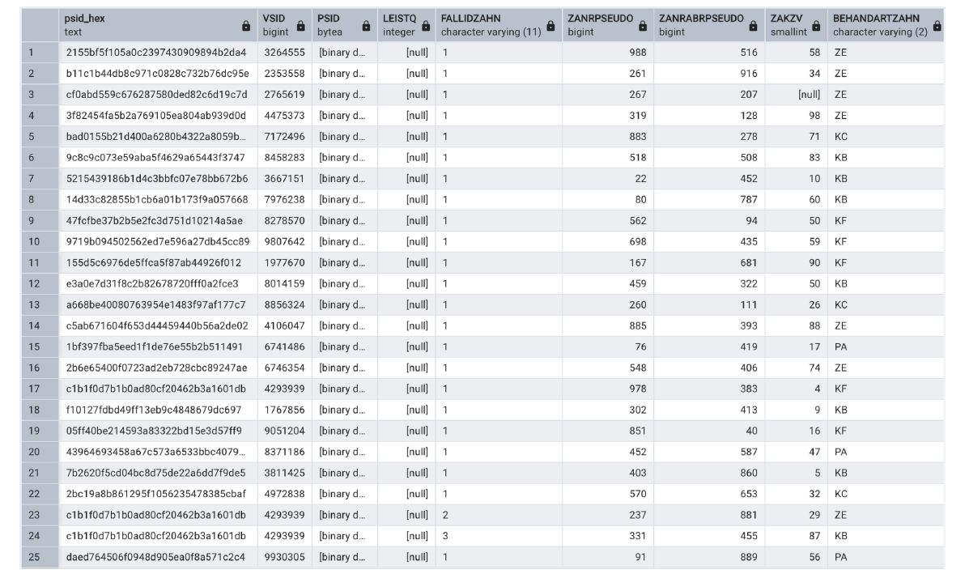
ZAHNFALL (Dental Case Master Data)
https://github.com/gokulethirajanT/CORE/tree/class1

Slide 8
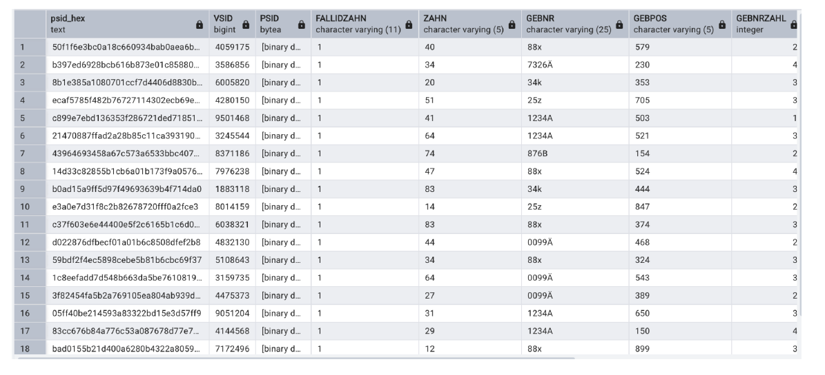
ZAHNLEIST (Dental Service Line Items)
https://github.com/gokulethirajanT/CORE/tree/class1

Slide 9
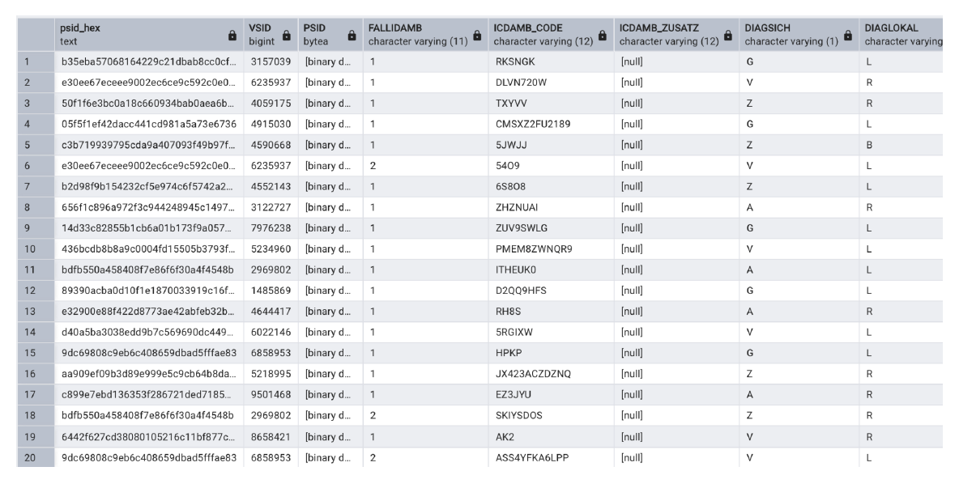
AMBLEIST (Outpatient Service Data)
https://github.com/gokulethirajanT/CORE/tree/class1

Slide 10
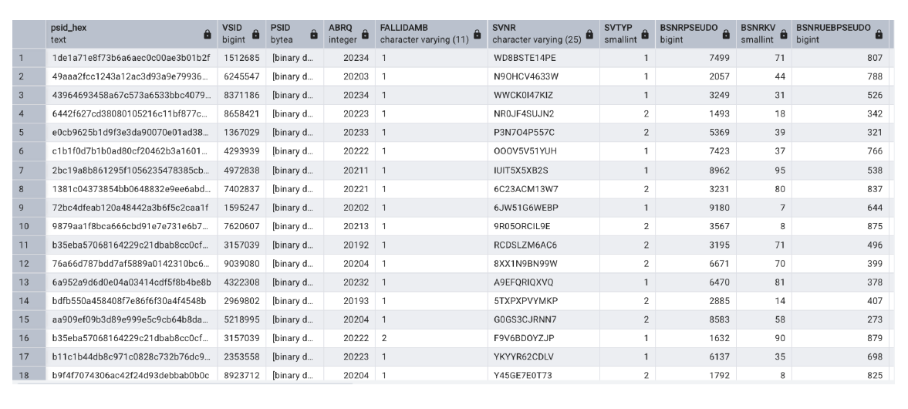
AMBFALL (Outpatient Case Master Data)
https://github.com/gokulethirajanT/CORE/tree/class1

Slide 11
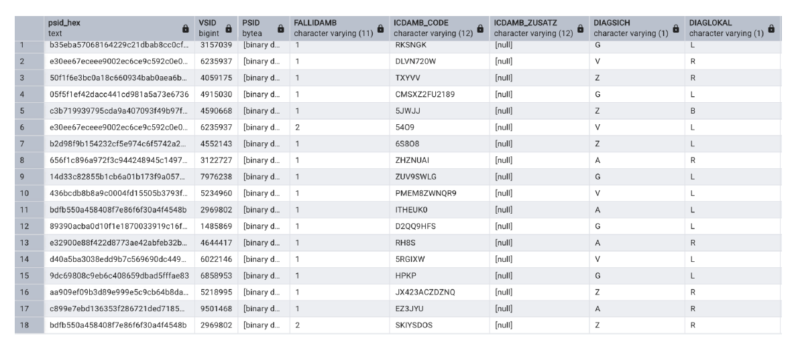
AMBDIAG (Outpatient Diagnosis Data)
https://github.com/gokulethirajanT/CORE/tree/class1

Slide 12
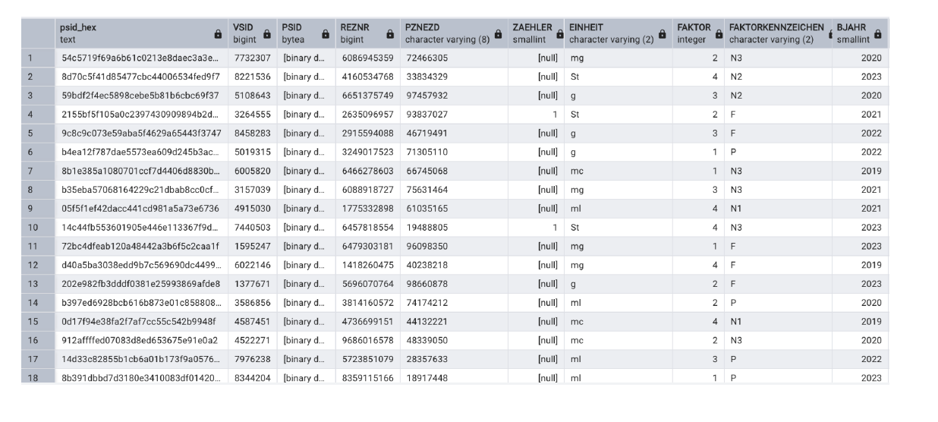
EZD ( Prescription Supplementary Data )
https://github.com/gokulethirajanT/CORE/tree/class1

