Slide 1
Master Thesis: CORE Pipeline Updates BACKEND PROGRESS
Gokul Thothathri 23.04.2025

Slide 2
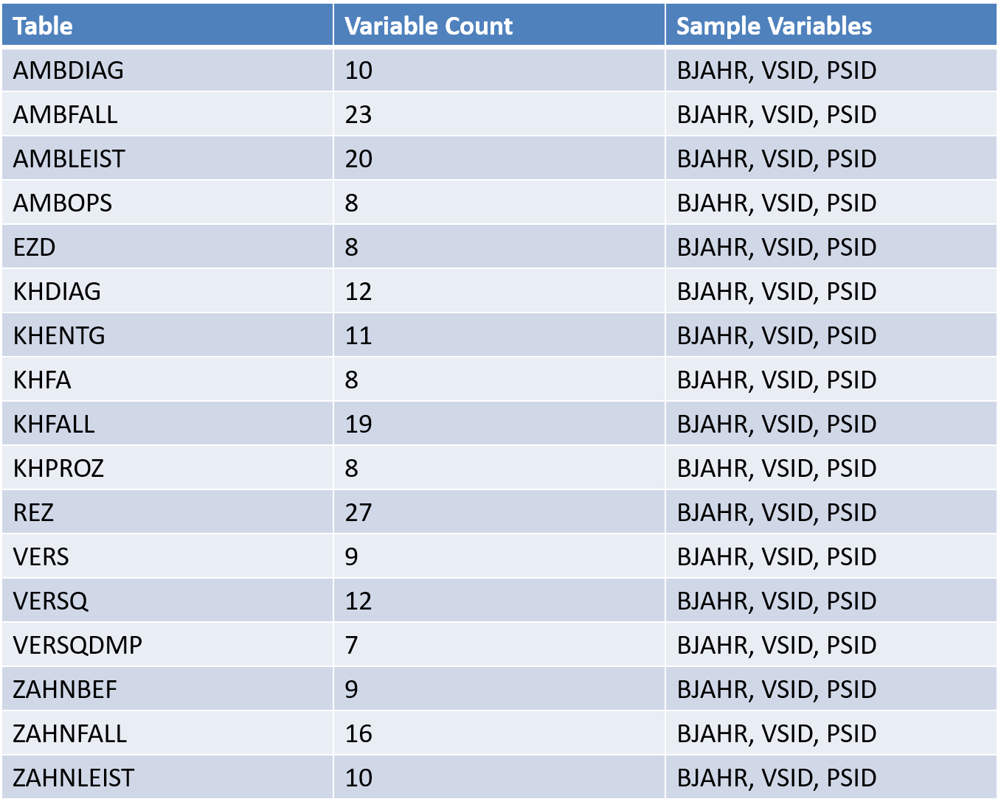
Metadata Overview of Health Data Lab Tables: DM3
The metadata comprises of 17 unique tables, each representing a distinct data domain in the Health Data Lab framework.
REZ, AMBFALL, AMBLIEST, KHFALL, ZAHNFALL are core Clinical/Billing Tables.
Commonly reported variables indicates (BJAHR – Reporting Year, VSID – Person-specific pseudonym for one year, PSID – Long-term pseudonym ) the tables are longitudinally linkable, essential for metadata cohort construction.
Many tables share structural identifiers,making joins and merges between tables possible, which is crucial for (1) Building Patient Jouneys (2) Synthetic PrEP datasets (3) Running temporal risk models

Slide 3
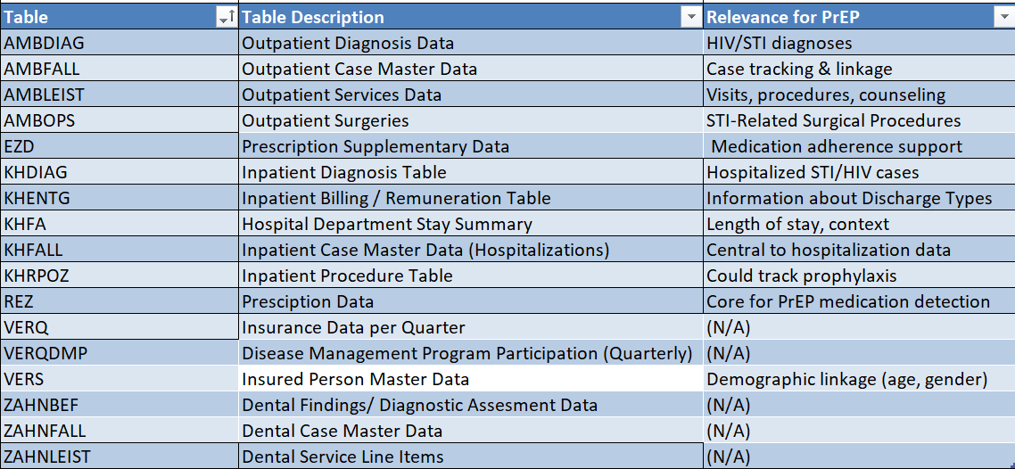
Clinical Table Descriptions and Relevance for PrEP

Slide 4
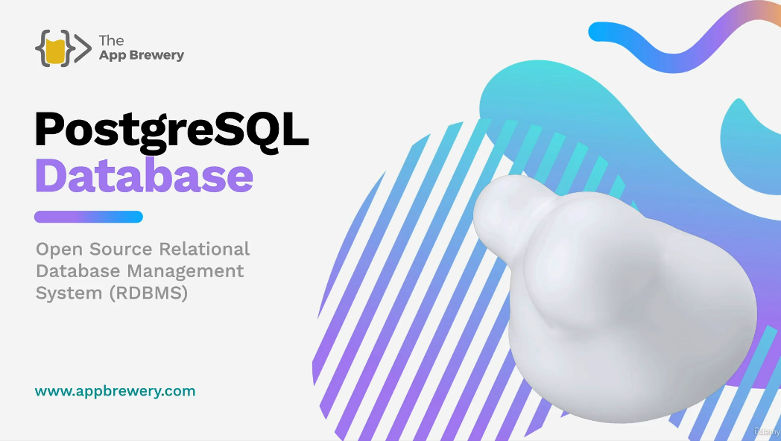

Learning Update: Enrolled for Postgresql course: Completed
Databases | SQL | Postgresql | database query | pg admin 4 | Relationships & Aliases| Interactive Practice

Slide 5
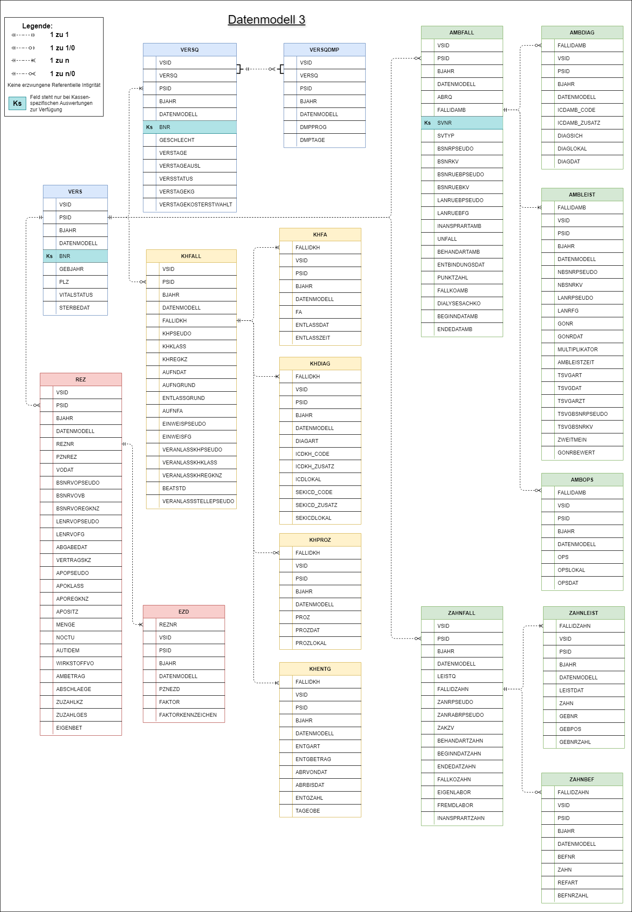
Hands on Implementation
Created and loaded 17 core DM3 tables in PostgreSQL.
Manually validated column types and constraints.
Used pgAdmin to verify schema visually.
Integrated screenshot records for validation.
Project Impact
DM3 PUF generation schema possible.
Apply Class 1 Anonymization Techniques.
Enable fast SQL queries for real-time validation.
Reduce pipeline dev time for mock and real data.

Slide 6
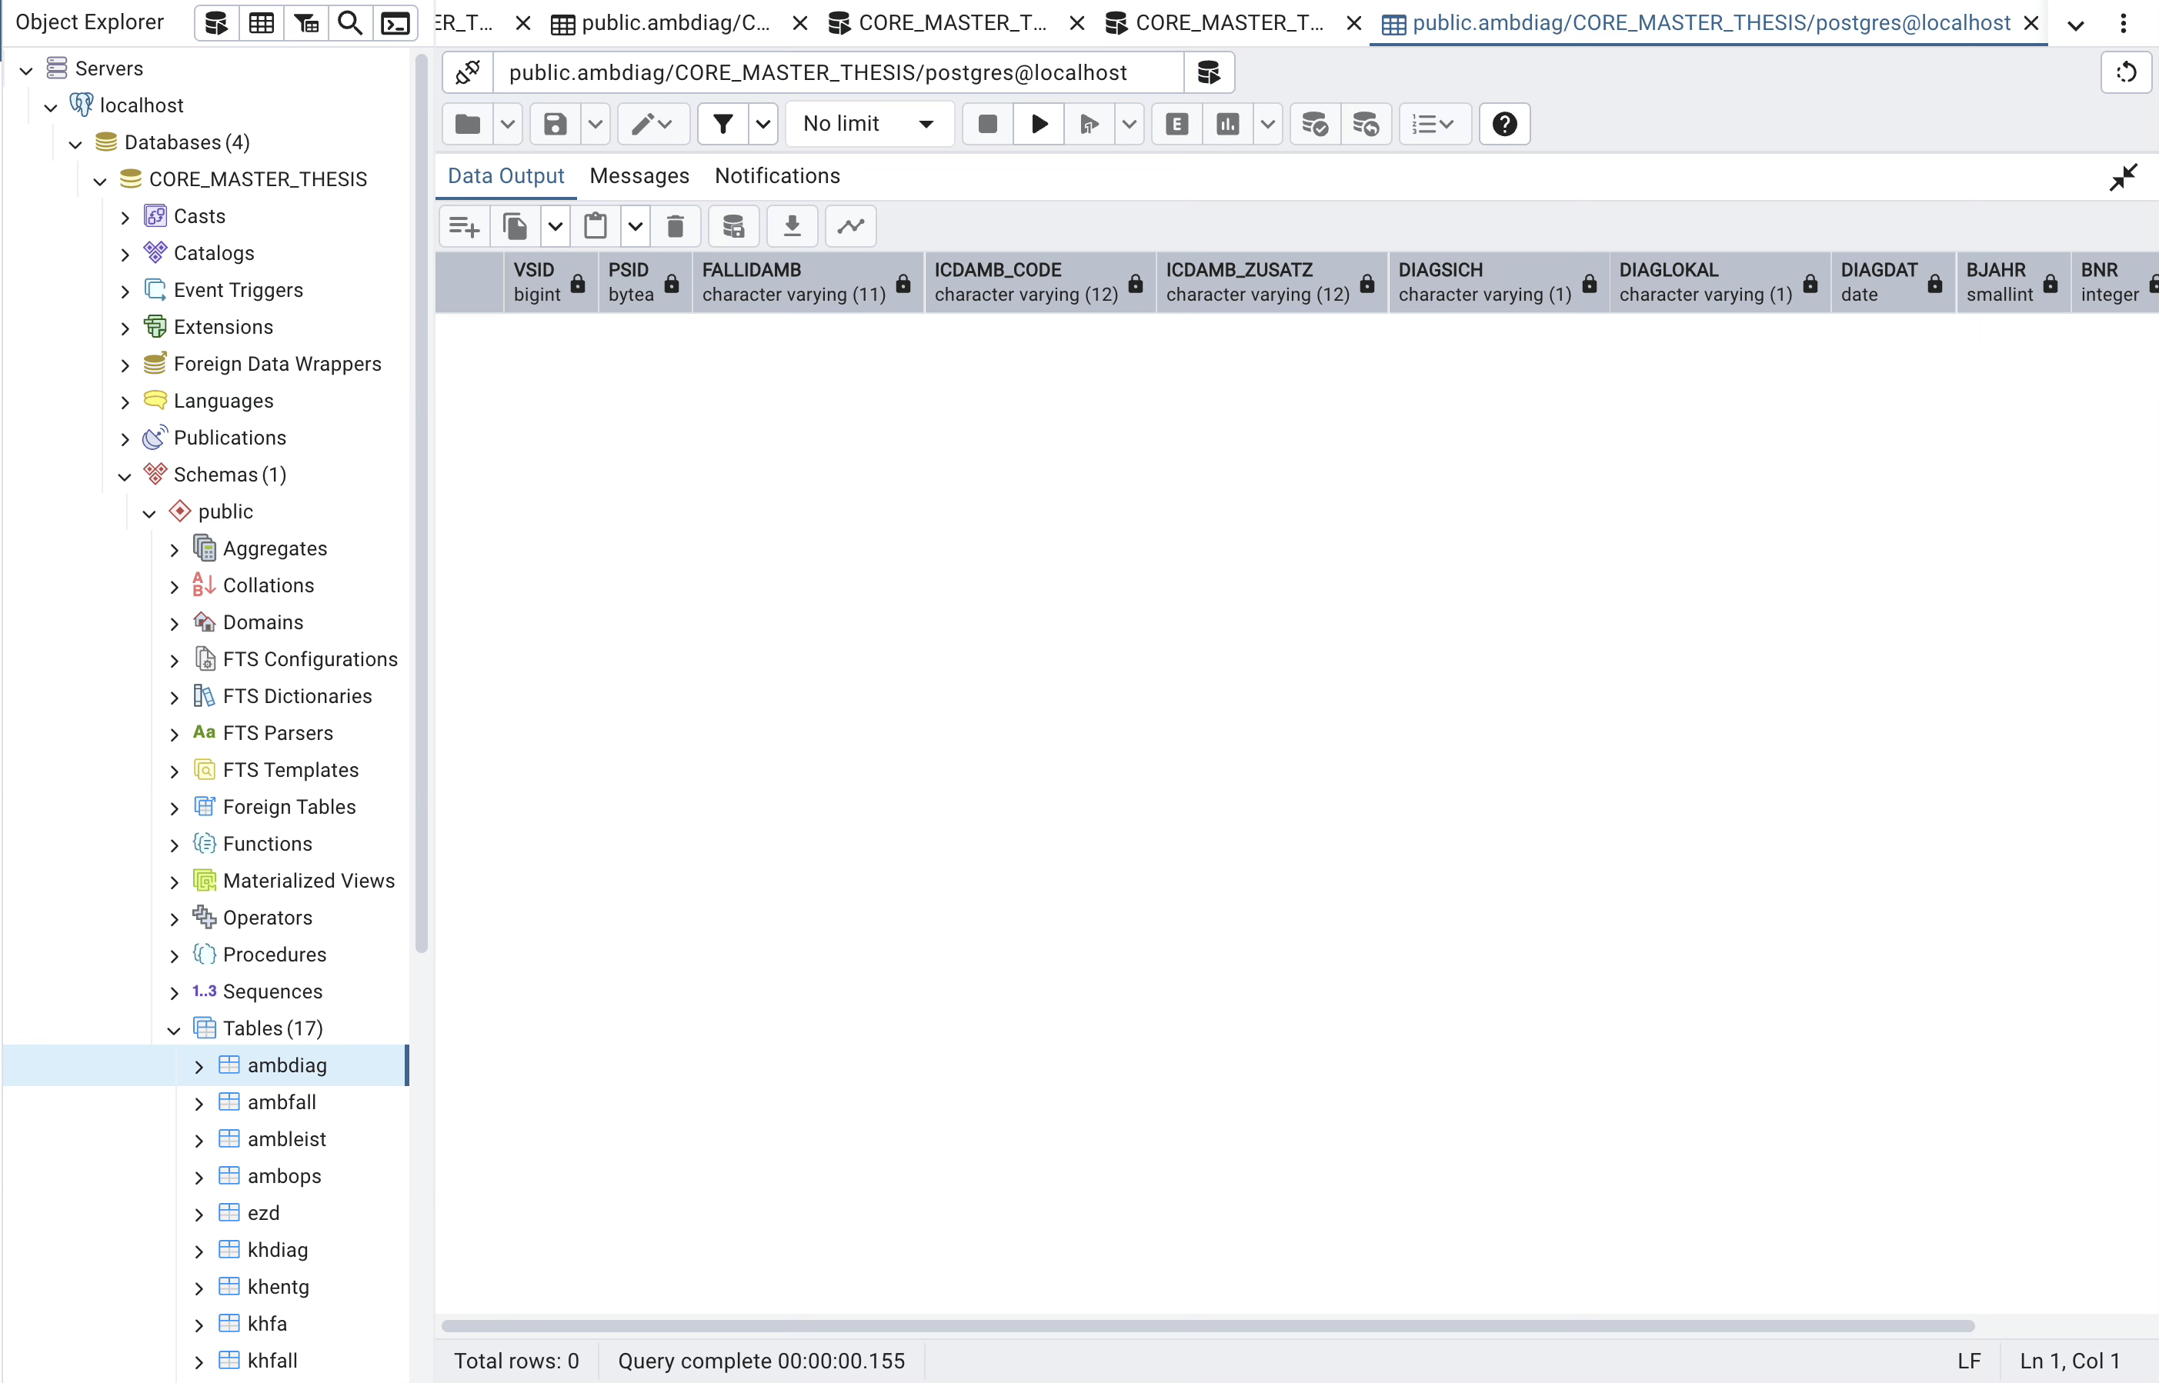

Slide 7
What‘s next ?
Migrate scripts to connect with PostgreSQL database.
Populate and Verify the Class 1 PUF annomization data into the tables.
Use SQL View to visualize and enable fast SQL Queries for real validation.
Integrated screenshot records for visualization.

