Slide 1
Master Thesis: CORE Pipeline Updates
Gokul Thothathri 26.03.2025

Slide 2
Progress Highlights 1. Goal: Building a privacy-preserving data pipeline for HIV-PrEP indicator reporting.
2. Based on the FDZ Gesundheit data structure (DaTrav) and ECDC PrEP indicators.
3. Emphasis on Synthetic Data Generation (PUF) using Class-1 anonymization techniques.

Slide 3

Technical Implementations 1. Fully local PUF generation pipeline (no database dependency).
2. Input reference/Folder with: a. DSB_ FDZ_Gesundheit_Tabellen.csv (tables)
b. DSB_ FDZ_Gesundheit_Variablen.csv (field metadata)
c. data_types.csv (used for typing & pseudo detection)
3. Output: Synthetic CSV per table (written to Data/)

Slide 4


Anonymization Techniques: Class 1 1. Pseudonymization: Secure ID replacement via generate_pseudonym.
2. Constant Variable Handling: Replaced with “CONST” where needed. 3. Shuffling: Each column randomized using secrets-based sorting
4. K-anonymity(k=3): Applied per column using force(k) function
5. Type-aware cleaning: Leveraging data_types.csv to simulate realistic fields

Slide 5

Code Architecture 1. generate_puf.py – main script
2. helpers_local.py– metadata parsing and data cleaning
3. functions_local.py– anonymization algorithms (shuffle, k-anon, pseudonym)
Three branch Git version control: Class 1 – Class 2 – Class 3 https://github.com/gokulethirajanT/CORE/tree/class1

Slide 6
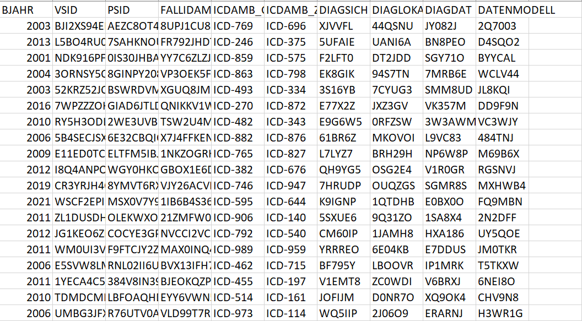
PUF Data Generation Snippet:

Slide 7
Next Phase 1. Validate the CSV files: Evaluation metrics (utility, information loss, k-risk etc) 2. Indicator mapping (ECDC) to synthetic data

