Slide 1
Digital Portfolio
STUDENT NAME: Gokul B
REGISTER NO AND NMID: asunm163u24cs142
DEPARTMENT: B.SC computer science
COLLEGE: COLLEGE/ UNIVERSITY Hindustan college of arts and science University of Madras

Slide 2
PROJECT TITLE
STUDENT DIGITAL PORTFOLIO USING HTML

Slide 3


AGENDA
Problem Statement
Project Overview
End Users
Tools and Technologies
Portfolio design and Layout
Features and Functionality
Results and Screenshots
Conclusion
Github Link
3/21/2024 Annual Review

Slide 4

PROBLEM STATEMENT
Clearly define the problem: Describe the specific issue or challenge you re addressing.
2. Explain the impact: Highlight the consequences of not solving the problem.
3. Identify the target audience: Specify who is affected by the problem.
4. Quantify the issue (if possible): Use data or Statistics to illustrate the problems scope.

Slide 5

PROJECT OVERVIEW
1.Project purpose: Briefly describe the project's goal and objective.
2. Key features: Highlight the main features and functionalities of your project.
3.Scope: Define the project's boundaries and limitations.
4.Expected outcomes: Describe the anticipated benefits and results of your project.

Slide 6

WHO ARE THE END USERS?
Target audience: Identify the specific group(s) of people who will use your project.
2. Demographics: Describe the characteristics of your target
audience, such as:AgeOccupationEducation levelInterests
3. User needs: Explain the needs and pain points of your target audience that your project addresses.
4. User goals: Describe what your target audience wants to achieve when using your project.

Slide 7

TOOLS AND TECHNIQUES
Programming languages: List the languages used, such as Python, Java, JavaScript.
2. Frameworks: Mention any frameworks utilized, like React, Angular, Django.
3. Databases: Specify the databases used, such as MySQL, MongoDB, PostgreSQL.
4. Development tools: List tools like Git, Visual Studio Code, IntelliJ.

Slide 8
POTFOLIO DESIGN AND LAYOUT
Clean and minimalistic: Describe the use of a simple, intuitive design.
2. Responsive: Mention the portfolios adaptability to various devices and screen sizes.
3. Visual hierarchy: Explain the use of typography. color, and layout to guide the viewers attention.
4. Consistency: Highlight the consistent use of design elements throughout the portfolio.
8

Slide 9
FEATURES AND FUNCTIONALITY
User-friendly interface: Describe the intuitive design and ease of use.
2. Core functionalities: Highlight the main features that solve the problem or meet the need.
3. Interactive elements: Mention any interactive components, such as forms, buttons, or animations.
4. Customization options: Explain any options for users to personalize their experience.

Slide 10
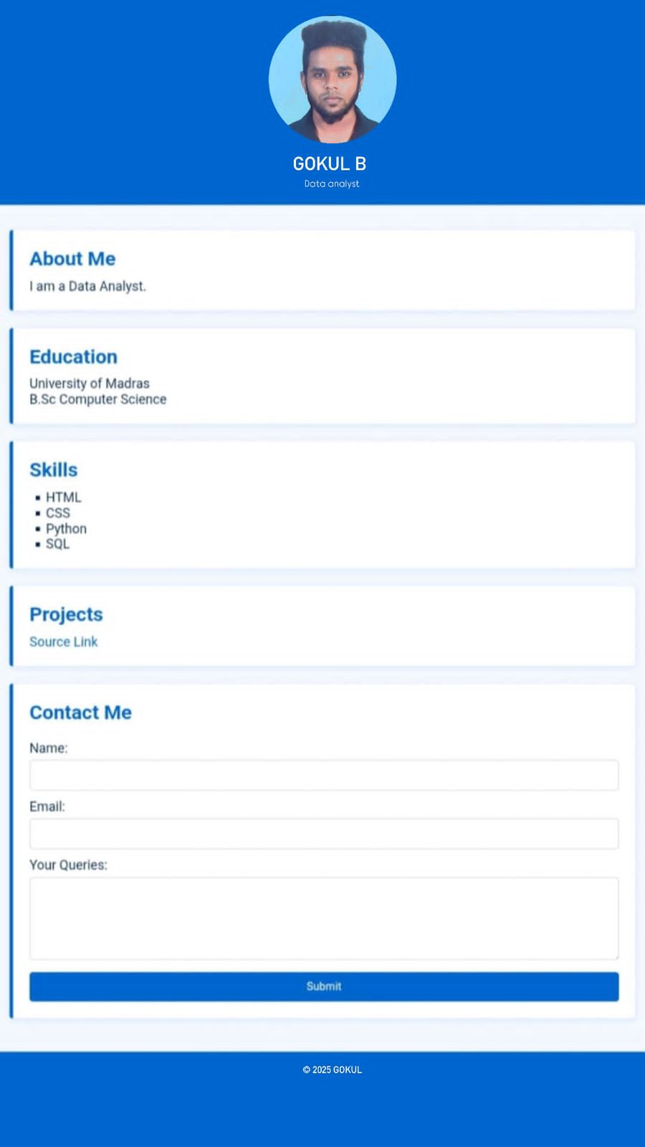
Screenshot

Slide 11

RESULTS AND SCREENSHOTS
Portfolio successfully created and tested✔ Projects, certificates, and achievements are displayed clearly✔ Responsive layout works on both desktop and mobile devices✔ Students can easily update and manage content(Insert screenshots of the portfolio homepage, project section, and mobile
3/21/2024 Annual Review
11

Slide 12
CONCLUSION
Summary of key points: Briefly recap the main points presented.
2. Project impact: Emphasize the potential impact or benefits of your project.
3. Future plans: Mention any future developments or improvements planned.
4. Call to action: Encourage the audience to engage with your project or learn more.
12

