Slide 1
Exploring the Impact of Health Indicators on Heart Disease
Ari Bernstein, Huai Hsuan Huang, Gokul Kumar Kesavan, Deepankar Makwana, Carissa Paul, Rui Yang
Group 12
December 2024
Data Management for Analytics Final Project

Slide 2
1
ASK 1: Dataset Description
Title: Heart Disease Dataset (2020 Cleaned)
Description: contains health information and heart disease status on just under 320,000 individuals regarding behavioral, demographic, and general health.
Size: 18 variables, 44MB, and 319,795 records each containing a unique individual’s health data.
Source: Kaggle, data records came from CDC Behavioral Risk Factor Surveillance System (BRFSS)
collects data from all 50 states
Why This Dataset?
Heart disease is a global health concern.
The data highlights risk factors and prevention strategies.
A team member's healthcare expertise adds value.
The dataset is clean and well-organized.
Concerns!
Relatively small sample size which may hinder some of the variables from applying entirely.
Some variables can be subjective rather than standardized (ex. General health status, physical and mental health).
Notes:
Heart disease has long plagued populations globally and this data allows us to provide critical education and analysis on risk factors and what leads to higher likelihood of heart disease and among which populations. We are also able to understand various prevention strategies of heart disease. Additionally, one of our team members has experience working in healthcare data analysis and this was a perfect opportunity to continue that passion.
This dataset was also clean, well-organized and well structured which was ideal for our analysis.
Concerns:
Relatively small sample size which may hinder some of the variables from applying entirely
Some variables can be subjective rather than standardized (ex. general health status, physical and mental health)

Slide 3
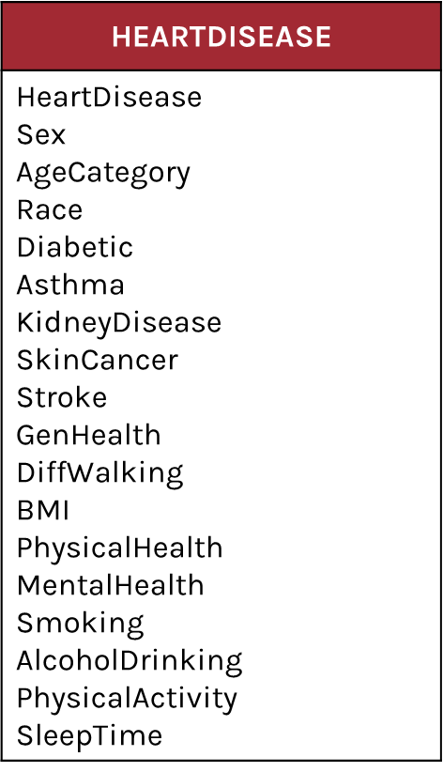
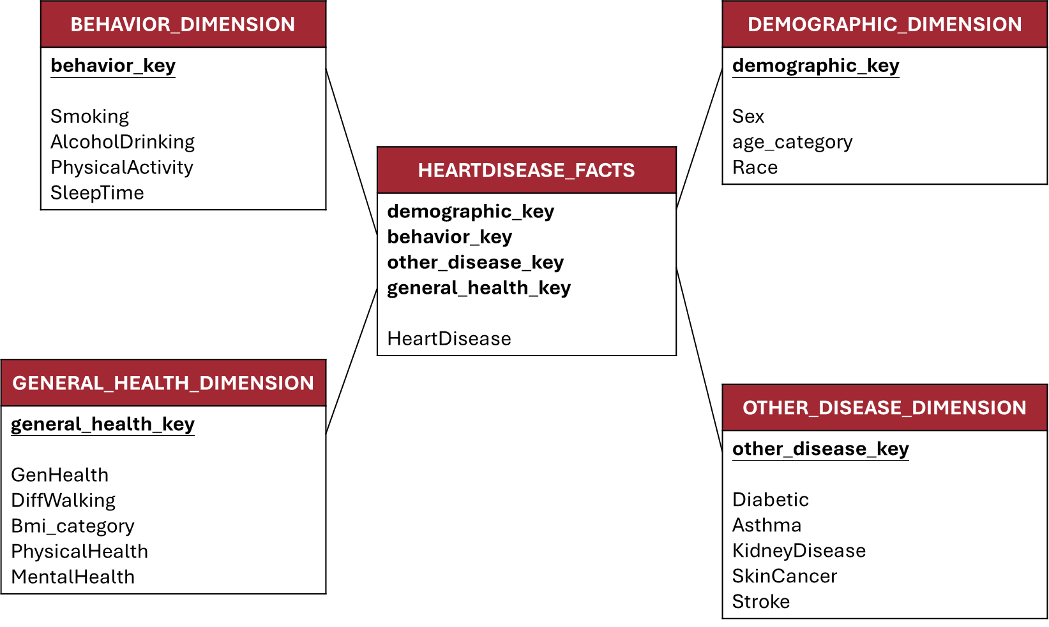
2
ASK 2: Data Wrangling
& Dimension Table
From this：
Data Cleaning Process
Inspect Column Names：Used csvcut -n to list all 18 column names
Data Types and Missing Values：Used csvstat to analyze the first 10,000 rows. Verified data types (boolean, numeric, categorical) and confirmed no missing values. Examined value distributions.
Define SQL Table Structure：Designed SQL schema using appropriate data types (BOOLEAN, VARCHAR, DECIMAL, FLOAT) based on column characteristics.
Import Data into Database：Check the file content to ensure the format was correct, resulting in a final count of 319,795 rows.
To this：

Slide 4
3
ASK 3: Data Analysis
Q1：Impact of Demographics and General Health Indicators on Heart Disease
Examine the role of demographic factors (ex. sex, age, race) and general health indicators (ex. BMI and self-reported health status) in predicting heart disease:
BMI：The prevalence of heart disease is slightly higher among individuals with Severely Obese.
Self-Reported Health Status：The highest prevalence of heart disease is found among individuals who self-reported ‘poor’ health status, with 34.10% of them having heart disease.
Difficult to Walk：Among individuals who reported ‘Difficult to Walk’, 22.58% have heart disease, which is notably higher.
Sex: 10.62% of males had heart disease where 6.69% of females had heart disease
Age: Older age groups have a higher proportion of individuals with heart disease.
Race: The prevalence is lower among Asian and Hispanic groups.
Severely Obese
Poor
Yes
Gender
Age Group
Race

Slide 5
3
ASK 3: Data Analysis
Q2：Effect of Health Behaviors on Heart Disease
Analyze how health behaviors (smoking and alcohol consumption, physical activity and sleep duration) influence the prevalence of heart disease.
Smoking: Among individuals who smoke, 12.16% have heart disease, compared to only 6.03% among non-smokers.
Alcohol: Among individuals who do not drink alcohol, 8.08% have heart disease, whereas only 5.24% of those who drink alcohol have heart disease.
Physical Activity: Among individuals who do not engage in physical activity, 13.76% have heart disease, whereas only 7.05% of those who engage in physical activity have heart disease.
Sleep Duration: Average SleepTime for those with heart disease: 7.09 hours (SD: 1.40). For those without: 7.14 hours (SD: 1.78).
Small Sample
 | Heart Disease
Alcohol Drinking | Yes | No
Yes | 1,141 | 20,636
No | 26,232 | 271,786
Yes
No
No
Smoking
Alcohol Drinking
Physical Activity

Slide 6
3
ASK 3: Data Analysis
Q3：Impact of Other Diseases on Heart Disease
Investigation of Relationship between Other Diseases (diabetes, asthma, stroke, kidney disease and skin cancer) with Heart Disease.
Diabetic: 21.95% of individuals who are diabetic also have heart disease, compared to 6.05% who are not diabetic.
Asthma: 11.51% of individuals who are asthmatic also have heart disease, compared to 8.10% who are not asthmatic.
Kidney Disease: 29.33% of individuals with kidney disease also have heart disease, compared to 7.77% who do not have kidney disease.
Stroke: 36.37% of individuals who had a stroke also have heart disease, compared to 7.47% who did not have a stroke.
Skin Cancer: 36.37% of individuals with skin cancer also have heart disease, compared to 7.47% who do not have skin cancer.
Yes
Yes
Yes
Yes
Yes
Diabetic
Asthma
Kidney Disease
Stroke
Skin Cancer

