Slide 1
Most popular components in syncfusion
GOKULKUMAR murugesan

Slide 2
POPULAR COMPONENTS
Data Grid
Charts
List View
Schedular
Diagram
PDF Viewer
Excel Library

Slide 3
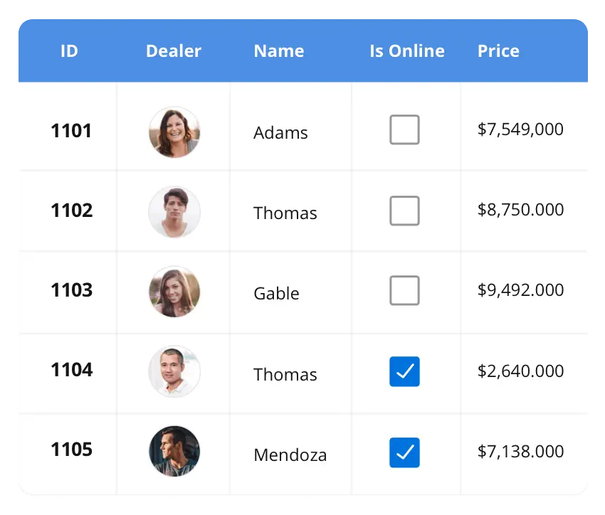



Datagrid
The datagrid control is a high-performance grid component that helps display and manipulate large amounts of data in a tabular format. Its rich feature set includes functionalities like data binding, sorting, grouping, editing, filtering, swiping, dragging, resizing, loading more items, pull-to-refresh, and exporting to excel and pdf file formats. Supported platforms
Blazor
Flutter
ASP.NETMVC
.NET Core
WinForms
WPF
WinUI
.NET MUAI
Xamarin
UWP
Flutter
Xamarin
Flutter
UWP
JavaScript
.NET MUAI

Slide 4
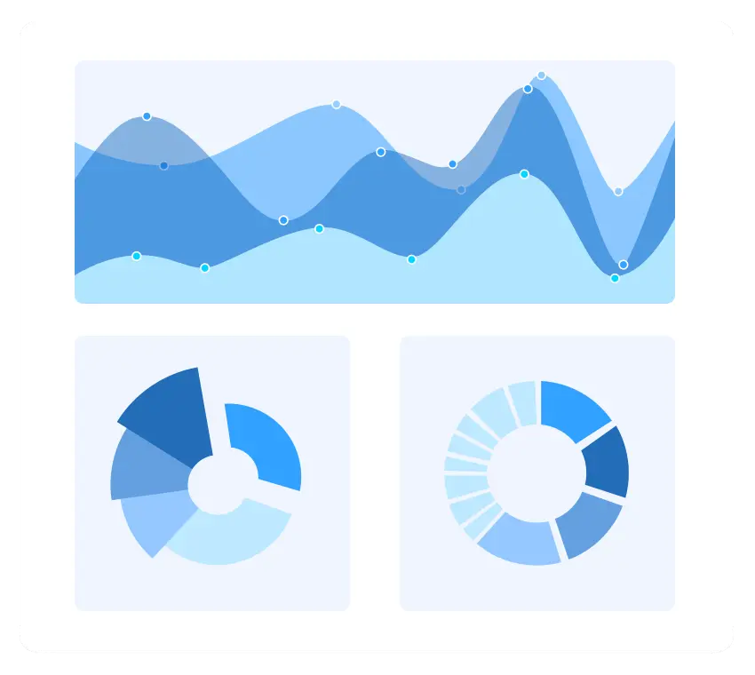
CHARTS
The Charts control can plot a wide range of chart types, ranging from line charts to specialized financial charts. Its rich feature set includes functionalities like data binding, multiple axes, legends, animation, data labels, annotations, trackballs, tooltips, and zooming.
Supported platforms
Blazor
Flutter
ASP.NETMVC
.NET Core
WinForms
WPF
WinUI
.NET MUAI
Xamarin
UWP
Flutter
Xamarin
Flutter
UWP
JavaScript
.NET MUAI

Slide 5
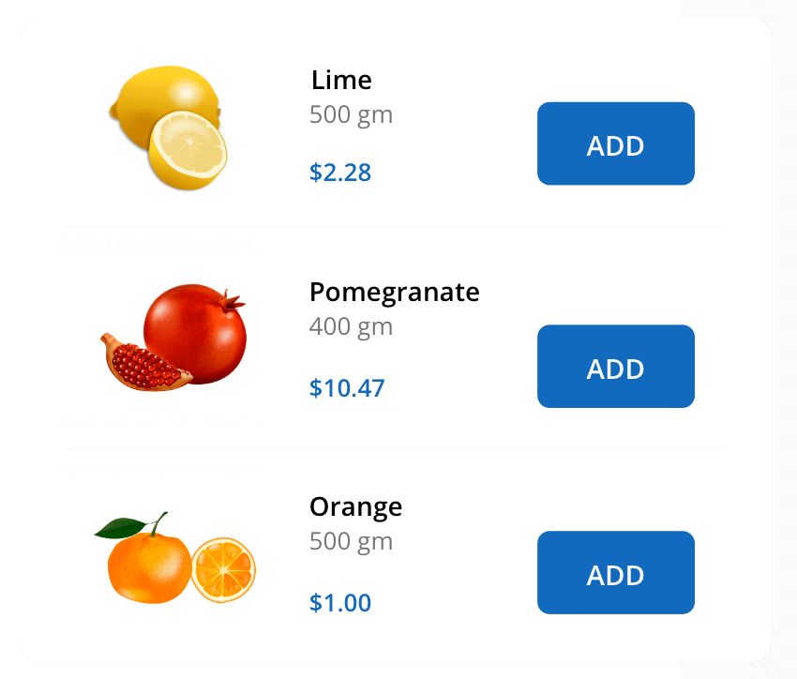
LISTVIEW
The ListView renders a set of data items with UI views or custom templates. It has many features like grouping, sorting, filtering, paging, swiping, multiple selection, drag and drop, and different layout types. The ListView control has been optimized to work with large amounts of data.
Supported platforms
Blazor
React
ASP.NETMVC
.NET Core
JavaScript
Angular
Vue
WinForms
.NET MUAI
Xamarin
Xamarin
Flutter
.NET MUAI

Slide 6
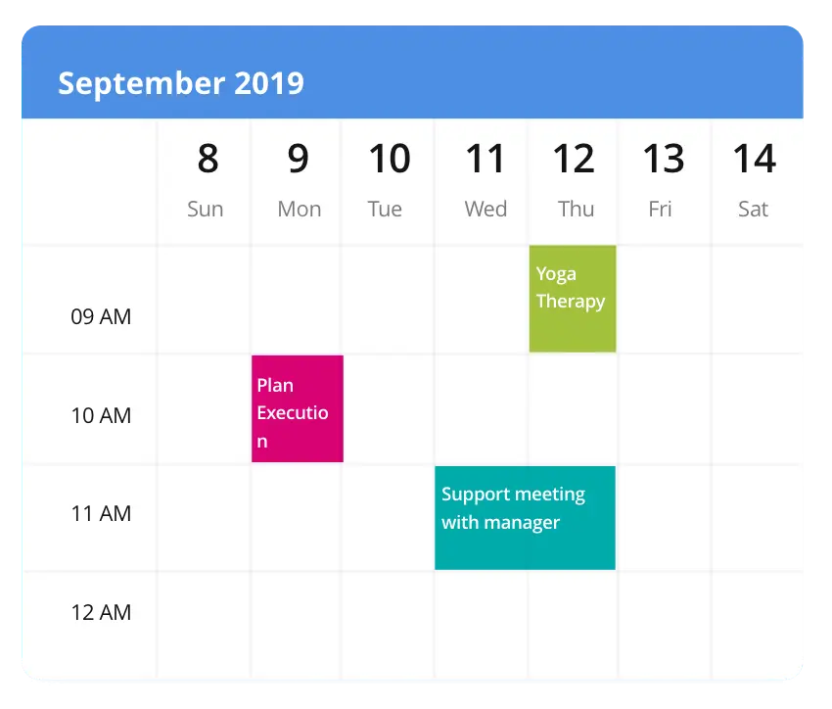
Scheduler
The Scheduler is a fully featured calendar component that allows you to manage your time efficiently. It facilitates easy resource scheduling, appointment rescheduling, drag and drop, resizing actions, and more.
Supported platformS
Blazor
Flutter
ASP.NETMVC
.NET Core
WinForms
WPF
WinUI
.NET MUAI
Xamarin
UWP
Flutter
Xamarin
Flutter
UWP
JavaScript
.NET MUAI

Slide 7
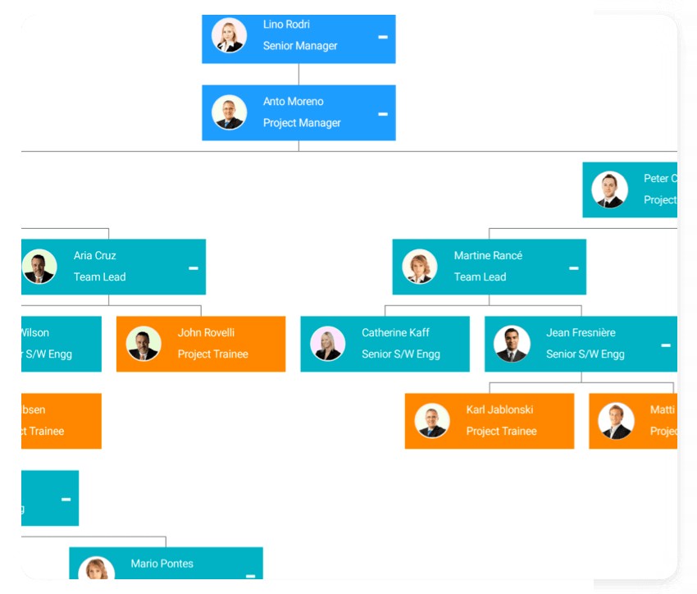
Diagram
The Diagram control can be used to create different types of diagrams such as flowcharts, use-case diagrams, workflow process diagrams, and mind maps. This control also provides built-in options to create organizational chart layouts and drill-down layouts.
Supported platforms
Blazor
Flutter
ASP.NETMVC
.NET Core
WinForms
WPF
WinUI
.NET MUAI
Xamarin
UWP
Flutter
Xamarin
Flutter
UWP
JavaScript
.NET MUAI

Slide 8

PDF VIEWER
The PDF Viewer is a feature-rich .NET PDF class library developed with 100% managed C# code that can be used to create, read, and write PDFs.
Supported platforms
Blazor
Flutter
ASP.NETMVC
.NET Core
WinForms
WPF
WinUI
.NET MUAI
Xamarin
UWP
Flutter
Xamarin
Flutter
UWP
JavaScript
.NET MUAI

Slide 9
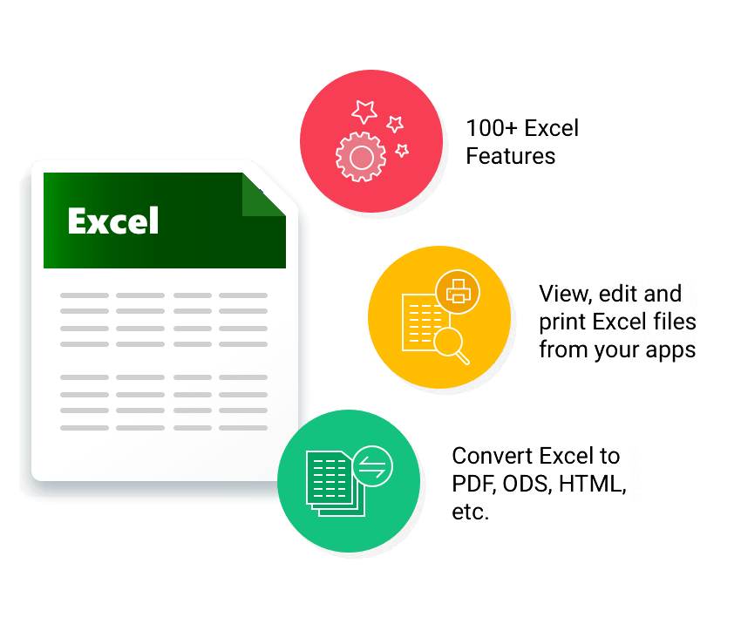
Excel Library
Excel Library is a native .NET class library that can be used to create and modify Microsoft Excel files by using C#, VB.NET, and managed C++ code.
Supported platforms
Blazor
Flutter
ASP.NETMVC
.NET Core
WinForms
WPF
WinUI
.NET MUAI
Xamarin
UWP
Flutter
Xamarin
Flutter
UWP
JavaScript
.NET MUAI

