Slide 1



HUMANEXA: Enterprise Social Impact Platform
AI-Powered Transparency & Accountability in Charity
Submitted by:
GOKUL M & TEAM
Department of AI & Data Science
Excel Engineering College

Slide 2
Introduction
Humanexa is a next-generation social impact ecosystem.
It leverages AI and real-time tracking to bridge the gap between donors and those in need.
Core Vision: Eliminating charity fraud and ensuring 100% transparency in contributions.

Slide 3
Problem Statement
Charity Fraud: Global rise in forged aid requests.
Lack of Transparency: Donors cannot track the exact destination of their funds.
Fragmented Ecosystem: Separate platforms for blood donation, NGO discovery, and volunteerism.
Inefficient Verification: Manual validation processes are slow and prone to error.

Slide 4
Existing System
Manual Coordination: reliance on social media groups and offline coordination.
Verification Gaps: No automated way to verify 'Proof of Help'.
Trust Deficit: Donors often hesitate due to uncertainty of impact.
Delayed Emergencies: Fragmented data leads to slow response in critical times.

Slide 5
Methodology
Agile Development: Iterative building of core modules.
System Architecture: MERN stack (MongoDB, Express, React, Node) + Python FastAPI for AI.
AI Verification Engine: Using Computer Vision for fraud detection and face blurring.
Security Protocols: JWT authentication and Role-Based Access Control (RBAC).

Slide 6
Proposed System: HUMANEXA
Integrated Platform: A unified hub for Donors, Helpers, and Institutions.
AI-Powered Verification: Automated analysis of proof images to prevent fraud.
Blockchain-Inspired Audit Logs: Immutable records of all transactions.
Real-Time Transparency: Live impact maps and verification status for every donation.

Slide 7
System Architecture
Frontend: React 18, TypeScript, Vite, Tailwind CSS.
Backend: Node.js (Express), MongoDB, Redis (Queue Management).
AI Service: Python FastAPI, TensorFlow/OpenCV (Fraud Detection).
Infrastructure: AWS S3, SES, SNS for global scalability.

Slide 8
Key Modules
Emergency Assistance: Real-time SOS for blood and medical aid.
Institution Discovery: Geo-spatial search for nearby NGOs and Shelters.
Live Impact Ticker: Real-time verification feed of ongoing help.
Admin Dashboard: Comprehensive control and analytics.

Slide 9
Premium Certificate System
Tiered Recognition:
- Welcome
- Bronze
- Silver
- Gold
- Platinum
- Diamond
Features:
- 300 DPI Export
- QR Verification
- Blockchain Metadata
- Museum-Grade Aesthetic

Slide 10
Implementation Highlights
Privacy First: Automated face blurring in help proof images.
Performance: Vite-powered frontend for sub-second load times.
Transparency: Every aid act has a public verification link.
Scalability: Dockerized microservices ready for cloud deployment.

Slide 11
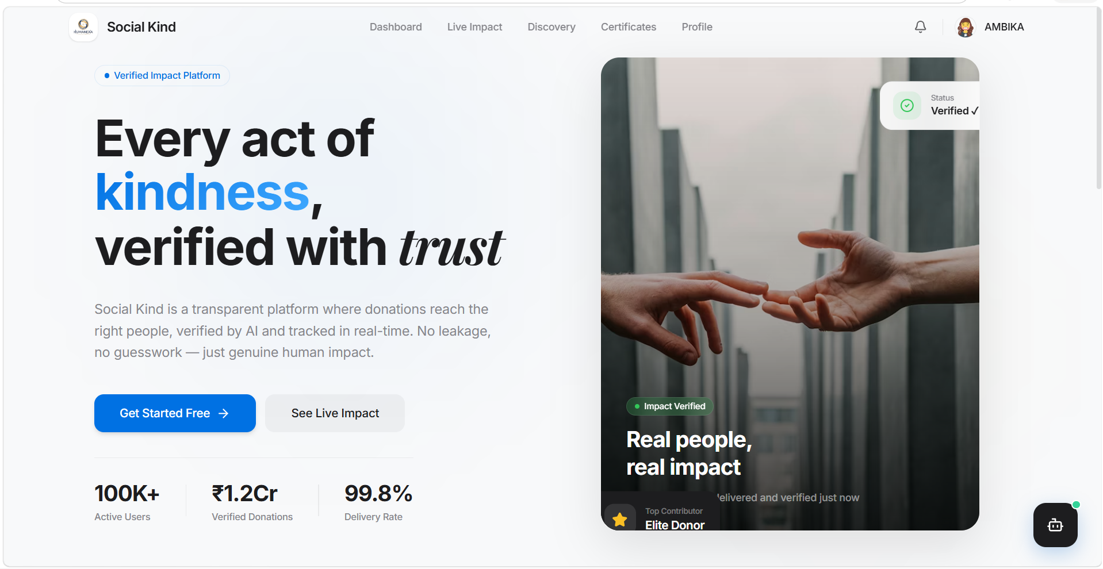
Result: Landing Page: Verified Impact Platform

Slide 12
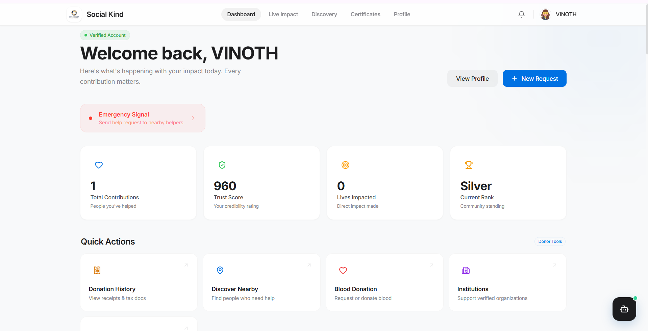
Result: Donor Dashboard: Real-time Impact Metrics

Slide 13
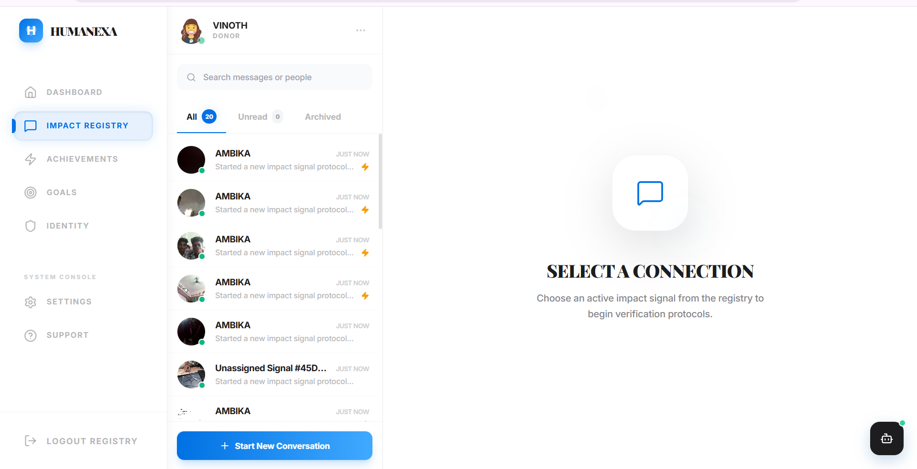
Result: Institution Discovery Portal

Slide 14
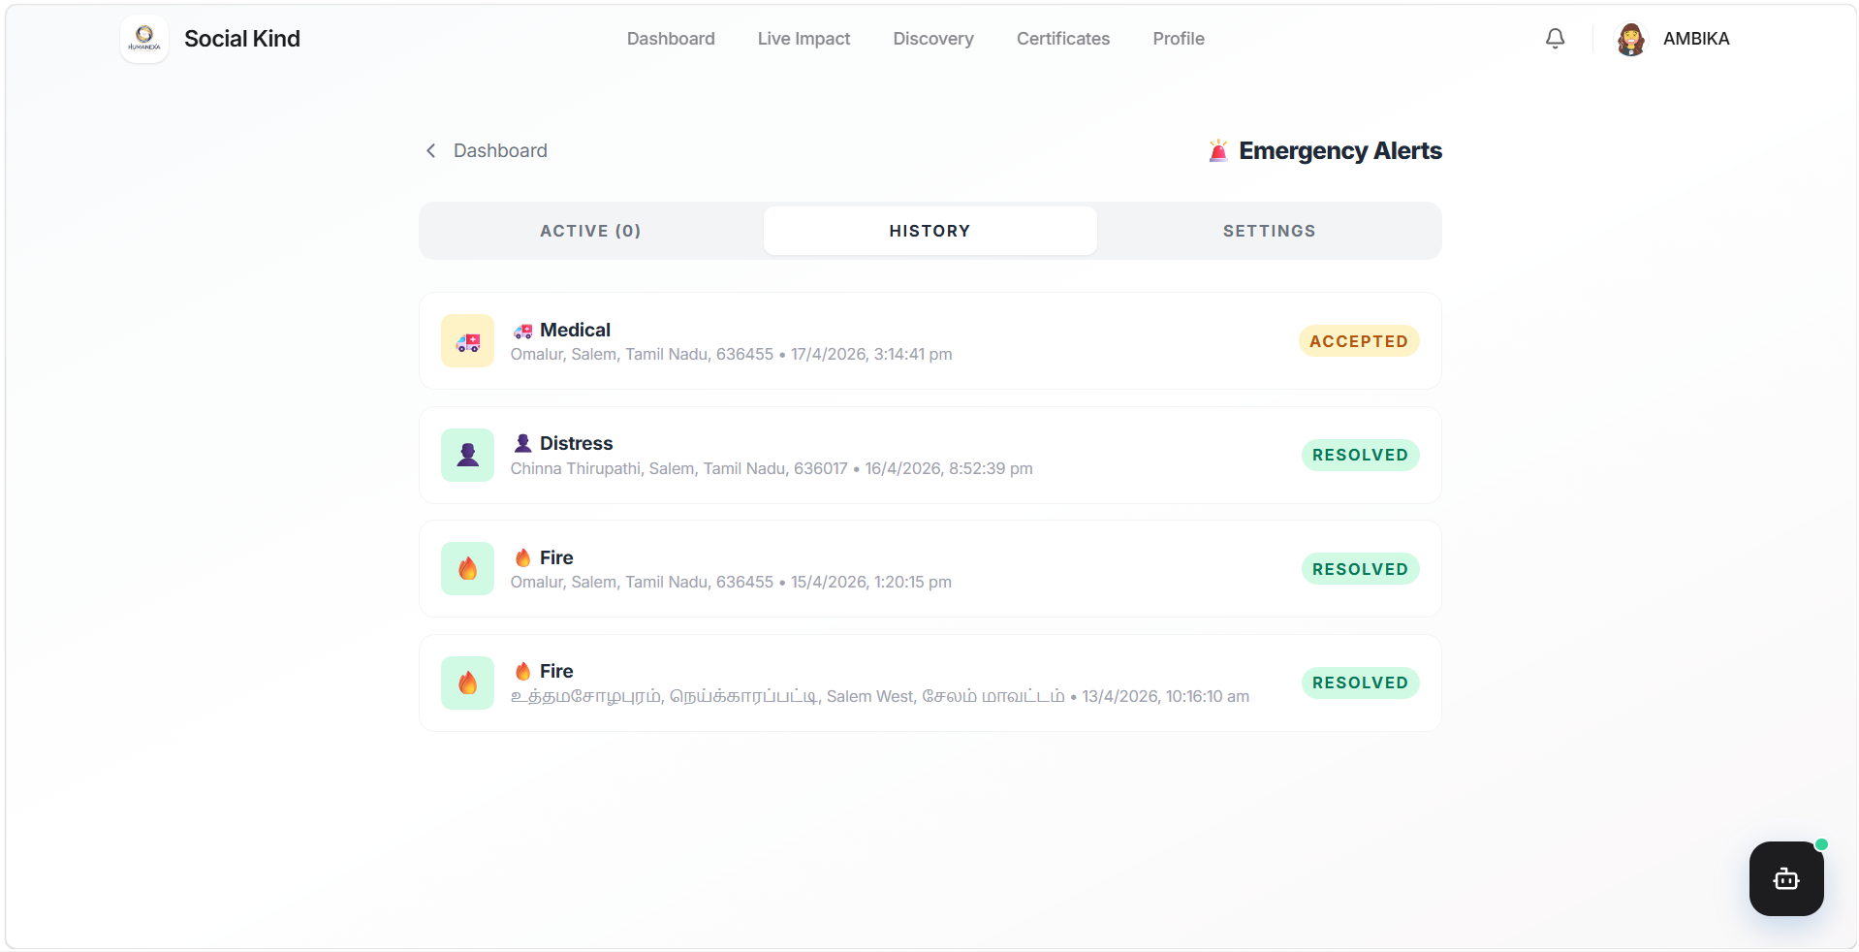
Result: Emergency Alerts: Accepted & Resolved SOS

Slide 15
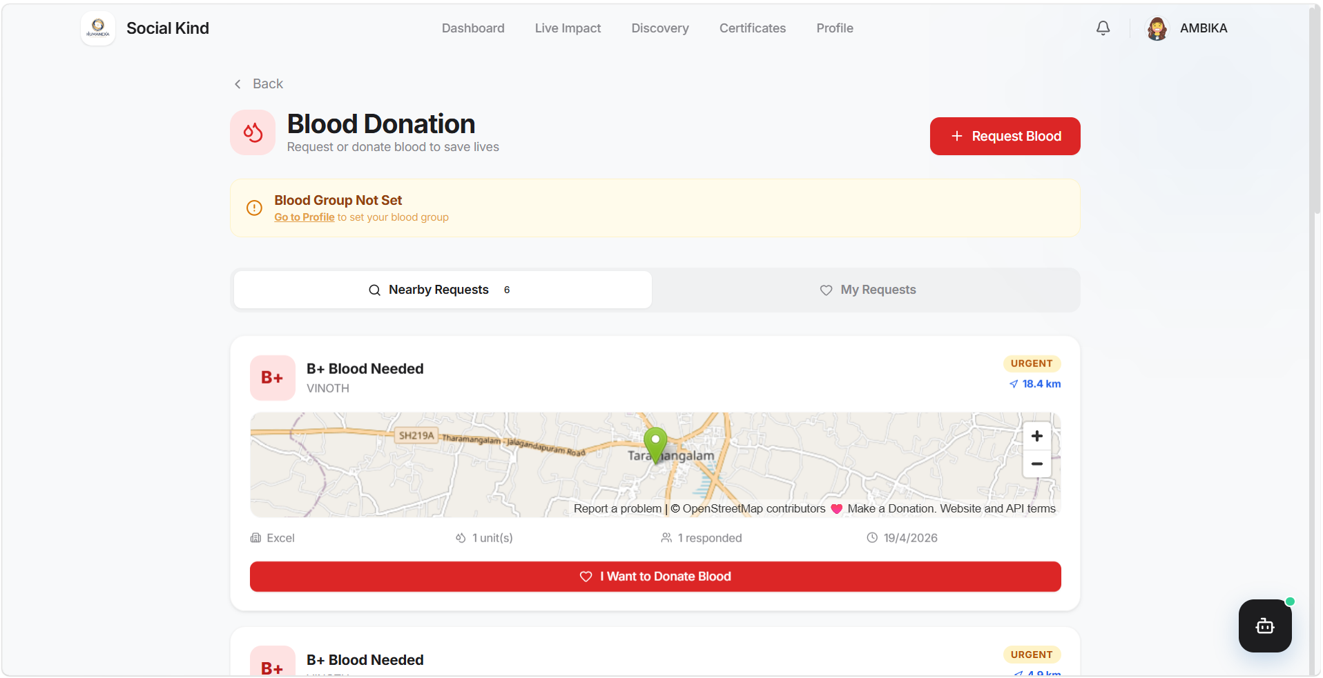
Result: Helper Verification Interface

Slide 16
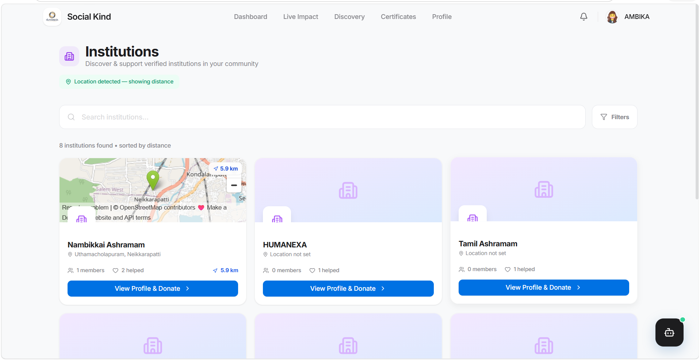
Result: Live Impact Feed & Audit Log

Slide 17
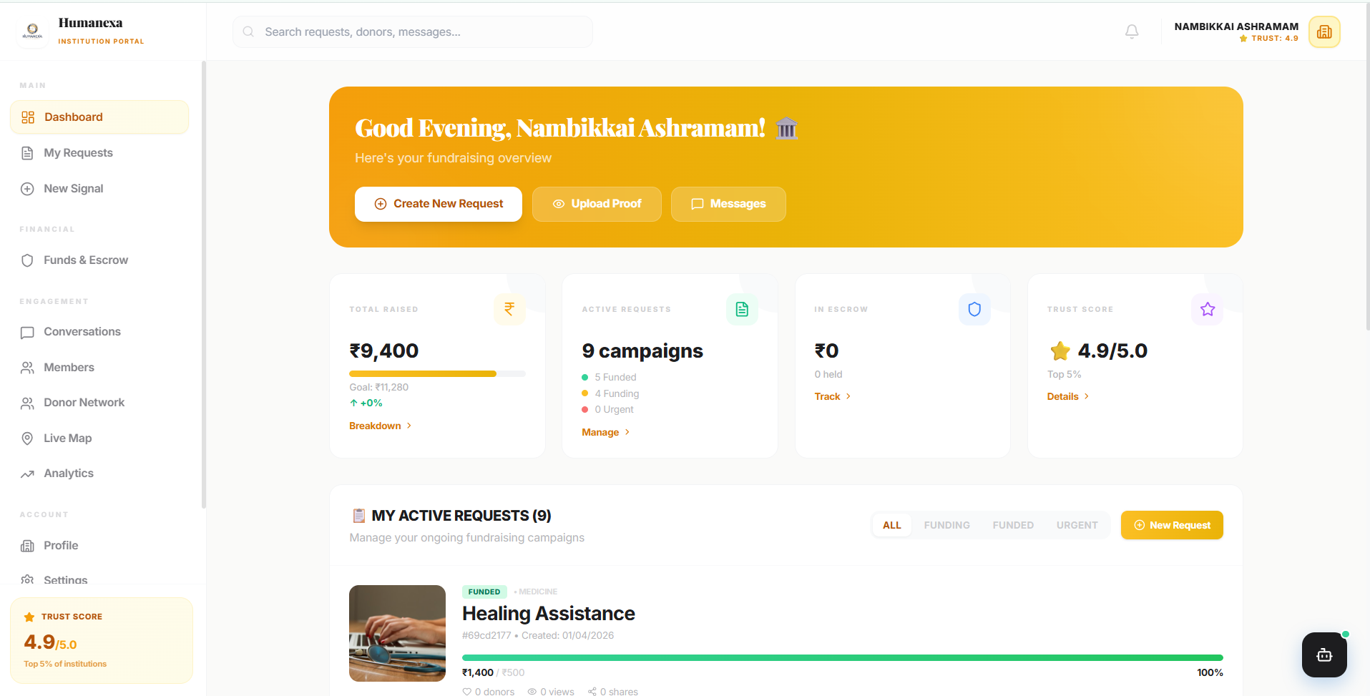
Result: Premium Certificate Generation

Slide 18
Conclusion & Future Scope
Future: Mobile App (React Native), Integration with UN SDG trackers.
Expansion: NFT-based charity collectibles for diamond donors.
Conclusion: Humanexa is a movement towards a trustable digital charity ecosystem.

Slide 19
THANK YOU
Questions & Feedback
Contact: gokulm@example.com
Humanexa Foundation

