Slide 1


Excel Engineering College (Autonomous) Komarapalayam – 637 303 Department of Artificial Intelligence and Data Science
AI-Based Resume Detection and Analysis System
Presented by
Priya Kumari (730922201087)
Santhosh M R (730922201099)
Manivannan M (730922201306)
Raja S (730922201308)
Under the Guidance of
Ms. S.Manju vidhya, B.E,M.E.,
Assistant Professor

Slide 2
Agenda
Abstract
Objectives
Problem Statement
Existing System
Proposed System
Software used
Architecture / Methodology Used
System Design/flow chart /DFD/ER/Use cases
Modules
Testing/Performance Evaluation /Results
Conclusion and Future Enhancements
Screenshot
References

Slide 3
ABSTRACT
This project aims to build an AI-based system that automatically reads, extracts, and analyzes resumes. Recruiters often face difficulties while checking hundreds of resumes manually. Our system solves this problem using Artificial Intelligence and Natural Language Processing (NLP) to pick out important details like name, contact, skills, education, and work experience from PDF resumes. It then compares these details with job requirements and gives a match score. This helps companies save time, reduce human error, and choose the best candidates easily. The project is developed using Python (Flask), HTML, CSS, and JavaScript, and supports database storage for future reference.

Slide 4
OBJECTIVES OF THE PROJECT
To create a system that automatically reads and analyzes resumes.
To extract key information like name, skills, education, and experience from resumes.
To match the extracted skills with job requirements using AI and NLP.
To help recruiters shortlist suitable candidates quickly and accurately
To reduce manual effort and save time in the hiring process.

Slide 5
PROBLEM STATEMENT
The main problem is that the traditional resume screening process is time-consuming and inaccurate. Due to human error and manual filtering, recruiters may miss out on ideal candidates. So, there is a need for a smart, automated system.

Slide 6
Literature survey
Traditional resume screening is time-consuming and often inaccurate. Most systems use keyword matching, which may miss the real potential of a candidate.
Recent studies suggest using Artificial Intelligence (AI) and Natural Language Processing (NLP) for better resume analysis. Tools like spaCy, NLTK, and PyMuPDF help extract important information from resumes effectively.
Our project builds on these technologies to create a smart system that automates resume reading and matches candidate skills with job requirements accurately.

Slide 7
PROPOSED SYSTEM
The proposed system is an AI-powered web application that helps recruiters automatically read and analyze resumes. Users can upload resumes in PDF format. The system uses Natural Language Processing (NLP) to extract important information like name, contact details, skills, education, and experience. After extracting the data, the system compares the candidate’s skills with the required job description and calculates a matching score. This score helps recruiters easily identify the most suitable candidates. The system also stores the results for future reference and provides an easy-to-use dashboard for viewing and filtering applicants. This reduces manual work, saves time, and improves the overall hiring process.

Slide 8
SOFTWARE USED
We have used the following technologies to build our system:
Frontend: HTML, CSS, JavaScript
Backend: Python with Flask Framework
Libraries: PyMuPDF for PDF reading, spaCy, and NLTK for Natural Language Processing
Database: MySQL

Slide 9
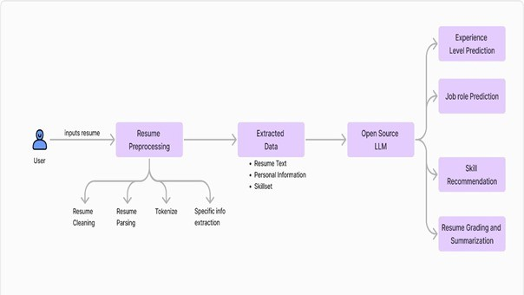
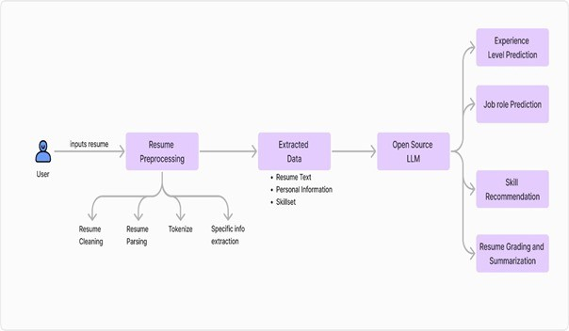
FLOW CHART

Slide 10
MODULES
The main modules of our system are:
Resume Upload and Parsing
Information Extraction
Skill Matching with Job Description
Admin Panel to view all results
Analytical Reports for better decision-making

Slide 11
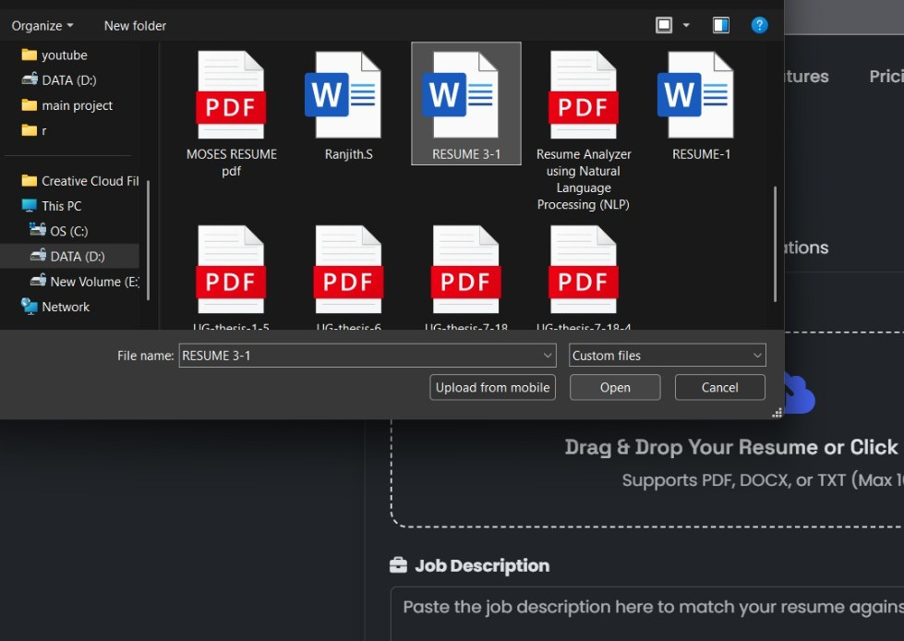
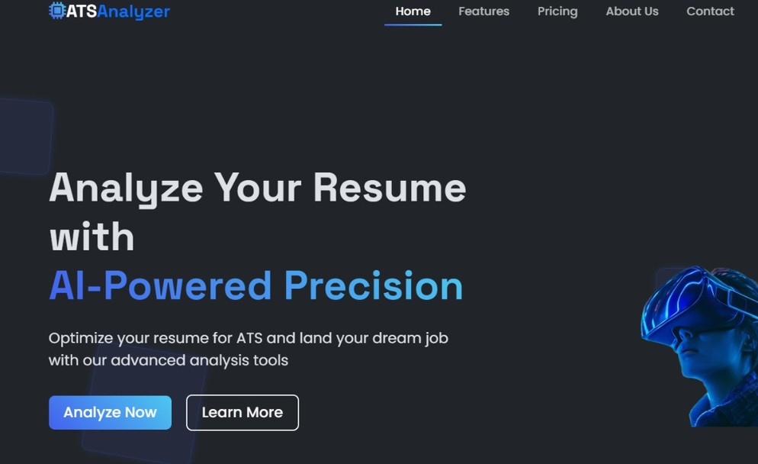
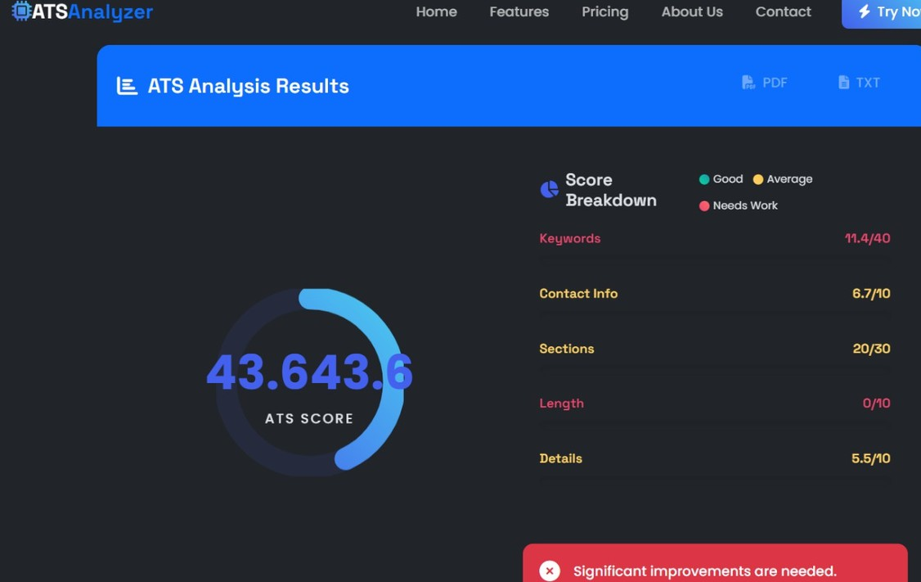
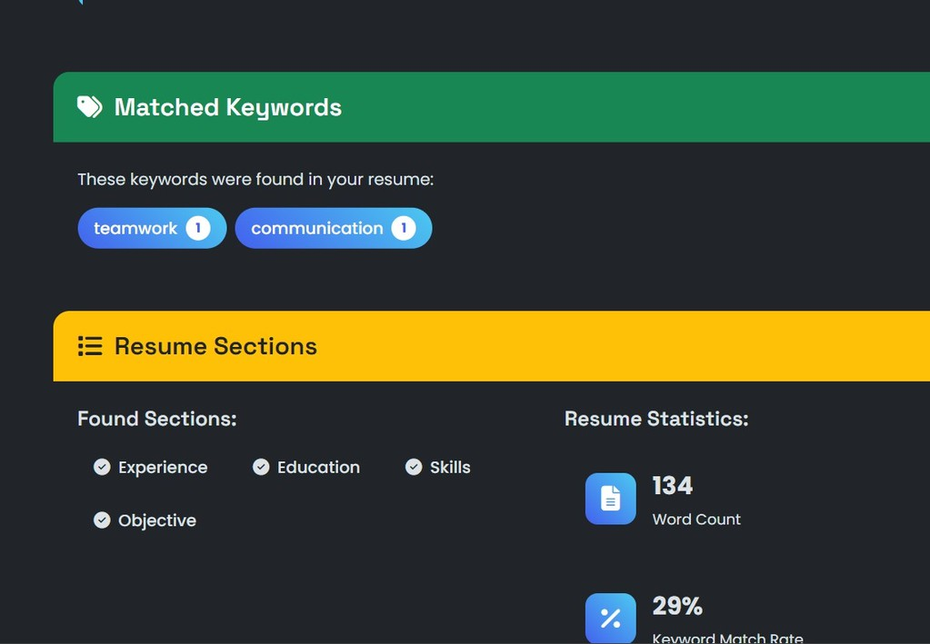
TESTING/PERFORMANCE EVALUATION/RESULTS/comparison chart (any one)

Slide 12
CONCLUSION
In this project, we developed an AI-based system that makes resume screening faster, smarter, and more accurate. It automatically extracts important information from resumes and matches them with job requirements using AI and NLP. This system reduces manual effort, saves time, and helps recruiters find the right candidates easily. Overall, it improves the recruitment process and makes it more efficient.

Slide 13
FUTURE ENHANCEMENTS
AI Interview Bot Integration: Add an AI chatbot to conduct initial screening interviews based on the resume content.
Voice Resume Parser: Allow candidates to record voice introductions, and the system can analyze tone, clarity, and confidence.
Fraud Detection System: Use AI to detect fake or copied resume content by comparing it with global resume databases.
Emotional Tone Analysis: Analyze the writing tone of resumes (formal, confident, confused) to help recruiters understand personality traits.
Diversity and Inclusion Check: Ensure unbiased shortlisting by checking for gender-neutral language and inclusive hiring.

Slide 14
REFERENCES
Research Paper: "Automated Resume Screening using Natural Language Processing" – IEEE, 20212.
spaCy Documentation – https://spacy.io/
PyMuPDF Documentation – https://pymupdf.readthedocs.io/
NLTK (Natural Language Toolkit) – https://www.nltk.org/
Flask Documentation – https://flask.palletsprojects.com/
"Machine Learning for Resume Screening" – International Journal of Computer Applications, 2020
Various online tutorials and GitHub repositories related to AI-based resume parsing and NLP

Slide 15



HUMANEXA: Enterprise Social Impact Platform
AI-Powered Transparency & Accountability in Charity
Submitted by:
GOKUL M & TEAM
Department of AI & Data Science
Excel Engineering College

Slide 16
Introduction
Humanexa is a next-generation social impact ecosystem.
It leverages AI and real-time tracking to bridge the gap between donors and those in need.
Core Vision: Eliminating charity fraud and ensuring 100% transparency in contributions.

Slide 17
Problem Statement
Charity Fraud: Global rise in forged aid requests.
Lack of Transparency: Donors cannot track the exact destination of their funds.
Fragmented Ecosystem: Separate platforms for blood donation, NGO discovery, and volunteerism.
Inefficient Verification: Manual validation processes are slow and prone to error.

Slide 18
Existing System
Manual Processes: reliance on social media groups and offline coordination.
Verification Gaps: No automated way to verify 'Proof of Help'.
Trust Deficit: Donors often hesitate due to uncertainty of impact.
Delayed Emergencies: Fragmented data leads to slow response in critical times (e.g., Blood needs).

Slide 19
Methodology
Agile Development: Iterative building of core modules.
System Architecture: MERN stack (MongoDB, Express, React, Node) + Python FastAPI for AI.
AI Verification Engine: Using Computer Vision for fraud detection and face blurring.
Security Protocols: JWT authentication and Role-Based Access Control (RBAC).

Slide 20
Proposed System: HUMANEXA
Integrated Platform: A unified hub for Donors, Helpers, and Institutions.
AI-Powered Verification: Automated analysis of proof images to prevent fraud.
Blockchain-Inspired Audit Logs: Immutable records of all transactions and aid acts.
Real-Time Transparency: Live impact maps and verification status for every donation.

Slide 21
System Architecture
Frontend: React 18, TypeScript, Vite, Tailwind CSS.
Backend: Node.js (Express), MongoDB, Redis (Queue Management).
AI Service: Python FastAPI, TensorFlow/OpenCV (Fraud Detection).
Cloud/Infrastructure: AWS S3, SES, SNS for global scalability.

Slide 22
Key Modules
Emergency Assistance: Real-time SOS for blood and medical aid.
Institution Discovery: Geo-spatial search for nearby NGOs and Shelters.
Live Impact Ticker: Real-time verification feed of ongoing help.
Admin Dashboard: Comprehensive control and analytics for the platform.

Slide 23
Premium Certificate System
Tiered Recognition:
- Welcome
- Bronze
- Silver
- Gold
- Platinum
- Diamond
Features:
- 300 DPI Export
- QR Verification
- Blockchain Metadata
- Museum-Grade Aesthetic

Slide 24
Implementation Highlights
Privacy First: Automated face blurring in help proof images.
Performance: Vite-powered frontend for sub-second load times.
Transparency: Every aid act has a public verification link.
Scalability: Dockerized microservices ready for cloud deployment.

Slide 25
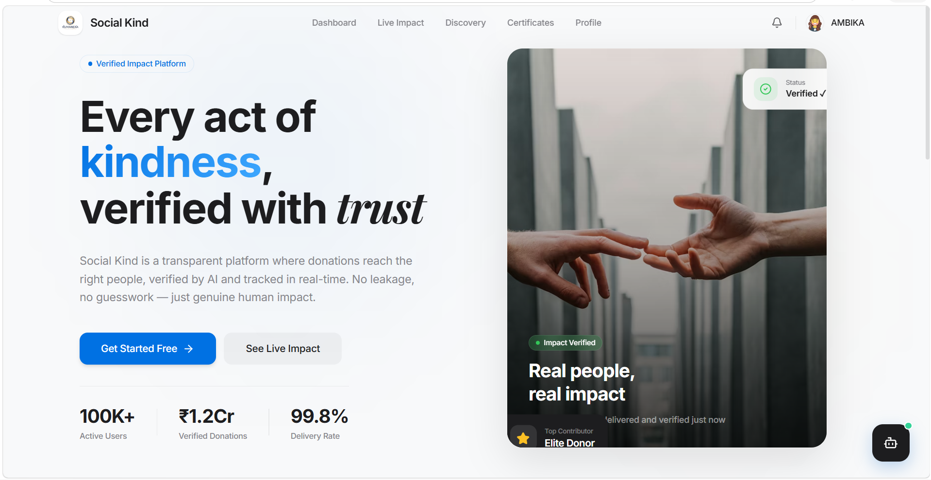
Result: Landing Page: Verified Impact Platform

Slide 26
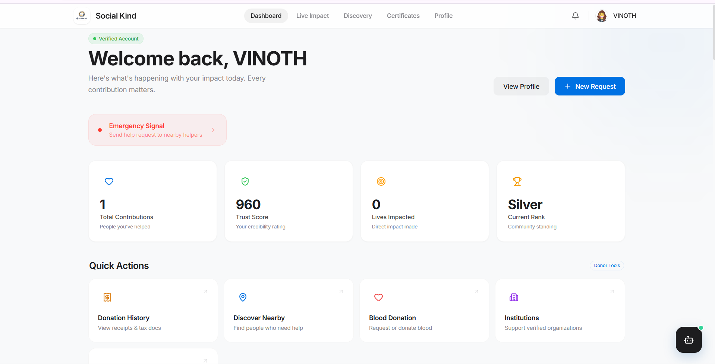
Result: Donor Dashboard: Real-time Impact Metrics

Slide 27
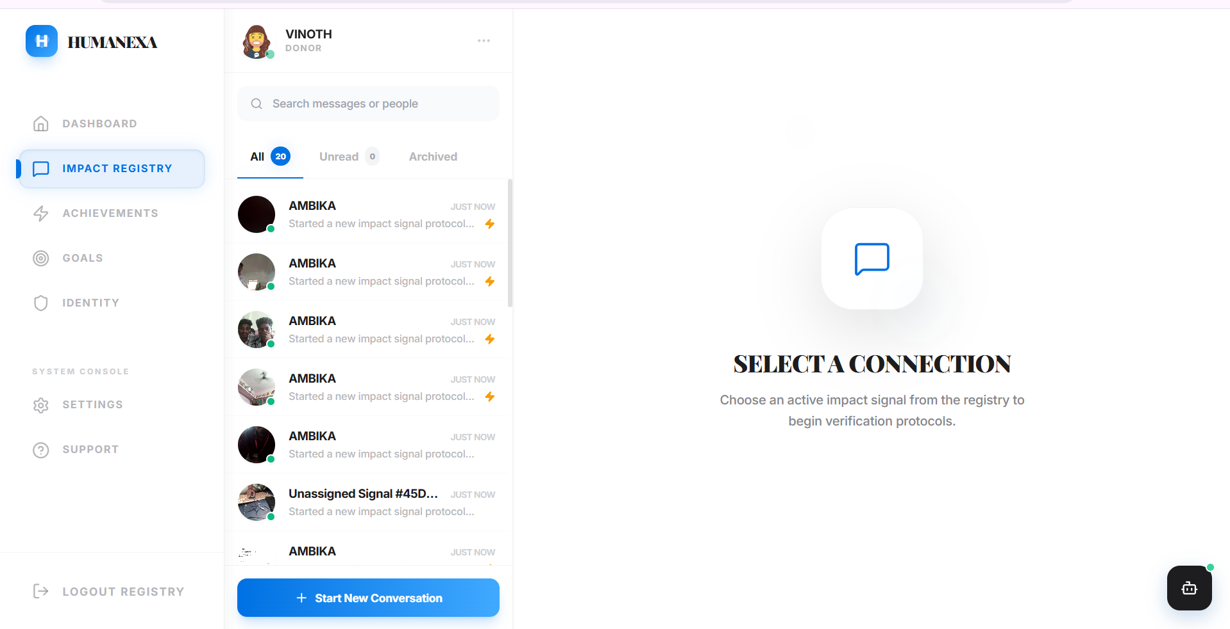
Result: Institution Discovery Portal

Slide 28
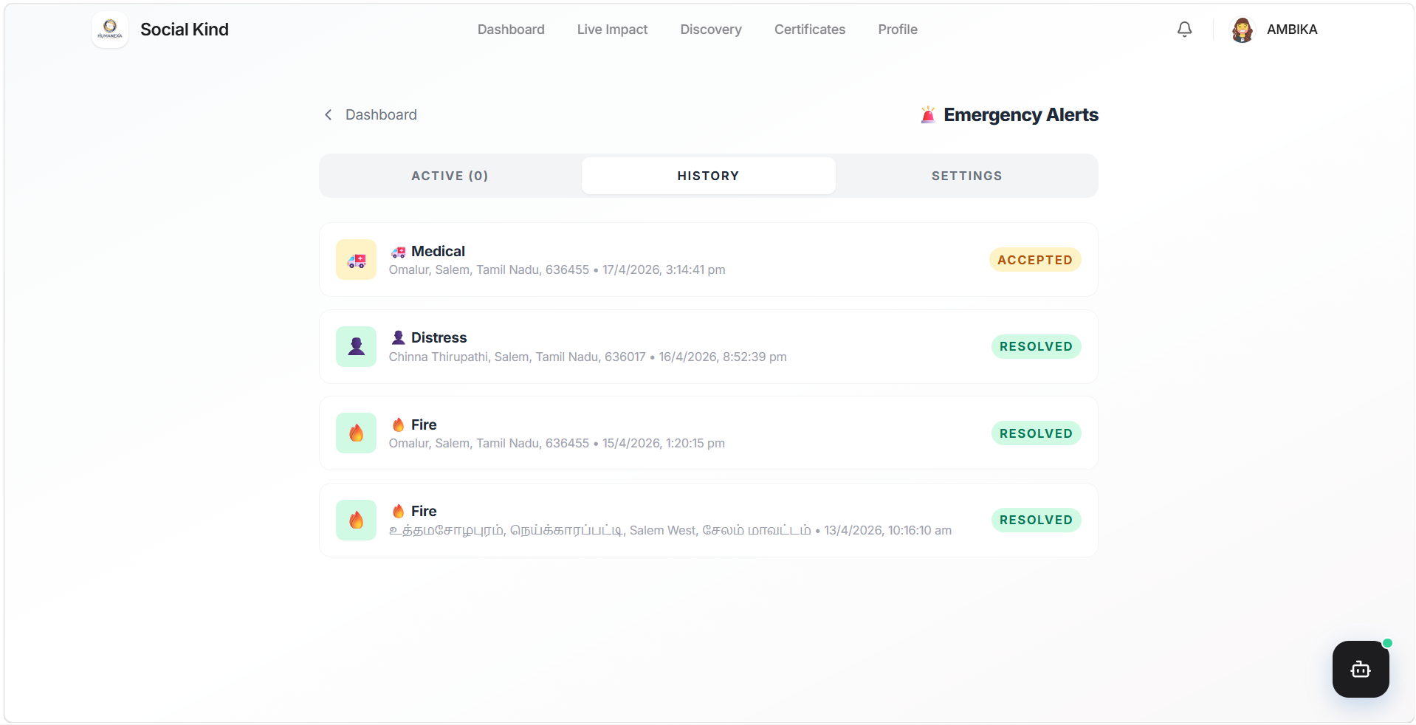
Result: Emergency Alerts: Accepted & Resolved SOS

Slide 29
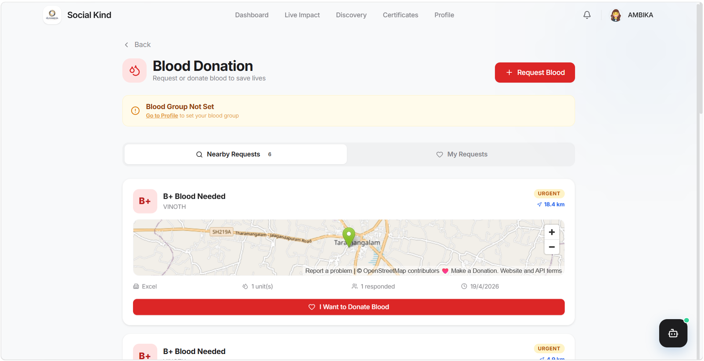
Result: Helper Verification Interface

Slide 30
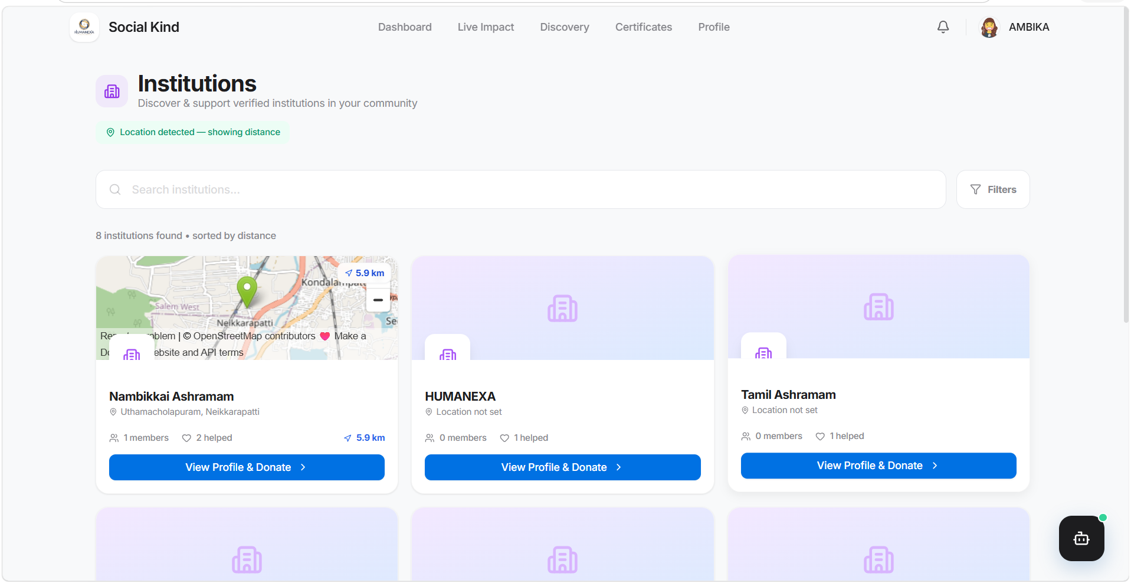
Result: Live Impact Feed & Audit Log

Slide 31
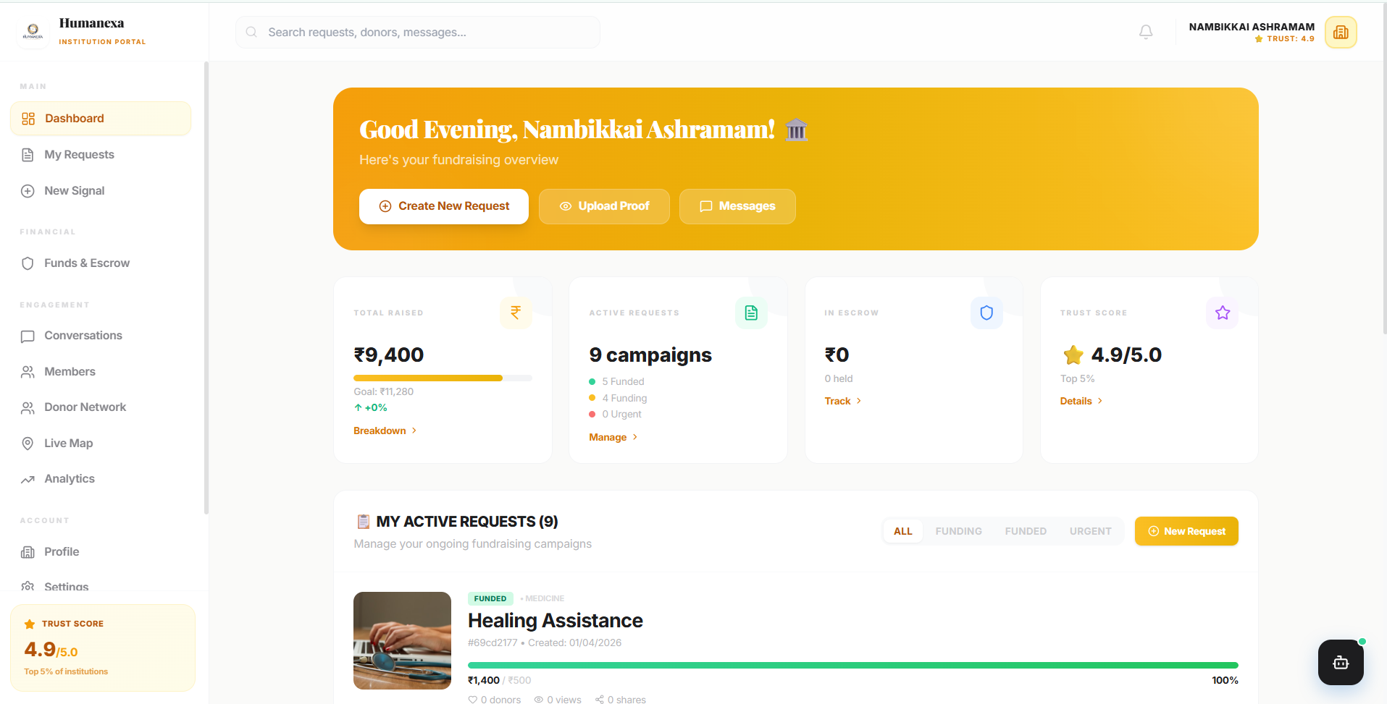
Result: Premium Certificate Generation

Slide 32
Conclusion & Future Scope
Future: Mobile App (React Native), Integration with UN SDG trackers.
Expansion: NFT-based charity collectibles for diamond donors.
Conclusion: Humanexa is not just an app, it's a movement towards a trustable digital charity ecosystem.

Slide 33
THANK YOU
Questions & Feedback
Contact: gokulm@example.com
Humanexa Foundation

