Slide 1
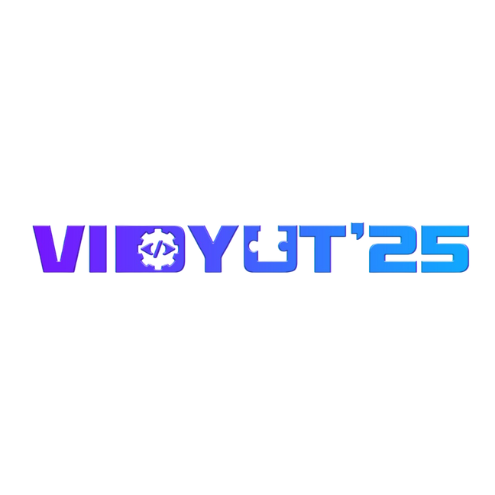
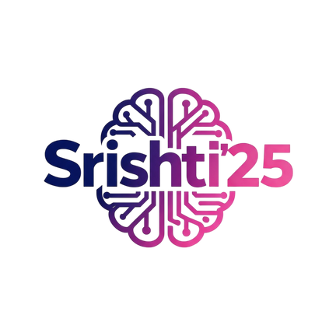
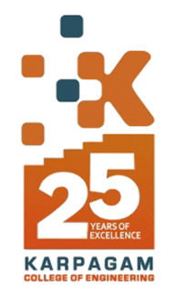

VIDYUT-SRISHTI’25 HACKATHON
TITLE PAGE
  Problem Statement ID :
  Problem Statement Title:
  Theme: Education
  PS Category: Software
  Team ID: 204_SRISHTI_Vidyut_25
  Team Name (Registered on portal): NeoHack
AI-Enabled Sign Language Learning and Multilingual Converter App for the Speech and Hearing Impaired

Slide 2


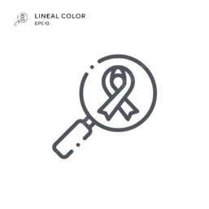

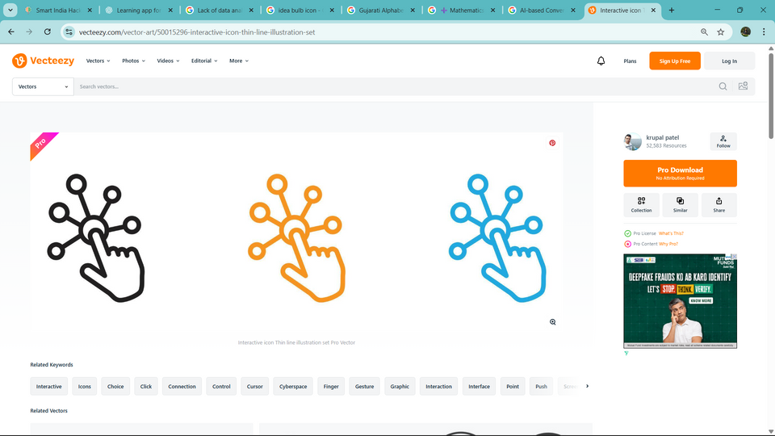



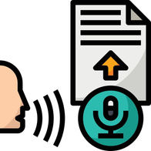
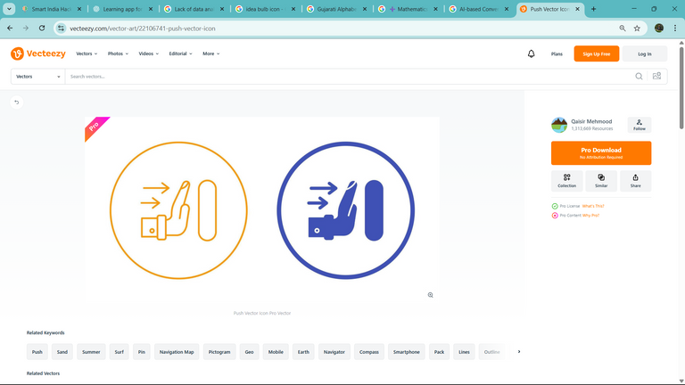
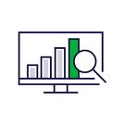
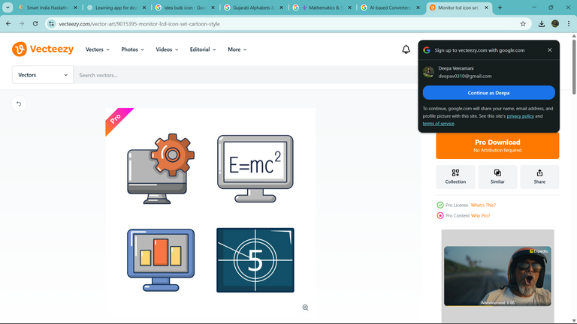
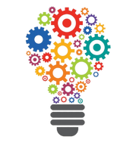
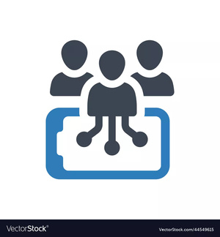
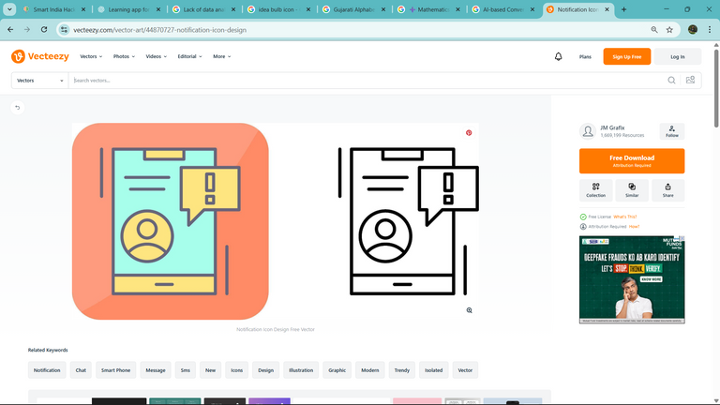
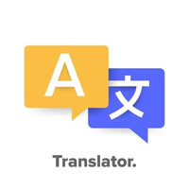

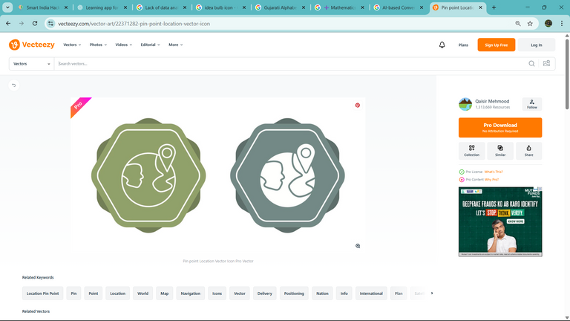
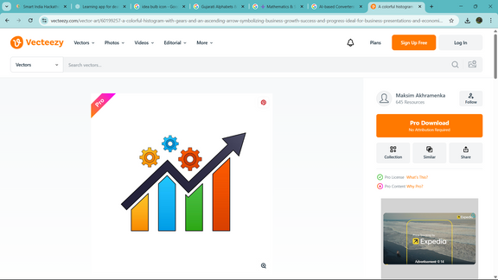
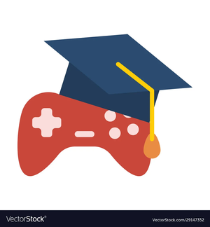
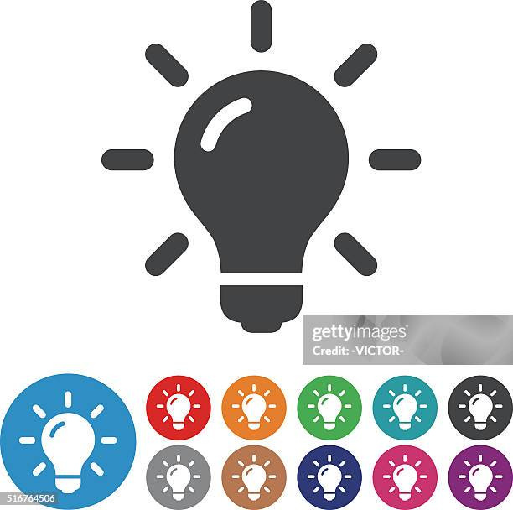
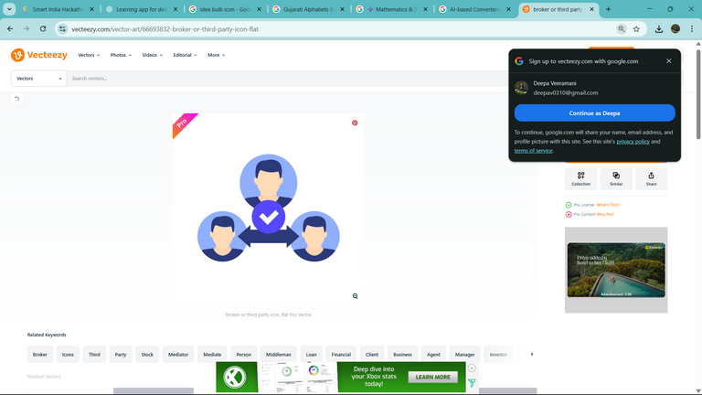
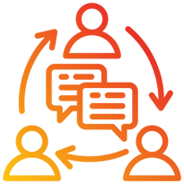
IDEA TITLE: AI-Enabled Sign Language Learning &Multilingual Converter App for the Speech & Hearing Impaired
Problem Statement Analysis
Proposed Solution
Uniqueness
Regional Alphabets & Numbers:
Algorithm:
Absence of localized ISL-Regional
learning content.
Fast, mobile-friendly DNN using 126 landmarks for accurate hand sign detection.
Animated ISL tutorials + handwriting pad for practice.
Fragmented tools — separate apps for speech,text, or sign conversion
Words & Sentences:
Learn and practice vocabulary using Regional
& ISL.
AI Model:
AI model converts gestures to
Indian Sign Language text in real time.
Lack of data analytics for teachers and
parents to monitor progress.
Mathematics & Science Modules:
Innovations
Step-by-step lessons, visual explanations,
and assessments.
Limited awareness and inclusion tools
for HR and institutions.
Smart AI app for real-time sign detection and interactive learning.
AI-based Converters:
Regional text ↔ ISL video animation
Speech ↔ Text ↔ Sign language translation
What is Needed
Personalized lessons with
regional sign options.
Learning Analytics:
Real-time conversion tools
— Speech ↔ Sign ↔ Text.
Gamified learning with quizzes,
badges, and leaderboards.
Personalized report cards and performance
insights.
Multi-User Roles:
Fun, visual, and accessible communication for all ages.
Data analytics dashboards for
teachers, parents, and HR professionals.
Teachers, Students, Parents, HR (for inclusivity training and interviews)
NeoHack
VIDYUT-SHRISTHI’25-idea submission
1

Slide 3


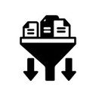
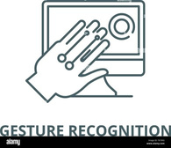
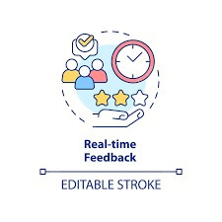

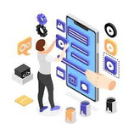


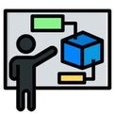


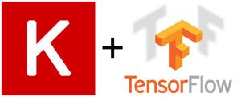


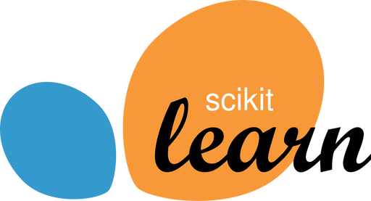
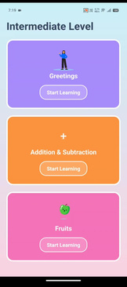
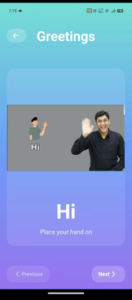
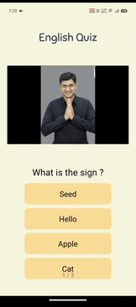
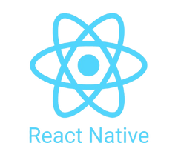
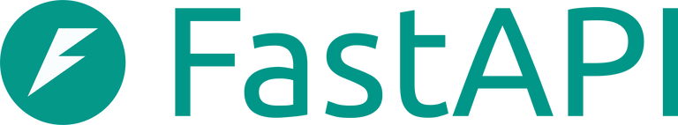
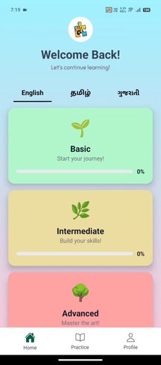
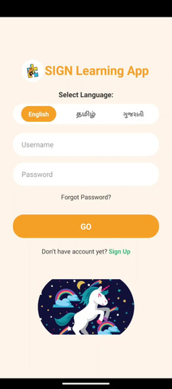
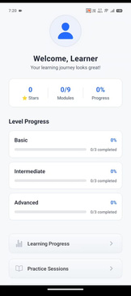
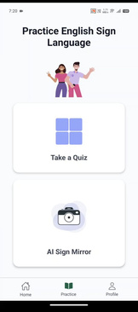
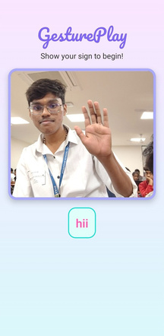
Technical Stacks
TECHNICAL APPROACH
Programming Language
System Flow
Real-Time Hand Capture
Feature Extraction
Gesture Classification
Real-Time Output
core language for model training, gesture recognition, and app logic
Core Libraries & Frameworks
App Development & Integration
Data set
Preprocessing
Model Training
Evaluation & Validation
Deployment Optimization
MediaPipe
Scikit-learn
c
User Journey
Deployment & Backend Integration
Study mode
Quiz
Parents/Teachers' Role
Practice Mode
Sign Mirror
Can track the child/students' Learning skills by ranking the rewards and showing the level they studeied.
Login Page
Welcome page
NeoHack
VIDYUT-SHRISTHI’25-idea submission
2

Slide 4
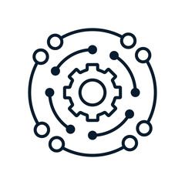
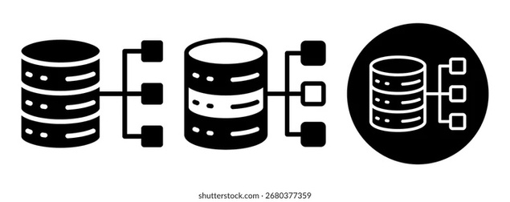
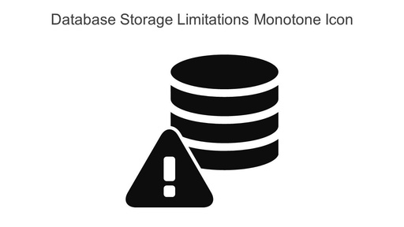
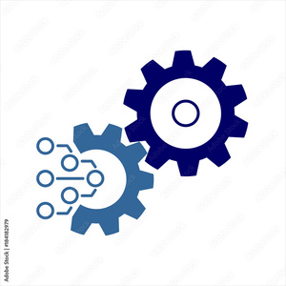
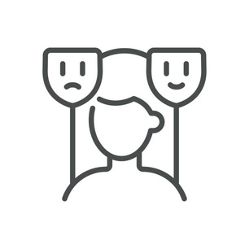
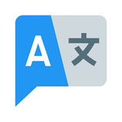
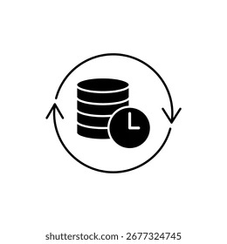
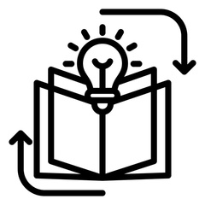
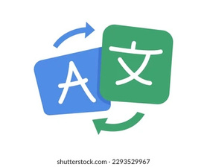
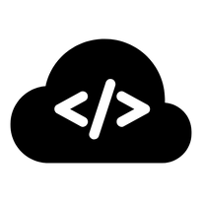
FEASIBILITY AND VIABILITY
Analysis of Feasibility
Potential Challenges & Risks
Strategies for overcoming these challenges
Model Complexity:
Real-time ISL gesture recognition via MediaPipe + DNN on mobile/edge devices.
Dataset Limitation:
Custom ISL Dataset:
Lack of large, diverse ISL datasets affects model accuracy; custom datasets are crucial.
Collaborate with ISLRTC & deaf institutions; use diverse gestures, lighting, hand types, and data augmentation.
Integration Capability:
Smooth deployment on Android/iOS using React Native and efficient camera-stream APIs.
Variability in User Gestures:
Multilingual Sign-to-Text:
Differences in hand size, speed, lighting, and ability require adaptive learning.
Support English & Gujarati with real-time transliteration and language switching.
Data Availability:
Custom ISL dataset collected from peers ensures consistency and real-time accuracy.
Multilingual Text:
Continuous Learning:
Server Deployment:
Translating gestures to English requires clear and educationally suitable hand signs.
Enable user-driven model updates, over-the-air refreshes, and training on custom gestures
Optimized .h5 model for high-performance processing on servers
NeoHack
VIDYUT-SHRISTHI’25-idea submission
3

Slide 5
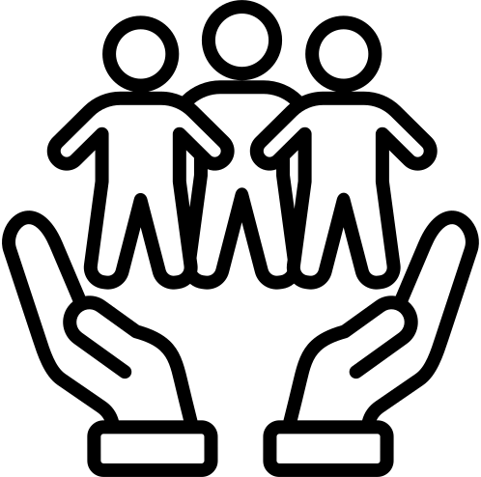

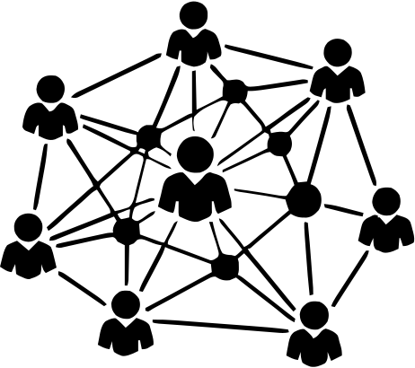

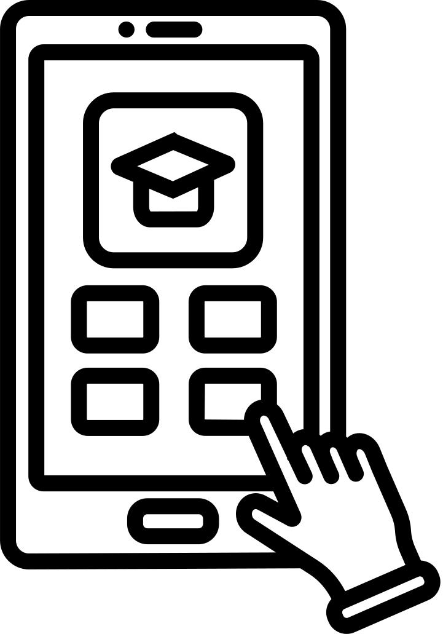

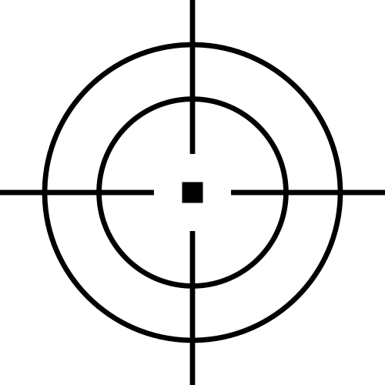




IMPACTS
BENEFITS
Empowered Learning
Strengthened Bonds
Bridges Communication Gap
Real-time gesture recognition helps deaf and mute users learn ISL independently, giving instant feedback to boost confidence and memory.
Inclusive tools help families and educators connect in ISL, improving daily communication and emotional bonds.
Social Connection
Mobile and Portable
Multilingual output ensures a wider audience. It connects signers and non-signers in various communities.
it helps deaf and mute users express themselves clearly to others.
It runs smoothly on Android and iOS through React Native (Expo).
Supports Indian Languages
it works with many regional Indian languages, allowing more people to use it comfortably.
Business Model
Target Customers: Special schools, government disability boards, NGOs, and Parents.
Value Proposition: Real-time ISL-to-text with support for regional languages to promote inclusivity.
Unique Selling Point (USP): Two-hand sign detection and an API for third-party integration.
Revenue Streams: Freemium model, institutional plans, API licensing, and CSR or government grants.
Channels: App stores, NGO or government partnerships, direct sales, and an online API portal.
NeoHack
VIDYUT-SHRISTHI’25-idea submission
4

Slide 6




RESEARCH AND REFERENCES
1. Research Articles on LearningAppforDeafAndMute:
  Description:The proposed comprehensive Mobile Application aims to address the key challenges faced in learning beyond classroom by deaf and mute students.The key features of the application include: Interpretationof Alphabets and numbers in Gujarati and English
  Link to Article:
Read Article
2.Machine Learning Techniques for Learning App for Deaf And Mute :
  Deep Learning offers high-accuracy recognition of static and dynamic sign gestures by extracting MediaPipe landmarks and modeling temporal sequences ().
  Link to Article: Read Article
3.Data Sources and Tools:
ISL-CSLTR: Indian Sign Language Dataset:The ISL-CSLTR dataset contains 700 annotated videos with 18,863 sentence frames and 1,036 word images for 100 sentences signed by 7 individuals. It supports deep learning-based sentence-level recognition and translation in Indian Sign Language
Link :
Explore Data
4.Tools:
  Machine Learning & Model Development :We used TensorFlow, Keras, and scikit-learn to build, train, and optimize our AI models.
  Computer Vision & Gesture Recognition :We used MediaPipe and OpenCV for real-time gesture tracking. We also used NumPy and Pandas for data handling and preprocessing.
  Backend & Deployment :We built the backend with FastAPI to create a fast and scalable API that connects the mobile app and AI models.
Team Name
VIDYUT-SHRISTHI’25-idea submission
6
NeoHack
VIDYUT-SHRISTHI’25-idea submission
5

