Slide 1
Transformers Attention is all it takes
Transformers
Gokul Packirisamy

Slide 2
Transformers
Transformers is a sequence-to-sequence model architecture that uses Attention mechanism and feed forward neural network.
Being a seq to seq model it consists of encoding and decoding. Encoding is when model transforms input to higher dimensional vector representation. Decoding is when model transforms high dimension vector to required output form.
Attention mechanism enables the model to focus on specific parts of input data, assigning varying degrees of importance to different elements.

Slide 3
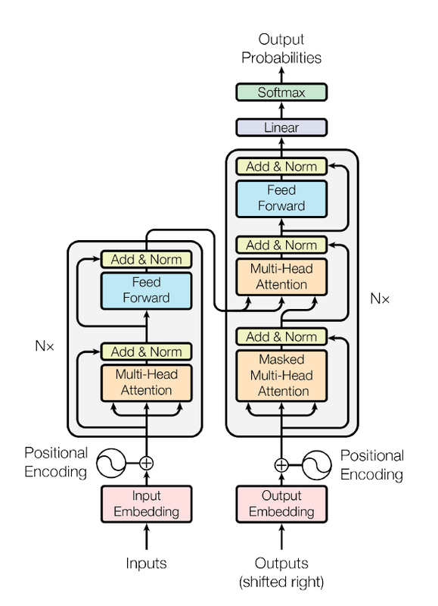
Why it’s called Transformer ?
Transformers name came from it’s attribute that it does multiple transformation to the input vectors to understand/extract information from them.
E.g.:
The attention mechanism with soft max transformation
The feedforward with nonlinear transformation.

Slide 4
Applications of transformers
Natural Language Processing:
Computer Vision:
Audio:
Multimodal:
Text classification
Named entity recognition
Question answering
Language modeling
Summarization
Translation
Multiple choice
Text generation.
Image classification
Object detection
Segmentation.
Automatic speech recognition
Audio classification
Table question answering,
Optical character recognition
Information extraction from scanned documents
Video classification
Visual question answering.

Slide 5
Primary components of a Transformers
Tokenizers for the conversion of text into tokens.
A single embedding layer for the conversion of tokens into vector representations.
Transformer layers for transformation of vector representations and extracting linguistic information (repeatedly).
Consists: Alternating attention and feedforward layers
(Un-embedding layer for the conversion final representation to a probability distribution.

Slide 6
Why it is so special?
Unlike other sequential models like LSTM and GRU, it does not require RNN (recurrent neural network).
It saves lot of time and computing power.
It works with any sequential data.
Transformers are popularly used architectures as in BERT, GPT, GPT-2, GPT-3, GPT-4, Claude, BERT, XLNet, RoBERTa and ChatGPT

