Slide 1
Performance metrics for machine learning models
Gokul Packirisamy

Slide 2

Table of content (Different types of performance metrics in ML)
Mean Absolute Error (MAE)
Mean Squared Error (MSE)
Root Mean Squared Error (RMSE)
R² (R-Squared)
ROC AUC
Log Loss

Slide 3

Mean Absolute Error
Also, known as average of absolute errors
Average of Absolute of errors ( difference of actuals and predicted)
Formula:
MAE =
Excel implementation:
S.No | Actuals | Predicted | Squared Error | Formula
1 | 10 | 17 | 7 | =ABS(B2-C2)
2 | 62 | 66 | 4 | =ABS(B3-C3)
3 | 13 | 19 | 6 | =ABS(B4-C4)
4 | 96 | 100 | 4 | =ABS(B5-C5)
5 | 11 | 13 | 2 | =ABS(B6-C6)
6 | 7 | 14 | 7 | =ABS(B7-C7)
7 | 93 | 98 | 5 | =ABS(B8-C8)
8 | 80 | 88 | 8 | =ABS(B9-C9)
9 | 80 | 87 | 7 | =ABS(B10-C10)
10 | 87 | 95 | 8 | =ABS(B11-C11)
 |  |  | 5.8 | =AVERAGE((D2:D11))
Gives estimation on how the Allocation difference contributes to the error.
Does not give weightage to outliers and large errors are not penalized.
Compares the magnitude of errors between two models but scale of the data is not measured

Slide 4

Mean Squared Error
Also, known as mean squared deviation
Average of squares of error ( difference of actuals and predicted)
Formula:
Excel implementation:
Gives estimation on how the variance contributes to the error.
Gives higher weight to the outliers and large errors are penalized.
Compares the Magnitude of errors between two models

Slide 5
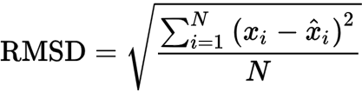
Root Mean Squared Error
Also, known as Root mean squared deviation
Square root of Average of squares of errors ( difference of actuals and predicted)
Formula:
Excel implementation:
S.No | Actuals | Predicted | Squared Error | Formula
1 | 10 | 17 | 49 | =(B2-C2)^2
2 | 62 | 66 | 16 | =(B3-C3)^2
3 | 13 | 19 | 36 | =(B4-C4)^2
4 | 96 | 100 | 16 | =(B5-C5)^2
5 | 11 | 13 | 4 | =(B6-C6)^2
6 | 7 | 14 | 49 | =(B7-C7)^2
7 | 93 | 98 | 25 | =(B8-C8)^2
8 | 80 | 88 | 64 | =(B9-C9)^2
9 | 80 | 87 | 49 | =(B10-C10)^2
10 | 87 | 95 | 64 | =(B11-C11)^2
 |  |  | 6.099180273 | =SQRT(AVERAGE((D2:D11)))
Gives estimation on how the variance contributes to the error.
Gives higher weight to the outliers and large errors are penalized.
Gives a single value to estimate a model and compare it with other.

Slide 6
Python implemtation of MAE, MSD and RMSE
def mae(data, ref):
mae = 0
c = 0
for i in data:
mae += abs(i-ref)
c += 1
return mae / c
def mse(data, ref):
mse = 0
c = 0
for i in data:
mse += (I- ref)**2
c += 1
return mse / c
def rmse(data, ref):
return (mse(data, ref))**(1/2)

Slide 7



R- Squared
Also, known as the coefficient of determination
The proportion of the variation in the dependent variable that is predictable from the independent variable
Excel implementation:
R-squared values range from 0 to 1.
Gives the extent in which one or more independent variables affect a dependent variable.
Compares the multiple variables and its effect with the target variable.

Slide 8
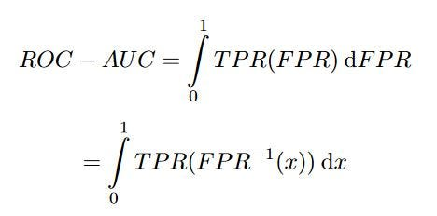
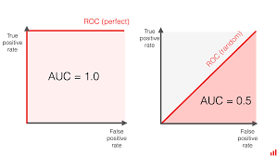
ROC - AUC
Aggregate measure of performance across all possible classification thresholds
Area Below the curve of graph between sensitivity and 1- specificity
Excel implementation:
 | ACTUALS |  | Cumulative | Cumulative | FPR | TPR | AUC
Age | affected | not affected | =SUM($B$3:B3) | =SUM($C$3:C3) | =1-D3/$D$9 | =1-E3/$E$9 | =(F3-F4)*G3
1 to 5 | 22 | 750 | 22 | 750 | 0.91 | 0.66 | 0.09
6 to 15 | 34 | 570 | 56 | 1320 | 0.77 | 0.41 | 0.08
16 to 25 | 46 | 320 | 102 | 1640 | 0.58 | 0.27 | 0.05
25 to 45 | 47 | 431 | 149 | 2071 | 0.38 | 0.07 | 0.02
45 to 65 | 55 | 120 | 204 | 2191 | 0.15 | 0.02 | 0.00
65 to 85 | 34 | 36 | 238 | 2227 | 0.01 | 0.00 | 0.00
85 and above | 2 | 5 | 240 | 2232 | 0.00 | 0.00 | 0.00
For a classification problem,
AUC = 0.5 → no discrimination
AUC = 0.7 to 0.8 → considered acceptable,
AUC = 0.8 to 0.9 → excellent
AUC = > 0.9 → outstanding

Slide 9
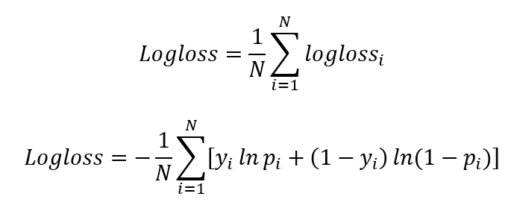
Log Loss
Also Known as
Binary cross entropy
the predicted probability for that given class in exponentials.
Python implementation:
It is an essential metric for Bi/multi class classification problem to find probability in values between zero and one for a particular class.
multi-class problems have a high tolerance for log loss.
from sklearn.metrics import log_loss:
LogLoss = log_loss(y_true, y_pred, eps = 1e-15,
normalize = True, sample_weight = None, labels = None)

Slide 10

Thanks

