Slide 1

Bias and Variance Balancing story of a trade off
Gokul Packirisamy

Slide 2
Table of content
Bias
Variance
Bias – Variance trade off
Various models and their Bias – Variance trade off

Slide 3
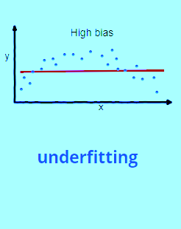
Bias
Changes in the average prediction from the correct value.
High bias model pays very little attention to the training data
Oversimplifies the model.
High error on training and test data.
Underfitting issue

Slide 4
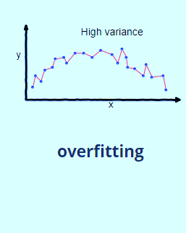
Bias
Variance is the variability of model prediction for a given data point
High variance pays a lot of attention to training data
Fails with new unseen data sets.
Performs well on training and not well on test.
Overfitting issue

Slide 5
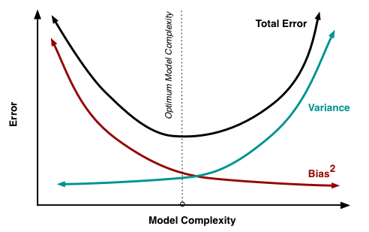
Bias variance trade off
Bias and variance are two forms of an error that can affect a model.
Aim of build a model is to have less variance and less Bias.
But higher bias tends to give lower variance and lowering the bias tend to give higher variance.
It is important to build a model in such way, the balance is very delicate, and the bias and variance are both minimal.

Slide 6
Various Models and their Bias Variance trade-offs
Algorithm | Bias | Variance
Linear Regression | High Bias | Less Variance
Decision Tree | Low Bias | High Variance
Bagging | Low Bias | High Variance (Less than Decision Tree)
Random Forest | Low Bias | High Variance (Less than Decision Tree and Bagging)
Boosting | Low Bias ( Less than Bagging) | High Variance

