Slide 1
Confusion Matrix
Gokul Packirisamy

Slide 2

Table of Content
Introduction
Instances in confusion matrix
Confusion matrix for Binary Classification
Confusion matrix for Multiclass classification
Formula for Metrics based on Confusion Matrix
Type 1 and Type 2 error

Slide 3
Introduction
A confusion matrix is a matrix used to summarize the performance of models with categorical data as output or prediction. It displays the number of accurate and inaccurate outputs in a matrix form.
It is used in categorical output data only. An example of categorical data,
Ordinal – Rank, Grade etc. - 1,2,3 or A,B,C
Nominal – Sex, Gender, Marital Status etc. – Male, Female

Slide 4
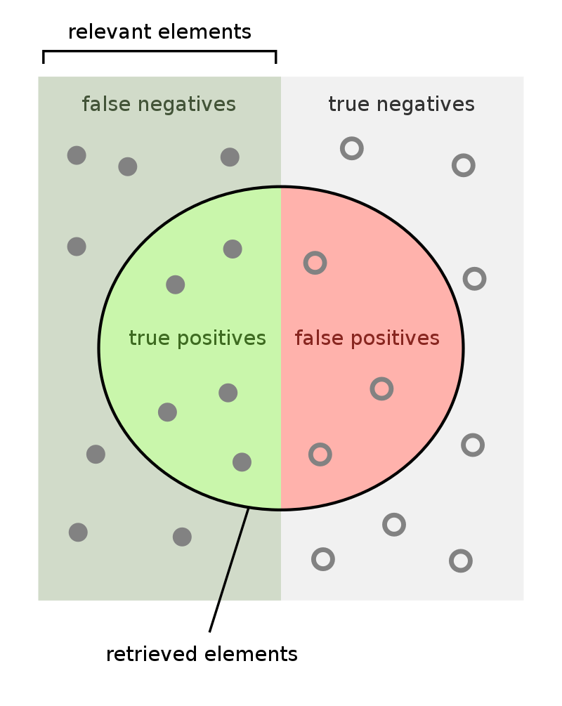
Instances in confusion matrix
True positives (TP) is number of model positive class that the model correctly predicted.
True negatives (TN) is number of model negative class that the model correctly predicted.
False positives (FP) is number of model positive class that the model wrongly predicted.
False negatives (FN) is number of model negative class that the model wrongly predicted.
Total of datapoints = (TP + TN + FP + FN)

Slide 5


Confusion matrix for Binary Classification
Binary classification has two classes of either one or another as predictor classes.
True Positive = Positive predicted as positive / Total Outcome
True Negative = Negative predicted as Negative / Total Outcome
False Positive = Negative predicted as Positive / Total Outcome
False Negative= Positive predicted as Negative / Total Outcome

Slide 6
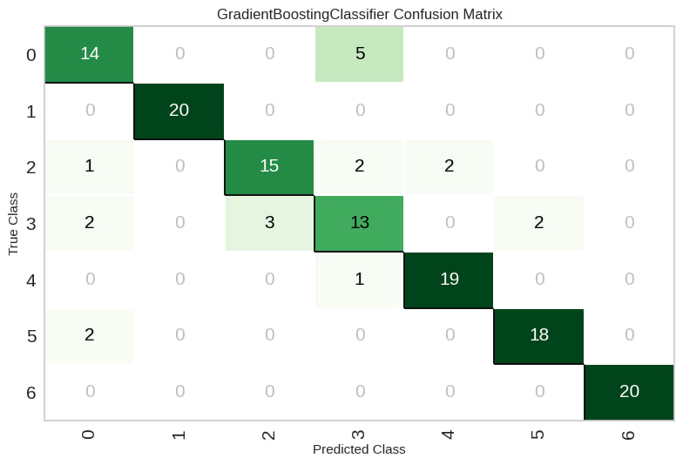
Confusion matrix for Multi-class Classification
Multi-class has three or more classes of predictor classes. Each class has separate confusion matrix.
True Positive = For k in list of classes: Mij where i = j = k
True Negative = For k in list of classes: SUM(Mij) where i and j not equal to k.
False Positive = For k in list of classes: SUM(Mij) where i not equal to k and j equal to k
False Negative= For k in list of classes: SUM(Mij) where i equal to k and j not equal to k

Slide 7

Formula for Metrics based on Confusion Matrix
Accuracy = (TP+TN) / (TP+TN+FP+FN)
Precision = TP / (TP+FP)
​Recall = TP / (TP+FN)
Specificity or True negative rate = TN / (TN+FP)
Sensitivity or True Positive rate = TP / (TP + FN)
F1-Score = (2⋅Precision⋅Recall)/ (Precision+Recall)

Slide 8
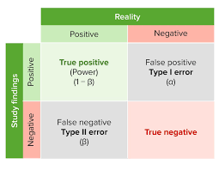
Type 1 and Type 2 error
Binary Classification
Multi-class Classification for S1 class
FALSE NEGATIVES
FALSE POSITIVES

