Slide 1
ADVANCED LINUX COMMANDS
BY:
GMON K
GOKUL P
AKHIL K M

Slide 2
CURL
curl is a tool to transfer data from or to a server, using one of the supported protocols (HTTP, HTTPS, FTP, FTPS, SCP, SFTP, TFTP, DICT, TELNET, LDAP or FILE).
The command is designed to work without user interaction.

Slide 3
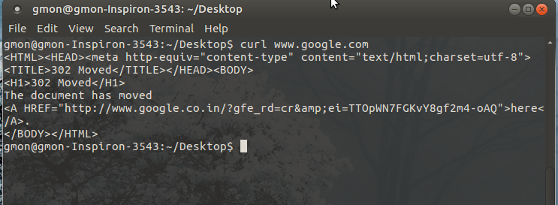
DOWNLOAD A SINGLE FILE
The following command will get the content of the URL and display it in the STDOUT (i.e on your terminal).
COMMAND:
$ curl http://www.google.com

Slide 4
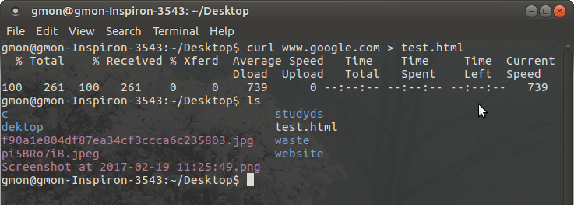
SAVE OUTPUT TO A FILE
To store the output in a file, you an redirect it as shown below. This will also display some additional download statistics.
Command:
curl http://www.google.com > test.html

Slide 5
o (lowercase o) the result will be saved in the filename provided in the command line
Command:
curl -o test.html www.google.com
-O (uppercase O) the filename in the URL will be taken and it will be used as the
Command:
curl -O https://www.google.com

Slide 6
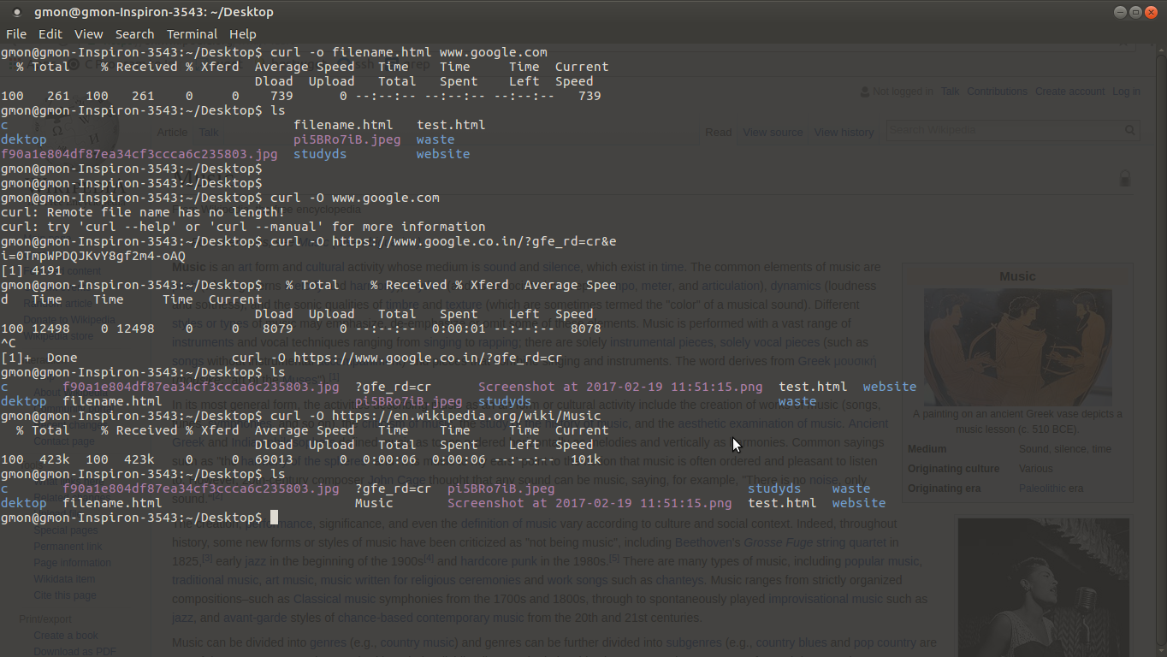

Slide 7
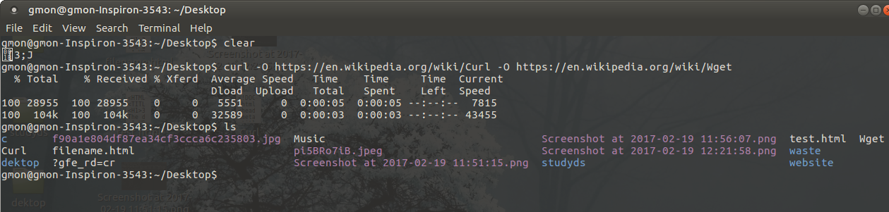
Fetch Multiple Files at a time
We can download multiple files in a single shot by specifying the URLs on the command
command:
curl -O URL1 -O URL2

Slide 8
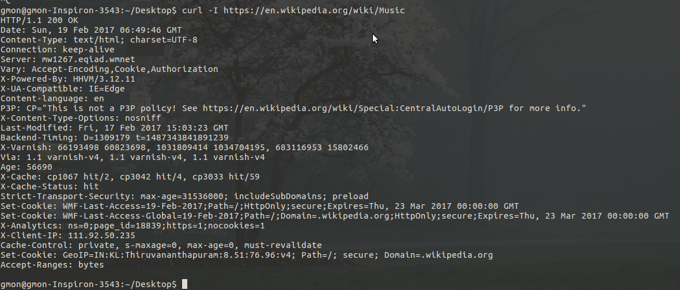
To show only response headers in curl
Command:
        curl -i www.google.com

Slide 9
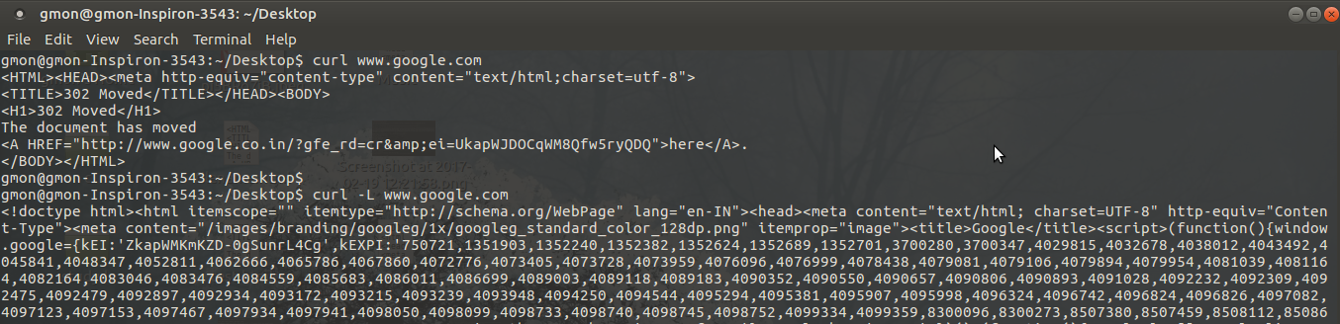
Follow HTTP Location Headers with -L option
The above output says that the requested document is moved to ‘http://www.google.co.in/’.We can insists curl to follow the redirection using -L option, as shown below. Now it will
Command:
curl -L http://www.google.com

Slide 10
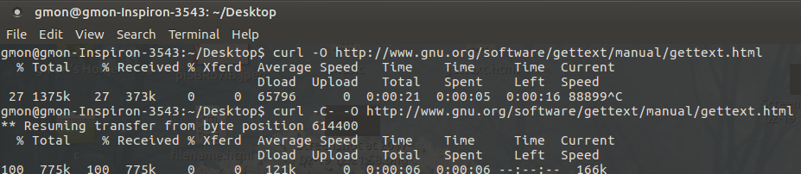
Continue/Resume a Previous Download
Now the above download was stopped at 20.1%. Using “curl -C -“, we can continue the
Command:
curl -C - -0 http://www.gnu.org/software/gettext/manual/gettext.html

Slide 11
Pass HTTP Authentication in curl
Sometime, websites will require a username and password to view the content ( can be donewith .htaccess file ). With the help of -u option, we can pass those credentials from cURL to the web server as shown below.
Command:
curl -u username:password URL

Slide 12
Download a file only if it is modified before/after the given time
We can get the files that are modified after a particular time using -z option in curl. This willwork for both FTP & HTTP.
Command:
curl -z 21-Dec-17 http://www.example.com/yy.html

Slide 13
ADVANCE LINUX COMMAND
WGET:
wget stands for "web get". It is a command-line utility which downloads files over a network.

Slide 14
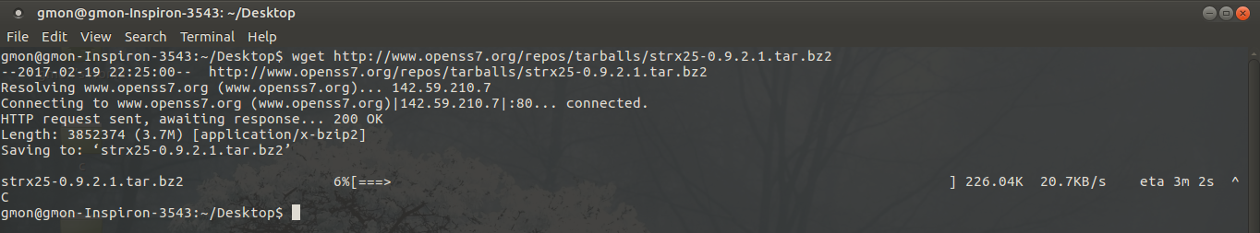
Single file download
The command will download single file and stores in a current directory. It also shows download progress, size, date and time while downloading.
Command
  wget http://www.openss7.org/repos/tarballs/strx25-0.9.2.1.tar.bz2

Slide 15
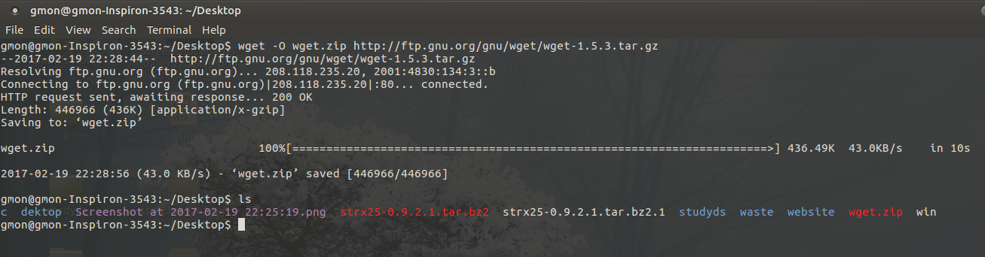
Download file with different name
Using -O (uppercase) option, downloads file with different file name. Here we have given wget.zip file name as show below.
  Command:
  wget -O wget.zip http://ftp.gnu.org/gnu/wget/wget-1.5.3.tar.gz

Slide 16
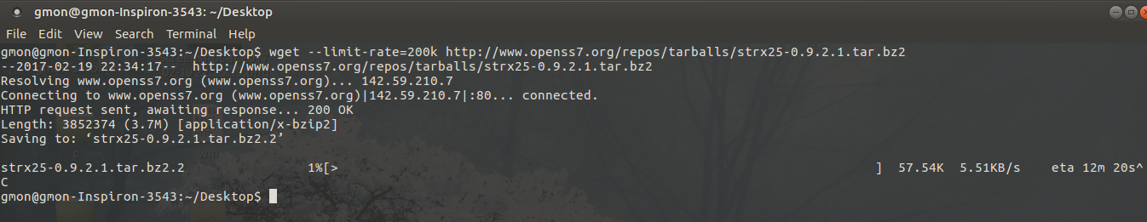
Specify Download Speed / Download Rate Using wget –limit-rate
Add a suffix "k" for jilobytes or "m" for megabytes. e.g. "--limit-rate = 2m" to limit the max download speed to 2Mbyte/sec.
Command: wget --limit-rate=[VALUE] [URL]

Slide 17
Continue the Incomplete Download Using wget -c
Restart a download which got stopped in the middle using wget -c option as shown below.
Command:
Wget -c http://www.openss7.org/repos/tarballs/strx25-0.9.2.1.tar.bz2

Slide 18
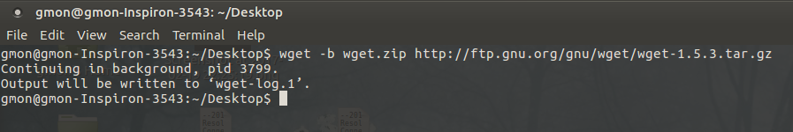
Download in the Background Using wget -b
Command:
wget -b http://www.openss7.org/repos/tarballs/strx25-0.9.2.1.tar.bz2

Slide 19
Resuming a Stopped/Interrupted Download
In case you face any system interruptions post starting the download of a massive file from the web using wget , you will be absolutely delighted to know if the command given below that shall help you resume the download process from where it stopped (without the hassle of starting the tedious process all over again!):All you need to do is execute the basic wget command with option "-c".
Command:
wget -c [URL]

Slide 20
Download Multiple Files / URLs Using Wget -i
First, store all the download files or URLs in a text file
Command:
  wget -i download-file-list.txt

Slide 21
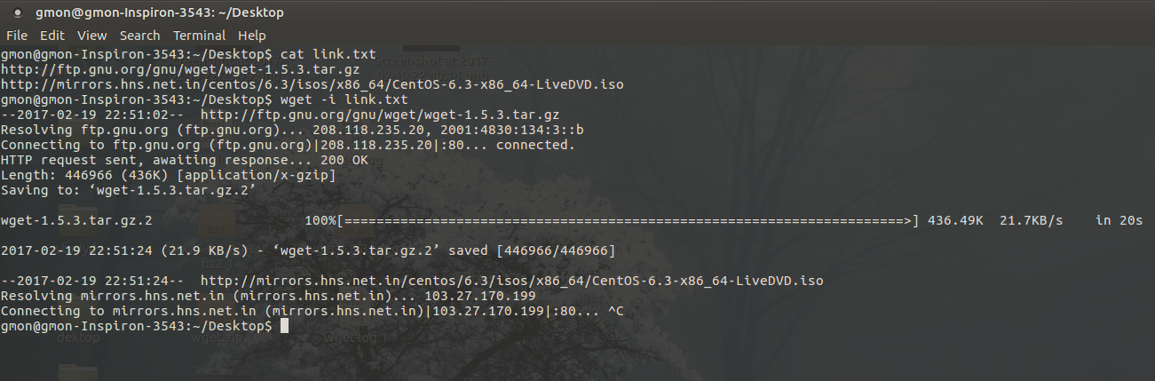

Slide 22
Emulating a Complete Website
If you wish to retain a copy of any website that you may like to refer to/read locally, or maybe save a copy of your blog to the hard disk as back up, you may execute the wget command with mirror option, as follows:
Command:
wget --mirror [Website Name]

Slide 23
FTP
FTP – File Transfer Protocol
It is the simplest and most secure way to exchange files over Internet.
Transferring files,
From client computer to a server computer
- Uploading
From server computer to a client computer
- Downloading

Slide 24
To access an FTP server, users must be able to connect to the internet.
FTP doesn’t not really move, it copies files from one computer to another.
An FTP Client is software that is designed to move files back-and-forth between two computers over the Internet.

Slide 25
Connect to a FTP site
$ ftp IP/hostname
or
$ ftp
ftp> open IP/hostname
You can directly open connection with a remote host using it’s IP or host name from the command line.

Slide 26
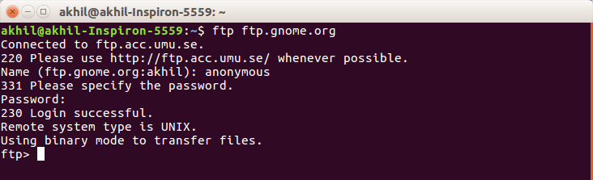
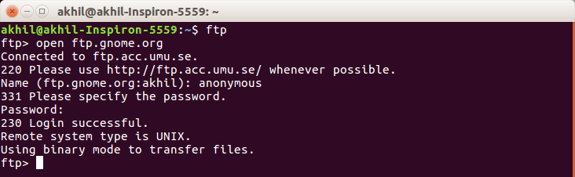

Slide 27
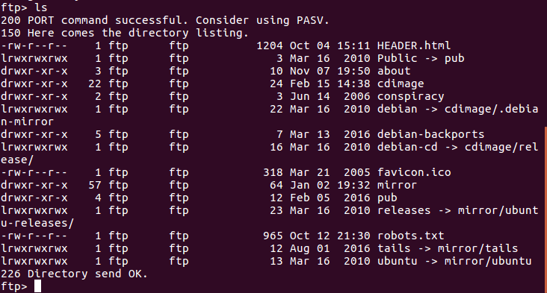
Listing the contents
ftp> ls
You can view the content of a remote directory using the ls / dir coomand

Slide 28
Changing Directory
ftp> cd
To navigate into the sub directory of a remote directory.
ftp> cd ..
To navigate to parent directory of a remote directory.

Slide 29
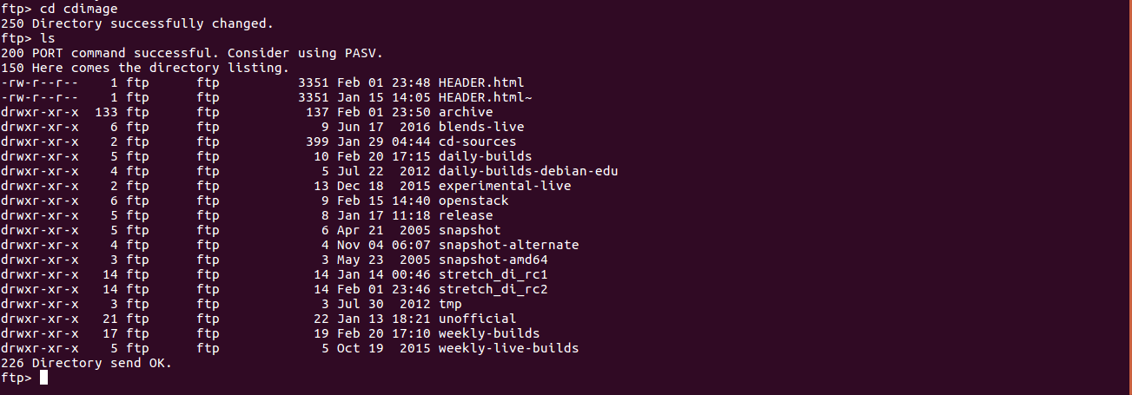

Slide 30
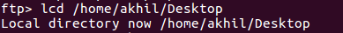
Set a download directory
ftp> lcd /home/user/yourdirectoryname
Before downloading a file, we should set the local ftp file download directory by using lcd command

Slide 31
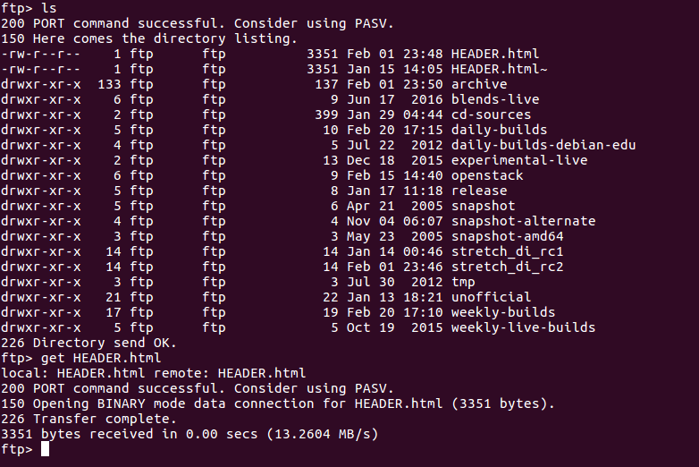
Download a file
ftp> get FILENAME
Using the get command to download file from a remote ftp server

Slide 32
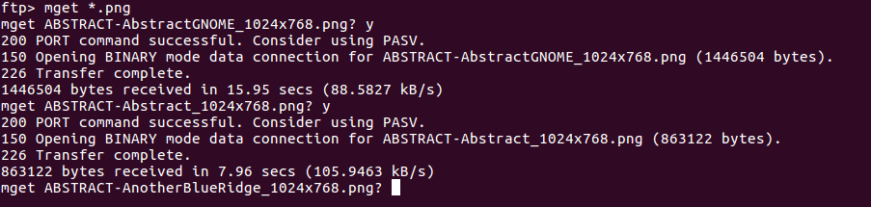
Download multiple files
ftp> mget *.file extension
mget command helps to download multiple files with same file extension.

Slide 33
Uploading file to FTP server
ftp> put FILENAME
To upload a file we can use put command.
ftp> put /path/FILENAME
When the file you want to upload is not in local directory.
ftp> mput *.file extension
To upload multiple files of same file extension, we can use mput command.

Slide 34
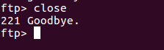
Closing the FTP connection
ftp> close
Without exiting the ftp prompt you may want to open a connection to another server. In that execute close command

Slide 35
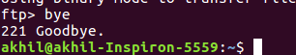
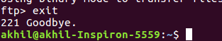
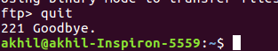
ftp> bye
ftp> exit
ftp> quit
To exit the ftp prompt

Slide 36
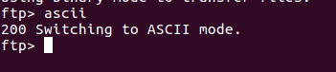
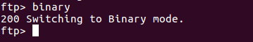
FTP mode to Binary or Ascii
ftp> ascii
Go to ftp Ascii mode.
ftp> binary
Go to ftp Binary mode.

Slide 37
GREP
GREP – Global Regular Expression Print
Searches for text in a file
Can search for simple words.
Can look for “regular expression”;more complex charecter strings( words followed by any no of spaces, followed by a digit or lowercase letter).

Slide 38
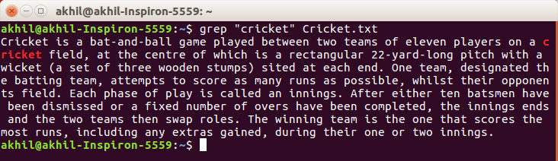
Searching the given string
$ grep “literal_string” filename
To search a specific string in a specified file

Slide 39
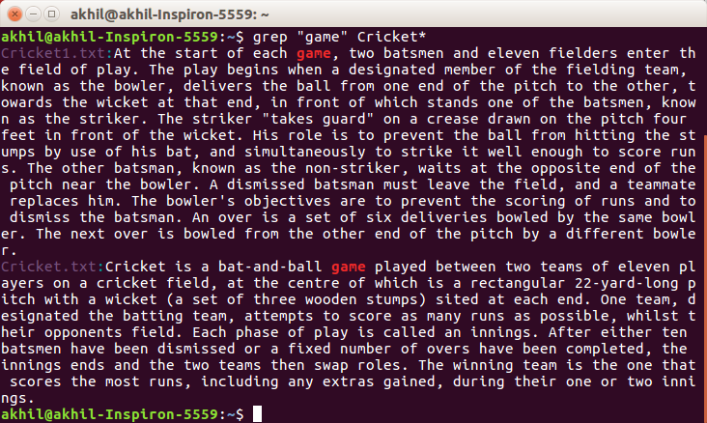
$ grep “string” FILE_PATTERN*
Checking for the given string in multiple files.

Slide 40
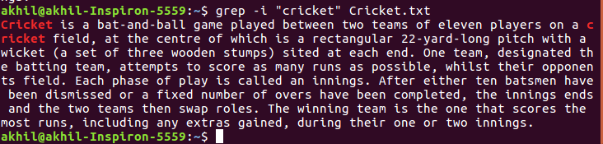
Case insensitive search
$ grep -i “string” filename
$ grep -i “string” FILE_PATTERN*
This searches for given string/pattern case insensitively.

Slide 41
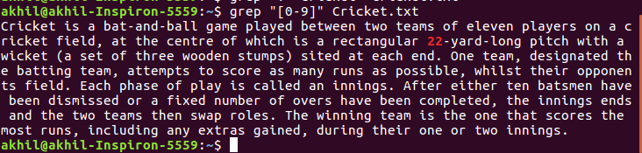
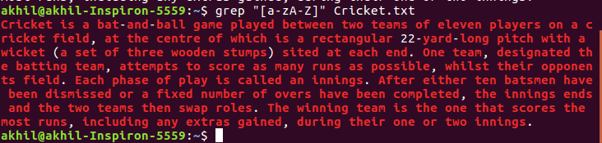
Simple regular expressions
“[0-9]” look for any digit
“[a-zA-Z]” look for one upper or lower case letter

Slide 42
“.” look for one charecter
“.*” any number of charecters
“\.” a literal decimal point
“\.161:” dot, then 161,then colon
“\.161[: ]” dot, then 161, then colon or space

Slide 43
Advanced regular expressions
Look for lines that hold either string1 or string2
$ grep -E ‘(string1|string2)’ filename
Lines that have string1 followed by string2 on the same line, but possibly with other charecters in between.
$ grep ‘string1.*string2’ filename

Slide 44
String1 has to be at the beginning of the line.
$ grep ‘^string1’ filename
Look for it at the end of the line.
$ grep ‘string1$’ filename

Slide 45
SSH(secure shell)

Slide 46
SSH features
Command line terminal connection tool
Replacement for rsh, rcp, telnet, and others
All traffic encrypted

Slide 47
Brief History
SSH.com's SSH1, originally completely free with source code, then license changed with version 1.2.13
SSH.com's SSH2, originally only commercial, but now free for some uses.

Slide 48
To install type
sudo apt-get install openssh-server
The most basic form of the command is:
ssh remote_host
The remote_host in this example is the IP address or domain name that you are trying to connect to.
If your username is different on the remote system, you can specify it by using this syntax:
$ ssh remote_username@remote_host

Slide 49
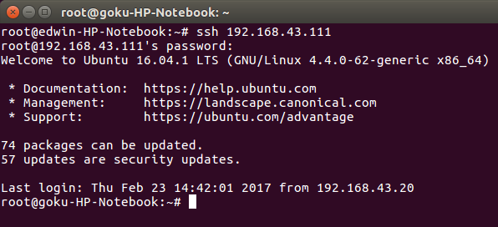
LOGING IN USING SSH

Slide 50
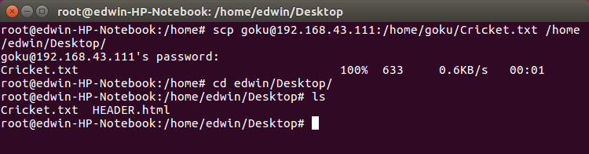
TO COPY FILES
$ scp source destination
Copy a file from local to host
Code:
$scp jsmith@remotehost.example.com:/home/jsmith/remotehostfile.txt
remotehostfile.txt

Slide 51
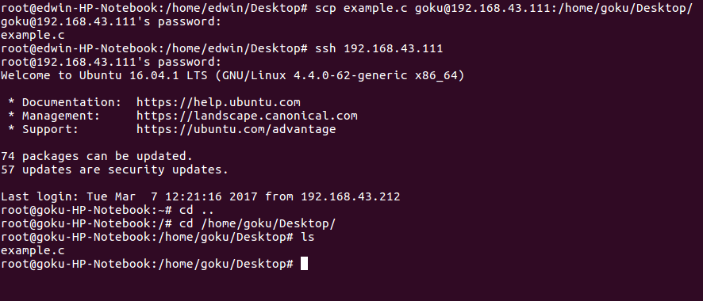
Copy file from host to local
Code:
$scp localhostfile.txt
jsmith@remotehost.example.com:/home/jsmith/localhostfile.txt

Slide 52
THANK YOU

