Slide 1

Digital Portfolio
STUDENT NAME: Kirubakaran
REGISTER NO:24131031802521024
NMID:818EE5E42C1996291EF45F32B51B8580
DEPARTMENT: B Sc Computer science
COLLEGE: Government Arts College

Slide 2
PROJECT TITLE
Digital Portfolio
It is accessible online anytime, anywhere. It can include text, images, videos, links, and interactive content. It helps students, professionals, and job seekers present their abilities in a modern and professional way.

Slide 3
AGENDA
1.Problem Statement
2.Project Overview
3.End Users
4.Tools and Technologies
5.Portfolio design and Layout
6.Features and Functionality
7.Results
8. Screenshots
9.Conclusion

Slide 4
PROBLEM STATEMENT
Many students and freshers find it difficult to showcase their skills, projects, and educational background in a professional way. A normal resume does not reflect creativity or technical ability. To solve this, a personal portfolio website was created to highlight skills, education, and contact details in an attractive and interactive manner.

Slide 5
Project Overview
This project is a digital portfolio website designed for Jaga, a BCA student. It includes sections like About, Skills, Education, and Contact. The portfolio gives a clear introduction, shows technical abilities, and provides a way for others to reach out easily. It serves as an online identity to present career achievements.

Slide 6
End users
The portfolio website is mainly useful for students who want to share their skills, employers or recruiters looking for candidates, and teachers or peers who want to know more about the student’s background and talents.

Slide 7
Tools and Technologies
The portfolio is built using HTML for structure, CSS for styling and design, and JavaScript for interactivity such as form validation and alerts. These basic web technologies make the site simple, responsive, and easy to maintain.

Slide 8
Portfolio Design and Layout
* Header Section: Title and navigation menu. * About Section: Profile picture and introduction. * Skills Section: Highlights of programming and web technologies. * Education Section: Academic background. * Contact Section: Contact form for easy communication. * Footer: Copyright information.

Slide 9
Features and Functionality
The portfolio has a clean and user-friendly design. It includes a working navigation bar, a profile photo with styling, skills and education listed in a professional format, and a functional contact form with simple validation. The site is lightweight, easy to use, and professional.

Slide 10
Results
The result is a fully working personal portfolio website. It clearly shows personal information, skills, and academic background in one place.

Slide 11
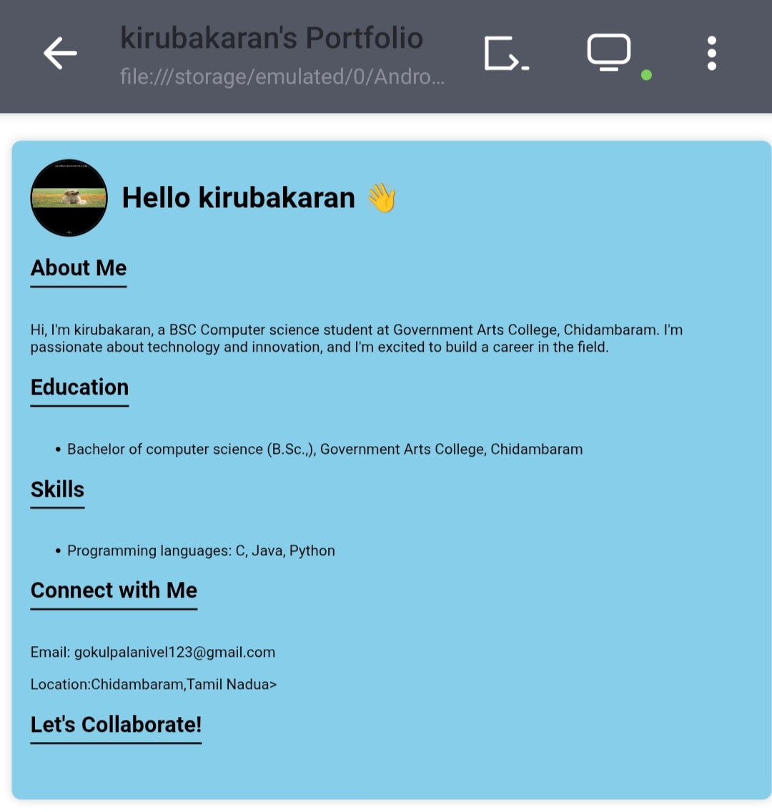
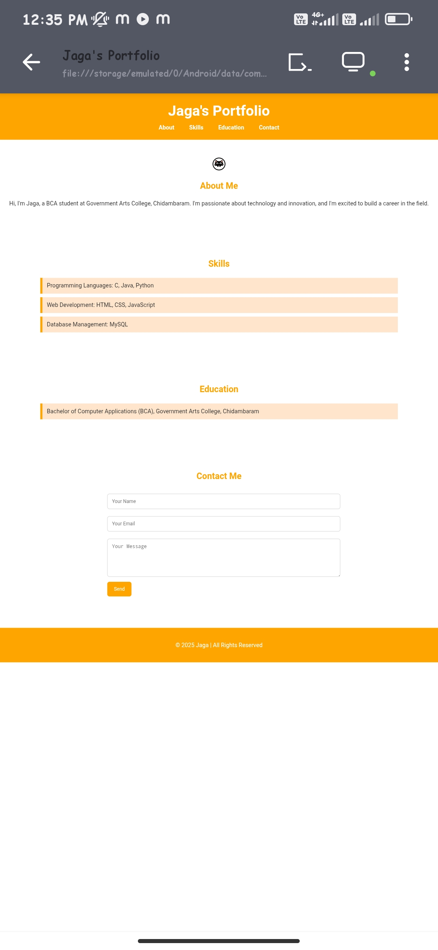
Screenshots

Slide 12
Conclusion
The portfolio project helps students present themselves in a professional way. It acts as a digital resume and personal brand, making it easier to connect with employers and opportunities. This website can be updated with new skills, projects, and links, making it a long-term career tool.

