Slide 1
Partitioning and Segmentation using Graph Laplacian
Group Memebers:
Rajananeeshwar (27)
Lakshaya K (39)
Gokul Prazath (62)
Vasudevan K M (67)

Slide 2
TABLE OF CONTENTS:
Theory
Adjacency & Incidence matrices
Graph Laplacian
Properties of the Graph Laplacian
Complete Graphs
Trees
Disconnected Graphs
Graph Partitioning Implementation & Output
Image Segmentation Implementation & Output

Slide 3
THEORY

Slide 4
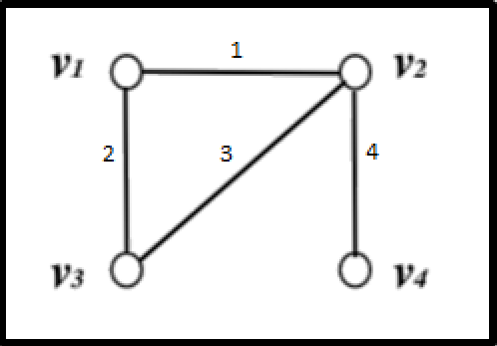
ADJACENCY MATRICES:
Each row corresponds to a node
Sum of elements of each row = Degree of that node
Edge
Node

Slide 5
INCIDENCE MATRICES:
For undirected graphs → convention that edge goes from lower to higher node
Each row corresponds to an edge
Each column → Node
Sum of elements of each row = 0

Slide 6
DEGREE MATRICES:
Degree Matrix (n x n):
Diagonal elements = Total edges from & into each node

Slide 7
GRAPH LAPLACIAN:

Slide 8
PROPERTIES OF THE GRAPH LAPLACIAN:
Square
Symmetric
Positive-semidefinite (All eigenvalues are non-negative)
2nd smallest eigenvalue of L → Algebraic Connectivity
Since the rows of the Laplacian sum to 0 → it doesn’t have full rank

Slide 9
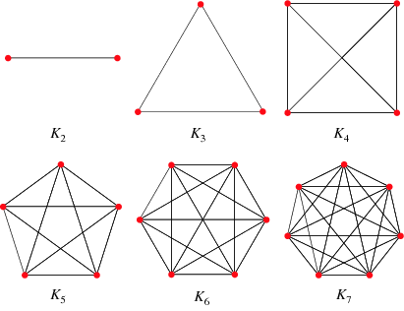
COMPLETE GRAPHS
If every pair of node is connected by an edge → graph is complete
It will have 0.5*n*(n-1) edges
ONLY ONE EIGENVALUE OF LAPLACIAN MUST BE ZERO
2nd smallest eigenvalue (algebraic connectivity) != 0
Higher the algebraic connectivity → the more strongly the graph is connected

Slide 10
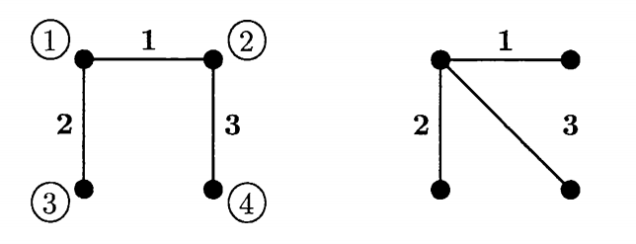
TREES:
ONLY ONE EIGENVALUE OF LAPLACIAN MUST BE ZERO
2nd smallest eigenvalue (algebraic connectivity) != 0
Higher the algebraic connectivity → the more strongly the graph is connected

Slide 11
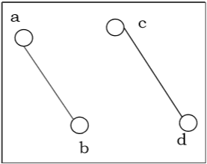
DISCONNECTED GRAPHS:
If at least two vertices of the graph are not connected by a path, a graph is disconnected.
MORE THAN ONE EIGENVALUE OF LAPLACIAN MUST BE ZERO
2nd smallest eigenvalue (algebraic connectivity) = 0
Shows that the graph is disconnected

Slide 12
BASIC CODE IMPLEMENTATION Graph Implementation

Slide 13
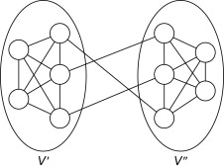
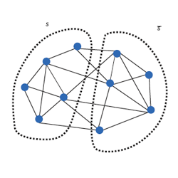
PARTITIONING A GRAPH
Given a set of nodes in a graph, the objective is to separate the nodes of the graph into 2 partitions
Steps:
Input given as excel sheet that contains information about each edge
Calculate the Adjacency, Degree and Laplacian matrices from the given graph
Compute the eigenvalues & eigenvectors of the Laplacian
Find the 2nd smallest eigenvalue & corresponding eigenvector
Partition the nodes in the graph based upon the signs of the entries in the eigenvector

Slide 14
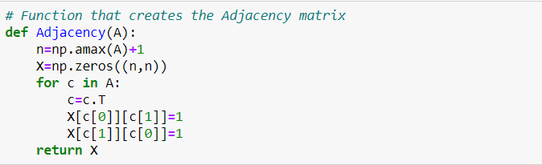
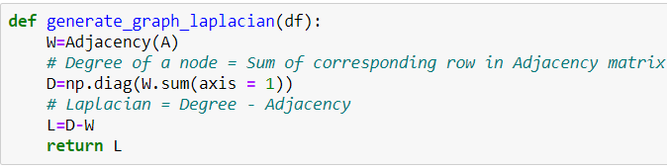
Creating the Adjacency & Laplacian matrices:

Slide 15
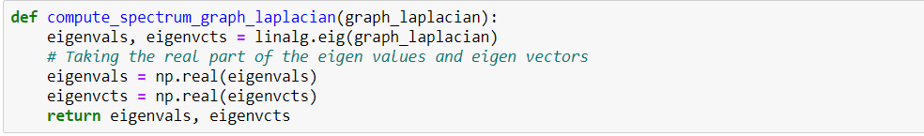
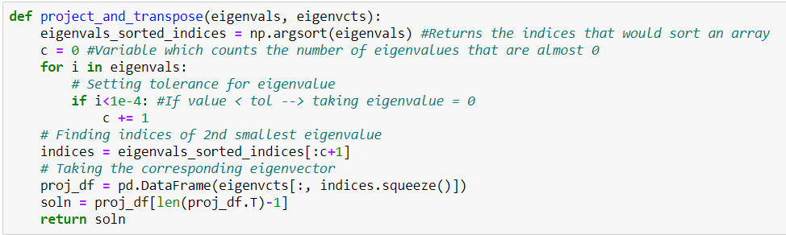
Computing the eigenvalues & taking the eigenvector corresponding to the 2nd smallest eigenvalue:

Slide 16
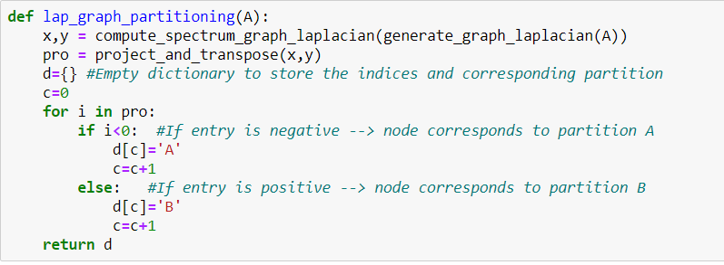
Partitioning:

Slide 17
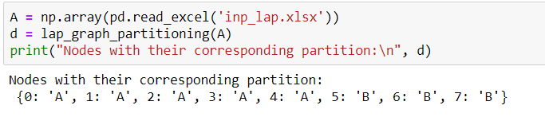
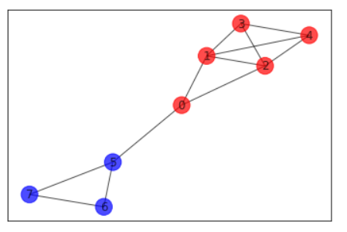
Output:

Slide 18
CODE IMPLEMENTATION
Image Segmentation

Slide 19
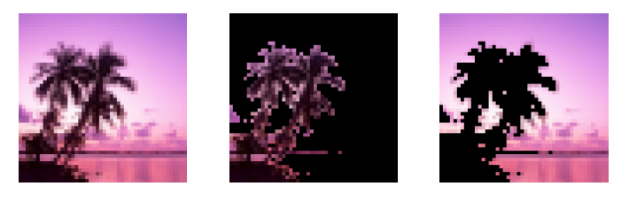
GRAPH-BASED IMAGE SEGMENTATION
Image segmentation is the process of:
Finding natural boundaries in an image
Partitioning the image along those boundaries
Uses:
Helps determine relations between objects
Finds context of objects in an image
Applications: face recognition, number plate identification, image-based searches etc
Humans can easily identify which portions of an image belong together, but it is not the same for a computer. To aid in this, image segmentation can be used.

Slide 20
Constructing the Image Graph:
Let G be a graph whose vertices are the mn pixels of an mxn image (grayscale or color)
Each vertex i has a brightness B(i), the grayscale of average RGB value of the pixel
And a coordinate location X(i) → Indices of the pixel in the original image array

Slide 21
Inferences:
Pixels that are further apart from given radius r are not connected at all in G
Pixels within r of each other are more strongly connected if they are similar in brightness and close together (value in exponential is negative but closer to zero)
High contrasting pixels have weaker connections (value in exponential is highly negative)

Slide 22
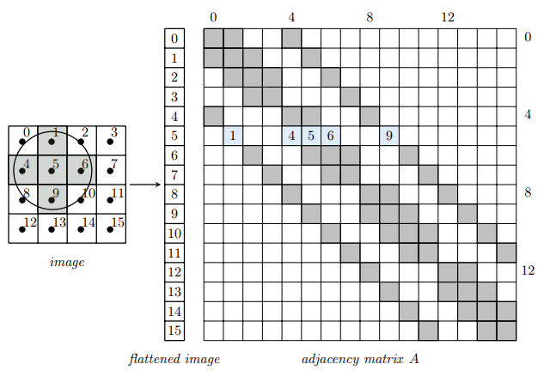
The grid on the left represents a 4 x 4 (m x n) image with 16 pixels.
On the right is the corresponding 16 x 16 (mn x mn) adjacency matrix with all non zero entries shaded.
Eg in row 5: entries 1, 4, 5, 6, and 9 are nonzero because those pixels are within radius r of pixel 5

Slide 23
Methodology to create Weighted Adjacency & Degree matrices:
Initialise Adjacency (A) as a sparse mn x mn matrix
Initialise Degree (D) as a vector with mn entries → Can be converted to matrix later
For each vertex i (i = 0, 1, …, mn-1):

Slide 24
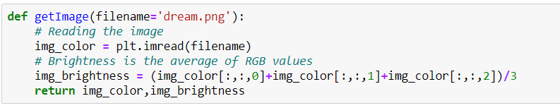
Function 1: Used to read the image from the system and compute the brightness of each pixel (average of rgb values)

Slide 25
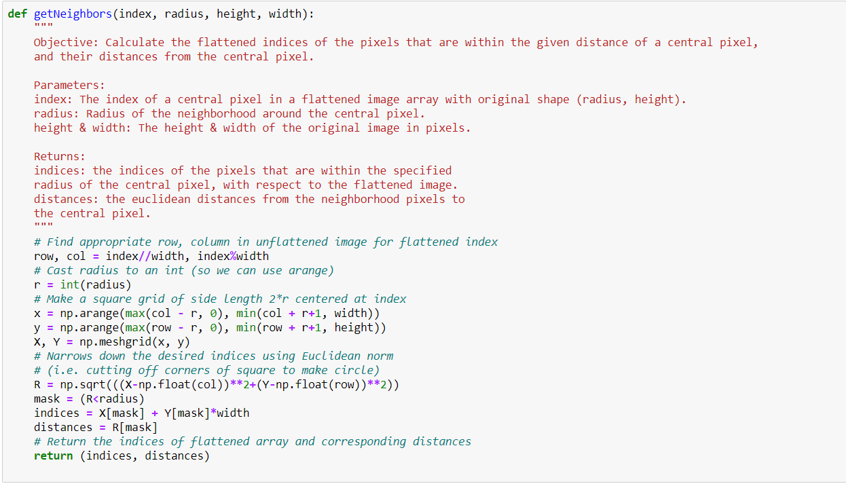
Function 2: finding neighborhood of each vertex (step 3.a)

Slide 26
Function 3: Creating adjacency and degree matrices:

Slide 27
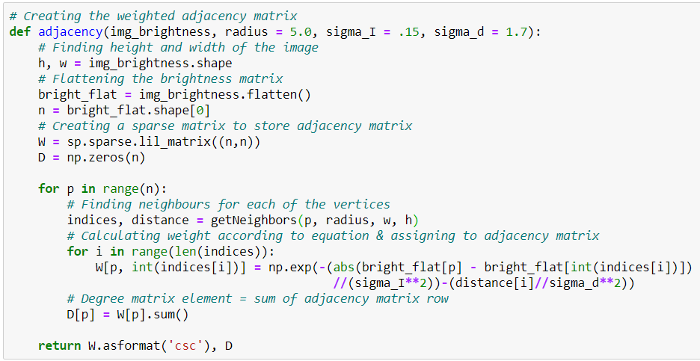

Slide 28
Segmenting the graph:
With an image represented as a graph G, the goal now is to split G into two distinct connected components by removing edges from the graph
This is known as cutting G, and the set of edges removed is called the cut
The cut with the least weight will best segment the image
Indices of the positive entries → Indices of the pixels in the flattened image that belong to one segment
Indices of the negative entries → Indices of the pixels which belong to the other segment

Slide 29

FUNCTION 4: Segmenting the graph and creating the masks

Slide 30
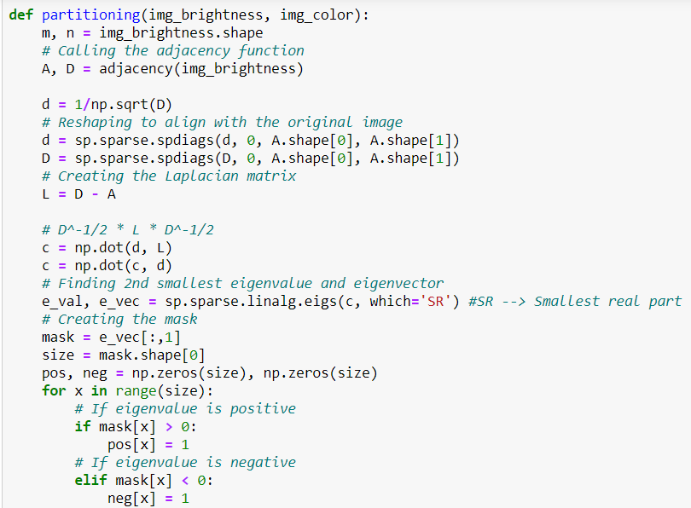
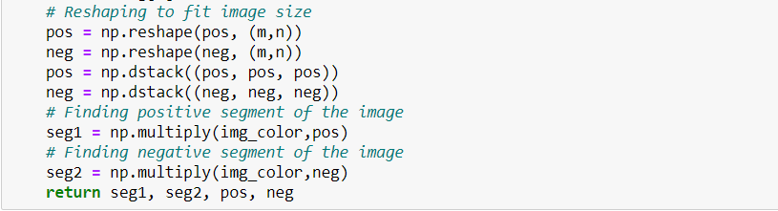

Slide 31
Functions 5 & 6: Driver function & Displaying Output

Slide 32
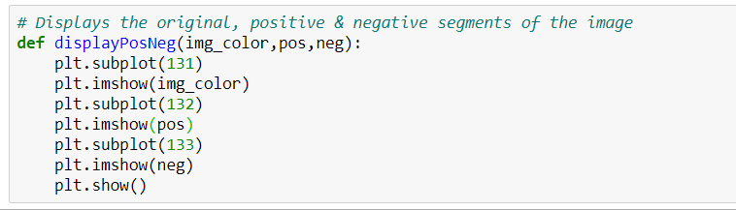
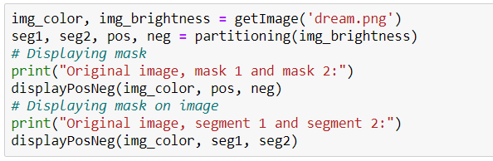

Slide 33
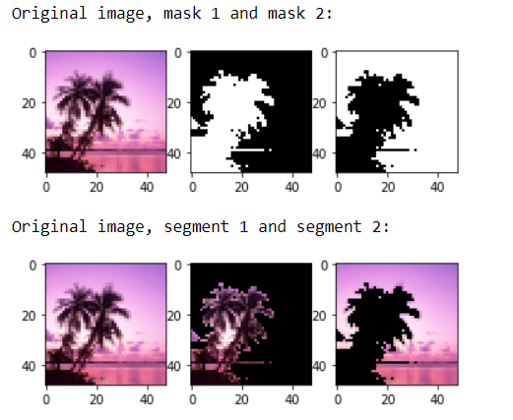
Output 1:
CREATED MASKS
SEGMENTED IMAGES

Slide 34
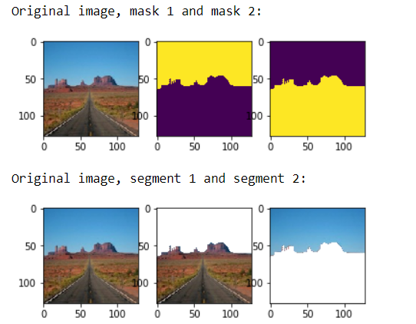
Output 2:
CREATED MASKS
SEGMENTED IMAGES

Slide 35

Thank You

