Slide 1
Digital Portfolio
STUDENT NAME: G.Gokulpriya
REGISTER NO AND NMID: 1B97427A10314CB80F842E64E07107DC/autunm1455unm1455bcaa2313658479
DEPARTMENT: BCA
COLLEGE: Tagore college of arts and science,University of madras

Slide 2
PROJECT TITLE
Personal Portfolio Website for Showcasing Skills and Projects"

Slide 3


AGENDA
Problem Statement
Project Overview
End Users
Tools and Technologies
Portfolio design and Layout
Features and Functionality
Results and Screenshots
Conclusion
Github Link
3/21/2024 Annual Review

Slide 4

PROBLEM STATEMENT
In the modern digital world, professionals face difficulty in effectively showcasing their skills, achievements, and projects. A traditional resume lacks interactivity and creativity, which reduces the chances of impressing recruiters or clients. Without an online portfolio, it is hard to create a strong digital presence

Slide 5

PROJECT OVERVIEW
This project is a personal portfolio website designed and developed by GokulPriya. It highlights personal details, professional skills, and career interests. The website includes sections such as Home, About Me, Contact Me, and provides an interactive contact form for communication. The portfolio not only demonstrates web design and development skills but also acts as a digital resume for professional opportunities.

Slide 6

WHO ARE THE END USERS?
Recruiters / Employers - To view skills and contact for job opportunities.
Clients - To hire for freelance projects.
Peers / Friends - To understand professional skills and achievements.
Self - To maintain a personal digital identity and showcase growth.

Slide 7

TOOLS AND TECHNIQUES
HTML5 - For webpage structure.
CSS3 For styling and layout.
JavaScript (if used) For interactivity.
GitHub Pages - For hosting the website.
VS Code / Any Code Editor - For development.

Slide 8
POTFOLIO DESIGN AND LAYOUT
Header Section - Navigation bar with links (Home, About Me, Contact Me).
Home Page - Personal photo, name, profession, short introduction.
About Me Page - Details about profession, career goals, and skills.
Contact Page Contact form with Name, Email, Subject, Message fields, and contact details (email, phone, address).
Footer - Copyright details and quick navigation links.
8

Slide 9
FEATURES AND FUNCTIONALITY
Simple and responsive design for easy access on mobile and desktop.
Navigation bar for smooth movement between pages.
Contact form to directly reach out via email.
Professional details like name, address, email, and phone number displayed clearly.
GitHub hosting for online availability anytime.

Slide 10

RESULTS AND SCREENSHOTS
Home Page - Displays name, introduction, and navigation.
Contact Page - Email, phone, address, and form (as shown in screenshots).
Responsive View - Adjusts to different screen sizes.
3/21/2024 Annual Review
10

Slide 11
CONCLUSION
The portfolio website successfully provides a professional digital presence for Gokul Priya. It helps in showcasing web designing and development skills, making it easier for recruiters and clients to connect. This project demonstrates the importance of personal branding in today's digital world and shows how a portfolio can act as an interactive resume.
11

Slide 12
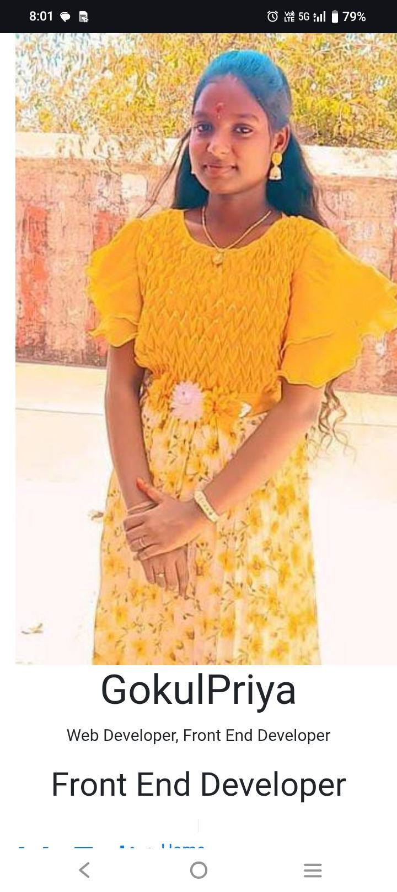
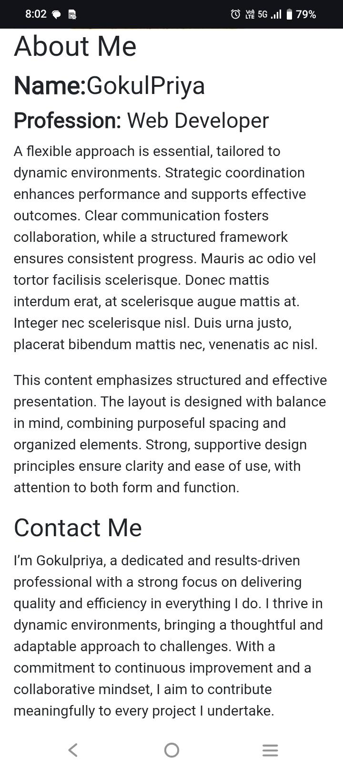
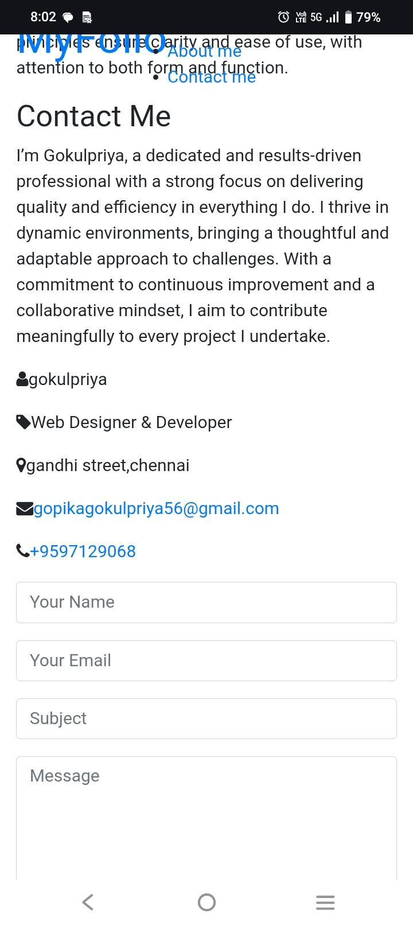

Slide 13
GitHub Link
https://gokulpriya56.github.io/gokulpriya_portfolio/

