Slide 1
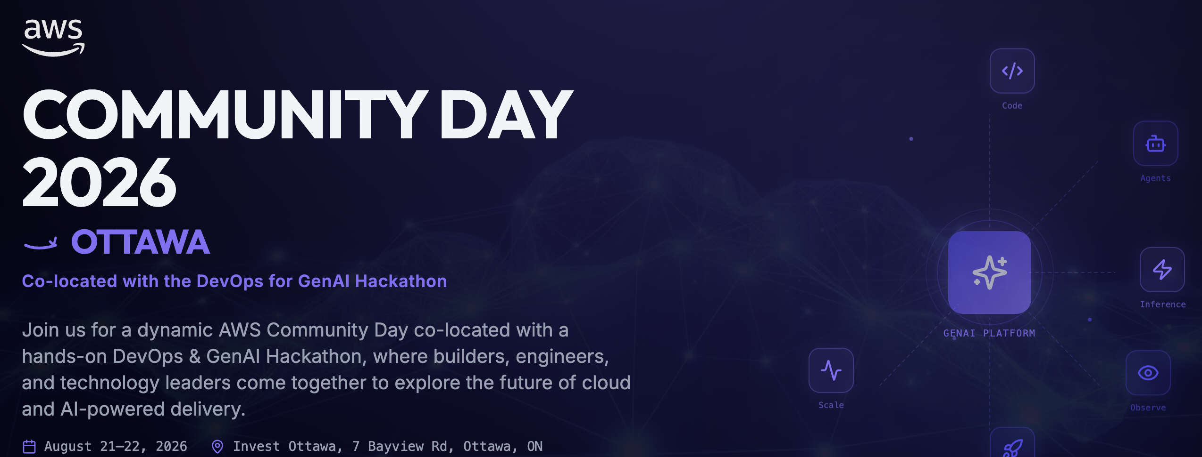
Sponsorship Package
https://awscommunityday.ca
AWS Community Day Collocated with DevOps for GenAI Hackathon
August 21st -22nd , 2026
Ottawa

Slide 2

Event Overview
AWS Community Day Ottawa 2026 + Collocated DevOps for GenAI Hackathon
Event: AWS Community Day Ottawa 2026, collocated with DevOps for GenAI Hackathon.
Impact: Biggest Cloud + AI event in Ottawa Location: Ottawa, Ontario
Format: Community conference + two-day hackathon activation. Follow through on website to check the run of the show.
Audience: Expected 250+ high tech attendees, technical leader, Software development Managers, AWS practitioners, cloud practitioners, DevOps professionals, platform teams, next-gen talent, startups

Slide 3

Why Sponsor AWS Community Day Ottawa 2026 + Collocated DevOps for GenAI Hackathon
Sponsors benefit from visibility across two complementary experiences: a community conference and a hackathon.
Brand exposure to Cloud, AI and DevOps practitioners.
Technical credibility through community association.
Lead Generation: Utilize booths and sponsored activities (e.g., coffee breaks, raffles) for voluntary attendee interaction
Recruiter access to builders and emerging talent.
Product discovery through demo and hackathon interactions.

Slide 4
Sponsorship Opportunities AWS Community Day Ottawa 2026 + Collocated DevOps for GenAI Hackathon
Tiered Packages
Annual Community Sponsor – CAD 10000
Logo on monthly User Group events every month, website and event signage, Largest booth/demo table in premium location, 10 passes, and sponsor recognition during the event. Opening remark opportunity. Mention in every meetup (monthly)
Gold Sponsor - CAD 5000
Logo on website and event signage, Large booth/demo table in premium location, 4 passes, and sponsor recognition during the event. One premium speaking slot.
Silver Sponsor - CAD 2000
Logo placement, one small booth/demo table , 2 passes, and mention in sponsor materials. One speaking slot.
Spotlight Sponsor - CAD 1,200
Logo placement, 1 pass and mention in sponsor materials. One spot as mentor for Hackathon.
Targeted Add-ons: Special sponsorship for, lunches, evening event, awards and Team Sponsor
Sponsor Lunch
Sponsor evening Happy Hours
Sponsor award for Hackathon
(1000 CAD)
Sponsor an enterprise team
(500 CAD)
In-Kind Sponsorship Opportunities:
Talk to us to be our partner, coffee/snacks, gift cards, books, subscriptions, credits photography etc.

Slide 5

Have a Question. Send us an email
info@capitalcarbonconsulting.com

Slide 6

Build with the community. Reach the builders shaping cloud and AI in Canada.
AWS Community Day Ottawa 2026 + Collocated DevOps for GenAI Hackathon

