Slide 1
NAAN MUDHALVAN • PROJECT PRACTICAL & VIVA
END-TO-END AI PIPELINE
C!
ComicCraft
01
Story Brief Input
Idea, Hero, Tone, 3–8 Panels
AI Comic Story Creator Using Gemini Models
02
2-Stage Gemini JSON
A resilient FastAPI web application that converts a short story brief into a structured, visually consistent multi-panel comic book with responsive browser preview, REST JSON API, and downloadable A4 PDF export.
Outline + Character Bible + Script
03
Pluggable Panel Art
Placeholder / HF SDXL / Diffusers
Python 3.11+
FastAPI + Uvicorn
Google Gemini JSON
Pydantic v2
SDXL / Diffusers
fpdf2 Unicode PDF
04
Web & A4 PDF Export
UUID Workspace + fpdf2 Output
Department of Computer Science | Project Demonstration & Viva
Zero-Credential Offline Demo Ready • 11/11 Pytest Verified
Notes:
[Tanglish Tip] First slide kaati Good Morning Sir/Ma'am solli project name matrum one-line summary sollunga.
[What to Speak in English]
Good morning respected examiners. Our Naan Mudhalvan project is ComicCraft — an AI Comic Story Creator built with Python and FastAPI. It turns a single-sentence story idea into a complete 3 to 8 panel illustrated comic book with web preview and A4 PDF export.

Slide 2
Abstract & Project Overview
02 / 10
Turning a compact creative brief into a structured, illustrated, downloadable comic book
FOUR-STAGE GENERATION WORKFLOW
EXECUTIVE ABSTRACT
▪ Compact Creative Brief: Users enter a story idea, main character, setting, tone, art style, and panel count (3–8 panels) via Web UI or REST JSON API.
▪ Two-Stage Gemini AI: Stage 1 creates a JSON outline and Character Bible; Stage 2 expands it into captions, narration, dialogue, and image prompts.
▪ Schema-Validated Data: All inputs and AI JSON responses are strictly validated using Pydantic v2 models instead of fragile text splitting.
▪ Pluggable Artwork & PDF: Generates per-panel PNGs (Placeholder, Hugging Face SDXL, or Local Diffusers) and compiles a Unicode A4 PDF via fpdf2.
▪ 100% Offline Resilience: Includes exponential-backoff retries, fallback models, and an offline deterministic Demo Mode requiring zero API keys.
01
PLAN • Story Outline & Character Bible
Gemini Outline model plans exact N sequential panels and locks hero visual traits in JSON.
02
WRITE • Full Comic Script
Gemini Story model writes panel captions, narration, 0–3 dialogue lines, and art prompts.
03
ILLUSTRATE • Seeded Panel Artwork
SHA-256 deterministic seed produces 1 PNG per panel via Placeholder, HF SDXL, or Diffusers.
04
PUBLISH • Web Preview & A4 PDF
Builds Cover + Panel PDF (fpdf2) and saves atomic comic.json inside a UUID workspace.
ComicCraft – AI Comic Story Creator Using Gemini Models | Naan Mudhalvan Project
Notes:
[Tanglish Tip] Abstract matrum 4 steps (Plan -> Write -> Illustrate -> Publish) epdi nadakuthunu explain pannunga.
[What to Speak in English]
ComicCraft simplifies comic creation into four automated stages: Plan, Write, Illustrate, and Publish. Using a two-stage Google Gemini JSON workflow validated by Pydantic v2, it creates consistent scripts and panel illustrations, then packages them into a web preview and an A4 PDF—even working offline without API keys.

Slide 3
Problem Statement & Core Objectives
03 / 10
Why manual or naive AI comic scripts fail — and the engineering goals ComicCraft achieves
PROBLEMS IN EXISTING / NAIVE APPROACHES
COMICCRAFT PROJECT OBJECTIVES
1. Multi-Skill Bottleneck
1. Unified Single-Brief Studio
Creating a comic manually requires separate writing, illustration, and page-layout skills, causing beginners to abandon projects.
Generate complete 3–8 panel comics from one browser form or versioned REST JSON API (/api/v1/comics).
2. Brittle Plain-Text Parsing
2. Strict JSON Schema Validation
Naive AI scripts split free-form chat text on markers like '**Panel' — minor formatting drift crashes the parser.
Use Gemini JSON mode parsed into Pydantic v2 contracts that enforce exact panel counts and numbering.
3. Character Visual Drift
3. Character Bible Continuity
Generating panel images independently causes the main character's face, clothes, and colors to change every panel.
Lock hero appearance in Stage 1 and repeat visual traits + negative prompts across every panel image.
4. Hard Failures & Paid Key Lock-In
4. Graceful Offline & Fallback Support
API rate-limits (429), retired model names (404), or missing paid credentials break the entire application.
Provide retries, fallback model chains, offline Demo Writer, and Pillow Placeholder art for 100% uptime.
ComicCraft – AI Comic Story Creator Using Gemini Models | Naan Mudhalvan Project
Notes:
[Tanglish Tip] Left side-la 4 problems (text split bug, character dress change, API failure) solli, right side-la namma 4 solutions/objectives sollunga.
[What to Speak in English]
Manual comic creation requires three separate skills, while naive AI scripts fail due to plain-text splitting, character drift across panels, and API rate limits. Our objective with ComicCraft was to build a single unified studio using strict Pydantic JSON contracts, a Character Bible for visual consistency, and offline-ready fallbacks.

Slide 4
Existing System vs Proposed System
04 / 10
Direct architectural comparison between conventional/fragile scripts and ComicCraft
Dimension | Existing / Naive AI System | Proposed System (ComicCraft)
Workflow Pipeline | Disconnected tools for script writing, illustration, and manual PDF layout. | Single integrated FastAPI pipeline from user brief to preview and A4 PDF.
AI Output Parsing | Free-form prose split by string markers; breaks on slight format changes. | Gemini JSON mode validated strictly by Pydantic v2 (ComicOutline & ComicScript).
Visual Continuity | Ad-hoc per-panel prompts cause hero's face and outfit to drift. | Stage-1 Character Bible repeated in every panel prompt + negative prompts.
Fault Tolerance | Single 429 rate-limit, 404 model rename, or missing key crashes the app. | Exponential backoff + fallback model chain + offline Demo & Placeholder modes.
Storage & Security | Unsafe prompt filenames, overwrites, and no reopenable state. | 32-hex UUID workspace, regex path guard, and atomic comic.json manifest.
Key Engineering Upgrade: Every AI response is treated as schema-validated structured JSON data — never fragile prose — with honest provider badges and warnings.
ComicCraft – AI Comic Story Creator Using Gemini Models | Naan Mudhalvan Project
Notes:
[Tanglish Tip] Table-la Existing-kum namma ComicCraft-kum ulla 5 mukkiyamaana vithyasangala point panni kaatunga.
[What to Speak in English]
Compared to manual workflows and fragile AI scripts, ComicCraft introduces five major upgrades: a single integrated FastAPI pipeline, Pydantic-validated JSON outputs, Character Bible continuity, multi-layer fallback resilience, and isolated UUID storage with atomic manifests.

Slide 5
Technology Stack & System Requirements
05 / 10
Verified open-source libraries, AI SDKs, and lightweight runtime specifications
BACKEND & SERVER
VALIDATION & CONFIG
AI STORY ENGINE
Python 3.11+ · FastAPI · Uvicorn
Pydantic v2 · pydantic-settings
Google Gemini · google-genai SDK
High-speed ASGI web framework with automatic Swagger /docs and run_in_threadpool() for blocking tasks.
Validates form/JSON inputs, AI JSON contracts, and loads .env API keys securely into SecretStr fields.
Two-stage JSON generation (Outline -> Story models) plus deterministic offline DemoStoryProvider.
IMAGE PROVIDERS
PDF & FRONTEND UI
TESTING & DEVOPS
Pillow · HuggingFace · Diffusers
fpdf2 + DejaVu · Jinja2 + JS
pytest (11 Tests) · Ruff · Docker
Pluggable protocol supporting local Placeholder PNGs, Cloud SDXL inference, and lazy Local Stable Diffusion.
Unicode-safe A4 PDF builder (cover + panel pages) and responsive framework-free HTML5/CSS3/JS UI.
~80% offline test coverage (zero paid API calls), clean static linting, and Docker Compose packaging.
MINIMUM SYSTEM REQUIREMENTS (RUNS FULLY OFFLINE WITHOUT GPU)
OS: Windows / Linux / macOS / Android Termux • CPU: Core i3 / Ryzen 3+ • RAM: 4 GB (8 GB rec.) • Disk: ~250 MB • Database: None (Local UUID Filesystem)
ComicCraft – AI Comic Story Creator Using Gemini Models | Naan Mudhalvan Project
Notes:
[Tanglish Tip] FastAPI, Pydantic v2, Google Gemini SDK, Pillow/HuggingFace, matrum fpdf2 ethukku use pannom nu sollunga. Database kedaiyathu — local UUID storage!
[What to Speak in English]
Our stack is built on Python 3.11 and FastAPI served by Uvicorn. We use Pydantic v2 for strict validation, google-genai for two-stage story generation, Pillow, Hugging Face Hub, and Diffusers for panel illustrations, and fpdf2 with bundled DejaVu fonts for Unicode PDF export. No external database or GPU is required for default operation.

Slide 6
System Architecture
06 / 10
Layered service-oriented architecture from client request to persisted UUID comic workspace
Web Browser Client
REST JSON API Client
DevOps & Diagnostics
Jinja2 Form (GET /, POST /generate) • Preview & Download
POST /api/v1/comics • GET /api/v1/comics/{id}
GET /health Probe • Interactive OpenAPI /docs
▼
▼
▼
FASTAPI APPLICATION LAYER (app/main.py & app/routes.py)
Pydantic ComicPrompt Validation • Security Headers (nosniff, SAMEORIGIN) • Async-Safe run_in_threadpool() • Error Handlers
▼
COMIC SERVICE ORCHESTRATOR (app/services/comic_service.py)
Creates Workspace -> Generates Story -> Renders Panel PNGs -> Builds PDF -> Saves Manifest
▼
▼
▼
▼
ResilientStoryService
ResilientImageService
PDFService
ComicRepository
services/llm.py
services/images.py
services/pdf_service.py
services/repository.py
• 2-Stage Gemini JSON
• Retry + Backoff + Jitter
• Model Fallback Chain
• Offline Demo Writer
• SHA-256 Panel Seed
• Pillow Placeholder Art
• Hugging Face SDXL API
• Local Diffusers SD v1.5
• fpdf2 A4 Layout
• Dark Styled Cover Page
• 180×145mm Aspect Fit
• Bundled DejaVu Fonts
• storage/comics/<uuid>/
• Regex ^[a-f0-9]{32}$
• panels/*.png & comic.pdf
• Atomic comic.json Save
ComicCraft – AI Comic Story Creator Using Gemini Models | Naan Mudhalvan Project
Notes:
[Tanglish Tip] Top-to-bottom architecture explain pannunga: Clients -> FastAPI -> ComicService Orchestrator -> 4 Services (Story, Image, PDF, Repository).
[What to Speak in English]
Both our browser interface and REST JSON endpoints share the same FastAPI layer and ComicService orchestrator. Blocking operations run inside FastAPI's threadpool. ComicService coordinates four modular services: ResilientStoryService, ResilientImageService, PDFService, and ComicRepository for isolated UUID storage.

Slide 7
Two-Stage Gemini Workflow & Character Continuity
07 / 10
How structured JSON generation and a Character Bible keep multi-panel stories coherent
STEP 1
STEP 2
STEP 3
STEP 4
Validated Brief
Stage 1: Outline
Stage 2: Script
Seeded Panel Art
ComicPrompt
gemini-3.5-flash-lite
gemini-3.5-flash
ImageProvider Protocol
• Story idea (10–1500 chars)
• Hero name & setting
• Tone & art style
• Panel count: 3 to 8
• Blocks control chars
• JSON MIME mode forced
• Generates Comic Title
• Creates Character Bible
• Plans N sequential scenes
• Validated by ComicOutline
• Receives approved outline
• Panel caption & narration
• 0–3 dialogue lines/panel
• Repeats Character Bible
• Validated by ComicScript
• SHA-256 deterministic seed
• Negative prompts applied
• No text bubbles inside art
• Saves panel-1..N.png
• Feeds PDF & Web preview
➔
➔
➔
WHY TWO GEMINI STAGES?
HOW CHARACTER CONTINUITY WORKS
Single-prompt generation mixes story planning with dialogue writing, causing missing panels or broken pacing. Splitting Outline (fast lite model) and Script (story model) guarantees exact panel counts and richer storytelling.
Stage 1 produces a 'character_bible' (fixed face, hair, outfit, and colors). Stage 2 embeds those exact traits into every panel's image_prompt, while negative prompts ban 'inconsistent clothing' and stray text bubbles.
ComicCraft – AI Comic Story Creator Using Gemini Models | Naan Mudhalvan Project
Notes:
[Tanglish Tip] Viva-la kandippa kepanga! Stage 1 Outline + Character Bible uruvakkum, Stage 2 Dialogue & Prompts ezhuthum. SHA-256 seed naala reproducible images varum.
[What to Speak in English]
This slide shows our core AI engineering. First, ComicPrompt validates user input. Stage 1 calls Gemini Flash-Lite in JSON mode to build a validated outline and a Character Bible. Stage 2 calls Gemini Flash to expand each panel into captions, narration, dialogue, and prompts that repeat the Character Bible so our hero looks consistent across all panels.

Slide 8
Resilience, Graceful Fallbacks & Security
08 / 10
Engineered so transient API failures, missing keys, or bad inputs never crash the application
1. SMART GEMINI RETRY & FALLBACK
2. PER-PANEL IMAGE PROTECTION
3. STORAGE & SECURITY GUARDS
▪ Transient 429 / 5xx Errors: Retries up to GEMINI_RETRY_ATTEMPTS using bounded exponential backoff (base × 2^attempt) plus random jitter.
▪ 400 / 404 Invalid Model IDs: Skips waiting and switches immediately to configured fallback Gemini models in .env.
▪ Offline Story Fallback: If all live models fail and ALLOW_AI_FALLBACK=true, DemoStoryProvider completes the comic with a visible warning.
▪ Pluggable Provider Layer: Supports Placeholder (Pillow), Hugging Face Hosted SDXL, and lazy-loaded Local Stable Diffusion.
▪ Panel-Level Isolation: If panel #3 fails on Hugging Face, the whole comic is NOT lost—only panel #3 falls back to a labeled Placeholder PNG.
▪ Honest Provider Metadata: ProviderInfo records exact models used, image providers, used_fallback=true, and user-visible warnings.
▪ Path Traversal Protection: Every comic_id must match ^[a-f0-9]{32}$ before any disk read/write, blocking '../' traversal attacks.
▪ Atomic Manifest Writes: Writes comic.json.tmp first and atomically replaces comic.json so crashed writes never corrupt saved comics.
▪ Secret & Header Hygiene: API keys stored as Pydantic SecretStr in .env; auto-deletes failed workspaces; sets nosniff & SAMEORIGIN headers.
ComicCraft – AI Comic Story Creator Using Gemini Models | Naan Mudhalvan Project
Notes:
[Tanglish Tip] 429 error vantha retry pannum, 404 vantha udane adutha model pogum, internet illana Offline Demo mode work aagum! Path traversal regex guard pathiyum sollunga.
[What to Speak in English]
Reliability is a first-class feature in ComicCraft. Transient 429 or 503 errors trigger exponential backoff with jitter, while 404 errors immediately switch to fallback models. Even if one image panel fails, only that panel switches to a labeled placeholder rather than losing the whole comic. On disk, strict hex-UUID validation and atomic JSON writes keep storage safe.

Slide 9
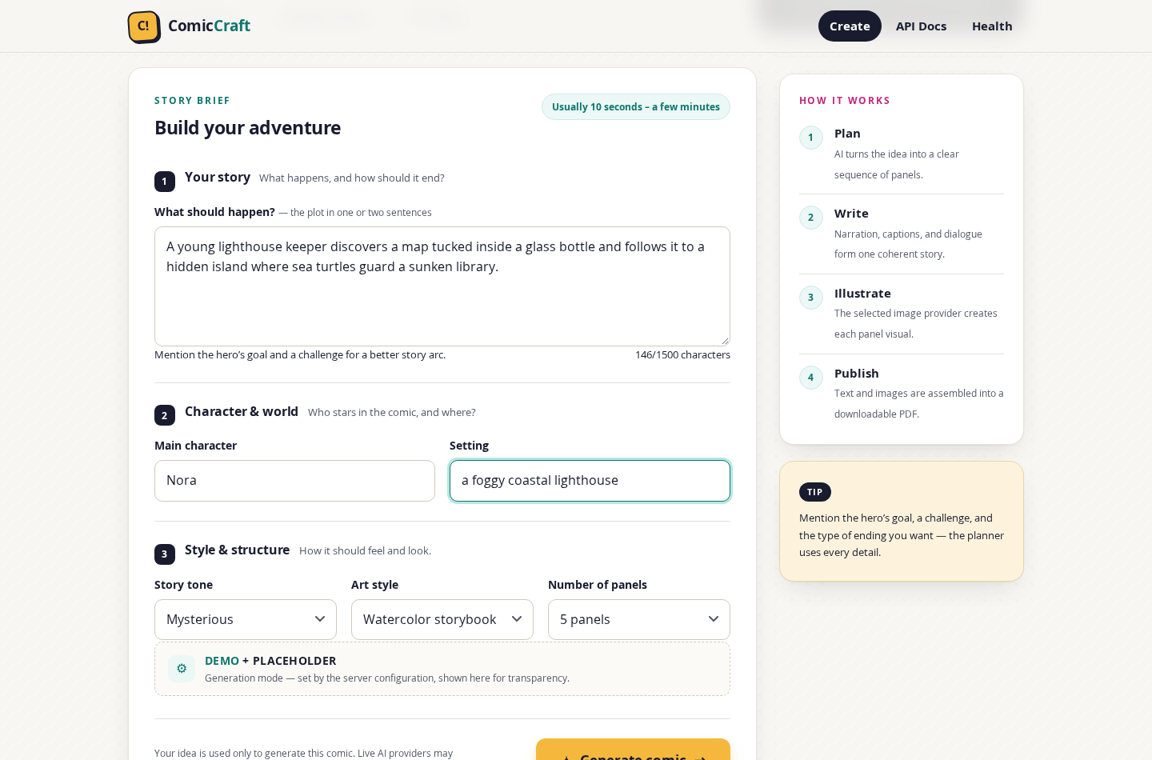
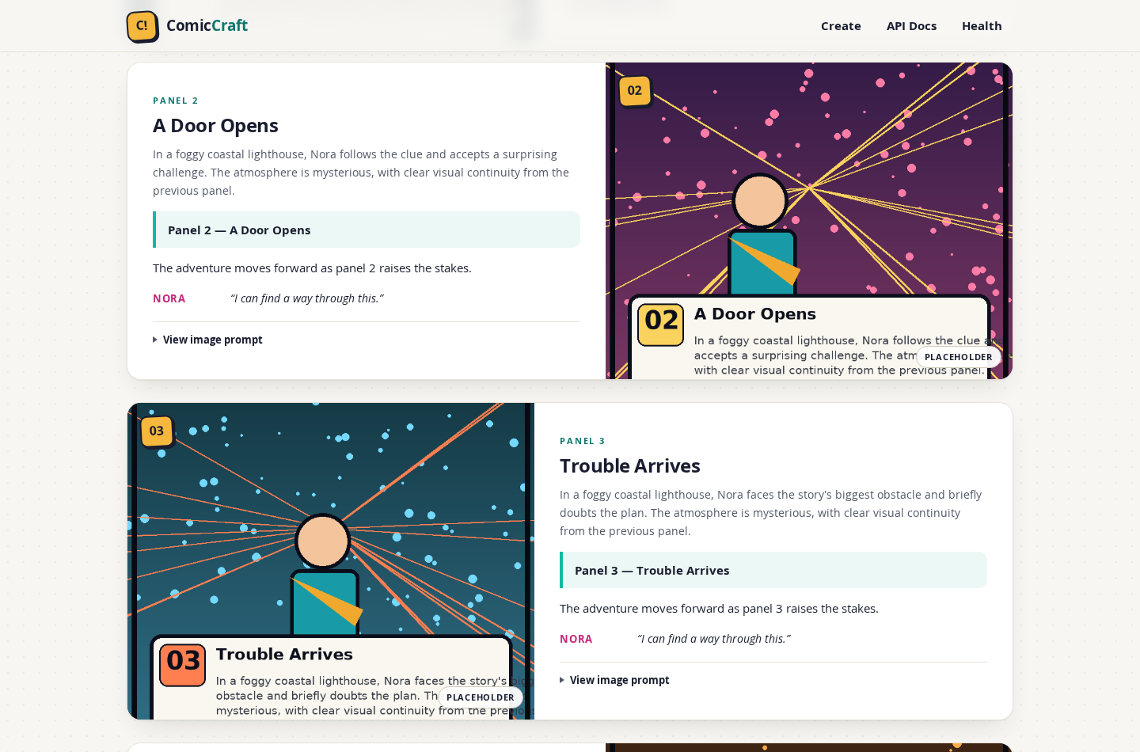
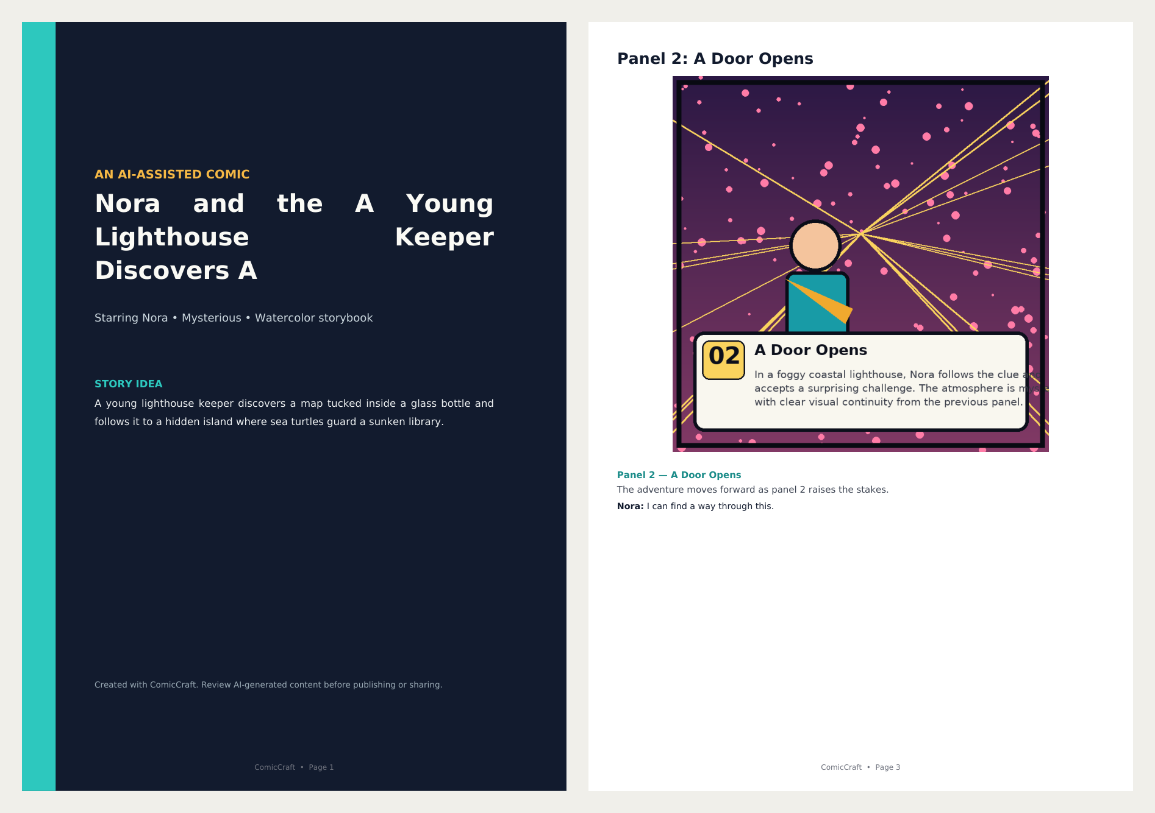
Application Output & Live Screenshots
09 / 10
Verified captures from the running ComicCraft application — Web Studio, Panels & A4 PDF
1. Interactive Story Brief Form
2. Generated Comic Panels UI
3. Exported A4 Comic PDF
Grouped sections (Story, Character & World, Style & 3–8 Panels) with live character counter and active mode card.
Alternating responsive cards pairing panel artwork, scene summary, caption, narration, dialogue, and provider badge.
Built with fpdf2 & DejaVu Unicode fonts: styled dark cover page + one aspect-preserved page per panel.
ComicCraft – AI Comic Story Creator Using Gemini Models | Naan Mudhalvan Project
Notes:
[Tanglish Tip] Moonu real output screenshots: 1) User Input Form, 2) Generated Panels Preview, 3) Download aana A4 PDF Cover + Panel page.
[What to Speak in English]
Here are real screenshots captured from our running application. On the left is the browser creation form with live character counting and provider status. In the center is the responsive comic preview displaying panel artwork, captions, and dialogue. On the right is the exported A4 PDF featuring a styled dark cover page and per-panel pages.

Slide 10
Testing, Future Enhancements & Conclusion
10 / 10
Verified offline test suite, roadmap for production scale, and final summary
AUTOMATED TESTING & QA
FUTURE ENHANCEMENTS
CONCLUSION
▪ 11 / 11 Pytest Suite PASS: Runs 100% offline using demo + placeholder providers and mocked Gemini clients—zero paid API calls.
▪ ~80% Code Coverage: 99% coverage on pdf_service.py, 95% on config.py, and 93% on main.py.
▪ End-to-End Verified: Tested /health, HTML form flow, REST 201 JSON lifecycle, PDF export, 422/404 handling, and 503/404 fallbacks.
▪ Async Background Queue: Add Celery/Redis task queues with live progress polling for multi-minute diffusion generations.
▪ Cloud Auth & Storage: Add user login, quotas, PostgreSQL metadata, and AWS S3 object storage for multi-user deployment.
▪ Rich Editing & Regional UI: Support single-panel regeneration, multi-panel comic grid layouts, and Tamil language comic scripts.
▪ Complete Integrated Product: Transforms a one-line story idea into a previewed, illustrated, A4 PDF comic book in one workflow.
▪ Production-Grade AI Patterns: Replaces brittle text splitting with Pydantic v2 JSON validation and Character Bible visual continuity.
▪ Always Demonstrable: Layered retries and offline fallbacks guarantee smooth operation with or without external API credentials.
Thank You! — Questions & Live Demo Welcome
Routes: / · /comics/{id} · /download/{id} · /docs
Run Live Demo: uvicorn app.main:app --host 0.0.0.0 --port 8000
ComicCraft – AI Comic Story Creator Using Gemini Models | Naan Mudhalvan Project
Notes:
[Tanglish Tip] 11 automated pytest pass aachu, ~80% coverage, future-la async queue + Tamil support add pannalam nu solli Thank You sollunga!
[What to Speak in English]
To conclude, ComicCraft is verified by 11 automated pytest tests with 80% code coverage, proving every route, PDF export, and fallback path works offline. In the future, we plan to add background job queues, cloud storage, single-panel regeneration, and Tamil language support. Thank you, and we are happy to show the live demo and answer your questions!

